Slide 1
Capstone Project 1: Predicting Poll Quality
Marcus Bamberger

Slide 2
What, exactly, is the goal?
Predict difference between poll and election
Do not predict difference between poll and current sentiment
Roy Moore
Sudden scandals will damage poll ratings
Time before election is a factor
How do we make better polls?
How do we know which polls to trust?
Notes:
Roy Moore’s polling dipped from a 6 point lead to anything goes after the Washington Post reported allegations against him. Polls of the race will be judged against final results, where Jones beat Moore by 1.5% of the vote.

Slide 3
General terminology
Margin: (Democrat – Republican)
Bias: (Predicted margin – actual margin)
Positive bias: Democrat did better than predicted
Error: |Bias|
Distance: Days before election
IVR: Interactive Voice Response
Notes:
In non-partisan races, margin is (candidate 1 – third party candidate) or (favorite – underdog)

Slide 4


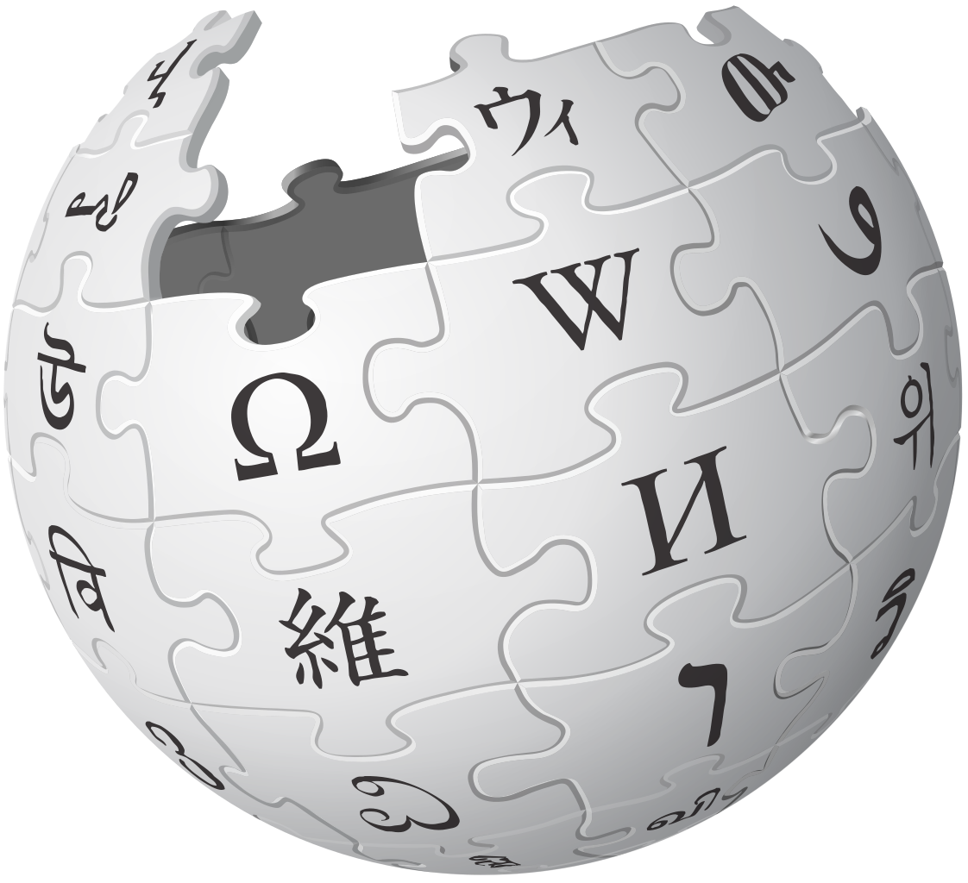
Acquiring and cleaning data
Notes:
Polling data taken from FiveThirtyEight, additional election results from NYT and Wikipedia.

Slide 5
‘Conventional Wisdom’
Larger polls are better than small polls
Humans are better than robots
Closer to election is better
Polls should agree
Herding – polls shouldn’t be in perfect agreement
Polls aren’t falsified
FiveThirtyEight aggregation
Notes:
When do you hit diminishing returns? How much is ‘better’?
Herding – some pollsters will tweak their results to better match previously published polls
Some pollsters publish falsified results. The FiveThirtyEight curates their dataset to exclude these polls.
Identifying falsified polls involves examination of different qualities of polls and will not be addressed here.

Slide 6
Costs of Polling
Spencer Kimball:
Student polls for $12-15K
Robopolls for ~$1,500
Michael Traugott:
Costs of live polls can reach $40K
Robopolls are 4-8x cheaper
Phone polls are getting more expensive
3-4x harder to poll by phone
Notes:
Kimball is a pollster and advisor for Emerson College Polling Society
Traugott is a University Michigan professor, former AAPOR president

Slide 7
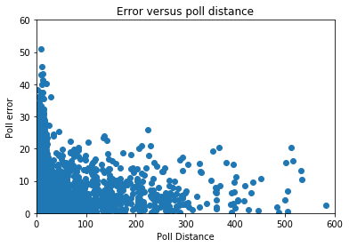
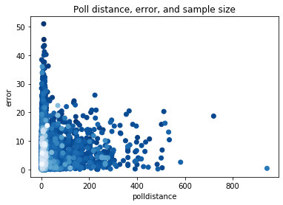
Sample Size, Distance, and Error
Notes:
We can see that sample size and poll distance confound each other. I’ve had some luck running sample size as a binary classifier at the 25 day mark.

Slide 8
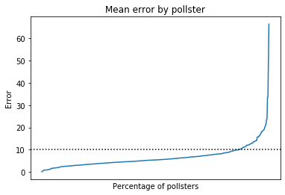
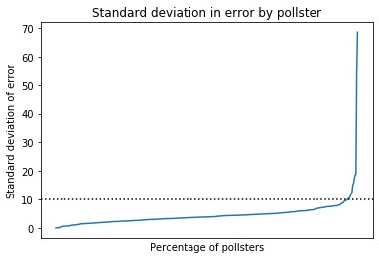
Pollster identity
359 pollsters with multiple, partisan polls
Only around 6% of pollsters have a standard deviation of bias > 10
Only 1% have a standard deviation of error > 10

Slide 9
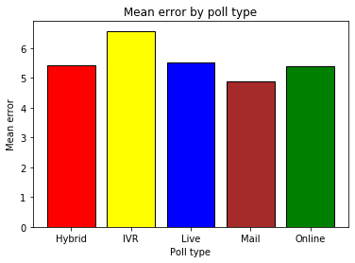
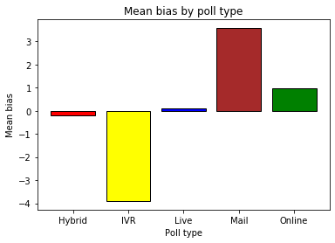
Polling type

Slide 10
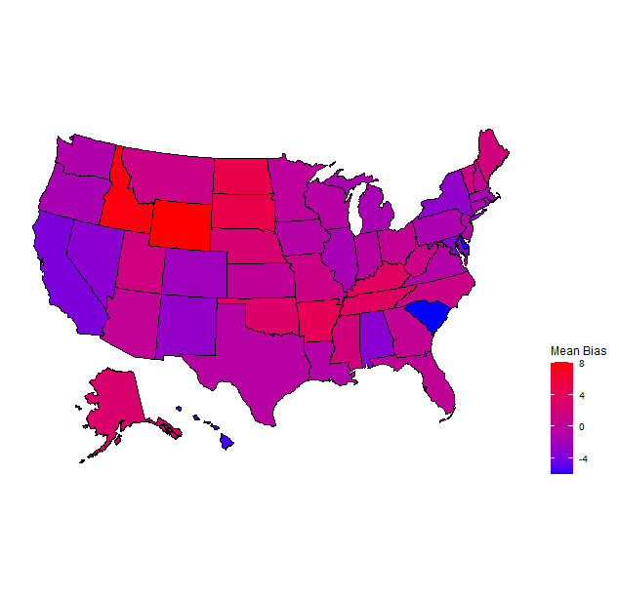
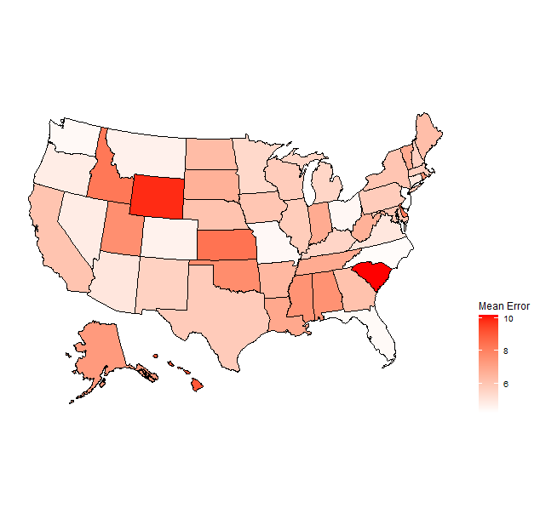
Location
Notes:
Location adds very little to the model – confounding variables

Slide 11
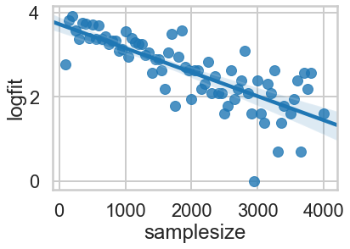
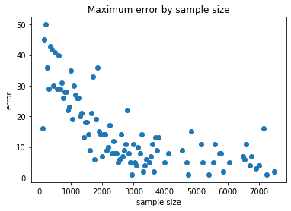
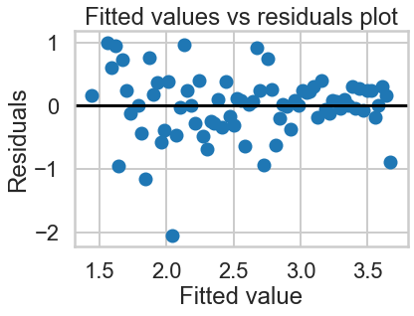
Model 1: Linear Regression
Straightforward to set up
Run with bins to find maximum error
Can struggle to capture complex relationships
Notes:
Error, sample size correlation.

Slide 12
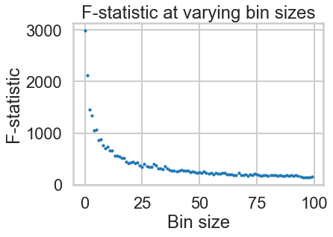
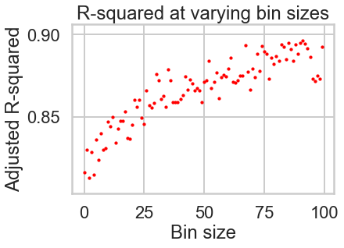
Performance
Notes:
Predicting log of maximum error works well: the residuals are well distributed. The linear relationship only holds to ~4000 people.
We can hold R-squared to .85 and get an f-statistic of ~500

Slide 13
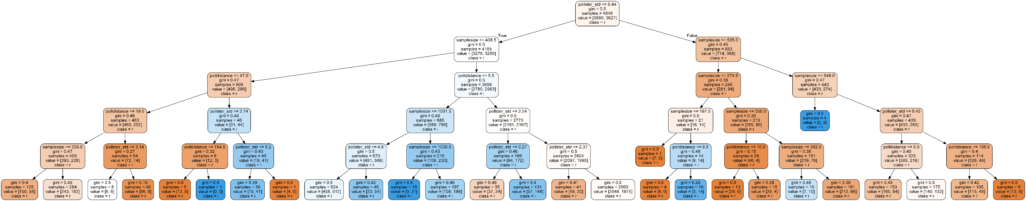
Model 2: Random Forest Classifiers
Classification models: better with even data
Gini, entropy classifiers
Prone to overfit if allowed to grow freely
Target: Within 4% error or not?
Notes:
Gini performed better than entropy overall
We can prune it by setting maximum depth, min samples/split, select tree criterion, dictate features/node (3 is best here), other options
Also tested ‘Got it right or not?’ with selection from larger dataset, but did not work as well

Slide 14
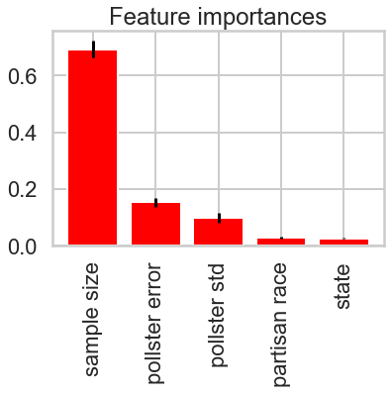
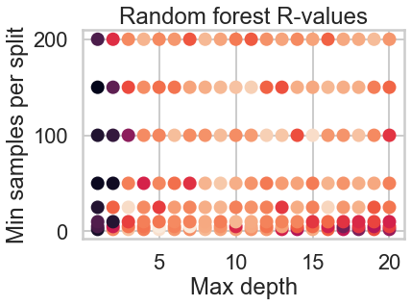
Performance
Notes:
Past performance and sample size were overwhelmingly the most important features
Final performance: .62 F-statistic, .63 R-squared.

Slide 15
Model 3: Random Forest Regression
Can we predict the future?
No
No, we can’t
Notes:
Final accuracy: ~.18 R-squared.

Slide 16
Results
Can predict max error from samplesize
Sample size, previous performance most important
Poll type affects bias, not error
Location, distance matter a little
Accuracy suffers for precise error
Still can’t predict the future

