Slide 1
Capstone Project 1: Predicting Poll Quality
Marcus Bamberger

Slide 2
General terminology
Margin: (Democrat – Republican)
Bias: (Predicted margin – actual margin)
Positive bias: Democrat did better than predicted
Error: |Bias|
Distance: Days before election
IVR: Interactive Voice Response
Notes:
In non-partisan races, margin is (candidate 1 – third party candidate) or (favorite – underdog)

Slide 3
What, exactly, is the goal?
Predict difference between poll and election
Do not predict difference between poll and current sentiment
Roy Moore
Sudden scandals will damage poll ratings
Time before election is a factor
How do we make better polls?
How do we know which polls to trust?
Notes:
Roy Moore’s polling dipped from a 6 point lead to anything goes after the Washington Post reported allegations against him. Polls of the race will be judged against final results, where Jones beat Moore by 1.5% of the vote.

Slide 4



Acquiring and cleaning data
Notes:
Polling data taken from FiveThirtyEight, additional election results from NYT and Wikipedia

Slide 5
‘Conventional Wisdom’
Larger polls are better than small polls
Humans are better than robots
Closer to election is better
Polls should agree
Herding – polls shouldn’t be in perfect agreement
Polls aren’t falsified
FiveThirtyEight aggregation
Notes:
When do you hit diminishing returns? How much is ‘better’?
Herding – some pollsters will tweak their results to better match previously published polls
Some pollsters publish falsified results. The FiveThirtyEight curates their dataset to exclude these polls.
Identifying falsified polls involves examination of different qualities of polls and will not be addressed here.

Slide 6
Costs of polling
Spencer Kimball:
Student polls for $12-15K
Robopolls for ~$1,500
Michael Traugott:
Costs of live polls can reach $40K
Robopolls are 4-8x cheaper
Phone polls are getting more expensive
3-4x harder to poll by phone
Notes:
Kimball is a pollster and advisor for Emerson College Polling Society
Traugott is a University Michigan professor, former AAPOR president

Slide 7
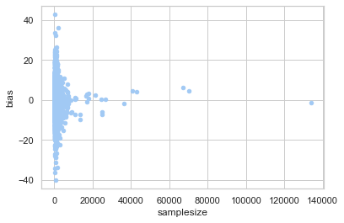
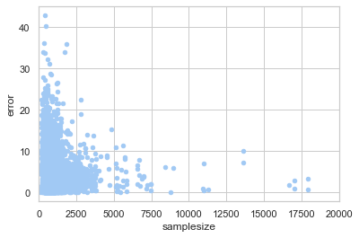
Sample size and accuracy
Notes:
This is all the data, 1998-2018, sorted by sample size against bias and error ( | bias | ).
I’ve omitted two massive outliers that projected a 0-100 sweep incorrectly.

Slide 8
Type | Mean error | Mean bias | Count
Automated Phone | 6.91 | -1.10 | 131
IVR | 6.06 | -3.90 | 215
IVR/Live | 5.45 | -0.21 | 193
IVR/Live Phone | 5.17 | 0.37 | 27
IVR/Online | 4.70 | -0.82 | 907
IVR/Online/Live | 4.45 | 0.13 | 826
IVR/Online/Live/Text | 10.86 | -10.86 | 3
IVR/Online/Text | 3.94 | 0.22 | 340
Landline | 2.86 | 2.24 | 10
Live | 4.72 | 0.10 | 2494
Live Phone | 5.13 | -0.40 | 598
Live Phone/Online | 3.87 | -1.54 | 25
Live* | 5.23 | 0.10 | 661
Mail | 4.46 | 3.57 | 17
Online | 5.08 | 0.96 | 1322
Online/Live | 6.00 | 0.59 | 207
Online/Live/Mail | 7.04 | 1.07 | 43
Nan | 34.07 | 34.07 | 2
Notes:
standard_partisan races only
Partisan races are more accurately called than non-partisan ones

Slide 9
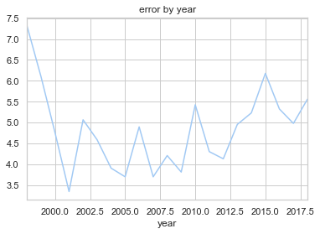
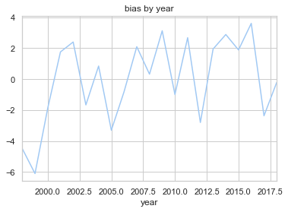
Polling over time

Slide 10
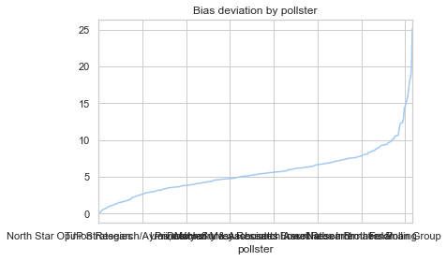
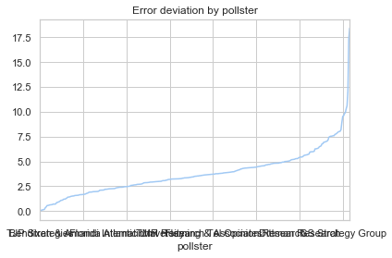
Pollster identity
359 pollsters with multiple, partisan polls
Only around 6% of pollsters have a standard deviation of bias > 10
Only 1% have a standard deviation of error > 10

Slide 11
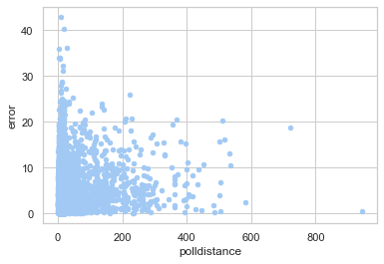
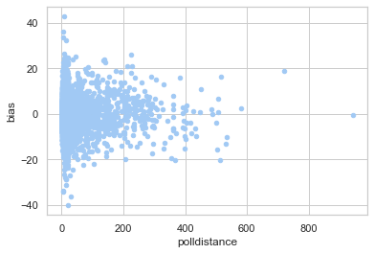
Why is this the result?

Slide 12
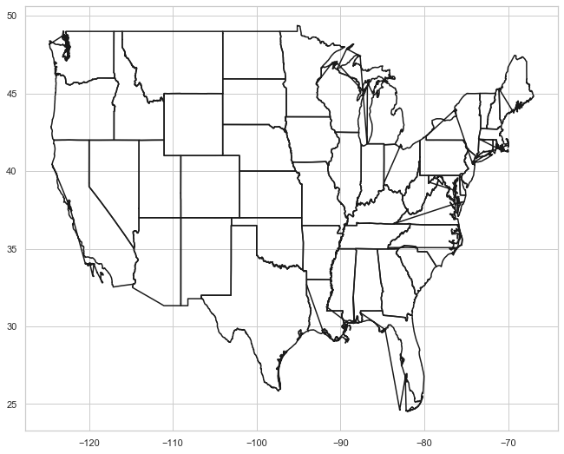
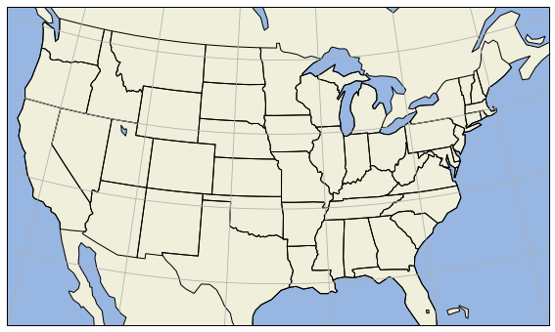
Mapping options

