Slide 1
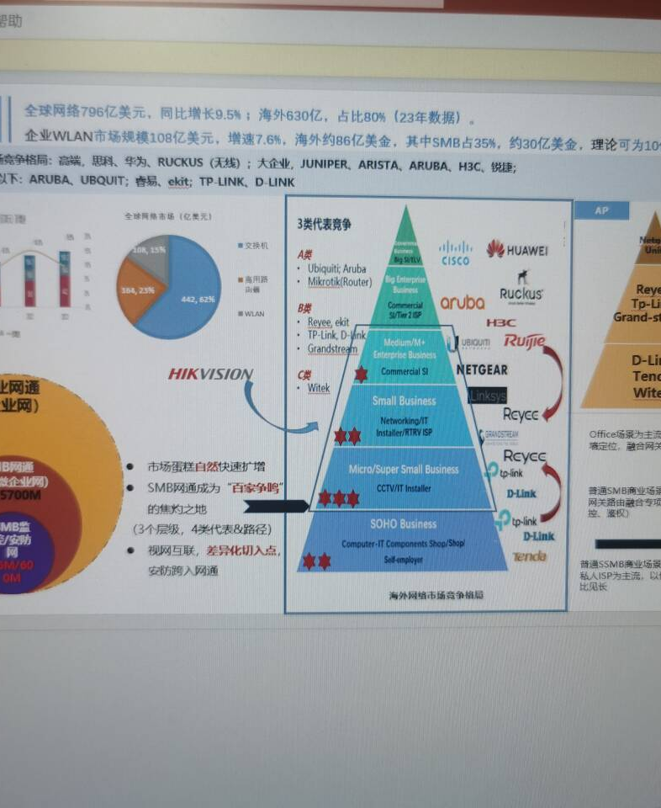
OVERSEAS SMB · WIRELESS BRIDGE
Wireless Bridge
Market Analysis
Market size | Growth | Customer pains | Portfolio
Win on lower deployment cost, stronger links and lighter operations—not on cheaper wireless hardware.
HIKVISION
Notes:
[Sources]
Internal market-reference slide supplied by the user.
Timing: 0:35. Talk track: Wireless bridges should compete on deployment economics and lifecycle reliability.

Slide 2
Overseas SMB is a clear bridge entry point
HIKVISION
Wireless bridges win where cabling is costly, launch is urgent and environments are complex—not in generic Wi-Fi price competition.
$79.6B
80%
$10.8B
≈$1B
Global network equipment (2023)
Overseas share, ≈$63B
Enterprise WLAN market
Theoretical SMB serviceable pool
What it means
Prioritize video backhaul, cross-building links, temporary sites and rural coverage—projects where wireless replaces expensive civil works.
Source: internal market-reference slides provided by the user; USD.
02
Notes:
[Sources]
Internal market-reference slides supplied by the user; values unchanged from source deck.
Timing: 0:50. Talk track: Anchor on the $1B theoretical serviceable pool and the project conditions where bridges win.

Slide 3
Serviceable growth outpaces the carrier market
HIKVISION
Growth index (2023=100)
5.2%
Serviceable pool CAGR
2023–2028
4.9%
Enterprise network CAGR
2023–2027
Drivers: wireless substitution for cabling, higher video bandwidth, SMB digitization and standardized channel delivery.
Source values indexed to 2023; CAGR calculated in the source deck.
03
Notes:
[Sources]
Internal market-reference slides supplied by the user. CAGR: 5.2% serviceable pool; 4.9% enterprise network.
Timing: 0:45. Talk track: Growth is steady; the serviceable pool is expanding faster than the carrier market.

Slide 4
Easy deployment and stable links come first
HIKVISION
01
Deployment complexity
Pre-paired units, one-click setup and clear alignment feedback
02
Stable links
Planning hypothesis
Interference resistance, auto channel selection and consistent throughput
03
Outdoor-ready
Weather protection, PoE/surge support and clear distance tiers
Planning hypothesis—validate through channel interviews and service tickets
04
Notes:
[Sources]
Pain-point weights are a planning hypothesis from the source deck, not a third-party survey.
Timing: 0:55. Talk track: Deployment and stability account for 52% of the assumed pain mix.

Slide 5
Three bridge tiers cover the core use cases
HIKVISION
Short-range
High-throughput
Long-range
Volume / fast setup
Primary offer
Project solution
USE CASES
USE CASES
USE CASES
Retail, temporary sites, small compounds
Multi-camera video, campus links, parking
Construction, rural and cross-area backhaul
CORE FEATURES
CORE FEATURES
CORE FEATURES
Basic bandwidth | pre-paired | PoE
Gigabit | high throughput | anti-interference
High gain | outdoor protection | remote O&M
Volume
Core revenue
Reference wins
Sell the outcome: less trenching, faster launch, stable video backhaul and remote maintainability.
05
Notes:
[Sources]
Portfolio recommendation synthesized from the source deck.
Timing: 0:55. Talk track: Lead with the high-throughput tier, use short-range for volume, and long-range for project wins.

Slide 6
Target four high-pain scenarios with repeatable kits
HIKVISION
Scenario
Buying trigger
Standard kit
Priority
Video backhaul
Dispersed cameras; long cable runs
Bridge + camera + PoE + accessories
Highest
Cross-building campus
Roads or buildings block cabling
Paired bridge + switch + link monitoring
High
Construction / temporary
Fast deployment; frequent relocation
Portable kit + quick-pair guide
High
Rural / agriculture
Long distance; harsh sites; costly maintenance
High-gain bridge + protection + remote O&M
Med–high
Next: turn insight into sellable assets in two weeks
① Validate with 10–15 channel/project interviews ② Map SKUs to three tiers ③ Build selector, BOM, installation SOP and competitive playbook
06
Notes:
[Sources]
Priority scenarios and package logic are synthesized from the user-provided market-reference slides.
Timing: 1:00. Talk track: Start with video backhaul, then replicate the package across campus, temporary-site and rural projects. Close on the two-week validation sprint.

