Slide 1
Sitecore Nirvana – Continous Deploymets
Michael Edwards
Hedgehog
@mikeedwards83

Slide 2

Team Development for Sitecore Automated Deployments
“If you can DREAM IT, we can make IT HAPPEN”
www.hhogdev.com

Slide 3
Who - Hedgehog Development
Sitecore Solutions and Technology Partner
Multiple Sitecore MVPs on Staff
Multiple Sitecore Site of The Year Awards
Deep Sitecore Knowledge and Expertise
Produce TDS and Razl
“If you can DREAM IT, we can make IT HAPPEN”
www.hhogdev.com
Notes:
Hedgehog are a Sitecore Solutions and Technology Partner, this means that we not only build solutions for clients but we also create tools for developers.
We have 4 MVPs on staff, myself, Charlie, Sean Kerney and Sean Holmsby.
We have one awards for The Knox and Equinox
Hedgehog produce Team Development for Sitecore, which allows you to pull Sitecore items into Source control and Razl which allows you to pull items easily between different Sitecore instances.

Slide 4


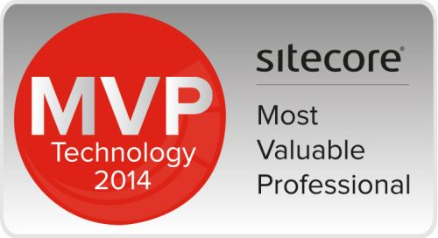
Who – Mike Edwards
Sitecore MVP since 2011
Founder of Glass.Mapper
8 Years Sitecore experience
Developer on TDS and Razl
Notes:
I have been a Sitecore MVP since 2011, most notably for my work on the Glass.Mapper solution (see my presentation later for more info).
I have been working with Sitecore since about 5.2/5.3, and I now work on adding features to TDS and Razl

Slide 5
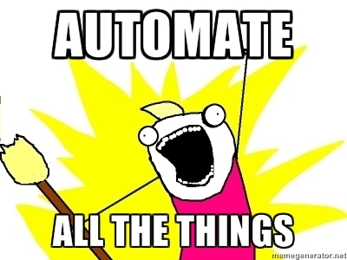
What?
Automate deployments to live and staging
New builds in a couple of clicks
Build server goodness
New developer goodness
Notes:
In this presentation I am going to show you a solution that allows you to fully automate all your deployments to both staging, live and to development.
We have all been in the scenario where the client is testing one feature on staging but then they want another feature deployed for testing. However they both features can’t be merged because they are being released at different times, so you need to duplicate your staging environment. In this demo we will look at how we can solve this problem with a few clicks so that you can have a new staging environment up and running in less than 10 minutes.
This will all be based around using your build server, I will be using TeamCity but the process should work with TFS or Bamboo. To help with this we are release as open source software some developer build goodness.. But more on that later.

Slide 6
Tools
Team Development for Sitecore
Razl
Sitecore Ship
Sitecore SIM
Sean Holmesby’s data folder extension
TeamCity
Git

Slide 7
DEMO

Slide 8
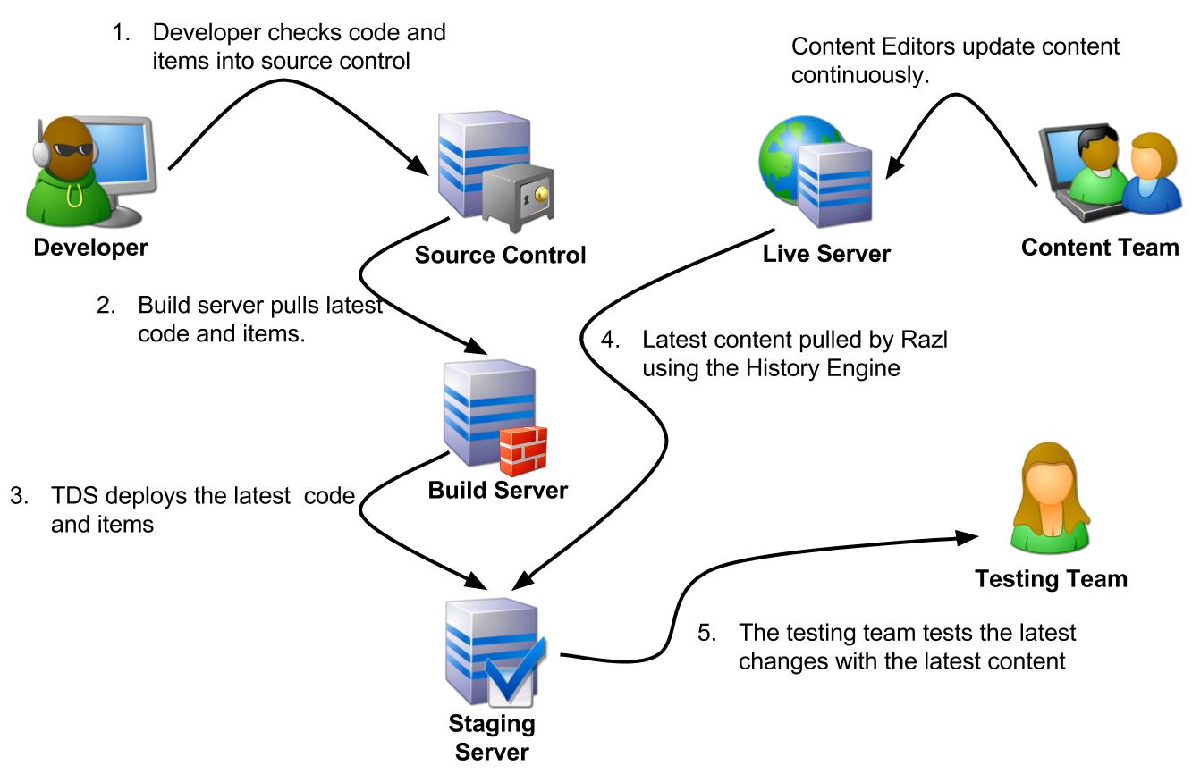

Slide 9
Find Out More
http://www.hhogdev.com/sugcon

Slide 10

Thank You
@mikeedwards83
@hhogdev
http://www.hhogdev.com
http://www.experimentsincode.com

Slide 11

















Thank you

