Slide 1
Prediction through Ensemble of Time Series Forecasting Models
Markets have very different statistical characteristics similar to natural phenomena such as weather patterns.
past performance of historical markets can be used as a good predictor of future returns by using the changes in small seasonal intervals whenever the series is stationary

Slide 2

Time Series Forecasting through Ensemble of 4 models
ARIMA Model (Combination of 3 sub-models-> AR, I , MA)
Combines AR (p), I (d) and MA (q) models, used in financial time series because it can be viewed as piecewise short-time stationary or variations become stable on logs
Autoregressive model -> output variable depends linearly on its own previous values and on a stochastic term (an imperfectly predictable term)
AR(2) -> based on previous 2 values, p-> time lags
Distributed regression of the time series is involved to convert to a stationary time series
I(d)=1 -> Random Walk;
If d=0, then the model becomes ARMA which is linear stationary model
MA -> no. of regression values as combination of lagged error values for whole data
Forecasting Drift = δ/(1 − Σφi).

Slide 3
Training of ARIMA model for stationarity for financial time series

Slide 4
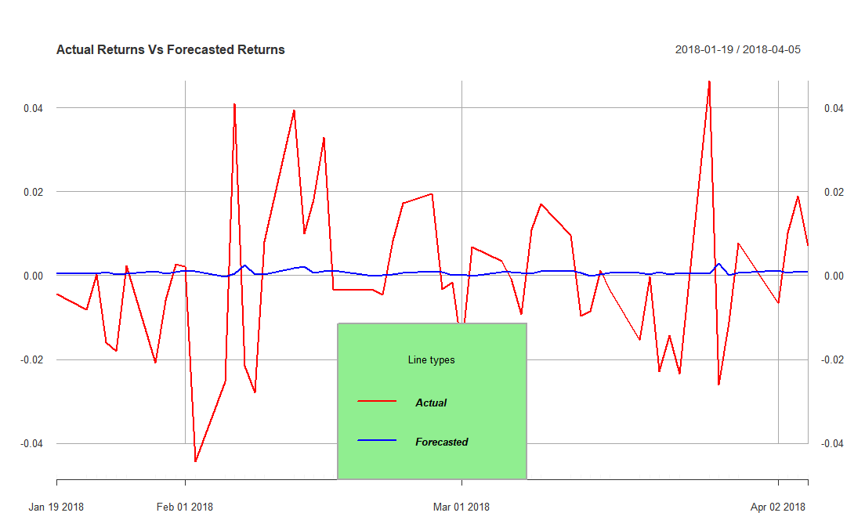
ARIMA Forecasts for Logarithmic Returns in initial building of model

Slide 5
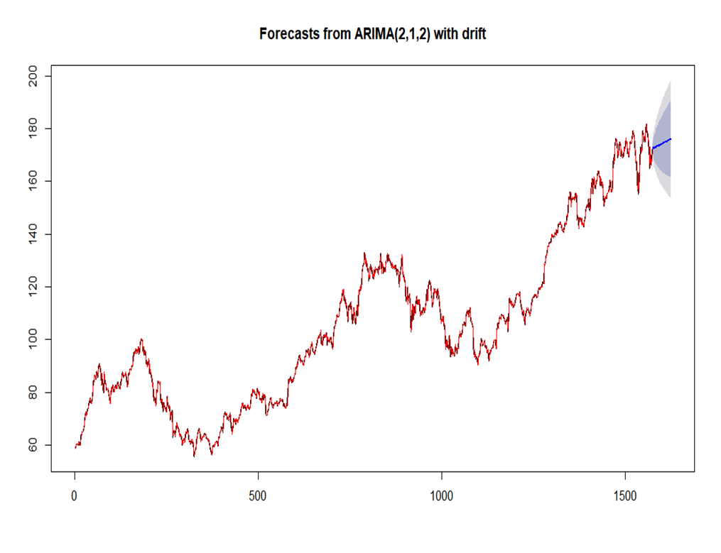
ARIMA Forecasts for Closing Price and Drift

Slide 6
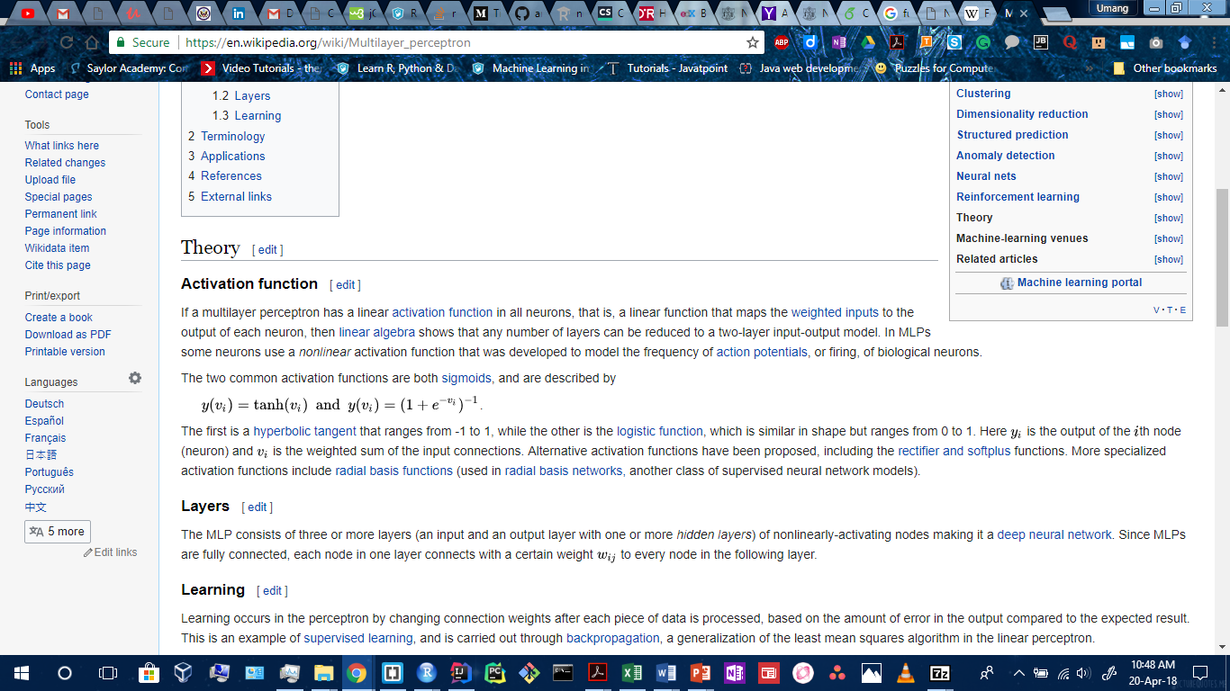
Neural Network (Feed Forward on ARIMA Times Series)
hidden layer with ARIMA’s trained lagged inputs for forecasting
Number of nodes in hidden layer = ( ½ (historical data nodes) + 1 )
Number of non-seasonal lags passed from ARIMA results of ‘p’
Networks fitted with random start weights = 20
logistic sigmoid function ranges from 0 to 1. Here y(v[i]) is the output of the ith node (neuron) and v[i] is the weighted sum of the input connections inside hidden layer, each node in one layer connects with a certain weight w[i,j] to every node in the following layer
more accurate closing price forecast of next 50 days from Ensemble of 89 %, with very low MAPE (Mean Absolute Percentage Error) = 2.75 and RMSE (Root Mean Square Error) = 5.43

Slide 7
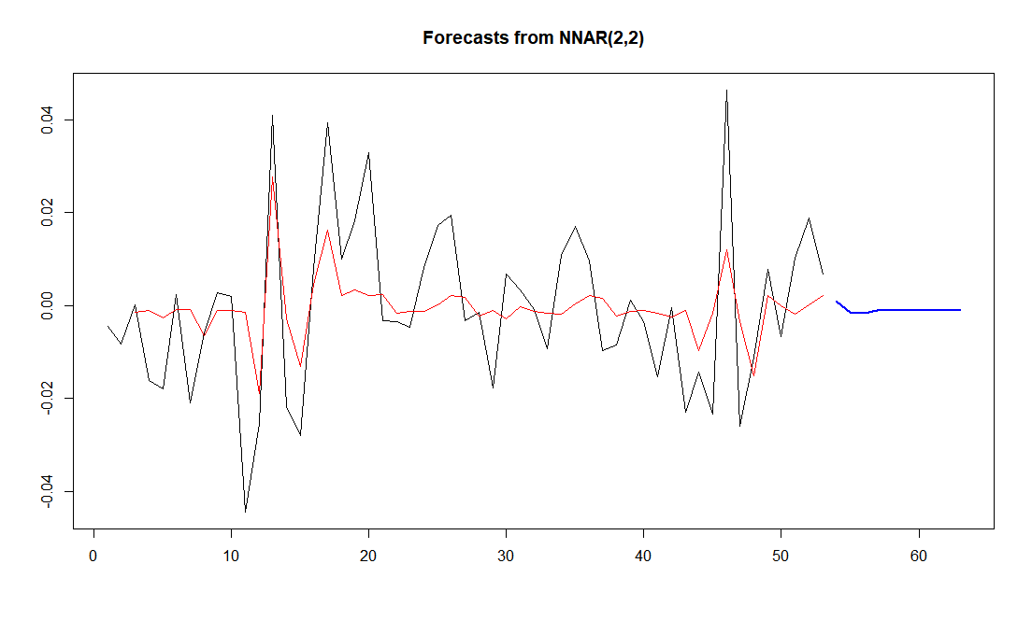
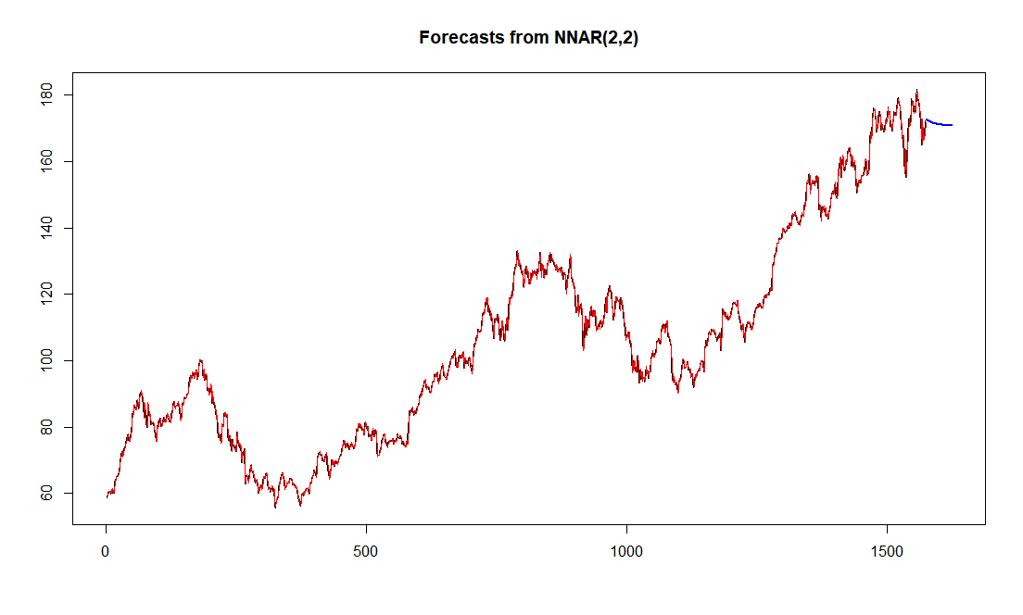
Neural Network and ARIMA combined forecasts for Log Returns and Closing Price

Slide 8
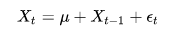
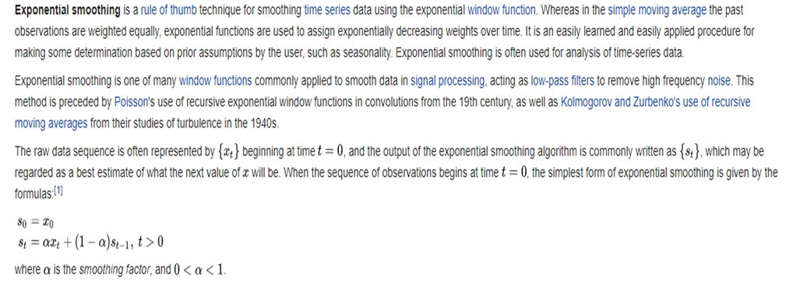
Drift Prediction from Random Walk on Hadoop
D=1 => Random Walk, a series of random steps on the financial historical dataset space such as the Daily Changes
X[t] is the prediction of Deviation in current day, X[t-1] is previous day’s closing price, u is the most probabilistic frequent boundary value of drift and error term is added along with it for stationary time series.
Random Drift of each day in percent is = ((close-open) /open)* 100%
Map Reduce on 40 years data gives frequencies of Drifts sorted in percentage values, most likely boundary percentage change for 95-90 % region
Drift confirmed from Exponential Timeseries Smoothening –
Assign exponentially decreasing weights over time

Slide 9
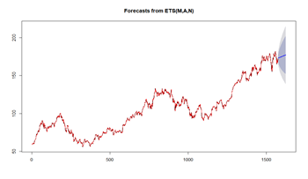
Random Walk and ETS Drift

Slide 10
Forecast from Ensemble for 9th April
The boundary values indicated a deviation of -9.31% to +9.91% [Fig.4.8] to be most frequent for 9th April and the magnitude of 1.96 is well within the interval [-9.31%,+9.91%] of 170.05 value of closing price.

