Slide 1

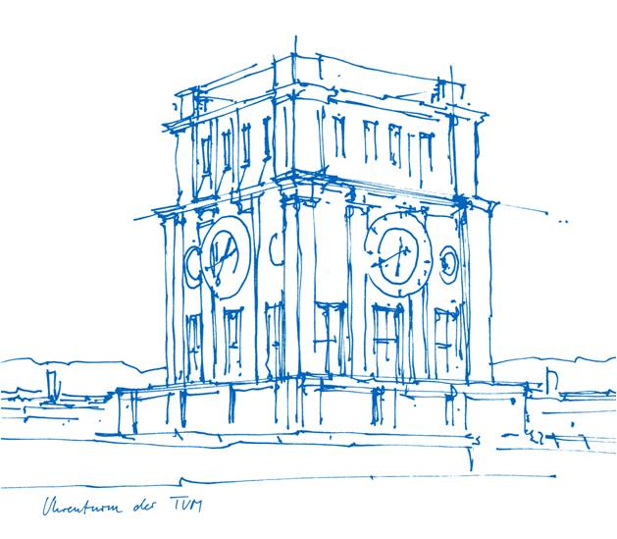
Improved Symbol Table Construction for FSST Compression
Hedi Chehaidar
Technische Universität München
TUM School of Computation, Information and Technology
Chair of Data Science and Engineering
Examiner: Prof. Dr. Thomas Neumann
Supervisors: Prof. Dr. Andreas Kipf, Mihail Stoian
Munich, 10th February 2026

Slide 2





Motivation

Slide 3
Motivation
FSST uses a greedy algorithm

Slide 4
Motivation
FSST uses a greedy algorithm ⇒ We introduce a better approach: BtrFSST

Slide 5
Motivation
FSST uses a greedy algorithm ⇒ We introduce a better approach: BtrFSST
Compression factor improved by up to 47.7%

Slide 6
Contents
Fast Static Symbol Table
Contributions
Benchmarks
Conclusion

Slide 7
Fast Static Symbol Table
Why?

Slide 8
Fast Static Symbol Table
Why?
String data dominating (van Renen [VLDB’24])

Slide 9
Fast Static Symbol Table
Why?
String data dominating (van Renen [VLDB’24])
Random access

Slide 10
Fast Static Symbol Table
Why?
String data dominating (van Renen [VLDB’24])
Random access
Fast decompression

Slide 11
Fast Static Symbol Table
Why?
String data dominating (van Renen [VLDB’24])
Random access
Fast decompression
Queries on compressed strings

Slide 12
Fast Static Symbol Table
How?

Slide 13
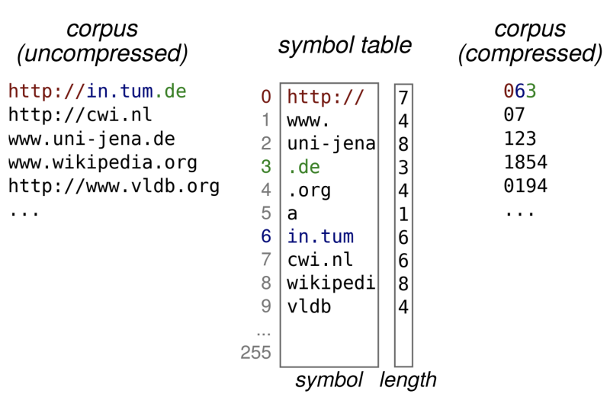
Fast Static Symbol Table
How?

Slide 14
Fast Static Symbol Table
Escaping

Slide 15
Fast Static Symbol Table
Escaping
Codes mapping to symbols: 0 - 254

Slide 16
Fast Static Symbol Table
Escaping
Codes mapping to symbols: 0 - 254
Code 255: Escape code

Slide 17
Fast Static Symbol Table
Escaping
Codes mapping to symbols: 0 - 254
Code 255: Escape code
Compression: No symbol matching current prefix ⇒ Place escape code followed by raw byte

Slide 18
Fast Static Symbol Table
Escaping
Codes mapping to symbols: 0 - 254
Code 255: Escape code
Compression: No symbol matching current prefix ⇒ Place escape code followed by raw byte
Decompression: Escape code encountered ⇒ Place next byte as is and advance by 2

Slide 19
Fast Static Symbol Table
Symbol Table Construction

Slide 20
Fast Static Symbol Table
Symbol Table Construction
5 iterations over a sample (generations)

Slide 21
Fast Static Symbol Table
Symbol Table Construction
5 iterations over a sample (generations)
Compress the sample and keep counts (compressCount)

Slide 22
Fast Static Symbol Table
Symbol Table Construction
5 iterations over a sample (generations)
Compress the sample and keep counts (compressCount)
Select symbols for the next table based on static gain (makeTable)

Slide 23
Fast Static Symbol Table
Symbol Table Construction
5 iterations over a sample (generations)
Compress the sample and keep counts (compressCount)
Select symbols for the next table based on static gain (makeTable)
Keep best table

Slide 24
Fast Static Symbol Table
Problems

Slide 25
Fast Static Symbol Table
Problems
Greedy algorithm for table construction and full column encoding

Slide 26
Fast Static Symbol Table
Problems
Greedy algorithm for table construction and full column encoding
Only two frequency counters

Slide 27
Fast Static Symbol Table
Problems
Greedy algorithm for table construction and full column encoding
Only two frequency counters
Conflicting symbols selected (overlapping)

Slide 28
Contributions
Solutions

Slide 29
Contributions
Solutions
DP algorithm for table construction and full column encoding

Slide 30
Contributions
Solutions
DP algorithm for table construction and full column encoding
Third frequency counter

Slide 31
Contributions
Solutions
DP algorithm for table construction and full column encoding
Third frequency counter
Symbol pruning during new table filling

Slide 32
Contributions
DP

Slide 33
Contributions
DP

Slide 34

Contributions
DP

Slide 35


Contributions
DP

Slide 36
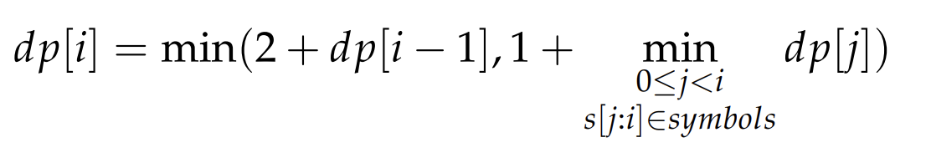
Contributions
DP

Slide 37
Contributions
DP
Escape last byte

Slide 38
Contributions
DP
Last byte belongs to a symbol

Slide 39
Contributions
Example Compression Available symbols:
Text to compress:
a | aa | ac | aac | cb
a | c | b | a | a | c | b | a | a

Slide 40
Contributions
Example Compression Available symbols:
Text to compress:
Greedy:
a | aa | ac | aac | cb
a | c | b | a | a | c | b | a | a
a | c | b | a | a | c | b | a | a

Slide 41
Contributions
Example Compression Available symbols:
Text to compress:
Greedy:
a | aa | ac | aac | cb
a | c | b | a | a | c | b | a | a
a | c | b | a | a | c | b | a | a

Slide 42
Contributions
Example Compression Available symbols:
Text to compress:
Greedy:
escaped ⇒ 2 bytes to compressed size!
a | aa | ac | aac | cb
a | c | b | a | a | c | b | a | a
a | c | b | a | a | c | b | a | a

Slide 43
Contributions
Example Compression Available symbols:
Text to compress:
Greedy:
a | aa | ac | aac | cb
a | c | b | a | a | c | b | a | a
a | c | b | a | a | c | b | a | a

Slide 44
Contributions
Example Compression Available symbols:
Text to compress:
Greedy:
escaped ⇒ 2 bytes to compressed size!
a | aa | ac | aac | cb
a | c | b | a | a | c | b | a | a
a | c | b | a | a | c | b | a | a

Slide 45
Contributions
Example Compression Available symbols:
Text to compress:
Greedy:
Total compressed size = 8 bytes
a | aa | ac | aac | cb
a | c | b | a | a | c | b | a | a
a | c | b | a | a | c | b | a | a

Slide 46
Contributions
Example Compression Available symbols:
Text to compress:
DP:
a | aa | ac | aac | cb
a | c | b | a | a | c | b | a | a
a | c | b | a | a | c | b | a | a
0

Slide 47
Contributions
Example Compression Available symbols:
Text to compress:
DP:
a | aa | ac | aac | cb
a | c | b | a | a | c | b | a | a
a | c | b | a | a | c | b | a | a
0 | 1

Slide 48
Contributions
Example Compression Available symbols:
Text to compress:
DP:
a | aa | ac | aac | cb
a | c | b | a | a | c | b | a | a
a | c | b | a | a | c | b | a | a
0 | 1 | 1

Slide 49
Contributions
Example Compression Available symbols:
Text to compress:
DP:
a | aa | ac | aac | cb
a | c | b | a | a | c | b | a | a
a | c | b | a | a | c | b | a | a
0 | 1 | 1 | 2

Slide 50
Contributions
Example Compression Available symbols:
Text to compress:
DP:
a | aa | ac | aac | cb
a | c | b | a | a | c | b | a | a
a | c | b | a | a | c | b | a | a
0 | 1 | 1 | 2 | 3

Slide 51
Contributions
Example Compression Available symbols:
Text to compress:
DP:
a | aa | ac | aac | cb
a | c | b | a | a | c | b | a | a
a | c | b | a | a | c | b | a | a
0 | 1 | 1 | 2 | 3 | 3

Slide 52
Contributions
Example Compression Available symbols:
Text to compress:
DP:
a | aa | ac | aac | cb
a | c | b | a | a | c | b | a | a
a | c | b | a | a | c | b | a | a
0 | 1 | 1 | 2 | 3 | 3 | 3

Slide 53
Contributions
Example Compression Available symbols:
Text to compress:
DP:
a | aa | ac | aac | cb
a | c | b | a | a | c | b | a | a
a | c | b | a | a | c | b | a | a
0 | 1 | 1 | 2 | 3 | 3 | 3 | 4

Slide 54
Contributions
Example Compression Available symbols:
Text to compress:
DP:
a | aa | ac | aac | cb
a | c | b | a | a | c | b | a | a
a | c | b | a | a | c | b | a | a
0 | 1 | 1 | 2 | 3 | 3 | 3 | 4 | 5

Slide 55
Contributions
Example Compression Available symbols:
Text to compress:
DP:
a | aa | ac | aac | cb
a | c | b | a | a | c | b | a | a
a | c | b | a | a | c | b | a | a
0 | 1 | 1 | 2 | 3 | 3 | 3 | 4 | 5 | 5

Slide 56
Contributions
Example Compression Available symbols:
Text to compress:
DP:
a | aa | ac | aac | cb
a | c | b | a | a | c | b | a | a
a | c | b | a | a | c | b | a | a
0 | 1 | 1 | 2 | 3 | 3 | 3 | 4 | 5 | 5

Slide 57
Contributions
Retrieving the symbols
dp:
opt:
a | c | b | a | a | c | b | a | a
0 | 1 | 1 | 2 | 3 | 3 | 3 | 4 | 5 | 5

Slide 58
Contributions
Retrieving the symbols
dp:
opt:
a | c | b | a | a | c | b | a | a
0 | 1 | 1 | 2 | 3 | 3 | 3 | 4 | 5 | 5
 |  |  |  |  |  |  | aa

Slide 59
Contributions
Retrieving the symbols
dp:
opt:
a | c | b | a | a | c | b | a | a
0 | 1 | 1 | 2 | 3 | 3 | 3 | 4 | 5 | 5
 |  |  |  |  | cb |  | aa

Slide 60
Contributions
Retrieving the symbols
dp:
opt:
a | c | b | a | a | c | b | a | a
0 | 1 | 1 | 2 | 3 | 3 | 3 | 4 | 5 | 5
 |  |  | aa |  | cb |  | aa

Slide 61
Contributions
Retrieving the symbols
dp:
opt:
a | c | b | a | a | c | b | a | a
0 | 1 | 1 | 2 | 3 | 3 | 3 | 4 | 5 | 5
 | cb |  | aa |  | cb |  | aa

Slide 62
Contributions
Retrieving the symbols
dp:
opt:
a | c | b | a | a | c | b | a | a
0 | 1 | 1 | 2 | 3 | 3 | 3 | 4 | 5 | 5
a | cb |  | aa |  | cb |  | aa

Slide 63
Contributions
Need two passes: one for DP and one for opt.

Slide 64
Contributions
Need two passes: one for DP and one for opt.
Implemented a single-pass function (backwards)

Slide 65
Contributions
Need two passes: one for DP and one for opt.
Implemented a single-pass function (backwards) ⇒ Fills DP and opt simultaneously

Slide 66
Contributions
Symbol search: Trie

Slide 67
Contributions
Symbol search: Trie
Break when no symbol matches a certain prefix

Slide 68
Contributions
Symbol search: Trie
Break when no symbol matches a certain prefix
DP in table construction and encoding ⇒ no hashing needed (no collisions)

Slide 69
Contributions
Symbol search: Trie
Break when no symbol matches a certain prefix
DP in table construction and encoding ⇒ no hashing needed (no collisions)
Compare one byte at a time instead of whole symbols

Slide 70
Contributions
Symbol search: Trie
Break when no symbol matches a certain prefix
DP in table construction and encoding ⇒ no hashing needed (no collisions)
Compare one byte at a time instead of whole symbols
Small additional memory (around 2 MB for extreme case)

Slide 71
Contributions
Third counter

Slide 72
Contributions
Third counter
DP approach may favor shorter symbols ⇒ balance with longer concatenations

Slide 73
Contributions
Third counter
DP approach may favor shorter symbols ⇒ balance with longer concatenations
Linear time overhead

Slide 74
Contributions
Third counter
DP approach may favor shorter symbols ⇒ balance with longer concatenations
Linear time overhead
Simple structure: hashmap of code triples to frequency

Slide 75
Contributions
Pruning

Slide 76
Contributions
Pruning
Gains remain static through table filling and do not account for current selected symbols

Slide 77
Contributions
Pruning
Available symbols:
Text:
Counts:
a | b | c
a | b | c | b | c | a | b | c | b | a

Slide 78
Contributions
Pruning
Available symbols:
Text:
Counts:
a | b | c
a | b | c | b | c | a | b | c | b | a
a: 3

Slide 79
Contributions
Pruning
Available symbols:
Text:
Counts:
a | b | c
a | b | c | b | c | a | b | c | b | a
a: 3 | b: 4

Slide 80
Contributions
Pruning
Available symbols:
Text:
Counts:
a | b | c
a | b | c | b | c | a | b | c | b | a
a: 3 | b: 4 | c: 3

Slide 81
Contributions
Pruning
Available symbols:
Text:
Counts:
a | b | c
a | b | c | b | c | a | b | c | b | a
a: 3 | b: 4 | c: 3 | ab: 2

Slide 82
Contributions
Pruning
Available symbols:
Text:
Counts:
a | b | c
a | b | c | b | c | a | b | c | b | a
a: 3 | b: 4 | c: 3 | ab: 2 | bc: 3

Slide 83
Contributions
Pruning
Available symbols:
Text:
Counts:
a | b | c
a | b | c | b | c | a | b | c | b | a
a: 3 | b: 4 | c: 3 | ab: 2 | bc: 3 | ba: 1

Slide 84
Contributions
Pruning
Available symbols:
Text:
Counts:
a | b | c
a | b | c | b | c | a | b | c | b | a
a: 3 | b: 4 | c: 3 | ab: 2 | bc: 3 | ba: 1 | ca: 1

Slide 85
Contributions
Pruning
Available symbols:
Text:
Counts:
a | b | c
a | b | c | b | c | a | b | c | b | a
a: 3 | b: 4 | c: 3 | ab: 2 | bc: 3 | ba: 1 | ca: 1 | cb: 2

Slide 86
Contributions
Pruning
Available symbols:
Text:
Counts:
Gains:
a | b | c
a | b | c | b | c | a | b | c | b | a
a: 3 | b: 4 | c: 3 | ab: 2 | bc: 3 | ba: 1 | ca: 1 | cb: 2
a: 3 | b: 4 | c: 3 | ab: 4 | bc: 6 | ba: 2 | ca: 2 | cb: 4

Slide 87
Contributions
Without Pruning
Text:
Counts:
Gains:
New symbol table:
a | b | c | b | c | a | b | c | b | a
a: 3 | b: 4 | c: 3 | ab: 2 | bc: 3 | ba: 1 | ca: 1 | cb: 2
a: 3 | b: 4 | c: 3 | ab: 4 | bc: 6 | ba: 2 | ca: 2 | cb: 4

Slide 88
Contributions
Without Pruning
Text:
Counts:
Gains:
New symbol table:
a | b | c | b | c | a | b | c | b | a
a: 3 | b: 4 | c: 3 | ab: 2 | bc: 3 | ba: 1 | ca: 1 | cb: 2
a: 3 | b: 4 | c: 3 | ab: 4 | bc: 6 | ba: 2 | ca: 2 | cb: 4
bc

Slide 89
Contributions
Without Pruning
Text:
Counts:
Gains:
New symbol table:
a | b | c | b | c | a | b | c | b | a
a: 3 | b: 4 | c: 3 | ab: 2 | bc: 3 | ba: 1 | ca: 1 | cb: 2
a: 3 | b: 4 | c: 3 | ab: 4 | bc: 6 | ba: 2 | ca: 2 | cb: 4
bc | ab

Slide 90
Contributions
Without Pruning
Text:
Counts:
Gains:
New symbol table:
a | b | c | b | c | a | b | c | b | a
a: 3 | b: 4 | c: 3 | ab: 2 | bc: 3 | ba: 1 | ca: 1 | cb: 2
a: 3 | b: 4 | c: 3 | ab: 4 | bc: 6 | ba: 2 | ca: 2 | cb: 4
bc | ab | cb

Slide 91
Contributions
Without Pruning
Text:
Counts:
Gains:
New symbol table:
a | b | c | b | c | a | b | c | b | a
a: 3 | b: 4 | c: 3 | ab: 2 | bc: 3 | ba: 1 | ca: 1 | cb: 2
a: 3 | b: 4 | c: 3 | ab: 4 | bc: 6 | ba: 2 | ca: 2 | cb: 4
bc | ab | cb | b

Slide 92
Contributions
Without Pruning
Text:
Counts:
Gains:
New symbol table:
a | b | c | b | c | a | b | c | b | a
a: 3 | b: 4 | c: 3 | ab: 2 | bc: 3 | ba: 1 | ca: 1 | cb: 2
a: 3 | b: 4 | c: 3 | ab: 4 | bc: 6 | ba: 2 | ca: 2 | cb: 4
bc | ab | cb | b | a

Slide 93
Contributions
Without Pruning
Text:
Counts:
Gains:
New symbol table:
a | b | c | b | c | a | b | c | b | a
a: 3 | b: 4 | c: 3 | ab: 2 | bc: 3 | ba: 1 | ca: 1 | cb: 2
a: 3 | b: 4 | c: 3 | ab: 4 | bc: 6 | ba: 2 | ca: 2 | cb: 4
bc | ab | cb | b | a

Slide 94
Contributions
With Pruning
Text:
Counts:
Gains:
New symbol table:
a | b | c | b | c | a | b | c | b | a
a: 3 | b: 4 | c: 3 | ab: 2 | bc: 3 | ba: 1 | ca: 1 | cb: 2
a: 3 | b: 4 | c: 3 | ab: 4 | bc: 6 | ba: 2 | ca: 2 | cb: 4

Slide 95
Contributions
With Pruning
Text:
Counts:
Gains:
New symbol table:
a | b | c | b | c | a | b | c | b | a
a: 3 | b: 4 | c: 3 | ab: 2 | bc: 3 | ba: 1 | ca: 1 | cb: 2
a: 3 | b: 4 | c: 3 | ab: 4 | bc: 6 | ba: 2 | ca: 2 | cb: 4
bc

Slide 96
Contributions
With Pruning
Text:
Counts:
Gains:
New symbol table:
a | b | c | b | c | a | b | c | b | a
a: 3 | b: 1 | c: 0 | ab: 2 | bc: 3 | ba: 1 | ca: 1 | cb: 2
a: 3 | b: 1 |  | ab: 4 | bc: 6 | ba: 2 | ca: 2 | cb: 4
bc

Slide 97
Contributions
With Pruning
Text:
Counts:
Gains:
New symbol table:
a | b | c | b | c | a | b | c | b | a
a: 3 | b: 1 | c: 0 | ab: 2 | bc: 3 | ba: 1 | ca: 1 | cb: 2
a: 3 | b: 1 |  | ab: 4 | bc: 6 | ba: 2 | ca: 2 | cb: 4
bc | ab

Slide 98
Contributions
With Pruning
Text:
Counts:
Gains:
New symbol table:
a | b | c | b | c | a | b | c | b | a
a: 1 | b: -1 | c: 0 | ab: 2 | bc: 3 | ba: 1 | ca: 1 | cb: 2
a: 1 |  |  | ab: 4 | bc: 6 | ba: 2 | ca: 2 | cb: 4
bc | ab

Slide 99
Contributions
With Pruning
Text:
Counts:
Gains:
New symbol table:
a | b | c | b | c | a | b | c | b | a
a: 1 | b: -3 | c: -2 | ab: 2 | bc: 3 | ba: 1 | ca: 1 | cb: 2
a: 1 |  |  | ab: 4 | bc: 6 | ba: 2 | ca: 2 | cb: 4
bc | ab | cb

Slide 100
Contributions
With Pruning
Text:
Counts:
Gains:
New symbol table:
a | b | c | b | c | a | b | c | b | a
a: 0 | b: -4 | c: -2 | ab: 2 | bc: 3 | ba: 1 | ca: 1 | cb: 2
 |  |  | ab: 4 | bc: 6 | ba: 2 | ca: 2 | cb: 4
bc | ab | cb | ba

Slide 101
Contributions
With Pruning
Text:
Counts:
Gains:
New symbol table:
a | b | c | b | c | a | b | c | b | a
a: -1 | b: -4 | c: -3 | ab: 2 | bc: 3 | ba: 1 | ca: 1 | cb: 2
 |  |  | ab: 4 | bc: 6 | ba: 2 | ca: 2 | cb: 4
bc | ab | cb | ba | ca

Slide 102
Benchmarks
Selected Data

Slide 103
Benchmarks
Selected Data
92 columns: dbtext, NextiaJD, CyclicJoinBench, Clickbench, and PublicBIbenchmark

Slide 104
Benchmarks
Selected Data
92 columns: dbtext, NextiaJD, CyclicJoinBench, Clickbench, and PublicBIbenchmark
Tables reduced to first 100K rows

Slide 105
Benchmarks
Selected Data
92 columns: dbtext, NextiaJD, CyclicJoinBench, Clickbench, and PublicBIbenchmark
Tables reduced to first 100K rows
String columns having at least 1K rows and size ≤ 35MB

Slide 106
Benchmarks
Selected Data
92 columns: dbtext, NextiaJD, CyclicJoinBench, Clickbench, and PublicBIbenchmark
Tables reduced to first 100K rows
String columns having at least 1K rows and size ≤ 35MB
FSST compressed size ≤ Dictionary encoding size

Slide 107
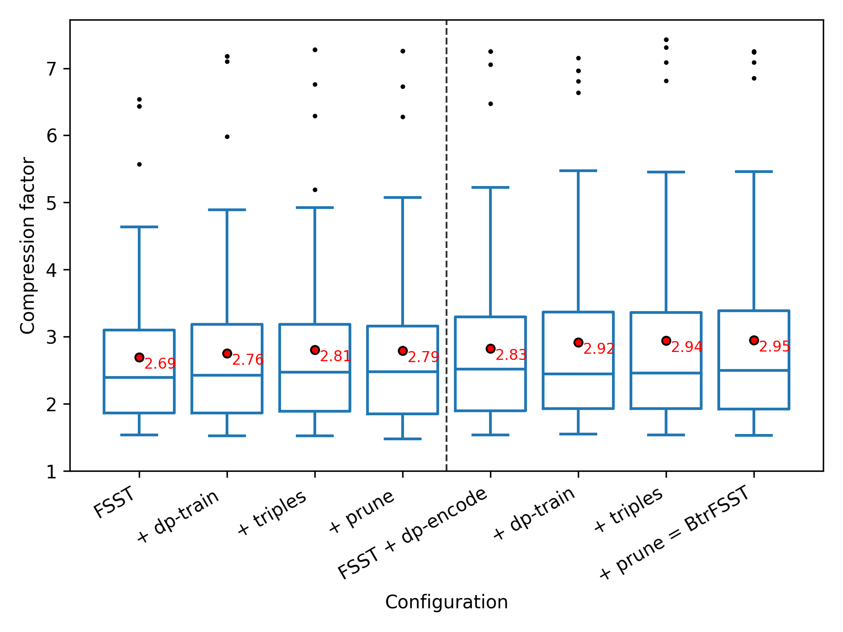
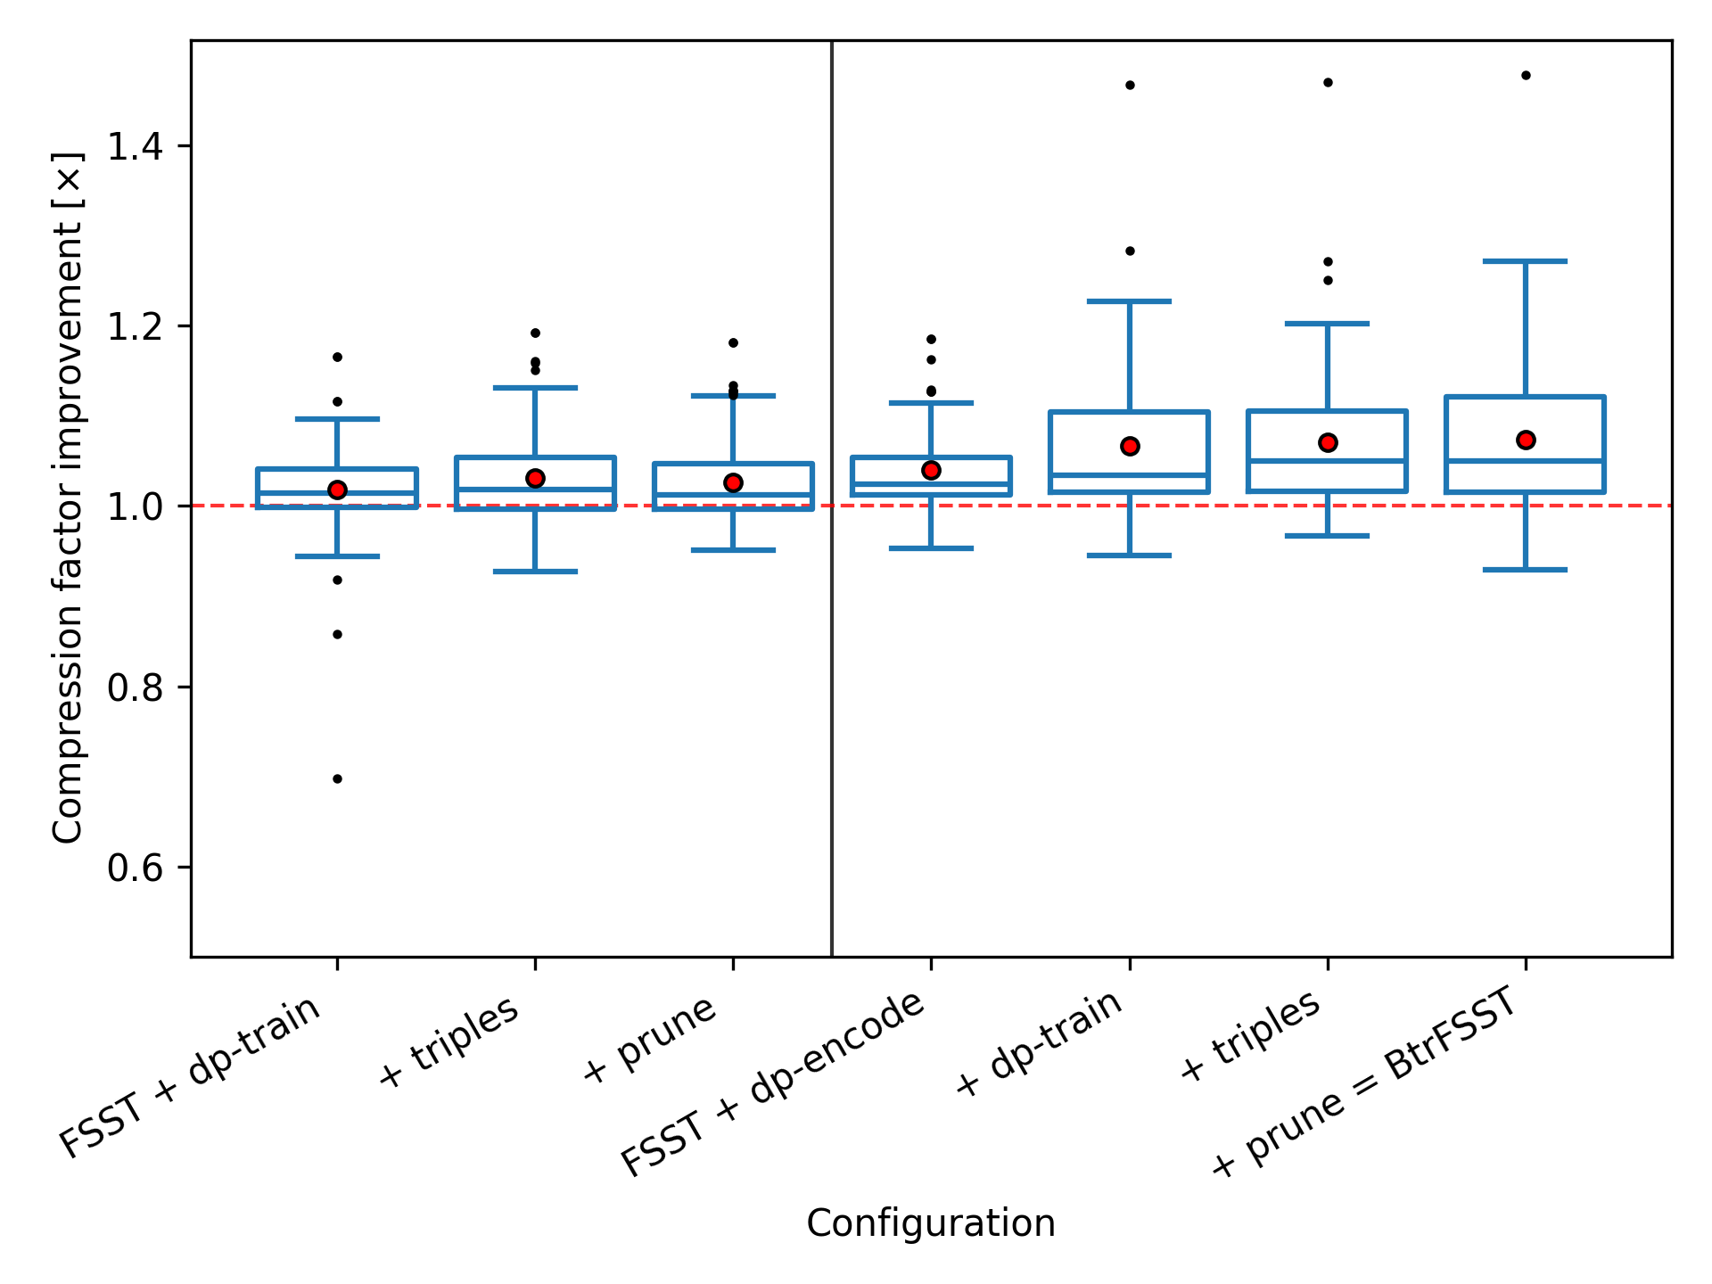
Benchmarks
Results
Notes:
7.3%
dp encode 3.9% table const 3.1% 2.5%

Slide 108
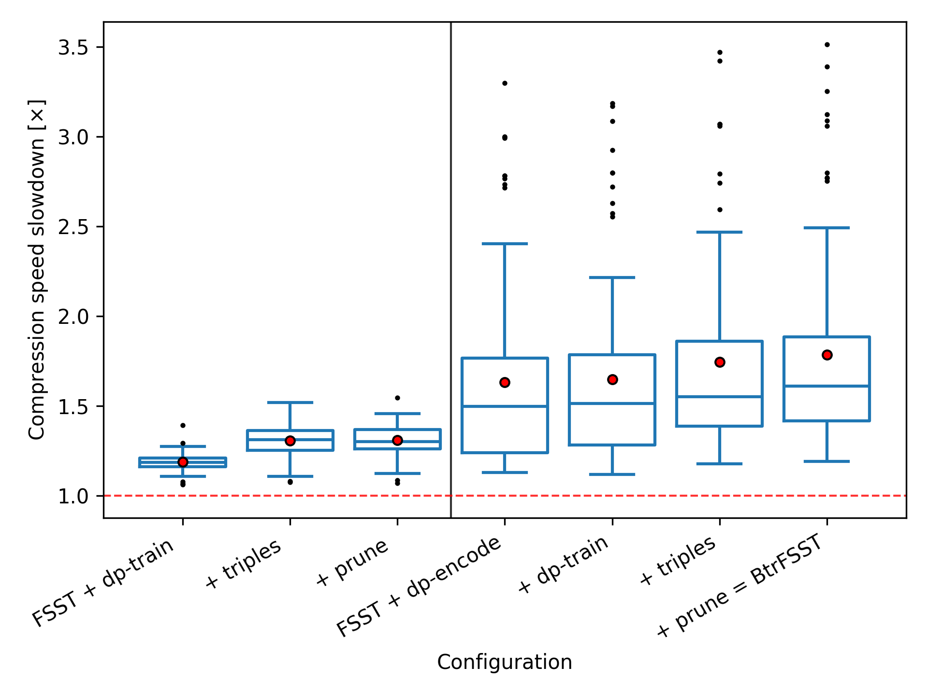
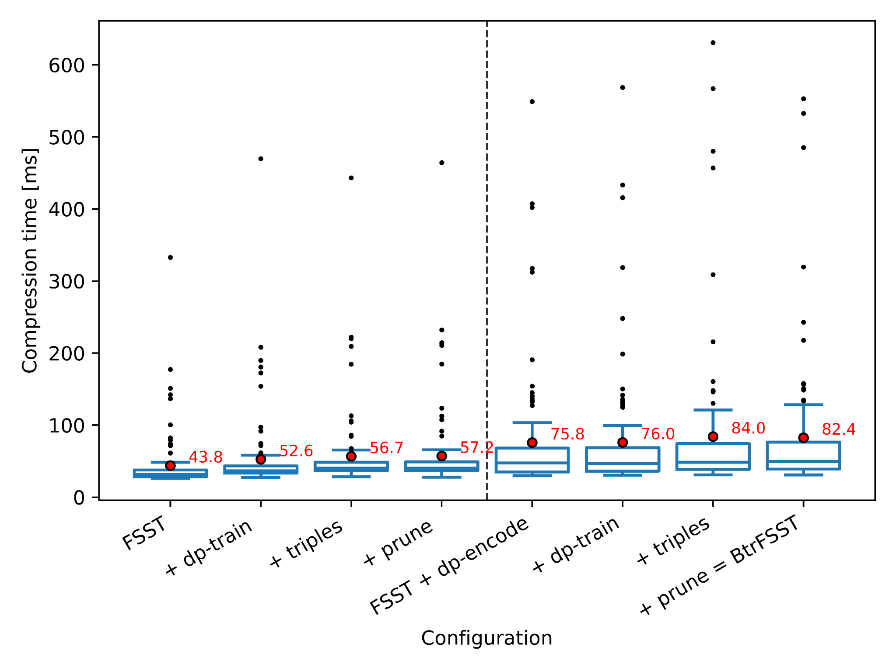
Benchmarks
Results
Notes:
78.3% dp encode 63% constrcution : 30.8%

Slide 109
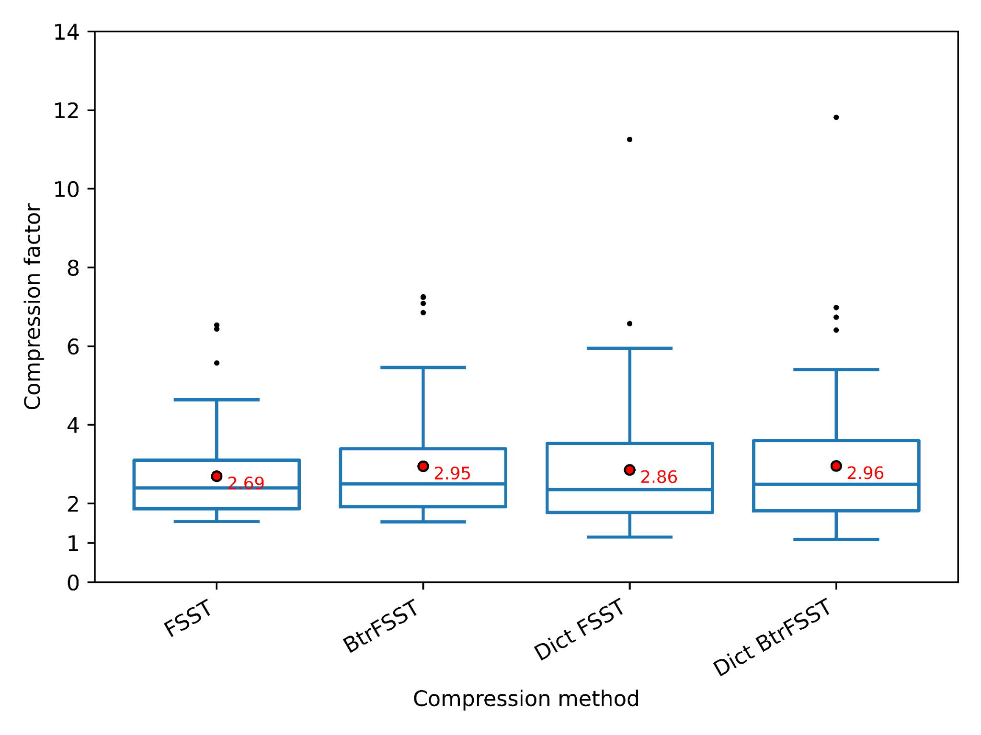
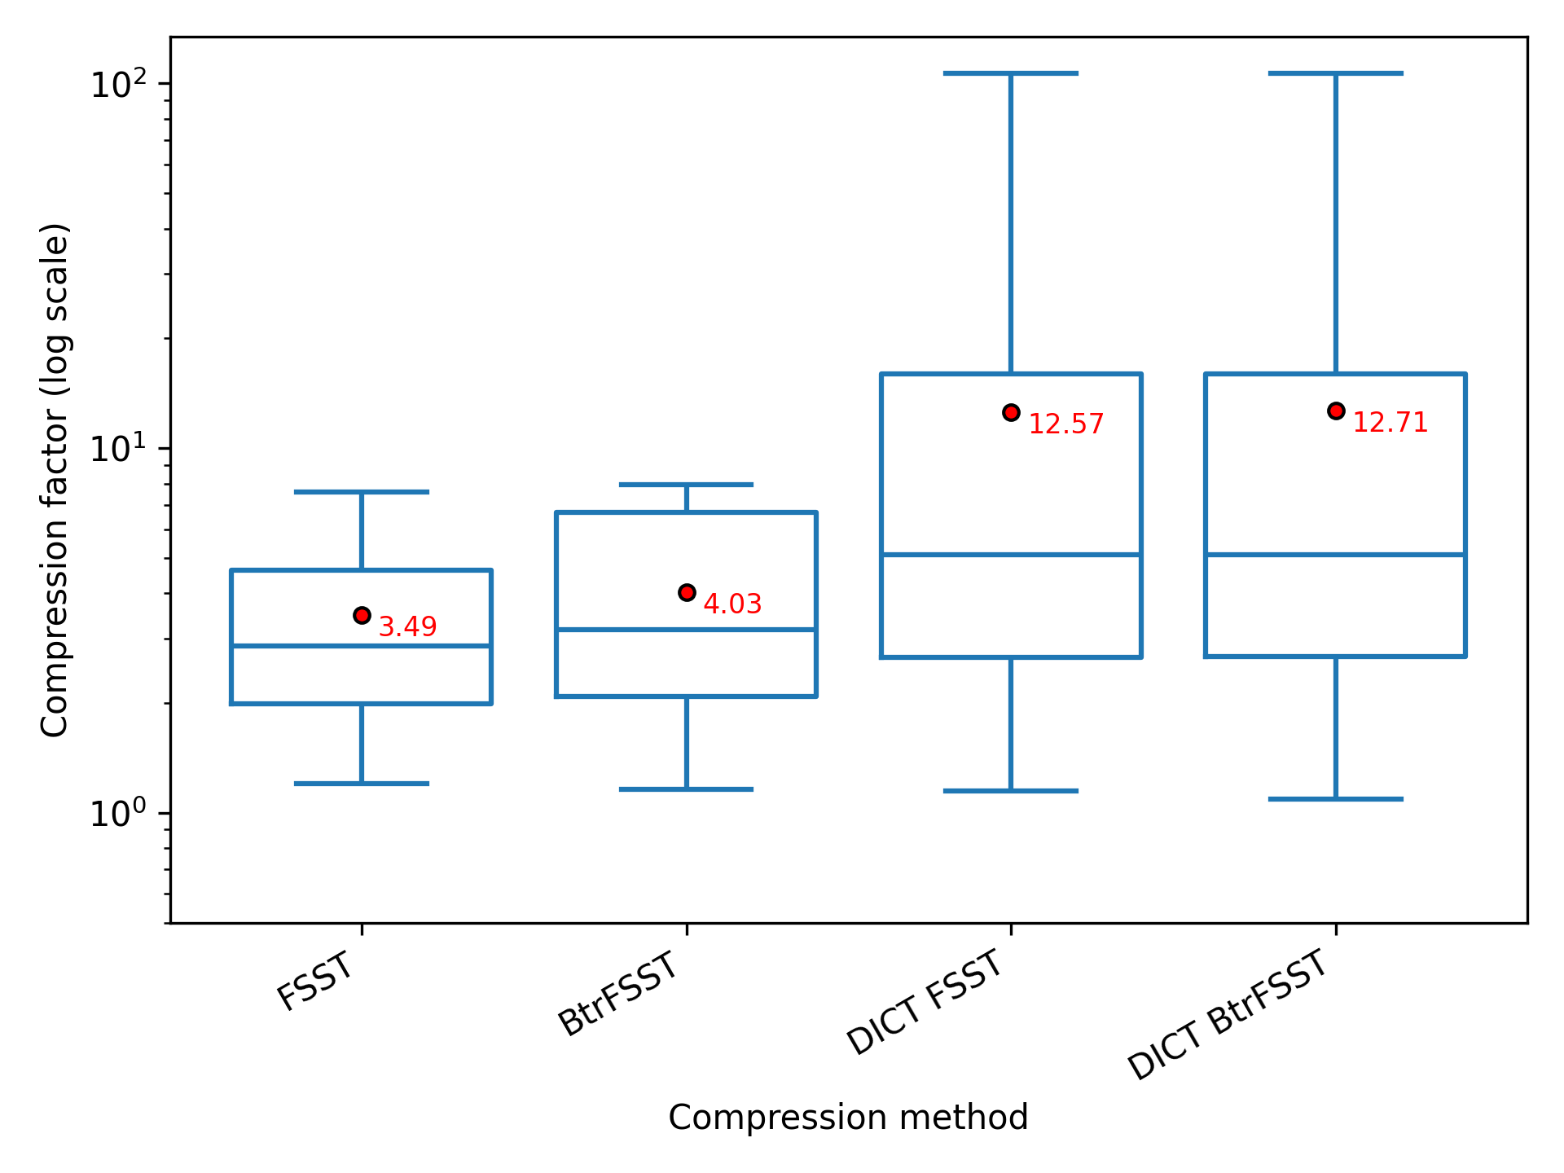
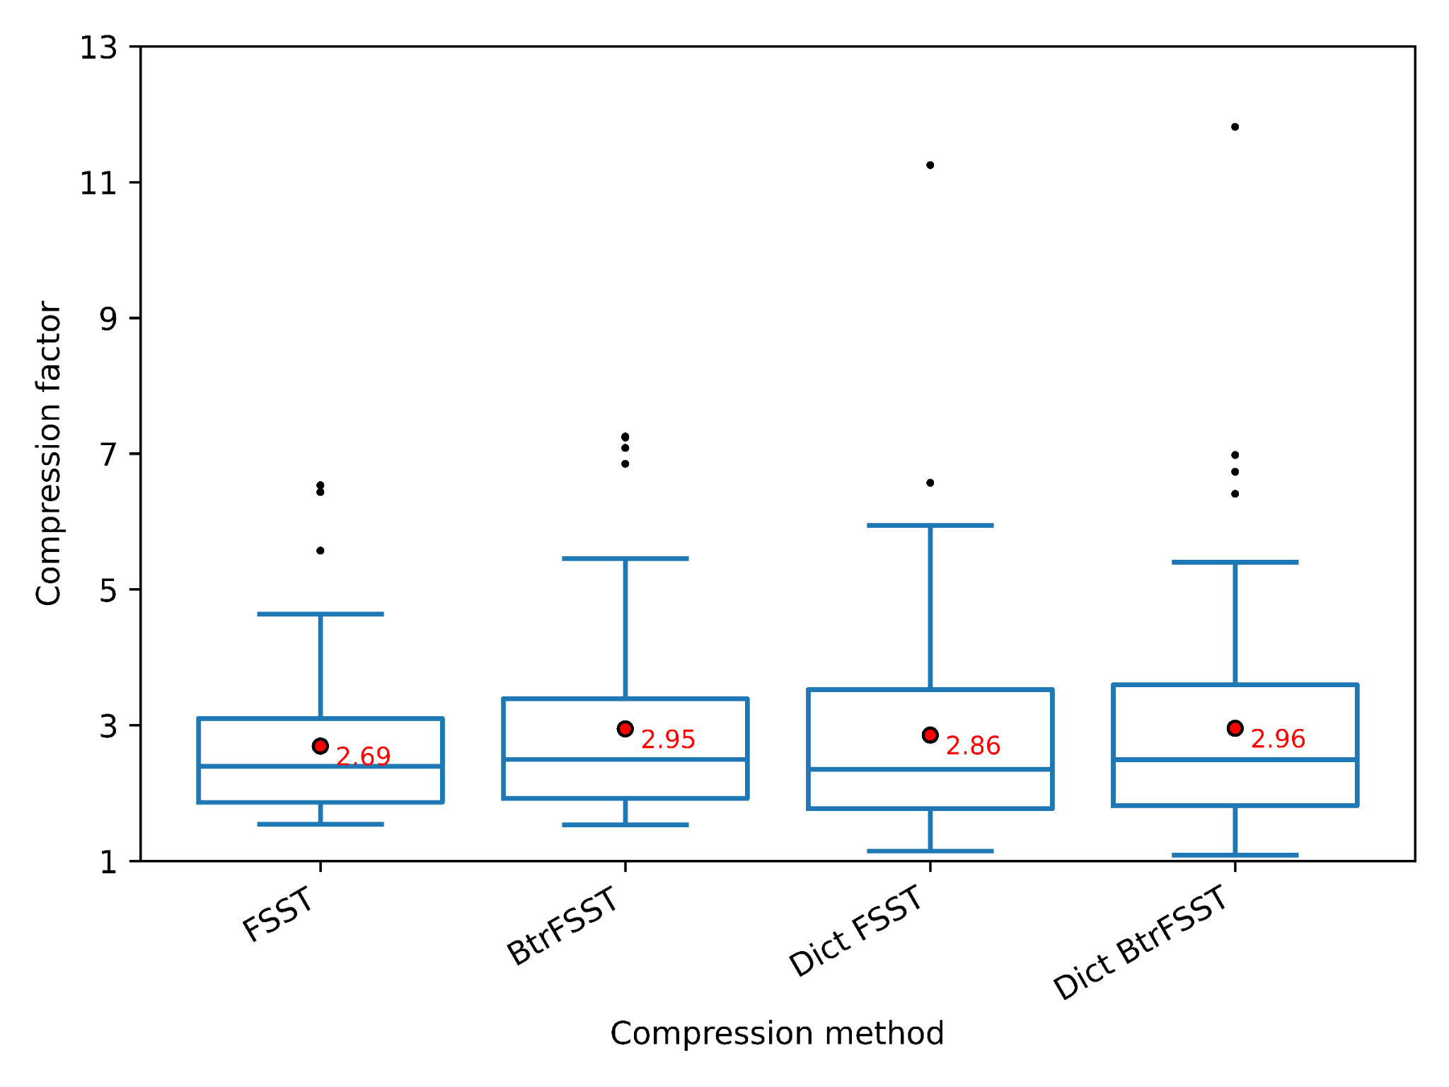
Benchmarks
Results
Notes:
15.4%

Slide 110
Benchmarks
Results
Notes:
1.1%

Slide 111
Conclusion
Summary

Slide 112
Conclusion
Summary
Reduced greedy aspect of symbol table construction

Slide 113
Conclusion
Summary
Reduced greedy aspect of symbol table construction
Overall better compression

Slide 114
Conclusion
Summary
Reduced greedy aspect of symbol table construction
Overall better compression
Runtime overhead

Slide 115
Conclusion
Areas of improvement

Slide 116
Conclusion
Areas of improvement
Runtime improvement (especially DP encoding): hybrid approach?

Slide 117
Conclusion
Areas of improvement
Runtime improvement (especially DP encoding): hybrid approach?
Pruning optimization

Slide 118
Conclusion
Areas of improvement
Runtime improvement (especially DP encoding): hybrid approach?
Pruning optimization
Global improvements across all generations instead of local improvements

Slide 119

https://github.com/Hedi-Chehaidar/btrfsst

Slide 120
Thank You

