Slide 1
Programming Essential in Python
Prepared by Dr. Mohammad Ahmad Safwat

Slide 2
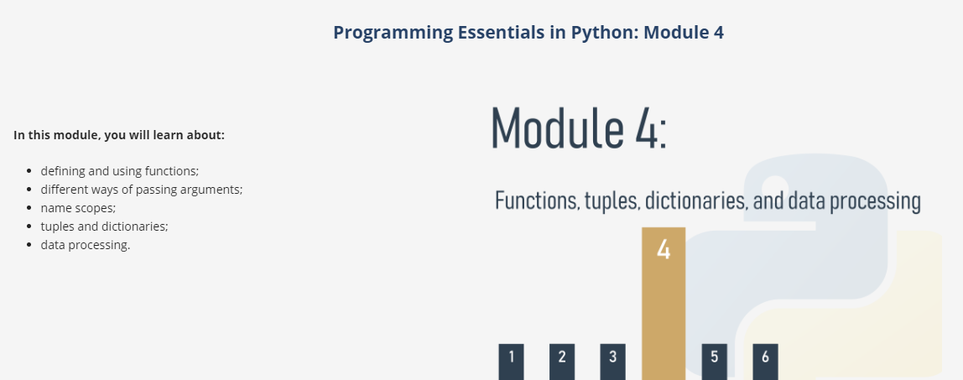

Slide 3
Functions
It often happens that a particular piece of code is repeated many times in your program
It may happen that the algorithm you're going to implement is so complex that your code begins to grow in an uncontrolled manner
Function has already taken:
print()
input()
int() or float()
We have also made use of some methods, which are in fact functions, but declared in a very specific way
Notes:
When you want some data to be printed on the console, you use print(). When you want to read the value of a variable, you use input(), coupled with either int() or float().
We can now define the first condition which can help you decide when to start writing your own functions: if a particular fragment of the code begins to appear in more than one place, consider the possibility of isolating it in the form of a function invoked from the points where the original code was placed before.
It may happen that the algorithm you're going to implement is so complex that your code begins to grow in an uncontrolled manner, and suddenly you notice that you're not able to navigate through it so easily anymore.

Slide 4
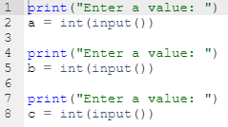
Functions
It's rather simple, but we only want it to be an example of transforming a repeating part of a code into a function
Notes:
Take a look at the snippet in the editor.
It's rather simple, but we only want it to be an example of transforming a repeating part of a code into a function.
The messages sent to the console by the print() function are always the same. Of course, there's nothing really bad in such a code, but try to imagine what you would have to do if your boss asked you to change the message to make it more polite, e.g., to start it with the phrase "Please,".
It seems that you'd have to spend some time changing all the occurrences of the message (you'd use a clipboard, of course, but it wouldn't make your life much easier). It's obvious that you'd probably make some mistakes during the amendment process, and you (and your boss) would get a bit frustrated.
Is it possible to separate such a repeatable part of the code, name it and make it reusable? It would mean that a change made once in one place would be propagated to all the places where it's used.
Of course, such a code should work only when it's explicitly launched.
Yes, it's possible. This is exactly what functions are for.

Slide 5
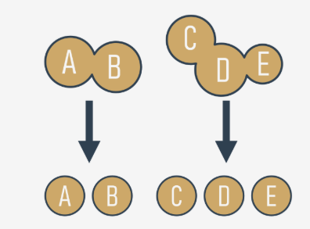
Functions
This considerably simplifies the work of the program, because each piece of code can be encoded separately, and tested separately. The process described here is often called decomposition.
We can now state the second condition: if a piece of code becomes so large that reading and understating it may cause a problem, consider dividing it into separate, smaller problems, and implement each of them in the form of a separate function.
A good and attentive developer divides the code (or more accurately: the problem) into well-isolated pieces, and encodes each of them in the form of a function.

Slide 6
Decomposition
It often happens that the problem is so large and complex that it cannot be assigned to a single developer, and a team of developers have to work on it. The problem must be split between several developers in a way that ensures their efficient and seamless cooperation
Each of them writes a clearly defined and described set of functions, which when combined into the module (we'll tell you about this a bit later) will give the final product.
Notes:
.
It seems inconceivable that more than one programmer should write the same piece of code at the same time, so the job has to be dispersed among all the team members.
This kind of decomposition has a different purpose to the one described previously - it's not only about sharing the work, but also about sharing the responsibility among many developers.
Each of them writes a clearly defined and described set of functions, which when combined into the module (we'll tell you about this a bit later) will give the final product.
This leads us directly to the third condition: if you're going to divide the work among multiple programmers, decompose the problem to allow the product to be implemented as a set of separately written functions packed together in different modules.

Slide 7
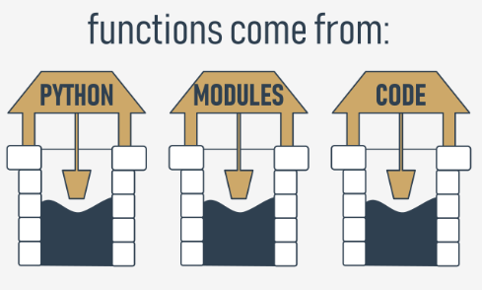
Where do the functions come from?
In general, functions come from at least three places:
from Python itself - numerous functions (like print()) are an integral part of Python “built-in functions”
from Python's preinstalled modules
directly from your code
Notes:
Where do the functions come from?
In general, functions come from at least three places:
from Python itself - numerous functions (like print()) are an integral part of Python, and are always available without any additional effort on behalf of the programmer; we call these functions built-in functions;
from Python's preinstalled modules - a lot of functions, very useful ones, but used significantly less often than built-in ones, are available in a number of modules installed together with Python; the use of these functions requires some additional steps from the programmer in order to make them fully accessible (we'll tell you about this in a while);
directly from your code - you can write your own functions, place them inside your code, and use them freely;
there is one other possibility, but it's connected with classes, so we'll omit it for now.

Slide 8
Your first function
def functionName():
functionBody
It always starts with the keyword def (for define)
next after def goes the name of the function (the rules for naming functions are exactly the same as for naming variables)
after the function name, there's a place for a pair of parentheses (they contain nothing here, but that will change soon)
the line has to be ended with a colon
the line directly after def begins the function body - a couple (at least one) of necessarily nested instructions, which will be executed every time the function is invoked; note: the function ends where the nesting ends, so you have to be careful
Notes:
Your first function
How do you make such a function?
You need to define it. The word define is significant here.
This is what the simplest function definition looks like:
def functionName(): functionBody It always starts with the keyword def (for define)
next after def goes the name of the function (the rules for naming functions are exactly the same as for naming variables)
after the function name, there's a place for a pair of parentheses (they contain nothing here, but that will change soon)
the line has to be ended with a colon;
the line directly after def begins the function body - a couple (at least one) of necessarily nested instructions, which will be executed every time the function is invoked; note: the function ends where the nesting ends, so you have to be careful.
We're ready to define our prompting function. We'll name it message - here it is:
def message(): print("Enter a value: ") The function is extremely simple, but fully usable. We've named it message, but you can label it according to your taste. Let's use it.
Our code contains the function definition now:
def message(): print("Enter a value: ") print("We start here.") print("We end here.") Note: we don't use the function at all - there's no invocation of it inside the code.
When you run it, you see the following output:
We start here. We end here. This means that Python reads the function's definitions and remembers them, but won't launch any of them without your permission.
We've modified the code now - we've inserted the function's invocation between the start and end messages:
def message(): print("Enter a value: ") print("We start here.") message() print("We end here.") The output looks different now:
We start here. Enter a value: We end here. Test the code, modify it, experiment with it.

Slide 9
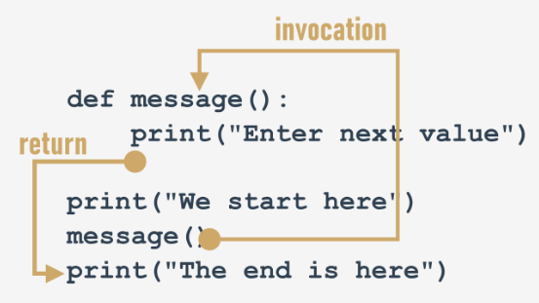
How functions work
Notes:
It tries to show you the whole process:
when you invoke a function, Python remembers the place where it happened and jumps into the invoked function;
the body of the function is then executed;
reaching the end of the function forces Python to return to the place directly after the point of invocation.

Slide 10
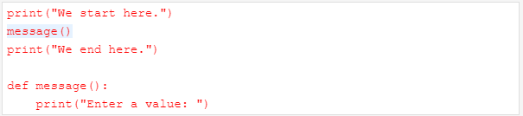

Take care
You mustn't invoke a function which is not known at the moment of invocation.
You mustn't have a function and a variable of the same name.
Notes:
There are two, very important, catches. Here's the first of them:
You mustn't invoke a function which is not known at the moment of invocation.
Remember - Python reads your code from top to bottom. It's not going to look ahead in order to find a function you forgot to put in the right place ("right" means "before invocation".)
We've inserted an error into this code - can you see the difference?
We've moved the function to the end of the code. Is Python able to find it when the execution reaches the invocation?
No, it isn't. The error message will read:
NameError: name 'message' is not defined
Don't try to force Python to look for functions you didn't deliver at the right time.
Assigning a value to the name message causes Python to forget its previous role. The function named message becomes unavailable.
Fortunately, you're free to mix your code with functions - you're not obliged to put all your functions at the top of your source file.
Look at the snippet:

Slide 11
Key takeaways
1. A function is a block of code that performs a specific task when the function is called (invoked). You can use functions to make your code reusable, better organized, and more readable. Functions can have parameters and return values.
2. There are at least four basic types of functions in Python:
built-in functions which are an integral part of Python (such as the print() function). You can see a complete list of Python built-in functions at https://docs.python.org/3/library/functions.html.
the ones that come from pre-installed modules
user-defined functions which are written by users for users - you can write your own functions and use them freely in your code,
the lambda functions
Notes:
1. A function is a block of code that performs a specific task when the function is called (invoked). You can use functions to make your code reusable, better organized, and more readable. Functions can have parameters and return values.
2. There are at least four basic types of functions in Python:
built-in functions which are an integral part of Python (such as the print() function). You can see a complete list of Python built-in functions at https://docs.python.org/3/library/functions.html.
the ones that come from pre-installed modules (you'll learn about them in Module 5 of this course)
user-defined functions which are written by users for users - you can write your own functions and use them freely in your code,
the lambda functions (you'll learn about them in Module 6 of this course.)

Slide 12
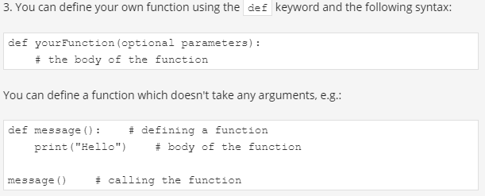
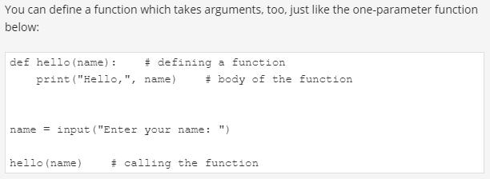

Slide 13
Exercises
Exercise 1
The input() function is an example of a: a) user-defined function b) built-in function
Exercise 2
What happens when you try to invoke a function before you define it? Example:
hi()
def hi():
print("hi!")
Exercise 3
What will happen when you run the code below?
def hi():
print("hi")
hi(5)
Notes:
Check
b - it's a built-in function
Check
An exception is thrown (the NameError exception to be more precise)
Check
An exception will be thrown (the TypeError exception to be more precise) - the hi() function doesn't take any arguments

Slide 14

How functions communicate with their environment - Parametrized functions
The function's full power reveals itself when it can be equipped with an interface that is able to accept data provided by the invoker
def function(parameter):
parameters live inside functions
arguments exist outside functions
Notes:
Parametrized functions
The function's full power reveals itself when it can be equipped with an interface that is able to accept data provided by the invoker. Such data can modify the function's behavior, making it more flexible and adaptable to changing conditions.
A parameter is actually a variable, but there are two important factors that make parameters different and special:
parameters exist only inside functions in which they have been defined, and the only place where the parameter can be defined is a space between a pair of parentheses in the def statement;
assigning a value to the parameter is done at the time of the function's invocation, by specifying the corresponding argument.
def function(parameter): ### Don't forget:
parameters live inside functions (this is their natural environment)
arguments exist outside functions, and are carriers of values passed to corresponding parameters.
There is a clear and unambiguous frontier between these two worlds.
Let's enrich the function above with just one parameter - we're going to use it to show the user the number of a value the function asks for.
We have to rebuild the def statement - this is how it looks now:
def message(number): ### The definition specifies that our function operates on just one parameter named number. You can use it as an ordinary variable, but only inside the function - it isn't visible anywhere else.
Let's now improve the function's body:
def message(number): print("Enter a number:", number) We've made use of the parameter. Note: we haven't assigned the parameter with any value. Is it correct?
Yes, it is.
A value for the parameter will arrive from the function's environment.
Remember: specifying one or more parameters in a function's definition is also a requirement, and you have to fulfil it during invocation. You must provide as many arguments as there are defined parameters.
Failure to do so will cause an error.

Slide 15
Parametrized functions
Remember: specifying one or more parameters in a function's definition is also a requirement, and you have to fulfil it during invocation. You must provide as many arguments as there are defined parameters.
Notes:
Try to run the code in the editor.
This is what you'll see in the console:
TypeError: message() missing 1 required positional argument: 'number'

Slide 16
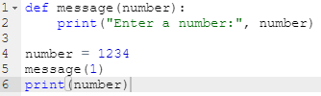
Parametrized functions
Shadowing
The parameter named number is a completely different entity from the variable named number.
This means that the snippet above will produce the following output:
Enter a number: 1
1234
Notes:
It's legal, and possible, to have a variable named the same as a function's parameter.
The snippet illustrates the phenomenon:
A situation like this activates a mechanism called shadowing:
parameter x shadows any variable of the same name, but...
... only inside the function defining the parameter.
The parameter named number is a completely different entity from the variable named number.
This means that the snippet above will produce the following output:
Enter a number: 1 1234

Slide 17


Parametrized functions
A function can have as many parameters as you want
Let's modify the function - it has two parameters now:
This also means that invoking the function will require two arguments.
Notes:
A function can have as many parameters as you want
def message(what, number):
print("Enter", what, "number", number)
# invoke function

Slide 18

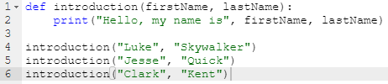
Positional parameter passing
A technique which assigns the i^{th} (first, second, and so on) argument to the i^{th} (first, second, and so on) function parameter is called positional parameter passing, while arguments passed in this way are named positional arguments.
Notes:
Positional parameter passing
A technique which assigns the i^{th} (first, second, and so on) argument to the i^{th} (first, second, and so on) function parameter is called positional parameter passing, while arguments passed in this way are named positional arguments.
You've used it already, but Python can offer a lot more. We're going to tell you about it now.
def myFunction(a, b, c): print(a, b, c) myFunction(1, 2, 3) Note: positional parameter passing is intuitively used by people in many social occasions. For example, it may be generally accepted that when we introduce ourselves we mention our first name(s) before our last name, e.g., "My name's John Doe."
Incidentally, Hungarians do it in reverse order.
Let's implement that social custom in Python. The following function will be responsible for introducing somebody:
def introduction(firstName, lastName): print("Hello, my name is", firstName, lastName) introduction("Luke", "Skywalker") introduction("Jesse", "Quick") introduction("Clark", "Kent") Can you guess the output? Run the code and find out if you were right.
Now imagine that the same function is being used in Hungary. In this case, the code would look like this:
def introduction(firstName, lastName):
print("Hello, my name is", firstName, lastName)
introduction("Skywalker", "Luke")
introduction("Quick", "Jesse")
introduction("Kent", "Clark")
The output will look different. Can you guess it?
Run the code to see if you were right here, too. Are you surprised?
Can you make the function more culture-independent?

Slide 19

Keyword argument passing
the meaning of the argument is dictated by its name, not by its position
The concept is clear - the values passed to the parameters are preceded by the target parameters' names, followed by the = sign.
Notes:
Keyword argument passing
Python offers another convention for passing arguments, where the meaning of the argument is dictated by its name, not by its position - it's called keyword argument passing.
Take a look at the snippet:
def introduction(firstName, lastName):
print("Hello, my name is", firstName, lastName)
introduction(firstName = "James", lastName = "Bond")
introduction(lastName = "Skywalker", firstName = "Luke") The concept is clear - the values passed to the parameters are preceded by the target parameters' names, followed by the = sign.
The position doesn't matter here - each argument's value knows its destination on the basis of the name used.
You should be able to predict the output. Run the code to check if you were right.
Of course, you mustn't use a non-existent parameter name.
The following snippet will cause a runtime error:
def introduction(firstName, lastName): print("Hello, my name is", firstName, lastName) introduction(surname="Skywalker", firstName="Luke") This is what Python will tell you:
TypeError: introduction() got an unexpected keyword argument 'surname'

Slide 20




Mixing positional and keyword arguments
You can mix both fashions if you want - there is only one unbreakable rule: you have to put positional arguments before keyword arguments.
Type Error: sum() got multiple values for argument 'a'
Notes:
Mixing positional and keyword arguments
You can mix both fashions if you want - there is only one unbreakable rule: you have to put positional arguments before keyword arguments.
If you think for a moment, you'll certainly guess why.
To show you how it works, we'll use the following simple three-parameter function:
def sum(a, b, c): print(a, "+", b, "+", c, "=", a + b + c) Its purpose is to evaluate and present the sum of all its arguments.
The function, when invoked in the following way:
sum(1, 2, 3) will output:
1 + 2 + 3 = 6 It was - as you may suspect - a pure example of positional argument passing.
Of course, you can replace such an invocation with a purely keyword variant, like this:
sum(c = 1, a = 2, b = 3) Our program will output a line like this:
2 + 3 + 1 = 6 Note the order of the values.
Let's try to mix both styles now.
Look at the function invocation below:
sum(3, c = 1, b = 2) Let's analyze it:
the argument (3) for the a parameter is passed using the positional way;
the arguments for c and b are specified as keyword ones.
This is what you'll see in the console:
3 + 2 + 1 = 6Be careful, and beware of mistakes. If you try to pass more than one value to one argument, all you'll get is a runtime error.
Look at the invocation below - it seems that we've tried to set a twice:
sum(3, a = 1, b = 2) Python's response:
TypeError: sum() got multiple values for argument 'a' Look at the snipet below. A code like this is fully correct, but it doesn't make much sense:
sum(4, 3, c = 2) Everything is right, but leaving in just one keyword argument looks a bit weird - what do you think?

Slide 21

Parametrized functions - more details
It happens at times that a particular parameter's values are in use more often than others. Such arguments may have their default (predefined) values
introduction("James", "Doe")
but when you invoke the function in a way that looks a bit suspicious at first sight, like this:
introduction("Henry")
introduction(firstName="William")
Notes:
Parametrized functions - more details
It happens at times that a particular parameter's values are in use more often than others. Such arguments may have their default (predefined) values taken into consideration when their corresponding arguments have been omitted.
They say that the most popular English last name is Smith. Let's try to take this into account.
The default parameter's value is set using clear and pictorial syntax:
def introduction(firstName, lastName="Smith"): print("Hello, my name is", fistName, lastName) You only have to extend the parameter's name with the = sign, followed by the default value./p>
Let's invoke the function as usual:
introduction("James", "Doe") Can you guess the output of the program? Run it and check if you were right.
And? Everything looks the same, but when you invoke the function in a way that looks a bit suspicious at first sight, like this:
introduction("Henry") or this:
introduction(firstName="William") there will be no error, and both invocations will succeed, while the console will show the following output:
Hello, my name is Henry Smith Hello, my name is William Smith Test it.
You can go further if it's useful. Both parameters have their default values now, look at the code below:
def introduction(firstName="John", lastName="Smith"): print("Hello, my name is", firstName, lastName) This makes the following invocation absolutely valid:
introduction() And this is the expected output:
Hello, my name is John Smith If you use one keyword argument, the remaining one will take the default value:
introduction(lastName="Hopkins") The output is:
Hello, my name is John Hopkins Test it.
Congratulations - you have just learned the basic ways of communicating with functions.

Slide 22
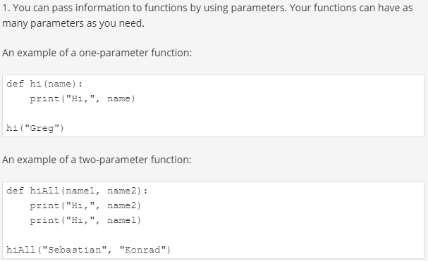
Key takeaways

Slide 23
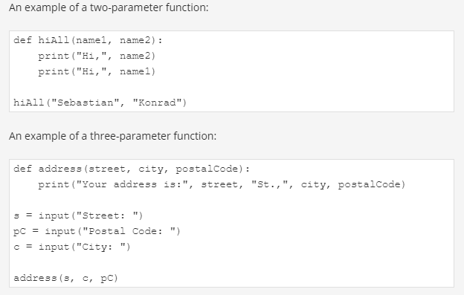
Key takeaways

Slide 24
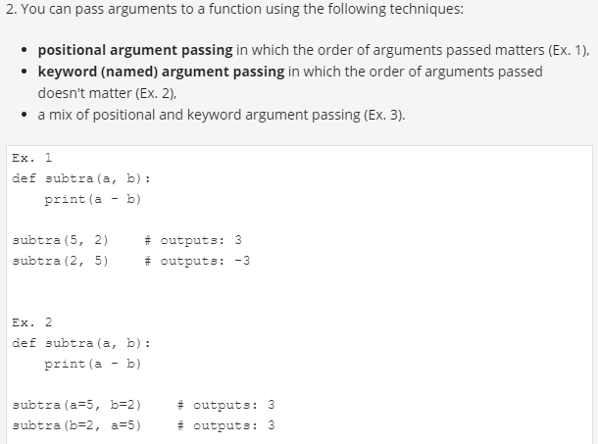
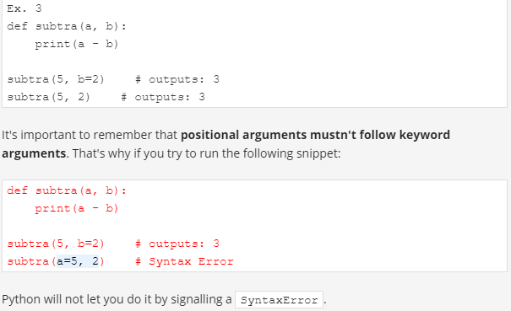

Slide 25
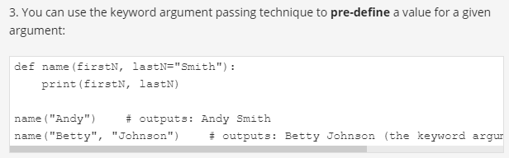
Key takeaways
Notes:
3. You can use the keyword argument passing technique to pre-define a value for a given argument:
def name(firstN, lastN="Smith"): print(firstN, lastN) name("Andy") # outputs: Andy Smith name("Betty", "Johnson") # outputs: Betty Johnson (the keyword argument replaced by "Johnson")

Slide 26
Exercises
Exercise 1
What is the output of the following snippet?
def intro(a="James Bond", b="Bond"):
print("My name is", b + ".", a + ".")
intro()
Exercise 2
What is the output of the following snippet?
def intro(a="James Bond", b="Bond"):
print("My name is", b + ".", a + ".")
intro(b="Sean Connery")
Notes:
Exercise 1
What is the output of the following snippet?
def intro(a="James Bond", b="Bond"): print("My name is", b + ".", a + ".") intro() Check
My name is Bond. James Bond.
Exercise 2
What is the output of the following snippet?
def intro(a="James Bond", b="Bond"): print("My name is", b + ".", a + ".") intro(b="Sean Connery") Check
My name is Sean Connery. James Bond.

Slide 27
Exercises
Exercise 3
What is the output of the following snippet?
def intro(a, b="Bond"):
print("My name is", b + ".", a + ".")
intro("Susan")
Exercise 4
What is the output of the following snippet?
def sum(a, b=2, c):
print(a + b + c)
sum(a=1, c=3)
Notes:
Exercise 3
What is the output of the following snippet?
def intro(a, b="Bond"): print("My name is", b + ".", a + ".") intro("Susan") Check
My name is Bond. Susan.
Exercise 4
What is the output of the following snippet?
def sum(a, b=2, c): print(a + b + c) sum(a=1, c=3) Check
SyntaxError - a non-default argument (c) follows a default argument (b=2)

Slide 28
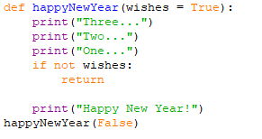
Effects and results: the return instruction
To get functions to return a value (but not only for this purpose) you use the return keyword.
The return instruction has two different variants - let's consider them separately.
return without an expression
it causes the immediate termination of the function's execution
you can use it to terminate a function's activities on demand, before the control reaches the function's last line
happyNewYear()
happyNewYear(False)
Notes:
Effects and results: the return instruction
All the previously presented functions have some kind of effect - they produce some text and send it to the console.
Of course, functions - like their mathematical siblings - may have results.
To get functions to return a value (but not only for this purpose) you use the return instruction.
This word gives you a full picture of its capabilities. Note: it's a Python keyword.
The return instruction has two different variants - let's consider them separately.
return without an expression
The first consists of the keyword itself, without anything following it.
When used inside a function, it causes the immediate termination of the function's execution, and an instant return (hence the name) to the point of invocation.
Note: if a function is not intended to produce a result, using the return instruction is not obligatory - it will be executed implicitly at the end of the function.
Anyway, you can use it to terminate a function's activities on demand, before the control reaches the function's last line.
Let's consider the following function:
def happyNewYear(wishes = True):
print("Three...")
print("Two...")
print("One...")
if not wishes:
return
print("Happy New Year!")
happyNewYear()
happyNewYear(False)

Slide 29
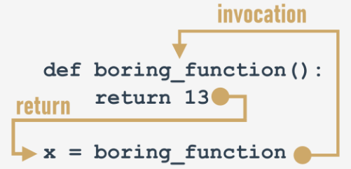

the return instruction
Return with an expression
The second return variant is extended with an expression:
it causes the immediate termination of the function's execution (nothing new compared to the first variant)
moreover, the function will evaluate the expression's value and will return (hence the name once again) it as the function's result.
Notes:
return with an expression
The second return variant is extended with an expression:
function(): return expression There are two consequences of using it:
it causes the immediate termination of the function's execution (nothing new compared to the first variant)
moreover, the function will evaluate the expression's value and will return (hence the name once again) it as the function's result.
Yes, we already know - this example isn't really sophisticated:
def boringFunction():
return 123
x = boringFunction()
print("The boringFunction has returned its result. It's:", x)

Slide 30
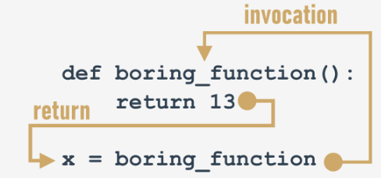
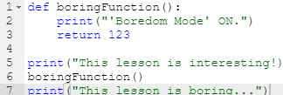

the return instruction
You are always allowed to ignore the function's result, and be satisfied with the function's effect (if the function has any)
Notes:
def boringFunction():
print("'Boredom Mode' ON.")
return 123
print("This lesson is interesting!)
boringFunction()
print("This lesson is boring...")

Slide 31



A few words about None
if a function doesn't return a certain value using a return expression clause, it is assumed that it implicitly returns None.
There are only two kinds of circumstances when None can be safely used:
when you assign it to a variable (or return it as a function's result)
when you compare it with a variable to diagnose its internal state.
Its data doesn't represent any reasonable value
None is a keyword
print(None + 2)
Notes:
A few words about None
Let us introduce you to a very curious value (to be honest, a none value) named None.
Its data doesn't represent any reasonable value - actually, it's not a value at all; hence, it mustn't take part in any expressions.
For example, a snippet like this:
print(None + 2) will cause a runtime error, described by the following diagnostic message:
TypeError: unsupported operand type(s) for +: 'NoneType' and 'int' Note: None is a keyword.
There are only two kinds of circumstances when None can be safely used:
when you assign it to a variable (or return it as a function's result)
when you compare it with a variable to diagnose its internal state.
Just like here:
value = None
if value == None:
print("Sorry, you don't carry any value")
Don't forget this: if a function doesn't return a certain value using a return expression clause, it is assumed that it implicitly returns None.
Let's test it.
def strangeFunction(n):
if(n % 2 == 0):
return True

Slide 32
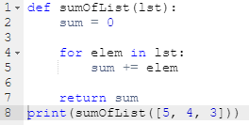
Effects and results: lists and functions
may a list be sent to a function as an argument?
Notes:
The first is: may a list be sent to a function as an argument?
Of course it may! Any entity recognizable by Python can play the role of a function argument, although it has to be assured that the function is able to cope with it.
So, if you pass a list to a function, the function has to handle it like a list.
def sumOfList(lst):
sum = 0
for elem in lst:
sum += elem
return sum
print(sumOfList([5, 4, 3]))
print(sumOfList(5)) Python's response will be unequivocal:
TypeError: 'int' object is not iterable This is caused by the fact that a single integer value mustn't be iterated through by the for loop.
Yes, of course! Any entity recognizable by Python can be a function result.
Look at the code in the editor. The program's output will be like this:
[4, 3, 2, 1, 0]

Slide 33
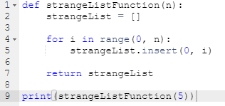
Effects and results: lists and functions
may a list be a function result?
Notes:
The second question is: may a list be a function result?
Yes, of course! Any entity recognizable by Python can be a function result.
Look at the code in the editor. The program's output will be like this:
[4, 3, 2, 1, 0] Now you can write functions with and without results.
Let's dive a little deeper into the issues connected with variables in functions. This is essential for creating effective and safe functions.
def strangeListFunction(n):
strangeList = []
for i in range(0, n):
strangeList.insert(0, i)
return strangeList
print(strangeListFunction(5))

Slide 34
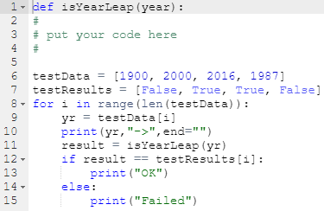
LAB
Estimated time
10-15 minutes
Level of difficulty
Easy
Scenario
Your task is to write and test a function which takes one argument (a year) and returns True if the year is a leap year, or False otherwise.
The seed of the function is already sown in the skeleton code in the editor.
Note: we've also prepared a short testing code, which you can use to test your function.
The code uses two lists - one with the test data, and the other containing the expected results. The code will tell you if any of your results are invalid.
Notes:
LAB Estimated time
10-15 minutes
Level of difficulty
Easy
Scenario
Your task is to write and test a function which takes one argument (a year) and returns True if the year is a leap year, or False otherwise.
The seed of the function is already sown in the skeleton code in the editor.
Note: we've also prepared a short testing code, which you can use to test your function.
The code uses two lists - one with the test data, and the other containing the expected results. The code will tell you if any of your results are invalid.

Slide 35
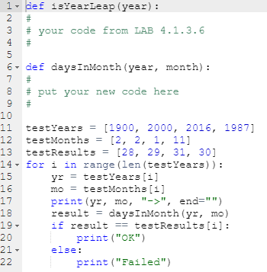
LAB
Estimated time
15-20 minutes
Level of difficulty
Medium
Prerequisites
LAB 4.1.3.6
Scenario
Your task is to write and test a function which takes two arguments (a year and a month) and returns the number of days for the given month/year pair (while only February is sensitive to the year value, your function should be universal).
The initial part of the function is ready. Now, convince the function to return None if its arguments don't make sense.
Of course, you can (and should) use the previously written and tested function (LAB 4.1.3.6). It may be very helpful. We encourage you to use a list filled with the months' lengths. You can create it inside the function - this trick will significantly shorten the code.
We've prepared a testing code. Expand it to include more test cases.
Notes:
LAB Estimated time
15-20 minutes
Level of difficulty
Medium
Prerequisites
LAB 4.1.3.6
Scenario
Your task is to write and test a function which takes two arguments (a year and a month) and returns the number of days for the given month/year pair (while only February is sensitive to the year value, your function should be universal).
The initial part of the function is ready. Now, convince the function to return None if its arguments don't make sense.
Of course, you can (and should) use the previously written and tested function (LAB 4.1.3.6). It may be very helpful. We encourage you to use a list filled with the months' lengths. You can create it inside the function - this trick will significantly shorten the code.
We've prepared a testing code. Expand it to include more test cases.

Slide 36
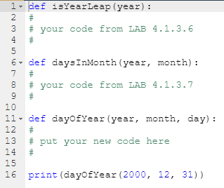
LAB
Estimated time
20-30 minutes
Level of difficulty
Medium
Prerequisites
LAB 4.1.3.6 LAB 4.1.3.7
Scenario
Your task is to write and test a function which takes three arguments (a year, a month, and a day of the month) and returns the corresponding day of the year, or returns None if any of the arguments is invalid.
Use the previously written and tested functions. Add some test cases to the code. This test is only a beginning
Notes:
LAB Estimated time
20-30 minutes
Level of difficulty
Medium
Prerequisites
LAB 4.1.3.6 LAB 4.1.3.7
Objectives
Familiarize the student with:
projecting and writing parameterized functions;
utilizing the return statement;
building a set of utility functions;
utilizing the student's own functions.
Scenario
Your task is to write and test a function which takes three arguments (a year, a month, and a day of the month) and returns the corresponding day of the year, or returns None if any of the arguments is invalid.
Use the previously written and tested functions. Add some test cases to the code. This test is only a beginning

Slide 37
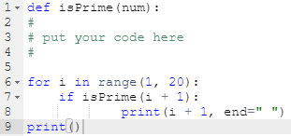
LAB
Estimated time
15-20 minutes
Scenario
A natural number is prime if it is greater than 1 and has no divisors other than 1 and itself.
Complicated? Not at all. For example, 8 isn't a prime number, as you can divide it by 2 and 4 (we can't use divisors equal to 1 and 8, as the definition prohibits this).
On the other hand, 7 is a prime number, as we can't find any legal divisors for it.
Your task is to write a function checking whether a number is prime or not.
The function:
is called isPrime;
takes one argument (the value to check)
returns True if the argument is a prime number, and False otherwise.
Hint: try to divide the argument by all subsequent values (starting from 2) and check the remainder - if it's zero, your number cannot be a prime; think carefully about when you should stop the process.
If you need to know the square root of any value, you can utilize the ** operator. Remember: the square root of x is the same as x^{0.5}
Complete the code in the editor.
Run your code and check whether your output is the same as ours.
Notes:
Estimated time
15-20 minutes
Level of difficulty
Medium
Objectives
familiarizing the student with classic notions and algorithms;
improving the student's skills in defining and using functions.
Scenario
A natural number is prime if it is greater than 1 and has no divisors other than 1 and itself.
Complicated? Not at all. For example, 8 isn't a prime number, as you can divide it by 2 and 4 (we can't use divisors equal to 1 and 8, as the definition prohibits this).
On the other hand, 7 is a prime number, as we can't find any legal divisors for it.
Your task is to write a function checking whether a number is prime or not.
The function:
is called isPrime;
takes one argument (the value to check)
returns True if the argument is a prime number, and False otherwise.
Hint: try to divide the argument by all subsequent values (starting from 2) and check the remainder - if it's zero, your number cannot be a prime; think carefully about when you should stop the process.
If you need to know the square root of any value, you can utilize the ** operator. Remember: the square root of x is the same as x^{0.5}
Complete the code in the editor.
Run your code and check whether your output is the same as ours.
Test Data
Expected output:
2 3 5 7 11 13 17 19

Slide 38
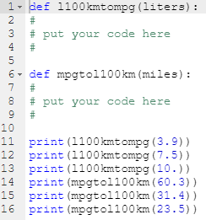
LAB
Estimated time
10-15 minutes
Level of difficulty
Easy
A car's fuel consumption may be expressed in many different ways. For example, in Europe, it is shown as the amount of fuel consumed per 100 kilometers.
In the USA, it is shown as the number of miles traveled by a car using one gallon of fuel.
Your task is to write a pair of functions converting l/100km into mpg, and vice versa.
The functions:
are named l100kmtompg and mpgtol100km respectively;
take one argument (the value corresponding to their names)
Complete the code in the editor.
Run your code and check whether your output is the same as ours.
Here is some information to help you:
1 American mile = 1609.344 metres;
1 American gallon = 3.785411784 litres.
Notes:
Estimated time
10-15 minutes
Level of difficulty
Easy
Objectives
improving the student's skills in defining, using and testing functions.
Scenario
A car's fuel consumption may be expressed in many different ways. For example, in Europe, it is shown as the amount of fuel consumed per 100 kilometers.
In the USA, it is shown as the number of miles traveled by a car using one gallon of fuel.
Your task is to write a pair of functions converting l/100km into mpg, and vice versa.
The functions:
are named l100kmtompg and mpgtol100km respectively;
take one argument (the value corresponding to their names)
Complete the code in the editor.
Run your code and check whether your output is the same as ours.
Here is some information to help you:
1 American mile = 1609.344 metres;
1 American gallon = 3.785411784 litres.
Test Data
Expected output:
60.31143162393162
31.36194444444444
23.52145833333333
3.9007393587617467
7.490910297239916
10.009131205673757

Slide 39
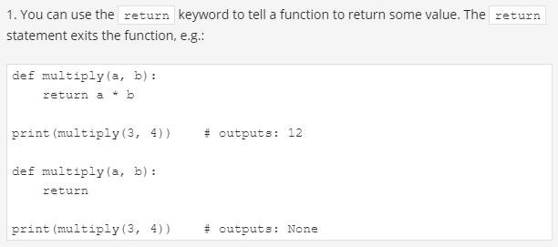
Key takeaways

Slide 40
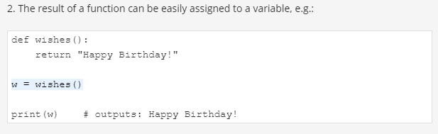
Key takeaways

Slide 41
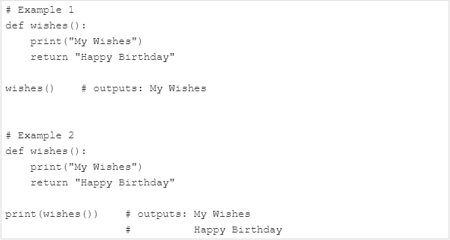
Key takeaways

Slide 42
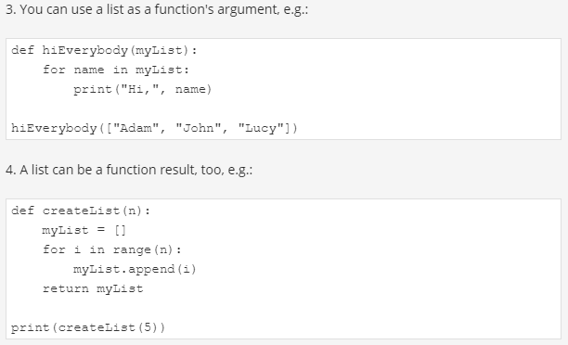
Key takeaways

Slide 43
Exercise s
Exercise 1
What is the output of the following snippet?
def hi():
return
print("Hi!")
hi()
Exercise 2
What is the output of the following snippet?
def isInt(data):
if type(data) == int:
return True
elif type(data) == float:
return False
print(isInt(5))
print(isInt(5.0))
print(isInt("5"))
Notes:
Exercise 1
What is the output of the following snippet?
def hi(): return print("Hi!") hi() Check
the function will return an implicit None value
Exercise 2
What is the output of the following snippet?
def isInt(data): if type(data) == int: return True elif type(data) == float: return False print(isInt(5)) print(isInt(5.0)) print(isInt("5")) Check
True False None

Slide 44
Exercises
Exercise 3
What is the output of the following snippet?
def evenNumLst(ran):
lst = []
for num in range(ran):
if num % 2 == 0:
lst.append(num)
return lst
print(evenNumLst(11))
Notes:
Exercise 3
What is the output of the following snippet?
def evenNumLst(ran): lst = [] for num in range(ran): if num % 2 == 0: lst.append(num) return lst print(evenNumLst(11)) Check
[0, 2, 4, 6, 8, 10]

Slide 45
Exercises
Exercise 4
What is the output of the following snippet?
def listUpdater(lst):
updList = []
for elem in lst:
elem **= 2
updList.append(elem)
return updList
l = [1, 2, 3, 4, 5]
print(listUpdater(l))
Notes:
Exercise 4
What is the output of the following snippet?
def listUpdater(lst): updList = [] for elem in lst: elem **= 2 updList.append(elem) return updList l = [1, 2, 3, 4, 5] print(listUpdater(l)) Check
[1, 4, 9, 16, 25]

Slide 46

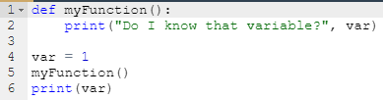
Functions and scopes
the scope of a function's parameter is the function itself. The parameter is inaccessible outside the function
a variable existing outside a function has a scope inside the functions' bodies.
Notes:
def scopeTest():
x = 123
scopeTest()
print(x)
def myFunction():
print("Do I know that variable?", var)
var = 1
myFunction()
print(var)

Slide 47
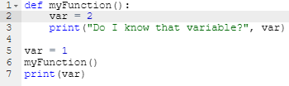

Functions and scopes
A variable existing outside a function has a scope inside the functions' bodies, excluding those of them which define a variable of the same name.
Notes:
the var variable created inside the function is not the same as when defined outside it –
it seems that there two different variables of the same name;
moreover, the function's variable shadows the variable coming from the outside world.
def myFunction():
var = 2
print("Do I know that variable?", var)
var = 1
myFunction()
print(var)

Slide 48
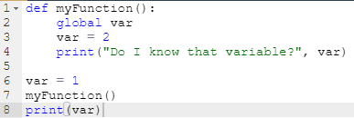

The global keyword
a keyword named ”global “ extends a variable's scope in a way which includes the functions' bodies
Using ”global “, a function is able to modify a variable defined outside it
Notes:
def myFunction():
global var
var = 2
print("Do I know that variable?", var)
var = 1
myFunction()
print(var)

Slide 49
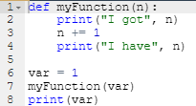

How the function interacts with its arguments
changing the parameter's value doesn't propagate outside the function
This also means that a function receives the argument's value, not the argument itself
Notes:
changing the parameter's value doesn't propagate outside the function (in any case, not when the variable is a scalar, like in the example).
This also means that a function receives the argument's value, not the argument itself. This is true for scalars.
def myFunction(n):
print("I got", n)
n += 1
print("I have", n)
var = 1
myFunction(var)
print(var)

Slide 50




Functions and Lists
Notes:
It seems that the former rule still works with lists.
Can you explain it?
Let's try:
if the argument is a list, then changing the value of the corresponding parameter doesn't affect the list (remember: variables containing lists are stored in a different way than scalars)
but if you change a list identified by the parameter (note: the list, not the parameter!), the list will reflect the change.
It's time to write some example functions. You'll do that in the next section.

Slide 51
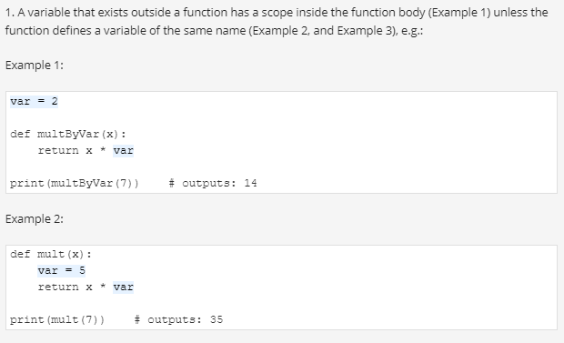
Key Takeaway

Slide 52
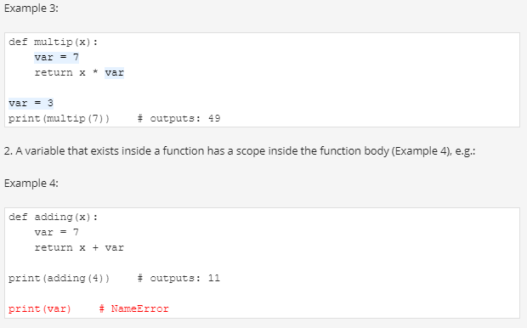
Takeaway

Slide 53
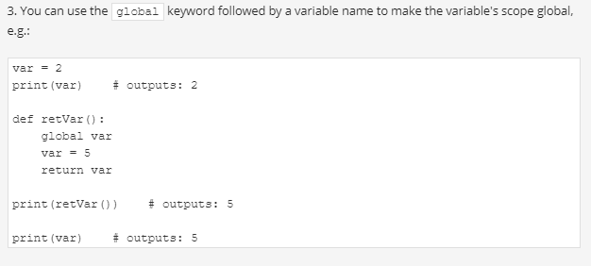
Takeaway

Slide 54
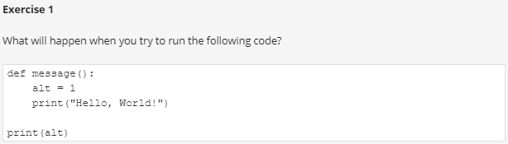
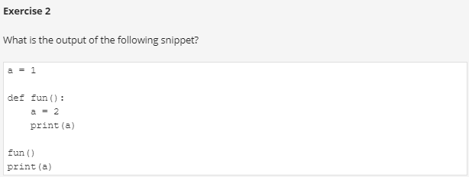
Exercises
Notes:
The NameError exception will be thrown (NameError: name 'alt' is not defined)
1

Slide 55
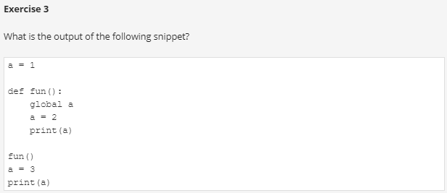
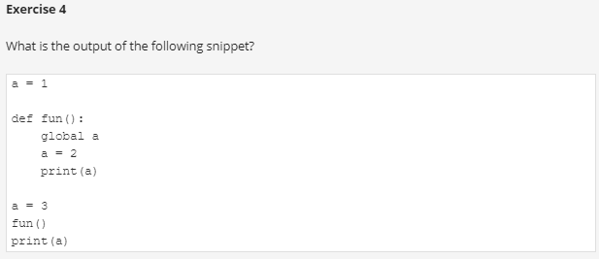
Exercises
Notes:
3
2 2

Slide 56

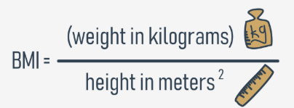
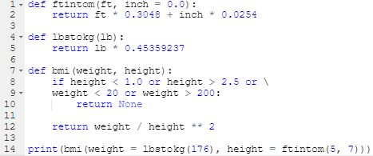
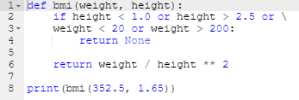



Some simple functions: evaluating the BMI
Let's get started on a function to evaluate the Body Mass Index (BMI).
the test invocation should ensure that the protection works properly
This function is not too useful for people accustomed to pounds, feet and inches.
It's quite possible that sometimes you may want to use just feet without inches. Will Python help you? Of course it will.
Notes:
Second, take a look at the way the backslash (\) symbol is used. If you use it in Python code and end a line with it, it will tell Python to continue the line of code in the next line of code.
Okay, but there's something we omitted too easily - the imperial measurements. This function is not too useful for people accustomed to pounds, feet and inches.
What can be done for them?
We can write two simple functions to convert imperial units to metric ones. Let's start with pounds.
It is a well-known fact that 1 lb = 0.45359237 kg. We'll use this in our new function.
This is our helper function, named lbtokg:

Slide 57
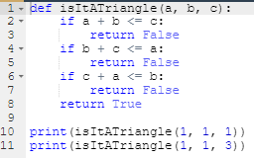
Triangle check
We'll start with a function to check whether three sides of given lengths can build a triangle.

Slide 58
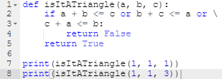
Triangle check
Can we make it more compact? It looks a bit wordy.

Slide 59

Triangle check
Can we compact it even more?

Slide 60
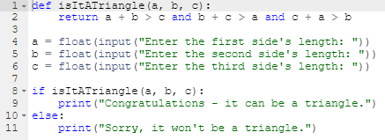
Triangle check
Look at the code in the editor. It asks the user for three values. Then it makes use of the isItATriangle function. The code is ready to run.
Notes:
Look at the code in the editor. It asks the user for three values. Then it makes use of the isItATriangle function. The code is ready to run.

Slide 61
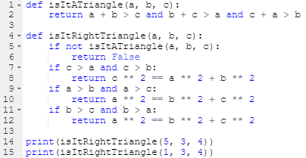
triangles and the Pythagorean theorem
In the second step, we'll try to ensure that a certain triangle is a right-angle triangle.
We will need to make use of the Pythagorean theorem: c² = a² + b²
Notes:
In the second step, we'll try to ensure that a certain triangle is a right-angle triangle.
We will need to make use of the Pythagorean theorem:
How do we recognize which of the three sides is the hypotenuse?
The hypotenuse is the longest side.
Here is the code:

Slide 62
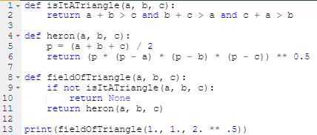
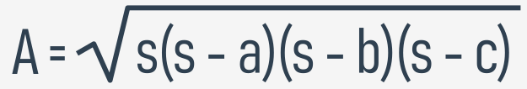

evaluating a triangle's field
We can also evaluate a triangle's field. Heron's formula will be handy here:

Slide 63

Some simple functions: factorials

Slide 64

Some simple functions: Fibonacci numbers
Are you familiar with Fibonacci numbers?
They are a sequence of integer numbers built using a very simple rule:
the first element of the sequence is equal to one (Fib₁ = 1)
the second is also equal to one (Fib₂ = 1)
every subsequent number is the sum of the two preceding numbers (Fib_{i} = Fib_{i-1} + Fib_{i-2})
Notes:
Are you familiar with Fibonacci numbers?
They are a sequence of integer numbers built using a very simple rule:
the first element of the sequence is equal to one (Fib₁ = 1)
the second is also equal to one (Fib₂ = 1)
every subsequent number is the sum of the two preceding numbers (Fib_{i} = Fib_{i-1} + Fib_{i-2})

Slide 65


Some simple functions: recursion
Recursion is a technique where a function invokes itself
factorials and Fibonacci numbers are examples for recursion
Notes:
There's one more thing we want to show you to make everything complete - it's recursion.
This term may describe many different concepts, but one of them is especially interesting - the one referring to computer programming.
In this field, recursion is a technique where a function invokes itself.
These two cases seem to be the best to illustrate the phenomenon - factorials and Fibonacci numbers. Especially the latter.

Slide 66

Key takeaway

Slide 67


Exercises
Notes:
RecursionError: maximum recursion depth exceeded
56

Slide 68
What is a tuple?
A tuple is an immutable sequence type
Mutable data can be freely updated at any time, so Immutable data cannot be modified in this way
A sequence type is a type of data in Python which is able to store more than one value
Tuple and List
the syntax used to create them
tuples prefer to use parenthesis whereas lists like to see brackets
tuple1 = (1, 2, 4, 8)
tuple2 = 1., .5, .25, .125
List is mutable while a tuple is an immutable
each tuple element may be of a different type (floating-point, integer, or any other not-as-yet-introduced kind of data)
Notes:
Sequence types and mutability
Before we start talking about tuples and dictionaries, we have to introduce two important concepts: sequence types and mutability.
A sequence type is a type of data in Python which is able to store more than one value (or less than one, as a sequence may be empty), and these values can be sequentially (hence the name) browsed, element by element.
As the for loop is a tool especially designed to iterate through sequences, we can express the definition as: a sequence is data which can be scanned by the for loop.
You've encountered one Python sequence so far - the list. The list is a classic example of a Python sequence, although there are some other sequences worth mentioning, and we're going to present them to you now.
The second notion - mutability - is a property of any of Python's data that describes its readiness to be freely changed during program execution. There are two kinds of Python data: mutable and immutable.
Mutable data can be freely updated at any time - we call such an operation in situ.
In situ is a Latin phrase that translates as literally in position. For example, the following instruction modifies the data in situ:
list.append(1) Immutable data cannot be modified in this way.
Imagine that a list can only be assigned and read over. You would be able neither to append an element to it, nor remove any element from it. This means that appending an element to the end of the list would require the recreation of the list from scratch.
You would have to build a completely new list, consisting of the all elements of the already existing list, plus the new element.
The data type we want to tell you about now is a tuple. A tuple is an immutable sequence type. It can behave like a list, but it mustn't be modified in situ.
What is a tuple?
The first and the clearest distinction between lists and tuples is the syntax used to create them - tuples prefer to use parenthesis, whereas lists like to see brackets, although it's also possible to create a tuple just from a set of values separated by commas.
Look at the example:
tuple1 = (1, 2, 4, 8) tuple2 = 1., .5, .25, .125 There are two tuples, both containing four elements.
Let's print them:
print(tuple1) print(tuple2) This is what you should see in the console:
(1, 2, 4, 8) (1.0, 0.5, 0.25, 0.125) Note: each tuple element may be of a different type (floating-point, integer, or any other not-as-yet-introduced kind of data).
How to create a tuple?
It is possible to create an empty tuple - parentheses are required then:
emptyTuple = ()

Slide 69
Tuple
If you want to create a one-element tuple, you have to take into consideration the fact that, due to syntax reasons (a tuple has to be distinguishable from an ordinary, single value), you must end the value with a comma:
oneElementTuple1 = (1, )
oneElementTuple2 = 1., Removing the commas won't spoil the program in any syntactical sense, but you will instead get two single variables, not tuples.

Slide 70


Operation with tuple
Notes:
1
1000
(10, 100, 1000)
(1, 10)
1
10
100
1000
AttributeError: 'tuple' object has no attribute 'append'

Slide 71

What else can tuples do for you?
Notes:
What else can tuples do for you?
the len() function accepts tuples, and returns the number of elements contained inside;
the + operator can join tuples together (we've shown you this already)
the * operator can multiply tuples, just like lists;
the in and not in operators work in the same way as in lists.
The snippet in the editor presents them all.
9
(1, 10, 100, 1000, 10000)
(1, 10, 100, 1, 10, 100, 1, 10, 100)
True
True

Slide 72

What else can tuples do for you?
Notes:
One of the most useful tuple properties is their ability to appear on the left side of the assignment operator. You saw this phenomenon some time ago, when it was necessary to find an elegant tool to swap two variables' values.
(2,) (3, 123) (1,)

Slide 73
What is a dictionary?
A dictionary is mutable data structure which has the following feature
It's not a sequence type (but can be easily adapted to sequence processing) and it.
a dictionary is a set of key-value pairs
each key must be unique ;
a key may be data of any type;
a dictionary is not a list;
the len() function works for dictionaries, too;
a dictionary is a one-way tool.
Notes:
each key must be unique - it's not possible to have more than one key of the same value;
a key may be data of any type: it may be a number (integer or float), or even a string;
a dictionary is not a list - a list contains a set of numbered values, while a dictionary holds pairs of values;
the len() function works for dictionaries, too - it returns the numbers of key-value elements in the dictionary;
a dictionary is a one-way tool - if you have an English-French dictionary, you can look for French equivalents of English terms, but not vice versa.

Slide 74


How to make a dictionary?
Notes:
In the first example, the dictionary uses keys and values which are both strings.
In the second one, the keys are strings, but the values are integers.
The reverse layout (keys → numbers, values → strings) is also possible, as well as number-number combination.
The list of pairs is surrounded by curly braces, while the pairs themselves are separated by commas, and the keys and values by colons.
The first of our dictionaries is a very simple English-French dictionary. The second - a very tiny telephone directory.
The empty dictionaries are constructed by an empty pair of curly braces - nothing unusual.
Have you noticed anything surprising? The order of the printed pairs is different than in the initial assignment. What does that mean?
First of all, it's a confirmation that dictionaries are not lists - they don't preserve the order of their data, as the order is completely meaningless (unlike in real, paper dictionaries). The order in which a dictionary stores its data is completely out of your control, and your expectations. That's normal. (*)
NOTE
(*) In Python 3.6x dictionaries have become ordered collections by default. Your results may vary depending on what Python version you're using.

Slide 75


How to use a dictionary?
you mustn't use a non-existent key
print(phoneNumbers['president'])
Notes:
If you want to get any of the values, you have to deliver a valid key value:
print(dict['cat']) print(phoneNumbers['Suzy']) Getting a dictionary's value resembles indexing, especially thanks to the brackets surrounding the key's value.
Note:
if the key is a string, you have to specify it as a string;
keys are case-sensitive: 'Suzy' is something different from 'suzy'.
The snippet outputs two lines of text:
chat
5557654321 And now the most important news: you mustn't use a non-existent key. Trying something like this:
print(phoneNumbers['president']) will cause a runtime error. Try to do it.
Fortunately, there's a simple way to avoid such a situation. The in operator, together with its companion, not in, can salvage this situation.

Slide 76


How to use a dictionary?

Slide 77


How to use a dictionary: the keys()
Can dictionaries be browsed using the for loop, like lists or tuples?
No and yes.
No, because a dictionary is not a sequence type - the for loop is useless with it.
Yes, because there are simple and very effective tools that can adapt any dictionary to the for loop requirements
The method returns a list built of all the keys gathered within the dictionary.
Notes:
Can dictionaries be browsed using the for loop, like lists or tuples?
No and yes.
No, because a dictionary is not a sequence type - the for loop is useless with it.
Yes, because there are simple and very effective tools that can adapt any dictionary to the for loop requirements (in other words, building an intermediate link between the dictionary and a temporary sequence entity).
The first of them is a method named keys(), possessed by each dictionary. The method returns a list built of all the keys gathered within the dictionary. Having a list of keys enables you to access the whole dictionary in an easy and handy way.
Just like here:

Slide 78


The sorted() function
Notes:
Do you want it sorted? Just enrich the for loop to get such a form:
for key in sorted(dict.keys()): The sorted() function will do its best - the output will look like this:
cat -> chat dog -> chien horse -> cheval

Slide 79




The item() and values() methods
Notes:
Another way is based on using a dictionary's method named items(). The method returns a list of tuples (this is the first example where tuples are something more than just an example of themselves) where each tuple is a key-value pair.
This is how it works:
There is also a method named values(), which works similarly to keys(), but returns a list of values.
As the dictionary is not able to automatically find a key for a given value, the role of this method is rather limited.
Here is the expected output:

Slide 80

How to use a dictionary: modifying and adding values
We're going to replace the value "chat" with "minou"
Notes:
Assigning a new value to an existing key is simple - as dictionaries are fully mutable, there are no obstacles to modifying them.
We're going to replace the value "chat" with "minou", which is not very accurate, but it will work well with our example.
Look:

Slide 81


Adding a new key
Notes:
Adding a new key
Adding a new key-value pair to a dictionary is as simple as changing a value - you only have to assign a value to a new, previously non-existent key.
Note: this is very different behavior compared to lists, which don't allow you to assign values to non-existing indices.
Let's add a new pair of words to the dictionary - a bit weird, but still valid:
You can also insert an item to a dictionary by using the update() method, e.g.:

Slide 82


Removing a key
Notes:
Removing a key
Can you guess how to remove a key from a dictionary?
Note: removing a key will always cause the removal of the associated value. Values cannot exist without their keys.
This is done with the del instruction.
To remove the last item in a dictionary, you can use the popitem() method:
In the older versions of Python, i.e., before 3.6.7, the popitem() method removes a random item from a dictionary.

Slide 83

Tuples and dictionaries can work together
Notes:
Tuples and dictionaries can work together
We've prepared a simple example, showing how tuples and dictionaries can work together.
Let's imagine the following problem:
you need a program to evaluate the students' average scores;
the program should ask for the student's name, followed by her/his single score;
the names may be entered in any order;
entering an empty name finishes the inputting of the data;
a list of all names, together with the evaluated average score, should be then emitted.
Look at the code in the editor. This how to do it.
Now, let's analyze it line by line:
line 1: create an empty dictionary for the input data; the student's name is used as a key, while all the associated scores are stored in a tuple (the tuple may be a dictionary value - that's not a problem at all)
line 3: enter an "infinite" loop (don't worry, it'll break at the right moment)
line 4: read the student's name here;
line 5-6: if the name is exit, leave the loop;
line 8: ask for one of the student's scores (an integer from the range 1-10)
line 10-11: if the student's name is already in the dictionary, lengthen the associated tuple with the new score (note the += operator)
line 12-13: if this is a new student (unknown to the dictionary), create a new entry - its value is a one-element tuple containing the entered score;
line 15: iterate through the sorted students' names;
line 16-17: initialize the data needed to evaluate the average (sum and counter)
line 18-20: we iterate through the tuple, taking all the subsequent scores and updating the sum, together with the counter;
line 21: evaluate and print the student's name and average score.
Enter the student's name and press Enter to stop: Bob
Enter the student's score (0-10): 7
Enter the student's name (or type exit to stop): Andy
Enter the student's score (0-10): 3
Enter the student's name (or type exit to stop): Bob
Enter the student's score (0-10): 2
Enter the student's name (or type exit to stop): Andy
Enter the student's score (0-10): 10
Enter the student's name (or type exit to stop): Andy
Enter the student's score (0-10): 3
Enter the student's name (or type exit to stop): Bob
Enter the student's score (0-10): 9
Enter the student's name (or type exit to stop): Andy : 5.333333333333333 Bob : 6.0

Slide 84

Key Takeaway

Slide 85

Key Takeaway

Slide 86

Key Takeaway

Slide 87

Key Takeaway

Slide 88

Key Takeaway

Slide 89

Key Takeaway

Slide 90

Key Takeaway

Slide 91

Key Takeaway

Slide 92

Key Takeaway

Slide 93

Key Takeaway

Slide 94

Key Takeaway

Slide 95


Slide 96

Exerxises
Notes:
The program will print 3 to the screen.
The program will print 6 to the screen. The tup tuple elements have been "unpacked" in the a, b, and c variables.

Slide 97


Exerxises
Notes:
tup = 1, 2, 3, 2, 4, 5, 6, 2, 7, 2, 8, 9 duplicates = tup.count(2) print(duplicates) # outputs: 4
d1 = {'Adam Smith':'A', 'Judy Paxton':'B+'}
d2 = {'Mary Louis':'A', 'Patrick White':'C'}
d3 = {}
for item in (d1, d2):
d3.update(item)
print(d3)

Slide 98


Exerxises
Notes:
l = ["car", "Ford", "flower", "Tulip"]
t = tuple(l)
print(t)
colors = (("green", "#008000"), ("blue", "#0000FF"))
colDict = dict(colors)
print(colDict)

Slide 99


Exerxises
Notes:
The program will print {'A': 1, 'B': 2} to the screen
white : (255, 255, 255) grey : (128, 128, 128) red : (255, 0, 0) green : (0, 128, 0)

Slide 100
PROJECT: Tic-Tac-Toe

Slide 101


Slide 102


Slide 103


