Slide 1

Writing an R package from scratch in 3 steps
Giorgia Mori
R-Ladies Meetup 21st August 2019

Slide 2
Distributing tips and tricks is a worthy purpose!
It often happens that I reuse my functions many times, mostly through the shameful method of copying the functions into the project directory.
Wouldn’t it be great if we will all start writing our own compilation of various R functions that we found helpful?
This is a great way to:
learn how to write an R package
encouraging good coding techniques (since it encourages to write separate functions with documentation)
allowing for easy reproducibility and collaboration with the broader community
When I think of R packages, I think of big, unified projects with a specified scientific aim.
This is a reminder that R packages exist solely for making it easier to distribute code for any purpose.

Slide 3
Step 0: Packages you will need
The package you will need to create a package is devtools;
>install.packages("devtools")
>library(devtools)

Slide 4
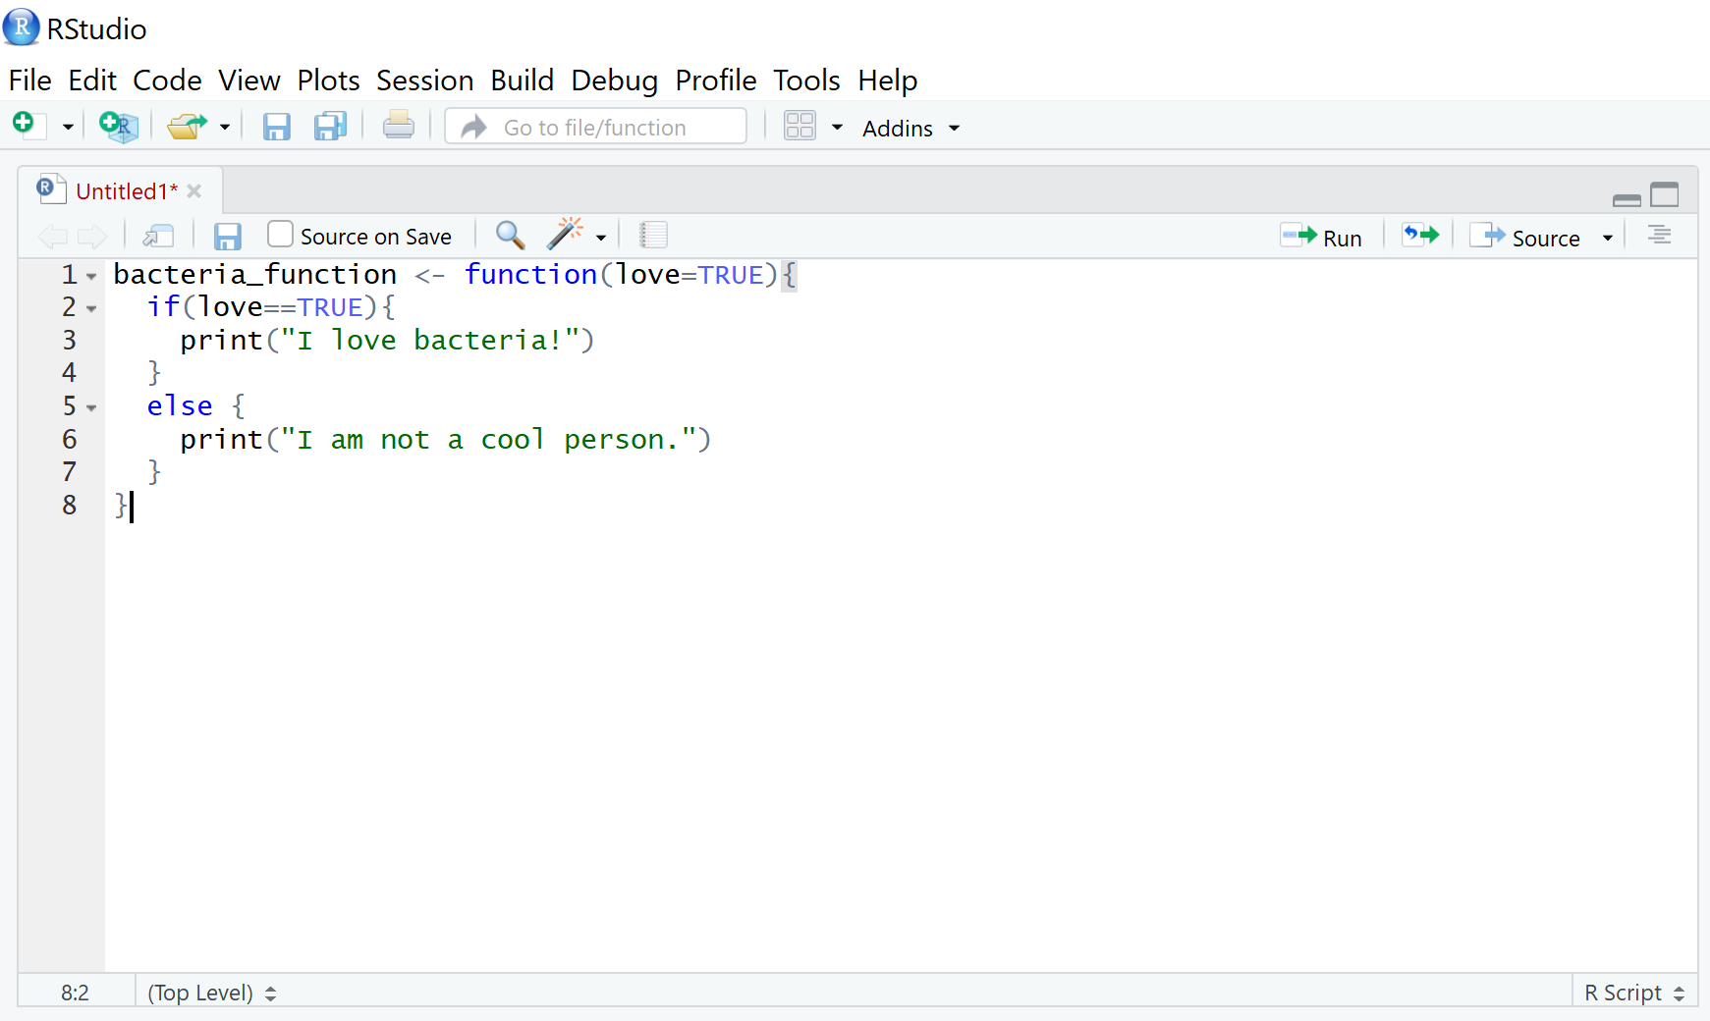
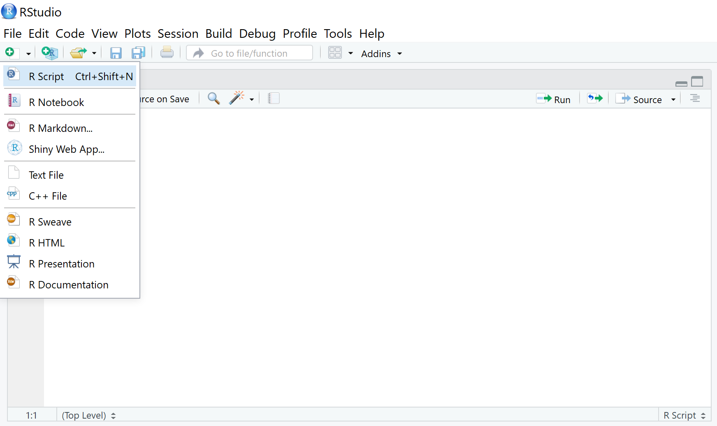
Step 1: Create your function file
Write the code for your functions in a new .R file. You can create one file with all of your functions or create separate files for each function.
Save these files somewhere where you can easily find them.

Slide 5
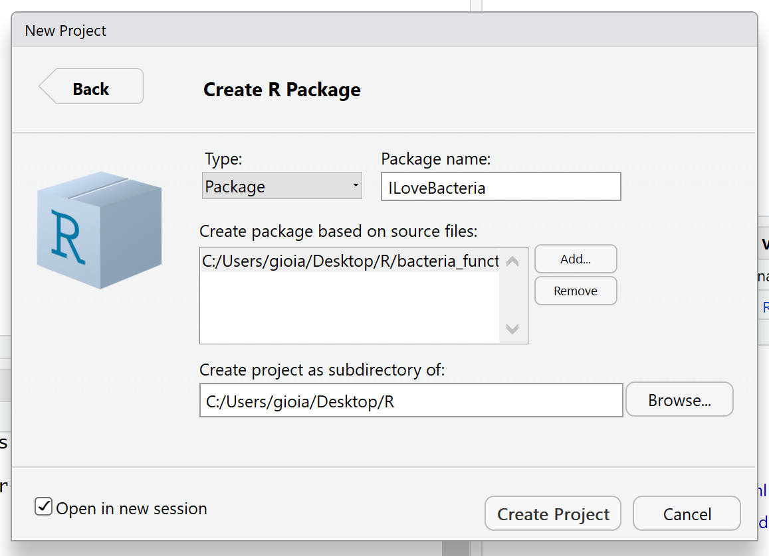
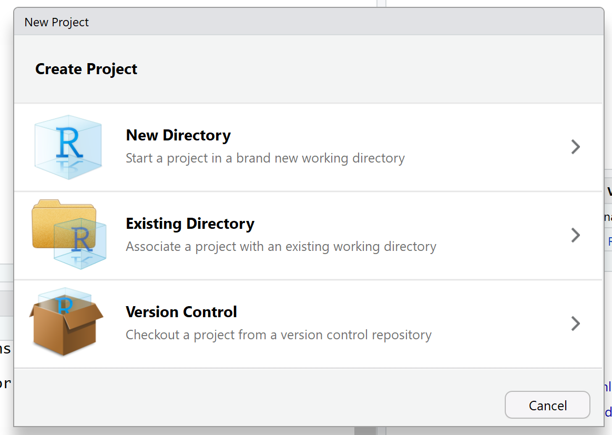
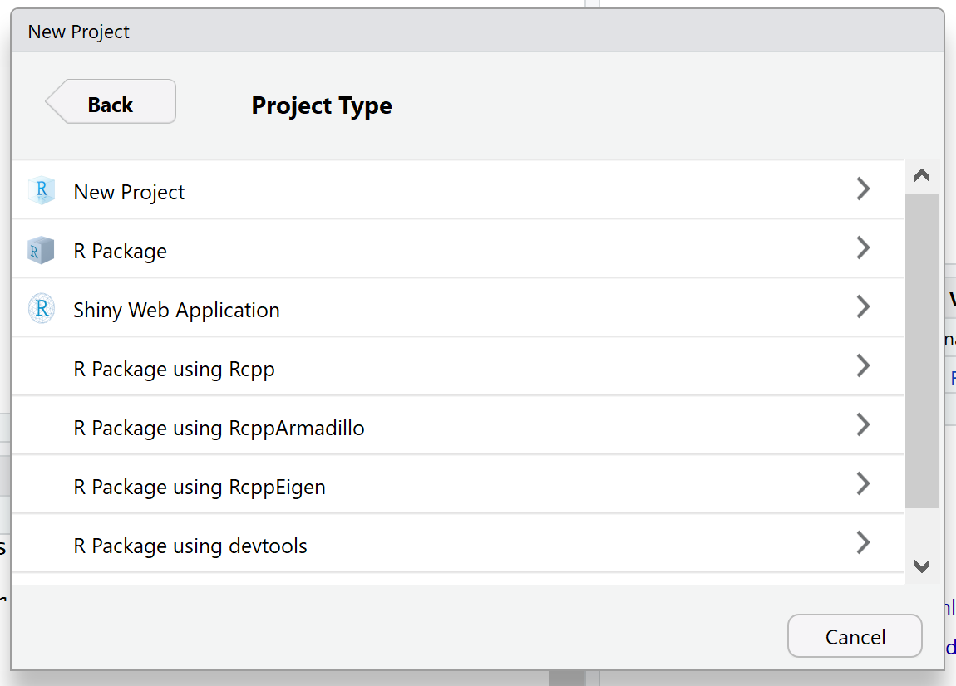
Step 2: Create your package directory
You are going to create a directory with the bare minimum folders of R packages. I am going to make a bacteria-themed package as an illustration.
Open a new project in RStudio. Go to the ‘File’ menu and click on ‘New Project.’ Then select ‘New Directory,’ and ‘R Package’ to create a new R package. Type the name of your package, then upload the .R file you created in step 1 under ‘Create package based on source files’. Click ‘Create project.’

Slide 6
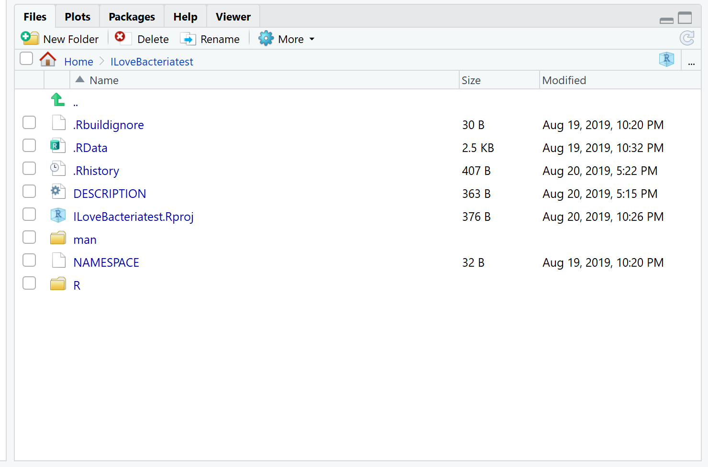
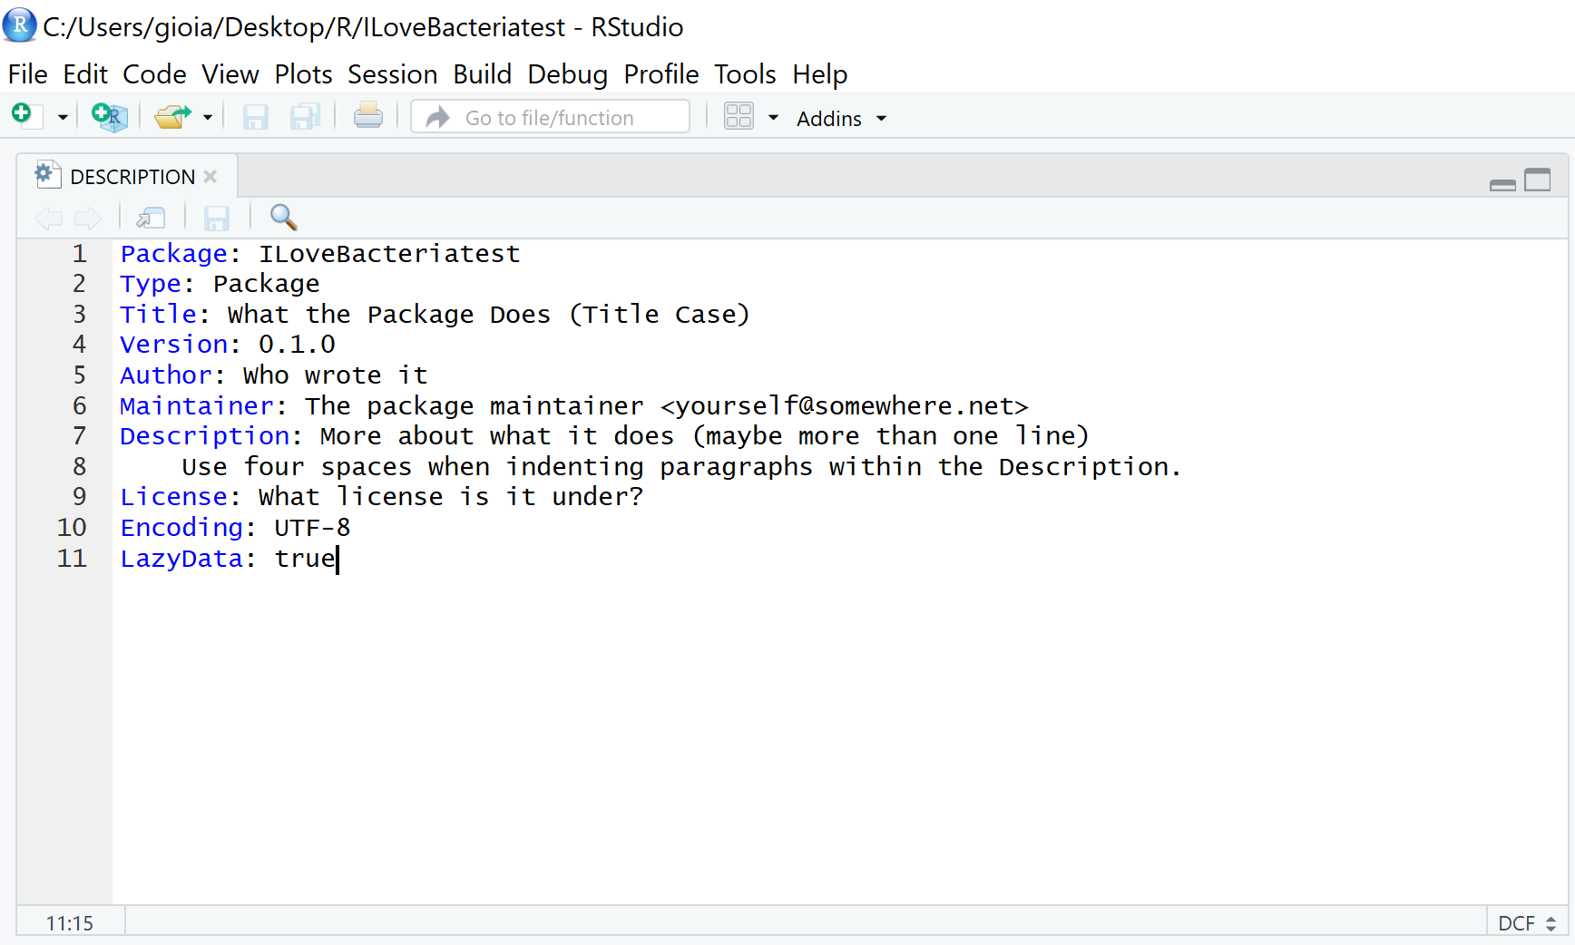
If you look in your default directory, you will now have a folder called ILoveBacteria, and in it you will have two folders and one file called DESCRIPTION. You should edit the DESCRIPTION file to include all of your contact information, etc.
The ‘man’ folder will contain the help files for each function in your package
The ‘R’ folder contains the code for your functions

Slide 7
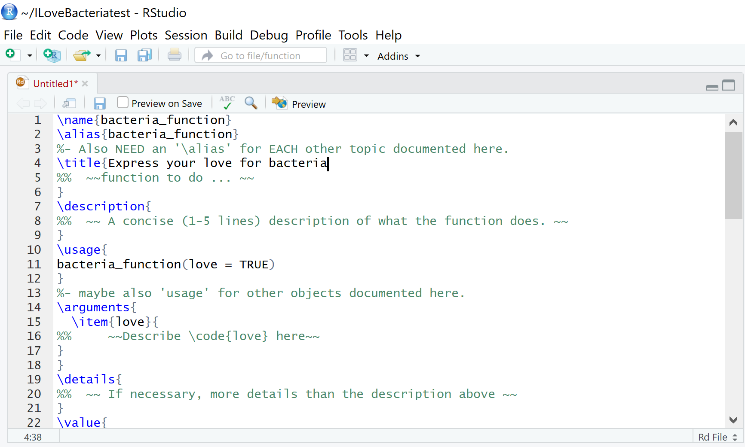
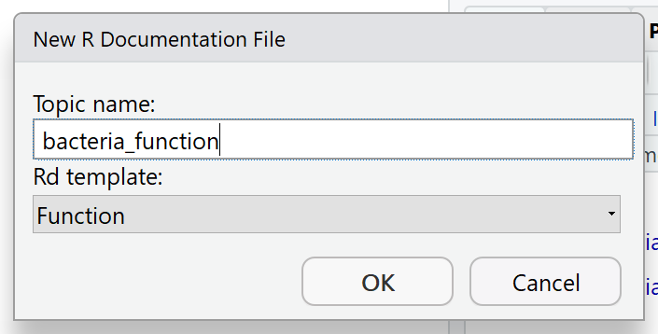
Depending on your version of RStudio, the help files may have been generated automatically as .Rd or “R documentation” files when you created your package.
If your ‘man’ folder is empty, you will have to manually create a .Rd file for each function. To do this, go to File > New File > R Documentation, enter the title of the function and select ‘Function’ under the ‘Rd template’ menu. Edit your new file to include something in the ‘title’ field (you may make other edits now or go back and make edits later, but your package will not compile if the ‘title’ field is empty). Save each .Rd file in the ‘man’ folder.

Slide 8
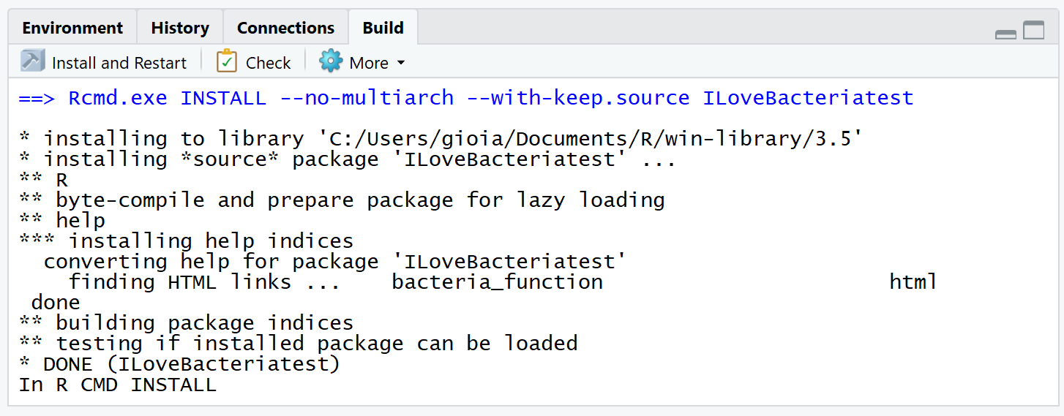
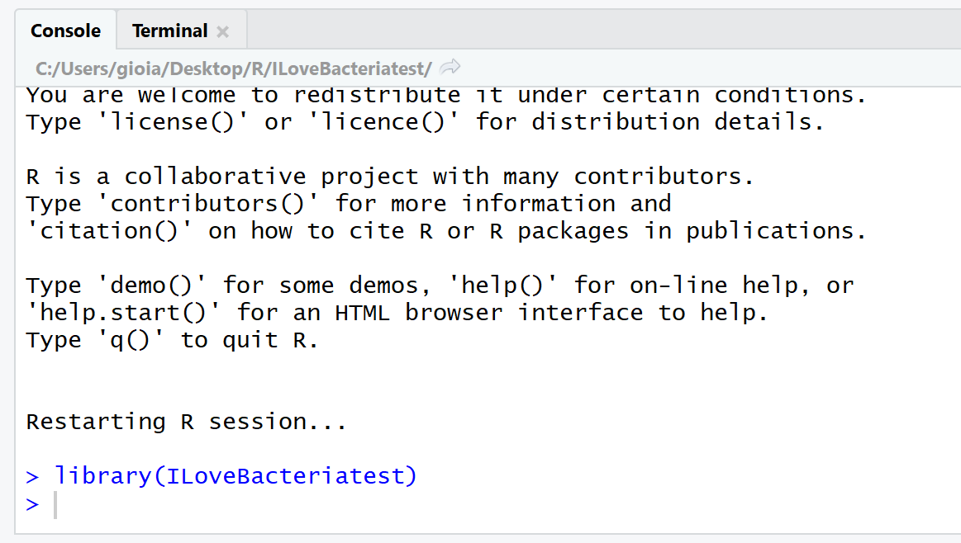
Step 3: Install!
Now you are ready to compile your package. Go to ‘Build’ on the top toolbar and select ‘Install and Restart’. If this works, your package will automatically load and you will see library(ILoveBacteria) at the bottom of your console.

Slide 9
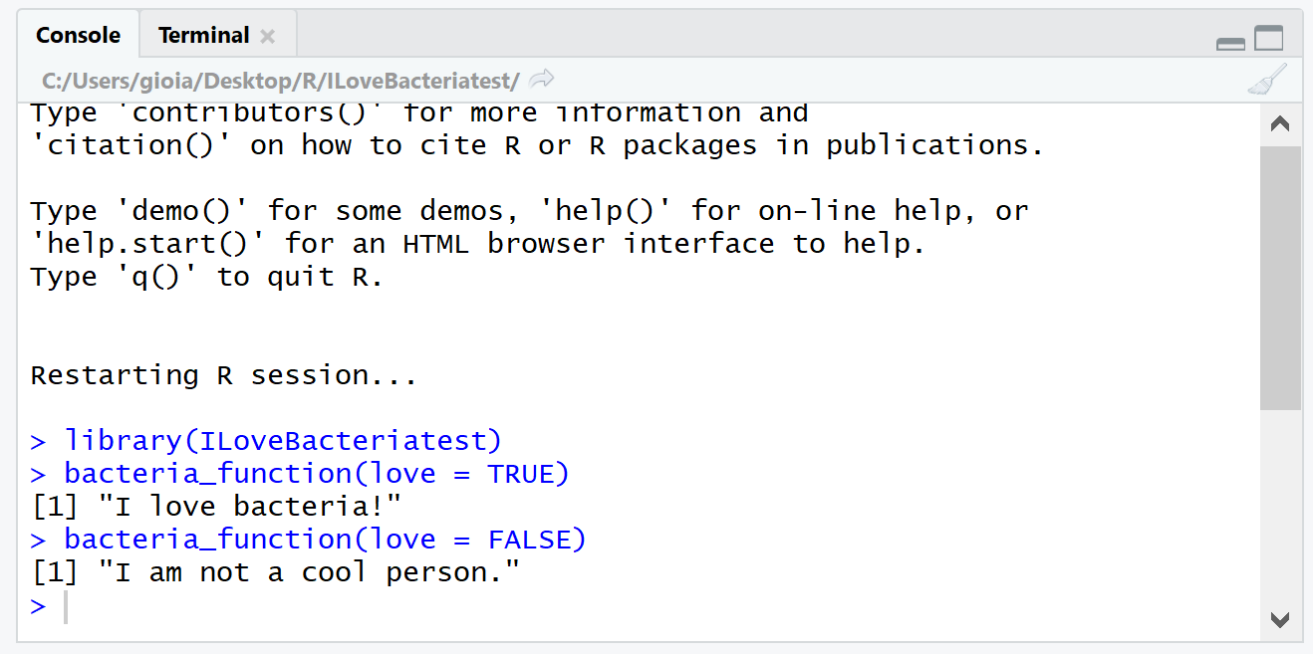
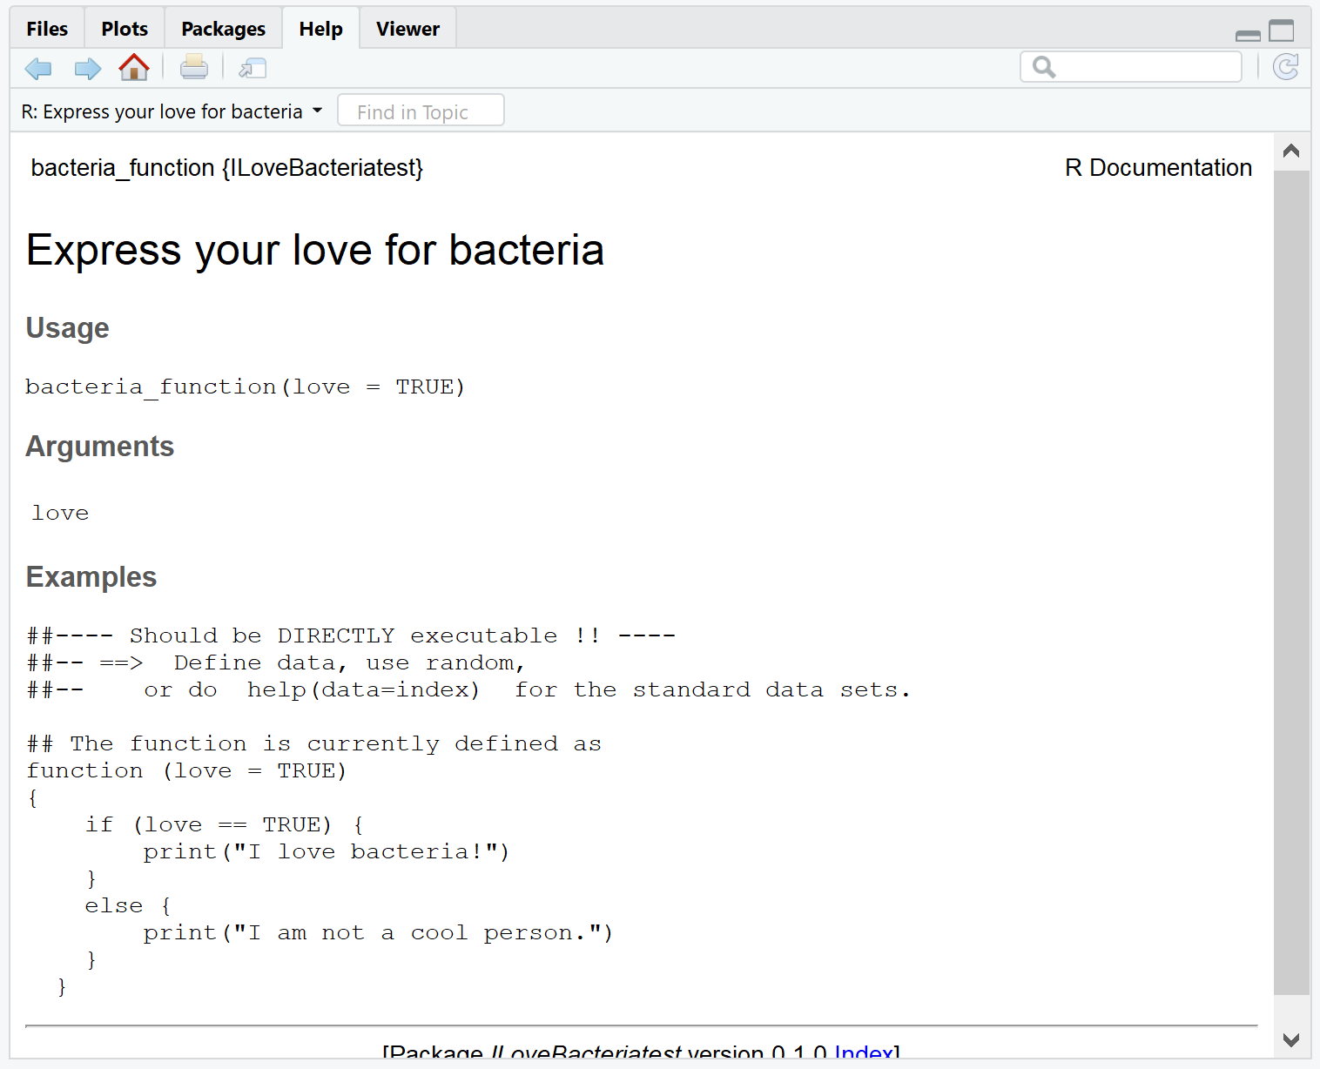
Test your function to make sure it works!
Try also typing ?bacteria_function.
You should see the standard help page pop up!

Slide 10
Extra Step: Make the package a GitHub repo
The benefitto putting your package onto GitHub is that you can use the devtools install_github() function to install your new package directly from the GitHub page.
>install_github(‘package_name','github_username')

Slide 11
Useful Resources
The DESCRIPTION file → http://r-pkgs.had.co.nz/description.html
Generate R package documentation → https://github.com/r-lib/roxygen2#roxygen2
An amazing R package tutorial → https://kbroman.org/pkg_primer/

