Slide 1









Slide 2





|
Twitter : @RLadiesBrisbane
Meetup: https://www.meetup.com/rladies-brisbane
Github: : https://github.com/rladies/meetup-presentations_brisbane

Slide 3



December networking event – in person!
@ The Charming Squire – 133 Grey St, South Brisbane
Start 5:30 for 2 hours, join us when you can
Please RSVP by Nov. 27th on Meetup

Slide 4
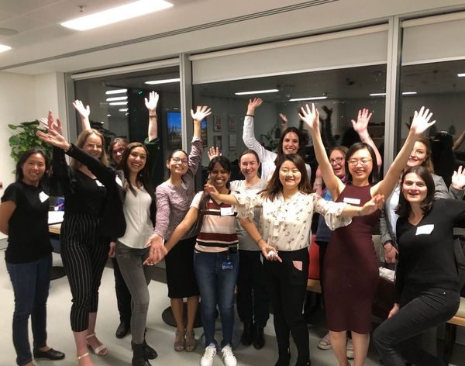


We would love to hear from you!
Please fill out our survey:
https://ckim455956.typeform.com/to/XEc0edJ1

Slide 5

RLadies Brisbane logo competition
Help us design an RLadies Brisbane logo to make hex stickers for our community!
Competition information:
Open for submission Nov. 10, 2020 and close Dec. 3rd, 2020.
Vote at Dec. 4th networking event.
Winner will be announced on Dec. 18, 2020.
The winner will need to grant full permission for RLadies Brisbane to use and produce materials with the winning logo and only use original or non-copyrighted elements in their design. Any shape design can be made into a hex sticker so don’t get too caught up on formatting!
Submit your entries to: c.kuempel@uq.edu.au by 5 PM December 3rd, 2020. Please subject the e-mail entry as: “Rladies Brisbane logo competition”
Useful resources:
Hex sticker templates: Powerpoint, Canva, or hexSticker R package
Blog posts:
https://zhuhao.org/post/tips-on-designing-a-hex-sticker-for-rstats-packages/
https://emitanaka.org/post/hexsticker/

Slide 6
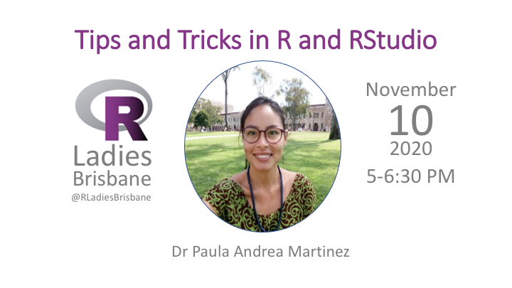
Rladies Brisbane November Meetup

