Slide 1

Introduction
Effective client communication is critical to the success of any project, regardless of the field involved. It ensures that the project is progressing in the right direction and strengthens the trust relationship between the client and the project team. However, communication can be challenging, especially if the client has no technical knowledge. In this case, it is essential to ensure that the exchanges are clear and understandable, avoiding technical terms and explaining concepts in a simple and concise manner.

Slide 2
Introduction
It is also crucial to involve the client in the various phases of the project, giving them the opportunity to provide feedback and suggestions throughout the process. This way, the client will feel invested in the project, which can significantly improve the quality of the final result. Finally, it is critical to report anomalies and problems as soon as they are discovered, to resolve them quickly and efficiently, thus avoiding delays and additional costs. In summary, clear and effective client communication is essential to the success of any project.

Slide 3

Problematic
To resolve problems, traditional methods such as email complaints or contacting company officials are often used. However, these methods can be time-consuming and do not offer real-time tracking of project or complaint status.
Using modern solutions like online project management platforms, real-time chat applications, or ticketing systems can improve communication with clients while providing real-time visibility on the status of their project or complaint. These solutions offer more efficient management of tasks, deadlines, and resources and help strengthen transparency and trust with clients by allowing them to track progress in real-time. Overall, modern solutions can significantly improve communication and management of projects and complaints.

Slide 4



Acteurs Identification
Résponsable
Client
Développeur

Slide 5
Acteurs Identification
S’authentifier
Gérer les membres
Consulter, Ajouter, Supprimer, Modifier
Gérer les tâches
Consulter, Ajouter, Supprimer, Modifier
Gérer les réclamations
Consulter, Modifier statut, Archiver, Supprimer
Communiquer avec les clients
Résponsable

Slide 6
Acteurs Identification
S’authentifier
Gérer les réclamations
Consulter, Ajouter, Supprimer, Modifier
Communiquer avec le responsable
Client

Slide 7
Acteurs Identification
S’authentifier
Modifier le statut des tâches qui lui sont assignées
Développeur

Slide 8
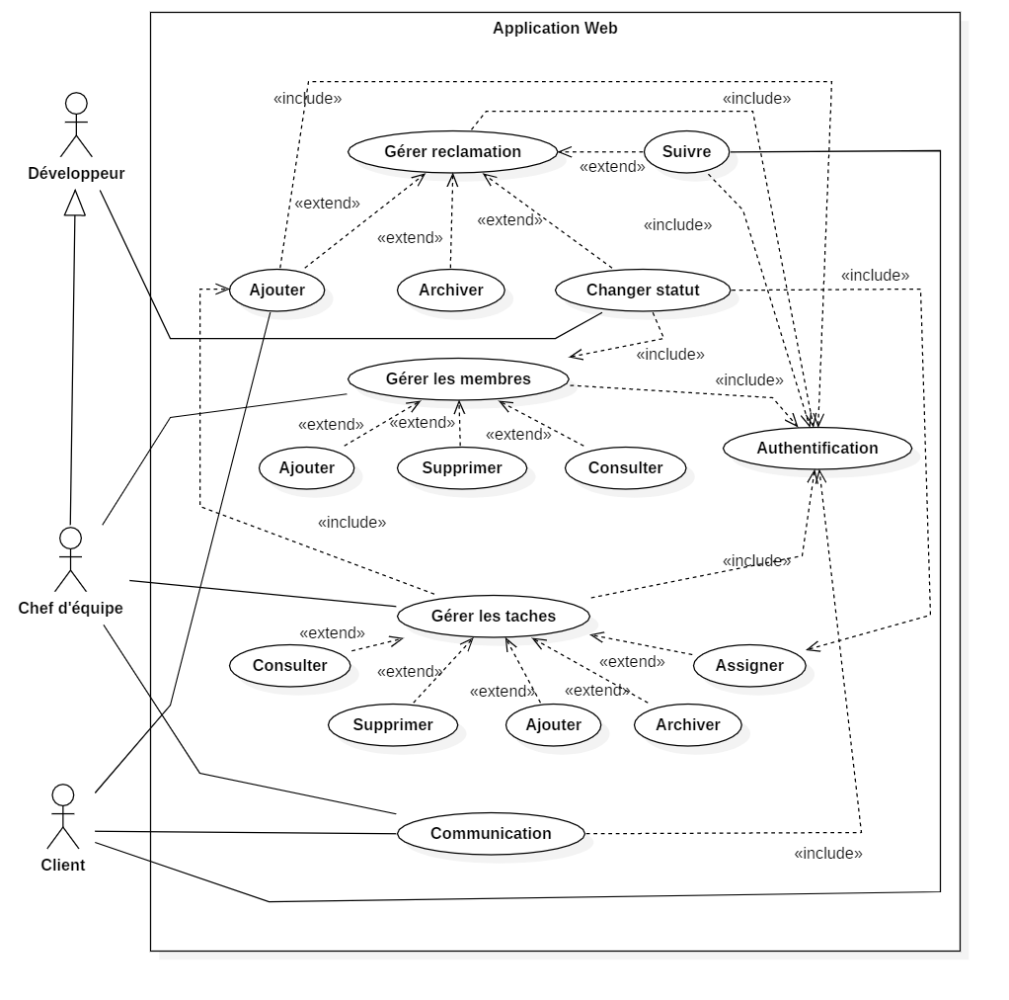
Use case diagram

Slide 9
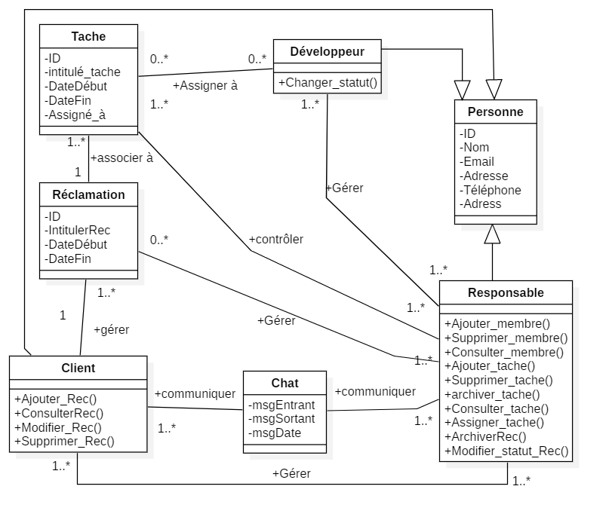
Class diagram

