Slide 1
Deep Learning - 5
20173277 이희창

Slide 2
contents
01
02
03
데이터 분류
학습
결과

Slide 3
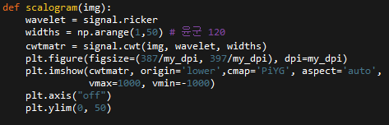
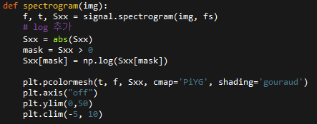
Scalogram, Spectrogram
widths = (1,50)
vmax=1000, vmin=-1000
Log 추가
Clim = (-5,10)

Slide 4
데이터 분류
01.

Slide 5
데이터 분류
 | TRAIN | VALIDATION | TEST
AFIB | 1420 (-1) | 355 | 443 (+1)
GSVT | 1446 | 362 | 452
SB | 2488 | 622 | 778
SR | 1422 | 356 | 444

Slide 6
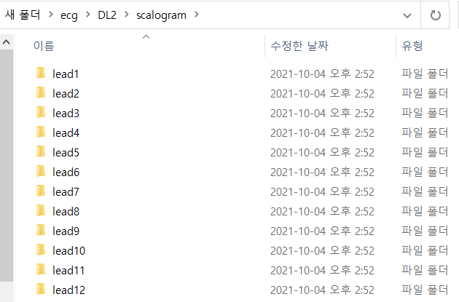
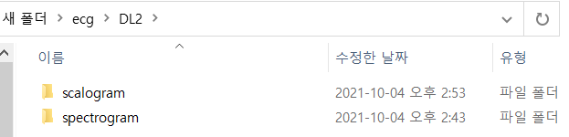


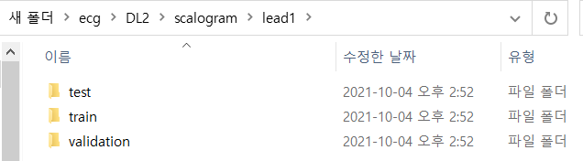
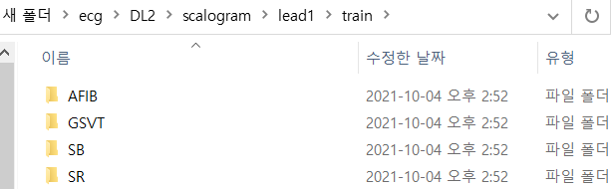
데이터 분류

Slide 7
학습
02.

Slide 8


학습
NUM_CLASSES = 34 -> 4
NUM_EPOCHS = 10 -> 1000
EARLY_STOP_PATIENCE = 3 -> 50

Slide 9
결과
03.

Slide 10
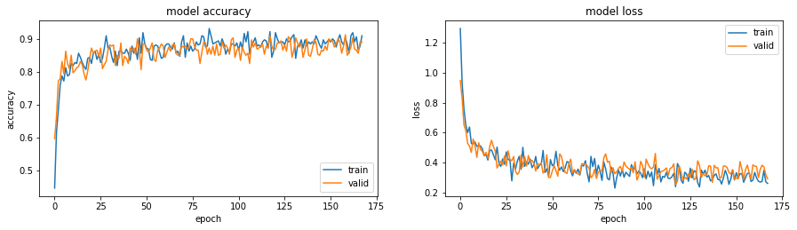
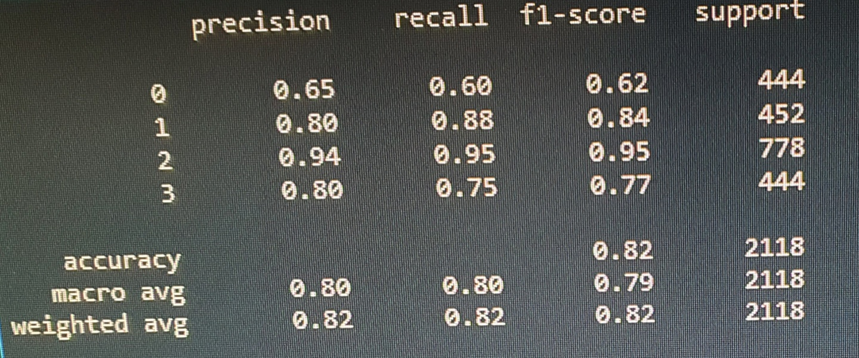
Spectrogram - 1
Accuracy : 0.82
Stop point : 175

Slide 11
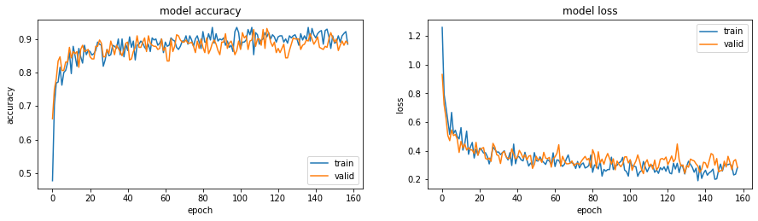
Spectrogram - 2
Accuracy : 0.83
Stop point : 160

Slide 12
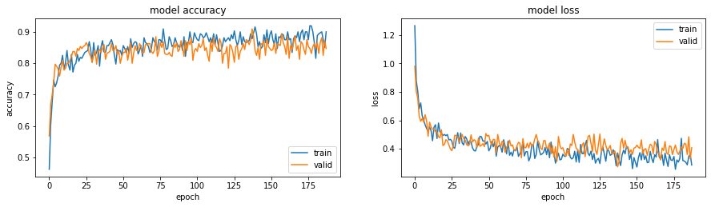
Spectrogram - 3
Accuracy : 0.83
Stop point : 175

Slide 13
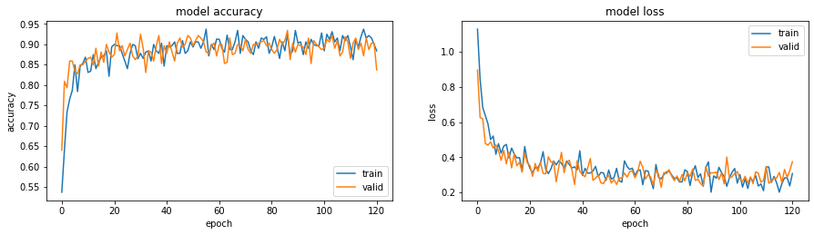
Spectrogram - 4
Accuracy : 0.81
Stop point : 120

Slide 14
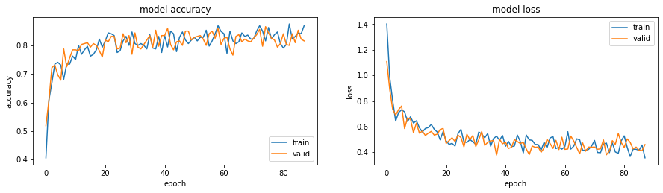
Spectrogram - 5
Accuracy : 0.81
Stop point : 80

Slide 15
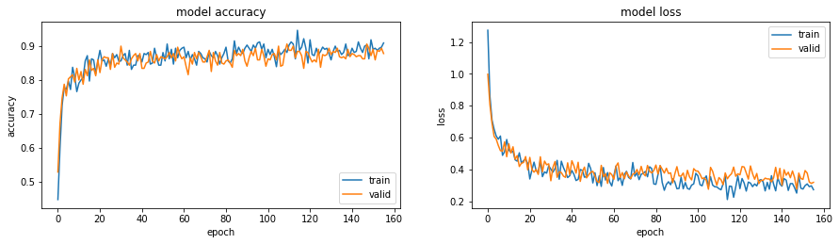
Spectrogram - 6
Accuracy : 0.82
Stop point : 160

Slide 16
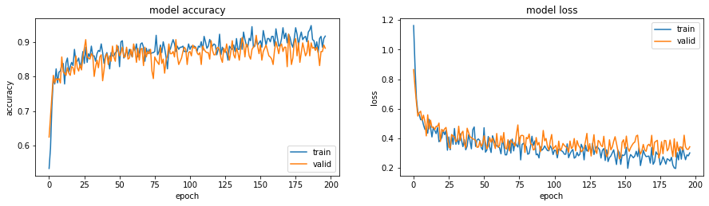
Spectrogram - 7
Accuracy : 0.84
Stop point : 200

Slide 17
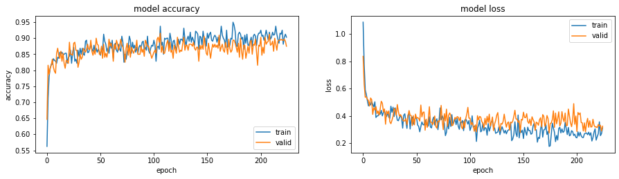
Spectrogram - 8
Accuracy : 0.84
Stop point : 200 ↑

Slide 18
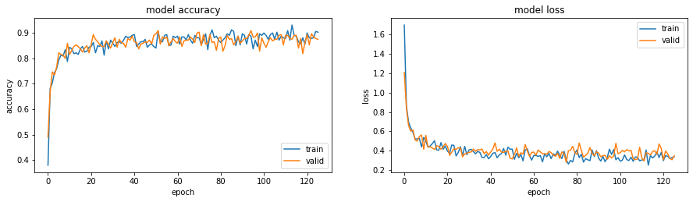
Spectrogram - 9
Accuracy : 0.81
Stop point : 120

Slide 19
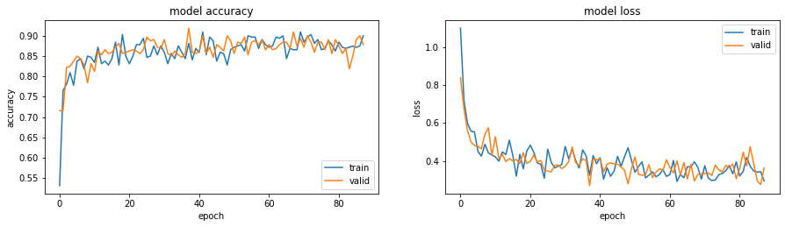
Spectrogram - 10
Accuracy : 0.83
Stop point : 80

Slide 20
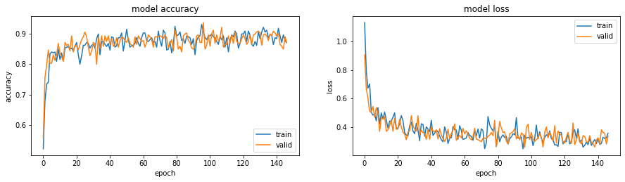
Spectrogram - 11
Accuracy : 0.81
Stop point : 140

Slide 21
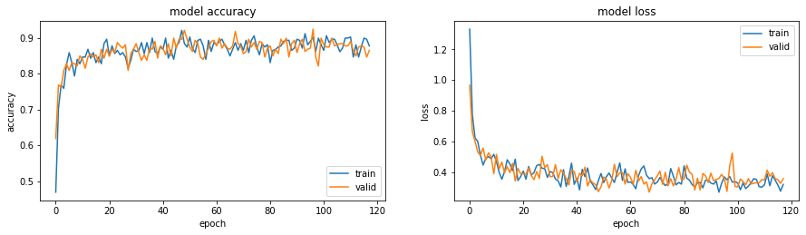
Spectrogram - 12
Accuracy : 0.81
Stop point : 120

Slide 22
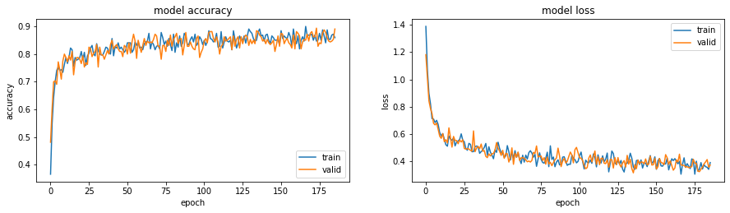
Scalogram - 1
Accuracy : 0.81
Stop point : 175

Slide 23
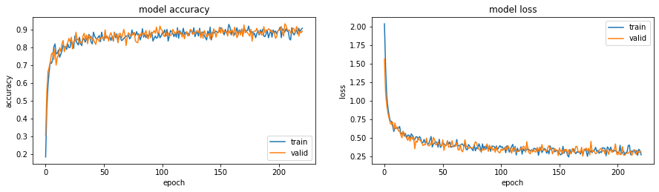
Scalogram - 2
Accuracy : 0.83
Stop point : 200

Slide 24
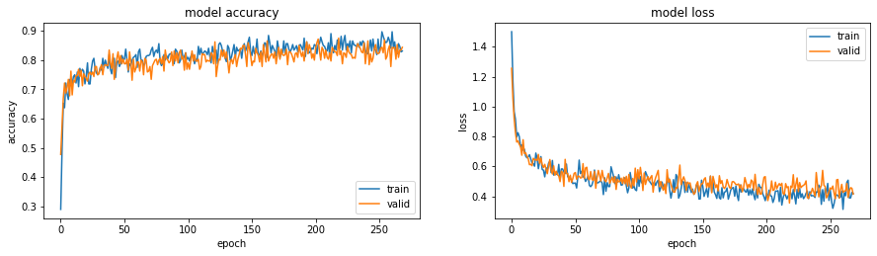
Scalogram - 3
Accuracy : 0.80
Stop point : 250

Slide 25
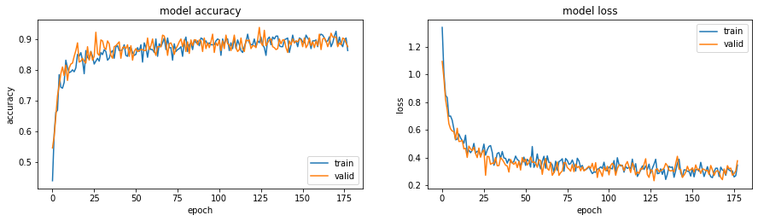
Scalogram - 4
Accuracy : 0.82
Stop point : 175

Slide 26
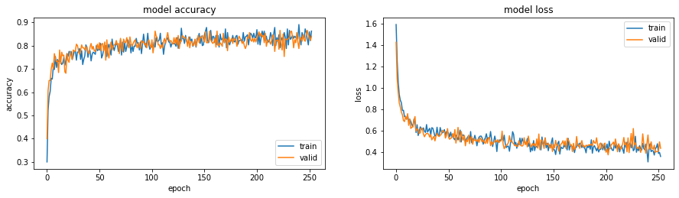
Scalogram - 5
Accuracy : 0.81
Stop point : 250

Slide 27
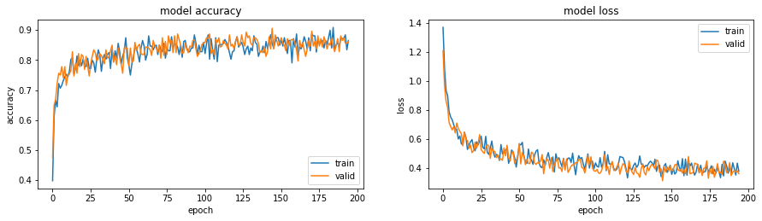
Scalogram - 6
Accuracy : 0.81
Stop point : 200

Slide 28
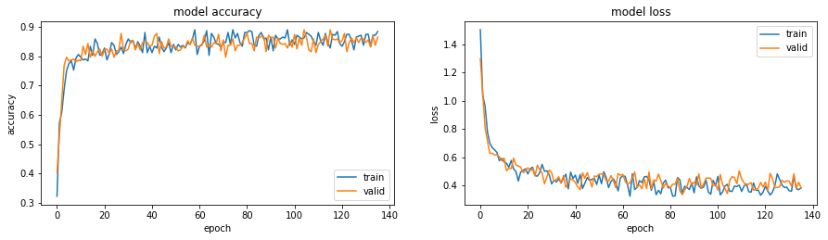
Scalogram - 7
Accuracy : 0.82
Stop point : 140

Slide 29
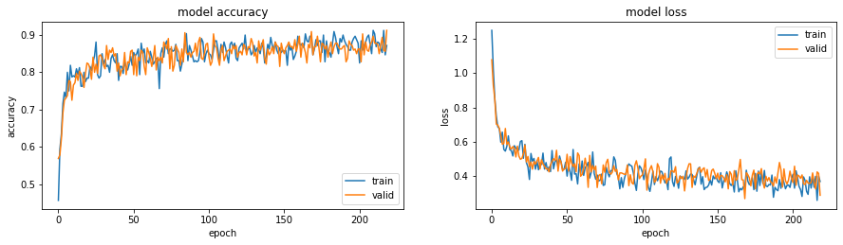
Scalogram - 8
Accuracy : 0.83
Stop point : 200

Slide 30
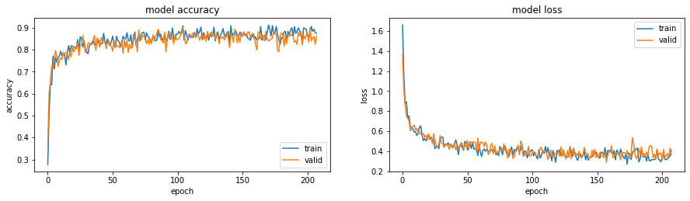
Scalogram - 9
Accuracy : 0.80
Stop point : 200

Slide 31
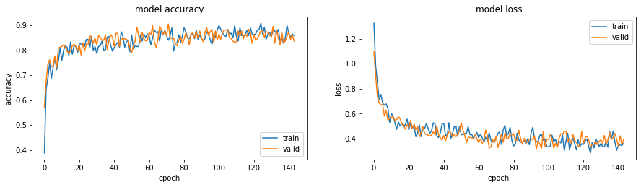
Scalogram - 10
Accuracy : 0.80
Stop point : 140

Slide 32
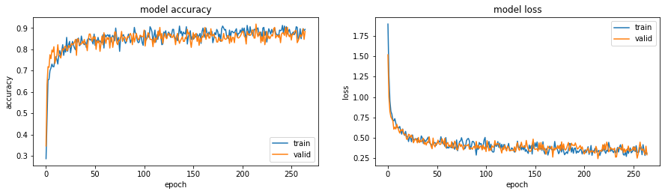
Scalogram - 11
Accuracy : 0.80
Stop point : 250

Slide 33
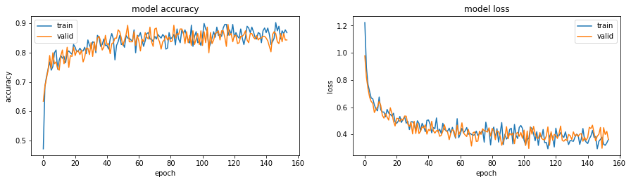
Scalogram - 12
Accuracy : 0.80
Stop point : 160

Slide 34
요약

Slide 35
 | Lead1 | Lead2 | Lead3 | Lead4 | Lead5 | Lead6 | Lead7 | Lead8 | Lead9 | Lead10 | Lead11 | lead12
Spectro | 0.82 175 | 0.83 160 | 0.83 175 | 0.81 120 | 0.81 80 | 0.82 160 | 0.84 200 | 0.84 200 | 0.81 120 | 0.83 80 | 0.81 140 | 0.81 120
Scalo | 0.81 175 | 0.83 200 | 0.80 250 | 0.82 175 | 0.81 250 | 0.81 200 | 0.82 140 | 0.83 200 | 0.80 200 | 0.80 140 | 0.80 250 | 0.80 160

