Slide 1
Accessible Tools
37 signals Philosophy
Anyone can be in business
One Person = Many Jos
Small & Profitable
Affordable Technology
Against Conventional Wisdom
New Reality
No 60-100 hours weeks
Focus on Fortune 5,000,000
Distributed Team
Flexible work
No Depleting Saving
Share Recipes & Secrets.
Work from Home/Remotely

Slide 2
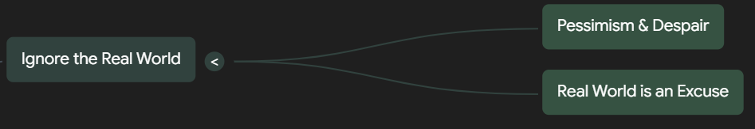
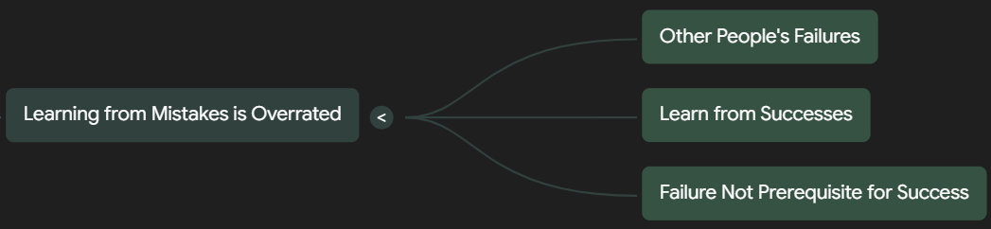
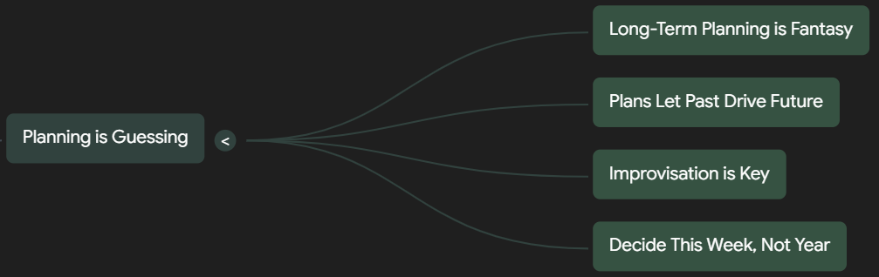
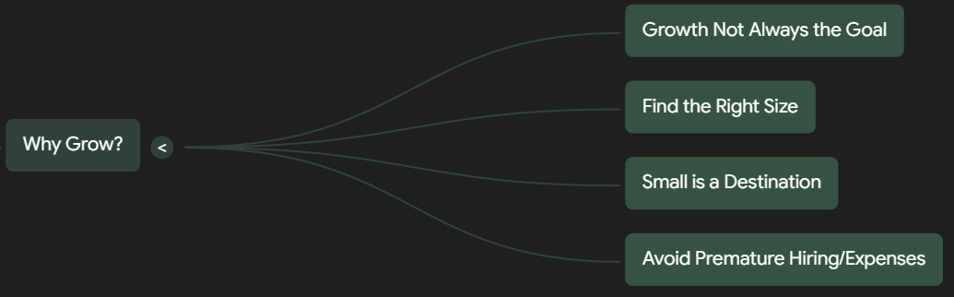
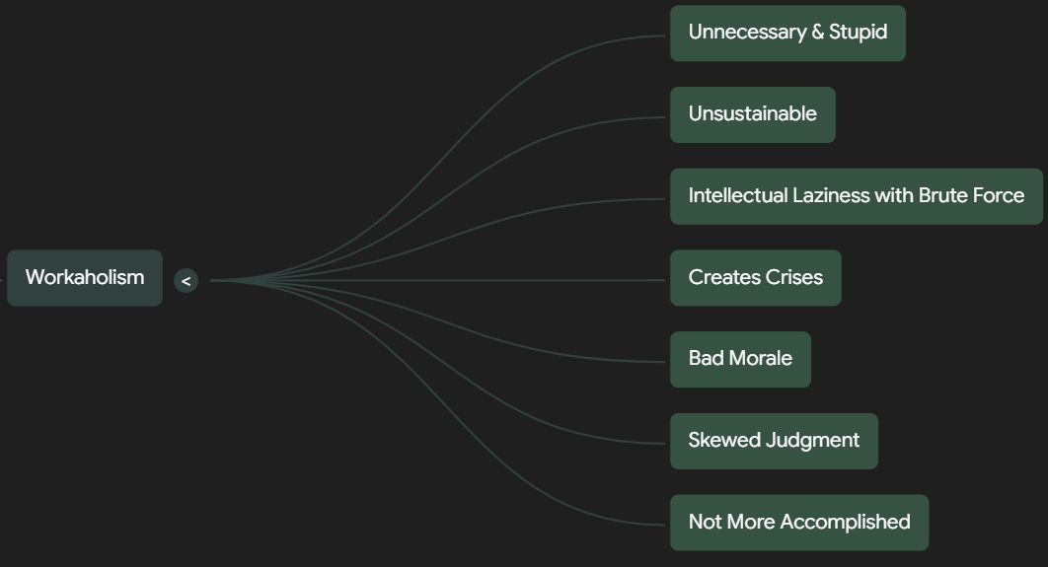

Slide 3
Takedowns (Challenging Conventional Widsom)

