Slide 1
ID

Slide 2


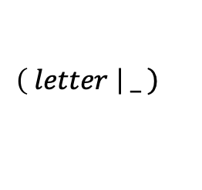
$$\left.\left( letter \right| _ \right)$$
letter
$ε$
$ε$
$ε$
_
$ε$

Slide 3






$$\left( letter | zero \left| non_zero \right| _ \right)$$
letter
$ε$
$ε$
zero
$ε$
$ε$
$ε$
non-zero
$ε$
$ε$
_
$ε$

Slide 4




$${\left( letter | zero \left| non_zero \right| _ \right)}^{∗}$$
$ε$
letter
$ε$
$ε$
zero
$ε$
$ε$
$ε$
$ε$
$ε$
non-zero
$ε$
$ε$
_
$ε$
$ε$

Slide 5









$$\left( letter \right| _ ) {\left( letter | zero \left| non_zero \right| _ \right)}^{∗}$$
$ε$
letter
letter
$ε$
$ε$
$ε$
$ε$
zero
start
$ε$
$ε$
$ε$
$ε$
$ε$
$ε$
non-zero
$ε$
$ε$
_
$ε$
$ε$
_
$ε$
$ε$

Slide 6
ID-D

Slide 7
$$\left( letter \right| _ ) {\left( letter | zero \left| non_zero \right| _ \right)}^{∗}$$
$ε$
I
letter
M
B
letter
D
$ε$
$ε$
$ε$
$ε$
zero
$ε$
J
N
$ε$
start
A
F
$ε$
G
$ε$
H
Q
$ε$
non-zero
R
$ε$
K
O
$ε$
$ε$
_
$ε$
C
E
$ε$
_
$ε$
L
P
$ε$

Slide 8

$$\left( letter \right| _ ) {\left( letter | zero \left| non_zero \right| _ \right)}^{∗}$$
letter
start
0
$$ε$$
letter
_
zero
non-zero
1
2
letter
letter
_
letter
_
_
non-zero
zero
letter
letter
6
_
3
_
zero
zero
_
letter
letter
non-zero
zero
non-zero
non-zero
non-zero
5
4
zero
non-zero
zero

Slide 9
INT

Slide 10

$$zero$$
zero

Slide 11



$$\left(− \right| ε)$$
_
$ε$
$ε$
$ε$
$$ε$$
$ε$

Slide 12

$$non_zero$$
non-zero

Slide 13
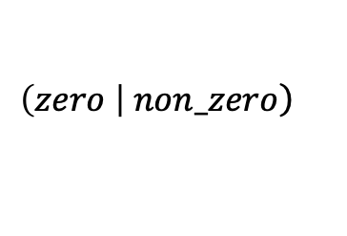

$$\left.\left(zero \right| non_zero\right)$$
$$zero$$
$ε$
$ε$
$ε$
non-zero
$ε$

Slide 14
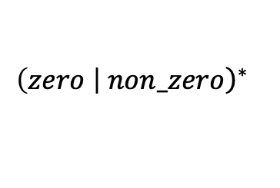


$${\left.\left(zero \right| non_zero\right)}^{∗}$$
$ε$
$$zero$$
$ε$
$ε$
$$ε$$
$$ε$$
$ε$
non-zero
$ε$
$ε$

Slide 15


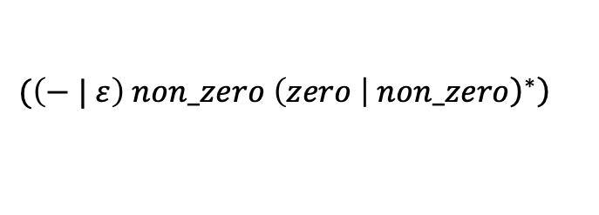



$$\left.(\left(− | ε\right) non_zero {\left.\left(zero \right| non_zero\right)}^{∗}\right)$$
$ε$
_
$$zero$$
$ε$
$ε$
$ε$
$ε$
$$ε$$
non-zero
$$ε$$
$$ε$$
$$ε$$
$ε$
$$ε$$
$ε$
$ε$
non-zero
$ε$
$ε$

Slide 16




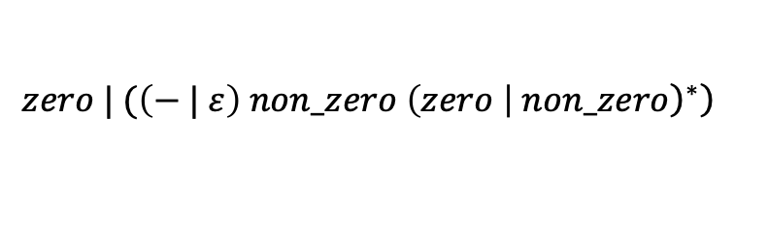





$$\left.zero | (\left(− | ε\right) non_zero {\left.\left(zero \right| non_zero\right)}^{∗}\right)$$
zero
$$ε$$
$$ε$$
$ε$
start
_
$$ε$$
$$zero$$
$ε$
$ε$
$ε$
$ε$
$$ε$$
$$ε$$
non-zero
$$ε$$
$$ε$$
$$ε$$
$ε$
$$ε$$
$ε$
$ε$
non-zero
$ε$
$ε$

Slide 17
INT-D

Slide 18
$$\left.zero | (\left(− | ε\right) non_zero {\left.\left(zero \right| non_zero\right)}^{∗}\right)$$
B
zero
T
$$ε$$
S
$$ε$$
$ε$
start
A
_
$$ε$$
D
F
M
$$zero$$
O
$ε$
$ε$
$ε$
$ε$
$$ε$$
$$ε$$
non-zero
$$ε$$
$$ε$$
$$ε$$
C
H
I
J
K
L
Q
R
$ε$
E
$$ε$$
G
$ε$
$ε$
N
non-zero
P
$ε$
$ε$

Slide 19
$$\left.zero | (\left(− | ε\right) non_zero {\left.\left(zero \right| non_zero\right)}^{∗}\right)$$
$$ε$$
zero
non-zero
start
zero
letter
0
2
-
non-zero
start
0
1
non-zero
3
zero
non-zero
zero
4
5
non-zero
zero
non-zero

Slide 20
STR

Slide 21

$$non_zero$$
$$"$$

Slide 22
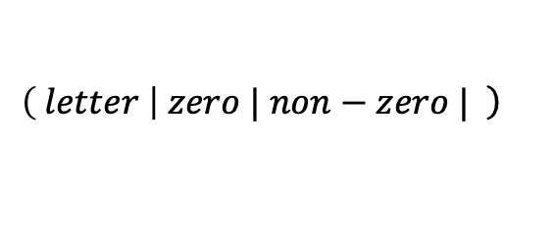
$$\left.\left( letter \right| zero | non−zero | \right)$$
letter
$ε$
$ε$
zero
$ε$
$ε$
$ε$
non-zero
$ε$
$ε$
$ε$

Slide 23
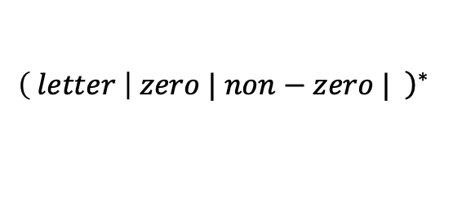
$${\left.\left( letter \right| zero | non−zero | \right)}^{∗}$$
$ε$
letter
$ε$
$ε$
zero
$ε$
$ε$
$ε$
$ε$
$ε$
non-zero
$ε$
$ε$
$ε$
$ε$

Slide 24
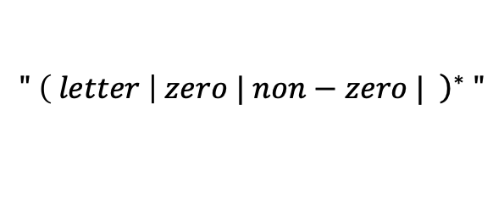


$$" {\left.\left( letter \right| zero | non−zero | \right)}^{∗} "$$
$ε$
letter
$ε$
$ε$
zero
$ε$
$ε$
start
$$"$$
$ε$
$ε$
$ε$
$ε$
$$"$$
$ε$
non-zero
$ε$
$ε$
$ε$
$ε$

Slide 25
STR-D

Slide 26
$$" {\left.\left( letter \right| zero | non−zero | \right)}^{∗} "$$
$ε$
E
letter
I
$ε$
$ε$
F
zero
J
$ε$
$ε$
start
$$"$$
$ε$
$ε$
$ε$
$ε$
$$"$$
A
B
C
D
M
N
O
P
$ε$
G
non-zero
K
$ε$
$ε$
$ε$
H
L
$ε$

Slide 27
$$" {\left.\left( letter \right| zero | non−zero | \right)}^{∗} "$$
start
0
“
1
6
non-zero
“
zero
non-zero
“
2
“
5
“
non-zero
letter
zero
non-zero
letter
“
letter
zero
non-zero
3
letter
4
zero
letter
zero

Slide 28
FLOT

Slide 29




$$non_zero$$
$$.$$
$$zero$$
zero
$$.$$
non-zero

Slide 30

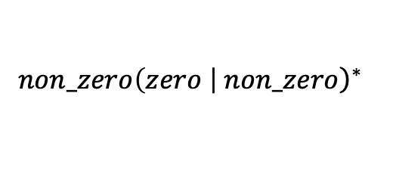
$$non_zero{\left.\left(zero \right| non_zero\right)}^{∗}$$
$ε$
$$zero$$
$ε$
$ε$
non-zero
$$ε$$
$$ε$$
$$ε$$
$ε$
non-zero
$ε$
$ε$

Slide 31

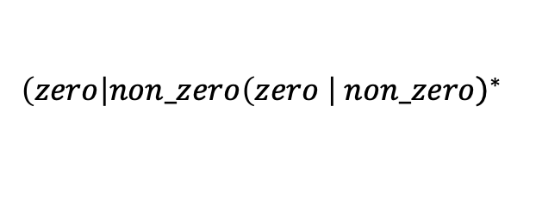



$$\left(zero\right|non_zero{\left.\left(zero \right| non_zero\right)}^{∗}$$
zero
$$ε$$
$ε$
$$ε$$
$$zero$$
$ε$
$ε$
$$ε$$
$$ε$$
non-zero
$$ε$$
$$ε$$
$$ε$$
$ε$
non-zero
$ε$
$ε$

Slide 32


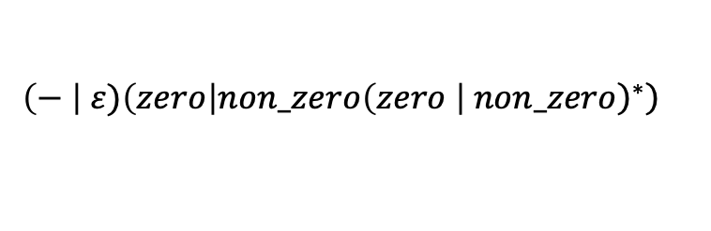


$$\left.\left(− \right| ε)\left(zero\right|non_zero{\left.\left(zero \right| non_zero\right)}^{∗}\right)$$
_
zero
$ε$
$ε$
$$ε$$
$ε$
$$ε$$
$$ε$$
$$zero$$
$ε$
$ε$
$ε$
$$ε$$
$ε$
$$ε$$
$$ε$$
non-zero
$$ε$$
$$ε$$
$$ε$$
$ε$
non-zero
$ε$
$ε$

Slide 33
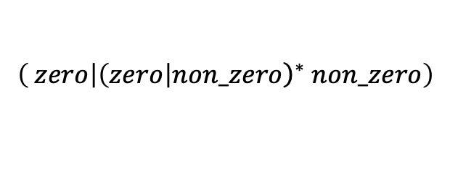



$$\left( zero | {\left.\left(zero\right|non_zero\right)}^{∗} non_zero\right)$$
zero
$$ε$$
$ε$
$$ε$$
$$zero$$
$ε$
$ε$
$$ε$$
$$ε$$
$$ε$$
$$ε$$
$$ε$$
non-zero
$ε$
non-zero
$ε$
$ε$

Slide 34





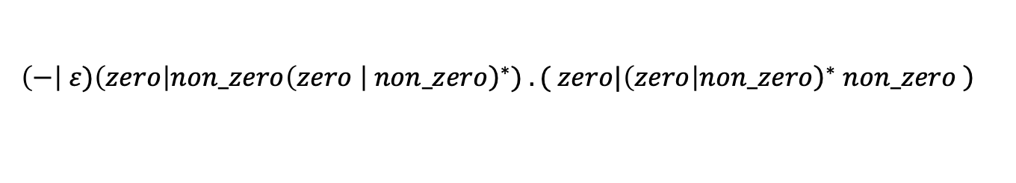






$$\left.\left(−\right| ε)\left(zero\right|non_zero{\left.\left(zero \right| non_zero\right)}^{∗}) . ( zero|{\left.\left(zero\right|non_zero\right)}^{∗} non_zero \right)$$
_
$ε$
$ε$
start
$ε$
$$ε$$
$ε$
$$ε$$
zero
$$ε$$
$ε$
$$ε$$
$$zero$$
$ε$
$ε$
$$ε$$
$$ε$$
non-zero
$$ε$$
$$ε$$
$$ε$$
$ε$
non-zero
$ε$
$ε$
$$.$$
$$ε$$
$$ε$$
zero
$$ε$$
$ε$
$$ε$$
$$zero$$
$ε$
$ε$
$$ε$$
$$ε$$
$$ε$$
$$ε$$
$$ε$$
non-zero
$ε$
non-zero
$ε$
$ε$

Slide 35
FL-D

Slide 36
_
$$\left.\left(−\right| ε)\left(zero\right|non_zero{\left.\left(zero \right| non_zero\right)}^{∗}) . ( zero|{\left.\left(zero\right|non_zero\right)}^{∗} non_zero \right)$$
4
5
$ε$
$ε$
start
1
6
$ε$
2
$$ε$$
3
$ε$
$$ε$$
8
zero
9
$$ε$$
$ε$
$$ε$$
7
16
$$zero$$
17
20
$ε$
$ε$
$$ε$$
$$ε$$
10
11
12
13
18
19
non-zero
$$ε$$
$$ε$$
$$ε$$
$ε$
14
$ε$
non-zero
15
$ε$
$$.$$
$$ε$$
22
21
$$ε$$
24
zero
25
$$ε$$
$ε$
$$ε$$
23
34
$$zero$$
35
40
$ε$
$ε$
$$ε$$
$$ε$$
30
31
36
37
38
39
$$ε$$
$$ε$$
$$ε$$
non-zero
$ε$
32
$ε$
non-zero
33
$ε$

Slide 37




2
zero
zero
$$.$$
start
0
-
1
7
zero
zero
non-zero
non-zero
$$.$$
3
4
non-zero
9
zero
zero
$$.$$
zero
zero
non-zero
non-zero
5
$$.$$
non-zero
zero
8
non-zero
6
non-zero
zero
non-zero
non-zero
letter

