Slide 1
Time-Division Measurement and Embedded-AI Signal
Decoupling for a Soft Single-Electrode Multimodal Sensor
Simultaneous Estimation of Strain, Proximity, and Contact Force
Heejun Moon
BioRobotics and Control Lab (BiRC), Dept. of Mechanical Engineering, Korea University

Slide 2
Outline
1
Motivation
Why multimodal perception, and what each modality is for
2
Problem Statement
Signal coupling and the limitations of prior work
3
Sensor Design
Single-electrode EGaIn spiral coil and fabrication
4
Measurement System
1 ms TDM architecture, PCB and test platform
5
Signal Characterization
(strain, d) response surfaces and contact-regime viscoelasticity
6
Decoupling Models
Two-stage structure → SLS-EMA + Gate-MoE
7
Embedded Implementation and Real-Time Validation
260 µs on-board inference on the STM32
8
Conclusion and Future Work
1

Slide 3
Motivation
A robot surface must perceive both its surroundings and its own state
Before contact
The approach of an object must be sensed in advance
Proximity
At contact
How hard the contact is must be known
Contact force
At all times
The body carrying the sensor itself deforms
Strain
In real interaction, however, all three stimuli act simultaneously.
→ A sensor measuring only one physical quantity has limited practical utility.
→ Distinct stimuli superimpose onto a single electrical response = signal coupling
2

Slide 4
Why Each Modality Is Needed
The case made by prior work
Proximity
The only means of intervening before a collision occurs
• Safe pHRI: reacting after contact is insufficient → anticipate the approach and correct the trajectory [6], [7] • Sensors over the whole arm exterior for full-surface collision avoidance [8]; quasi whole-body sensing [9] • Pre-shaping the hand before it reaches the object
Contact force
Grasp stability depends directly on the applied force
• Without tactile feedback an object is dropped, or damaged by excessive force [10] • Slip leads immediately to grasp failure unless detected and corrected quickly [11] • Proximity answers when contact occurs; force answers how hard [12]
Strain
Essential whenever the body carrying the sensor deforms
• Soft robots have effectively infinite DOF → accurate open-loop control is very difficult [13] • Proprioception is a precondition for closing the control loop [14] • Liquid-metal strain sensors enabling closed-loop soft crawling robots [15]
3

Slide 5
Why They Must Be Measured Together, at One Point
The three modalities are not independent
On a deforming surface, the very reference for the proximity and contact signals shifts with the deformation state.
Measured: the strain state changes the pressure sensitivity by up to 6.6× (cross-sensitivity)
At ε = 0 %, loading to 10 N → ΔR/R₀ span 3.95 %p
At ε = 30 %, loading to 9.2 N → ΔR/R₀ span 26.14 %p
→ Without knowing the strain, a given resistance change cannot be mapped to a contact force.
• Measuring the three quantities with three separate sensors does not remove this coupling.
• It merely adds the problem of registering values measured at different locations.
▶ Acquire the three signals at the very point where the coupling arises, and decouple them jointly.
4

Slide 6
Limitations of Prior Work and How This Work Responds
Prior approach
Limitation
Response in this work
Distributed rigid proximity sensors
Cannot conform to curved or deformable surfaces; wire count ∝ sensor count
A single planar, stretchable coil with a two-wire electrode
Capacitive proximity + tactile sensors
Strain and proximity appear as the same capacitance change — hard to separate
Exploits the asymmetry: L depends on (ε, d) while R depends on ε alone
Inductive soft sensors (single modality)
Use only strain or only proximity because decoupling is hard
Estimates all three simultaneously from the same coil
Hybrid integration of multiple devices
Wiring, thickness and cross-talk grow with the device count
Time-shares one device with a 1 ms TDM schedule instead of adding devices
Inductance measured with an LCR meter
Requires benchtop instrumentation; not mobile or wearable
Replaced by a 65 × 52 mm board carrying an LDC1614
PC-based AI decoupling
20–40 ms USB round trip, ±5–15 ms jitter → feedback control impossible
On-board MCU inference at 260 µs with ~2 µs spread
5

Slide 7
Our Approach
Three design decisions
① Single electrode
② 1 ms TDM
③ Embedded AI
Divide one device in time rather than multiplying devices
Apply AC excitation, DC excitation and no excitation in sequence
Complete both measurement and inference inside the MCU
• One EGaIn spiral coil, two wires • Device cross-talk cannot arise • Wire count stays 2 regardless of the number of modalities • Planarity and stretchability preserved
• AC → resonant frequency (L) • DC → voltage divider (R) • None → floating coil (TENG V) • 1 kHz acquisition, 93.9 % CPU idle
• Analytical inversion diverges at singularities • PC inference costs a 20–40 ms round trip • 1,413-parameter model on the STM32 • Measured 260 µs, inside the 1 ms cycle
6

Slide 8
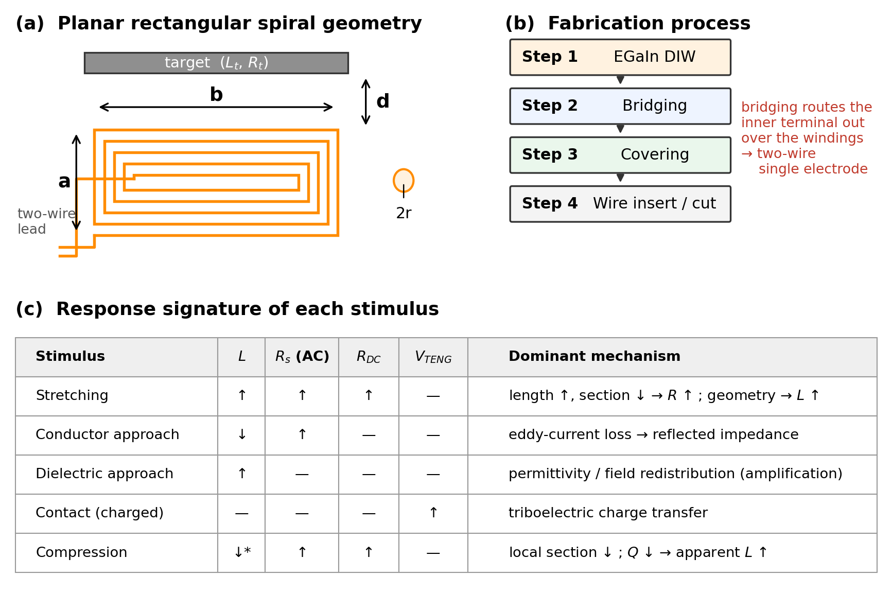
Sensor Design and Fabrication
EGaIn liquid-metal planar rectangular spiral coil (120 mm initial length, 0–30 % strain)
Key step: bridging
The inner terminal of the spiral is routed out over the windings.
Without it the inner terminal cannot be reached without a through-connection or a counter electrode — which would immediately compromise planarity and stretchability.
Raising pressure sensitivity: bump array
5 mm diameter, 0.5 mm height, formed by film masking and an applicator
Load for a 100 % ΔR/R₀ response 210 N → 20 N (about 10×)
7

Slide 9
Electromagnetic Characteristics — Response Signature
Stimulus
L
R_s (AC)
R_DC
V_TENG
Dominant mechanism
Stretching
↑
↑
↑
—
length ↑, section ↓ → R ↑ ; coil geometry → L ↑
Conductor approach
↓
↑
—
—
eddy-current loss → reflected impedance (attenuation)
Dielectric approach
↑
—
—
—
permittivity change / field redistribution (amplification)
Contact (charged body)
—
—
—
↑
triboelectric charge transfer
Compression (bumps)
↓*
↑
↑
—
local section ↓ ; Q ↓ → apparent L ↑
ΔL has opposite signs for conductors and dielectrics → not a nuisance, but information for identifying an object's electrical property
8

Slide 10
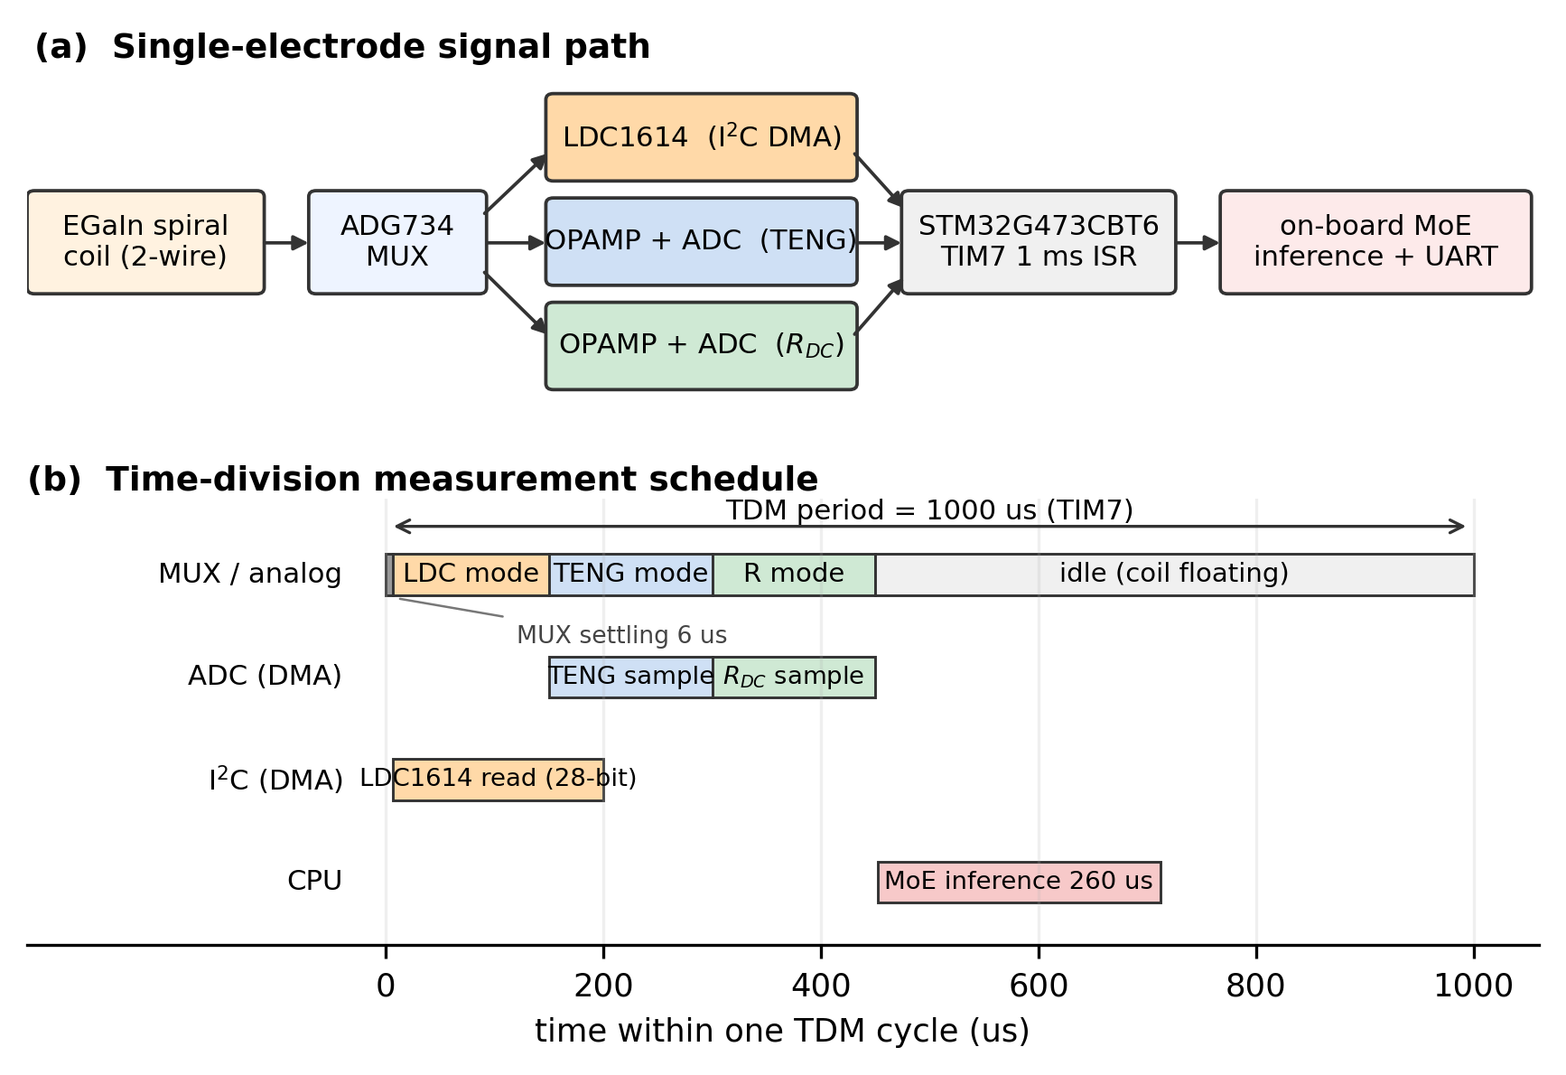
Measurement System — 1 ms Time-Division Measurement
A TIM7 interrupt starts both paths → I²C DMA (LDC1614, ~200 µs) in parallel with ADC DMA (TENG 150 µs → R 150 µs)
All transfers use DMA → no blocking wait · 93.9 % CPU idle · a fixed period prevents jitter when coupled to the AI model
9

Slide 11
Hardware
A dedicated PCB and an in-house test platform
Multisignal switching PCB
Five-axis test platform
• STM32G473CBT6 — Cortex-M4F 170 MHz, 128 KB flash, 32 KB SRAM
• LDC1614 — 28-bit, 1 kHz–10 MHz, I²C2 at 0x2A
• ADG734 — 4-channel analog switch, t_on 29 ns, 200 MHz BW
• 65 × 52 mm six-layer board, up to a 4-channel array
• TVS diodes protecting the TENG path
• Four symmetric tensile axes (XA/XB/YA/YB) + an independent Z proximity axis
• 700 × 700 mm frame, Nema23 + TB6600 drivers, Arduino Uno
• 320 steps/mm, PyQt5 GUI driving the sequence
• Six-axis F/T sensor over CAN recording ground-truth force
• PC-MCU time sync + automatic is_steady tagging of accel/decel transients
Why not a commercial tensile tester?
In single-sided tension the specimen centre translates as it elongates. The proximity target must sit directly above the coil centre, so that translation becomes an error in the distance label.
10

Slide 12
Datasets
Model inputs are always only (ΔL/L₀, ΔR/R₀); positions and forces are used solely as ground-truth labels
Protocol
Size
Purpose
D1
37 strain levels + continuous 50→0 mm proximity (asynchronous)
≈ 78,000 rows
Initial two-stage PINN training
D2
P1: 19 strain levels × proximity sweep P2: 13 proximity levels × strain sweep
metal 45,633 rows hand 37,116 rows
Characterizing the (ε, d) response surface
D3
Two continuous simultaneous sweeps, PC-MCU synchronized
188,232 rows → 33,450 after preprocessing
Training the proximity + strain decoupler
D4
19 strain levels × proximity-to-contact traverse with F/T recording (up to 10.1 N)
51,858 rows / 569 s
Contact physics analysis · MoE training
D5
Three on-hardware sessions (Part 1 proximity / Part 2 strain / Part 3 both)
26.7k / 34.0k / 32.6k rows
Embedded real-time validation
11

Slide 13
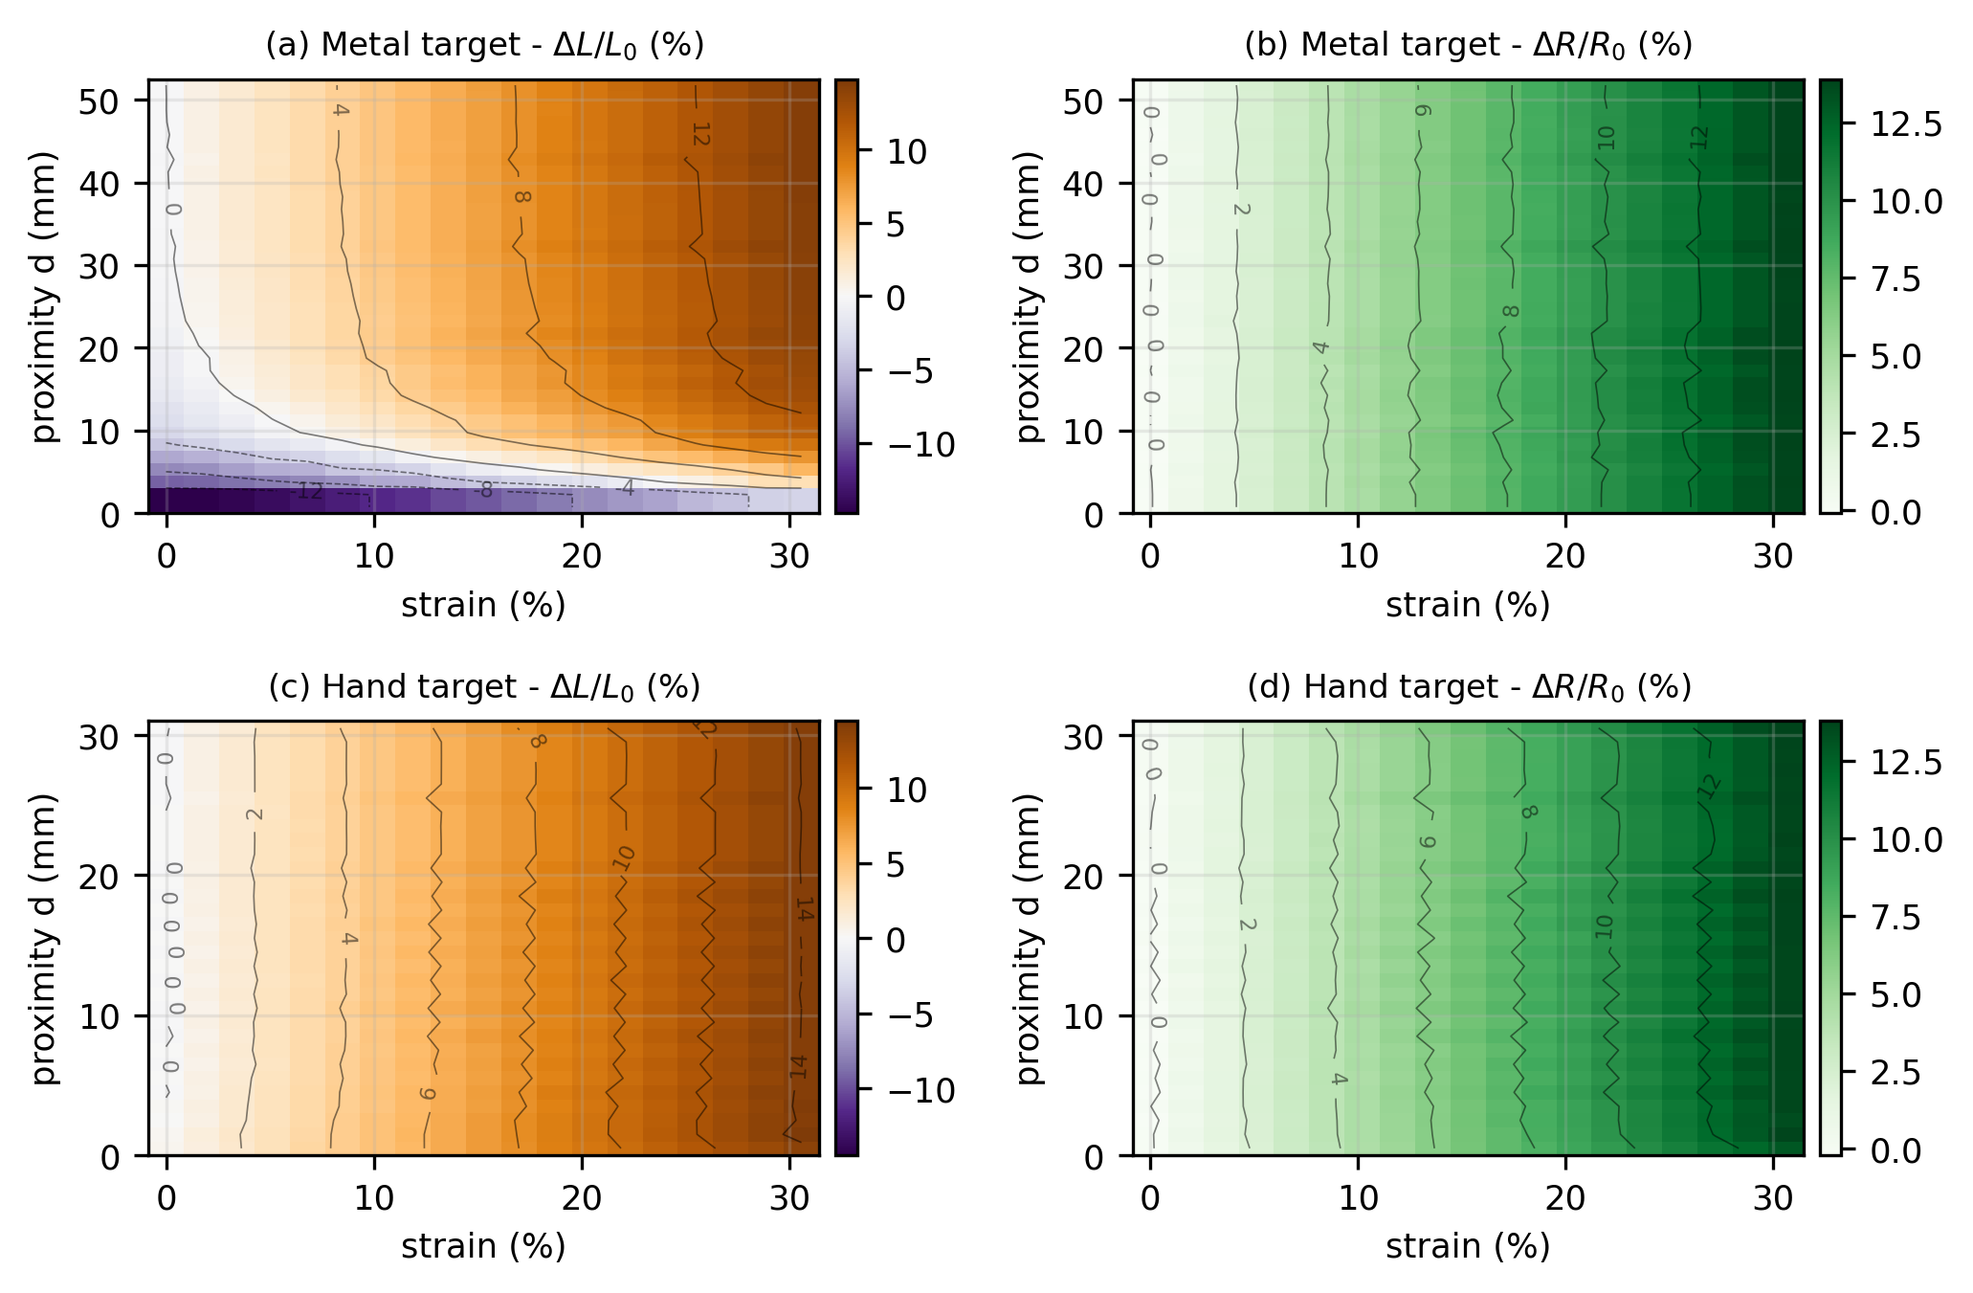
Key Evidence — the (ε, d) Response Surfaces
The physical reason decoupling is possible
Metal target
ΔR contours are essentially parallel to the distance axis → resistance depends on strain alone
ΔL contours bend sharply for d < 10 mm → at fixed strain it swings from −15.7 % to +14.5 %, changing sign
Hand (dielectric) target
Contours of both signals are nearly vertical → little proximity information is carried by the inductance here
∇L and ∇R are globally linearly independent → direct evidence that decoupling is feasible
12

Slide 14
Why Not Simply Invert the Relations Analytically?
Two reasons Jacobian inversion fails
[ΔR, ΔL]ᵀ = J · [Δε, Δd]ᵀ → [ε, d]ᵀ = [ε₀, d₀]ᵀ + J⁻¹ · [ΔR, ΔL]ᵀ
① Truncation error
The near field is dominated by the M² term and large strain by sinh⁻¹ and ln terms → the linear approximation is valid only locally
② Singularity / loss of orthogonality
As the directions of ∇R and ∇L converge, det(J) → 0 → J⁻¹ diverges and small measurement noise is greatly amplified
Measured: direct inversion of the physics expression with the cross term → R² = 0.26 (diverging to R² = −75 near ε ≈ 0 with lower-quality data)
The problem lies in the inversion method, not in missing information → adopt a learned decoupler that performs only forward operations, so singularities cannot arise, and runs with O(1) latency
13

Slide 15
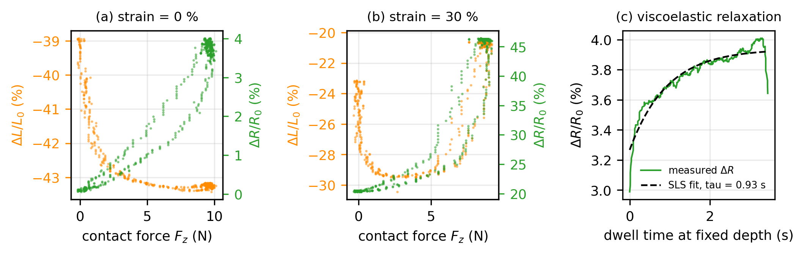
Adding the Contact Modality — New Physics Appears
Hysteresis, creep and cross-sensitivity
• During a constant-depth dwell, ΔL drifts a further 2.33 %p and ΔR 5.73 %p → residuals after unloading are only 0.57 %p and 0.08 %p
• So most of it is a reversible time-lag component, not permanent damage → consistent with a standard linear solid (SLS) model
▶ Exponential relaxation fit over the dwell → τ = 0.93 s (channel-wise: τ_L 1.33 s, τ_R 0.59 s; combined τ = 1.01 s)
14

Slide 16
Why Inductance Appears to Rise Under Compression
An inversion artefact caused by the falling Q factor
Q = ω · (max. stored energy / energy dissipated per cycle) = X / R_s = ω L / R_s
The sensor is pressed
L ↓ , R_DC ↑ , R_eddy ↑
Q falls sharply
Q = ω L / R_s
The true resonant frequency drops
f = 1/(2π√(LC)) · √(1 − 1/Q²)
But we invert with the approximation
f ≈ 1/(2π√(LC)) , ΔL/L₀ = f₀²/f² − 1
L is reported as having increased
an artefact — not a genuine rise in inductance
No correction was applied. The learned decoupler maps (ΔL, ΔR) directly onto the target quantities, so as long as the Q dependence is consistently present in its inputs it produces correct outputs without an explicit inversion correction — a practical advantage over analytical inversion.
15

Slide 17
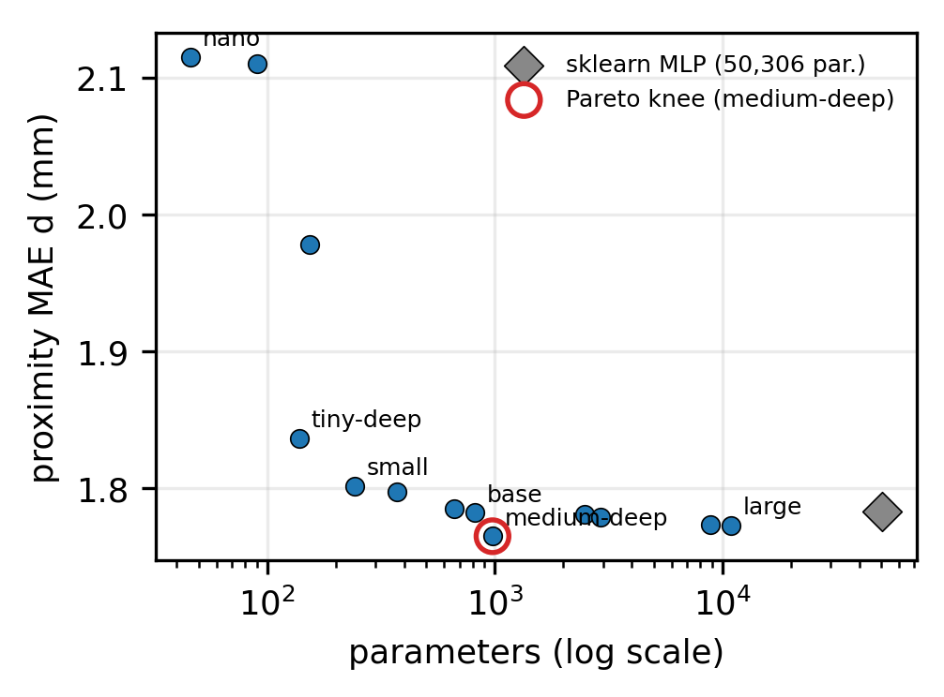
Decoupling Model ① — Two-Stage Structure
The physical asymmetry, transferred directly into the architecture
Stage 1 : ΔR → ε̂ Stage 2 : (ΔL, ε̂) → d̂
Imposes the physical fact that resistance is a function of strain alone, as an inductive bias
Fair comparison at an equal budget (≈ 50 K parameters)
• Two-stage proximity MAE 1.783 mm (50,306 par.)
• End-to-end proximity MAE 1.827 mm (49,592 par.)
Asymmetry in the error structure
• Strain error is homoscedastic — uniform across the range
• Distance error is heteroscedastic — unstable beyond d = 10 mm
→ d ≤ 15 mm and d ≤ 10 mm are reported separately hereafter
The 978-parameter medium-deep sits at the Pareto knee — within 0.09 mm of the 50,306-parameter model
16

Slide 18
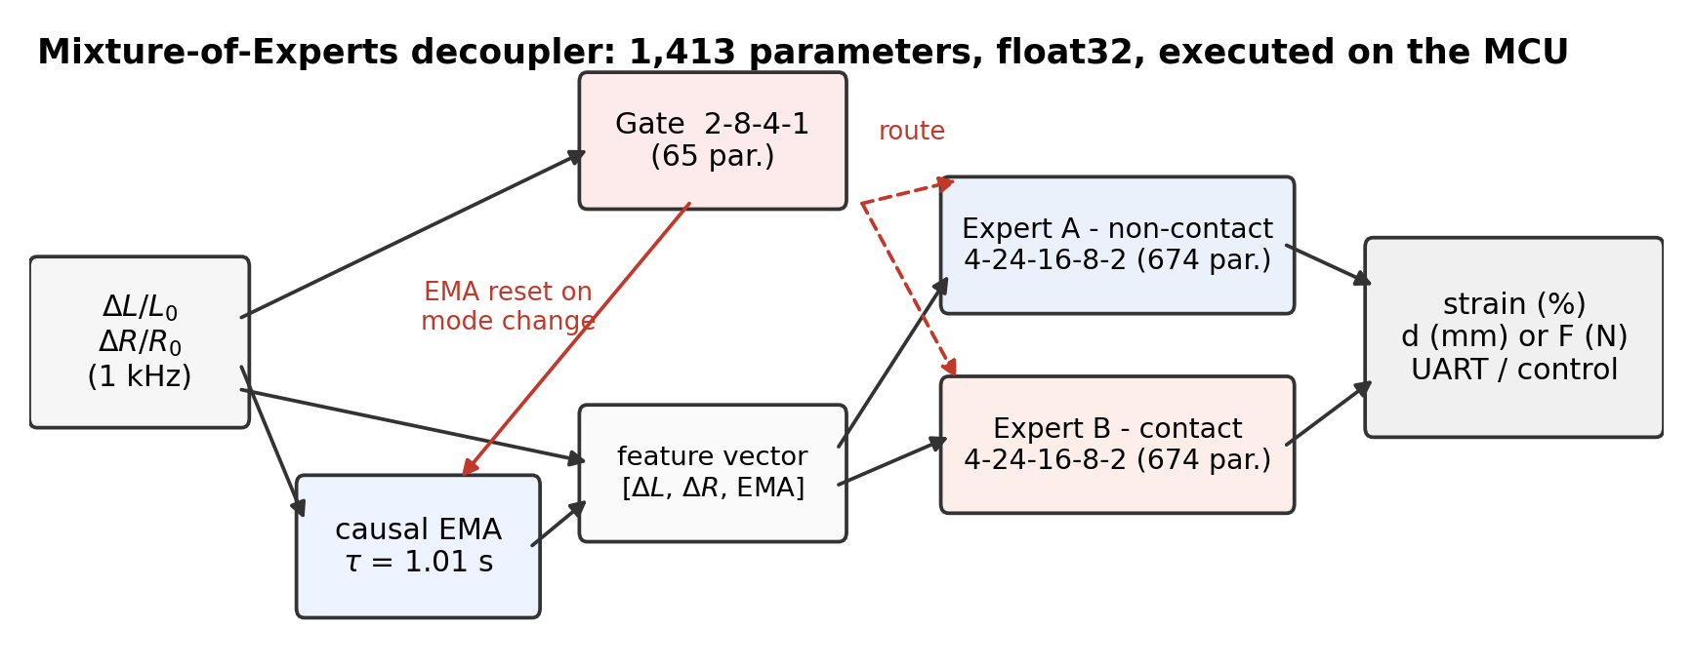
Decoupling Model ② — SLS-EMA + Gate-MoE
Contact and non-contact differ in the very quantities to be produced
SLS-EMA: the τ = 1.01 s obtained in Section 5 is reduced to a causal exponential-moving-average history feature
• EMAₙ = EMAₙ₋₁ + α(xₙ − EMAₙ₋₁), α = 1 − exp(−Δt/τ) → one multiplication and one state variable; MCU cost effectively zero
• Computed from the live ΔL and ΔR alone, not from labels → the training feature is reproducible exactly on the deployed board
▶ This single feature cuts the force RMSE from 0.521 N to 0.253 N (the F/T sensor's own noise is ±0.19 N)
17

Slide 19
Ablation Study
Separating the contributions of Gate-MoE and SLS-EMA (D4, cycle-wise held-out)
Model
Gate acc.
Strain RMSE
Distance RMSE
Force RMSE
Param.
A: Gate-MoE + SLS-EMA
1.000
0.108 %p
0.318 mm
0.253 N
1,429
B: SLS-EMA only (unified)
—
0.288 %p
0.322 mm
0.079 mm †
1,506
C: Gate-MoE only (no history)
0.982
0.194 %p
0.410 mm
0.521 N
1,317
D: Gate-MoE + GRU
1.000
0.123 %p
0.318 mm
0.263 N
1,061
• The benefit of SLS-EMA is concentrated in force — from C to A the force RMSE falls 0.521 → 0.253 N (less than half), strain only 0.194 → 0.108 %p
• The gate-expert structure shows up from B to A — the unified model is 2.7× worse in strain RMSE (0.288 %p), because the strain response differs between regimes
• The GRU (D) ties on accuracy with only 306 parameters for the pressure expert — yet A was deployed (mature dense-layer support in X-CUBE-AI, no hidden state to carry)
18

Slide 20
Embedded Implementation
sklearn → ONNX → stedgeai → STM32, with on-board inference once per TDM cycle
Item
Two-stage INT8 (first)
medium-deep
MoE (final)
Parameters
50,306
978
1,413
Weight ROM
~52 KB
3,912 B
5.66 KB
Activation SRAM
15.3 KB
288 B
368 B
Total flash
112.5 KB (85.8 %)
~68 KB
83.5 KB (65.2 %)
Inference latency (DWT)
1,068 µs
141 µs
260 µs (p95 263 µs)
Completes within 1 ms
no
yes
yes
The latency spread is only ~2 µs → usable in a deterministic control loop
The same inference on a PC costs a 20–40 ms USB round trip with ±5–15 ms jitter → edge inference here is a requirement for real-time operation, not an optimization
19

Slide 21
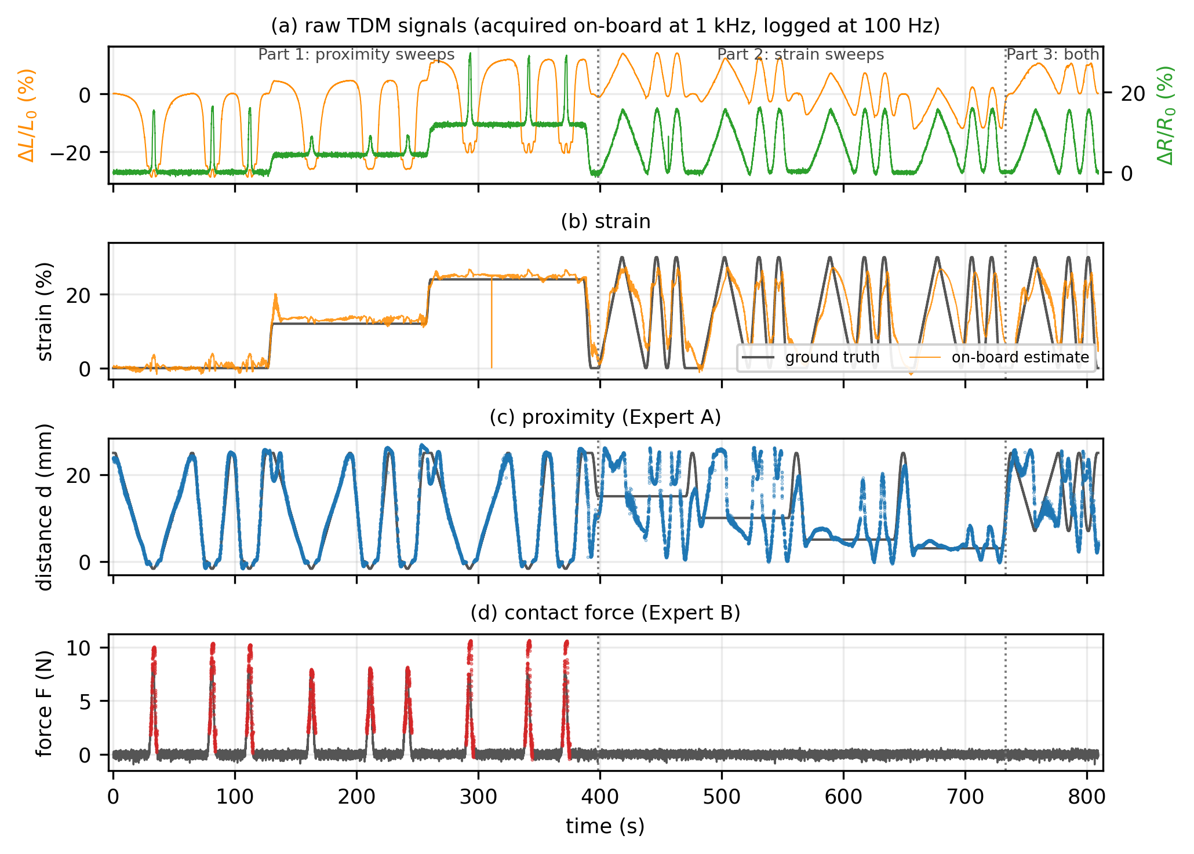
On-Hardware Real-Time Validation
A session separate from training · no post-hoc inference on the PC (session 0819-153948, 809 s)
Part 1 (0–398 s) strain held, proximity swept | Part 2 (400–730 s) proximity held, strain swept | Part 3 (from 738 s) both axes together
20

Slide 22
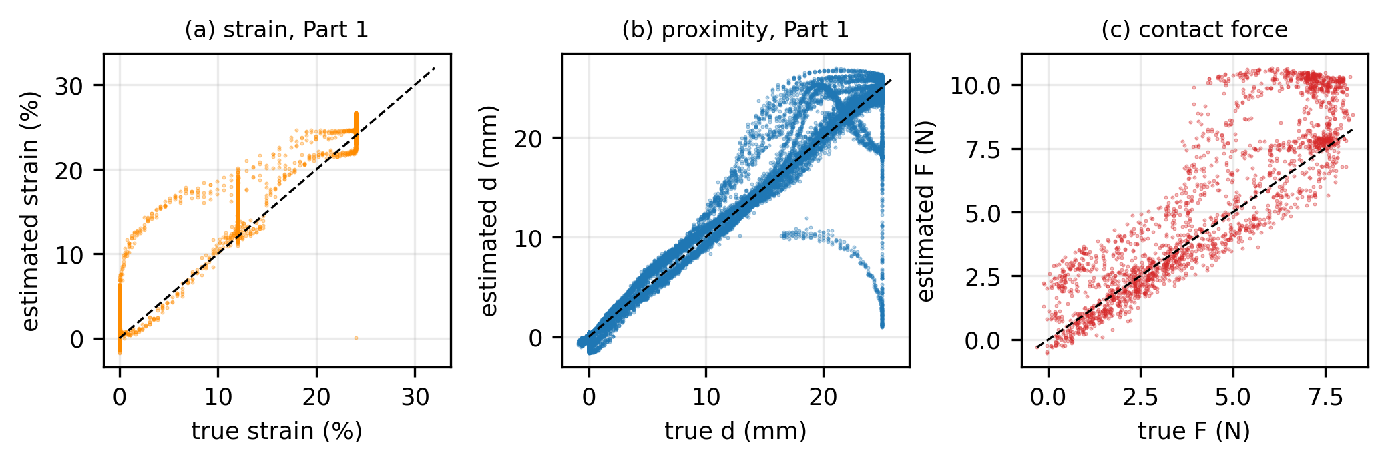
Part-Wise Results
Isolating the case where each axis varies alone from where both vary
Segment
Strain R²
Distance R²
Force R²
Part 1 — proximity only
0.981
0.940
0.430
Part 2 — strain only
0.492
−0.797
—
Part 3 — simultaneous
0.602
−2.051
—
Part 1 — all three quantities recovered well
Strain RMSE 1.37 %p · distance RMSE 2.11 mm Gate accuracy 98.3 %
Parts 2 and 3 — the distance R² goes negative
Proximity is quasi-static, so the ground-truth variance is very small. Since R² = 1 − RMSE²/Var(y), a small denominator degrades R² even for a modest absolute error. (Part 2 RMSE 6.19 mm — about 3× Part 1)
The degradation is nonetheless real: when proximity is quasi-static, the information left in the inductance falls to the noise level.
21

Slide 23
A Failure Mode Visible Only on Hardware
Offline metrics alone cannot guarantee embedded performance
Offline held-out gate accuracy 100.0 % → yet on hardware the gate kept reporting contact after release
Cause — a self-reinforcing loop created by the training/deployment mismatch
1
On release, the raw ΔL and ΔR change immediately
2
But the EMA stays at the pressed value for about τ ≈ 1 s
3
The gate, seeing that stale EMA, keeps reporting contact
4
Its decision never changes, so the EMA reset never triggers ↺
In training the EMA could be reset at the exact instant using the label z; the deployed board has no such ground truth.
Fix — revert the gate to a two-input form without EMA
Contact is an instantaneous physical transition with no reason to be smoothed. Offline accuracy dropped from 100.0 % to 98.2 %, but behaviour on hardware was restored. Experts A and B, where history genuinely helps regression, kept their four inputs.
22

Slide 24
Conclusion
Three signals acquired simultaneously from one electrode
Two-wire EGaIn spiral coil · 1 ms TDM · 1 kHz · 93.9 % CPU idle
The physical basis for decoupling confirmed by measurement
R depends on ε alone, L on (ε, d) — ∇L and ∇R are globally linearly independent
Contact-regime physics identified and folded into the model
SLS viscoelasticity τ ≈ 1.0 s → causal EMA history feature; the Q-factor artefact explained
A 1,413-parameter model embedded on the STM32
On-board inference at 260 µs per TDM cycle (p95 263 µs), ~2 µs spread
On-hardware performance reported together with its limits
Part 1: strain R² 0.981 · distance R² 0.940 · gate 98 %; quasi-static degradation reported as measured
23

Slide 25
Future Work
(i)
Also acquire the AC equivalent series resistance R_s
Obtaining R_s in the same TDM slot completes the response signature, letting conductors and dielectrics be told apart by sign and enabling the Q-factor correction to be applied directly.
(ii)
Multi-frequency impedance measurement
Real and imaginary impedance at several frequencies would improve material discrimination and proximity estimation together, and the extra channels may ease the quasi-static problem.
(iii)
Two-dimensional strain decomposition
ΔL = f(Δl, ΔA, Δd) whereas ΔR = f(Δl) → L and R have different effective eigen-directions. The cruciform specimen and four-axis stage are already in place.
(iv)
Migration to a recurrent structure
The GRU matched the EMA-based models with 306 parameters. Verifying X-CUBE-AI's recurrent-layer support, hidden-state reset and quantization stability on this board is the next task.
24

Slide 26
Thank you
Heejun Moon · BioRobotics and Control Lab, Korea University

