Slide 1
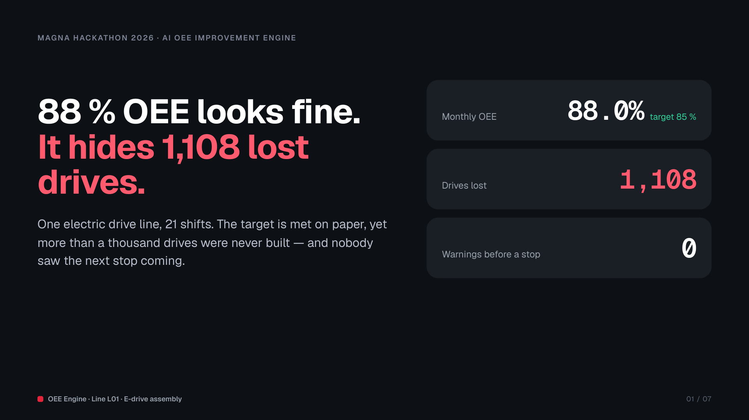
Notes:
88 % OEE beats the 85 % target, so on paper the line is fine. But in 21 shifts it lost 1,108 electric drives, and today nobody gets a warning before a stop. Our engine makes every loss visible and actionable before the line stops.

Slide 2
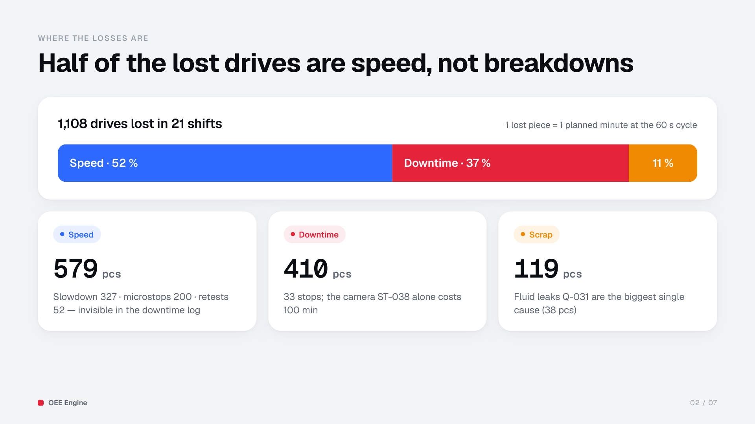
Notes:
Where did 1,108 drives go? 52 % is speed — slowdowns, microstops and retests that never show up in the downtime log. 37 % is downtime, 33 stops; the camera ST-038 alone costs 100 minutes. 11 % is scrap, led by fluid leaks Q-031.

Slide 3
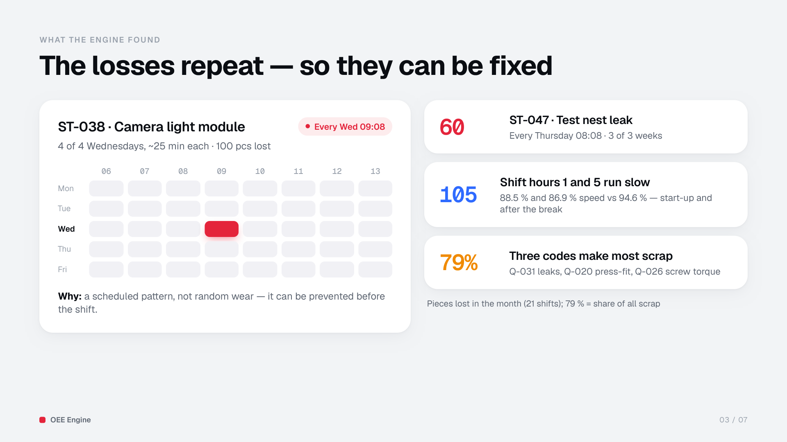
Notes:
The losses repeat. ST-038 stops the line every Wednesday at 09:08, four weeks out of four. ST-047 leaks every Thursday at 08:08. Hours 1 and 5 — start-up and after the break — run slower every day. Three codes make 79 % of scrap. Repeating means preventable.

Slide 4
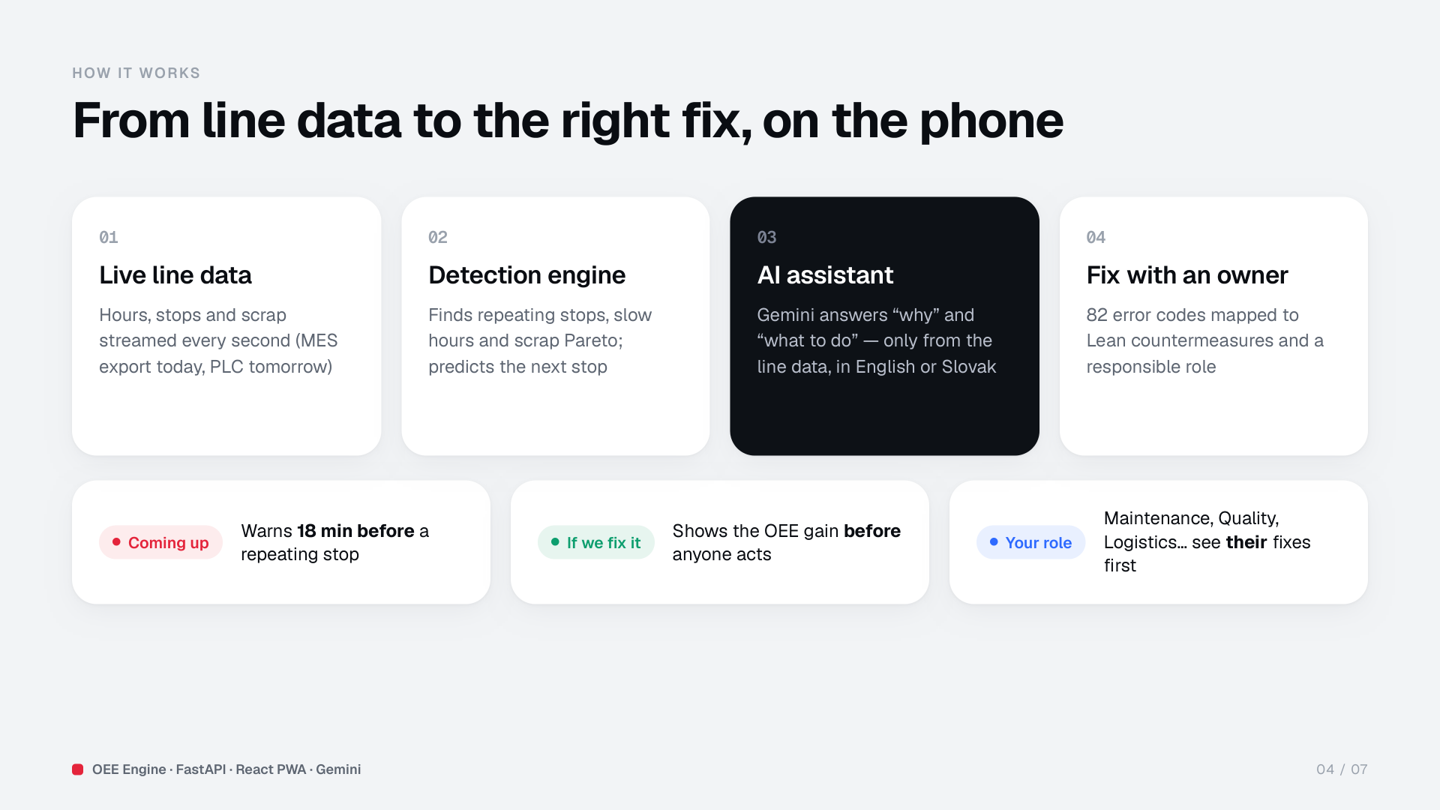
Notes:
Line data streams in every second. The detection engine finds repeating stops, slow hours and scrap causes and predicts the next stop. The AI assistant answers why and what to do, only from the line data, in English or Slovak. Every error code has a Lean countermeasure and an owner.

Slide 5
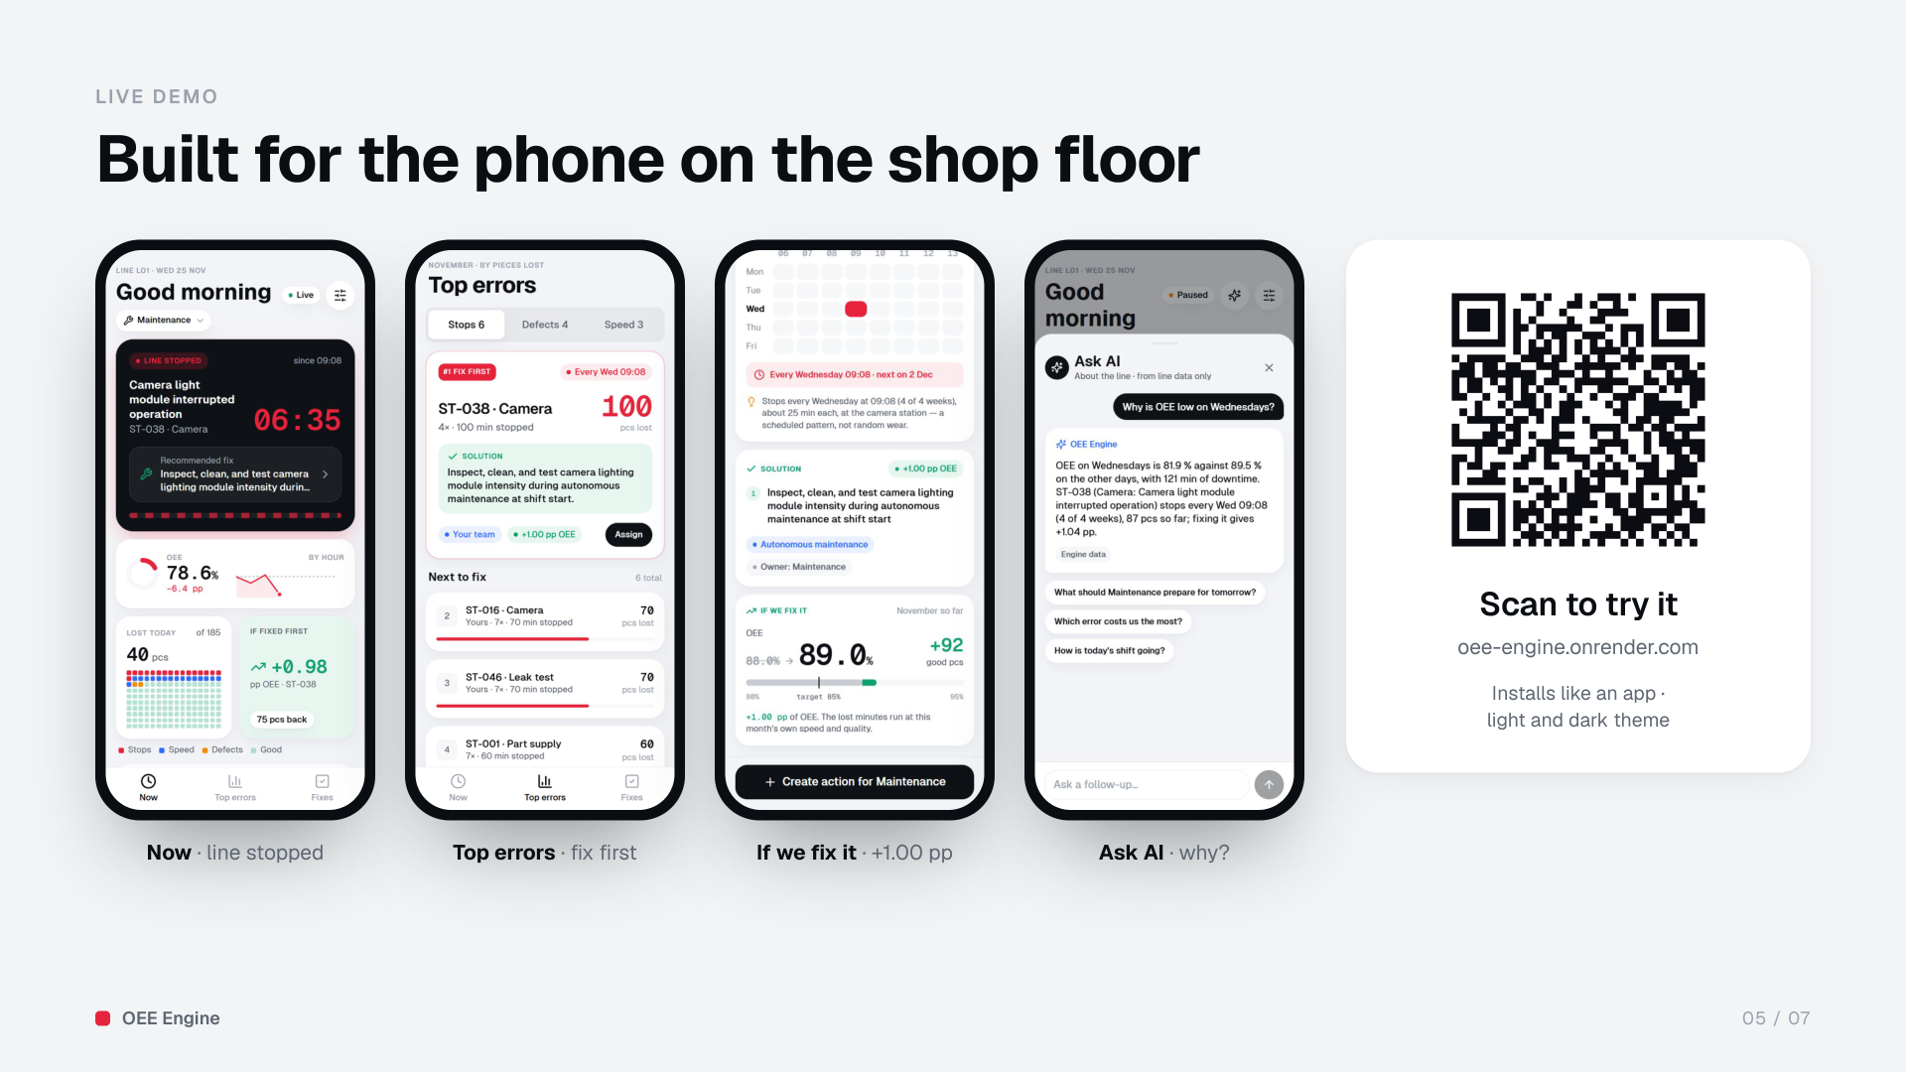
Notes:
Live demo: Settings, Start demo. Coming up warns that ST-038 is due in 18 minutes. At 09:08 the line stops; the fix is already on screen. Top errors shows ST-038 as fix first; the detail shows every Wednesday 09:08 and +1.00 pp if fixed. Ask AI: why is OEE low on Wednesdays? Create the action for Maintenance. Scan the QR code to try it.

Slide 6
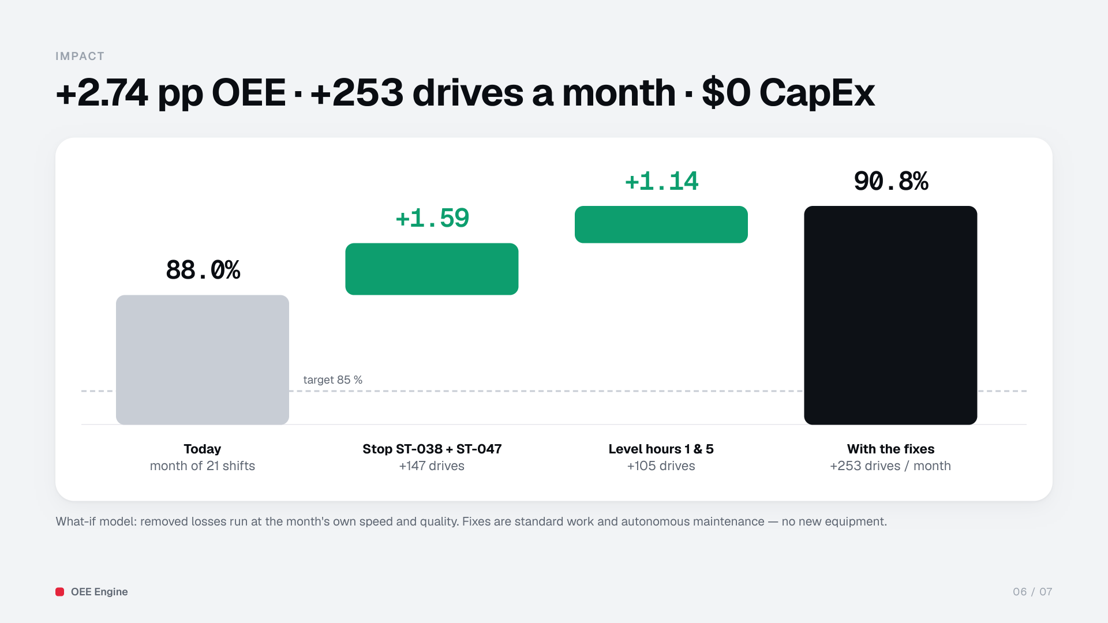
Notes:
Fixing the two repeating stops gives +1.59 pp, levelling hours 1 and 5 another +1.14 pp: 88.0 % to 90.8 % OEE, 253 more drives a month. The what-if model runs the removed losses at the month's own speed and quality. No new equipment — standard work and autonomous maintenance.

Slide 7
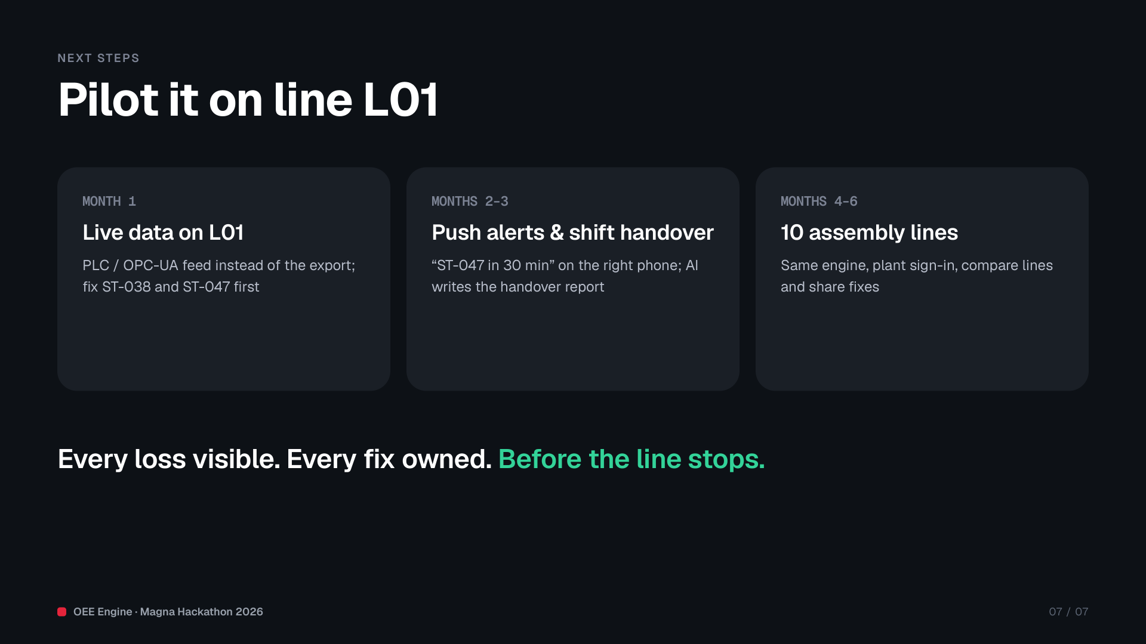
Notes:
Next: one month on line L01 with a live PLC feed, fixing ST-038 and ST-047 first. Then push alerts and an AI shift handover. Then ten assembly lines. Every loss visible, every fix owned — before the line stops. Thank you.

