Slide 1
Credit Scoring Project
김병견
윤희경
조유현

Slide 2
Table of Contents
Data & Goal
Two Approaches: Logistic Regression & Support Vector Machine
Conclusion
Appendix
 | Logistic Regression | Support Vector Machine (SVM)
1. Process Data | Split data into training, cross validation and test sets Random sampling Training: cross validation: test = 60:20:20
2. Build First Model | Language: Python Algorithm | Language: Octave Algorithm
3. Evaluate Model | Learning Curve | Learning Curve
4. Modify Model | Lambda Threshold | C

Slide 3
1 Data
Content: credit history of customers
Size: 150,000 records * (1 id + 10 features + 1 target)
Variable Name | Description | Type
SeriousDlqin2yrs | Person experienced 90 days past due delinquency or worse | Y/N
RevolvingUtilizationOfUnsecuredLines | Total balance on credit cards and personal lines of credit except real estate and no installment debt like car loans divided by the sum of credit limits | percentage
age | Age of borrower in years | integer
NumberOfTime30-59DaysPastDueNotWorse | Number of times borrower has been 30-59 days past due but no worse in the last 2 years. | integer
DebtRatio | Monthly debt payments, alimony,living costs divided by monthy gross income | percentage
MonthlyIncome | Monthly income | real
NumberOfOpenCreditLinesAndLoans | Number of Open loans (installment like car loan or mortgage) and Lines of credit (e.g. credit cards) | integer
NumberOfTimes90DaysLate | Number of times borrower has been 90 days or more past due. | integer
NumberRealEstateLoansOrLines | Number of mortgage and real estate loans including home equity lines of credit | integer
NumberOfTime60-89DaysPastDueNotWorse | Number of times borrower has been 60-89 days past due but no worse in the last 2 years. | integer
NumberOfDependents | Number of dependents in family excluding themselves (spouse, children etc.) | integer

Slide 4
1 Goal
Business goal: Filtering out customers with high possibility of default
Analysis goal: Build credit scoring model with maximum f-score, not accuracy
Why “F-score”, not accuracy?

Slide 5
2.1 Process Data
1 shuffle entire data set
2 slice first 60% data to make ‘training’ data set
3 slice next 20% data to make ‘cross validation’ data set
4 slice remaining 20% data to make ‘test’ data set
5 for [training, crossValidation, test]
1 splitData to X, y
2 featureScale X
3 addBias to X

Slide 6
2.2 Logistic Regression: Algorithm - train
def LogisticRegression
1 optimize theta with initial theta, cost function, gradient function, X, y, lambda
def costFunction
def gradFunction
1 return transpose(sigmoid(X * y)) * y + lambda * sum(theta[1:])/m

Slide 7
2.2 Logistic Regression: Algorithm - predict
def predict
def getPrediction
def getMeasures

Slide 8
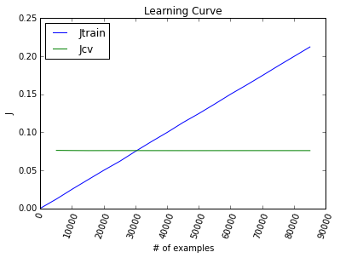
2.3 Logistic Regression: Learning Curve
explanation

Slide 9
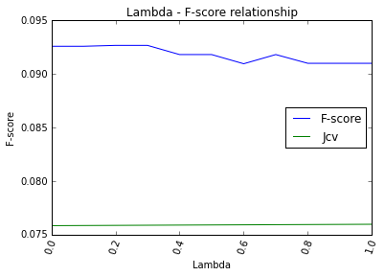
2.4 Logistic Regression: Modify Model

Slide 10
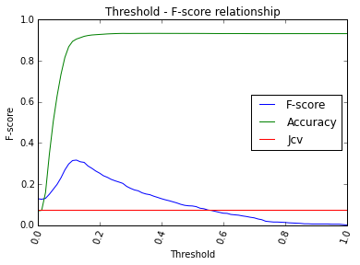
2.4 Logistic Regression: Modify Model

Slide 11
3 Conclusion
F Score (Accuracy) | Logistic Regression | Support Vector Machine
First Model | 0.0795 (0.9336)
Modified Model | 0.3197 (0.9062)

Slide 12
4 Appendix
Explore Data

