Slide 1
Credit Scoring Project
김병견
윤희경
조유현

Slide 2
Table of Contents
Data & Goal
Two Approaches: Logistic Regression & Support Vector Machine
Conclusion
Appendix
 | A. Logistic Regression | B. Support Vector Machine (SVM)
1. Process Data | Split data into training, cross validation and test sets Random sampling Training: cross validation: test = 60:20:20
2. Build First Model | Language: Python Algorithm | Language: Python, Octave Algorithm
3. Evaluate Model | Learning Curve | Learning Curve
4. Modify Model | Lambda Threshold | C

Slide 3
1 Data
Content: credit history of customers
Size: 150,000 records * (1 id + 10 features + 1 target)
Variable Name | Description | Type
SeriousDlqin2yrs | Person experienced 90 days past due delinquency or worse | Y/N
RevolvingUtilizationOfUnsecuredLines | Total balance on credit cards and personal lines of credit except real estate and no installment debt like car loans divided by the sum of credit limits | percentage
age | Age of borrower in years | integer
NumberOfTime30-59DaysPastDueNotWorse | Number of times borrower has been 30-59 days past due but no worse in the last 2 years. | integer
DebtRatio | Monthly debt payments, alimony,living costs divided by monthy gross income | percentage
MonthlyIncome | Monthly income | real
NumberOfOpenCreditLinesAndLoans | Number of Open loans (installment like car loan or mortgage) and Lines of credit (e.g. credit cards) | integer
NumberOfTimes90DaysLate | Number of times borrower has been 90 days or more past due. | integer
NumberRealEstateLoansOrLines | Number of mortgage and real estate loans including home equity lines of credit | integer
NumberOfTime60-89DaysPastDueNotWorse | Number of times borrower has been 60-89 days past due but no worse in the last 2 years. | integer
NumberOfDependents | Number of dependents in family excluding themselves (spouse, children etc.) | integer

Slide 4
1 Goal
Business goal: Filtering out customers with high possibility of default
Analysis goal: Build credit scoring model with maximum f-score, not accuracy
Why “F-score”, not accuracy?
Our goal is to filter out customers with high possibility of default.
High accuracy can be achieved without filtering out even a single default customer.
How so?
The data is a skewed data with tiny percentage of default customers (SeriousDlqin2yrs = 1).

Slide 5
2.1 Process Data
Random sampling Data 100% = Training data 60% + Cross validation data 20% + Test data 20%
1 shuffle entire data set 2 slice first 60% data to make ‘training’ data set 3 slice next 20% data to make ‘cross validation’ data set 4 slice remaining 20% data to make ‘test’ data set 5 for [training, crossValidation, test] 1 splitData to X, y 2 featureScale X

Slide 6
2.Logistic Regression
LR2.2 Build First Model
LR2.3 Evaluate Model
LR2.4 Modify Model

Slide 7
LR2.2 Build First Model – train algorithm
Method 1) Manually Implemented Implement logistic regression learning algorithm with cost function & gradient function. Use “scipy.optimize.fmin_cg” to optimize theta.
def LogisticRegression(cost function, grad function, X, y, lambda): 1 optimize theta with initial theta, cost function, gradient function, X, y, lambda 2 return theta
def costFunction(theta, *args): 1 unpack args to get X, y, lambda 2 compute J 3 return J | def gradFunction(theta, *args): 1 unpack args to get X, y, lambda 2 compute gradients for each theta 3 return gradient vector

Slide 8
LR2.2 Build First Model – train algorithm
Method 2) LogisticRegression Module -> We’ll stick to this method onward! Use “sklearn.linear_model.LogisticRegression” module
from sklearn.linear_model import LogisticRegression clf = LogisticRegression() clf.fit(Xtrain, ytrain)

Slide 9
LR2.2 Build First Model – predict algorithm
With optimized theta, predict labels for a new data set. Use “sklearn.metrics.precision_recall_fscore_support” get f-score.
def predict(clf, X, y, threshold = 0.5): 1 get prediction 2 get measures 3 print measures 4 return prediction
def getPrediction(clf, X, threshold = 0.5): 1 probability = clf.predict_proba(X) 2 prediction = probability > threshold 3 return prediction | def getMeasures(y, prediction): 1 accuracy = (prediction == y).mean() 2 get precision, recall, f_score, support with sklearn.metrics.precision_recall_fscore_support 3 measures = (accuracy, precision, recall, f_score) 4 return measures

Slide 10
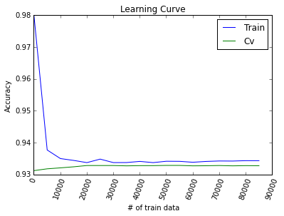
LR2.3 Evaluate Model: Learning Curve
High bias
Increase in # of train data doesn’t improve cv accuracy.
There is no big gap between train accuracy and cv accuracy.
Increasing # of train data won’t be much helpful.
We need to develop more complex model.

Slide 11
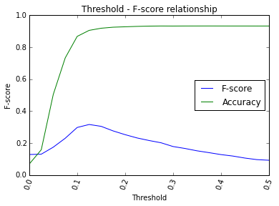
LR2.4 Modify Model: Threshold
Threshold that maximizes F-score >> 0.125
Accuracy is sacrificed for better f-score.

Slide 12
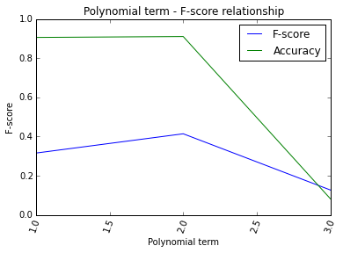
LR2.4 Modify Model: Polynomial Features
Polynomial term that maximizes F-score >> 2
10 features (original) -> 66 features (poly 2)

Slide 13
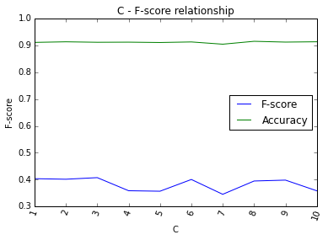
LR2.4 Modify Model: C (regularization term)
C that maximizes F-score >> 3

Slide 14
3 Conclusion
 | Logistic Regression |  | Support Vector Machine
 | F score | Accuracy | F score | Accuracy
First Model | 0.0786 | 0.9336
Modified Model | 0.4027 | 0.9108
Change (%) | + 412.34% | -2.44%
 |  |  | (Tested on ‘test’ data set)

Slide 15
4 Appendix
Explore Data(histograms, scatter plots)

