Slide 1
Predict the Probability of Purchasing
2011120355 윤희경
2011120290 심재민

Slide 2
Table of Contents
Data
Task
Progress
Plan

Slide 3
4 Plan
Data Processing
Data Mining
Predict
Sampling 1 from each srch_id Convert non-numeric data into numeric data Delete unnecessary attributes Convert numeric target value into non-numeric data type (to run logistic regression) | Clustering into 3 clusters Find optimum set of attributes (Classify: logistic regression) | Process test data Cluster the data Classify the data Rank the result

Slide 4
Predict
1 Process
Test Data
Remove unnecessary attributes (R)
Into numeric values (R)
2 Cluster
Test Data
Cluster as supplied test set (weka)
Join (R)
3 Classify
Test Data
Add pseudo target (R)
Temporarily remove srch_id, prop_id columns (R)
Predict as supplied test set (weka)
4 Rank
the Result
Text into csv (python)
Join probability with data (R)
Sort by srch_id, probability (excel)

Slide 5
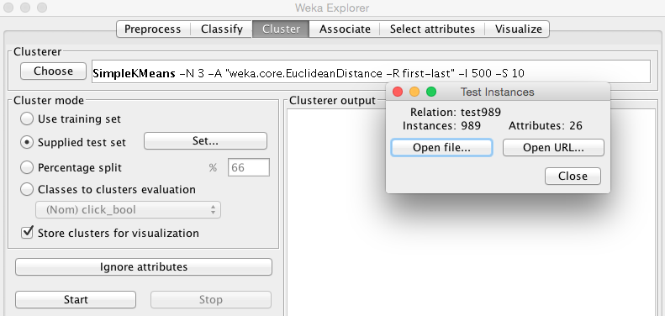
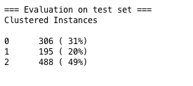
2 Cluster Test Data: cluster with supplied test set

Slide 6
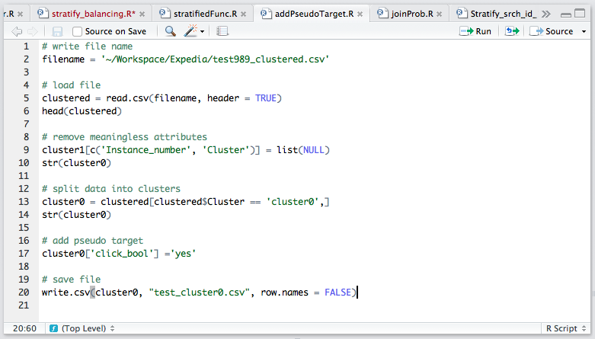
3 Classify Test Data: split into clusters & add pseudo targets

Slide 7
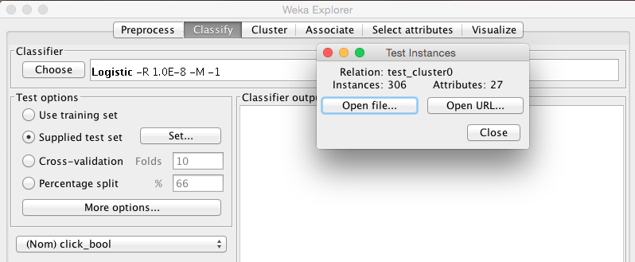
3 Classify Test Data: classify with supplied test set

Slide 8
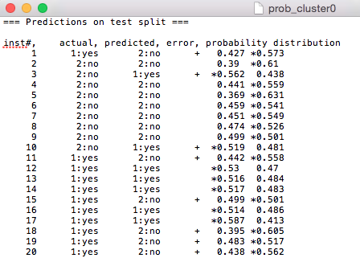

4 Rank the Result: Probability text into csv file
.txt
.csv

Slide 9
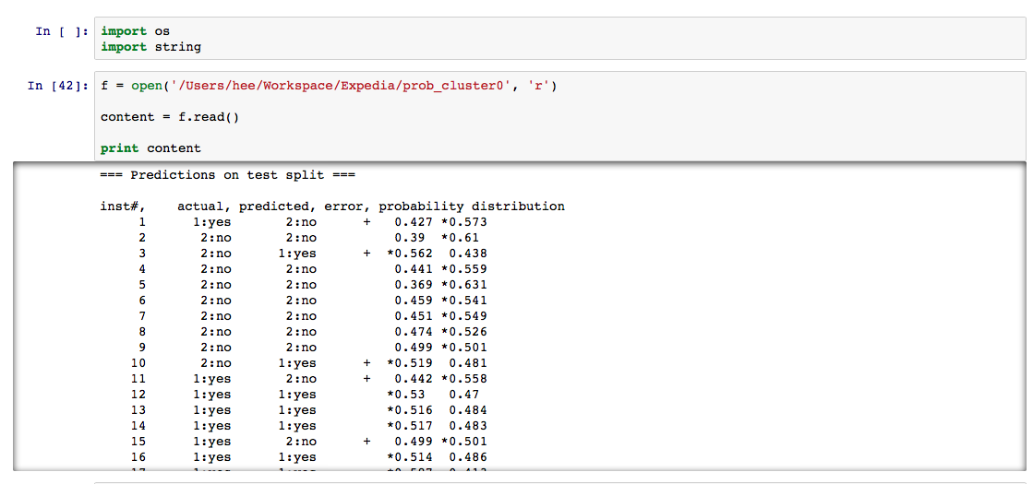
4 Rank the Result: Probability text into csv file

Slide 10
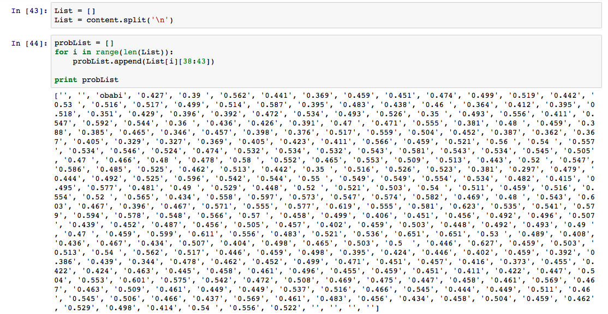
4 Rank the Result: Probability text into csv file

Slide 11
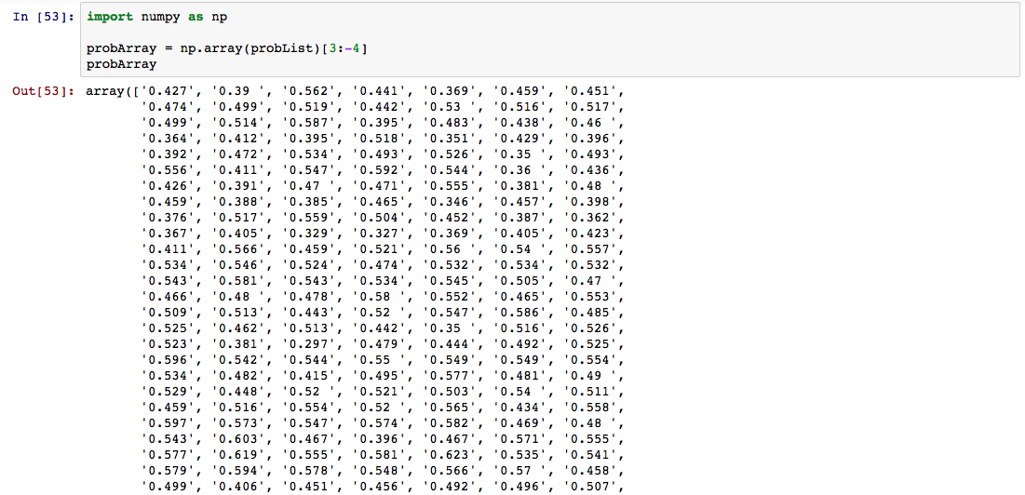
4 Rank the Result: Probability text into csv file

Slide 12
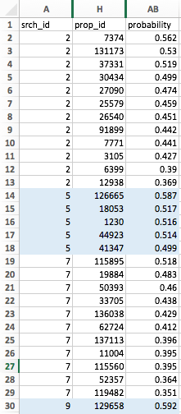
4 Rank the Result: sort by srch_id & probability

Slide 13
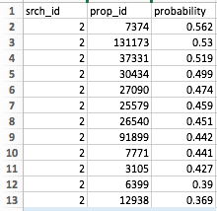
4 Rank the Result: sort by srch_id & probability
Highest Probability of clicking
Lowest Probability of clicking
Task Complete:
개인별로 구매확률이 가장 높은 순서로 호텔 상품을 배열하여 구매율을 향상시킨다.

