Slide 1
Coefficients
Positively Correlated
Negatively Correlated
Srch_length_of_stay
Srch_booking_window
Srch_room_count
Prop_starrating
Prop_review_score
Prop_brand_bool
srch_Saturday_night_bool

Slide 2
Coefficients
Positively Correlated
Negatively Correlated
숙박 기간이 길수록
여행 전에 미리 알아볼수록
예약 방 갯수가 많을 수록
별점이 낮을수록
평점이 낮을수록
브랜드 호텔이 아닐수록
숙박기간 중에 토요일이 포함되지 않을수록

Slide 3
4 Predict

Slide 4
4 Predict
Data Processing
Data Mining
Predict
Sampling 1 from each srch_id Convert non-numeric data into numeric data Delete unnecessary attributes Convert numeric target value into non-numeric data type (to run logistic regression) | Clustering into 3 clusters Find optimum set of attributes (Classify: logistic regression) | Process test data Cluster the data Classify the data Rank the result

Slide 5
Predict
1 Process
Test Data
Remove unnecessary attributes (R)
Into numeric values (R)
2 Cluster
Test Data
Cluster as supplied test set (weka)
Join (R)
3 Classify
Test Data
Add pseudo target (R)
Temporarily remove srch_id, prop_id columns (R)
Predict as supplied test set (weka)
4 Rank
the Result
Text into csv (python)
Join probability with data (R)
Sort by srch_id, probability (excel)

Slide 6
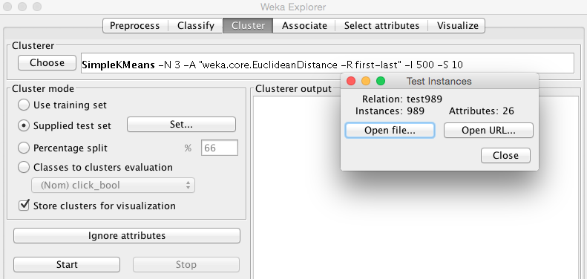
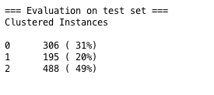
2 Cluster Test Data: cluster with supplied test set

Slide 7
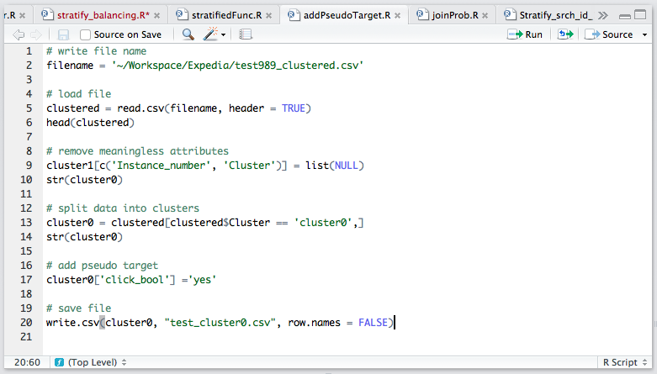
3 Classify Test Data: split into clusters & add pseudo targets

Slide 8
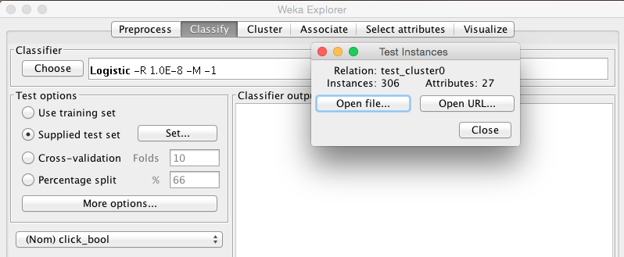
3 Classify Test Data: classify with supplied test set

Slide 9
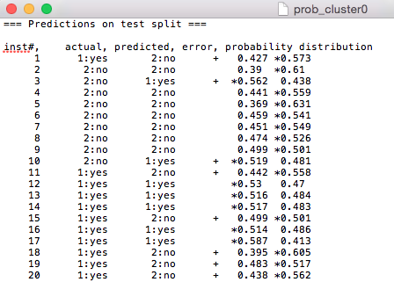

4 Rank the Result: Probability text into csv file
.txt
.csv

Slide 10
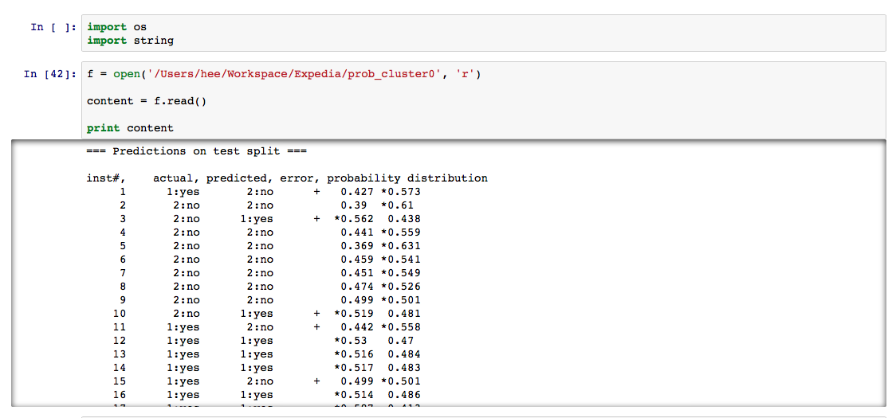
4 Rank the Result: Probability text into csv file

Slide 11
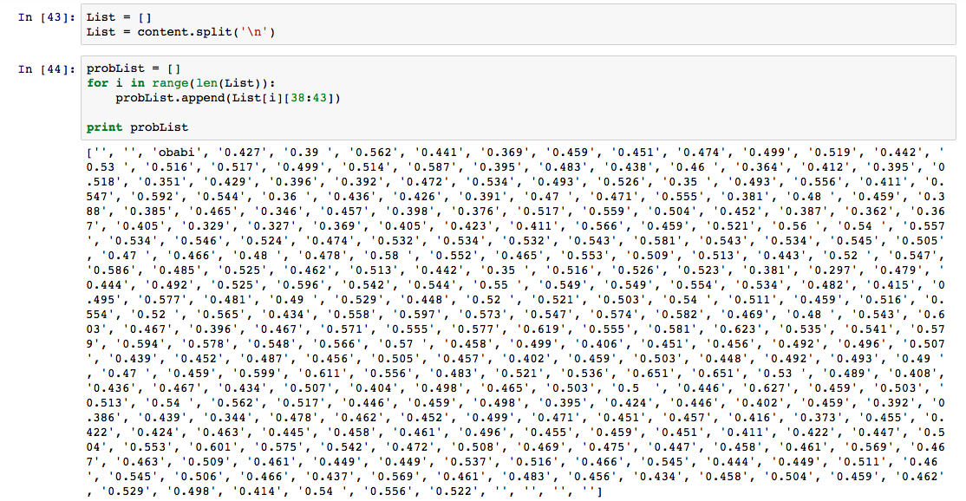
4 Rank the Result: Probability text into csv file

Slide 12
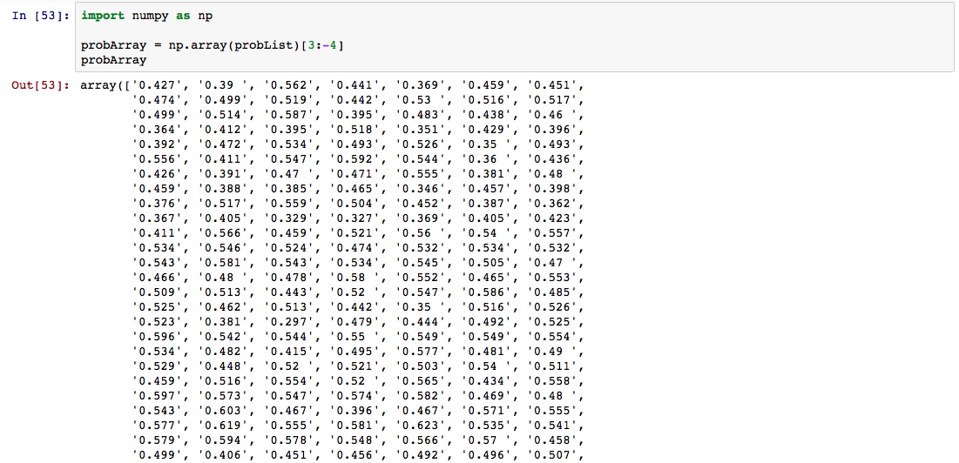
4 Rank the Result: Probability text into csv file

Slide 13
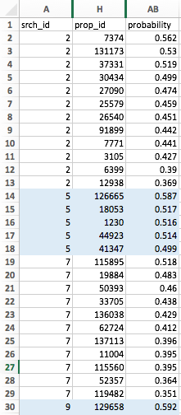
4 Rank the Result: sort by srch_id & probability

Slide 14
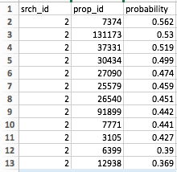
4 Rank the Result: sort by srch_id & probability
Highest Probability of clicking
Lowest Probability of clicking
Task Complete:
개인별로 구매확률이 가장 높은 순서로 호텔 상품을 배열하여 구매율을 향상시킨다.

Slide 15
검색 결과 예시
## Hostel
Prop_id 7374
$$ Hotel
Prop_id 131173
^^ Guest House
Prop_id 37331

