Slide 1
Predict the Probability of Purchasing
2011120355 윤희경
2011120290 심재민

Slide 2
Table of Contents
Data
Task
Progress
Plan

Slide 3
1 Data

Slide 4
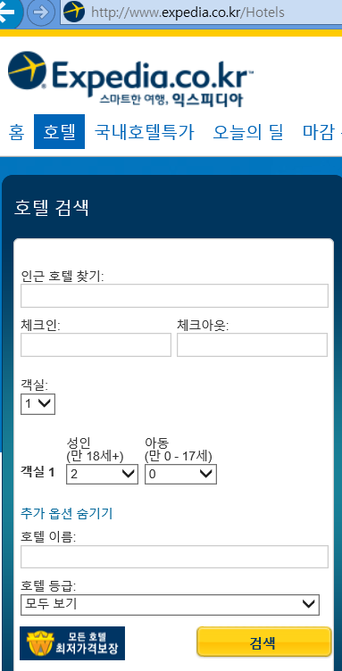
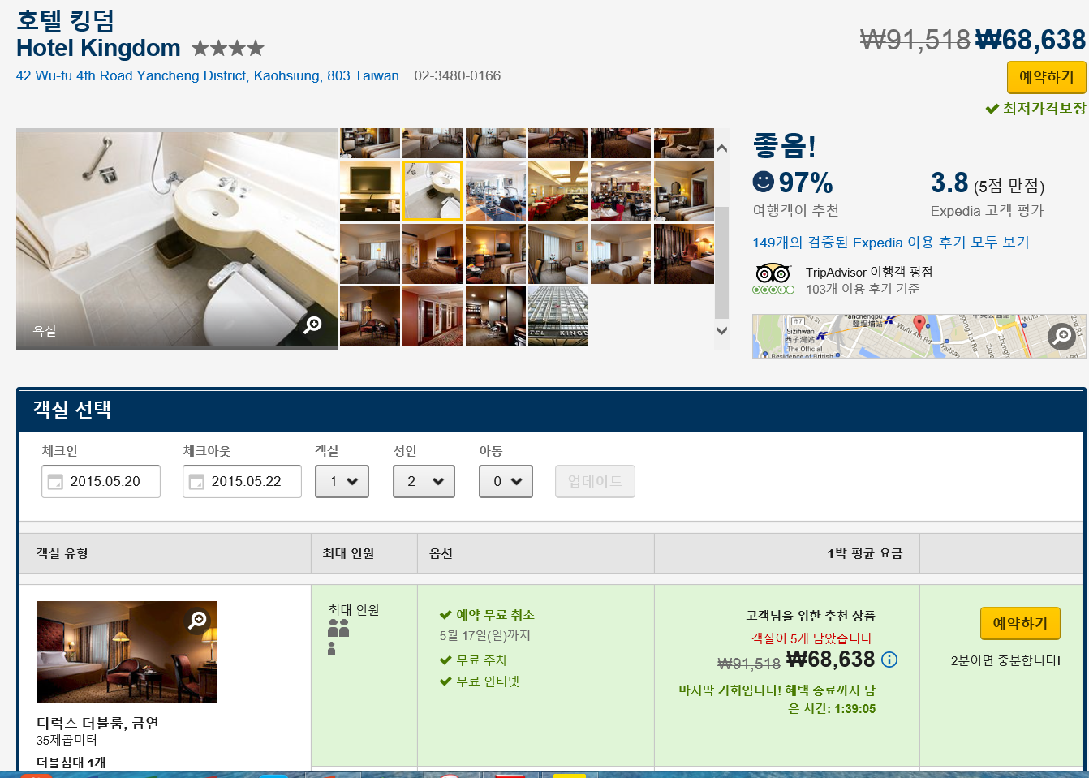
Site_id
Prop_starrating
Price
Srch_length_of_stay
Srch_room_count
Prop_review_score
Srch_adult_count

Slide 5
Attributes
visitor
Hotel
Query
prop_country_id
srch_destination_id
srch_id
prop_starrating
srch_length_of_stay
date_time
prop_id
srch_booking_window
promotion_flag
site_id
srch_adults_count
prop_review_score
visitor_location_country_id
srch_children_count
prop_brand_bool
prop_location_score1
srch_room_count
visitor_hist_adr_usd
prop_location_score2
srch_Saturday_night_bool
prop_log_historical_price
srch_query_affinity_score
price_usd

Slide 6
2 Task

Slide 7
2 Task
개인별로 구매확률이 가장 높은 순서로 호텔 상품을 배열하여 구매율을 향상시킨다.
배열 기준: 구매확률
구매확률 예측 방법: 방문자 정보, 쿼리 정보, 호텔 상품 정보를 바탕으로 구매확률을 예측 (Logistic Regression 이용)

Slide 8
3 Progress

Slide 9
3 Progress
Data Processing
Data Mining
Predict
Delete unnecessary attributes Sampling 1 from each srch_id Convert non-numeric data into numeric data Convert numeric target value into non-numeric data type (to run logistic regression) | Clustering into 3 clusters Find optimum set of attributes (Classify: logistic regression) | Process test data Cluster the data Classify the data Rank the result

Slide 10
Data Processing
Excel로 파일을 열 수 없어서 R로 작업
Delete unnecessary attributes -R
Sampling 1 from each srch_id -R
Convert non-numeric data into numeric data -R
Convert numeric target value into non-numeric data type (to run logistic regression) -R

Slide 11
Data Mining
시도해 본 여러가지 알고리즘들

Slide 12
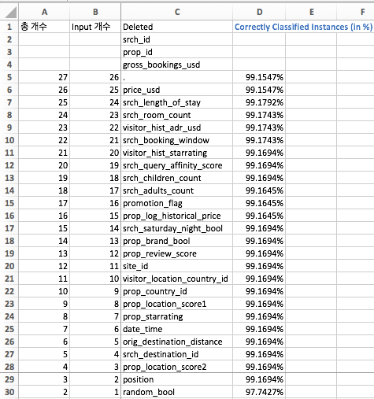
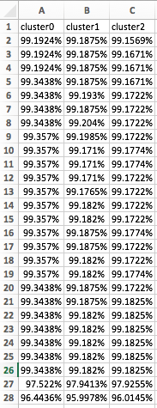
Data Mining: find optimum set of attributes
Entire data set
Cluster0 /Clsuter1/ Cluster2

Slide 13
3 Progress
Data Processing
Data Mining
Predict
Delete unnecessary attributes Sampling 1 from each srch_id Convert non-numeric data into numeric data Convert numeric target value into non-numeric data type (to run logistic regression) | Clustering into 3 clusters Find optimum set of attributes (Classify: logistic regression) | Process test data Cluster the data Classify the data Rank the result
Trouble Shooting

Slide 14
Trouble Shooting
Problem
Solution
1. Two Target Values
One Target Value
2. Unbalanced Data
Balancing data

Slide 15
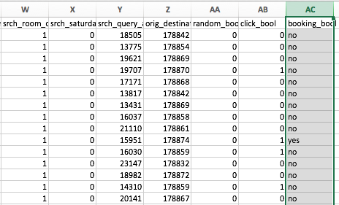
Problem 1. Two Target Values
New Data for Prediction

Slide 16
Solution 1. Target click_bool

Slide 17
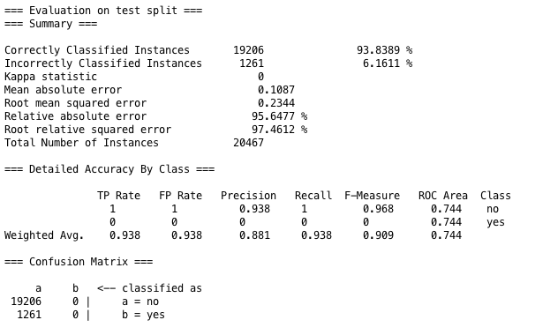
Problem 2. Unbalanced Data
How well other attributes predict click_bool? -> Not at all.

Slide 18
Solution 2. Balancing Data
9,917,530 records
887,344 records
60,000 records
NO 9,473,858
YES 443,672
Balancing
Stratified
Sampling
NO 443,672
YES 443,672
NO 30,000
YES 30,000

Slide 19
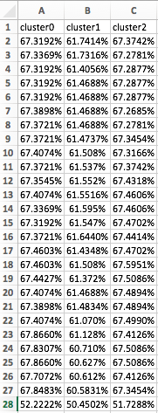
Target booking_bool
With click_bool
Target click_bool
Without click_bool + Balanced Data

Slide 20
4 Plan

Slide 21
4 Plan
Data Processing
Data Mining
Predict
Sampling 1 from each srch_id Convert non-numeric data into numeric data Delete unnecessary attributes Convert numeric target value into non-numeric data type (to run logistic regression) | Clustering into 3 clusters Find optimum set of attributes (Classify: logistic regression) | Process test data Cluster the data Classify the data Rank the result

Slide 22
Predict
1 Process
Test Data
Remove unnecessary attributes (R)
Into numeric values (R)
2 Cluster
Test Data
Cluster as supplied test set (weka)
Join (R)
3 Classify
Test Data
Add pseudo target (R)
Temporarily remove srch_id, prop_id columns (R)
Predict as supplied test set (weka)
4 Rank
the Result
Text into csv (python)
Join probability with data (R)
Sort by srch_id, probability (excel)

Slide 23
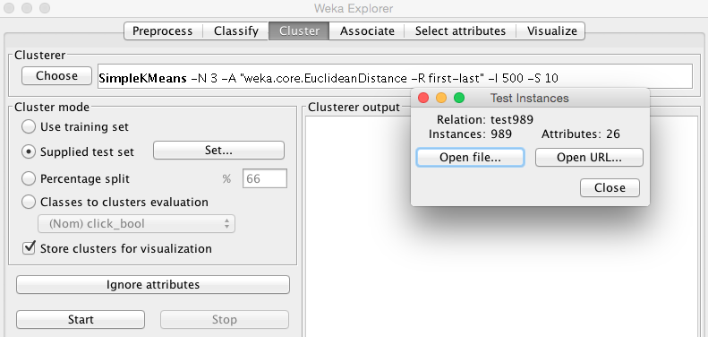
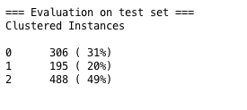
2 Cluster Test Data: cluster with supplied test set

Slide 24
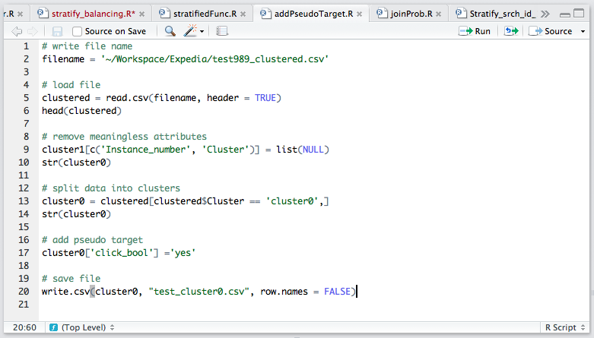
3 Classify Test Data: split into clusters & add pseudo targets

Slide 25
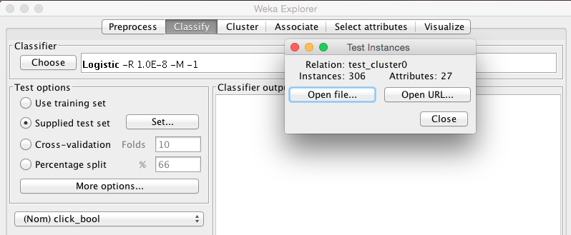
3 Classify Test Data: classify with supplied test set

Slide 26
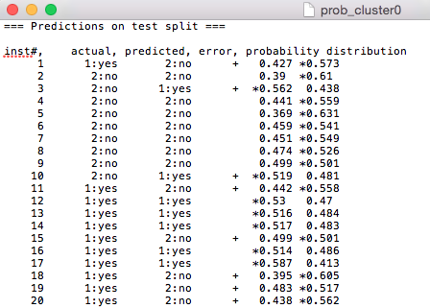

4 Rank the Result: Probability text into csv file
.txt
.csv

Slide 27
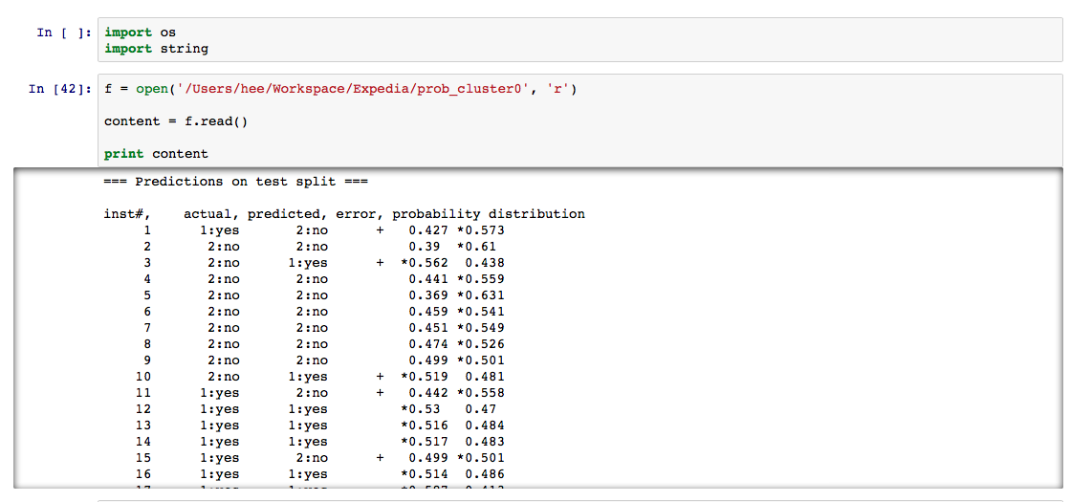
4 Rank the Result: Probability text into csv file

Slide 28
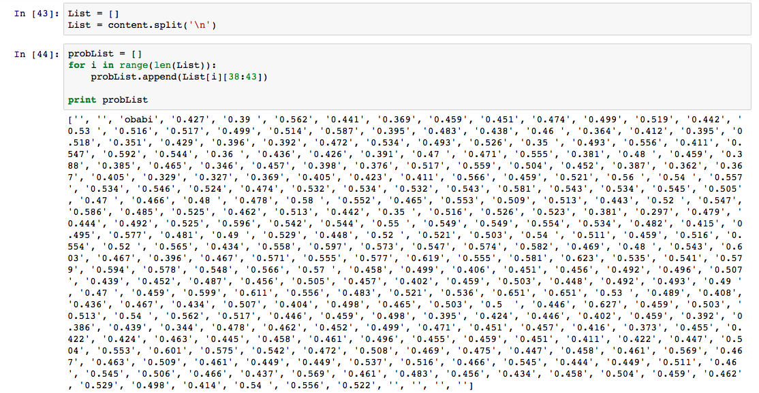
4 Rank the Result: Probability text into csv file

Slide 29
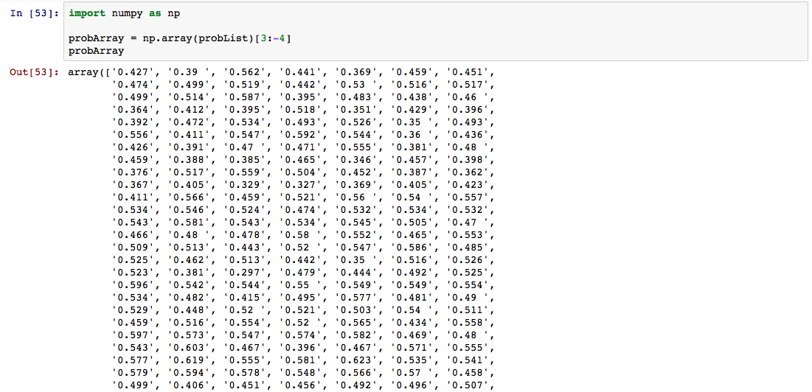
4 Rank the Result: Probability text into csv file

Slide 30
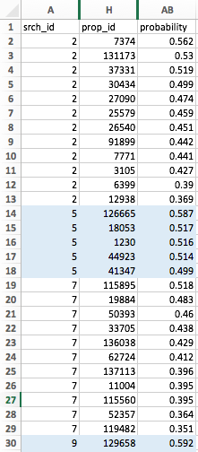
4 Rank the Result: sort by srch_id & probability

Slide 31
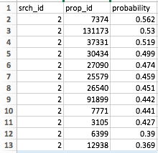
4 Rank the Result: sort by srch_id & probability
Highest Probability of clicking
Lowest Probability of clicking
Task Complete:
개인별로 구매확률이 가장 높은 순서로 호텔 상품을 배열하여 구매율을 향상시킨다.

