Slide 1
COSE471: Data Science
Spring 2015
HW3
Adapted from Data Science(CS109)
by Pfister and Blitzstein (Harvard U.)

Slide 2
For Mac users,
Please make sure that your file
runs on Windows!

Slide 3
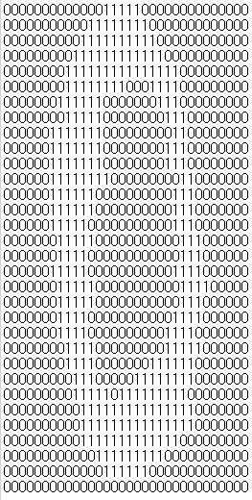
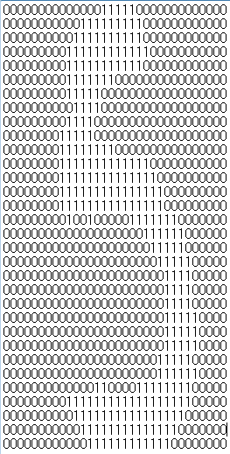
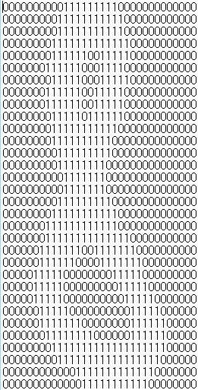
We will go through the following steps:
Read the files from folder
Convert from the image(32X32) format to the list(1X1024) format
Train your Training files with SVM library
Predict Test files with your trained SVM model
Measure your accuracy for your Test
Compare with other Classificaiton Models ( 1 or 2 model)
0. Prepare your Data
Make sure your traning examples and testing examples in your "IPython Notebook" directory (train, test)

Slide 4
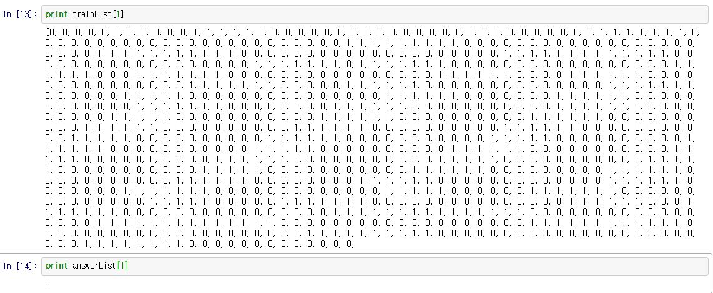
1. Preprocess your Data
Read the files from folder
For Training Data / Convert from the image(32X32) format to the list(1X1024) format
For Training Label(Answer for Data) / Name of the file

Slide 5
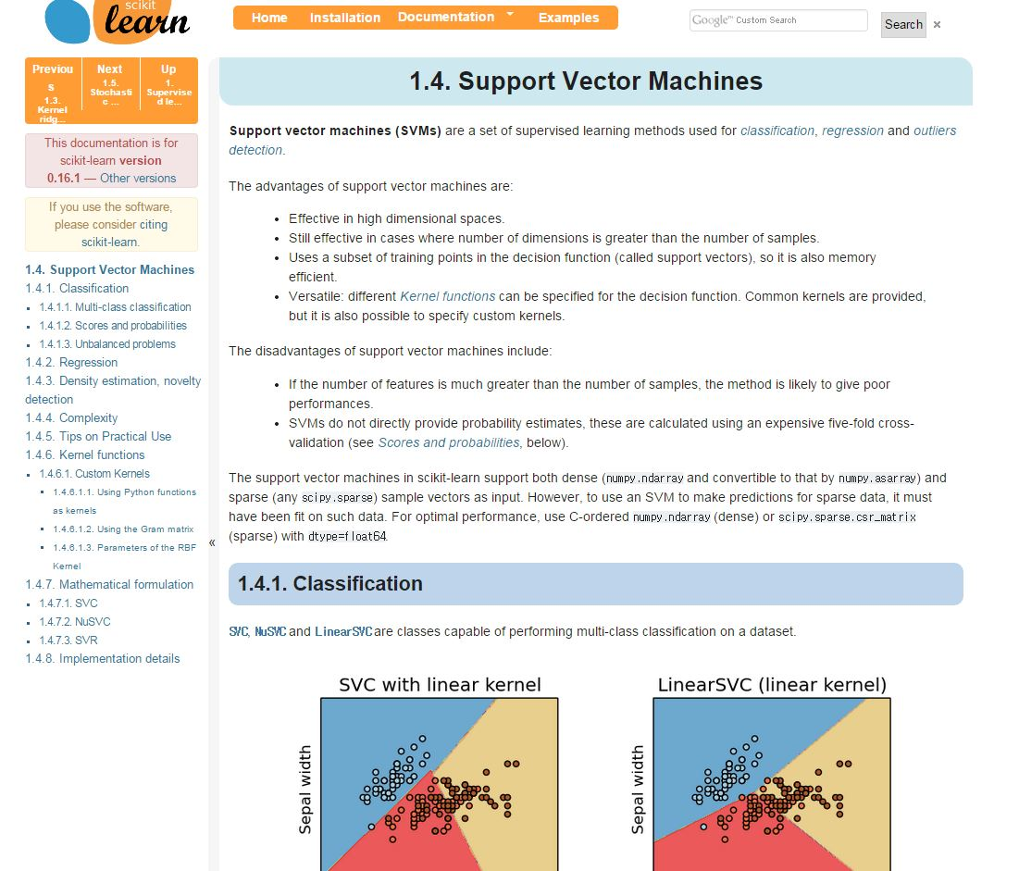
2. Train your Training files with SVM library
Refer to this link
http://scikit-learn.org/stable/modules/svm.html
Try to set your parameter for SVM model

Slide 6
3. Predict Test files with your trained SVM model
Read the files from folder
For Test Data / Convert from the image(32X32) format to the list(1X1024) format
For Test Label(Answer for Data) / Name of the file
4. Measure your accuracy for your Test Data
Accuracy = (number of correct answers) / (all number of documents)
5. Compare with other Classification Models ( 1 or 2 model)
Compare your results and Show your analysis for each results
You can also analyze about different types of parameter for SVM
You are welcome to use all kinds of libraries

Slide 7
Submission
Please turn in your zip file(.ipynb code inside) on the Blackboard.
In the format of HW3_20#######_@@@.zip
e.g. HW0_2012210023_홍길동
HW3_20#######.ipynb
Due : 05/24(SUN) 11:59:00 PM

