Slide 1
Bank Credit Scoring Algorithm
김병견
윤희경
조유현
Notes:
김병건, 윤희경, 조유현 조입니다.
저희 조는 고객의 과거 신용기록을 바탕으로 미래 파산 가능성을 예측하는 은행의 신용 평가 모델을 만들었습니다.

Slide 2
Table of Contents
Data & Goal
Two Approaches: Logistic Regression & Support Vector Machine
Conclusion
Appendix
 | A. Logistic Regression | B. Support Vector Machine
1. Process Data | Split data into training, cross validation and test sets Random sampling Training: cross validation: test = 60:20:20
2. Build First Model | Language: Python Train algorithm Predict algorithm | Language: Python, Octave Train algorithm Predict algorithm
3. Evaluate Model | Learning Curve | Learning Curve
4. Modify Model | Threshold Polynomial C | C Kernel Type Degree (when kernel = ‘poly’)
Notes:
먼저
어떤 데이터로 무엇을 할 것인지 설명하고
저희가 사용한 두 가지 모델, 로지스틱 리그레션과 서포트 벡터 머신에 대해 설명하도록 하겠습니다

Slide 3
1 Data
Content: credit history of customers
Size: 150,000 records * (1 id + 10 features + 1 target)
Variable Name | Description | Type
SeriousDlqin2yrs | Person experienced 90 days past due delinquency or worse | Y/N
RevolvingUtilizationOfUnsecuredLines | Total balance on credit cards and personal lines of credit except real estate and no installment debt like car loans divided by the sum of credit limits | percentage
age | Age of borrower in years | integer
NumberOfTime30-59DaysPastDueNotWorse | Number of times borrower has been 30-59 days past due but no worse in the last 2 years. | integer
DebtRatio | Monthly debt payments, alimony,living costs divided by monthy gross income | percentage
MonthlyIncome | Monthly income | real
NumberOfOpenCreditLinesAndLoans | Number of Open loans (installment like car loan or mortgage) and Lines of credit (e.g. credit cards) | integer
NumberOfTimes90DaysLate | Number of times borrower has been 90 days or more past due. | integer
NumberRealEstateLoansOrLines | Number of mortgage and real estate loans including home equity lines of credit | integer
NumberOfTime60-89DaysPastDueNotWorse | Number of times borrower has been 60-89 days past due but no worse in the last 2 years. | integer
NumberOfDependents | Number of dependents in family excluding themselves (spouse, children etc.) | integer
Notes:
저희가 사용할 데이터는 십 오만명의 고객에 대한 과거 신용기록 데이터입니다.
타겟 밸류는 파산여부이고 나머지 10개의 어트리뷰트는 신상 정보 및 과거 신용에 대한 정보입니다.

Slide 4
1 Goal
Business goal: Filtering out customers with high possibility of default
Analysis goal: Build credit scoring model with maximum f-score, not accuracy
Why “F-score”, not accuracy?
Our goal is to filter out customers with high possibility of default.
High accuracy can be achieved without filtering out even a single default customer.
How so?
The data is a skewed data with tiny percentage of default customers (SeriousDlqin2yrs = 1).
Notes:
저희는 이 데이터를 가지고 어떤 고객이 잠재적으로 파산 위험이 높은 고객인지 분류해내는 모델을 만들려고 합니다.
이는 다시 말해서 가장 큰 에프 스코어를 기록하는 신용 평가 모델을 만드는 것인데요
저희가 정확도가 아닌 에프 스코어를 사용 하는 이유는
잠재적 파산 위험이 높은 고객군은 굉장히 소수이기 때문입니다.
이런 경우 모든 사람이 파산하지 않을 것이라고 예측하면 정확도는 올라가지만 아무 쓸모 없는 모델이 되기 때문에
저희는 정확도보다는 에프 스코어를 기준으로 모델을 평가하려고 합니다.

Slide 5
2.1 Process Data
Random sampling Data 100% = Training data 60% + Cross validation data 20% + Test data 20%
1 shuffle entire data set 2 slice first 60% data to make ‘training’ data set 3 slice next 20% data to make ‘cross validation’ data set 4 slice remaining 20% data to make ‘test’ data set 5 for [training, crossValidation, test] 1 splitData to X, y 2 featureScale X

Slide 6
2.Two Approaches: Logistic Regression
LR2.2 Build First Model
LR2.3 Evaluate Model
LR2.4 Modify Model

Slide 7
LR2.2 Build First Model – train algorithm
Method 1) Manually Implemented Implement logistic regression learning algorithm with cost function & gradient function. Use “scipy.optimize.fmin_cg” to optimize theta.
def LogisticRegression(cost function, grad function, X, y, lambda): 1 optimize theta with initial theta, cost function, gradient function, X, y, lambda 2 return theta
def costFunction(theta, *args): 1 unpack args to get X, y, lambda 2 compute J 3 return J | def gradFunction(theta, *args): 1 unpack args to get X, y, lambda 2 compute gradients for each theta 3 return gradient vector

Slide 8
LR2.2 Build First Model – train algorithm
Method 2) LogisticRegression Module -> We’ll stick to this method onward! Use “sklearn.linear_model.LogisticRegression” module
from sklearn.linear_model import LogisticRegression clf = LogisticRegression() clf.fit(Xtrain, ytrain)

Slide 9
LR2.2 Build First Model – predict algorithm
With optimized theta, predict labels for a new data set. Use “sklearn.metrics.precision_recall_fscore_support” get f-score.
def predict(clf, X, y, threshold = 0.5): 1 get prediction 2 get measures 3 print measures 4 return prediction
def getPrediction(clf, X, threshold = 0.5): 1 probability = clf.predict_proba(X) 2 prediction = probability > threshold 3 return prediction | def getMeasures(y, prediction): 1 accuracy = (prediction == y).mean() 2 get precision, recall, f_score, support with sklearn.metrics.precision_recall_fscore_support 3 measures = (accuracy, precision, recall, f_score) 4 return measures

Slide 10
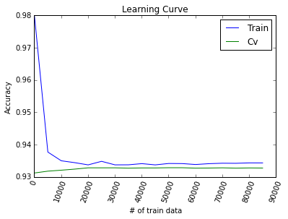
LR2.3 Evaluate Model: Learning Curve
High bias
Increase in # of train data doesn’t improve cv accuracy.
There is no big gap between train accuracy and cv accuracy.
Increasing # of train data won’t be much helpful.
We need to develop more complex model.

Slide 11
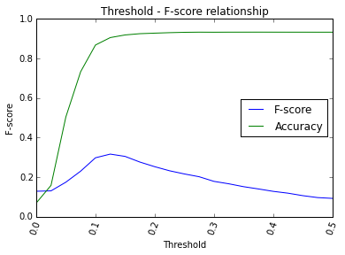
LR2.4 Modify Model: Threshold
Threshold that maximizes F-score >> 0.125
Accuracy is sacrificed for better f-score.

Slide 12
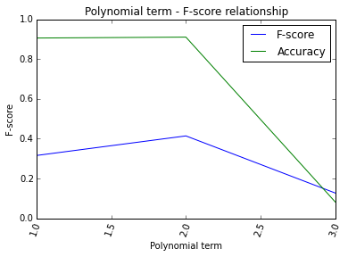
LR2.4 Modify Model: Polynomial Features
Polynomial degree that maximizes F-score >> 2
10 features (original) -> 66 features (poly 2)

Slide 13
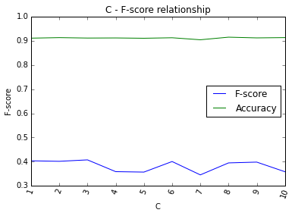
LR2.4 Modify Model: C (regularization term)
C that maximizes F-score >> 3

Slide 14
LR2.4 Modify Model: Modified Model
 | Logistic Regression
 | Threshold | Polynomial | C | F score | Accuracy
First Model | 0.5 | 1 | 1 | 0.0786 | 0.9336
Modified Model | 0.125 | 2 | 3 | 0.4027 | 0.9108
Change (%) |  |  |  | + 412.34% | -2.44%
 |  |  |  | (Tested on Test Data)

Slide 15
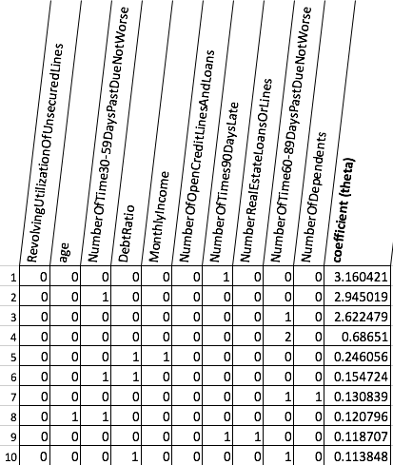
LR2.4 Modify Model: Modified Model - Coefficients
10 most positively correlated features (out of 66 polynomial features)
How to interpret the table
When 1, multiply once.
When 2, multiply twice.
For example,
Feature #5: DebtRatio*MonthlyIncome
Feature #4: NumberOfTimes60-89DaysPastDueNotWorse^2

Slide 16
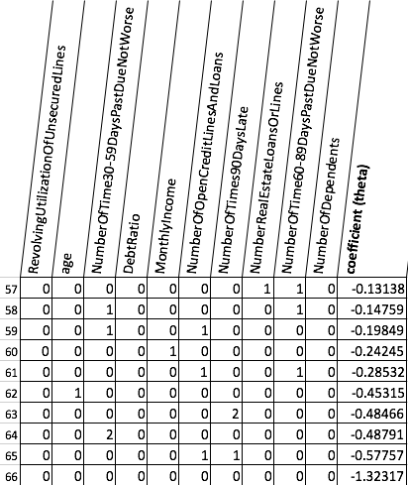
LR2.4 Modify Model: Modified Model - Coefficients
10 most negatively correlated features (out of 66 polynomial features)

Slide 17
2. Two Approaches: Support Vector Machine
SVM2.2 Build First Model
SVM2.3 Evaluate Model
SVM2.4 Modify Model

Slide 18
SVM2.2 Build First Model – train algorithm
Method 1) Support Vector Machine Module Use “sklearn.svm.SVC” module
from sklearn.svm import SVC clf = SVC() clf.fit(Xtrain, ytrain)

Slide 19
SVM2.2 Build First Model – predict algorithm
Method 1) Support Vector Machine Module Use “sklearn.svm.SVC” module With optimized support vector, predict labels for a new data set. get precision, recall, f_score with manually Implement algorithm.
prediction = clf.predict_proba(xtest) pred = prediction[:, 1] Label = pred > 0.1 a = (3 * (ytest) - label) TP = sum(a == 2) FP = sum(a == -1) FN = sum(a == 0) TN = sum(a == 3) Precision = TP / (TP + FP) Recall = TP / (TP + TN) fscore = 2 * (Precision * Recall) / (Precision + Recall)

Slide 20
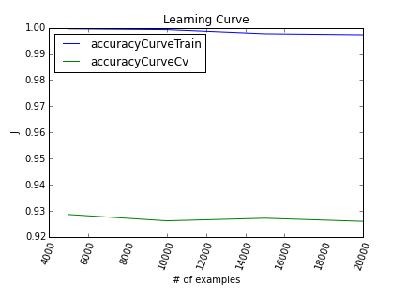
SVM2.3 Evaluate Model: Learning Curve (a) rbf-kernel
High bias
Increase in # of train data doesn’t improve cv accuracy.
There is no big gap between train accuracy and cv accuracy.
Increasing # of train data won’t be much helpful.
We need to develop more complex model.

Slide 21
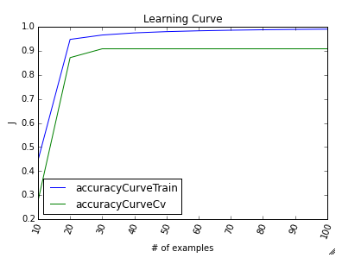
SVM2.3 Evaluate Model: Learning Curve (b) linear-kernel
Linear kernel is much expensive to train(need a lot of time) when trainset is big.
But when high-bias case, don’t have to train with many data.

Slide 22
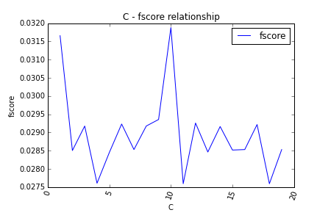
SVM2.4 Modify Model: C
Threshold that maximizes F-score >> 0.031
Accuracy is sacrificed for better f-score.

Slide 23
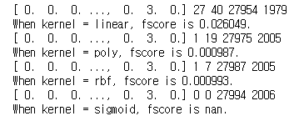
SVM2.4 Modify Model: kernel type
Fscore kernel type
Linear > rbf > poly > sigmod

Slide 24
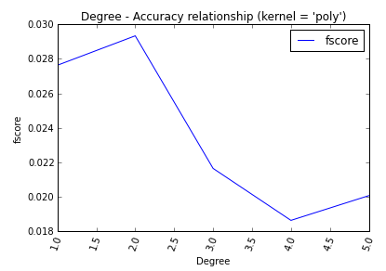
SVM2.4 Modify Model: kernel degree (when polynomial kernel)
Polynomial kernel’s degree that maximizes F-score >> 0.02
but linear kernel performs better

Slide 25
SVM2.4 Modify Model: Modified Model
 | Support Vector Machine
 | C | Kernel type | Degree (when poly kernel) | F score | Accuracy
First Model | 1 | rbf | Not applicable | 0.0199 | 0.9247
Modified Model | 10 | Linear | Not applicable | 0.0261 | 0.9328
Change (%) |  |  |  | +31.16% | +0.86%
 |  |  |  | (Tested on Test Data)

Slide 26
3 Conclusion
Improvements made from the first model to the modified model

Slide 27
3 Conclusion
 | Logistic Regression |  | Support Vector Machine
 | F score | Accuracy | F score | Accuracy
First Model | 0.0786 | 0.9336 | 0.0077 | 0.9310
Modified Model | 0.4027 | 0.9108 | 0.1416 | 0.9329
Change (%) | + 412.34% | -2.44% | +1738.96% | +0.20%
 |  |  | (Tested on ‘test’ data set)

Slide 28
4 Appendix
Explore Data
One Feature: Histograms
Two Features: Scatter Plots & Separated Histograms
2. SVM in Octave code

Slide 29
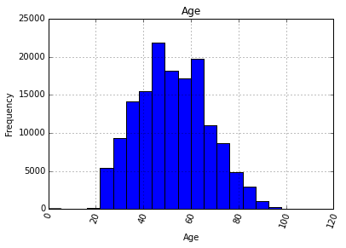
4.1 Explore Data
I. One feature: Histogram
One Feature: Histogram
Two Features: Scatter Plot & Separated Histograms
In the report, we only take ‘age’ feature as an example. For more features, please refer to ‘Appendix_ExploreData.html’

Slide 30
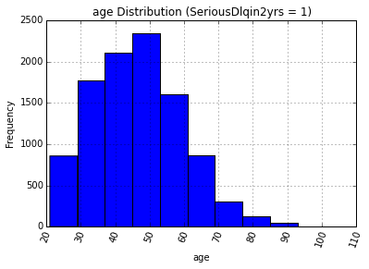
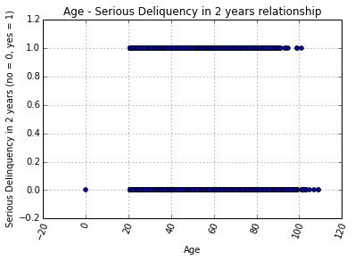
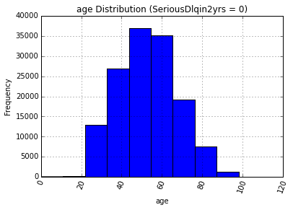
2. Two Feature: Scatter Plot
2. Separated Histograms

Slide 31
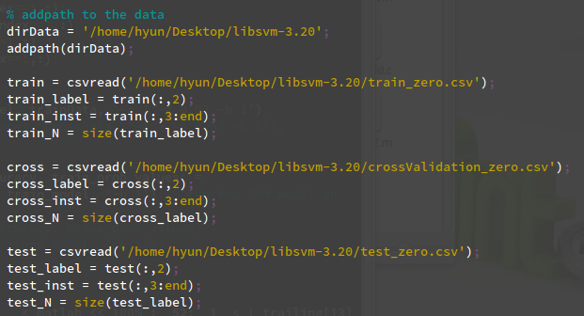
4.2 SVM in Octave code
SVM in Octave(Mathlab)
- Import svmlibrary and data

Slide 32
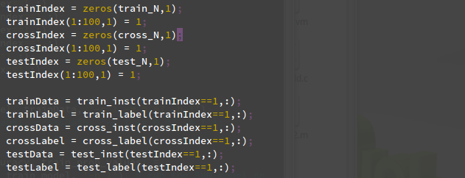
SVM in Octave(Mathlab)
- Select data size (train, crossvalidation, test)

Slide 33
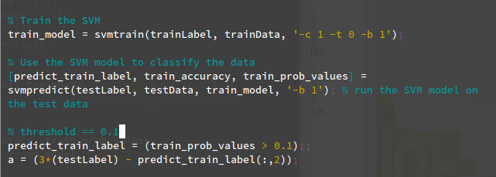
SVM in Octave(Mathlab)
- Train the model with train data

Slide 34
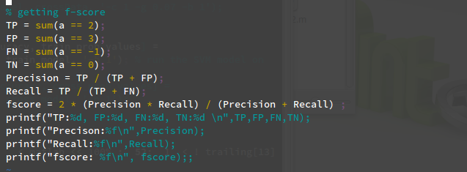
SVM in Octave(Mathlab)
- Getting f-score

Slide 35
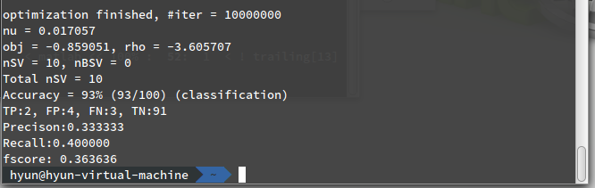
SVM in Octave(Mathlab)
- Result

Slide 36
The End.

