Slide 1
Bank Credit Scoring Algorithm
김병견
윤희경
조유현
Notes:
김병건, 윤희경, 조유현 조입니다.
저희 조는 고객의 과거 신용기록을 바탕으로 미래 파산 가능성을 예측하는 은행의 신용 평가 모델을 만들었습니다.

Slide 2


Slide 3
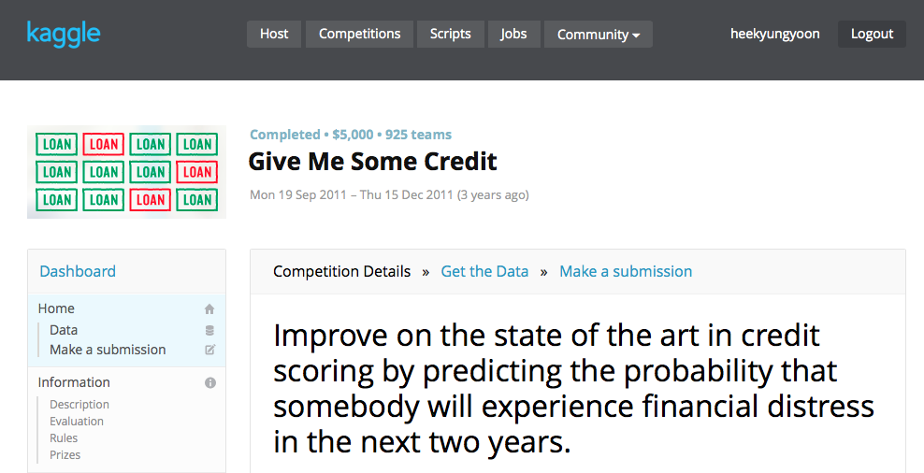

Slide 4
Table of Contents
Data & Goal
Two Approaches: Logistic Regression & Support Vector Machine
Conclusion
Appendix
 | A. Logistic Regression | B. Support Vector Machine
1. Process Data | Split data into training, cross validation and test sets Random sampling Training: cross validation: test = 60:20:20
2. Build First Model | Language: Python Train algorithm Predict algorithm | Language: Python, Octave Train algorithm Predict algorithm
3. Evaluate Model | Learning Curve | Learning Curve
4. Modify Model | Threshold Polynomial C | C Kernel Type Degree (when kernel = ‘poly’)
Notes:
먼저
어떤 데이터로 무엇을 할 것인지 설명하고
저희가 사용한 두 가지 모델, 로지스틱 리그레션과 서포트 벡터 머신에 대해 설명하도록 하겠습니다

Slide 5
1 Data
Content: credit history of customers
Size: 150,000 records * (1 id + 10 features + 1 target)
Variable Name | Description | Type
SeriousDlqin2yrs | Person experienced 90 days past due delinquency or worse | Y/N
RevolvingUtilizationOfUnsecuredLines | Total balance on credit cards and personal lines of credit except real estate and no installment debt like car loans divided by the sum of credit limits | percentage
age | Age of borrower in years | integer
NumberOfTime30-59DaysPastDueNotWorse | Number of times borrower has been 30-59 days past due but no worse in the last 2 years. | integer
DebtRatio | Monthly debt payments, alimony,living costs divided by monthy gross income | percentage
MonthlyIncome | Monthly income | real
NumberOfOpenCreditLinesAndLoans | Number of Open loans (installment like car loan or mortgage) and Lines of credit (e.g. credit cards) | integer
NumberOfTimes90DaysLate | Number of times borrower has been 90 days or more past due. | integer
NumberRealEstateLoansOrLines | Number of mortgage and real estate loans including home equity lines of credit | integer
NumberOfTime60-89DaysPastDueNotWorse | Number of times borrower has been 60-89 days past due but no worse in the last 2 years. | integer
NumberOfDependents | Number of dependents in family excluding themselves (spouse, children etc.) | integer
Notes:
저희가 사용할 데이터는 십 오만명의 고객에 대한 과거 신용기록 데이터입니다.
타겟 밸류는 파산여부이고 나머지 10개의 어트리뷰트는 신상 정보 및 과거 신용에 대한 정보입니다.

Slide 6
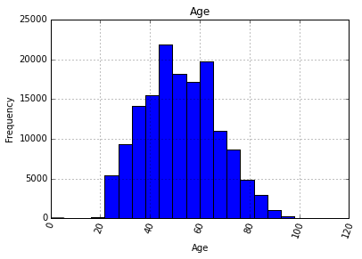
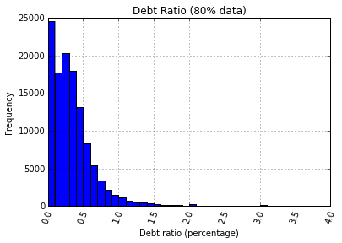
Features
Age Distribution
Debt Ratio

Slide 7
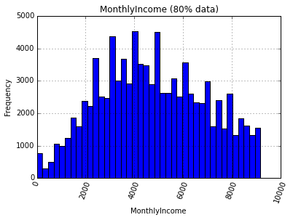
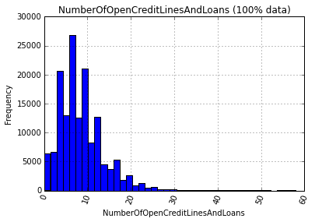
Features
Monthly Income
Number of Loans

Slide 8
Target Value: Default or Not?

Slide 9
1 Goal
Business goal
Maximize profit by filtering out customers with high possibility of default
Analysis goal
Build credit scoring model with maximum f-score, not accuracy
Notes:
저희는 이 데이터를 가지고 어떤 고객이 잠재적으로 파산 위험이 높은 고객인지 분류해내는 모델을 만들려고 합니다.
이는 다시 말해서 가장 큰 에프 스코어를 기록하는 신용 평가 모델을 만드는 것인데요
저희가 정확도가 아닌 에프 스코어를 사용 하는 이유는
잠재적 파산 위험이 높은 고객군은 굉장히 소수이기 때문입니다.
이런 경우 모든 사람이 파산하지 않을 것이라고 예측하면 정확도는 올라가지만 아무 쓸모 없는 모델이 되기 때문에
저희는 정확도보다는 에프 스코어를 기준으로 모델을 평가하려고 합니다.

Slide 10
Why F-Score?
The data is a skewed data with tiny percentage of default customers (SeriousDlqin2yrs = 1).
Over 93% accuracy can be achieved without filtering out a single default customer.

Slide 11
Table of Contents
Data & Goal
Two Approaches: Logistic Regression & Support Vector Machine
Conclusion
Appendix
 | A. Logistic Regression | B. Support Vector Machine
1. Process Data | Split data into training, cross validation and test sets Random sampling Training: cross validation: test = 60:20:20
2. Build First Model | Language: Python Train algorithm Predict algorithm | Language: Python, Octave Train algorithm Predict algorithm
3. Evaluate Model | Learning Curve | Learning Curve
4. Modify Model | Threshold Polynomial C | C Kernel Type Degree (when kernel = ‘poly’)
Notes:
먼저
어떤 데이터로 무엇을 할 것인지 설명하고
저희가 사용한 두 가지 모델, 로지스틱 리그레션과 서포트 벡터 머신에 대해 설명하도록 하겠습니다

Slide 12
First Model
Evaluate
Modified Model
Process Data
Threshold
Polynomial Degree
C (Regularization Term)

Slide 13
1 Process Data

Slide 14
2.1 Process Data
Cross Validation
(20 %)
Original Data
150,000 records
(100 %)
Training
(60 %)
Random Sampling by Shuffling Data
Test
(20 %)

Slide 15
2 Build First Model

Slide 16
First Model
 | Logistic Regression
 | Threshold | Polynomial | C | F score | Accuracy
First Model | 0.5 | 1 | 1 | 0.0786 | 0.9336
Modified Model
Change (%)
 |  |  |  | (Tested on Test Data)

Slide 17
3 Evaluate Model

Slide 18
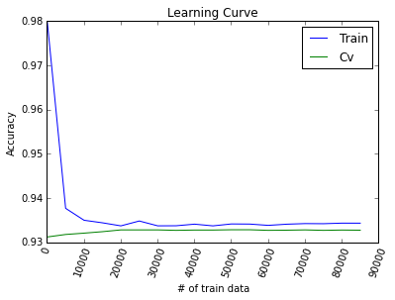
LR2.3 Evaluate Model: Learning Curve
High bias
Increase in # of train data doesn’t improve cv accuracy.
There is no big gap between train accuracy and cv accuracy.
Increasing # of train data won’t be much helpful.
We need to develop more complex model.

Slide 19
4 Modify Model
1. Threshold
2. Polynomial Degree
3. C (Regularization Term)

Slide 20
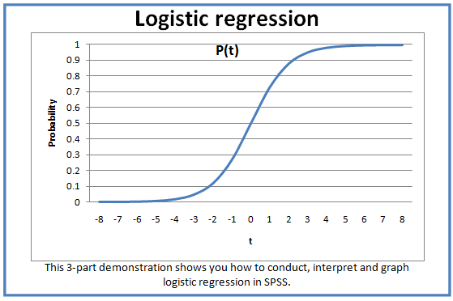
1. Threshold

Slide 21
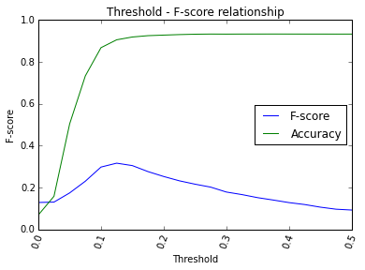
1. Threshold
Threshold that maximizes F-score >> 0.125
Accuracy is sacrificed for better f-score.

Slide 22
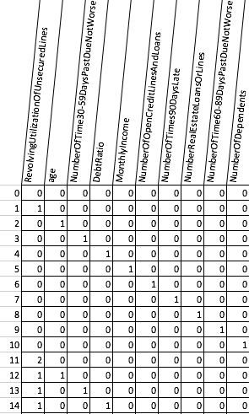
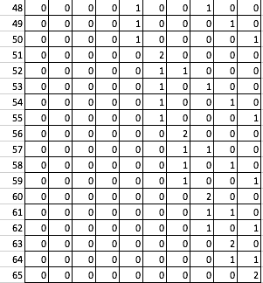
2. Add Polynomial Features

Slide 23
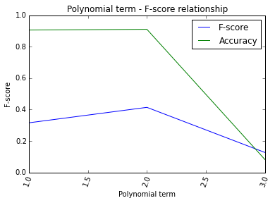
2. Add Polynomial Features
Polynomial degree that maximizes F-score >> 2
10 features (original) -> 66 features (poly 2)

Slide 24
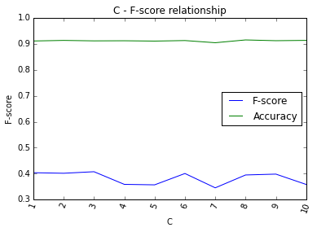
3. C (regularization term)
C that maximizes F-score >> 3

Slide 25
5. Conclusion
Improvements made from the first model to the modified model

Slide 26
Modified Model
 | Logistic Regression
 | Threshold | Polynomial | C | F score | Accuracy
First Model | 0.5 | 1 | 1 | 0.0786 | 0.9336
Modified Model | 0.125 | 2 | 3 | 0.4027 | 0.9108
Change (%) |  |  |  | + 412.34% | -2.44%
 |  |  |  | (Tested on Test Data)

Slide 27
How many default customers were filtered out?
40.28%
4.23%

Slide 28
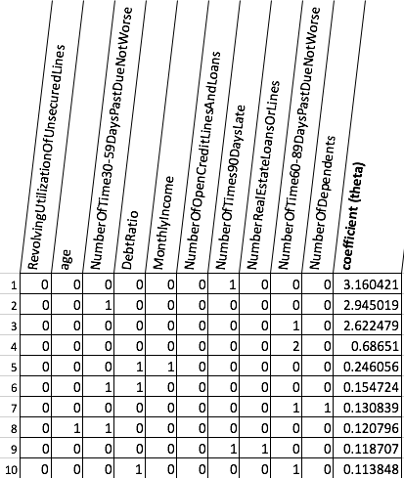
Modified Model - Coefficients
10 most positively correlated features (out of 66 polynomial features)
How to interpret the table
When 1, multiply once.
When 2, multiply twice.
For example,
Feature #5: DebtRatio*MonthlyIncome
Feature #4: NumberOfTimes60-89DaysPastDueNotWorse^2

Slide 29
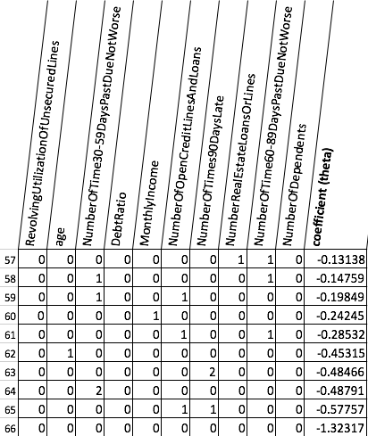
Modified Model - Coefficients
10 most negatively correlated features (out of 66 polynomial features)

Slide 30
Logistic Regression & Support Vector Machine
 | Logistic Regression |  | Support Vector Machine
 | F score | Accuracy | F score | Accuracy
First Model | 0.0786 | 0.9336 | 0.0077 | 0.9310
Modified Model | 0.4027 | 0.9108 | 0.1416 | 0.9329
Change (%) | + 412.34% | -2.44% | +1738.96% | +0.20%
 |  |  | (Tested on ‘test’ data set)

Slide 31
The End.

Slide 32
4 Appendix
Explore Data
One Feature: Histograms
Two Features: Scatter Plots & Separated Histograms
2. SVM in Octave code

Slide 33
4.1 Explore Data
I. One feature: Histogram
One Feature: Histogram
Two Features: Scatter Plot & Separated Histograms
In the report, we only take ‘age’ feature as an example. For more features, please refer to ‘Appendix_ExploreData.html’

Slide 34
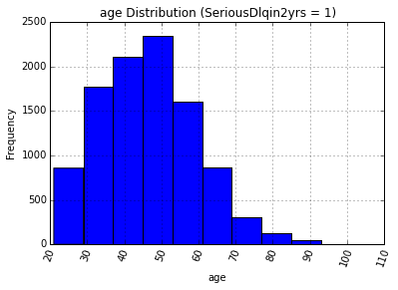
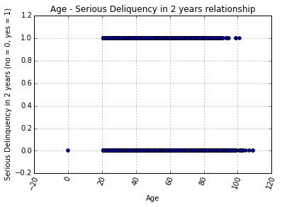
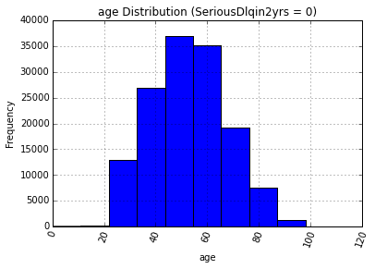
2. Two Feature: Scatter Plot
2. Separated Histograms

