Slide 1
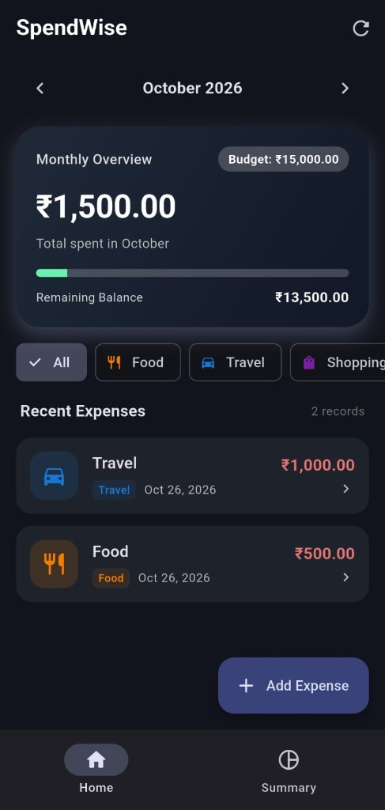
SpendWise - Expense & Budget Tracker
Mobile Application Development (MAD) Mini Project
Department of Information Technology, ADIT | CVM University
Developed by: Heel Soni (12302080601034) | Semester VII
SpendWise - ADIT Information Technology | Heel Soni (12302080601034)

Slide 2
Problem Statement & Need
Why Offline Personal Finance?
• College students on monthly allowances frequently suffer financial deficits due to unmonitored micro-spending.
• Commercial apps mandate cloud sync, intrusive accounts, third-party trackers, and advertisements.
• Paper diaries and spreadsheets lack automatic alerts, real-time calculations, and mobile convenience.
• Need: A lightweight, 100% offline, privacy-first mobile budgeting companion.
SpendWise - ADIT Information Technology | Heel Soni (12302080601034)

Slide 3
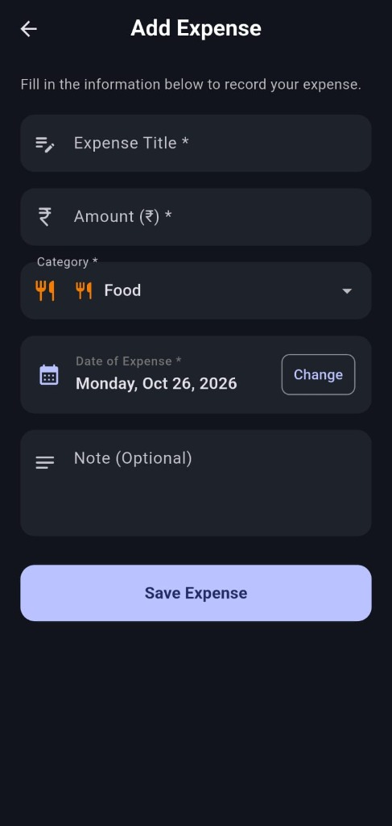
Project Objectives & Key Features
Core Capabilities of SpendWise
• Full CRUD Operations: Create, view, update, and swipe-to-delete daily expenses.
• Monthly Budget Tracking: Real-time calculation of remaining balance and total spent.
• Automated Over-Budget Warning: Dynamic visual alert when spending exceeds limits.
• Interactive Category Pie Chart: Visual expenditure breakdown using fl_chart.
• Zero Cloud Dependencies: 100% offline persistence using embedded SQLite (sqflite).
SpendWise - ADIT Information Technology | Heel Soni (12302080601034)

Slide 4
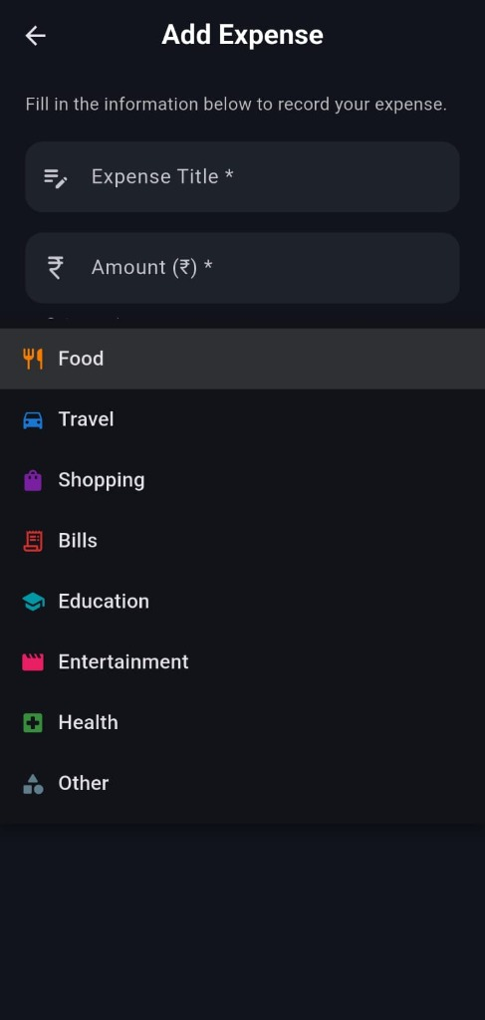
Technology Stack & Architecture
Modern Modular Architecture
• Flutter (v3.47+): Cross-platform UI toolkit with 60+ FPS hardware acceleration.
• Dart (v3.13+): Strongly-typed, object-oriented reactive programming.
• SQLite (sqflite): Embedded ACID-compliant database with thread-safe Singleton pattern.
• fl_chart: Hardware-accelerated dynamic interactive pie chart.
• intl & Material 3: ISO 8601 parsing, INR (₹) formatting, and sleek dark mode theme.
SpendWise - ADIT Information Technology | Heel Soni (12302080601034)

Slide 5
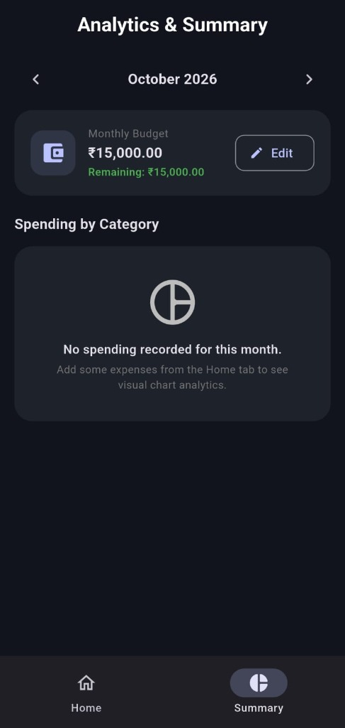
Database Design (SQLite)
Relational Tables & Optimized Queries
• Table 'expenses': id (PK AUTOINCREMENT), title, amount, category, date, note.
• Table 'budgets': month_key (PK 'YYYY-MM'), amount (REAL).
• Wildcard Date Queries: Efficiently retrieve monthly data via 'WHERE date LIKE 2026-10%'.
• Category Grouping: 'SELECT category, SUM(amount) FROM expenses GROUP BY category'.
• Singleton DBHelper: Guarantees single database handle, preventing lock contention.
SpendWise - ADIT Information Technology | Heel Soni (12302080601034)

Slide 6
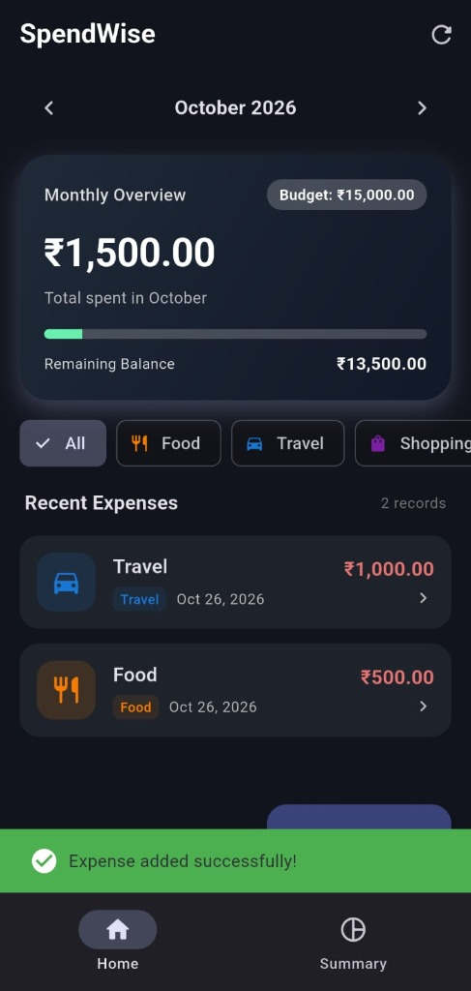
Testing, Results & Viva Defense
100% Pass Rate Across 10 Test Cases
• Input Validation: Bulletproof rules against negative amounts, non-numeric strings, and empty titles.
• Swipe-to-Delete with Undo: Prevents accidental deletions with 4-second restoration SnackBar.
• Release APK: 49.1 MB standalone APK compiled successfully for Android 8.0+.
• Instant Launch Speed: App cold starts under 850ms with zero network latency.
• GitHub Repository: Open-source repository with full source, tests, and documentation.
SpendWise - ADIT Information Technology | Heel Soni (12302080601034)

