Slide 1
Movie Recommendation System
Using PySpark and Alternating Least Squares (ALS) Algorithm

Slide 2
Problem Statement
Aim: To build a movie recommendation system based on 'Kaggle' dataset using PySpark and Alternating Least Squares (ALS) Algorithm.
We wish to integrate the aspects of personalization of user with the overall features of movie such as genre, popularity etc.
The goal of the project is to recommend a movie to the user on the basis of ratings, genre.
Providing related content out of relevant and irrelevant collection of items to users of online service providers.

Slide 3
Introduction
A recommendation system or recommendation engine is a model used for information filtering where it tries to predict the preferences of a user and provide suggests based on these preferences.
Movie Recommendation Systems helps us to search our preferred movies among all of these different types of movies and hence reduce the trouble of spending a lot of time searching our favourable movies.
Recommendation systems have several benefits, the most important being customer satisfaction and revenue

Slide 4
Objective
The goal of our project is to develop a movie recommendation system for binge watchers to help and recommend them good quality of movies.
The Objectives are:
Improving the Accuracy of the recommendation system.
Improve the Quality of the movie Recommendation system.
Improving the Scalability.
Enhancing the user experience.

Slide 5
EXISTING SYSTEM
Netflix: Netflix: Netflix uses a recommendation system to suggest movies and TV shows to its users based on their viewing history and preferences.
Amazon prime video: Amazon Prime Video also has a recommendation system that suggests movies and shows based used on the user's viewing history and ratings.
IMDb: IMDb offers a personalized movie recommendations based on user’s ratings and watch.

Slide 6
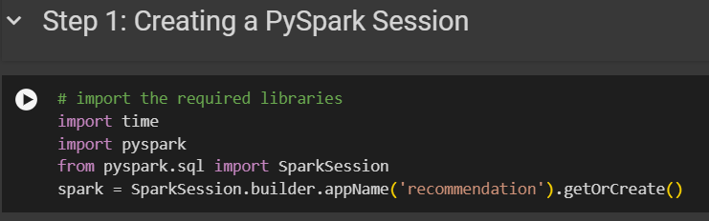
To Read Data:
1. Installed required libraries (PySpark).
2. Created a PySpark session for the recommendation system.

Slide 7
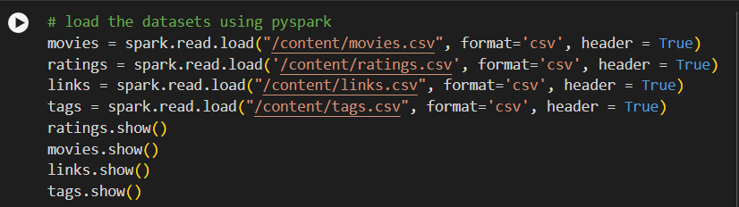
Data Loading and Preprocessing
1. Loaded datasets (movies, ratings, links, tags) using PySpark.
2. Displayed datasets and analyzed schema.
3. Preprocessed data: Type casting and filtering.
4. Split data into training, validation, and test sets.

Slide 8
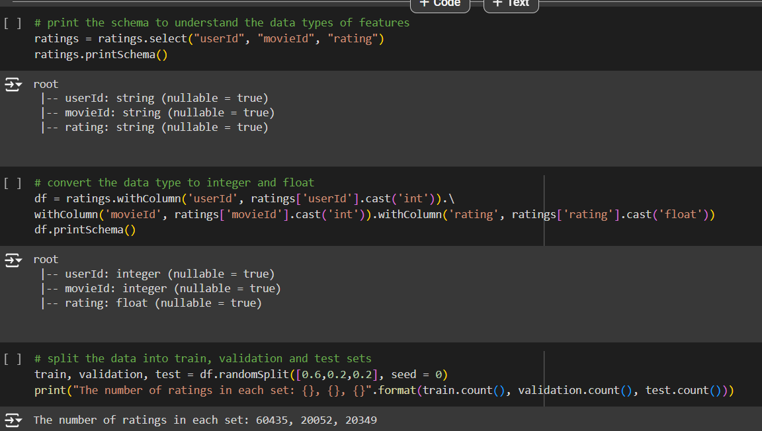

Slide 9
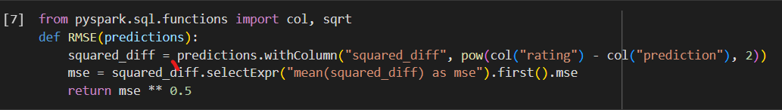
Model Training and Validation
1. Implemented ALS algorithm for collaborative filtering.
2. Trained the model using the training set.
3. Validated the model using the validation set.

Slide 10
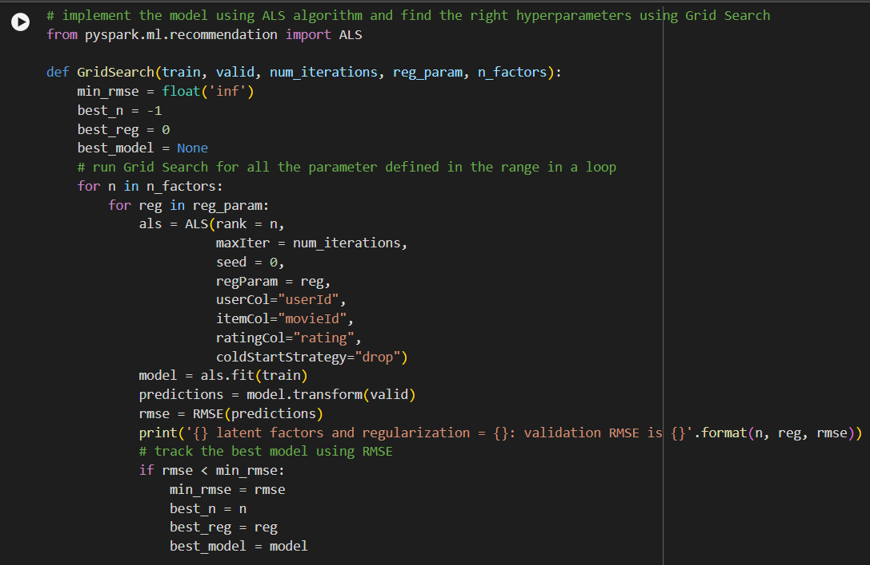
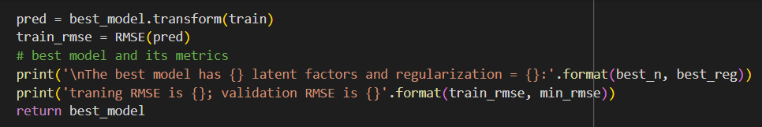

Slide 11
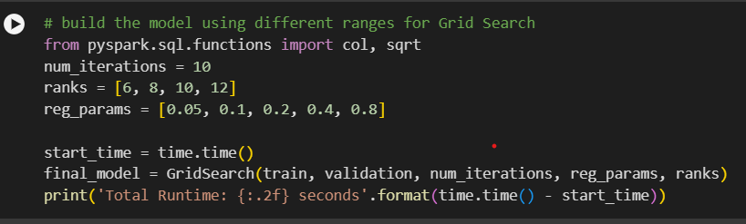
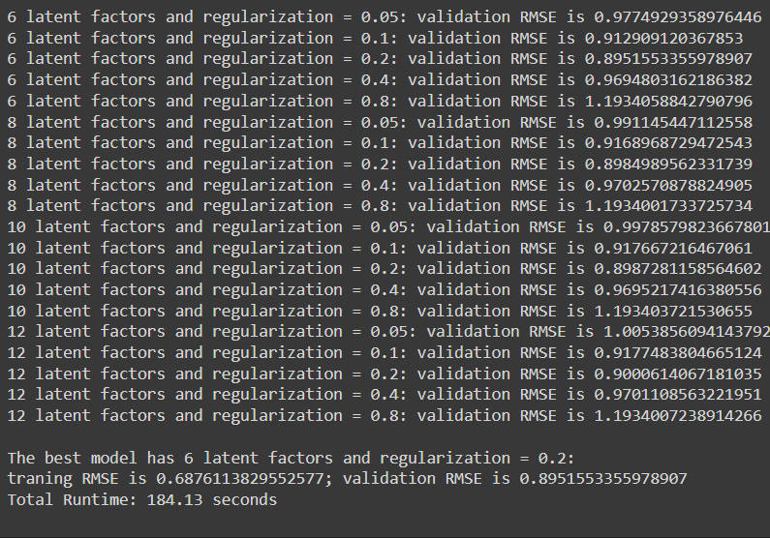

Slide 12
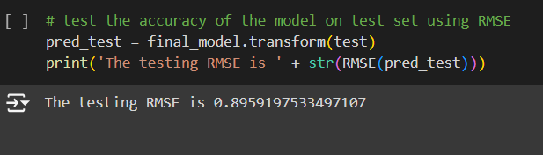
Model Evaluation
1. Evaluated model performance on the test set.
2. Analyzed the results to measure accuracy and precision.

Slide 13
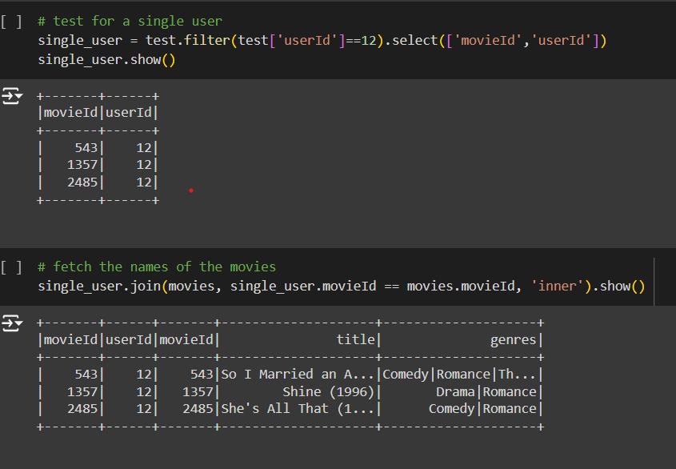

Slide 14
Prediction and Recommendations
1. Used the trained model to predict user ratings.
2. Generated movie recommendations for users based on their preferences.

Slide 15
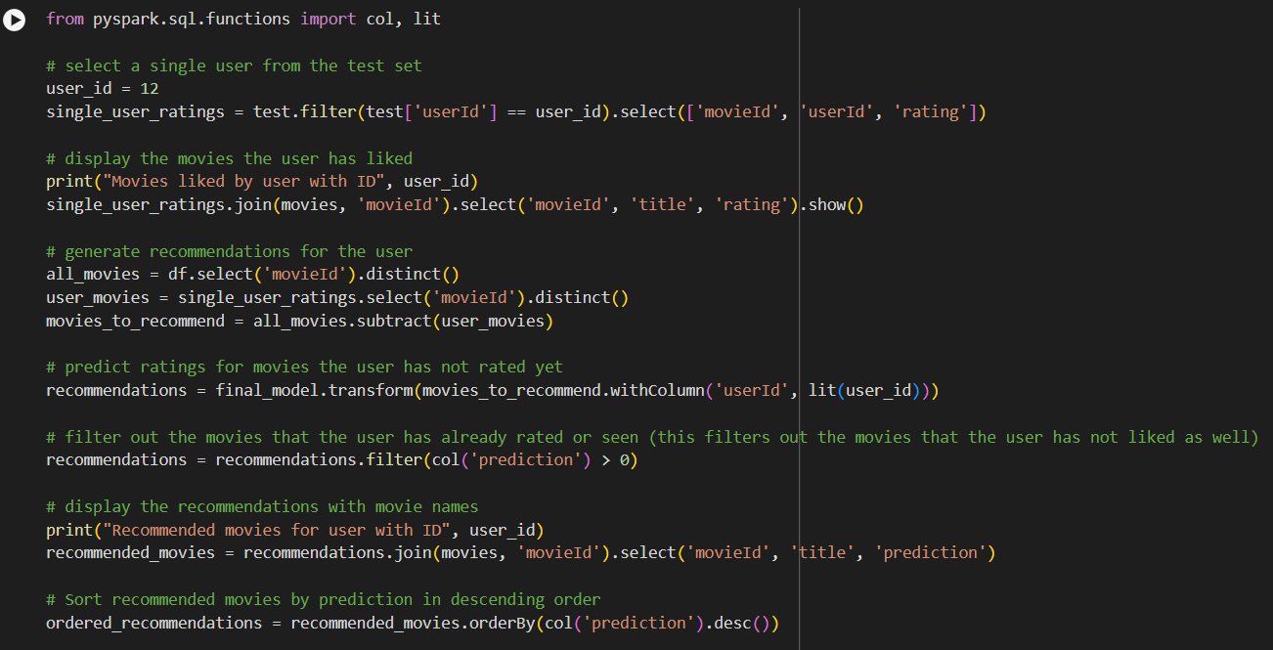

Slide 16
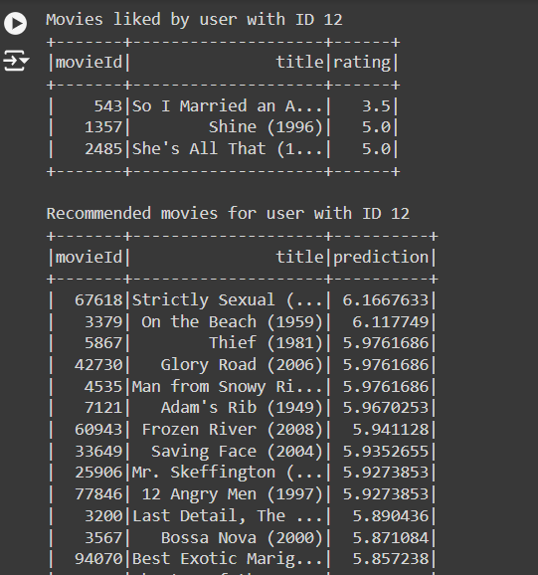

Slide 17
Conclusion:
Recommendation system are widely used is today’s world for searching for efficient and reliable information.
The Movie Recommendation system in this project recommends movies to the user based on a few features cases, director, genres and keywords.

