Slide 1
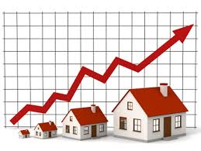
NextHikes IT Solutions
project -3
EDA for Real Estate Pricing
- BY HEENA

Slide 2
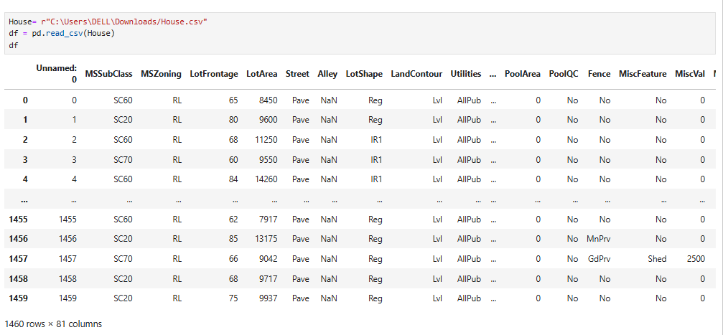
Load the data
To load the data, we can use the pandas library in Python. Here's an example:

Slide 3
Cleaning the Data
Here are some short sub-points of cleaning the data
Handling Missing Values: Identify and impute or drop missing values.
Removing Duplicates: Remove duplicate rows or records.
Data Normalization: Scale numeric data to a common range.
Data Transformation: Convert data types or formats as needed.
Outlier Detection: Identify and handle outliers or anomalies.
Error Correction: Correct errors in data entry or formatting.

Slide 4
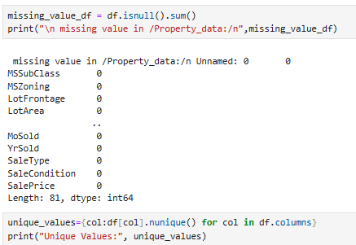
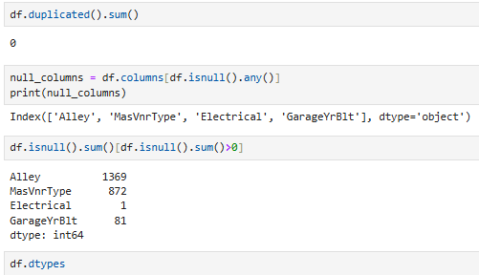
Benefits of Data Cleaning:- 1. Improved Accuracy: Cleaning data improves the accuracy of analysis and models. 2. Reduced Errors: Cleaning data reduces errors and inconsistencies. 3. Better Insights: Cleaning data provides better insights and patterns.

Slide 5
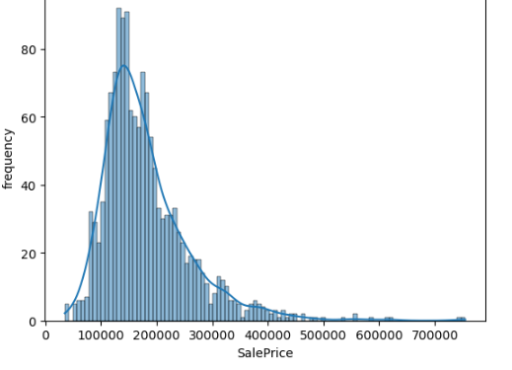
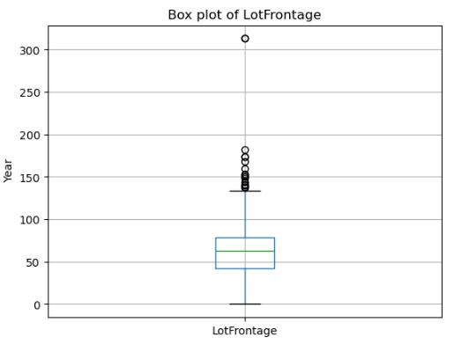
Univariate Analysis
Univariate analysis is a type of statistical analysis that focuses on understanding the distribution and characteristics of a single variable.
Frequency of SalePrice
BoxPlot of Linear feet of street connected to property

Slide 6
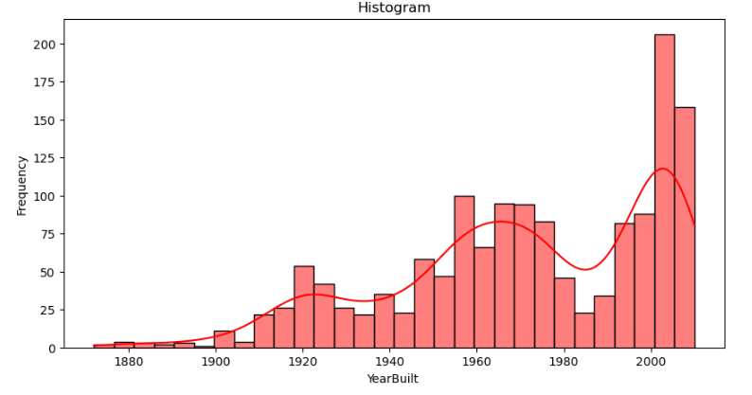
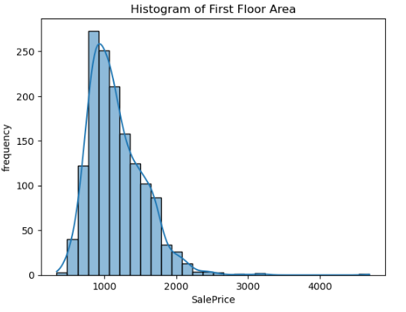
A histogram is a graphical representation of the distribution of a single variable.
1. Understanding Data Distribution: Univariate analysis helps understand the distribution of a single variable.
2. Informing Further Analysis: Univariate analysis can inform further analysis and modeling by providing insights into the characteristics of the data.

Slide 7
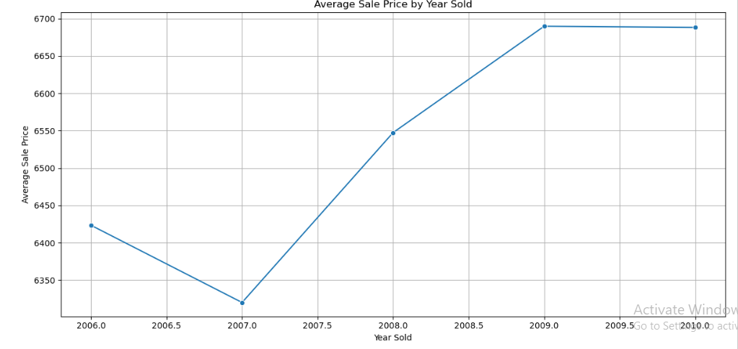
Bivariate Analysis
Bivariate analysis is a type of statistical analysis that examines the relationship between two variables.

Slide 8
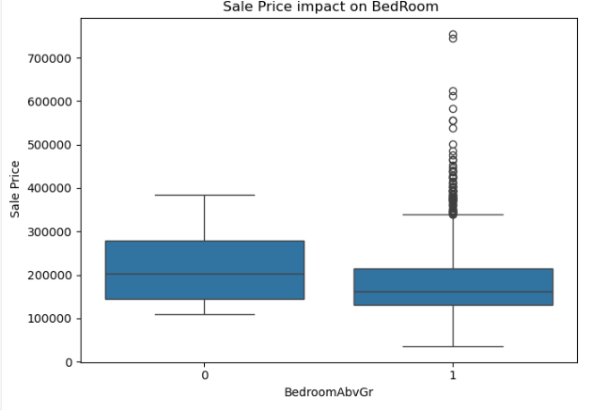
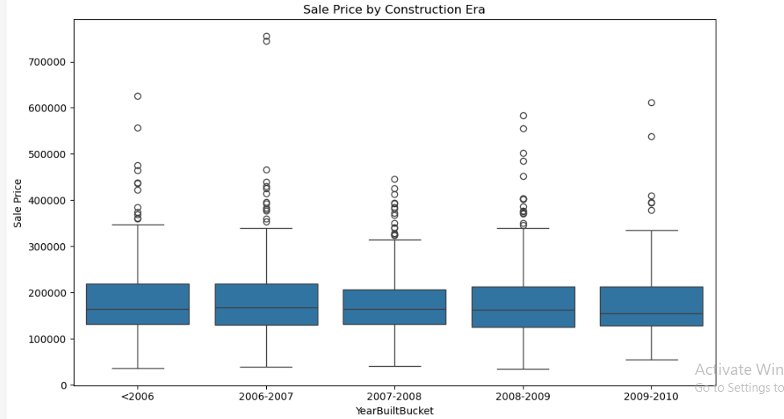
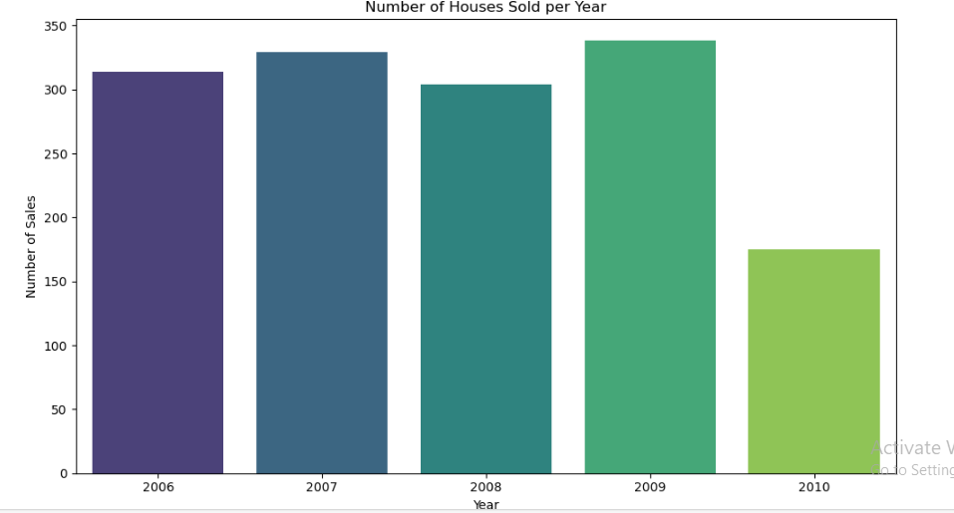
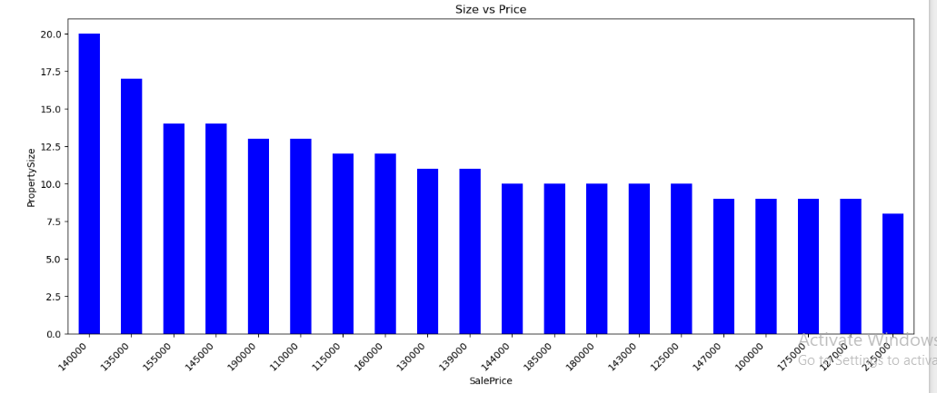
Here, are we can see example through Histogram , BoxPlot and Bargraph…

Slide 9
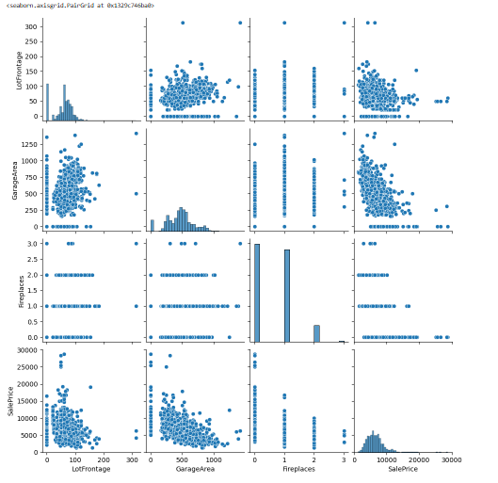
Heatmap- A heatmap is a graphical representation of the correlation matrix between variables. It shows the strength and direction of the linear relationship between each pair of variables. Pairplot- A pairplot is a visualization tool that shows the relationships between each pair of variables in a dataset. It is a matrix of scatter plots that helps understand the relationships between multiple variables.
Multivariate Analysis

Slide 10
Feature Engineering
Feature engineering is the process of selecting, transforming, and creating new features from existing ones to improve the performance of machine learning models.
Feature engineering can significantly improve model performance by providing more relevant and informative features.
It can improve model interpretability by creating features that are more meaningful and understandable.

Slide 11
Feature Engineering and Size Impact
Feature engineering impacts model size by influencing the complexity and amount of data needed for training and deployment. Feature engineering is the act of converting raw observations into DESIRED FEATURES using statistical or machine learning approaches. Feature engineering is the process of selecting, manipulating and transforming raw data into features that can be used in SUPERVISED LEARNING.
Impact of Feature Engineering on Model Size:
Improving Model Performance - better generalization, potentially allowing for smaller, more efficient models.
Reducing Feature Size-Feature selection and elimination of irrelevant features can significantly decrease the size of the model.
;

Slide 12
Market Trends and Historical Pricing
The real estate market is dynamic, with prices influenced by various factors such as economic conditions, interest rates, and government policies. Here's an overview of current trends and historical pricing:
Current Trends-
India's Housing Market: The Reserve Bank of India's Housing Price Index (HPI) shows a 3.1% increase in Q3 2024-25, with varying growth rates across cities like Kolkata (8.1%) and Kanpur (0.1%).

Slide 13
Historical Pricing-
Residential property prices in India increased 3.81% in the fourth quarter of 2023 compared to the same quarter in the previous year.- The average annual growth rate from 2010 to 2023 was 10.36%, with a peak growth rate of 26.26% in Q4 2011 and a low of 1.10% in Q3 2020.- According to a Reuters poll, India home prices are expected to rise 6.5% in 2025, driven by demand from wealthy buyers.²

Slide 14
Customer Preferences and Amenities
Customer preferences and amenities play a crucial role in shaping the customer experience. Understanding what customers want and need is essential for businesses to deliver personalized experiences that drive loyalty and growth.
Amenities That Enhance Customer Experience:-
Personalized Recommendations: Tailored suggestions based on browsing history and preferences.
Digital Amenities: Proactive customer service chatbots, easy navigation, and seamless checkout processes.
Luxurious Amenities: Fitness centers, spa facilities, and relaxing environments that cater to diverse preferences.
Services: Services that save time and effort, such as free shipping or in-store pickup.

Slide 15
Websites used for research.
https://www.youtube.com/
Meta AI
https://www.geeksforgeeks.org
https://www.google.co.in/
https://github.com/

Slide 16
thankyou

