Slide 1

NEXTHIKES IT Solutions
Python GUI Calculator
A Python-based GUI calculator is a simple application that performs basic arithmetic
Operations using Tkinter library, featuring a graphical interface with buttons and display screen.
- Heena

Slide 2

Some common functionalities in a calculator include:
Basic Arithmetic Operations:
Addition (+): Combines two or more numbers to get a total or sum.
Subtraction (-): Finds the difference between two numbers.
3. Multiplication (x): Repeats a number a certain number of times to get a product.
4. Division (/): Shares a number into equal parts or groups to get a quotient.

Slide 3

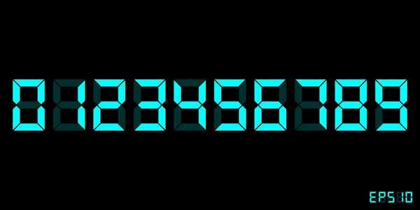
About basic functionality of calculator :
The Display area and Button panel are part of the User Interface (UI) functionality of a calculator.
Input area: Where you enter numbers and expressions.
Display area: Shows calculation results.

Slide 4
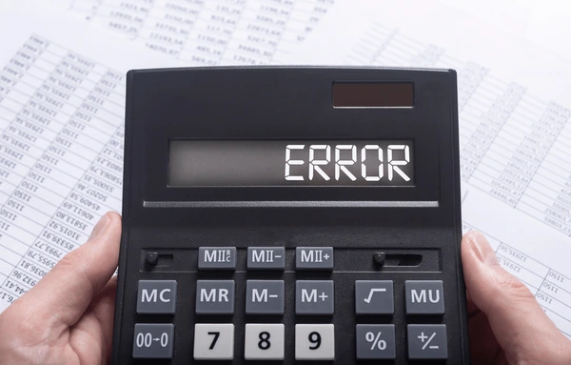
Some common problems faced while making a basic calculator include:
Syntax errors: Mistakes in coding syntax can prevent the calculator from working correctly.
Logical errors: Flaws in the programming logic can lead to incorrect calculations or results.
Input validation: Handling invalid or unexpected user input can be challenging.
Error handling: Dealing with errors such as division by zero or overflow can be problematic.

Slide 5
References & inspirations
Youtube
Tkinter Library
Online Tutorial

Slide 6
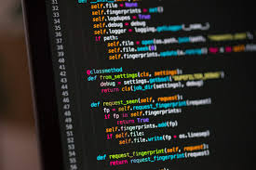
Youtube - YouTube provides video tutorials and coding guides that help in building a calculator.
Tkinter – Go through so many Tkinter libaray via a geeksforgeeks.

Slide 7


