Slide 1

NEXTHIKE IT SOLUTIONS
Project-4
Feature Extraction and Price Prediction for Mobile Phones
-By Heena

Slide 2
Project Tasks
Introduction
Data Exploration
Data Preprocessing
Feature Extraction
Model Building
Model Evaluation
Feature Importance Analysis
Conclusion
References

Slide 3
Introduction
This project helps in predicting the price of the mobile phone with respect to its specifications. Different types of mobile phones are being launched in vast amount in the market hence there are many kinds of mobile phones available. This makes difficult for the customers to choose a mobile phone. To make this process feasible we developed a program that evaluates the price of the mobile by giving its features.
Machine learning algorithms such as Linear Regression, Random Forest and Neural Networks are trained on the dataset to predict the price of a mobile phone based on its features. This involves collecting a dataset of a mobile phone specifications and prices from various sources.

Slide 4
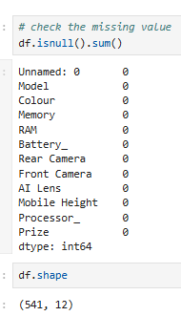
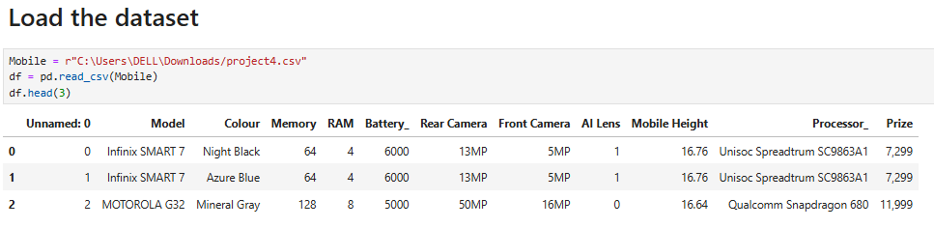
Data Exploration
Data exploration is the process of analyzing and understanding the underlying structure and patterns in a dataset.

Slide 5
Data Preprocessing
Data preprocessing is the process of transforming and preparing raw data into a suitable format for analysis or modeling.
Steps in Data Preprocessing
1. Data Cleaning: Handling missing values, outliers, and data inconsistencies.
2. Data Transformation: Converting data types, scaling, and normalizing data.
3. Feature Engineering: Creating new features from existing ones.
4. Data Reduction: Reducing data dimensionality using techniques like PCA.
Techniques Used in Data Preprocessing
Handling Missing Values: Imputation, interpolation, or deletion.
Data Normalization: Scaling data to a common range.
Data Encoding: Converting categorical variables into numeric formats.
Outlier Detection: Identifying and handling outliers.

Slide 6
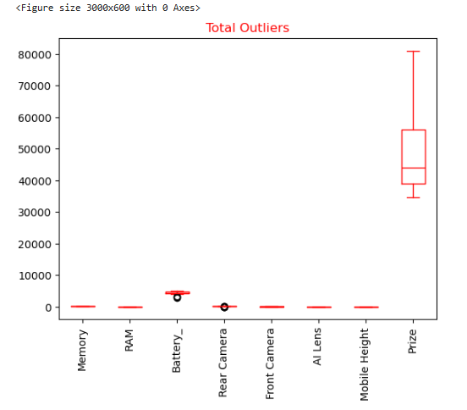
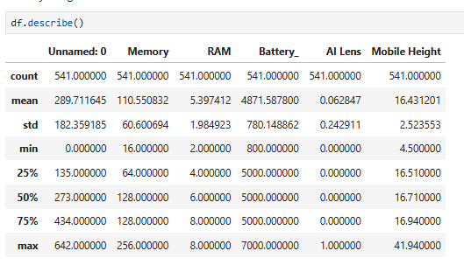
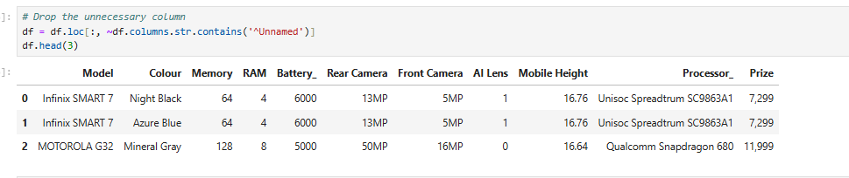
Here are some examples:

Slide 7
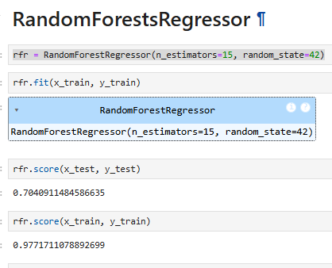
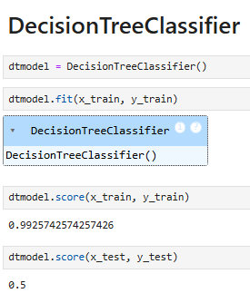
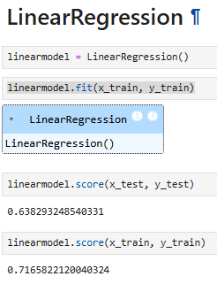
Feature Extraction
Feature extraction is the process of selecting and transforming raw data into relevant features that can be used in machine learning models.

Slide 8
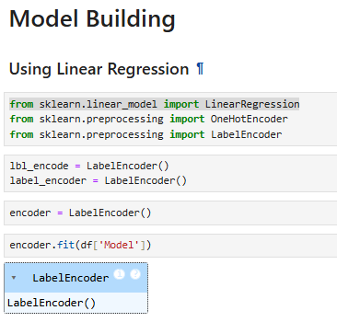
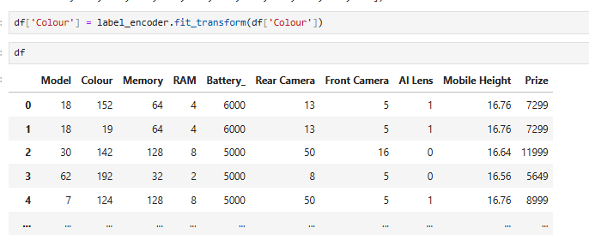
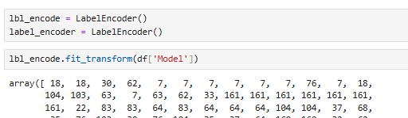
Model Building
Model building is the process of creating a machine learning model that can make predictions or take actions based on data.

Slide 9
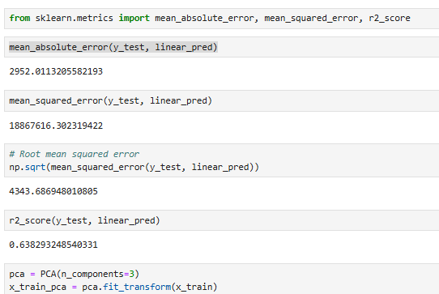
Model Evaluation
Model evaluation is the process of assessing the performance of a machine learning model.
Mean Absolute Error (MAE): Average difference between predicted and actual values.
Mean Squared Error (MSE): Average squared difference between predicted and actual values.
Root Mean Squared Error (RMSE): Square root of MSE.
R-squared (R²): Proportion of variance explained by the model.

Slide 10
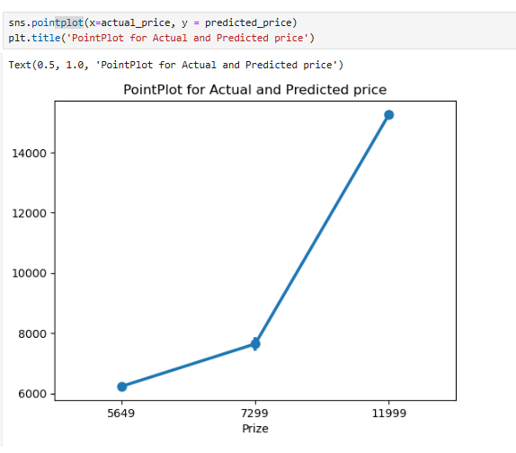
Feature Importance Analaysis
Feature importance scores quantify how much each input feature affects the model's ability to predict the target variable (e.g., stock price).
Higher scores indicate a greater impact on the prediction, suggesting that the feature is more important.
It reveals which features are most influential in determining the price, whether actual or predicted.
This analysis can be valuable for understanding market dynamics and improving prediction accuracy.

Slide 11
Conclusion
The conclusion of mobile price prediction depends on the specific approach and model used to make the predictions. In general, the accuracy of the prediction will depend on the quality and quantity of the data used to train the model, as well as the complexity of the algorithm.
If the model was trained on a large dataset of high-quality mobile phone data, and the algorithm used was well-suited to the task of predicting prices, then the predictions are likely to be relatively accurate.
However, it is important to remember that mobile phone prices can be affected by a wide range of factors, such as market trends, consumer preferences, and technological advancements. As a result, even the most accurate prediction model may not be able to account for all of these variables and may therefore produce inaccurate predictions from time to time.
Overall, mobile price prediction can be a valuable tool for businesses and consumers alike, but it is important to use it in conjunction with other sources of information and to always keep in mind the potential limitations of the prediction.

Slide 12
Websites used for research.
https://www.youtube.com/
https://www.google.co.in/
Meta AI
https://github.com/
https://www.geeksforgeeks.org

Slide 13


