Slide 1
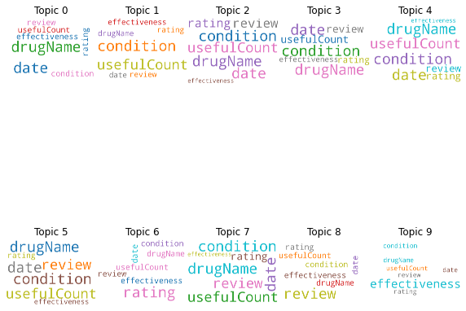
CATEGORIZATION OF DRUG REVIEWS
Comparison of Multi Layer Perceptron and Recurrent Neural Networks
-Heena Rijhwani

Slide 2
Dataset description and Research Scenario
Drug review Dataset sourced from UCI Machine Learning Repository
161297 rows/ reviews and 6 columns/ attributes. For the purpose of this project, I will be using 2 attributes: drug review and its respective rating.
Aim: To analyze drug reviews and categorize them into 5 groups: ineffective, marginally effective, moderately effective, considerably effective or highly effective.
Applications:
Pharmaceutical companies- to take public opinion into consideration, increase revenue by adopting required marketing strategies based on the reviews and ensuring safety of individuals from any harmful side effects of the drugs.
Patients- to help them assess efficiency of various drugs and decide which one to go with.
Clinicians- to ensure patient safety, assess drug reactions, complications and effectiveness before prescribing them to patients.

Slide 3

Overview of Deep Learning workflow

Slide 4
Input features for Hypothyroid
Dropping null values
Data subset: I will be using the top 5000 reviews for the purpose of this project.
Text Preprocessing
-Converting the reviews to lowercase
-Removing special characters and numbers
-Removing encoded characters, mentions, urls, hashtags, emojis and additional white spaces.
Stop word removal: Commonly occurring stop words were removed from the data (including articles, conjunction, prepositions and pronouns)
Stemming and Lemmitization: To convert words to their root/base form.
Discretizing data: The rating column was discretized into 5 unique categories of ineffective, marginally effective, moderately effective, considerably effective or highly effective.
Encoding class attribute using One Hot Encoding.
Splitting the data: into train, test and validation sets.
80-20% split for training and test sets. 10% from the training data was allocated as the validation set.
Sr No. | Attribute | Description
1 | drugName | Name of the drug
2 | condition | Name of the condition
3 | review | Patient review
4 | rating | 10 star patient rating
5 | date | Date of review entry
6 | usefulcount | Number of users who found the review useful

Slide 5
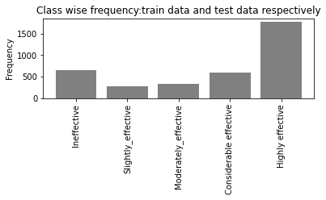
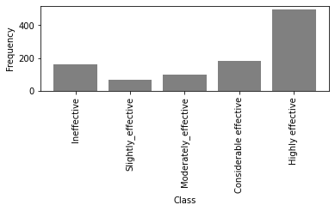
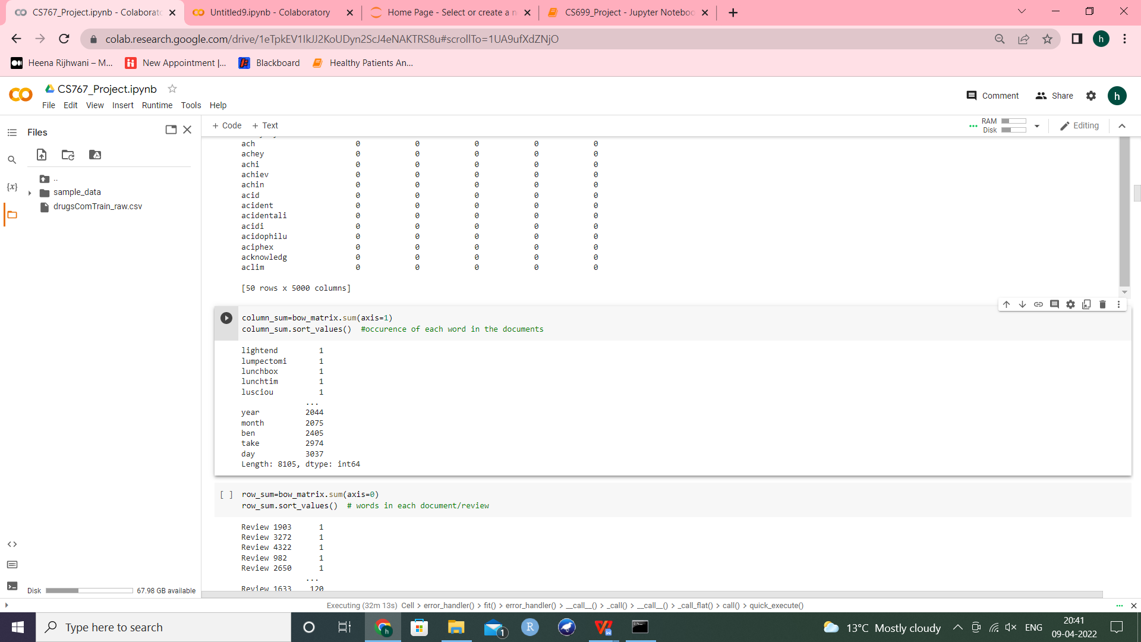
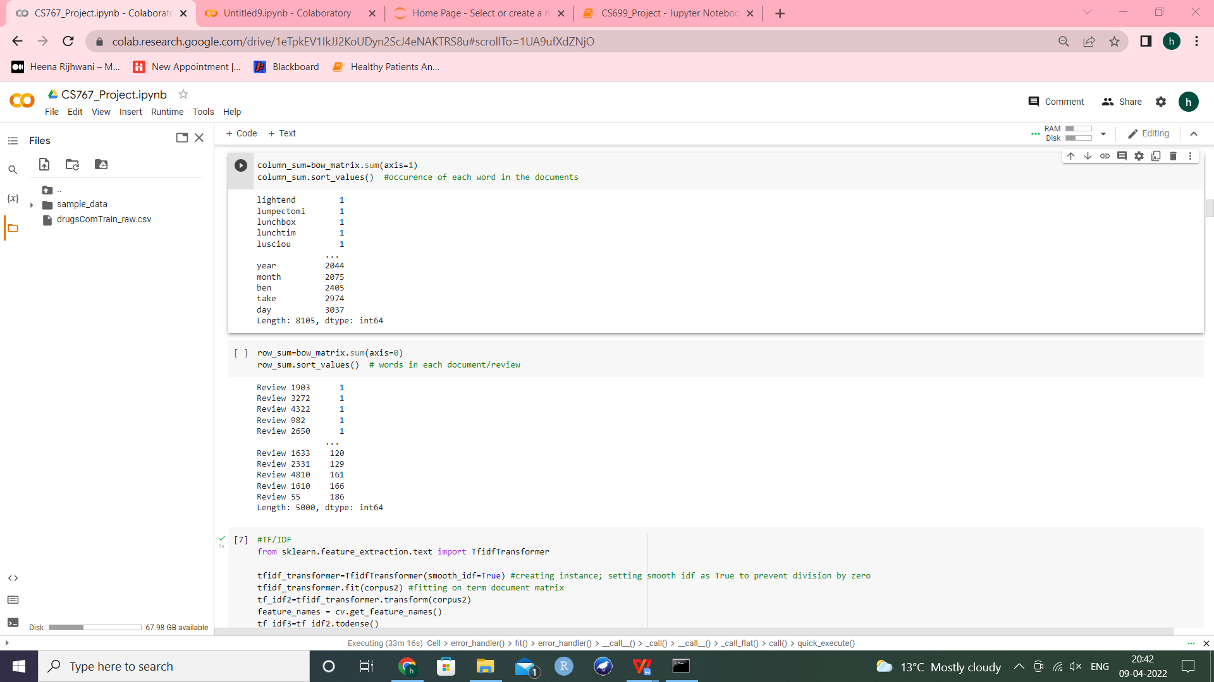
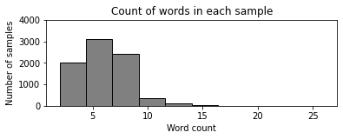
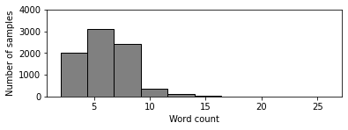
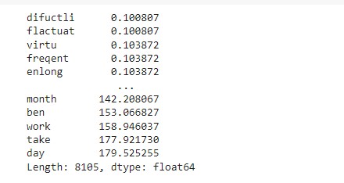
Bag of Words model Data Visualizations
Computing the frequency of each token/word using CountVectorizer().
Normalizing term frequencies using TF/IDF to get relative importance of each term in the reviews.

Slide 6
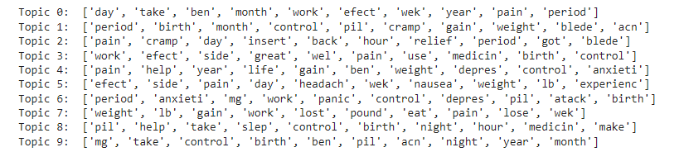
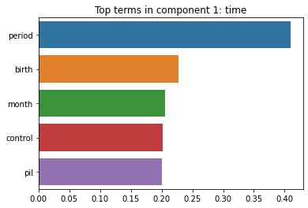
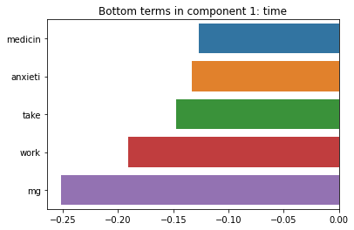
Topic Modelling
Latent Semantic Analysis to find clusters of similar words
Latent Dirichlet Allocation to get weightage of each term in the reviews

Slide 7
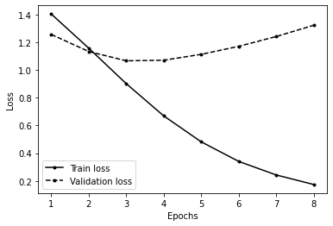
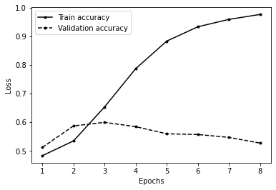
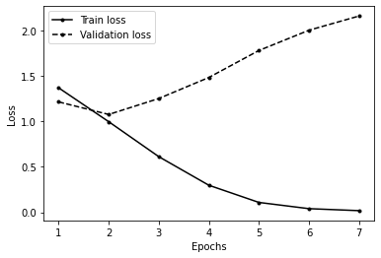
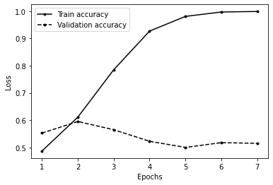
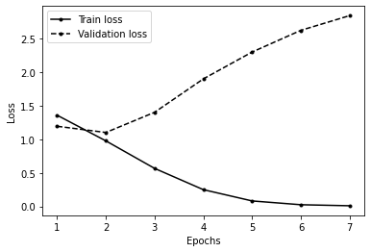
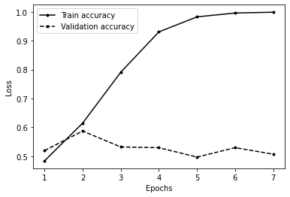
Classification using Neural Networks Multi Layer Perceptron
1, 2, 3 and 4 hidden layers
With and without early stopping
Model | Accuracy with early stopping | Loss with early stopping | Accuracy without early stopping | Loss without early stopping
MLP (1 layer) | 0.5500 | 0.1877 | 0.5160 | 1.6120
MLP(2 layers) | 0.5590 | 0.1876 | 0.5030 | 2.6396
MLP(3 layers) | 0.4910 | 1.2790 | 0.4890 | 3.7317
MLP(4 layers) | 0.5330 | 1.2552 | 0.4820 | 5.3042

Slide 8
Activation functions Batch Normalization
Tanh
Elu
Relu
Sigmoid
Softplus
To normalize inputs at each layer
Standardize and scale layer inputs
Add 4 parameters: mean and standard deviation (calculated using moving average of mini batches), alpha and beta (learnt using backpropagation).
Activation | Loss (on 2 layer MLP) | Accuracy (on 2 layer MLP)
Tanh | 1.1932 | 0.5470
Elu | 1.1963 | 0.5454
Relu | 1.2014 | 0.5530
Sigmoid | 1.2098 | 0.5430
Softplus | 1.1712 | 0.5590
Model | Accuracy | Test Loss | Train loss | Validation loss
MLP Without Batch Normalization | 0.5430 | 1.2014 | 0.0189 | 2.0996
MLP With Batch Normalization | 0.5390 | 1.9010 | 0.0065 | 1.7940

Slide 9
Learning Rate Schedulers Regularization
Piecewise Constant Scheduling
Power Scheduling
Exponential Scheduling
Performance Scheduling
1cycle Scheduling
L1 Regularization
L2 Regularization
Elasticnet Regularization
Maxnorm Regularization
Dropout Regularization
Rate= 0.2
Rate= 0.3
Rate = 0.5
Learning rate scheduler | Accuracy | Loss
Piecewise constant scheduling | 0.5050 | 3.1784
Power scheduling | 0.5100 | 1.9001
Exponential scheduling | 0.5100 | 1..4607
Performance scheduling | 0.5240 | 1.9199
1cycle scheduling | 0.4990 | 2.0211
Regularization | Accuracy | Loss
L1 | 0.4840 | 2.9052
L2 | 0.5130 | 2.5276
Elasticnet | 0.5240 | 2.7915
Dropout (rate=0.2, 0.3, 0.5) | 0.5060 | 1.3029
 | 0.4990 | 1.3467
 | 0.5260 | 1.2314
Alpha dropout | 0.4950 | 1.3243

Slide 10
Weight Initialization Optimizers
Glorot Initialization
Lecun Initialization
He Initialization
Stochastic Gradient Descent
Rmsprop
Adagrad
Adam
Nadam
Adamax
Initialization | Accuracy | Loss
He normal | 0.5390 | 1.2143
He uniform | 0.5360 | 1.2220
Lecun normal | 0.5370 | 1.2589
Lecun uniform | 0.5450 | 1.1655
Glorot normal | 0.5430 | 1.2166
Glorot uniform | 0.5270 | 1.4457
Optimizer | Accuracy | Loss
SGD | 0.5510 | 1.2309
Adagrad | 0.4760 | 1.3801
Rmsprop | 0.5410 | 1.1962
Adam | 1.3261 | 0.5330
Adamax | 1.2338 | 0.5430
Nadam | 1.2038 | 0.5454

Slide 11
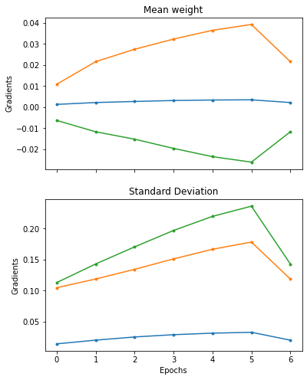
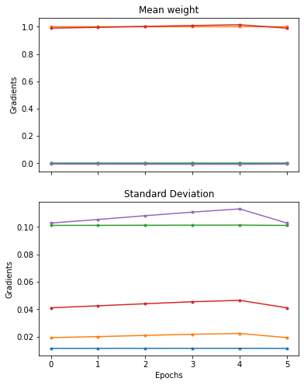
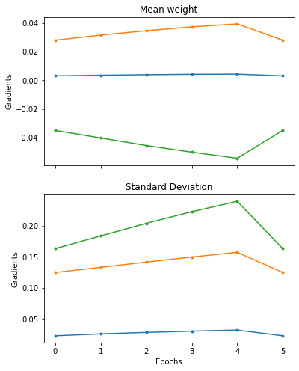
Gradient Clipping Analyzing mean and standard deviation of gradients across all epochs: Gradients were most stable for batch normalization, while gradient clipping showed slight improvement as compared to the original model.
Without Gradient Clipping
With Batch
Normalization
With Gradient
Clipping

Slide 12
Number of Neurons in each hidden layer Best accuracy for 100 neurons in layer 1 and 30 in layer 2
Number of neurons in layer 1 | Number of neurons in layer 2 | Accuracy | Loss
30 | 30 | 0.5510 | 1.2936
30 | 50 | 0.5454 | 1.2817
30 | 100 | 0.5350 | 1.2423
30 | 200 | 0.5410 | 1.2918
50 | 30 | 0.5370 | 1.2100
50 | 50 | 0.5340 | 1.3707
50 | 100 | 0.5210 | 1.4135
50 | 200 | 0.5110 | 1.3647
100 | 30 | 0.5500 | 1.2006
100 | 50 | 0.5440 | 1.5837
100 | 100 | 0.5420 | 1.2179
100 | 200 | 0.5360 | 1.6310
200 | 30 | 0.5320 | 1.2735
200 | 50 | 0.5390 | 1.2993
200 | 100 | 0.4950 | 1.3585
200 | 200 | 0.4960 | 1.3277

Slide 13
Recurrent Neural Networks And their variations
Layer Normalization
Done across feature dimension, not batch dimension. Learns scale and shift parameters for each input independently.
LSTM (Long Short Term Memory)
Deals with RNN’s short term memory problem. Two states: short term state (output at current time step) and long term state. Three gates: forget, input and output. Certain memories are dropped when the long term state passes through the forget gate. The input gate selects certain memories which are then added to the long term state. The final output is then filtered by the output gate to give short term state.
GRU (Gated Recurrent Unit)
It is a simpler version of LSTM. It has no output gate and the full state vector will act as output at each time step. The same output controls the forget and input gates. There is a new ‘r’ gate which controls which part of the previous output is given to the main layer.
Bidirectional RNN
Also looks ahead at next inputs (future) before generating the current output. One recurrent layer will read the inputs from left to right and the second recurrent layer will read the inputs from right to left. Eventually their outputs will be concatenated at each time step.
Dropout and Recurrent dropout in RNN
Dropout is applied between the network layers to drop certain inputs for every instance. (Vertical direction)
Recurrent dropout drops inputs between the recurrent connections. (Horizontal direction between time steps)
1d Convolution network
Learn sequences by sliding kernels across a sequence. Here, I built a 2 layer 1D Conv Net, flattened the output using a global max pooling layer and fed this to a dense network.
Hybrid model (RNN + CNN)
I built a hybrid model using recurrent layers as well as 1d convolution layers. This network comprised of 2 Conv1D layers (each followed by a max pooling layer), 2 bidirectional LSTM layers and a fully connected network.

Slide 14
Recurrent Neural Networks Learnings and Observations
Number of layers | Accuracy | Loss
Simple RNN (1 layer) | 0.4950 | 0.4341
Deep RNN ( 2 layers | 0.4950 | 1.3696
Deep RNN with Layer Normalization | 0.4935 | 0.4355
LSTM (1 layer) | 0.4954 | 0.4353
LSTM (2 layers) | 0.4950 | 0.4383
LSTM (with Dropout) Dropout rate=0.5 | 0.4960 | 0.4344
GRU (1 layer) | 0.4859 | 0.4362
GRU (2 layers) | 0.4950 | 0.4352
GRU (with dropout) Dropout rate=0.5 | 0.4950 | 0.4358
Stacked Bidirectional LSTM | 0.4950 | 1.3661
Stacked Bidirectional LSTM with recurrent dropout | 0.4930 | 0.4357
Stacked Bidirectional LSTM + dense network with 5 layers | 0.4950 | 1.3578
1d Convolutional Neural Network | 0.4987 | 1.3576
Hybrid model (Conv 1d+ recurrent layers) | 0.4950 | 1.3594
Best Model: 2 layer LSTM with Dropout (rate= 0.5)
Even after trying a myriad of variations, the model’s performance still has a long way to go.
However when a machine learning model, Random Forest, is used on this data, we get an accuracy of 32%, which is lower than that achieved by our final neural network model (49.5%).
In fact, it is even lower than the accuracy achieved by a simple MLP network. Thus we can conclude that neural networks showed a significant improvement over statistical machine learning models in this case.

Slide 15
Thank you.

