Slide 1

CLASSIFYING WHETHER AN INDIVIDUAL IS LIKELY TO DIE IN THE NEXT TEN YEARS
Comparison of Classification algorithms and Feature selection techniques
-Heena Rijhwani

Slide 2
Dataset description and Data Mining goal
National health and nutrition examination survey (NHEFS).
Sourced from Center for Disease Control and Prevention (CDC).
Data collected over a period of 11 years from 1971 to 1982.
1629 rows/ samples/ patients and 50 columns/features/ clinical and behavioral attributes.
Aim: Predict whether an individual is likely to die within the next ten years or not (yes/no).
Application: Proactive and early diagnosis; Allow individuals to make informed decisions and start early treatments; Warn individuals to take precautionary health measures, focus on quality of life and eventually improve life expectancy.
Data Mining tools used: Python (numpy, pandas, matplotlib, seaborn, sklearn), Jupyter notebook.

Slide 3

Overview of Data Mining workflow

Slide 4
Input features for Hypothyroid
Sr No. | Variable name | Description
1 | active | How active are you? 0: very 1: moderate 2:inactive
2 | age | Age of individual
3 | alcoholfreq | How often do you drink? 0: almost everyday 1: 2 to 3 times/month 2: 1 to 4 times/month 3: less than 12 times a year 4: no alcohol
4 | alcoholhowmuch | How much alcohol do you drink?
5 | alcoholpy | Have you had a drink in the past year?
6 | alcoholtype | Which type of alcohol do you drink?
7 | allergies | Do you have any allergies? 0:No 1:Yes
8 | asthma | Do you have asthma? 0:No 1:Yes
9 | birthcontrol | Have you take birth control pills in the last 6 months? 0:No 1:Yes
10 | birthplace | Place of birth (state codes)
11 | boweltrouble | Do you use bowel trouble medication?
12 | bronchitis | Do you have chronic bronchitis? 0:No 1:Yes
…… | …… | ………
14 | chroniccough | Do you have Chronic cough?
Converting columns to required datatypes.
Renaming columns
For example: “death” was renamed to “Class” indicating the class attribute.
Handling missing values using data imputation
Missing values found in 12 columns. Columns with majority values as missing were dropped. For the remaining columns, we replaced missing values with median/mode of the column with respect to class label, depending on datatype of column.
Encoding
We encoded categorial/nominal columns using Label Encoding and ordinal columns using Ordinal Encoding (columns like exercise, active where the class labels had a meaningful ranking).
Checking for outliers using IQR criteria
Outliers were found in some columns but we decided to keep them due to the sensitive nature of medical data. It is possible that individuals had extreme values for these attributes, they do not seem like data entry errors. Getting rid of the outliers may increase our model's accuracy but they are essential to show the natural variation in medical data.
Feature scaling to normalize the range of the data.
Splitting the data
We split the data into train and test sets. 66% of data was used for training and 34% for testing. We used stratify=y to ensure that class distribution is preserved in train and test sets.

Slide 5
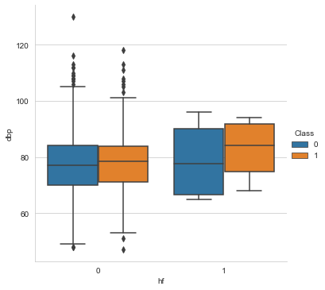
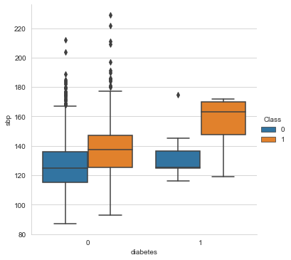
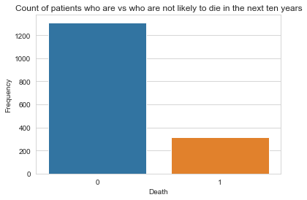
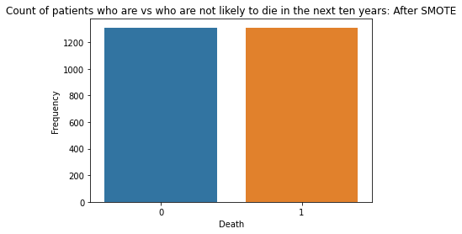
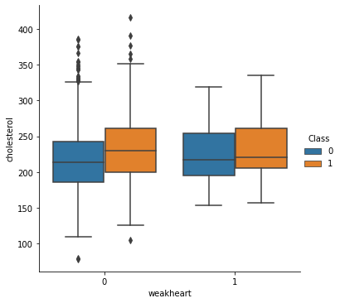
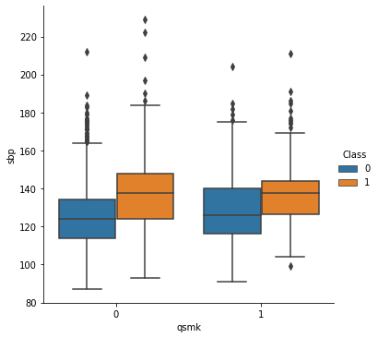
Oversampling and Data Visualizations Analyzing attributes for patients who did vs did not die based on if they have diabetes, weak heart, heart failure and if they have quit smoking.
SMOTE
Randomly resample (synthetic samples) from the minority class (class=1) in order to deal with class imbalance problem
After SMOTE, equal number of samples in both classes.

Slide 6
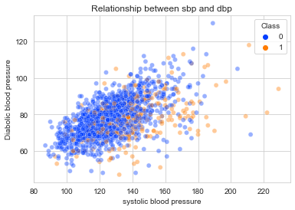
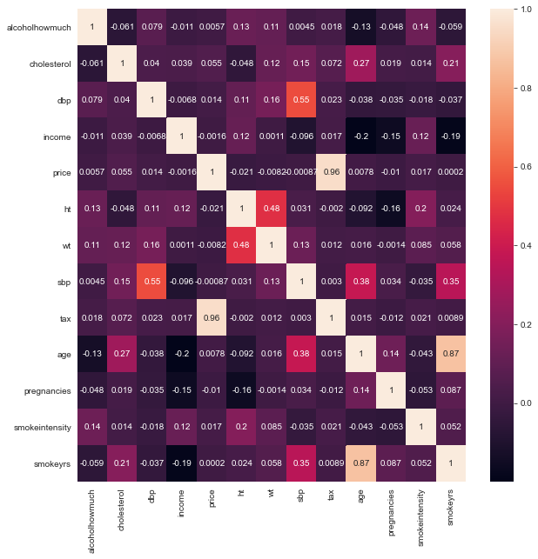
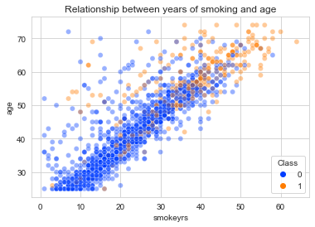
Correlation between features Strongest correlation between price and tax, age and smokeyrs, diabolic bp and systolic bp

Slide 7
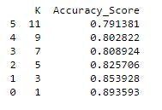
Classification Algorithms
Logistic Regression
It uses logistic/sigmoid function to compute the probability of an instance belonging to each class.
p = 1/(1+e^-y) ….where y is the weighted sum of input features
The instance is then assigned a class label based on these computed probability p. Usually a threshold of 0.5 is used. If p>0.5 the instance belongs to class 1 and if p<0.5 the instance belongs to class 0.
KNearest Neighbor
It is an example of Instance based learning. It calculates the distance from the point which needs to be labelled to all other data points (using L1, L2 norm, etc). The k closest data points (also called “neighbors”) are selected. The majority class of these neighbors is then assigned to the new instance. Here we found optimal number of neighbors to be 3.

Slide 8
Classification Algorithms
Decision Tree
It is represented in the form of a flow chart, consisting of a root node, multiple internal nodes for testing conditions and leaf nodes for final classifications. The edges connecting the nodes represent results of test conditions. The aim is to have a simple/shallow or pure tree, i.e., samples belonging to only one class after partitioning. Attribute selection measures such as information gain, gain ratio, gain index are used to select attributes at each node.
Random Forest
It is an ensemble method which combines multiple base learners or decision trees. Random samples with replacement are extracted from the data (bootstrap) and a separate Decision Tree model is built on each of these sample sets using a subset of features.
Support Vector Classifier
SVC uses a linear decision boundary or a hyperplane to separate instances of the two classes. Two parallel planes are drawn, which pass through the closest data points on either side of the hyperplane (support vectors). The aim is to maximize margin between these two lines.

Slide 9
Overall metrics Weighted average Using k fold cross validation
Model | TPR | TNR | FPR | FNR | Precision | MCC | F measure | ROC area | Recall
Logistic Regression | 0.75 | 0.8 | 0.2 | 0.25 | 0.7868 | 0.5445 | 0.7658 | 0.7719 | 0.75
Decision Tree | 0.9200 | 0.93 | 0.07 | 0.08 | 0.9281 | 0.8459 | 0.9224 | 0.9229 | 0.92
Random Forest | 0.88 | 0.88 | 0.12 | 0.12 | 0.8770 | 0.7582 | 0.8794 | 0.8790 | 0.88
Support Vector Classifier | 0.73 | 80.4 | 0.2 | 0.26 | 0.7900 | 0.542 | 0.7629 | 0.7707 | 0.74
KNN | 0.68 | 0.91 | 0.09 | 0.32 | 0.8872 | 0.6135 | 0.7726 | 0.7986 | 0.68
Model | TPR | TNR | FPR | FNR | Precision | MCC | F measure | ROC area | Recall
Logistic Regression | 0.7719 | 0.77 | 0.22 | 0.214 | 0.7726 | 0.5445 | 0.978 | 0.8588 | 0.771
Decision Tree | 0.9229 | 0.92 | 0.0770 | 0.073 | 0.9230 | 0.8459 | 0.922 | 0.9263 | 0.922
Random Forest | 0.8790 | 0.87 | 0.120 | 0.114 | 0.8791 | 0.7582 | 0.8790 | 0.9432 | 0.879
Support Vector Classifier | 0.7707 | 0.77 | 0.2292 | 0.217 | 0.7719 | 0.5427 | 0.7705 | 0.8558 | 0.770
KNN | 0.798 | 0.79 | 0.2013 | 0.146 | 0.8151 | 0.6135 | 0.7959 | 0.8971 | 0.798

Slide 10
Class 0 Class 1 Using k fold cross validation
Model | Confusion matrix | TPR | TNR | FPR | FNR | Precision | MCC | F measure | ROC area | Recall
Logistic Regression | [[1072 239] [324 987]] | 0.75 | 0.8 | 0.2 | 0.25 | 0.7868 | 0.5445 | 0.7658 | 0.858 | 0.75
Decision Tree | [[1224 87] [105 1206]] | 0.92 | 0.9 | 0.07 | 0.08 | 0.928 | 0.84 | 0.9224 | 0.927 | 0.92
Random Forest | [[1145 166] [135 1176]] | 0.88 | 0.8 | 0.12 | 0.12 | 0.8770 | 0.7582 | 0.8794 | 0.951 | 0.88
Support Vector Classifier | [[1075 236] [333 978]] | 0.74 | 0.8 | 0.2 | 0.26 | 0.7900 | 0.542 | 0.7629 | 0.855 | 0.790
KNN | [[1290 21] [362 949]] | 0.68 | 0.9 | 0.09 | 0.32 | 0.8872 | 0.6135 | 0.7726 | 0.897 | 0.68
Model | Confusion matrix | TPR | TNR | FPR | FNR | Precision | MCC | F measure | ROC area | Recall
Logistic Regression | [[987 324] [239 1072]] | 0.8 | 0.75 | 0.25 | 0.2 | 0.7585 | 0.5445 | 3.1914 | 0.858 | 0.8
Decision Tree | [[1206 105] [87 1224]] | 0.92 | 0.91 | 0.08 | 0.07 | 0.9178 | 0.8459 | 0.9234 | 0.925 | 0.929
Random Forest | [[1176 135] [166 1145]] | 0.87 | 0.88 | 0.11 | 0.12 | 0.8811 | 0.7582 | 0.8787 | 0.935 | 0.876
Support Vector Classifier | [[978 333] [236 1075]] | 0.80 | 0.73 | 0.26 | 0.19 | 0.7539 | 0.5427 | 0.7781 | 0.855 | 0.804
KNN | [[949 362] [21 1290]] | 0.91 | 0.68 | 0.32 | 0.09 | 0.7430 | 0.6135 | 0.8193 | 0.897 | 0.91

Slide 11
Feature Selection
Fisher score or chi square test
It is a type of filtering method. A Chi square statistic is calculated for each categorical feature and class attribute. Features highly correlated with the target variable are then selected. This means features with higher chi square value (null hypothesis will be rejected) are more correlated with the class attribute and are selected.
Recursive Feature Elimination
It uses a machine learning model at its core and acts as a wrapper function for this model. It starts by fitting the model on all the features, ranks them based on importance and removes the least important feature. This process continues till we are left with desired number of features.
Mutual information
It is filtering method. If one variable is known, mutual information gives an estimate of how much information we can obtain about another variable. If variables are not correlated, knowing one of them will not give any information about the other. It is a measure of dependency between the variables. If features have high correlation, knowing one of the variables would help determine value of the other, thus mutual information value will be high.

Slide 12
Feature Selection
Anova f value
It is a type of filtering method. A similar 5 step hypothesis test procedure is followed as in chi square test where null hypothesis states that there is no relationship between explanatory and response variable. Alternate hypothesis states that there is a relation between the two variables. F statistic is computed for each feature and target variable. Features correlated with target variable(higher f value) are selected.
Forward Selection
It is a wrapper method. It starts with no features and at every iteration, a single feature is added at a time as long as it helps improve model performance. The feature which improves model performance the most is added first. The criteria used to determine performance varies (highest accuracy, lowest p value, etc.). In this case, we have used R2 score for this purpose. It adds one feature at a time and tests at every step in order to achieve a reduced set of features.

Slide 13
Features selected by each of the attribute selection methods Features selected using the 5 methods were not the same
Method | Selected features
Fisher score | ['sbp', 'smokeyrs', 'asthma', 'polio', 'nerves', 'hbpmed', 'active', 'pregnancies', 'cholesterol', 'tax']
Recursive feature elimination | ['race', 'smokeyrs', 'asthma', 'bronch', 'hf', 'hepatitis', 'tumor','alcoholfreq', 'otherpain', 'cholesterol']
Information gain | ['cholesterol', 'tax', 'pregnancies', 'active', 'hbpmed', 'smokeyrs','qsmk', 'polio', 'hf', 'pica']
Anova f value | ['pregnancies', 'tax', 'active', 'hbpmed', 'polio', 'cholesterol', 'nerves', 'asthma', 'hf', 'sbp']
Forward selection | ['income', 'wt', 'bronch', 'tb', 'hf', 'colitis', 'hayfever', 'polio','alcoholpy', 'pregnancies']
Attribute selection:
Fisher score
Recursive Feature Elimination
Information gain
Anova f value
Forward selection

Slide 14
Recall/ TPR/ Sensitivity comparison
 | LoR | DT | RF | SVC | KNN
Chi Sq | 0.95 | 0.90 | 0.96 | 0.96 | 0.97
Anova f | 0.94 | 0.93 | 0.98 | 0.95 | 0.96
Mutual Info | 0.95 | 0.93 | 0.98 | 0.96 | 0.98
Forward selection | 0.99 | 0.97 | 1.0 | 1.0 | 1.0
Rfe | 0.98 | 0.97 | 0.99 | 1.0 | 1.0
 | LoR | DT | RF | SVC | KNN
Chi Sq | 0.95 | 0.90 | 0.96 | 0.96 | 0.97
Anova f | 0.94 | 0.93 | 0.98 | 0.95 | 0.96
Mutual Info | 0.95 | 0.93 | 0.98 | 0.96 | 0.98
Forward selection | 0.99 | 0.97 | 1.0 | 1.0 | 1.0
Rfe | 0.98 | 0.97 | 0.99 | 1.0 | 1.0
Overall Recall
Class 0 Recall
 | LoR | DT | RF | SVC | KNN
Chi Sq | 0.42 | 0.69 | 0.61 | 0.38 | 0.4
Anova f | 0.51 | 0.74 | 0.67 | 0.45 | 0.44
Mutual Info | 0.46 | 0.73 | 0.67 | 0.44 | 0.38
Forward selection | 0.20 | 0.69 | 0.60 | 0.57 | 0.49
Rfe | 0.98 | 0.68 | 0.62 | 0.52 | 1.0
Class 1 Recall

Slide 15
Overall performance after feature selection
Model | Confusion matrix | TPR | TNR | FPR | FNR | Precision | MCC | F measure | ROC area | Recall
Logistic Regression-Reduced features (chi sq) | [[434 25] [ 55 40]] | 0.95 | 0.42 | 0.58 | 0.05 | 0.8875 | 0.429 | 0.9156 | 0.6832 | 0.95
Decision Tree Reduced features (chi sq) | [[415 44] [ 29 66]] | 0.9 | 0.69 | 0.31 | 0.1 | 0.9346 | 0.5658 | 0.9191 | 0.7994 | 0.9
Random Forest Reduced features (chi sq) | [[439 20] [ 37 58]] | 0.96 | 0.61 | 0.39 | 0.04 | 0.9222 | 0.6144 | 0.9390 | 0.7834 | 0.96
SVC reduced features (chi sq) | [[442 17] [ 59 36]] | 0.96 | 0.38 | 0.62 | 0.04 | 0.8822 | 0.4381 | 0.9208 | 0.6709 | 0.96
KNN reduced features (chi sq) | [[444 15] [ 57 38]] | 0.97 | 0.4 | 0.6 | 0.03 | 0.8862 | 0.4707 | 0.9249 | 0.6836 | 0.97
LoR(anova f ) | [[433 26] [ 47 48]] | 0.94 | 0.51 | 0.49 | 0.06 | 0.9020 | 0.4970 | 0.9222 | 0.7243 | 0.94
DT(anova f ) | [[429 30] [ 25 70]] | 0.93 | 0.74 | 0.26 | 0.07 | 0.9449 | 0.6580 | 0.93975 | 0.8357 | 0.93
RF(anova f ) | [[452 7] [ 31 64]] | 0.98 | 0.67 | 0.33 | 0.02 | 0.9358 | 0.7424 | 0.9596 | 0.8292 | 0.98
SVC(anova f ) | [[434 25] [ 52 43]] | 0.95 | 0.45 | 0.55 | 0.05 | 0.8930 | 0.4573 | 0.91851 | 0.6990 | 0.95
KNN(anova f ) | [[442 17] [ 53 42]] | 0.96 | 0.44 | 0.56 | 0.04 | 0.8929 | 0.4949 | 0.9266 | 0.7025 | 0.96
LoR(mutual info) | [[436 23] [ 51 44]] | 0.95 | 0.46 | 0.54 | 0.05 | 0.8952 | 0.4774 | 0.9217 | 0.7065 | 0.95
DT(mutual info) | [[428 31] [ 26 69]] | 0.93 | 0.73 | 0.27 | 0.07 | 0.9427 | 0.6456 | 0.9375 | 0.8293 | 0.93
Model | Confusion matrix | TPR | TNR | FPR | FNR | Precision | MCC | F measure | ROC area | Recall
RF(mutual info) | [[449 10] [ 31 64]] | 0.98 | 0.67 | 0.33 | 0.02 | 0.9354 | 0.7222 | 0.9563 | 0.8585 | 0.98
SVC(mutual info) | [[439 20] [ 53 42]] | 0.96 | 0.44 | 0.56 | 0.04 | 0.8922 | 0.4764 | 0.9232 | 0.6992 | 0.96
KNN(mutual info) | [[448 11] [ 59 36]] | 0.98 | 0.38 | 0.62 | 0.02 | 0.8836 | 0.4801 | 0.9275 | 0.7041 | 0.98
LoR(forward selection) | [[456 3] [ 93 2]] | 0.99 | 0.02 | 0.98 | 0.01 | 0.8306 | 0.0578 | 0.9047 | 0.5072 | 0.99
DT(forward selection) | [[447 12] [ 29 66]] | 0.97 | 0.69 | 0.31 | 0.03 | 0.9390 | 0.7245 | 0.9561 | 0.8342 | 0.97
RF(forward selection) | [[459 0] [ 38 57]] | 1.0 | 0.6 | 0.4 | 0.0 | 0.9235 | 0.7443 | 0.9602 | 0.8 | 1.0
SVC(forward selection) | [[459 0] [ 41 54]] | 1.0 | 0.57 | 0.43 | 0.0 | 0.918 | 0.7223 | 0.9572 | 0.7842 | 1.0
KNN(forward selection) | [[457 2] [ 48 47]] | 1.0 | 0.49 | 0.51 | 0.0 | 0.9049 | 0.6509 | 0.9481 | 0.7451 | 1.0
LoR(rfe) | [[451 8] [ 85 10]] | 0.98 | 0.11 | 0.89 | 0.02 | 0.8414 | 0.1867 | 0.9065 | 0.5439 | 0.98
DT(rfe) | [[445 14] [ 30 65]] | 0.97 | 0.68 | 0.32 | 0.03 | 0.9368 | 0.7046 | 0.9528 | 0.8268 | 0.97
RF(rfe) | [[455 4] [ 36 59]] | 0.99 | 0.62 | 0.38 | 0.01 | 0.9266 | 0.7270 | 0.9578 | 0.8061 | 0.99
SVC(rfe) | [[459 0] [ 46 49]] | 1.0 | 0.52 | 0.48 | 0.0 | 0.9089 | 0.6846 | 0.9522 | 0.7578 | 1.0
KNN(rfe) | [[458 1] [ 56 39]] | 1.00 | 0.41 | 0.59 | 0.0 | 0.8910 | 0.5946 | 0.9414 | 0.7041 | 1.0

Slide 16
Class 0 performance
Model | Confusion matrix | TPR | TNR | FPR | FNR | Precision | MCC | F measure | ROC area | Recall
Logistic Regression-Reduced features (chi sq) | [[40 55] [ 25 434]] | 0.95 | 0.4 | 0.58 | 0.05 | 0.8875 | 0.4293 | 0.9156 | 0.847 | 0.95
Decision Tree Reduced features (chi sq) | [[66 29] [ 47 412]] | 0.9 | 0.6 | 0.31 | 0.1 | 0.9346 | 0.5658 | 0.9191 | 0.787 | 0.9
Random Forest Reduced features (chi sq) | [[63 32] [11 448]] | 0.96 | 0.6 | 0.39 | 0.04 | 0.9222 | 0.6144 | 0.9390 | 0.887 | 0.96
SVC reduced features (chi sq) | [[36 59] [17 442]] | 0.96 | 0.3 | 0.62 | 0.04 | 0.8822 | 0.4381 | 0.9208 | 0.843 | 0.96
KNN reduced features (chi sq) | [[38 57] [15 444]] | 0.97 | 0.4 | 0.6 | 0.03 | 0.8862 | 0.4707 | 0.9249 | 0.811 | 0.97
LoR(anova f ) | [[48 47] [26 433]] | 0.94 | 0.5 | 0.49 | 0.06 | 0.9020 | 0.4970 | 0.9222 | 0.842 | 0.94
DT(anova f ) | [[69 26] [35 424]] | 0.93 | 0.7 | 0.26 | 0.07 | 0.9449 | 0.6580 | 0.9397 | 0.842 | 0.93
RF(anova f ) | [[56 39] [17 442]] | 0.98 | 0.67 | 0.33 | 0.02 | 0.9358 | 0.7424 | 0.9596 | 0.885 | 0.98
SVC(anova f ) | [[43 52] [25 434]] | 0.95 | 0.45 | 0.55 | 0.05 | 0.8930 | 0.4573 | 0.9185 | 0.829 | 0.95
KNN(anova f ) | [[42 53] [17 442]] | 0.96 | 0.44 | 0.56 | 0.04 | 0.89292 | 0.4949 | 0.9266 | 0.788 | 0.96
LoR(mutual info) | [[44 51] [23 436]] | 0.95 | 0.46 | 0.54 | 0.05 | 0.8952 | 0.4774 | 0.9217 | 0.846 | 0.95
DT(mutual info) | [[68 27] [31 428]] | 0.93 | 0.73 | 0.27 | 0.07 | 0.9427 | 0.6456 | 0.9375 | 0.811 | 0.93
RF(mutual info) | [[61 34] [ 12 447]] | 0.98 | 0.67 | 0.33 | 0.02 | 0.9354 | 0.7222 | 0.9563 | 0.858 | 0.98
Model | Confusion matrix | TPR | TNR | FPR | FNR | Precision | MCC | F measure | ROC area | Recall
SVC(mutual info) | [[42 53] [20 439]] | 0.96 | 0.44 | 0.56 | 0.04 | 0.8922 | 0.4764 | 0.9232 | 0.845 | 0.96
KNN(mutual info) | [[36 59] [11 448]] | 0.98 | 0.38 | 0.62 | 0.02 | 0.8836 | 0.4807 | 0.927 | 0.829 | 0.98
LoR(forward selection) | [[4 91] [2 457]] | 0.99 | 0.02 | 0.98 | 0.01 | 0.8306 | 0.0578 | 0.9047 | 0.670 | 0.99
DT(forward selection) | [[65 30] [14 445]] | 0.97 | 0.69 | 0.31 | 0.03 | 0.9390 | 0.7245 | 0.9561 | 0.847 | 0.97
RF(forward selection) | [[57 38] [ 1 458]] | 1.0 | 0.6 | 0.4 | 0.0 | 0.9235 | 0.7443 | 0.9602 | 0.903 | 1.0
SVC(forward selection) | [[51 44] [1 458]] | 1.0 | 0.57 | 0.43 | 0.0 | 0.918 | 0.7223 | 0.9572 | 0.783 | 1.0
KNN(forward selection) | [[43 52] [ 1 458]] | 1.0 | 0.49 | 0.51 | 0.0 | 0.9049 | 0.6509 | 0.9481 | 0.825 | 1.0
LoR(rfe) | [[10 85] [ 8 451]] | 0.98 | 0.11 | 0.89 | 0.02 | 0.8414 | 0.1867 | 0.90653 | 0.723 | 0.98
DT(rfe) | [[65 30] [14 445]] | 0.97 | 0.68 | 0.32 | 0.03 | 0.9368 | 0.7046 | 0.9528 | 0.818 | 0.97
RF(rfe) | [[57 38] [0 459] | 0.99 | 0.62 | 0.38 | 0.01 | 0.9266 | 0.7270 | 0.9578 | 0.899 | 0.99
SVC(rfe) | [[49 46] [ 0 459]] | 1.0 | 0.52 | 0.48 | 0.0 | 0.9089 | 0.6846 | 0.9522 | 0.794 | 1.0
KNN(rfe) | [[39 56] [1 458]] | 1.00 | 0.41 | 0.59 | 0.0 | 0.8910 | 0.5946 | 0.9414 | 0.811 | 1.0

Slide 17
Class 1 performance
Model | Confusion matrix | TPR | TNR | FPR | FNR | Precision | MCC | F measure | ROC area | Recall
Logistic Regression-Reduced features (chi sq) | [[434 25] [55 40]] | 0.42 | 0.95 | 0.05 | 0.58 | 0.6153 | 0.4293 | 0.5 | 0.847 | 0.42
Decision Tree Reduced features (chi sq) | [[412 47] [29 66]] | 0.69 | 0.9 | 0.1 | 0.31 | 0.6 | 0.5658 | 0.6439 | 0.769 | 0.69
Random Forest Reduced features (chi sq) | [[448 11] [32 63]] | 0.61 | 0.96 | 0.04 | 0.39 | 0.7435 | 0.6144 | 0.6705 | 0.874 | 0.61
SVC reduced features (chi sq) | [[442 17] [59 36]] | 0.38 | 0.96 | 0.04 | 0.62 | 0.6792 | 0.4381 | 0.4864 | 0.844 | 0.38
KNN reduced features (chi sq) | [[444 15] [57 38]] | 0.4 | 0.97 | 0.03 | 0.6 | 0.7169 | 0.4707 | 0.5135 | 0.811 | 0. 0.4
LoR(anova f ) | [[433 26] [47 48]] | 0.51 | 0.94 | 0.06 | 0.49 | 0.6486 | 0.4970 | 0.5680 | 0.842 | 0.51
DT(anova f ) | [[424 35] [26 69]] | 0.74 | 0.93 | 0.07 | 0.26 | 0.7 | 0.6580 | 0.7179 | 0.844 | 0.74
RF(anova f ) | [[442 17] [ 39 56]] | 0.67 | 0.98 | 0.02 | 0.33 | 0.9014 | 0.7424 | 0.7710 | 0.897 | 0.67
SVC(anova f ) | [[434 25] [52 43]] | 0.45 | 0.95 | 0.05 | 0.55 | 0.6323 | 0.4573 | 0.5276 | 0.831 | 0.45
KNN(anova f ) | [[442 17] [53 42]] | 0.44 | 0.96 | 0.04 | 0.56 | 0.7118 | 0.4949 | 0.5454 | 0.788 | 0.44
LoR(mutual info) | [[436 23] [51 44]] | 0.46 | 0.95 | 0.05 | 0.54 | 0.6567 | 0.4774 | 0.5432 | 0.846 | 0.46
DT(mutual info) | [[428 31] [27 68]] | 0.73 | 0.93 | 0.07 | 0.27 | 0.69 | 0.6456 | 0.7076 | 0.836 | 0.73
RF(mutual info) | [[447 12] [34 61]] | 0.67 | 0.98 | 0.02 | 0.33 | 0.8648 | 0.7222 | 0.7573 | 0.882 | 0.67
Model | Confusion matrix | TPR | TNR | FPR | FNR | Precision | MCC | F measure | ROC area | Recall
SVC(mutual info) | [[439 20] [ 53 42]] | 0.44 | 0.96 | 0.04 | 0.56 | 0.6774 | 0.4764 | 0.5350 | 0.845 | 0.44
KNN(mutual info) | [[448 11] [ 59 36]] | 0.38 | 0.98 | 0.02 | 0.62 | 0.7659 | 0.4801 | 0.5070 | 0.829 | 0.38
LoR(forward selection) | [[457 2] [ 91 4]] | 0.02 | 0.99 | 0.01 | 0.98 | 0.4 | 0.0578 | 0.0399 | 0.670 | 0.02
DT(forward selection) | [[445 14] [30 65]] | 0.69 | 0.97 | 0.03 | 0.31 | 0.8461 | 0.7245 | 0.7630 | 0.848 | 0.69
RF(forward selection) | [[458 1] [38 57]] | 0.6 | 1.0 | 0.0 | 0.4 | 1.0 | 0.7443 | 0.7499 | 0.874 | 0.6
SVC(forward selection) | [[458 1] [ 44 51]] | 0.57 | 1.0 | 0.0 | 0.43 | 1.0 | 0.7223 | 0.7248 | 0.787 | 0.57
KNN(forward selection) | [[458 1] [52 43]] | 0.49 | 1.0 | 0.0 | 0.51 | 0.959 | 0.6509 | 0.6527 | 0.825 | 0.49
LoR(rfe) | [[451 8] [85 10]] | 0.98 | 0.98 | 0.02 | 0.89 | 0.555 | 0.1867 | 0.1769 | 0.723 | 0.98
DT(rfe) | [[445 14] [30 65]] | 0.68 | 0.97 | 0.03 | 0.32 | 0.8227 | 0.7046 | 0.7471 | 0.816 | 0.68
RF(rfe) | [[459 0] [38 57]] | 0.62 | 0.99 | 0.01 | 0.38 | 0.9365 | 0.7270 | 0.7468 | 0.893 | 0.62
SVC(rfe) | [[459 0] [46 49]] | 0.52 | 1.0 | 0.0 | 0.48 | 1.0 | 0.6846 | 0.0 | 0.793 | 0.52
KNN(rfe) | [[458, 1] [56 39]] | 1.00 | 1.0 | 0.0 | 0.59 | 0.975 | 0.5946 | 0.5777 | 0.853 | 1.0

Slide 18
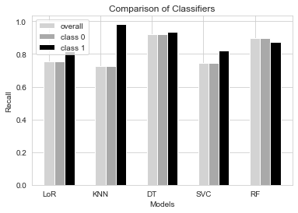
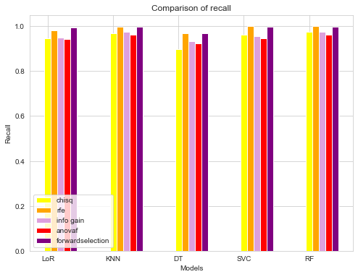
Metrics used to choose best model KNN after Recursive Feature Selection
True Positive Rate or Recall
Reducing false negatives
Worse case scenario: If a person is going to die in the next 10 years but has been predicted to not (false negative)
Best model: maximum recall score
Least number of patients who are likely to die in the next 10 years to be predicted as not likely, thus we used class 1 Recall or True Positive Rate
We also looked at overall recall and weighted average of recall.

Slide 19
Comparison of KNN before Recall of KNN after Recursive and after RFE Feature Elimination
Model | TPR | TNR | FPR | FNR | Precision | MCC | F measure | ROC area | Recall
KNN before feature selection (Overall) | 0.68 | 0.91 | 0.09 | 0.32 | 0.8872 | 0.6135 | 0.7726 | 0.7986 | 0.68
KNN after feature selection using rfe (Overall) | 1.0 | 0.41 | 0.59 | 0.0 | 0.8910 | 0.5946 | 0.9414 | 0.7041 | 1.0
KNN before feature selection using rfe (Class 0) | 0.68 | 0.9 | 0.09 | 0.32 | 0.8872 | 0.6135 | 0.7726 | 0.897 | 0.68
KNN after feature selection using rfe (Class 0) | 1.0 | 0.41 | 0.59 | 0.0 | 0.8910 | 0.5946 | 0.9414 | 0.811 | 1.0
KNN before feature selection using rfe (Class 1) | 0.91 | 0.68 | 0.32 | 0.09 | 0.7430 | 0.6135 | 0.8193 | 0.897 | 0.91
KNN after feature selection using rfe (Class 1) | 1.0 | 1.0 | 0.0 | 0.59 | 0.975 | 0.5946 | 0.5777 | 0.853 | 1.0
KNN before feature selection using rfe (Weighted Average) | 0.798 | 0.79 | 0.201 | 0.30 | 0.8151 | 0.6135 | 0.7959 | 0.8971 | 0.798
KNN after feature selection using rfe (Weighted Average) | 0.8971 | 0.51 | 0.488 | 0.42 | 0.9054 | 0.5946 | 0.8790 | 0.8183 | 0.8971
KNN after Recursive Feature Selection Recall Scores
Accuracy | 89.71%
Overall Recall | 1.0
Class 1 Recall | 1.0
Class 0 Recall | 1.0
Weighted average for Recall | 0.89

Slide 20
Randomized search Learnings and Hyperparameter tuning for best model Observations
Importance of different metrics based on the use case
There is no single best metric which can always be used to give optimal results
Importance of data reduction
How it can improve model performance in many cases.
Trying random combinations of parameters to get optimal results
Best parameters are : {'weights': 'distance', 'p': 1, 'n_neighbors': 23}
Recall metrics after Randomized search:
True positive rate is 1.0
True positive rate for class 0 is 1.0
True positive rate for class 1 is 0.48
Weighted average of True positive rate/Recall is 0.91
Observation: Accuracy increased from 89.71 to 91.16%
Weighted average of recall increased from 0.89 to 0.91
However, recall for class 1 decreased substantially.

Slide 21
Thank you.

