Slide 1
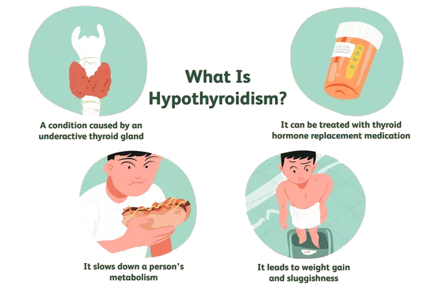
Classification of Hypothyroidism
A comparative study of the
performance of various
Machine Learning algorithms.
-Heena Rijhwani

Slide 2
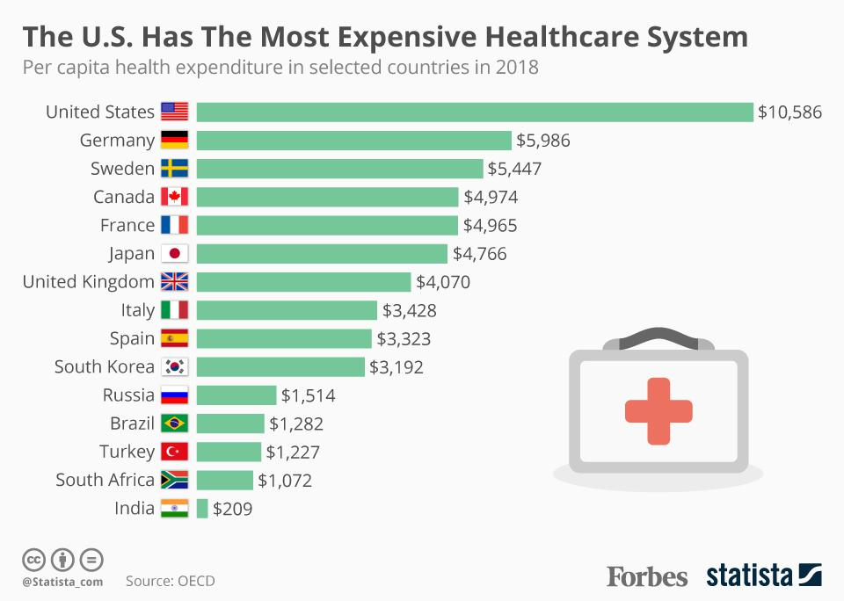
Inefficiency in Health care Systems

Slide 3
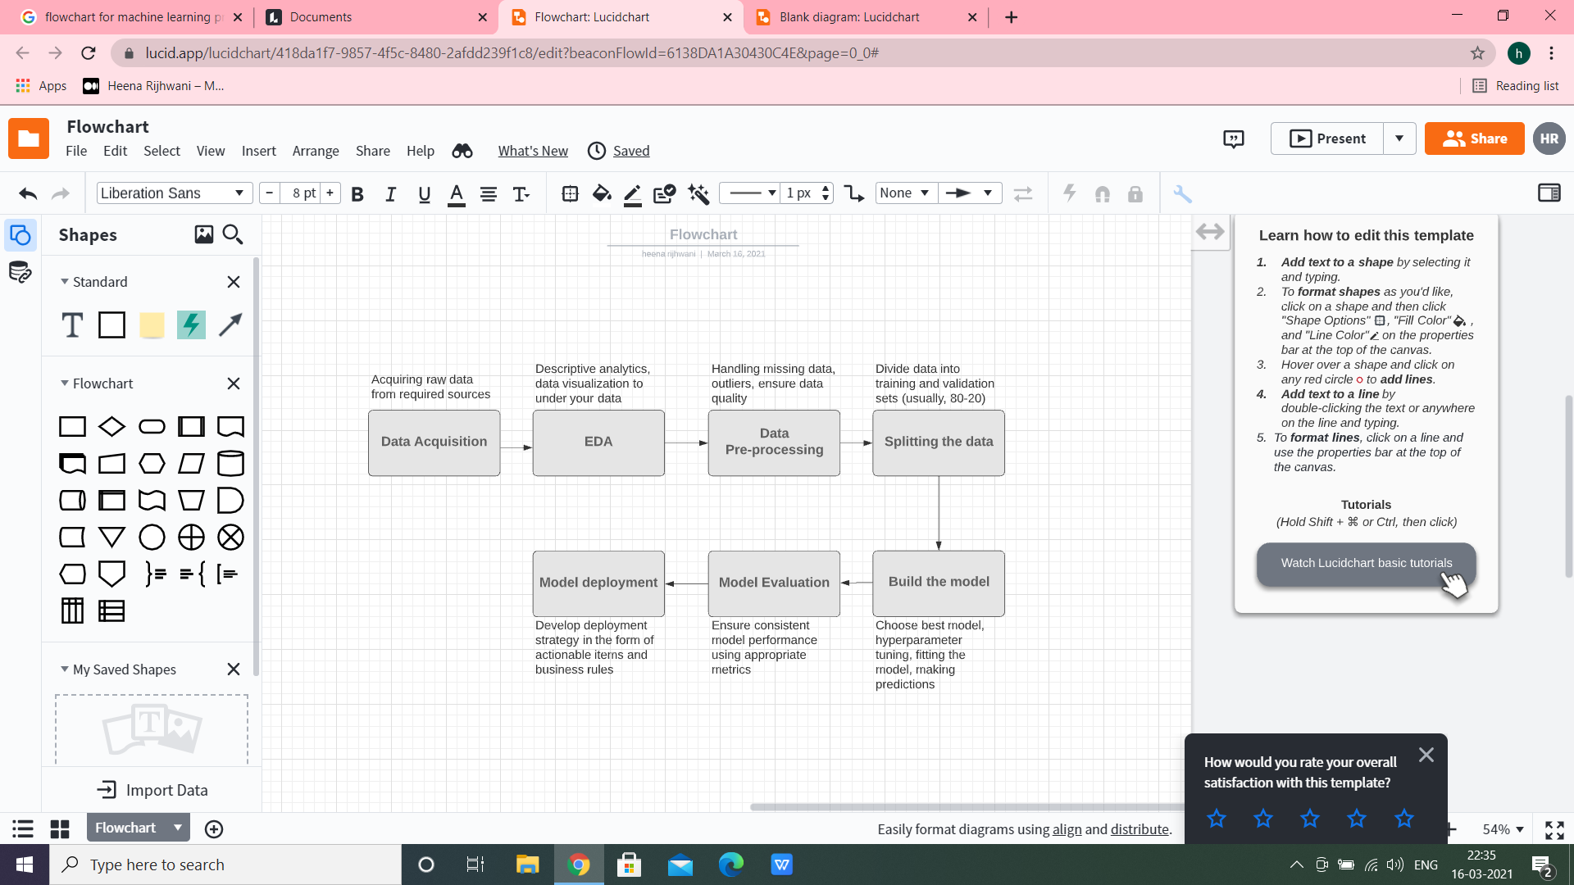
Overview of Machine Learning workflow

Slide 4
Input features for Hypothyroid
Sr. No.- | Attribute | Details
1 | Age | Patient’s age in yrs
2 | Sex | F:female, M:male
3 | On thyroxine | True/false
4 | Query on thyroxine | True/false
5 | On antithyroid mdication | True/false
6 | Sick | True/false
7 | Pregnant | True/false
8 | Thyroid surgery | Tru/false
9 | I131 treatment | True/false
10 | TSH | Thyroid simulating hormone level
11 | T3 | Triiodothyronine level
12 | Lithium | True/false
13 | Goitre | True/false
14 | Tumor | True/false
15 | Hypopituitary | True/false
16 | Psych | True/false
….…. | ….… | ….….
30 | Outcome | 0: patient does not have hypothyroid1: patient has hypothyroid
➢Converting columns to required datatypes
➢Dropping column TBG with majority values as null
Handling remaining missing values by replacing with
median of the column with respect to class label
Encoding categorial columns using Label Encoder
➢Checking for outliers using IQR criteria
➢Feature scaling

Slide 5
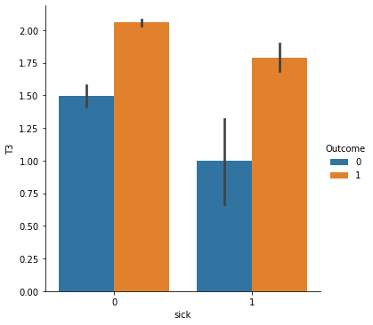
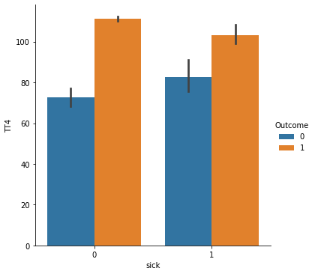
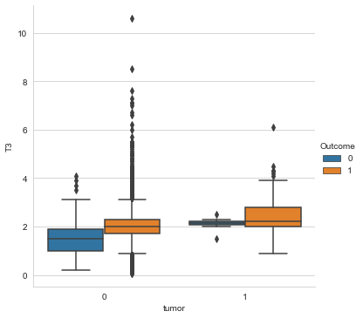
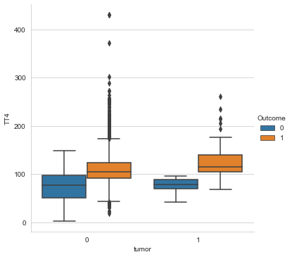
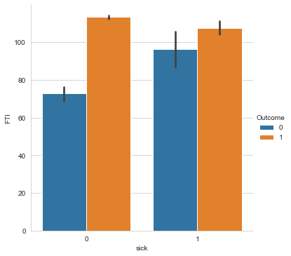
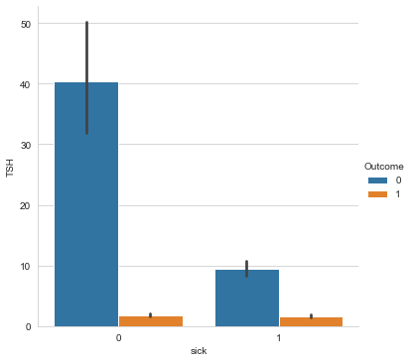
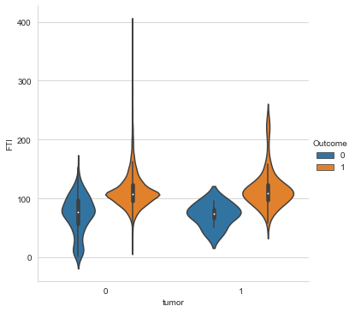
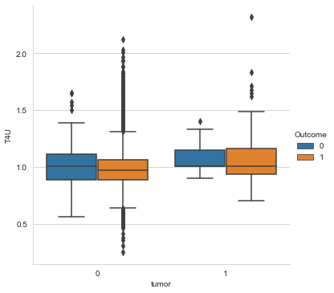
Data Visualizations Analyzing hormone levels for patients with and without hypothyroid based on if they are sick and had a tumor or not.

Slide 6
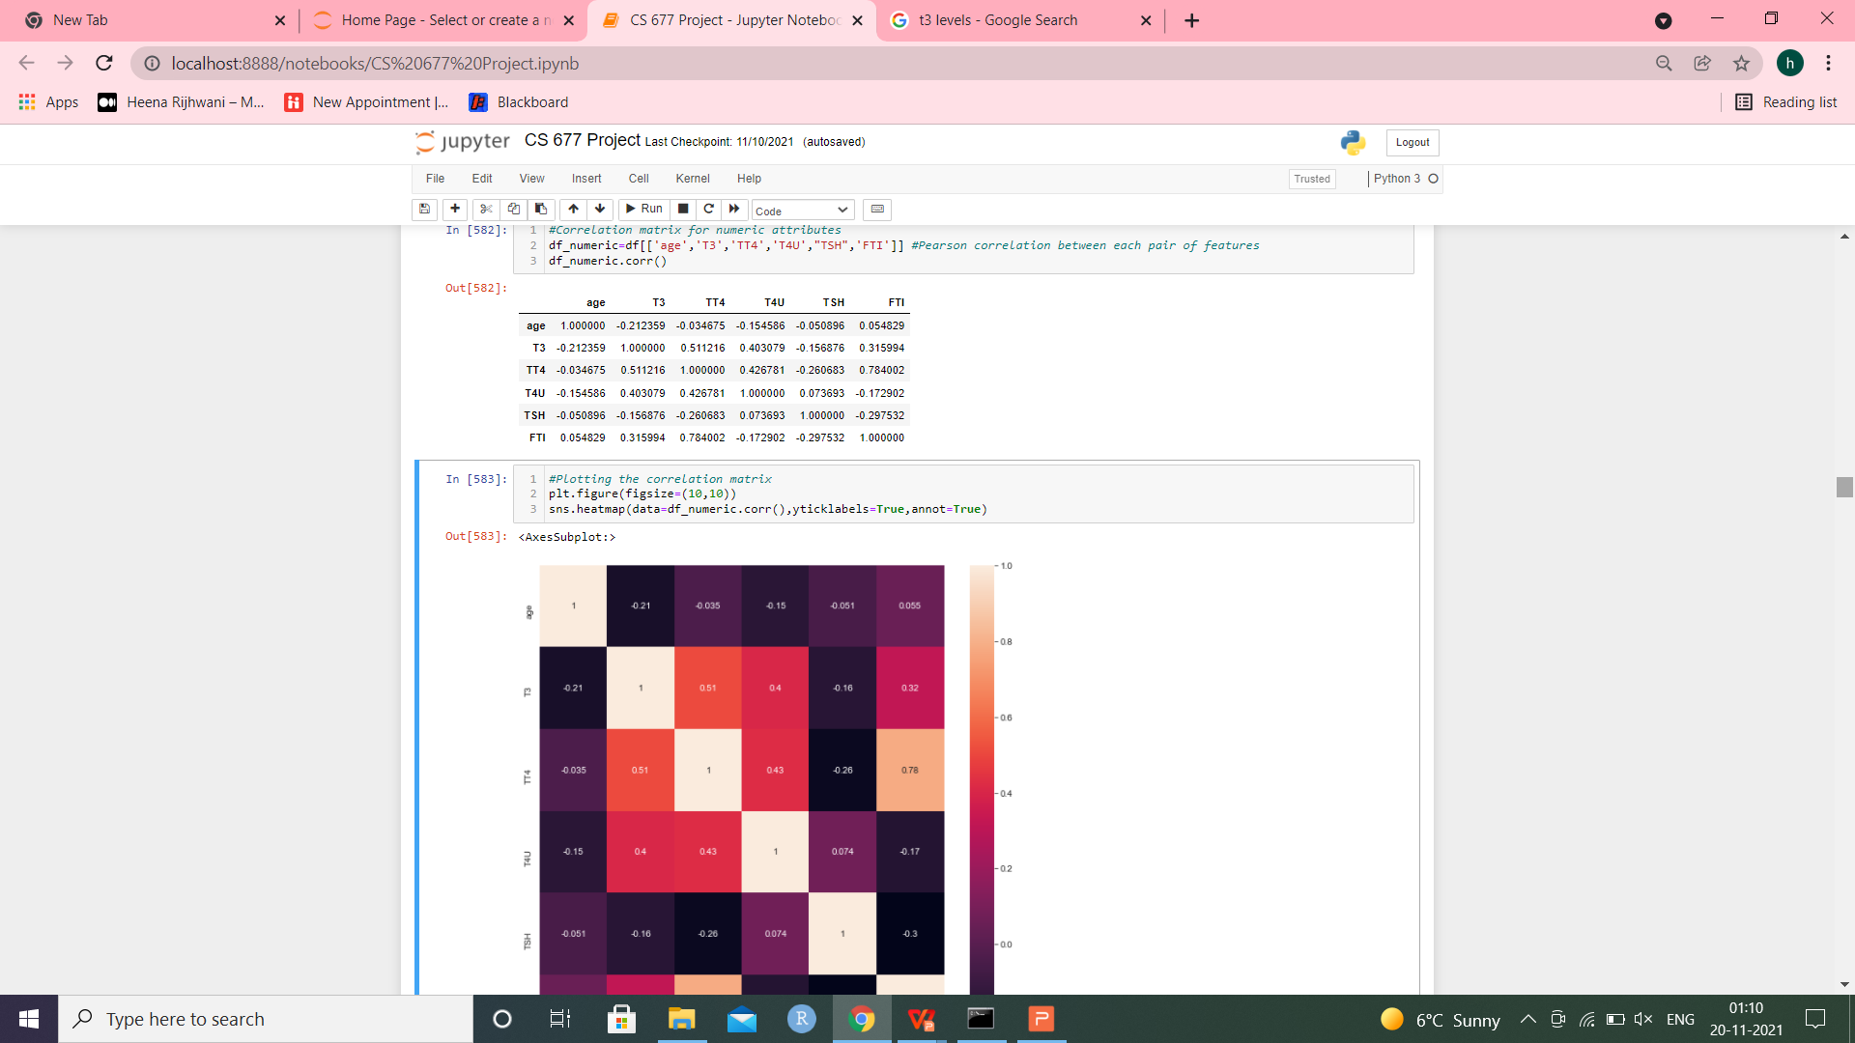
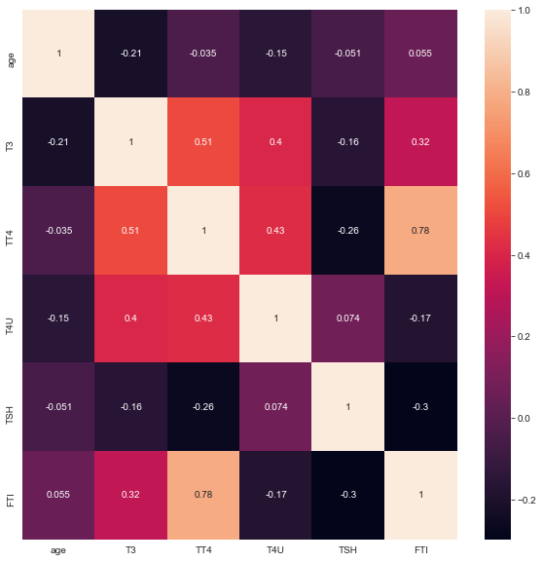
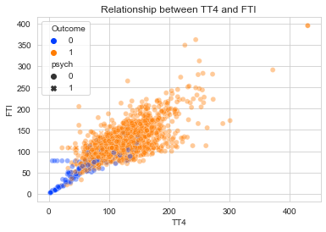
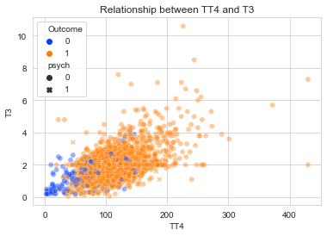
Correlation between features Strongest correlation between TT4 and FTI, followed by TT4 and T3.

Slide 7
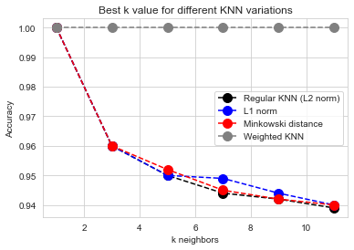
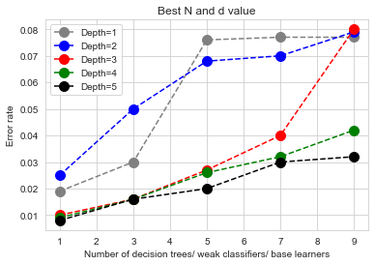
KNN Variations Random Forest Weighted KNN (k=3) performed the best. Best d (max_depth) and N(no. of estimators)
KNN Variation | Best k | Accuracy
Regular KNN (Euclidean distsnce or L2 norm) | 1 | 100%
Manhattan distance (L1 norm) | 1 | 100%
Minkowski distance | 1 | 100%
Weighted knn | 3 | 100%
Nearest Centroid method | N/A | 82.66%
Best combination: N=3, d=5
i.e. 3 weak learners or deicision trees, with a maximum depth of 5 each.

Slide 8
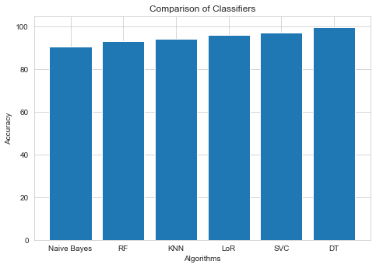
Comparison of Classifiers Best accuracy by Decision Tree
 | LoR | KNN (weighted, k=3) | Naive Bayes (multinomial+gaussian) | Random Forest | Decision Tree | Support Vector Classifier (Linear kernel gave best results)
Accuracy | 95.92% | 94.06% | 90.57% | 93.11% | 99.72% | 96.98%
ConfusionMatrix | [[ 74 72] [ 5 1735]] | [[ 74 72] [ 40 1700]] | [[ 68 78] [ 100 1640]] | [[ 18 128] [ 2 1738]] | [[ 146 0] [ 5 1735]] | [[ 95 51] [ 6 1734]]
Recallor true positive rate | 50.68 | 50.68 | 46.58 | 12.33 | 100 | 65.07
True negative rate or specificity | 99.71 | 97.77 | 94.25 | 98.89 | 99.71 | 99.66

Slide 9
Feature importance (Shapley algorithm)
Feature | Accuracy
 | LoR | KNN | Random Forest | Decision Tree | Support Vector Classifier
Original | 95.92% | 94.06% | 93.11% | 99.72% | 96.98%
Age | 95.92% | 95.17% | 99.26% | 99.72% | 96.98%
Sex | 95.97% | 93.69% | 97.14% | 99.72% | 96.92%
On thyroxine | 95.23% | 94.22% | 96.34% | 98.20% | 95.23%
Query on thyroxine | 96.02% | 94.17% | 99.05% | 99.72% | 96.98%
Medication | 95.92% | 94.06% | 97.56% | 99.68% | 96.98%
Sick | 95.92% | 94.01% | 97.89% | 99.72% | 97.08%
Pregnant | 95.92% | 94.06% | 98.52% | 99.72% | 96.92%
Surgery | 95.28% | 94.01% | 96.28% | 99.05% | 96.02%
I131 treatment | 95.92% | 94.06% | 95.71% | 99.72% | 96.98%
Query hypothyroid | 95.81% | 94.49% | 98.57% | 99.72% | 96.87%
Query hyperthyroid | 95.92% | 94.33% | 94.91% | 99.72% | 96.87%
Lithium | 95.92% | 94.33% | 96.71% | 99.72% | 96.87%
Goitre | 95.97% | 94.27% | 99.10% | 99.72% | 96.87%
Tumor | 95.81% | 94.38% | 98.67% | 99.72% | 96.87%
Hypopituitary | 95.97% | 94.27% | 95.76% | 99.72% | 96.87%
Psych | 95.92% | 94.28% | 98.61% | 99.72% | 96.87%
TSH measured | 96.13% | 94.34% | 98.61% | 99.72% | 96.92%
TSH | 94.06% | 91.89% | 93.11% | 91.67% | 93.74%
T3 measured | 95.97% | 94.27% | 98.09% | 99.72% | 96.92%
T3 | 95.92% | 94.38% | 93.55% | 99.68% | 96.55%
TT4 measured | 95.92% | 94.49% | 99.15% | 99.72% | 96.92%
TT4 | 95.97% | 94.01% | 98.20% | 99.47% | 96.92%
T4U measured | 95.92% | 94.27% | 98.94% | 99.68% | 96.87%
T4U | 96.02% | 95.28% | 95.60% | 99.63% | 96.92%
FTI measured | 95.92% | 94.33% | 98.72% | 99.72% | 96.87%
FTI | 95.97% | 94.06% | 96.92% | 99.63% | 96.92%
TBG measured | 95.92% | 94.27% | 98.57% | 99.72% | 96.87%

Slide 10
Feature importance
LoR: Accuracy decreased the mose on removing feature TSH. It increased the most on removing feature TSH measured.
Most import feature: TSH
Least important feature: TSH measured
KNN:
Most import feature: TSH
Least important feature: T4U
RF:
Most import feature: TSH
Least important feature: age
DT:
Most import feature: TSH
Least important feature: Accuracy remained almost the same when other features were removed.
SVC:
Most import feature: TSH
Least important feature: sick

Slide 11
Hyperparameter Tuning and Cross Validation For best classifier (i.e. Decision Tree)
Randomized Search
Selects random combinations of hyperparameters to train the model.
random_grid = {"max_depth": [i for i in range(1,100)],
"max_features": ['auto', 'sqrt','log2'],
"min_samples_leaf" : [j for j in range(1,11)],
"criterion": ["gini", "entropy"],
"splitter":["best", "random"]}
#Using Startified KFold Cross Validation.
cv = RepeatedStratifiedKFold(n_splits=10, n_repeats=5, random_state=3)
#Specifying base estimator, parameter grid, number of iterations and cross validation.
dt_after_randomizedsearch=RandomizedSearchCV(estimator=dt2,param_distributions=random_grid,n_iter=100,cv=cv)
Best parameters:
{'splitter': 'best',
# 'min_samples_leaf': 1,
# 'max_features': 'sqrt',
# 'max_depth': 9,
# 'criterion': 'gini'}
Grid Search
Tries every possible combination of hyperparameters.
more exhaustive, but time consuming.
Supplying best parameters got from random search + additional parameter options as well.
#Specifying base estimator (from randomized search), possible parameters and cross validation.
dt_after_gridsearch=GridSearchCV(estimator=dt3,param_grid=param_grid,cv=cv)
#Fitting classifier on best params.
dt4 = DecisionTreeClassifier(splitter='best',
min_samples_leaf=1,
max_features= 'auto',
max_depth= 200,
criterion= 'entropy')
Final accuracy was slightly higher (99.72% ---> 99.89%).

Slide 12
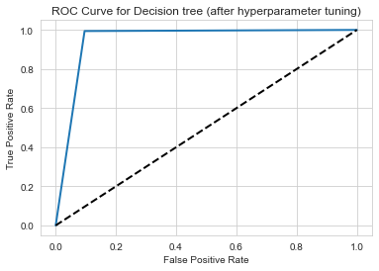
Evaluation Metrics For Decision Tree after hyperparameter tuning and cv
 | Accuracy
Accuracy | 99.89%
ConfusionMatrix | [[ 132 14] [ 10 1730]]
True positive rate or recall or sensitivity | 90.41
True negative rate or selectivity or specificity | 99.43
Precision or positive predicted value (PPV) | 0.93
Negative predicted value | 0.99
F1 score | 0.92
False negative rate or miss rate | 0.10
False positive rate or fallout rate | 0.01
False discovery rate | 0.07
False omission rate | 0.01
ROC-AUC score | 0.95

Slide 13
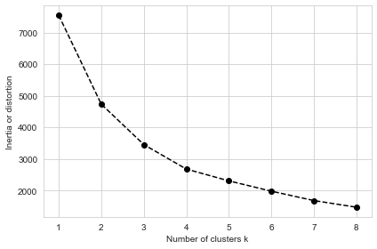
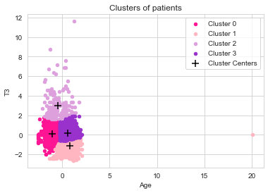
KMeans Clustering
Plotting number of clusters vs inertia. (Best k =4)
Cluster centroids are: [[-1.00486819 0.08231764]
[ 0.81368309 -1.1619196 ]
[-0.45584153 2.9871567 ]
[ 0.56775931 0.13522548]]
Percentage of healthy and unhealthy labels in first cluster is 6.53 % and 93.47 % respectively.
Percentage of healthy and unhealthy labels in second cluster is 19.8 % and 80.2 % respectively. (Comparatively impure cluster).
Percentage of healthy and unhealthy labels in third cluster is 2.38 % and 97.62% respectively.(Purest cluster-mostly hypothyroid patients).
Percentage of healthy and unhealthy labels in fourth cluster is 3.78 % and 96.22 % respectively.
Cluster1: Patients with lower age and lower T3
Cluster2: Patients with comparatively higher age and lower T3
Cluster3: Patiets with higher age and slighty higher T3
Cluster4: Patientswith higher T3.

Slide 14
Thank you.

