Slide 1


Slide 2
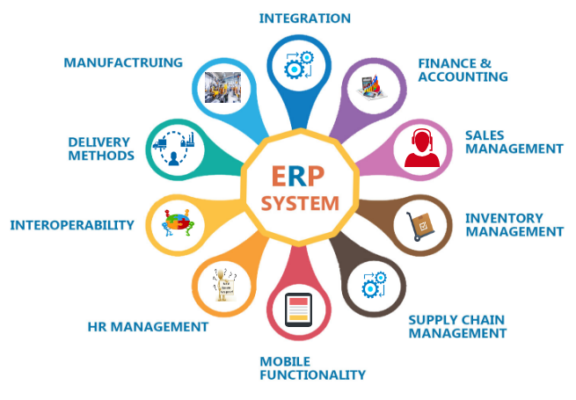
Introduction
SAP is the ERP (Enterprise Resource Planning) system that aims to integrate all the different modules in the company.
SAP stands for Systems, Applications, and Products in Data Processing .
Significant company growth is driven by the SAP HANA in-memory platform that makes lightning-fast data analytics a reality.
Strategic acquisitions coupled with continued innovation make SAP a leader in cloud computing and e-commerce business networks.

Slide 3

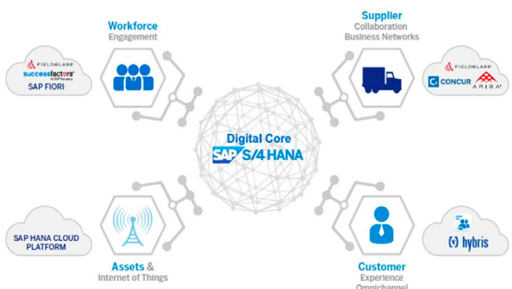
SAP- Digital Supply Chain Solutions
Supply Chain Planning
Make agile, market-driven plans with supply chain visibility, collaboration, and intelligence.
Collaborative supply chain network
Integrated business planning
Inventory optimization
Procurement and supplier management
Predictive analytics, AI, and machine learning

Slide 4

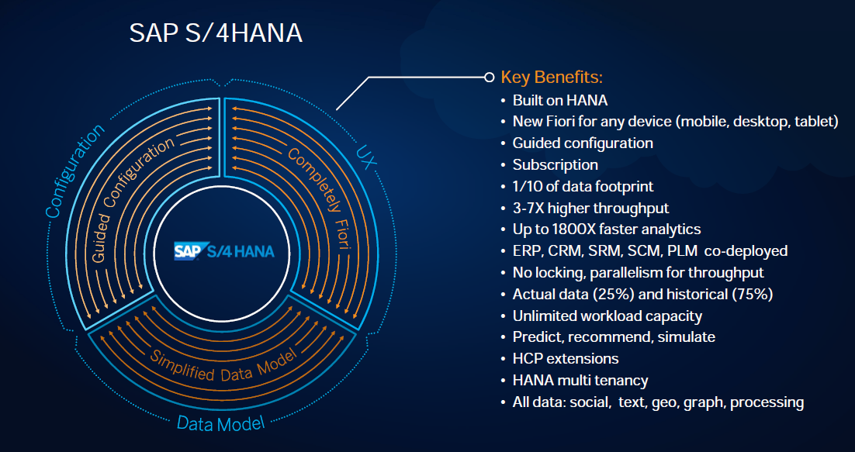
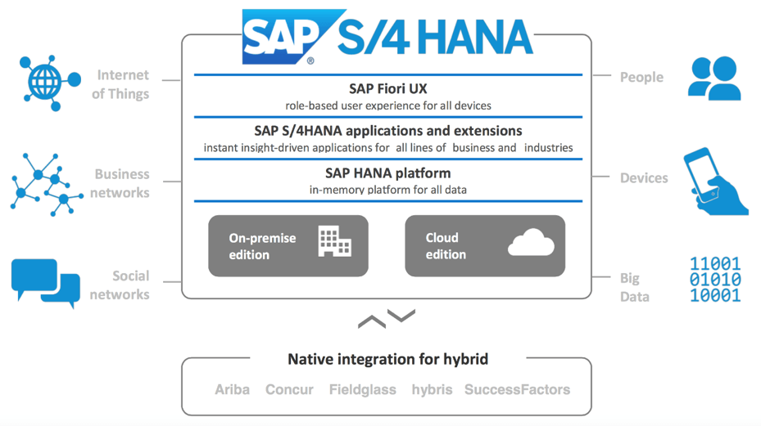
Notes:
https://blogs.sap.com/2020/01/17/cloud-vs-on-premises-with-sap-s-4-hana/
SAP S/4HANA is SAP's ERP for large enterprises.
Simplicity of the Data Model
Powered by HANA (in-memory columnar database)
Visualization through Fiori

Slide 5
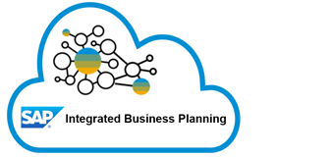
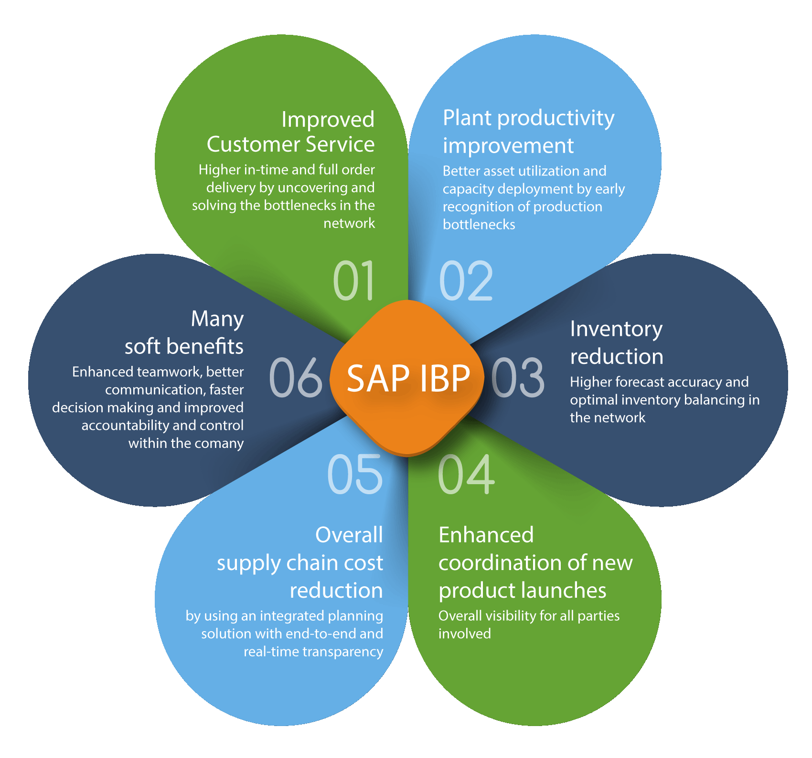
SAP IBP
SAP Integrated Business Planning (SAP IBP) is a SAP HANA-based cloud solution to manage the strategic, tactical, and operational objectives of the company—all in an integrated environment.
Applications of SAP IBP
SAP IBP for sales and operations
SAP IBP for demand
SAP IBP for response and supply
SAP IBP for inventory
SAP Supply Chain Control Tower

Slide 6
Case Study
Company C, which has SAP S/4HANA and IBP implemented, plans to improve the supply chain planning process.
The company is currently using a forecast in combination with MRP run, with good forecast quality.
Material can be produced in several facilities across the globe, but not all plants have enough capacity to produce the entire quantity forecasted for the materials.
Which planning process and relevant functions should be implemented to help the company ?

Slide 7
Planning Processes in SAP Mentioned in the diagram are the planning processes in SAP The following Solutions have been chosen to alleviate the issue with Company C : 1)INVENTORY PLANNING 2)SUPPLY PLANNING
SAP Planning Processes
Sales and Operations Planning
Demand Planning
Inventory Optimization
Demand-Driven Replenishment
Response and Supply Planning
Supply Network Planning

Slide 8
SAP SCM Planning Processes :-
SUPPLY PLANNING
MRP
Supply Network Planning
PP/DS
Response & Supply Planning
MRP Live
INVENTORY PLANNING
ERP using MRP Monitor
ERP with Simulation Safety stock (SSS)
DDMRP

Slide 9
Production Planning & Detailed Scheduling

Slide 10
WHAT PP/DS
Supply planning process
Use to analyze the lead time and resources
To determine what, when and where to make/buy

Slide 11
WHY PP/DS
MRP and capacity planning are strictly seperated
primarily the tool of choice for planning critical products

Slide 12
HOW PP/DS
Aim of right quantity in the right place at the right time .
Enables to plans accurate to the hour, not just to the day.
Algorithms are available to plan both material and capacity.

Slide 13
Planning process Using PP/DS
Mastrer Data
PP/DS Setting
Transfer Of Data To PP/DS
Automatic Production Planning
Inventory Planning
Production Execution

Slide 14
Response and Supply Planning

Slide 15
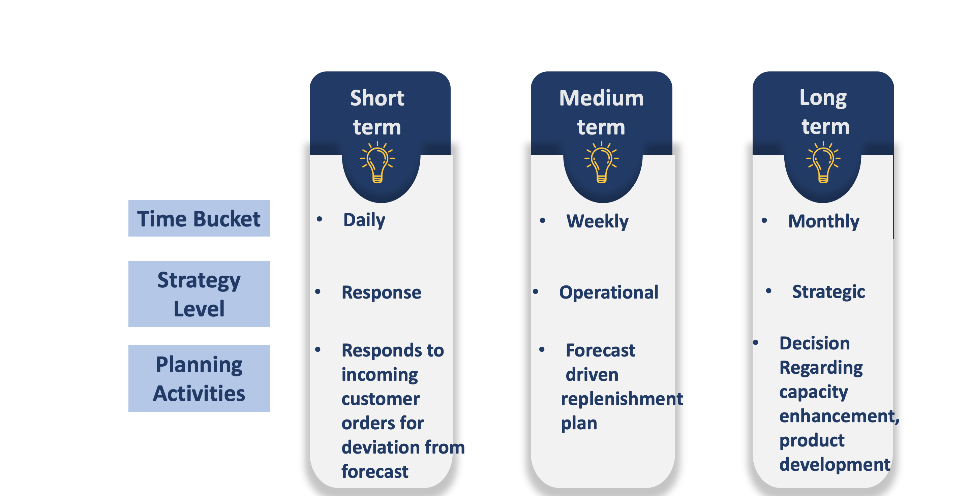
PLANNING HORIZONS

Slide 16
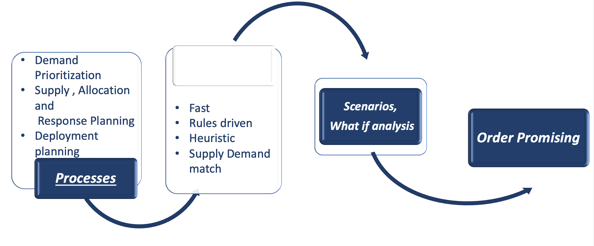
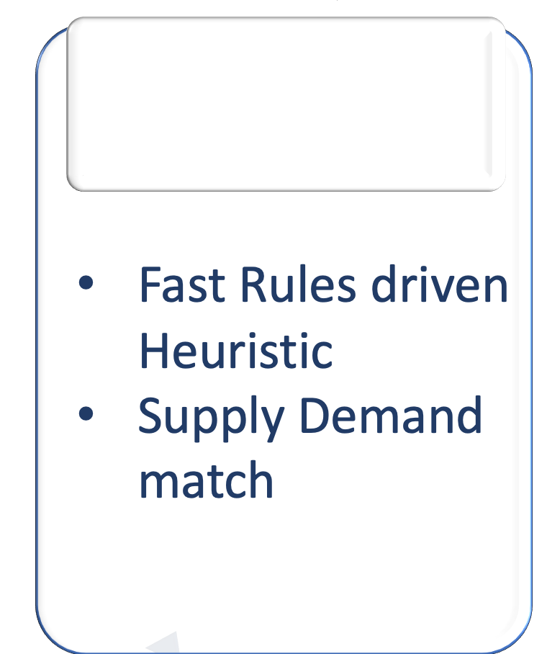
OPERATIONAL AND RESPONSE PLANNING
Demand
Supply

Slide 17
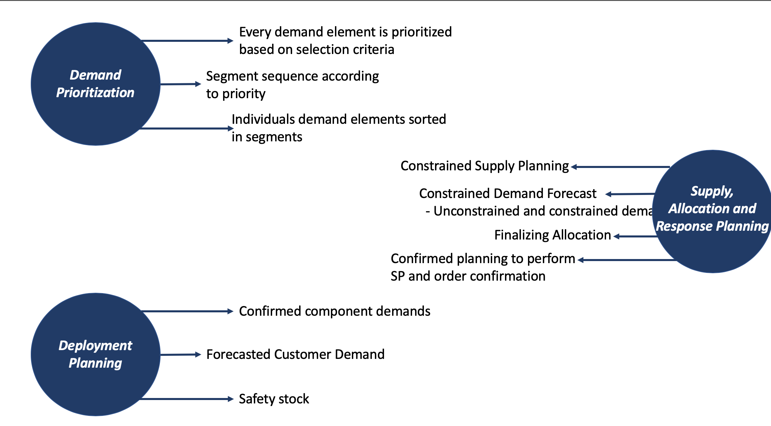

Slide 18
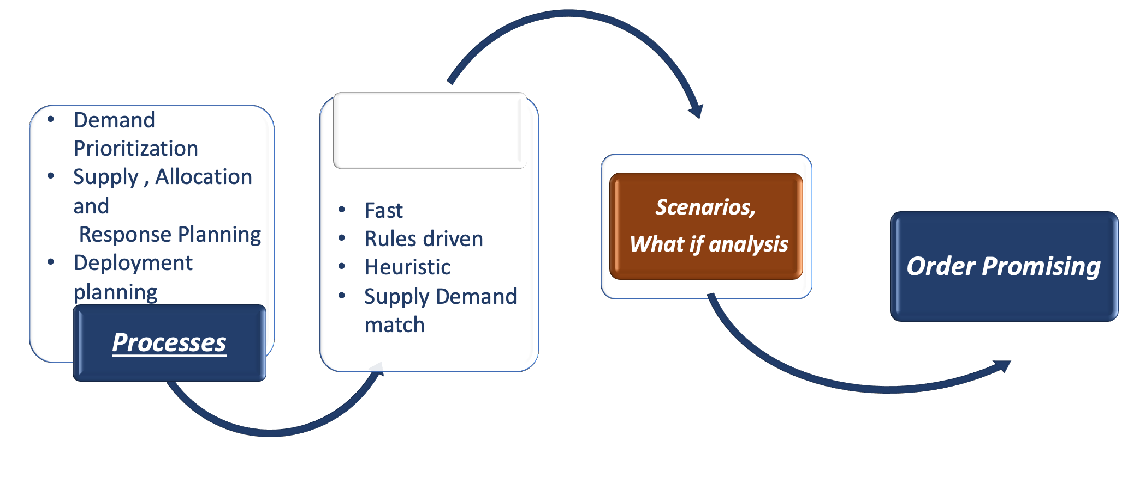
OPERATIONAL AND RESPONSE PLANNING
DEMAND
SUPPLY

Slide 19
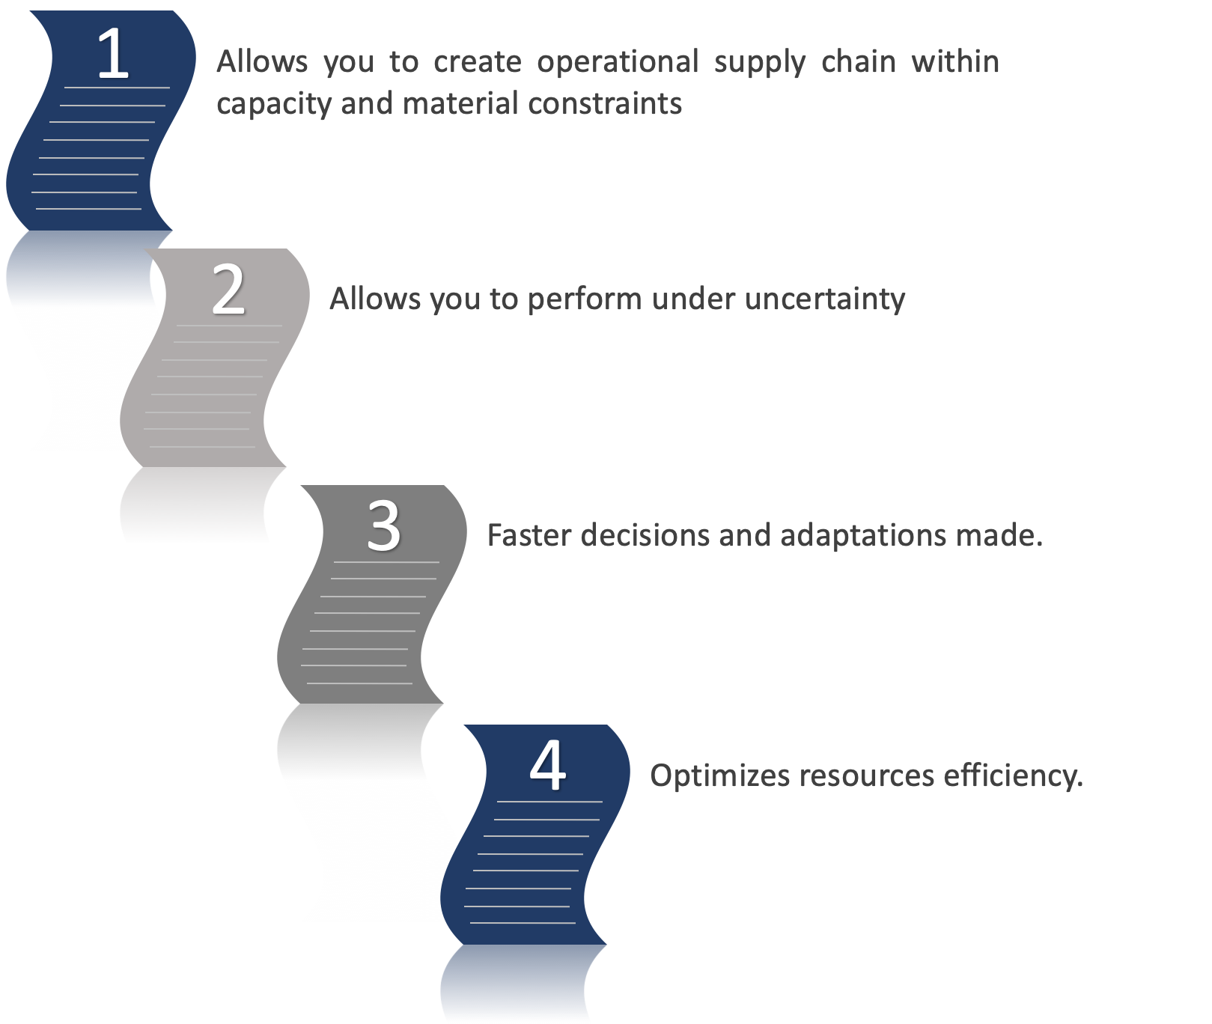

Slide 20
Demand Driven Material Requirement Planning

Slide 21

Plan and manage supply chains efficiently based on customer demand.
End to End Methodology for Planning.
Material Shortage Quantity.
Not only Quantity but Timeline considerations.

Slide 22
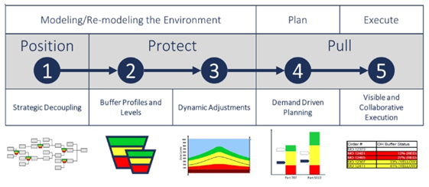
Components Of DDMRP

Slide 23
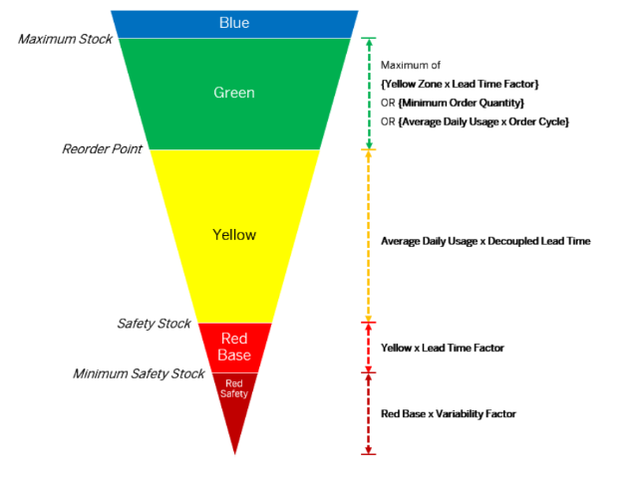
Buffer Zones

Slide 24



LEAD TIME COMPRESSION
LOWER SUPPLY CHAIN COST
CUSTOMER SERVICE
RIGHT SIZE INVENTORY
WHY DDRM

Slide 25


Production Planning / Detailed Scheduling
Planning of resources
Alert monitor during material requirement planning run
Planning critical products having long replenishment
Backlog Free Planning
Automatic Planning irrespective of change in the customer requirement
Planning MTS and MTO
Better co-ordination reduces lead-time, increases throughput, on-time delivery
Only On Premise
No buffer stock consideration
No order-based scheduling

Slide 26
Response & Supply Planning
On Cloud
Quick adaptation based on demand
Order based scheduling
Constrained and unconstrained
Integration with the entire supply chain increases sales, reduces cost and inventory level thus improving production
No buffer stock consideration
Entire supply chain is considered whereas the focus of the problem is in the production line

Slide 27
Demand-Driven Material Requirement Planning
On cloud
Inventory Planning
Replenishment based on actual demand as well as forecasted demand
Efficient Planning of Buffer stock
Buffer Alerts
IBP already implemented in the company, hence no additional cost incurred

Slide 28
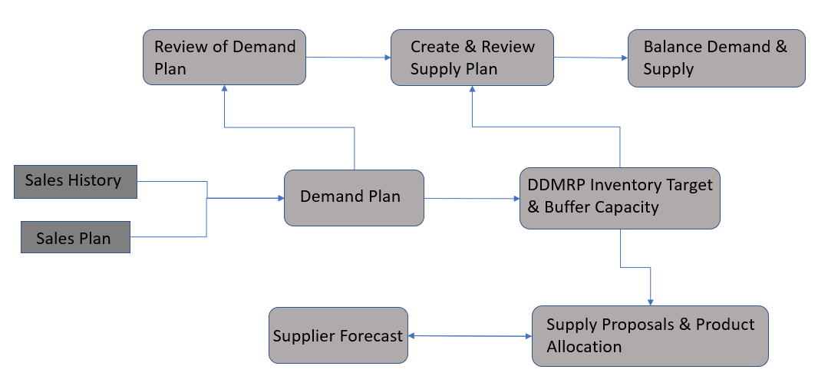
Effects on the End to End Process

Slide 29
Conclusion
Considering, the main pain point of the company, DDMRP is the optimal solution for resolving the issue of insufficient capacity for production in the facilities.
DDMRP uses strategic decoupling points to drive supply order generation and management throughout a supply chain. It enables companies to determine where product should be stocked and in what form.
Regardless of other benefits of DDMRP, taking a company's supply chain from chaos to a controlled state will be of huge value to companies, both financially and otherwise.
At the end we can conclude that using the combination of all the three solutions to have a much optimized and feasible solution for the case study.

