Slide 1
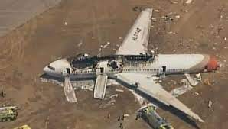
AIRCRAFT COLLISIONS IN USA
DATA 230
Project Presentation
Presented By,
Heer Parekh
015270320

Slide 2

Project Background
• What? – Aircraft collisions in the USA since 1982
• Why? – number of air crashes has remained consistent since 1982 and detailed study of the causal elements is not done on a regular basis by the aviation industry
• How? – Identifying significant patterns, trends and outliers from the visualizations created
• Benefits? - Evaluate the data by discussing the different effects of aviation accidents caused and how we could increase the quality and safety of air travel

Slide 3






Deliverables
DELIVERABLES
To provide total statistics of impairments caused after the crash
Display the location details, fatality rate per crash, etc
Total crashes and accidents that have taken place

Slide 4

Project Requirements
Requirement Gathering
Aircraft Collision data for United States of America
Reliable data sourced from ‘Kaggle.com’
‘Kaggle.com’ - public licensed visibility with a provenance collection methodology.
Data Requirements
Output
output.csv data, for USA has data from 1982 to 2020.
Information about diverse records of the air collision such as State, Event. Date, accident_carrier,total_injured, etc.
Hexagon_map
Hexagon_map .csv data, contains geographical details of USA.
Includes information about latitude, longitude, City, State, Abbreviations, etc.

Slide 5

Project Required Resources
Find an appropriate aircraft collision dataset and select the appropriate technology and platforms.
Function | Resource
Collection of Data | Kaggle.com
Data Processing | Tableau Prep Builder
Visualizations | Tableau Desktop

Slide 6

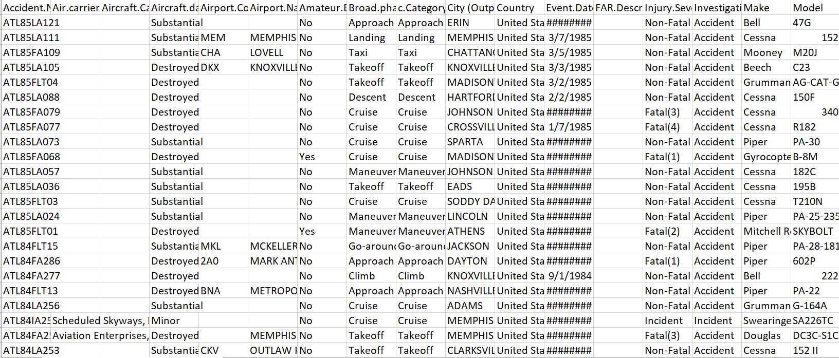
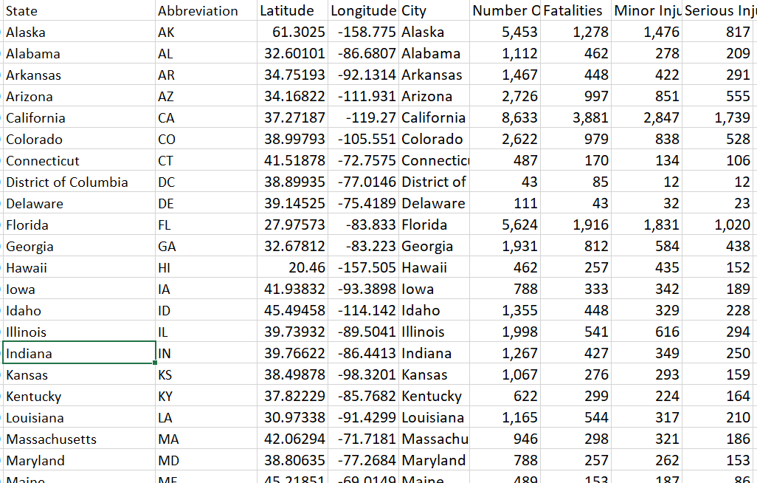
Data Collection
Output.csv
Hexagon_map.csv
Primary data – Kaggle.com
Collected data for particular factors
Data from 1982-2020
Data complexity - 30 attributes like State, Investigation status, country, event_date, airport_code, purpose_of_flight, number_of_accidents, etc.
Consists of 79,170 records.
Secondary data - Kaggle.com
Data complexity - nine attributes
Contains longitude, latitude, City, State, Abbreviations, fatalities, minor_injuries,etc.
consists of 60 records.

Slide 7

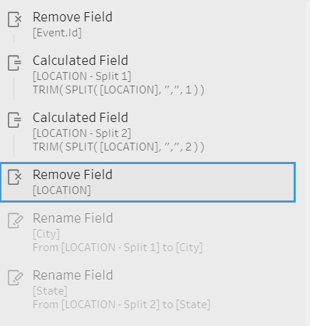
Data Processing
Merge the two datasets in Tableau Prep.
Removing nulls, duplicates and redundant attributes.
Data formatting, removing unnecessary columns, splitting of columns, renaming different fields
Only informative attributes are selected to create meaningful visualizations

Slide 8

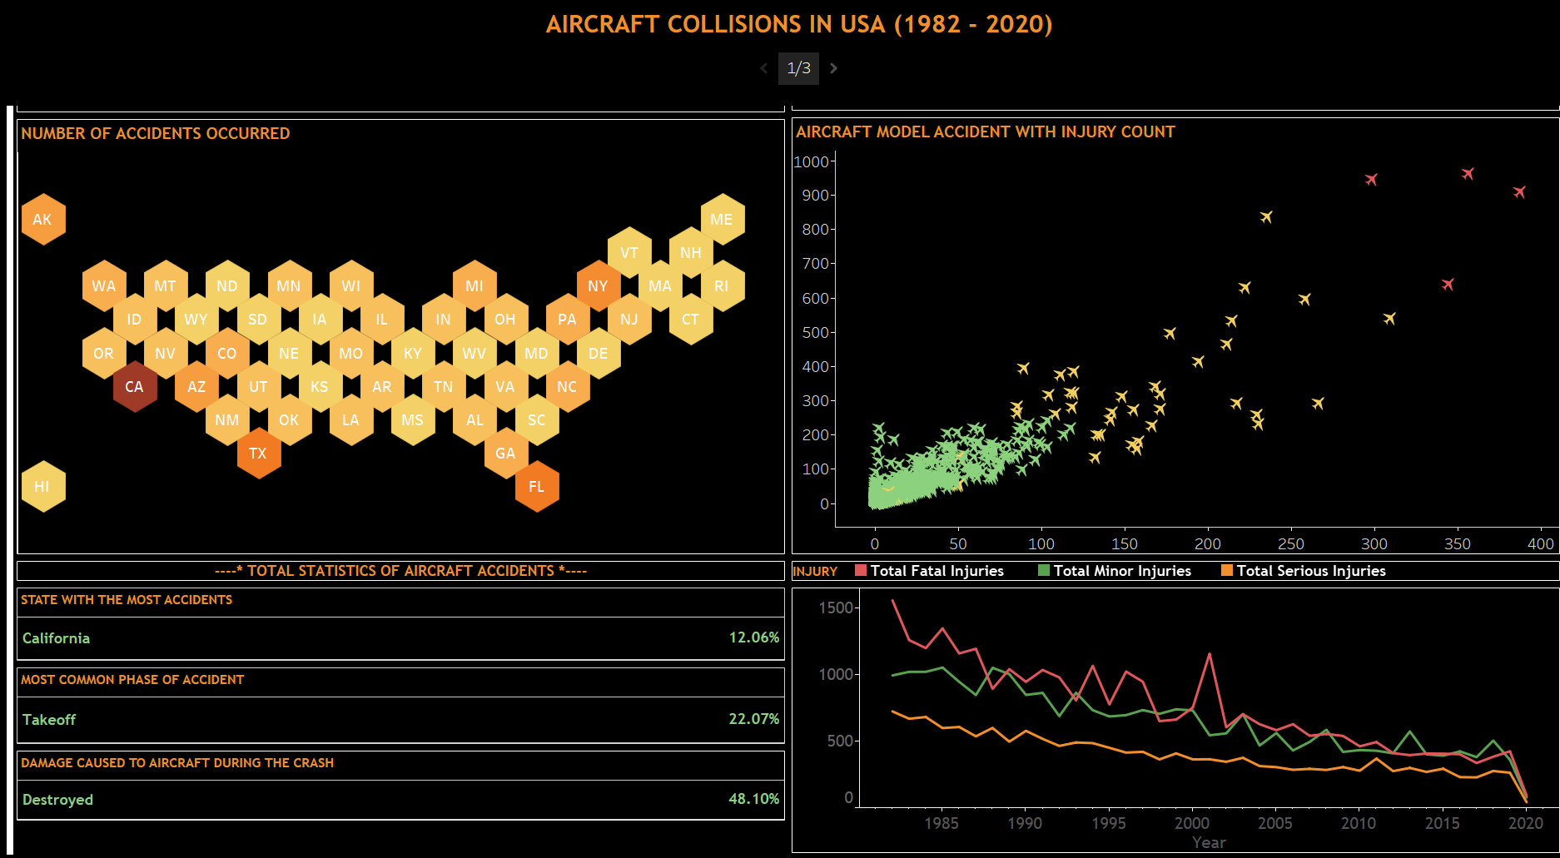
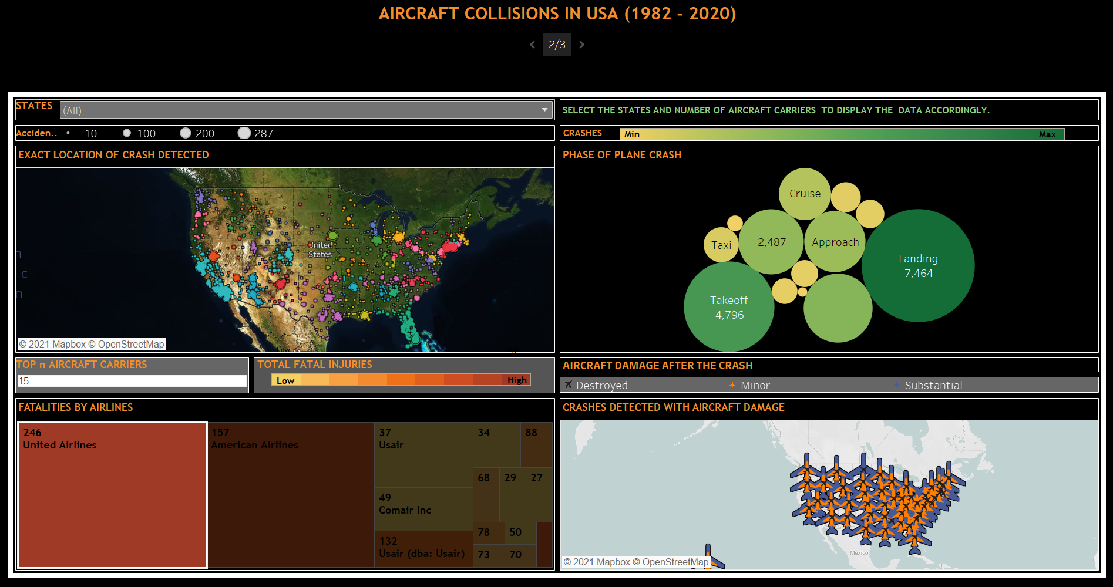
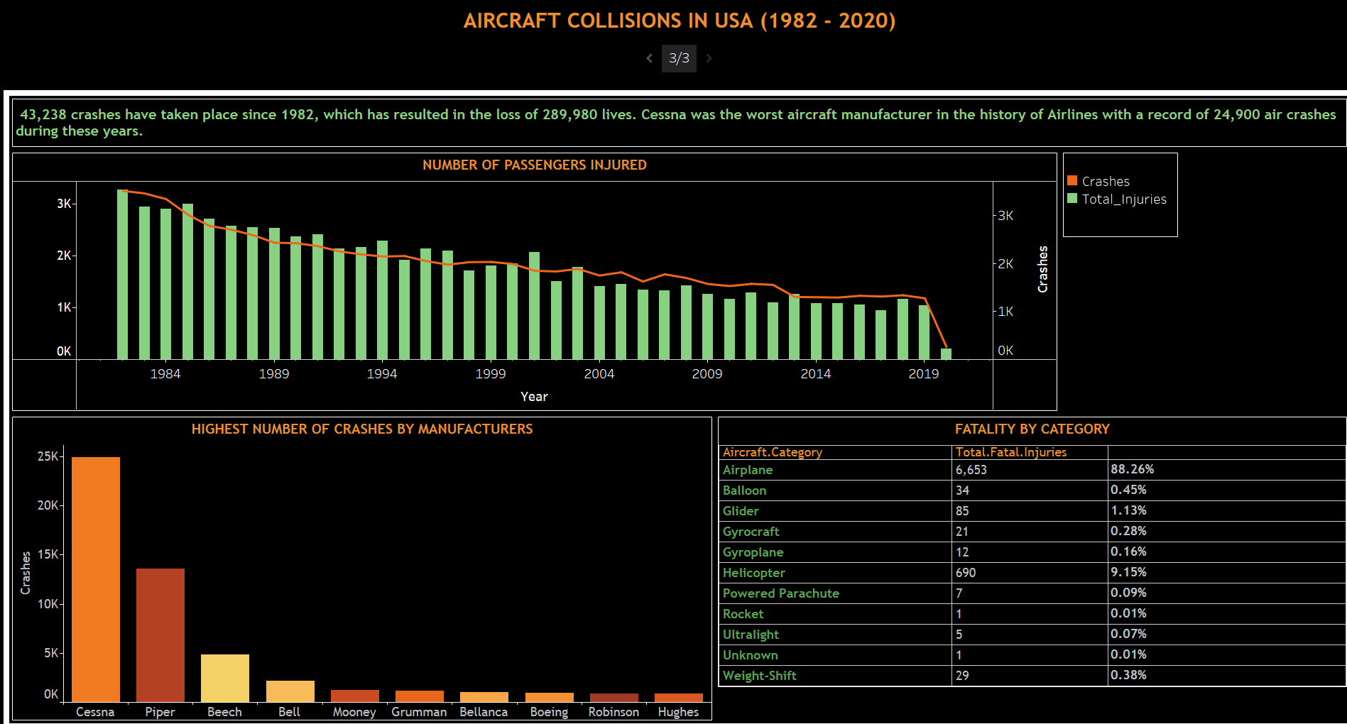
Visualizations

Slide 9
Thank You!

