Slide 1
T
theatreOS
A smarter interval.
A stronger food business.
One connected experience for guests, staff and managers.
WORKING MVP • CLIENT DISCUSSION
Prepared for CINELUX · October 2026
THEATREOS / CINELUX PROPOSAL
01

Slide 2
THE OPPORTUNITY
The interval is where service and sales collide.
Guests want convenience; the team needs control; managers need a clear picture of what worked.
01 / GUEST
02 / TEAM
03 / MANAGER
Ordering friction
Peak-time pressure
Decisions by instinct
A guest may miss the chance to buy if queues and timing feel uncertain.
Kitchen and runners need the seat, target time and prep sequence in one place.
Without joined-up data, menu, offer and staffing choices are hard to validate.
THEATREOS CONNECTS ALL THREE MOMENTS IN ONE WORKFLOW
THEATREOS / CINELUX PROPOSAL
02

Slide 3
THE SOLUTION
One system. Three connected moments.
An order made at the seat becomes an actionable kitchen ticket—and then a measurable business signal.
01
02
03
Guest
→
Team
→
Manager
Seat QR → menu, ingredients, ETA and interval pre-order
Prep-deadline queue → kitchen and runner progression
Menu, offer, timing and capacity insights
THEATREOS / CINELUX PROPOSAL
03

Slide 4
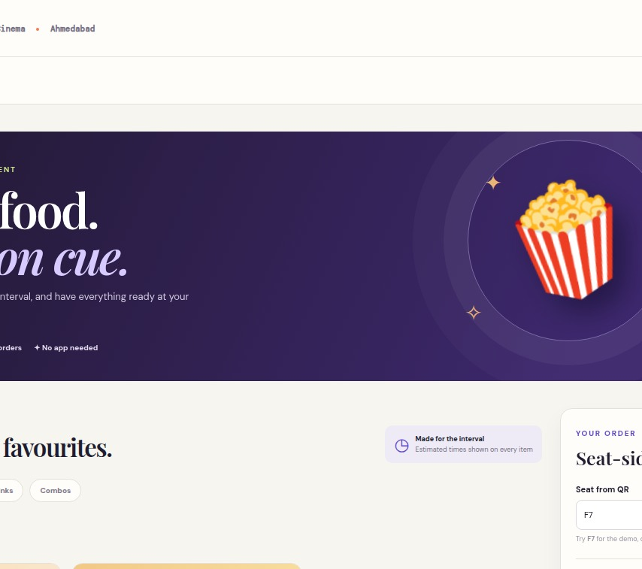
01 / GUEST EXPERIENCE
Scan. Choose.
Pre-order.
A seat QR opens the menu—no app download.
Combos, best sellers, ingredients and allergens are visible.
Guests see an estimated delivery time and can order for the interval.
A direct-ticket food coupon can be demonstrated.
DEMO CHECKOUT · NO PAYMENT COLLECTED
THEATREOS / CINELUX PROPOSAL
04

Slide 5
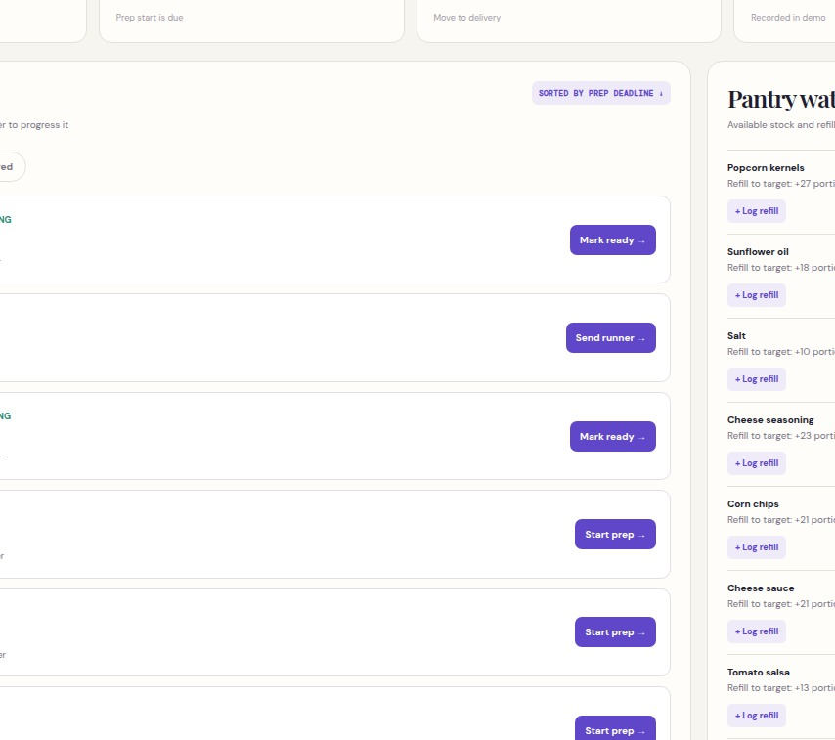
02 / KITCHEN & STAFF
A queue designed
for the rush.
Tickets carry the screen, seat and promised time.
Orders sort by when preparation must start.
Staff move each order from prep to delivery.
Pantry levels and refill needs stay visible.
THEATREOS / CINELUX PROPOSAL
05

Slide 6
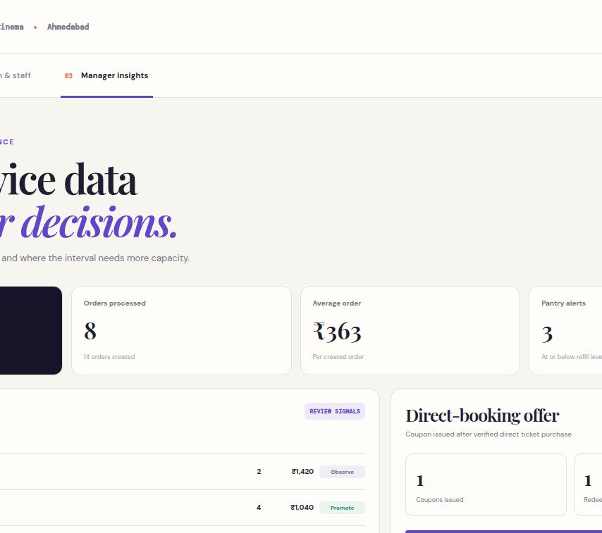
03 / MANAGER INSIGHTS
Turn service data
into decisions.
See order volume, average basket and item performance.
Track coupon issuance and redemption.
Review on-time preparation and delivery.
Estimate runner capacity for the next interval.
SAMPLE METRICS · NOT A FORECAST
THEATREOS / CINELUX PROPOSAL
06

Slide 7
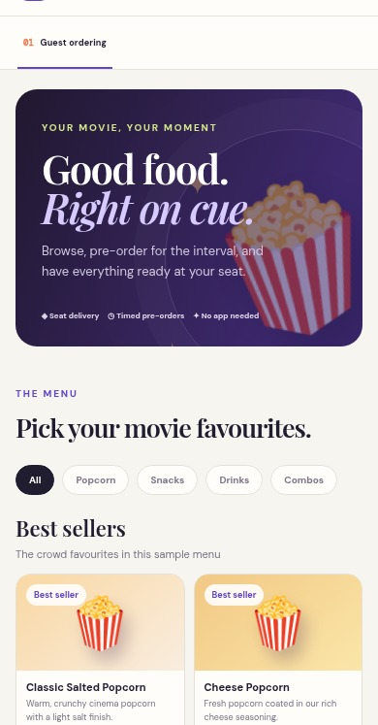
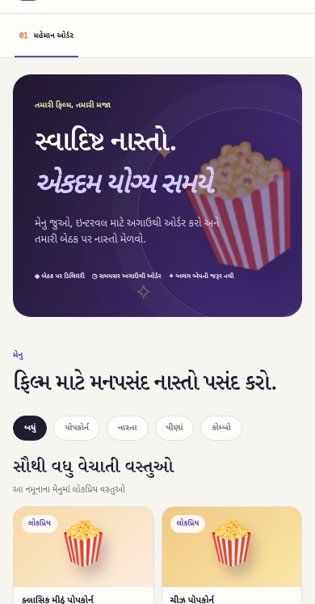
BUILT FOR THE AUDIENCE
English ↔ ગુજરાતી, in one tap.
Guests and staff can switch language without changing the order data. Gujarati QR links can open directly in Gujarati.
One menu.
Two languages.
ENGLISH
ગુજરાતી
THEATREOS / CINELUX PROPOSAL
07

Slide 8
BUSINESS CASE
Prove the value with a pilot—not assumptions.
The dashboard turns each proposed benefit into a measurable operating question.
More food orders
QR-to-order conversion · F&B attach rate
Better basket value
Average order value · combo share
More reliable service
Ready-on-time · delivered-on-time · cancellations
Smarter staffing & stock
Stock-outs · waste · runner workload
Direct-ticket coupon impact should be compared with its discount and channel cost; redemption alone is not incremental profit.
THEATREOS / CINELUX PROPOSAL
08

Slide 9
NEXT STEP
A controlled pilot, then a scale decision.
Proposed sequence for one auditorium or a defined show set.
1
2
3
4
Align
Connect
Run
Review
Menu, seat map, interval timings, baseline and owner
Payment, ticketing/POS and inventory inputs
Supervised ordering, kitchen and delivery trial
Compare conversion, basket, speed and operations
Before real orders: complete payment, ticket validation, POS reconciliation and operational security review.
THEATREOS / CINELUX PROPOSAL
09

Slide 10

T
theatreOS
Let’s make one interval
work better.
Approve a pilot workshop: menu, seat map, show timings, integration owners and success measures.
SCAN FOR THE
GUJARATI DEMO
Open the working TheatreOS demo →
Live preview uses sample data; payments and ticketing are not connected.
THEATREOS / CINELUX PROPOSAL
10

