Slide 1

MERIDIAN
Hospital Management System
A ward & outpatient management console for admins, doctors and patients —
built to run entirely in the browser.
HTML · CSS · JAVASCRIPT · NO BACKEND REQUIRED

Slide 2
THE PROBLEM
Hospitals still run the front desk on paper
Registers, sticky notes and phone calls make it hard to know who's booked in, which beds are free, or what a doctor's day actually looks like. Front-desk staff, doctors and patients all see a different, incomplete picture.
WITHOUT A SHARED SYSTEM
“Which doctor is free
at 3 PM tomorrow?”
No single source of truth
Patient, doctor and bed records live in different notebooks and spreadsheets.
A question every front desk asks — and today, answering it means flipping through paper.
Scheduling collisions
Appointments get double-booked with no shared calendar to check against.
Zero visibility for patients
Meridian replaces all of it with one console.
Patients have no way to see their own appointments or history.
02 / 10

Slide 3
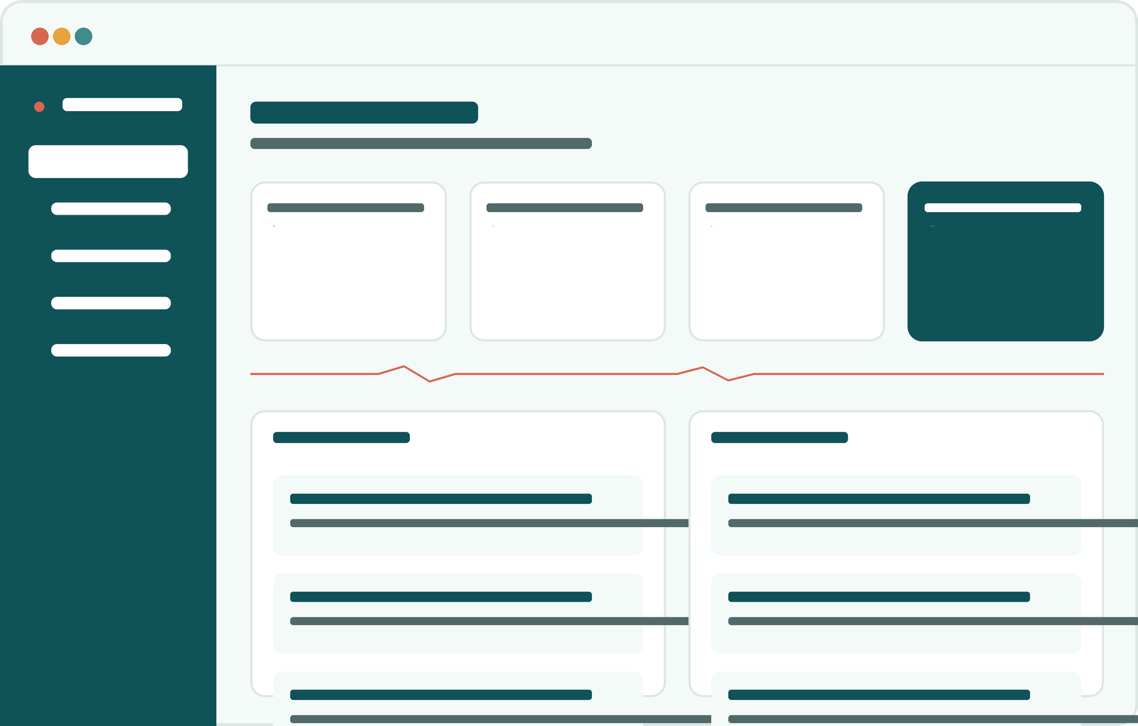
THE SOLUTION
One console. Every role.
Meridian gives admins, doctors and patients a shared, role-aware view of the same data — patients, doctors, appointments and ward beds — updated the moment anyone makes a change.
A single dashboard tailored to admins, doctors and patients
Runs entirely in the browser — no server or database setup
Patients self-register and book their own appointments
03 / 10

Slide 4




CORE MODULES
Four modules, working together
Patient Records
Doctor Directory
Admit, search and update patient details — condition, blood group, contact and admission date.
Maintain staff profiles by department, experience and contact — browsable by patients too.
Appointments
Ward Beds
Book, complete or cancel visits with a shared calendar so nothing double-books.
A live grid of every ward — click a bed to mark it free or occupied in real time.
04 / 10

Slide 5

ACCESS CONTROL
Built for three different logins
Every account sees exactly what its role needs — nothing more.
Admin
Doctor
Patient
Full patient & doctor CRUD
Sees their own schedule
Self-registers an account
Manages all appointments
Completes / cancels visits
Books their own visits
Ward bed control
Views assigned patients
Browses the doctor directory
05 / 10

Slide 6

OVERVIEW DASHBOARD
Every number, one glance away
The moment someone signs in, Meridian tallies patients, doctors, today's appointments and ward capacity — recalculated live from whatever's been entered, no page reload needed.
48
12
9
22/34
Registered
patients
Doctors on
staff
Appointments
today
Ward beds
occupied
Each role sees its own version of this view — a doctor's dashboard totals only their own visits; a patient's shows only their own bookings.
06 / 10

Slide 7

ACCOUNTS & ACCESS
Sign in, sign up, stay in your lane
Self-service signup
Patients and doctors create their own account — the matching patient or doctor record is generated automatically.
Role-checked at every login
Session persistence
Credentials are matched against the selected role tab, so an account can only sign in the way it was created.
A signed-in session is remembered in the browser, so reloading the page doesn't sign anyone out.
Scoped permissions
A short branded splash screen greets every visit before handing off to sign-in.
Only admins can edit or remove patient and doctor records; doctors and patients get read or self-only access.
07 / 10

Slide 8

VISUAL DESIGN
A design system built for the clinic, not a template
Deep teal
Vital teal
Mint tint
Amber
Coral
#0F5257
#3E8C8C
#E7F3EF
#E8A33D
#D8674F
TYPOGRAPHY
SIGNATURE MOTIF
Fraunces
Display headings — warm, editorial serif
Rounded cards, soft shadows, calm mint backgrounds throughout.
Inter / JetBrains Mono
A recurring “vitals line” divider — one wave, used consistently across the dashboard and this deck.
Body text and data — clean, highly legible
08 / 10

Slide 9
UNDER THE HOOD
Three files. Zero backend.
Meridian is a static site — open index.html and it runs, in VS Code or any browser.
HTML5
CSS3
Vanilla JavaScript
Browser localStorage
Semantic structure for the login, dashboard and every role-based view.
Custom properties for theming, plus responsive breakpoints down to mobile.
Handles auth, navigation and all CRUD logic — no framework required.
Every patient, doctor, appointment and bed persists between visits.
09 / 10

Slide 10
Built to make the front desk
feel like one system, not five.
MERIDIAN — WARD & OUTPATIENT MANAGEMENT CONSOLE
Thank you

