Slide 1
Case Study: BetterReads Book Application
Developed a Single Page Application titled as ‘BetterReads’ using Angular 13 + Spring Boot.
Spring Boot Microservices using REST API
Workflow of Spring Boot Architecture
Code Implementation of Spring Boot using REST API +
MongoDB for Model Classes and perform CRUD
Operations.
Running the Spring Boot Application using Postman
Implementation of Test Cases for each layer of Spring
Boot Application.
Building Angular Components to perform CRUD operations.

Slide 2
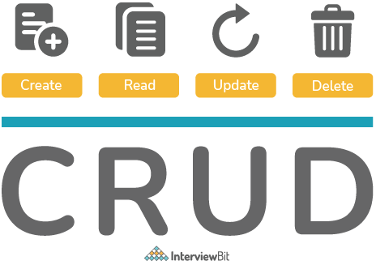
Spring Boot
Open-source, microservice-based Java web framework.
Main purpose of Springboot is to create Microservices.
“@SpringBootApplication” annotation specifies the starting point of
Application
REST stands for “Representational State Transfer”. It is a way to send
& receive data between distributed systems using only HTTP.

Slide 3
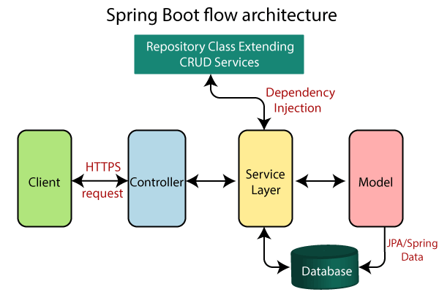

Slide 4
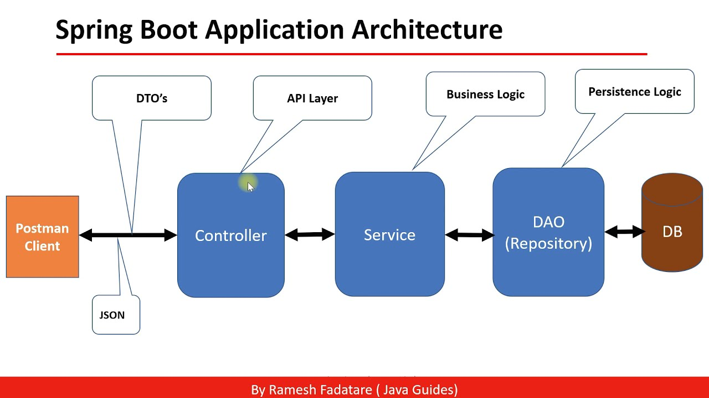

Slide 5
API url’s for Book Service
Base URL: ("/api/v1”) - Port No. 8085
Method | API url’s starts with base url | Operation
POST | "/books" | Add book
GET | "/allBooks" | Get all books
GET | “/book/{book_id}” | Get single record of book by given id in url
PUT | “/books/{book_id}” | Update book record by id
DELETE | “/book/{book_id}” | Delete book record by id
GET | “/favorite/getFav” | Get favorite books

Slide 6
API url’s for User Service
Base URL: ("/api/u1”) - Port No. 8082
Method | API url’s starts with base url | Operation
POST | "/users" | Add User
GET | "/allUsers" | Get all users
GET | “/user/{userId}” | Get single record of user by given id in url
PUT | “/users/{userId}” | Update user record by id
DELETE | “/users/{userId}” | Delete user record by id

Slide 7
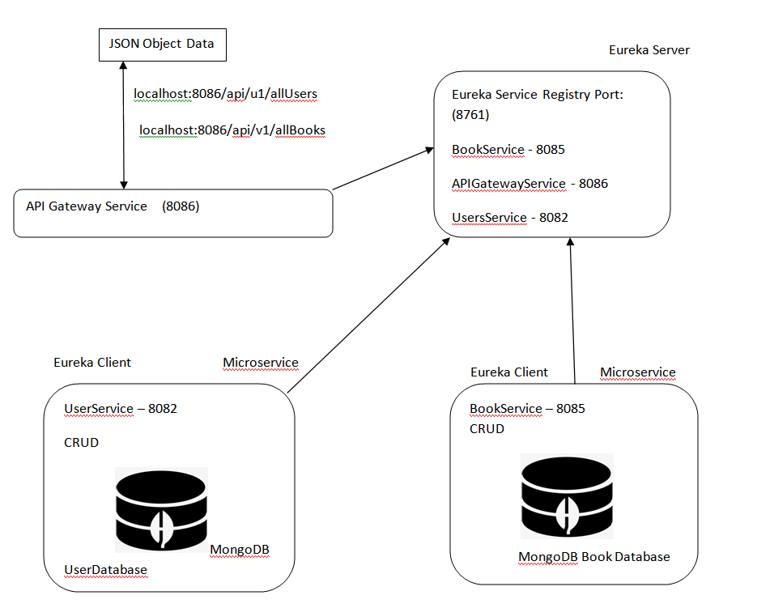
Microservices Architecture Flow of BetterReads Book Application

Slide 8
Angular – UI Framework
A platform for building Single Page Client Application using HTML and
TypeScript. Angular is written in TypeScript.
It has built-in features like Dependency Injection , Data Binding.
FrontEnd Modules Implementation:
HTML 5
CSS 3 & Bootstrap
Angular 12 or above
Components
Services
Modules
Routing
Forms & Validation

Slide 9
Angular 13
TypeScript
Front-End Tools and Technologies Used
Node JS and NPM
VS Code IDE
Angular CLI
Bootstrap 4+
Spring Boot 4
Server side Technologies Used
Maven
JDK 1.8
Embedded Tomcat
MongoDB Database
Bootstrap 4+

Slide 10



Angular 13 + Spring Boot 4 Full Stack Application Architecture
View
Templates
Components
Services
HTTP
Client
Spring Rest Controller
Spring Data
MongoDB

Slide 11

Presented By:
Heeramani Madhwani

