Slide 1
Case Study: BetterReads Book Application
Spring Boot Microservices using REST API
Workflow of Spring Boot Architecture
Code Implementation of Spring Boot using REST API +
MongoDB for Model Classes and perform CRUD
Operations.
Running the Spring Boot Application using Postman
Implementation of Test Cases for each layer of Spring
Boot Application.

Slide 2
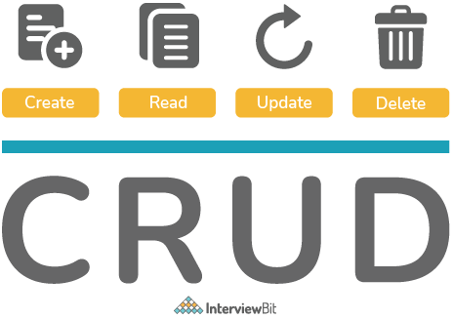
Spring Boot
Open-source java-based framework.
Main purpose of Springboot is to create Microservices.
“@SpringBootApplication” annotation specifies the starting point of
Application
REST stands for “Representational State Transfer”. It is a way to send
& receive data between distributed systems using only HTTP.

Slide 3
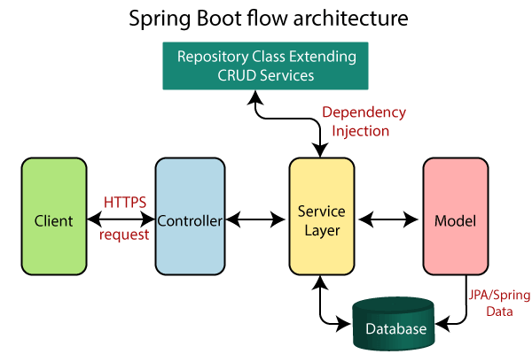

Slide 4
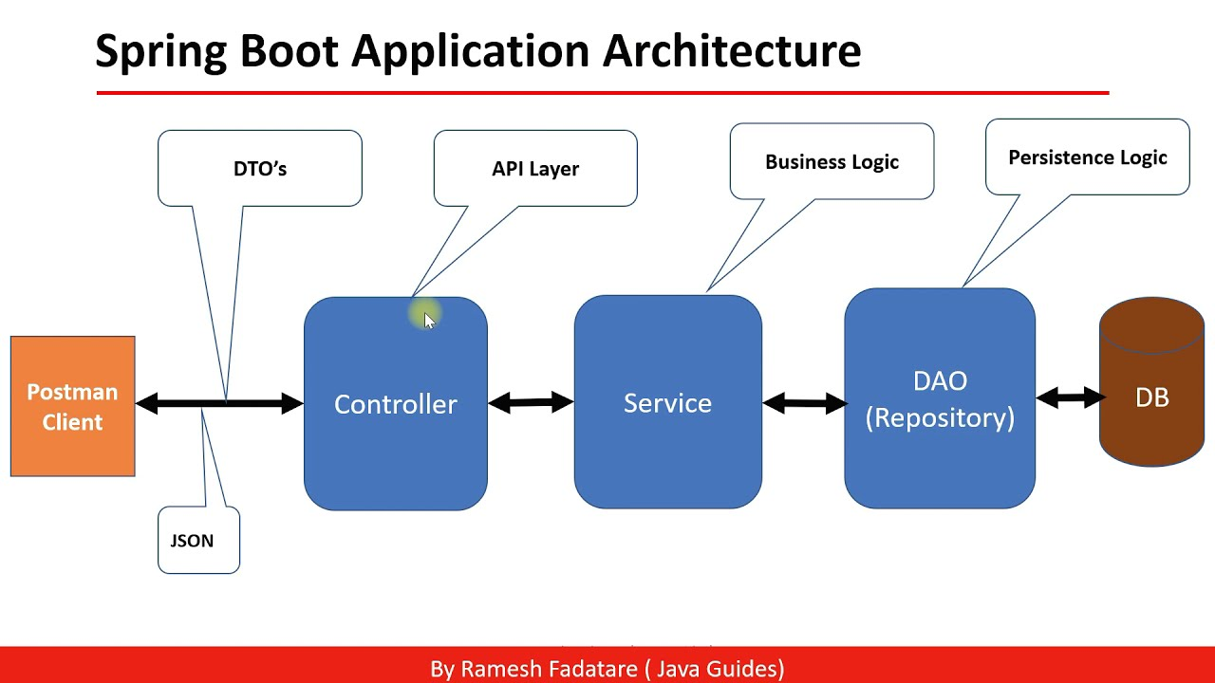

Slide 5
API url’s for Book Service
Base URL: ("/api/v1”) - Port No. 8085
Method | API url’s starts with base url | Operation
POST | "/books" | Add book
GET | "/allBooks" | Get all books
GET | “/book/{book_id}” | Get single record of book by given id in url
PUT | “/books/{book_id}” | Update book record by id
DELETE | “/book/{book_id}” | Delete book record by id
GET | “/favorite/getFav” | Get favorite books

Slide 6
API url’s for User Service
Base URL: ("/api/u1”) - Port No. 8082
Method | API url’s starts with base url | Operation
POST | "/users" | Add User
GET | "/allUsers" | Get all users
GET | “/user/{userId}” | Get single record of user by given id in url
PUT | “/users/{userId}” | Update user record by id
DELETE | “/users/{userId}” | Delete user record by id

Slide 7
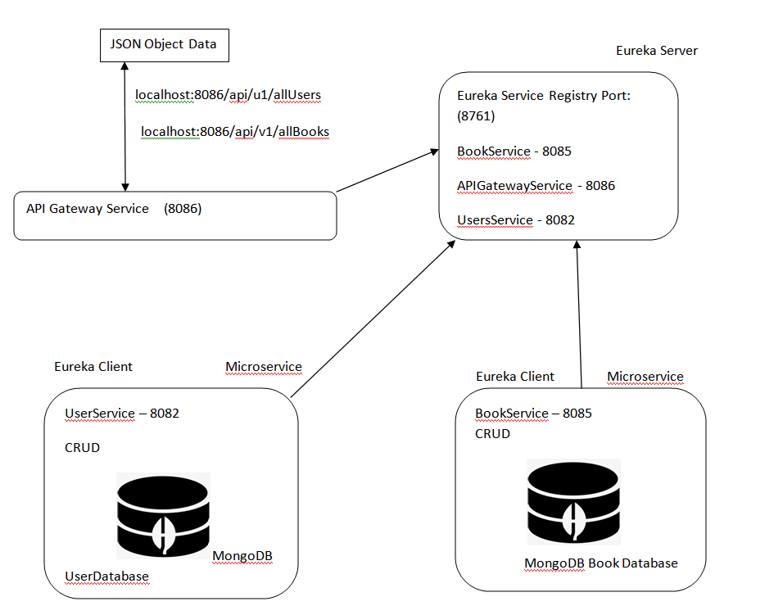
Microservices Architecture Flow of BetterReads Book Application

