Slide 1
Computer-aided diagnosis of Trypanosomiasis using unstained microscopy images and deep machine learning
Heesoo Song
Student number: 01514152
August 20th, 2020
Center for Biotech Data Science | Center for Biomedical Research
Counsellors: Esla Timothy Anzaku, Utku Ozbulak
Supervisors: Prof. Wesley De Neve, Prof. Arnout Van Messem, Prof. Stefan Magez

Slide 2
contents
Introduction & Problem Statement
Experimental Setup
Results & Discussion
Conclusions

Slide 3
contents
Introduction & Problem Statement
Experimental Setup
Results & Discussion
Conclusions

Slide 4





Introduction
Trypanosomiasis occurs mostly in remote rural communities. Diagnosing trypanosomiasis using machine learning could lead to significant time savings and more accurate diagnosis, and where this approach can be easily and practically used in the field.

Slide 5


Problem statement
Is it possible to design an accurate machine learning model that can classify infected raw blood sample images?
Labeling images to develop deep learning models is expensive. Can active learning with minimal human-in-the-loop interaction help in creating the required dataset for training a model?

Slide 6
contents
Introduction & Problem Statement
Experimental Setup
Results & Discussion
Conclusions

Slide 7
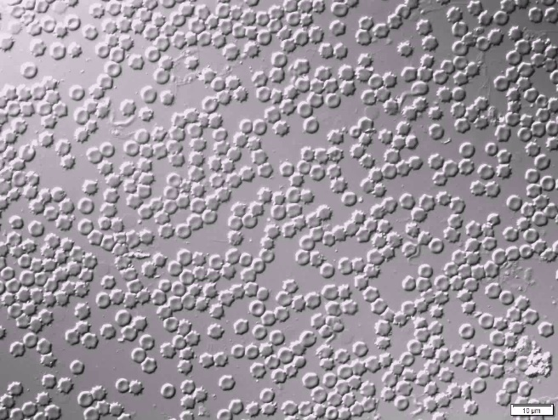
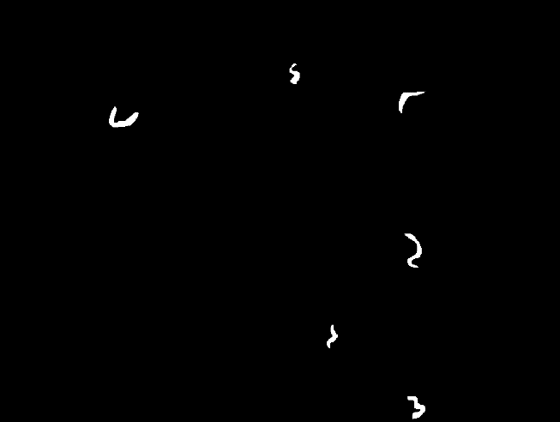
Dataset - annotation
7 videos are taken
-> ≈ 100 images generated per video
Positive sample image
Annotated binary image
Number of labeled images = 123
(½ video 1, ½ video 3)
Resolution of Raw Image = 1024 x 1360
Notes:
Vid1=73, vid3=50, vid9=48, Too small dataset, Too much information in one image -> increase num. and reduce image size by cropping

Slide 8
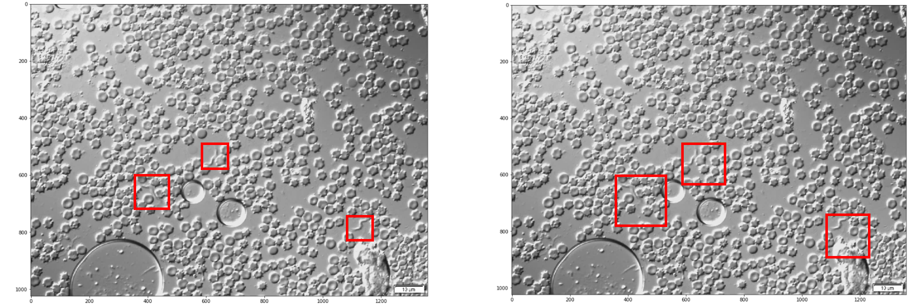
Dataset – positive dataset
Tight bounding boxes
Bounding boxes with extra 60 pixels
Tight bounding boxes = 502 images
Bounding boxes with extra 60 pixels = 1073 images
RoI <900 pixels are discarded
Total cropped positive images = 1300 images
8/21

Slide 9
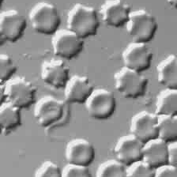
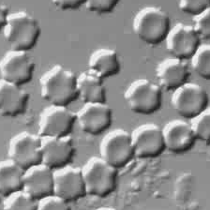


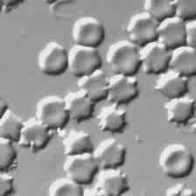
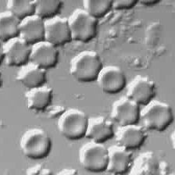

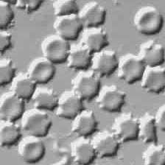
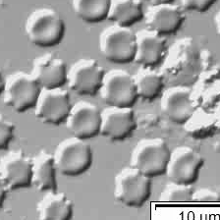

Dataset – negative dataset
N
N
N
P
P
P
Cropped negative images = 1300 images (randomly selected)
9/21

Slide 10
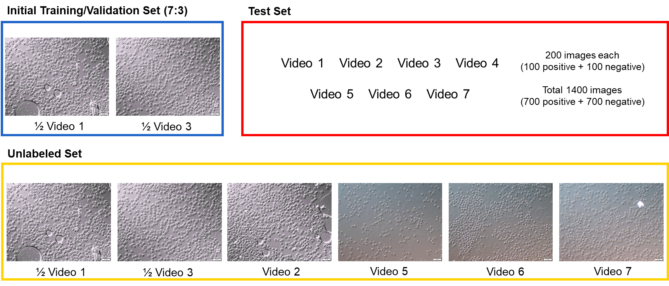
Dataset - distribution

Slide 11
Experiment - Active learning
<Motivation>
1300 positive images + 1300 negative images are still not enough to train ML model to perform well
Query is to doubt its validity or accuracy. In Active Learning, the query process means the human correction or labeling. By querying unlabeled images by certain criteria, the ML model is expected to correct its predictions
Notes:
ACTIVE LEARNING
Train a model from existing limited labels (segmented binary masks)
Measure model performance with test set and select the best model
Get probabilities of unlabeled images using trained model
Choose images over certain criteria (e.g. > 0.95)
Move chosen images into temporary folder before redistribution into train set
Manually check if the images are correctly classified (Human-in-the-loop)
Redistribute checked images into train set
Repeat 3 ~ 7 until the model reaches enough accuracy
*Step 6 can be skipped if the model is reliable enough
-> the classification at the beginning is very important
-> it highly affects the following models

Slide 12
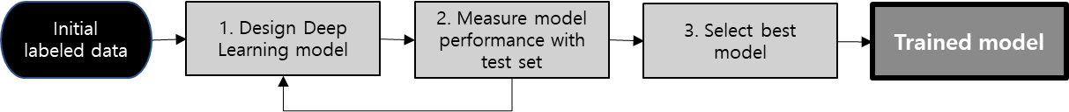
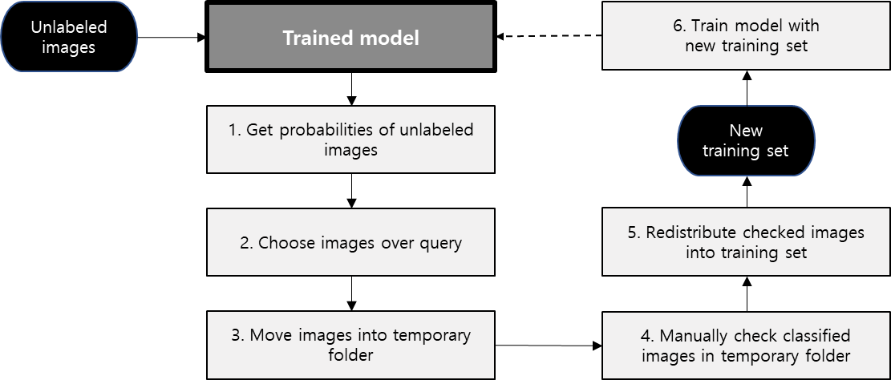
Experiment - Active learning
1.
2.
<Best Model>
Model frame: ResNet50
Optimizer: Adagrad (lr=0.01, lr_decay=0, weight_decay=0, eps=1e-10)
Notes:
ACTIVE LEARNING
Train a model from existing limited labels (segmented binary masks)
Measure model performance with test set and select the best model
Get probabilities of unlabeled images using trained model
Choose images over certain criteria (e.g. > 0.95)
Move chosen images into temporary folder before redistribution into train set
Manually check if the images are correctly classified (Human-in-the-loop)
Redistribute checked images into train set
Repeat 3 ~ 7 until the model reaches enough accuracy
*Step 6 can be skipped if the model is reliable enough
-> the classification at the beginning is very important
-> it highly affects the following models

Slide 13
Experiment
Experiment 1:
Experiment 2:
Experiment 3:
Weighted query (Certainty-based query)
1000 images with top predicted probabilities are queried
Queried images will be manually corrected
Random query
Randomly selects 1000 images to query
Queried images will be manually corrected
Will prove the effect of weighted query strategy
Certainty-based query without human interaction
Same query method with Experiment 1
But no human correction for queried images
Will prove the effect of human interaction

Slide 14
contents
Introduction & Problem Statement
Experimental setup
Results & Discussion
Conclusions

Slide 15
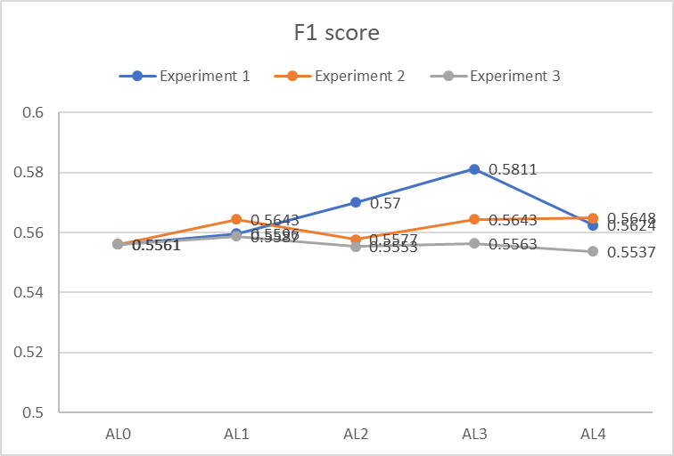
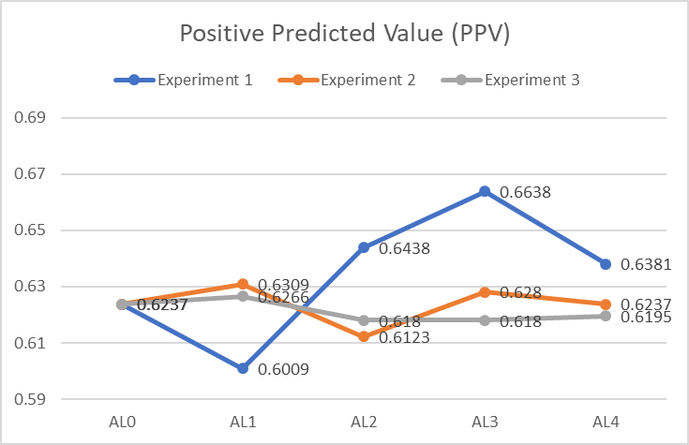
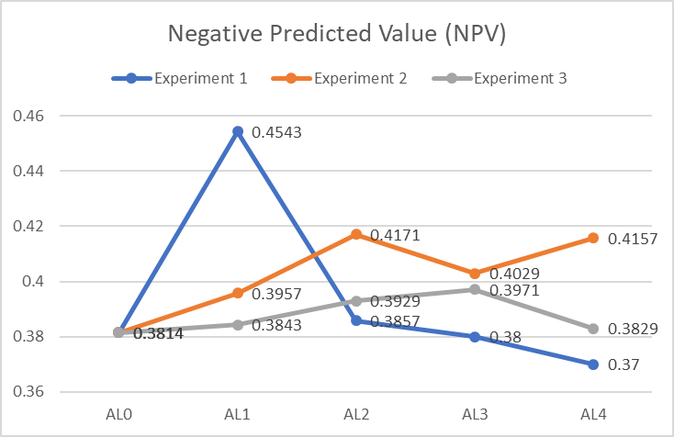
Results – Evaluation metrics
Best scores recorded in Experiment 1. However, the values in Experiment 1 fluctuates a lot
Experiment 2 shows slight improvement in F1 score and NPV, but not as dramatic as Experiment 1
-> Extreme changes in Experiment 1 are due to certainty-based query strategy
Experiment 3 results barely changes
-> Changes in Experiment 1 are caused by manual correction

Slide 16
Results – Probability distribution
Experiment 1 : Certainty based query
x axis: number of images
Y axis: predicted probabilities

Slide 17
Results – Probability distribution
Experiment 2: Random Query
x axis: number of images
Y axis: predicted probabilities

Slide 18
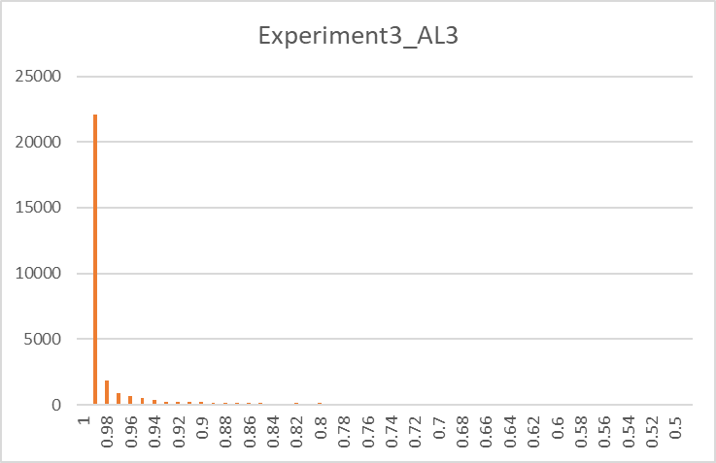
Results – Probability distribution
Experiment 3 : Certainty based query without human interaction
x axis: number of images
Y axis: predicted probabilities
Avg = 0.96

Slide 19
contents
Introduction & Problem Statement
Experimental Setup
Results & Discussion
Conclusions

Slide 20
conclusions
CONTRIBUTIONS
The model is trained with unstained raw blood sample images
We confirmed that the weighted query strategy can quickly improve the classification accuracy
However, we observed that the improvements are not sufficient and not continuous
FUTURE WORK
Study more AL sampling strategies
Try data augmentation or unbalanced datasets
Acquire more diversified images and ensure good cell and parasite quality

Slide 21

Q&A

