Slide 1
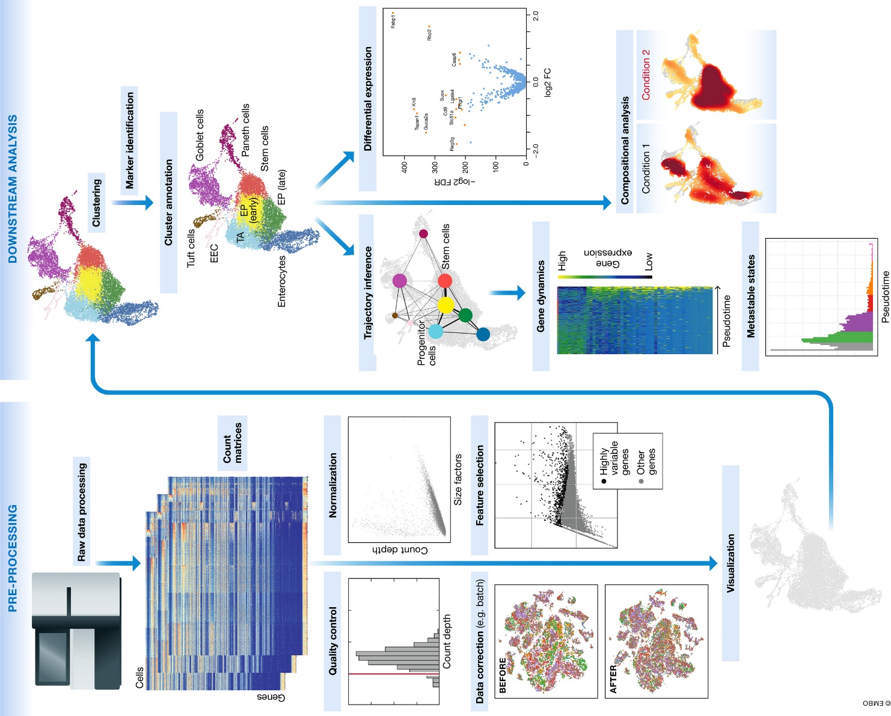
④
③
①
②

Slide 2
Correlation
Ligands
Target Genes
1
0
0
1
0
…
Target Genes
3e-3
1e-4
5e-4
6e-2
8e-4
…
Ligands
…
…
0.234 0.197 0.163 0.140 …
User data
Receiver genes
(Gene set OI + background genes)
Prior model
Ligand-target matrix
Correlation scores

Slide 3
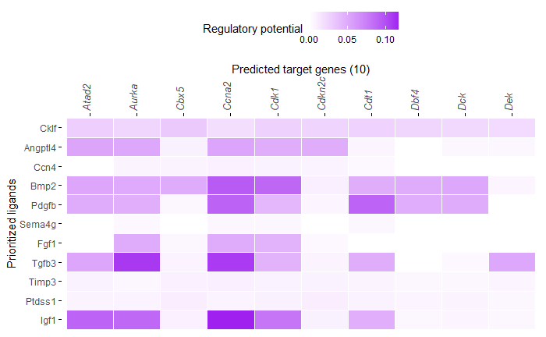
Expressed sender genes
Ligand-receptor network
From | To | database | source
Ligand 1 | Receptor 1 | Omnipath | Omnipath
Ligand 2 | Receptor 2 | Omnipath | Omnipath
… | … | … | …
Potential ligands
Ligand-target network
Expressed receiver genes
 | Ligand 1 | Ligand 2 | …
Target 1 | 0 | 0 | …
Target 2 | 0.003 | 0.0002 | …
… | … | … | …
Gene set of interest
Prioritized
ligand-target interactions
Ligand-target network
Top 250
 | Ligand 1 | Ligand 2 | …
Target 1 | 0 | 0 | …
Target 2 | 0.003 | 0.0002 | …
… | … | … | …
quantile cutoff (0.25)
Ligand activity scores
Calculate correlation
Top 20

Slide 4
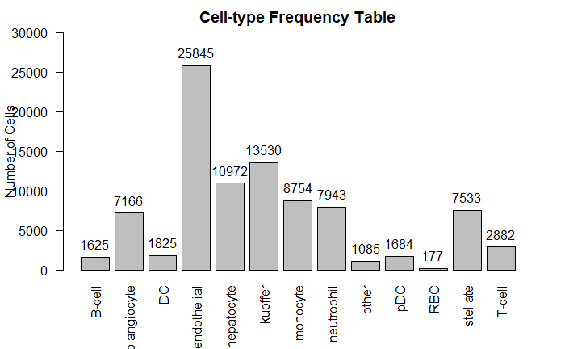
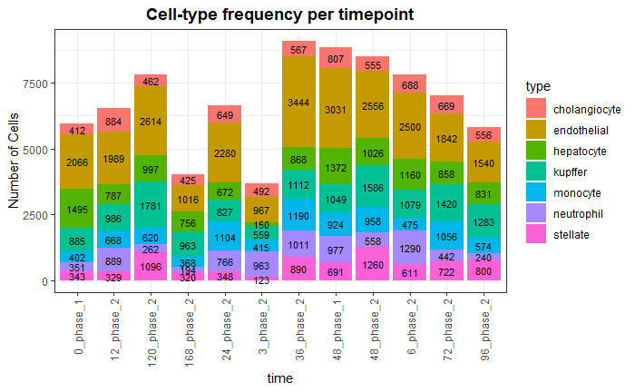
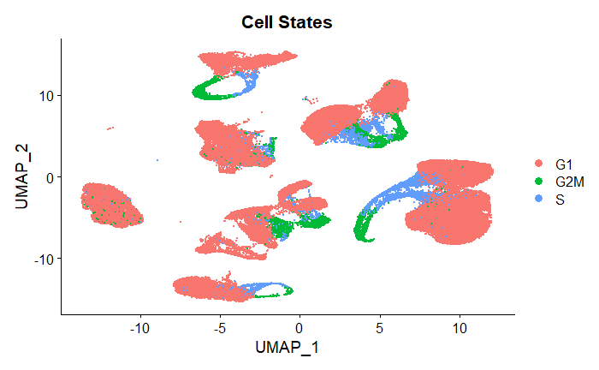
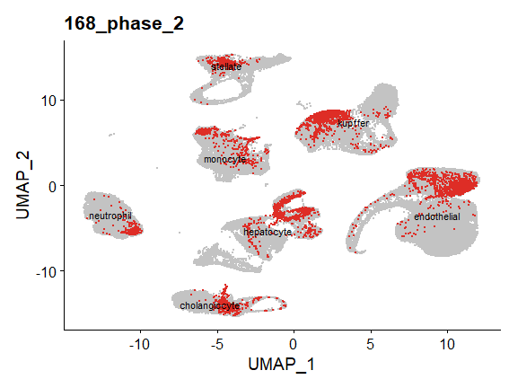
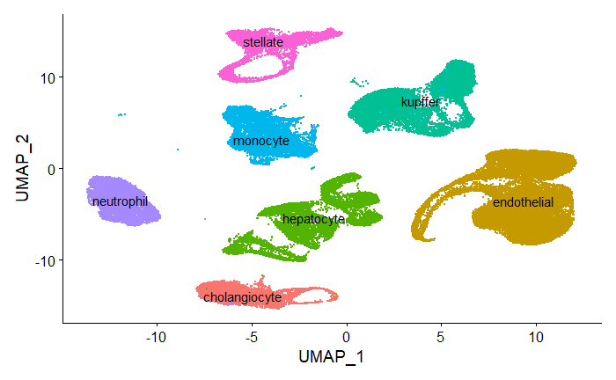
A.
B.
Cho
C.
D.
E.

Slide 5
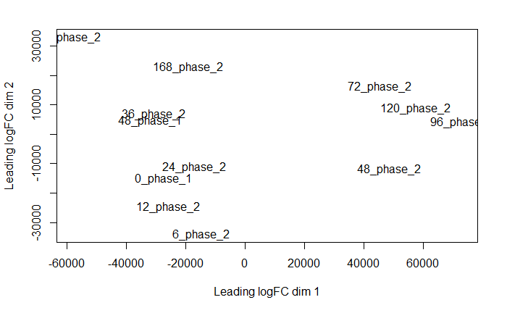
3_

Slide 6
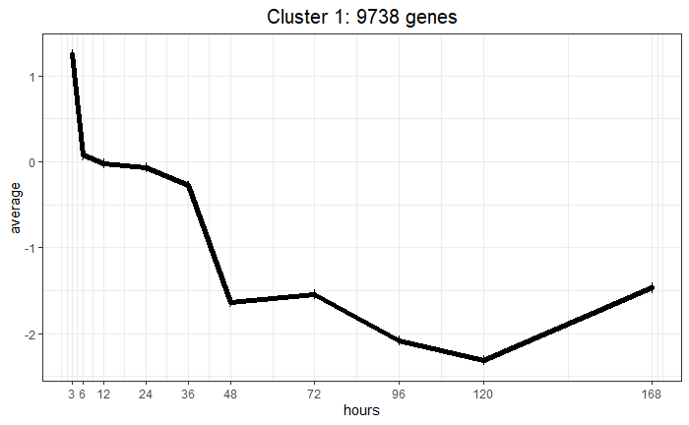
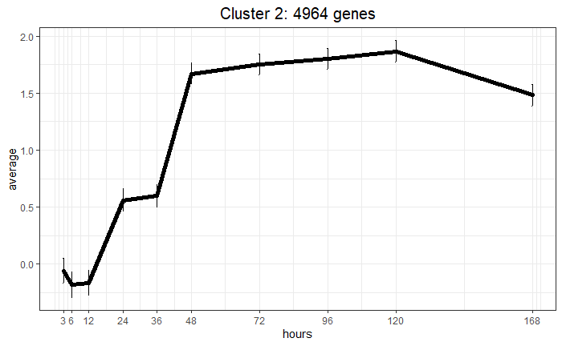
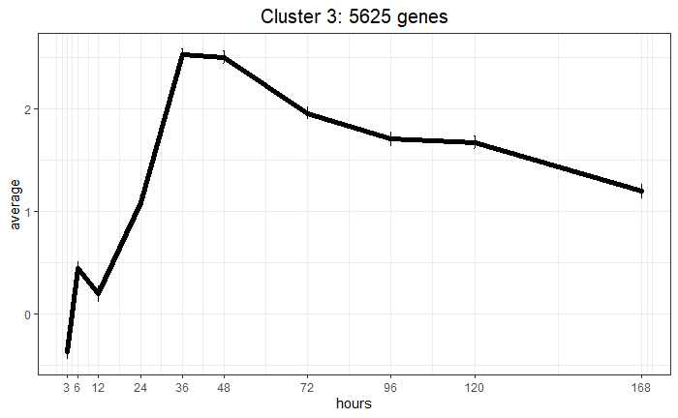
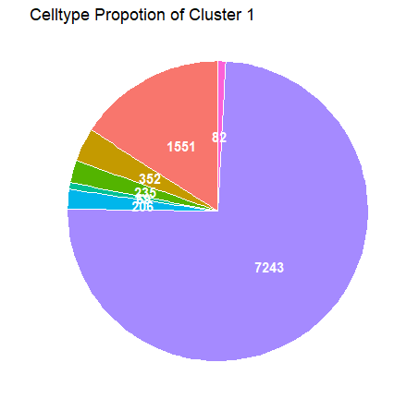
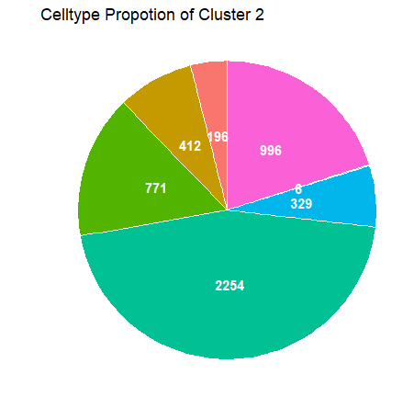
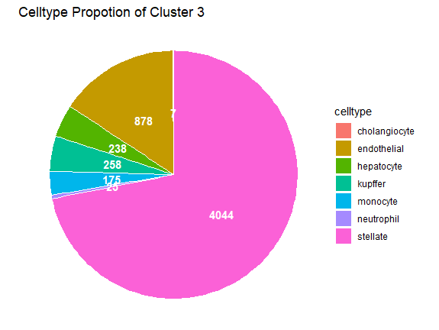
A.
B.

Slide 7
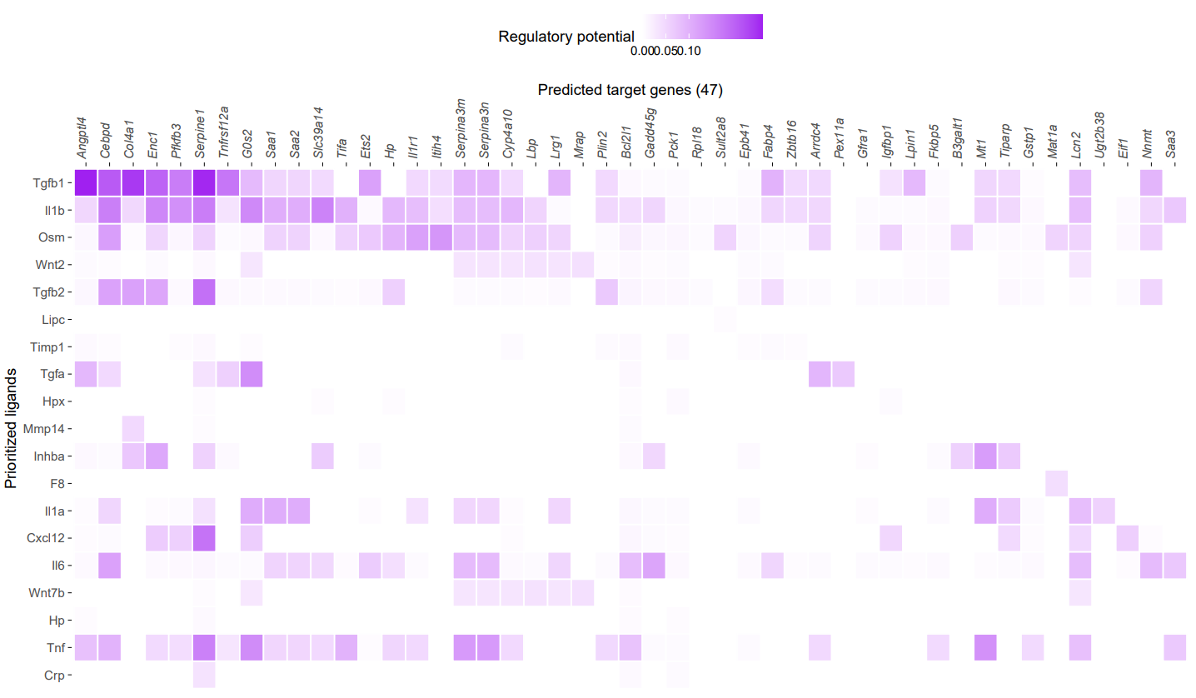
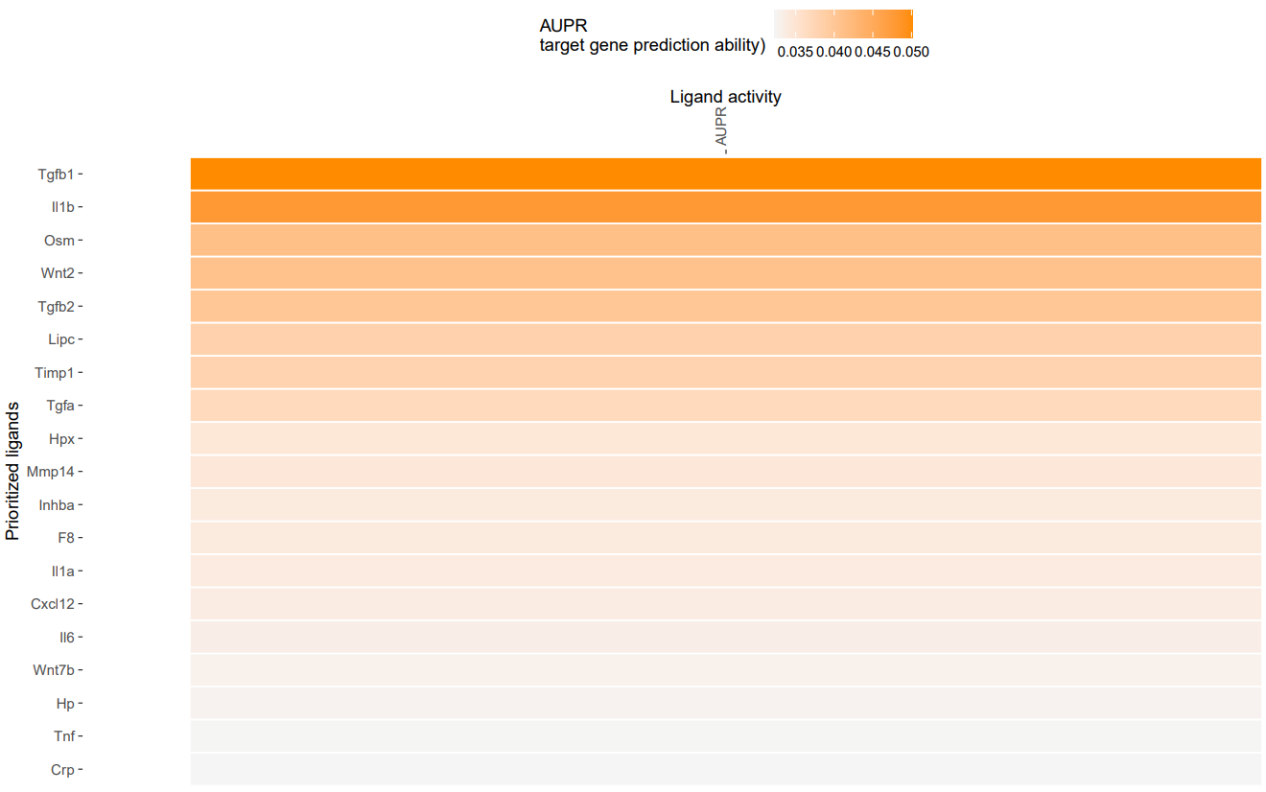

Slide 8
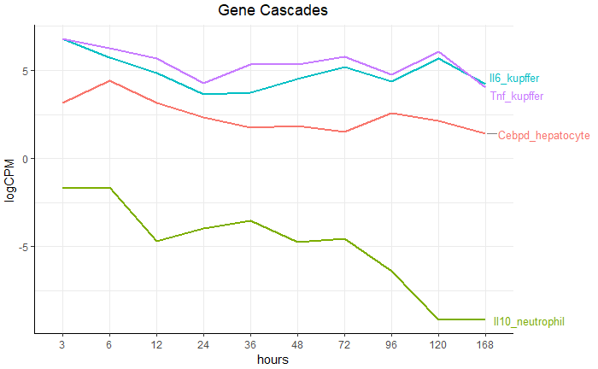
Neutrophil
IL10
Kupffer
IL6
TNF
Hepatocyte
CEBPD

Slide 9
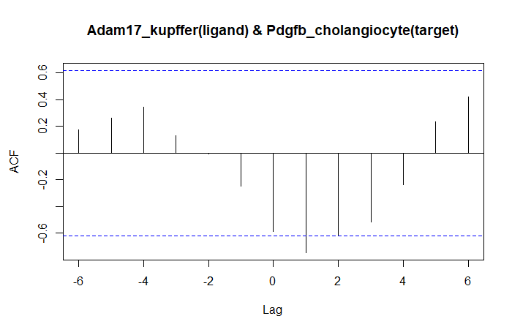
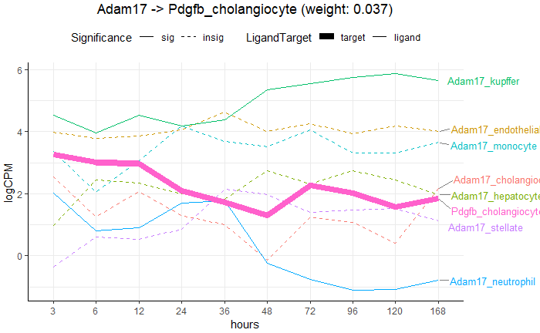
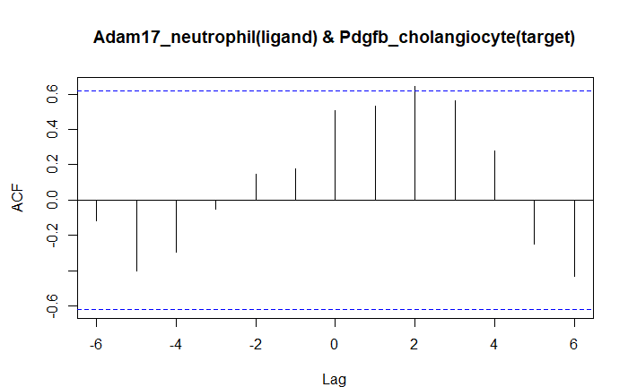

Slide 10
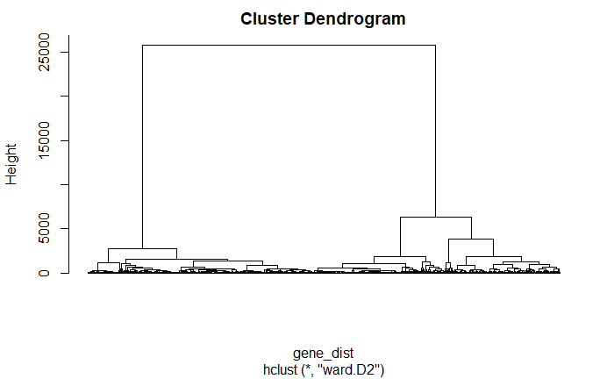
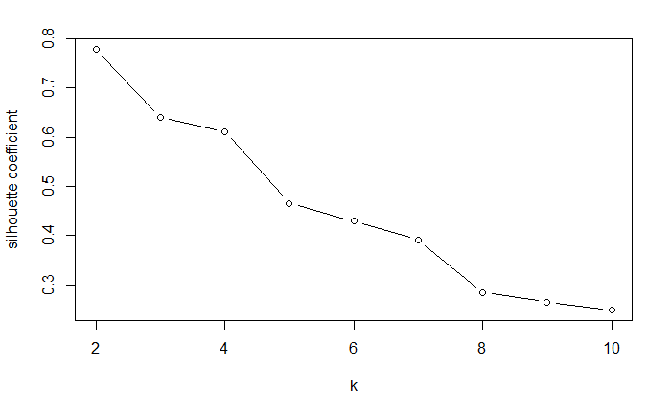

Slide 11
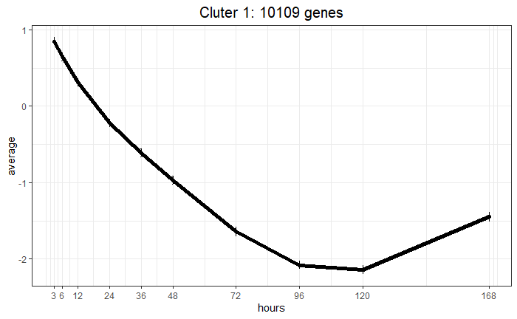
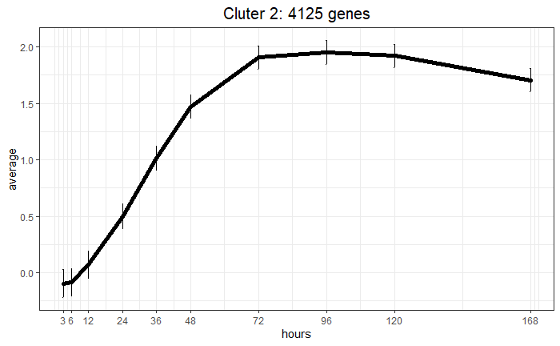
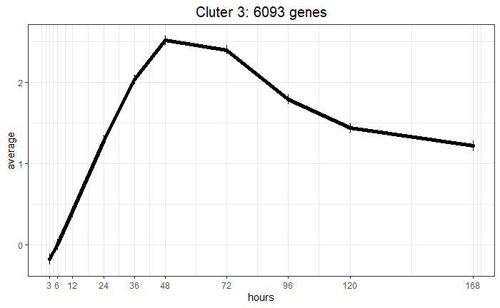

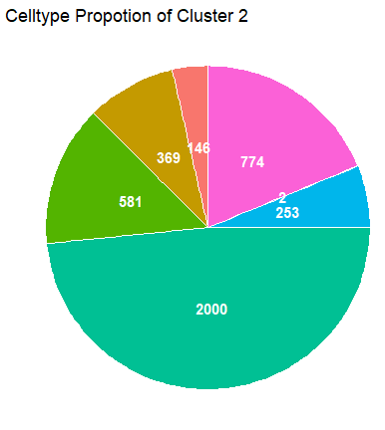
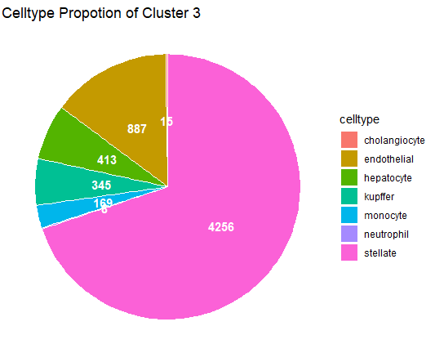
A.
B.
Notes:
Supplementary

