Slide 1
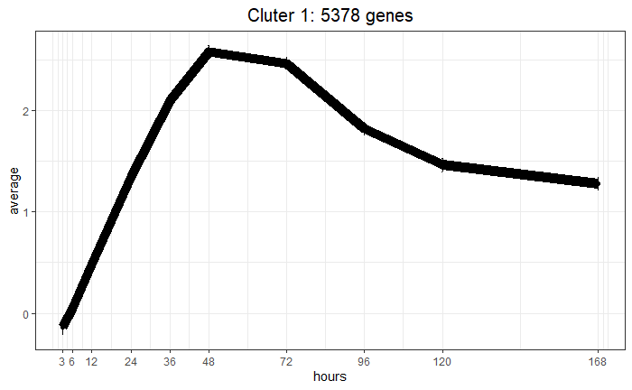
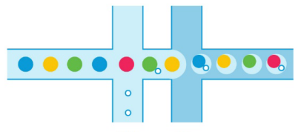

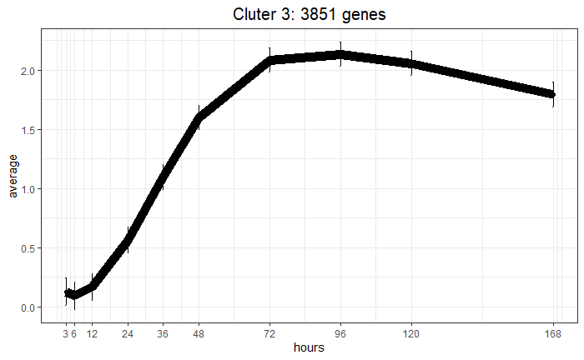
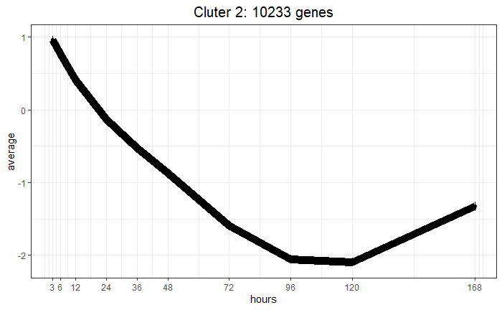
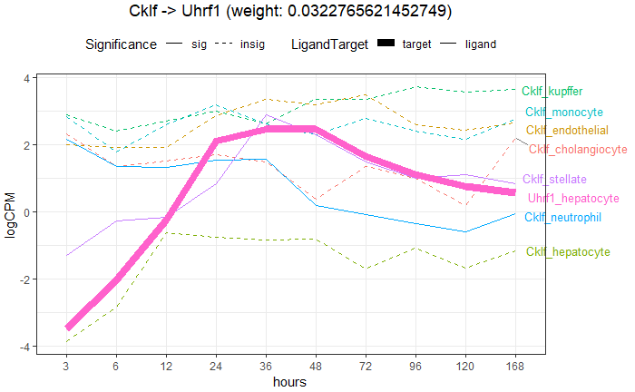
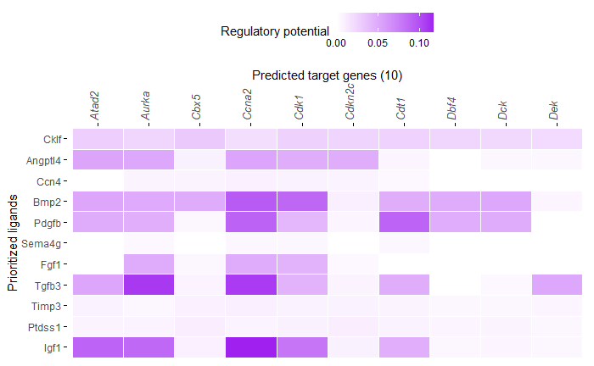
Gene_Celltype | 3h | 6h | 12h | …
Cklf_kupffer | 23 | 15 | 3 | 3
Cklf_neutrophil | 0 | 0 | 4 | 20
… | . | . | . | .
∑
DE
Time
36
72
96
120
168
3
6
12
24
0
48
1) Time-series single cell RNAseq data
2) Pseudobulk
3) Temporal cluster
NicheNet
Ligand | Target | Ligand_ Cell Type | Target Cell Type | -6 | … | 6
Angptl | Rdh16f | kupffer | hepatocyte | 0.060 | 0.402 | 0.421
Angptl | Acsm5 | kupffer | hepatocyte | 0.058 | 0.380 | 0.321
… | . | . | . | .
CCF
6) Prioritized ligand-target interaction with cell type information
5) Top ligand-target cell type temporal expression
4) Prioritized ligand-target interactions

