Slide 1
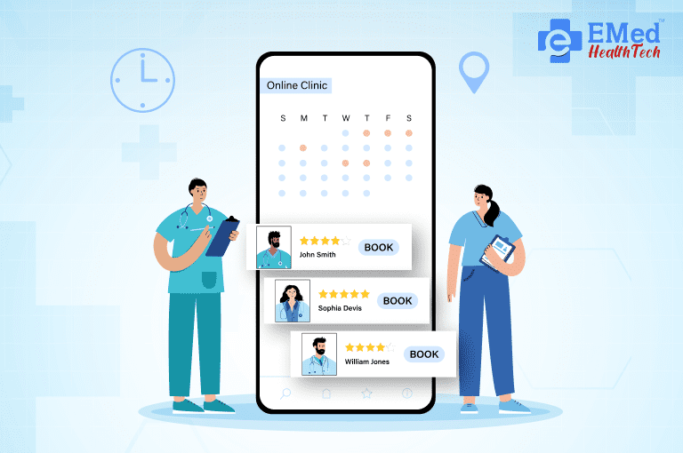
Appointment Booking System with Payment Gateway Integration
This presentation will explore the development of a user-friendly appointment booking system featuring seamless online payment integration. The system leverages modern technologies to streamline the healthcare appointment process for both patients and doctors, ultimately enhancing accessibility and efficiency.
By:
Heet Mangroliya – 22SE02IT021
Vivek Boghani – 22SE02IT048
Jinit Rathod – 22SE02IT084
Mentor :
Mr. Anurag Yadav

Slide 2
Abstract
This project focuses on the development of an online appointment booking system with an integrated payment gateway. The platform aims to simplify the process of scheduling appointments with doctors while providing an intuitive and user-friendly experience. Users can search for doctors based on their specialties, select available time slots within a multiple window, and confirm bookings with seamless online payments. The system includes dedicated dashboards for admins and doctors to manage bookings and profiles efficiently. Using a modern tech stack, including React JS, Tailwind CSS, Node.js, Express, and MongoDB, the project offers a scalable and efficient solution for healthcare appointment management.

Slide 3
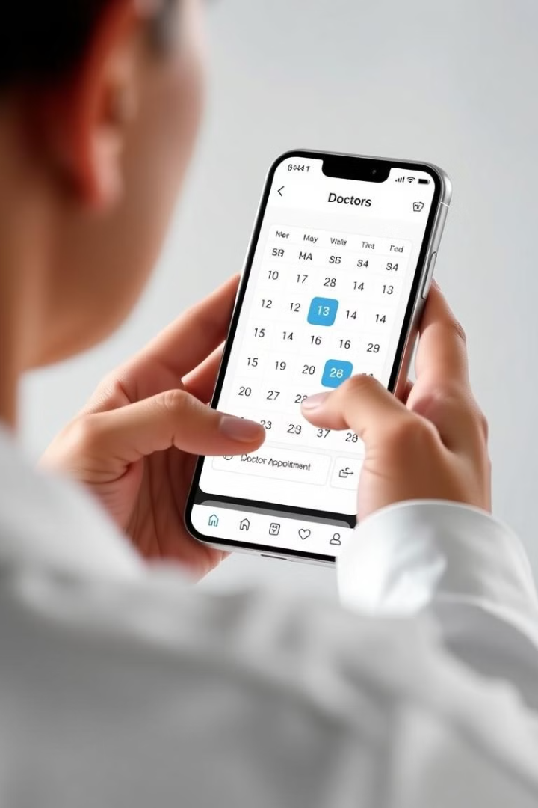
Introduction
Growing Demand for Accessible Healthcare
Addressing Challenges of Traditional Methods
The increasing demand for healthcare services necessitates efficient appointment booking systems.
Traditional methods often involve long waiting times and inefficiencies, which can be minimized using digital platforms.
Streamlining Appointment Management
This project provides a comprehensive online platform for booking appointments based on doctor availability and specialty.

Slide 4
Why We Built It?
1
Visiting clinics without prior appointments often leads to long wait times and unnecessary stress.
Patients frequently struggle to find doctors based on specialty, location, or availability.
Manual booking systems lack transparency and are inefficient.
Our solution centralizes appointment booking, giving users access to verified doctors, real-time slot availability, and easy booking – all from the comfort of their home.
2
3
4

Slide 5
Project Objectives
User-Friendly Interface
Doctor Filtering and Availability
Develop a user-friendly web interface for booking appointments.
Allow users to filter doctors based on their specialties and availability.
Real-Time Booking
Secure Payment Gateway
Provide real-time booking for time slots within a 7-day window.
Integrate a secure payment gateway for online transaction processing.
Admin Dashboard
Doctor Dashboard
Create an admin dashboard to manage doctor profiles and bookings.
Provide a doctor's dashboard for profile management, appointment tracking, and earnings overview.

Slide 6
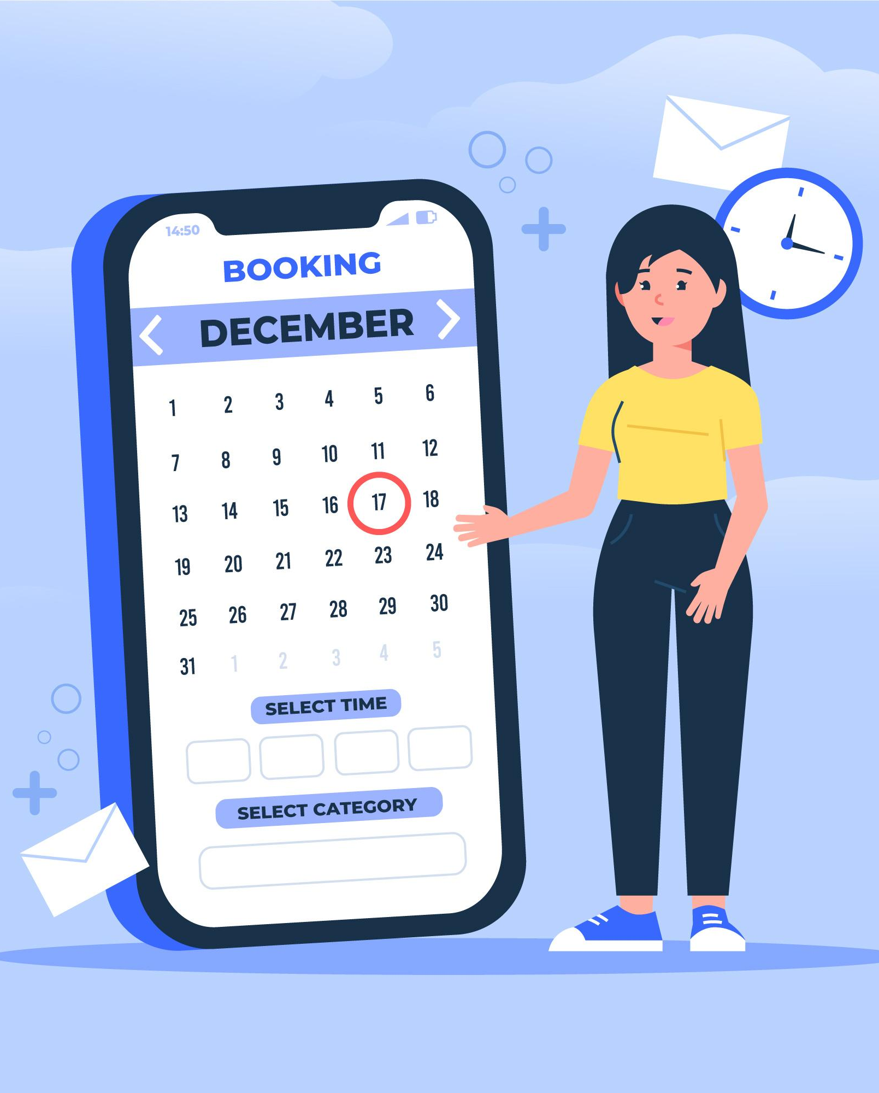




Technology Stack
React JS
Node.js
For building a responsive and interactive user interface.
For server-side logic and API development.
MongoDB
Stripe or Razorpay
For storing user data, appointment details, and doctor profiles.
For secure online payment processing.

Slide 7
System Design
User Interface
1
Login/Signup page
Search and filter options for doctors
2
Admin Dashboard
Booking form with date and time slot selection
Manage doctor profiles (add, update, delete)
Payment gateway integration
View and manage appointments
Doctor Dashboard
3
View schedule and upcoming bookings
Manage profile and earnings
Database Design
4
Collections for users, doctors, appointments, and transactions.
System Architecture
5
Follows a client-server architecture.
RESTful APIs for communication between the frontend and backend.

Slide 8





Results and Discussion
Successful System Implementation
Key Features
Addressing Challenges
Iterative Optimization
Key features, such as doctor filtering, time-slot selection, and dashboards, function as intended.
Challenges faced included optimizing API performance and handling edge cases in payment processing.
These challenges were addressed through iterative debugging and code optimization.
The system effectively fulfills its objectives, providing a seamless user experience for appointment booking and payment.

Slide 9





Future Scope
Expand Time Window
1
Expand the time-slot selection beyond a 7-day window.
Mobile App Development
2
Develop a mobile application for Android and iOS.
AI Integration
3
Integrate AI for personalized doctor recommendations.
Video Consultation
4
Add support for video consultations.
Multilingual Support
5
Include multilingual support for broader accessibility.

Slide 10
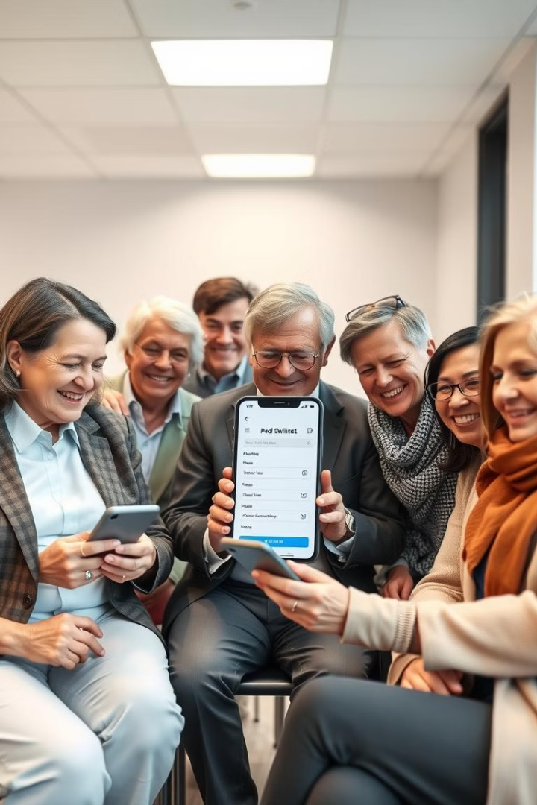
Conclusion
1
2
Modern Healthcare Solution
Digital Platform
The Appointment Booking System with Payment Gateway Integration provides a modern solution to streamline healthcare services.
It bridges the gap between patients and doctors through an efficient digital platform.
3
Scalable and User-Centric
The project leverages the latest technologies to deliver a scalable and user-centric solution, with potential for further enhancements.

