Slide 1
Preparing Data: Machine Learning
Prof. K.R. Makvana

Slide 2
Original Data
Types of data
Structures of data
Data Preparation
Data quality and
remediation
Data Pre-Processing:
Dimensionality reduction, Feature subset selection
Training Set(s)
Validation Set
T
est Set
Train the Model
Fine tune The Model
Evaluate the Model
Predictive Model

Slide 3
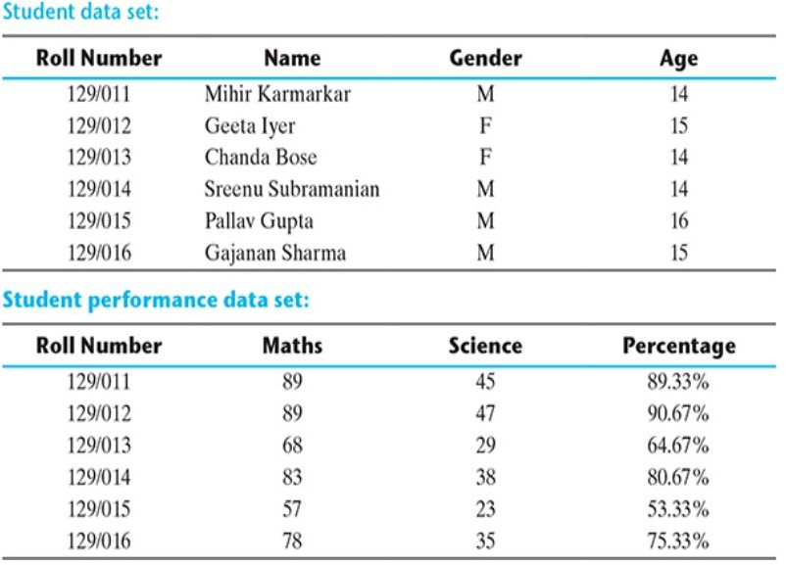
BASIC TYPES OF DATA IN MACHINE LEARNING
Data can broadly be divided into following two types:
Qualitative data
Quantitative data
Information that cannot be measured using some scale of measurement are called qualitative data. Eg. Gender, Name, Roll Number.

Slide 4
BASIC TYPES OF DATA IN MACHINE LEARNING
Qualitative data is also
called categorical data.
Which is
further
subdivided into;
Nominal data
Ordinal data
Nominal data is one which has no numeric value, but a named value
Nominal values cannot be quantified. Examples of nominal data are;
Blood group: A, B, O, AB, etc
Nationality: Indian, American, British, etc.
Gender: Male, Female, Other

Slide 5
BASIC TYPES OF DATA IN MACHINE LEARNING
Qualitative data is also called categorical data. Which is further subdivided into;
Nominal data
Ordinal data
Operations allowed in Nominal data is Mode only.
Ordinal data,
in addition to properties of
possessing the
nominal data, can also be naturally ordered.
Examples;
Customer satisfaction: ‘Very Happy’, ‘Happy’, ‘Unhappy’, etc.
Grades: A, B, C, etc.
Hardness of Metal: ‘Very Hard’, ‘Hard’, ‘Soft’, etc.

Slide 6
Qualitative data ? Ordinal Data
Like nominal data, basic counting is possible for ordinal data. Hence, the mode can be identified. Since ordering is possible in case of ordinal data, median, and quartiles can be identified in addition. Mean can still not be calculated.

Slide 7
Quantitative data
Quantitative data (numeric data) relates to information about the quantity of an object – hence it can be measured.
Temperature , age, etc.
There are two types of quantitative data:
Interval data
Ratio data
Interval data is numeric data for which not only the order is
known, but the exact difference between values is also known. An ideal example of interval data is Celsius temperature.
For interval data, mathematical operations such as addition and
subtraction are possible. For that reason, for interval data, the
central tendency can be measured by mean, median, or mode. Standard deviation can also be calculated.
However, interval data do not have something called a ‘true zero’
value. For example, there is nothing called ‘0 temperature’ or ‘no temperature’.

Slide 8
Quantitative data Ratio Data
Ratio data represents numeric data for which exact value can be measured. Absolute zero is available for ratio data.
Also, these variables can ^{A}b^{t}e^{trib}a^{u}d^{t}d^{e}e^{s} d, subtracted, multiplied, or divided. The central tendency can be measured by mean,
median, or mode and methods of dispersion such as
standard deviation. Examples of ratio data include height,
weight, age, salary, etc.
Qualitative/C ategorical
Quantitative/ Numerical
Nominal
Ordinal
Interval
Ratio

Slide 9
Discrete Vs Continuous data
Discrete attributes: Countable finite or Countably infinite values
roll number, street number, pin code
count, rank of students
binary attribute include: male/ female, positive/negative, yes/no, etc
Continuous attributes: Any possible real numbers
length, height, weight, price, etc.
http://archive.ics.uci.edu/datasets

Slide 10
Exploring numerical data
There are two most effective mathematical plots to explore numerical data;
box plot and histogram
But before exploration of data it is essential to understand statistical computation of numerical data i.e. mean, median, standard deviation, variance, etc.
•

Slide 11
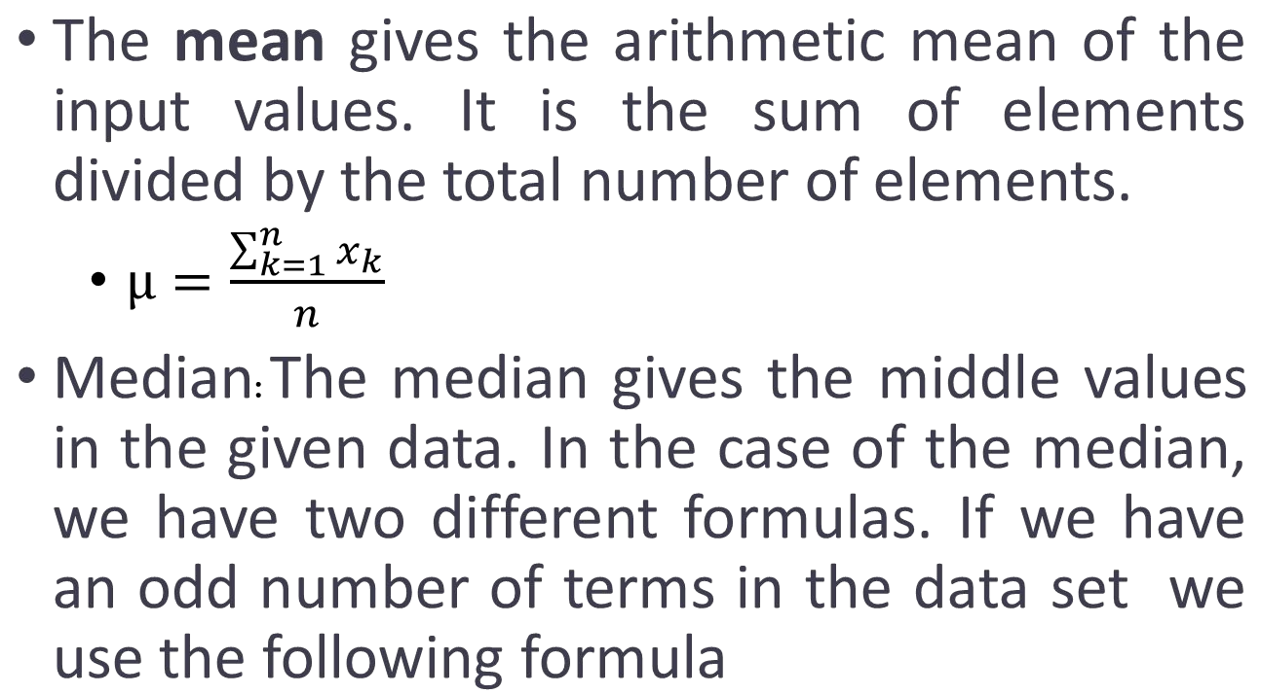
Mean and Median
•

Slide 12
What is the purpose of mean and median?
Mean and median are impacted differently by data values appearing at the beginning or at the end of the range. Mean being calculated from the cumulative sum of data values, is impacted if too many data elements are having values closer to the far end of the range,
i.e. close to the maximum or minimum values. It is especially
sensitive to outliers, i.e. the values which are unusually high or low, compared to the other values. Mean is likely to get shifted drastically even due to the presence of a small number of outliers. If we observe that for certain attributes the deviation between values of mean and median are quite high, we should investigate those attributes further and try to find out the root cause along with the need for remediation

Slide 13
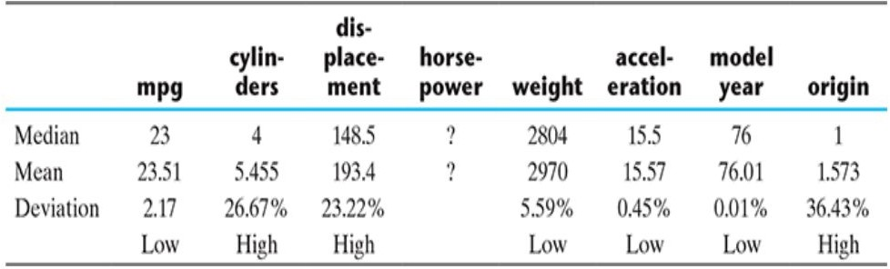
Mean vs. Median for Auto MPG dataset

Slide 14
Granular view of the data spread
Mean and median represent central tendency of data and from the deviation between mean and median, we can identify how data is dispersed.
However, this manual review is not efficient for huge datasets available, so we will take granular view of data sets in the form of;
Data dispersion methods
Variance and standard deviation
Position of different data value
Quartile
Let us try to understand data dispersion using simple example

Slide 15
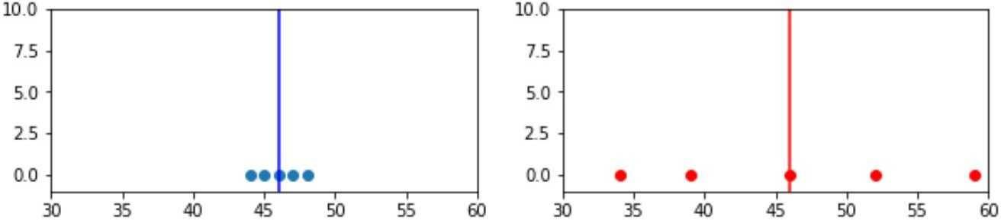
Measuring Data dispersion
To measure the extent of
dispersion of a data, or to find out how
Attribute 1 values : 44, 46, 48, 45, and 47
Attribute 2 values : 34, 46, 59, 39, and 52
Mean and median of both attributes are 46
much the different
values of a data are spread
the
out,
variance/std of the data is measured

Slide 16
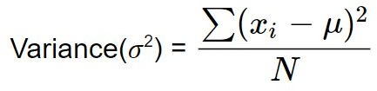
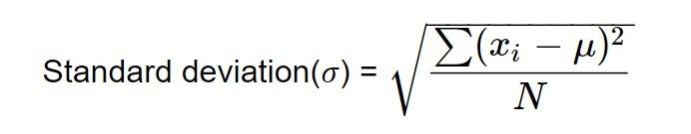
Measuring Data dispersion
Variance: The variance is defined as the total of the
square distances from the mean (μ) of each term in the
distribution, divided by the number of distribution terms (N).
Standard Deviation: By evaluating the deviation of each data point relative to the mean, the standard deviation is calculated as the square root of variance.
Larger value of variance or standard deviation indicates more dispersion in the data and vice versa.

Slide 17
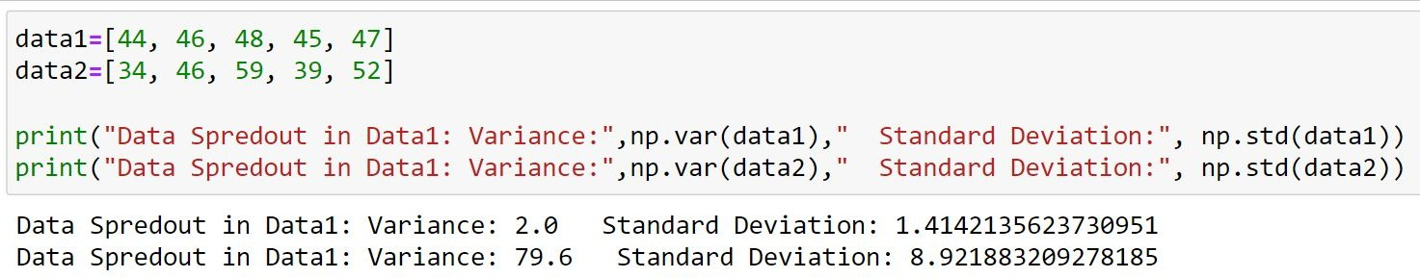
So it is quite clear from the measure that attribute 1 values are quite concentrated around the mean while attribute 2 values are extremely spread out. Since this data was small, a visual inspection and understanding were possible and that matches with the measured value.

Slide 18
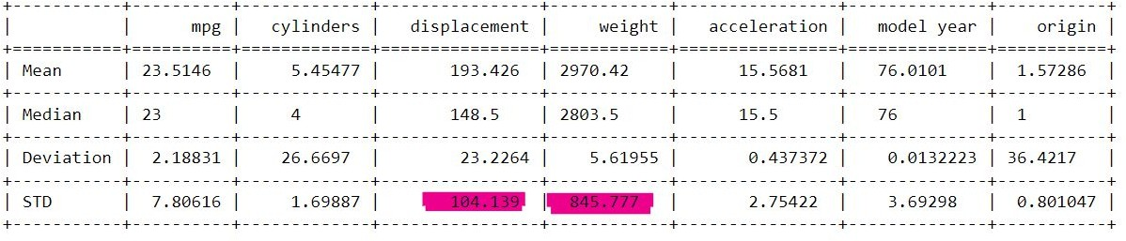
Looking at auto MPG dataset

Slide 19
Measuring data value position: IQR
a = [40,43,53,57,78,79,87,90,92,93,98]
b = [5,22,39,75,79,85,90,91,93,93,94,95]
(Do by self)
40 | 43 | 53 | 57 | 78 | 79 | 87 | 90 | 92 | 93 | 98
40 | 43 | 53 | 57 | 78 | 79 | 87 | 90 | 92 | 93 | 98
Median (Q2) = 79

Slide 20
Measuring data value position: IQR
40 | 43 | 53 | 57 | 78 | 79 | 87 | 90 | 92 | 93 | 98
40 | 43 | 53 | 57 | 78 | 79 | 87 | 90 | 92 | 93 | 98
Median (Q2) = 79
40 | 43 | 53 | 57 | 78 | 79 | 87 | 90 | 92 | 93 | 98
Q1= 53
40 | 43 | 53 | 57 | 78 | 79 | 87 | 90 | 92 | 93 | 98
Q3= 92

Slide 21
Measuring data value position: IQR
40 | 43 | 53 | 57 | 78 | 79 | 87 | 90 | 92 | 93 | 98
Lower Whisker
Q1= 53
Median(Q2)= 79
Q3= 92
Upper Whisker
IQR = 92-53=39
A box plot is an extremely effective mechanism to get a one-shot view and understand the nature of the data i.e. spread as well as outliers.

Slide 22
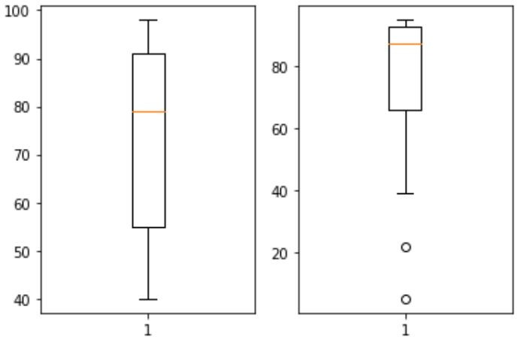
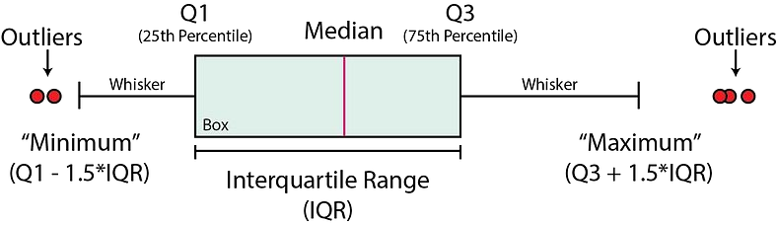
Boxplot
a = [40,43,53,57,78,79,87,90,92,93,98]
b = [5,22,39,75,79,85,90,91,93,93,94,95]
Q1-1.5*IQR is the outlier. There
Tukey other
methods for identification of outliers.
Analyze the two boxplot and write conclusions

Slide 23
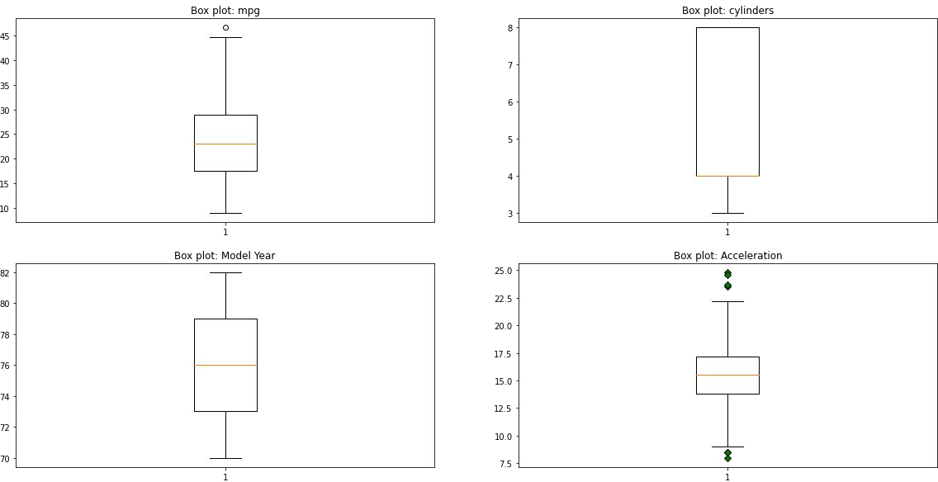
Box Plot of Auto MPG data set

Slide 24
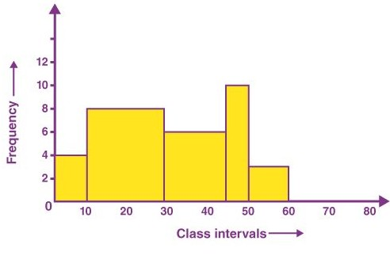
Histogram
A histogram divides the variable into bins, counts the data points in each bin, and shows the bins on the x-axis and the counts on the y-axis.

Slide 25
Types of Histogram
The histogram can be classified into different types based on the frequency distribution of the data.
Uniform histogram
Symmetric histogram
Bimodal histogram
Probability histogram

Slide 26
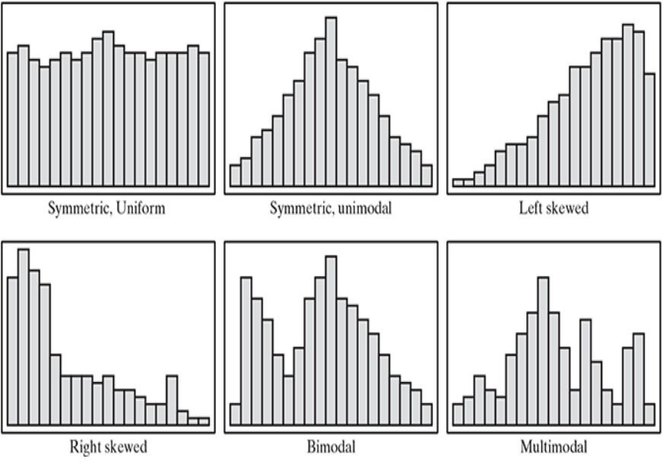
Types of Histogram

Slide 27
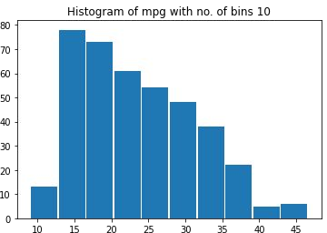
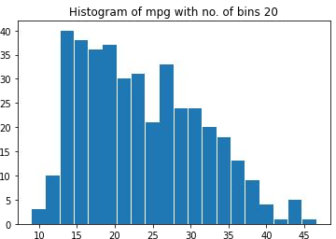
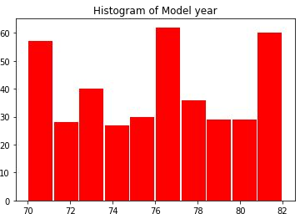
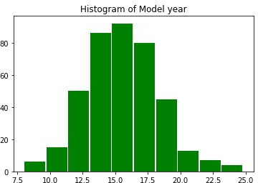

Slide 28

Self Study When Histograms Fail
https://towardsdatascience.com/histograms-and-dens ity-plots-in-python-f6bda88f5ac0

Slide 29
Data Exploration: Multiple attributes
Till now we have been exploring single attributes in isolation. One more important angle of data
exploration attributes.
Scatter plot
is to explore relationship between
Two-way cross-tabulations

Slide 30
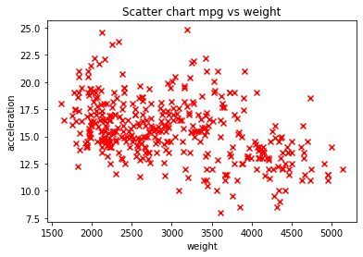
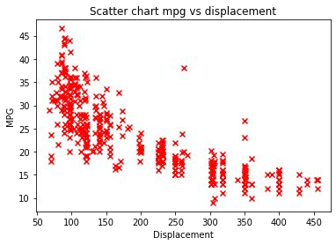
Scatter plot
A scatter plot helps in visualizing bivariate relationships, i.e. relationship between two variables.
It is a two-dimensional plot in which points or dots are drawn on coordinates provided by values of the attributes.

Slide 31
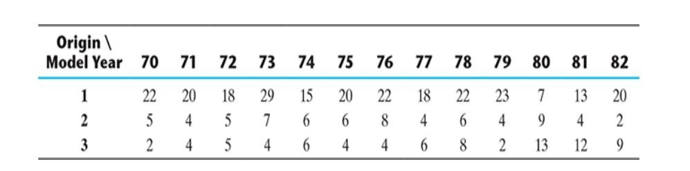
Two-way cross-tabulations
A cross-tabulation (Frequency table/Contingency table ) is simple but effective way to inspect relationship between two or more categorical or discrete variables.

Slide 32
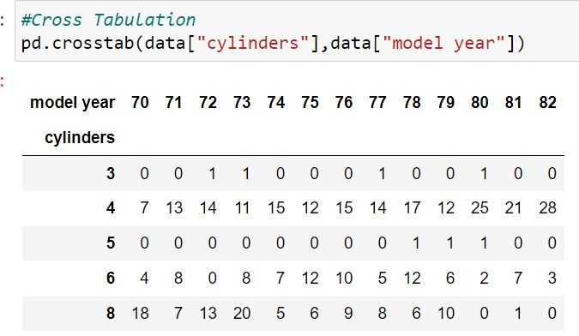

Slide 33
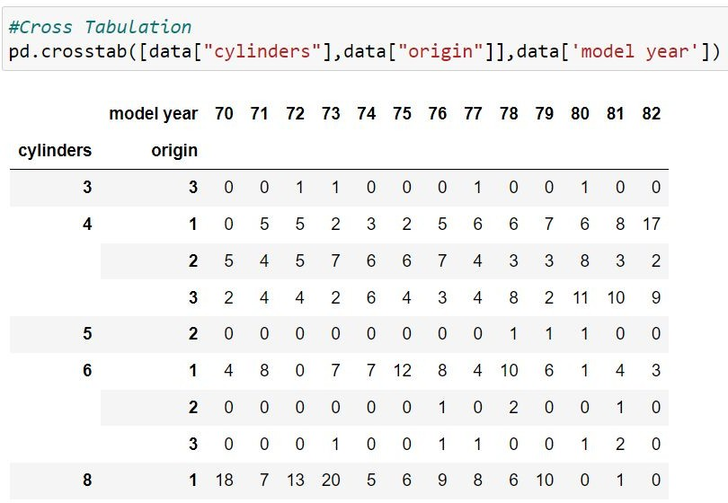

Slide 34
DATA QUALITY AND REMEDIATION

Slide 35
Data quality
Quality of dataset can be affected due to;
Wrong sample set selection
Missing values / outliers
Data Remediation
Handling outliers
Handling missing values

Slide 36
Handling outliers
Remove outliers: If the number of records which are outliers is not many, a simple approach may be to remove them.
Imputation: One other way is to impute the value with mean or median or mode. The value of the most similar data element may also be used for imputation.
Capping: For values that lie outside the 1.5|×| IQR limits, we can cap them by replacing those observations below the lower limit with the value of 5th percentile and those that lie above the upper limit, with the value of 95th percentile.

Slide 37
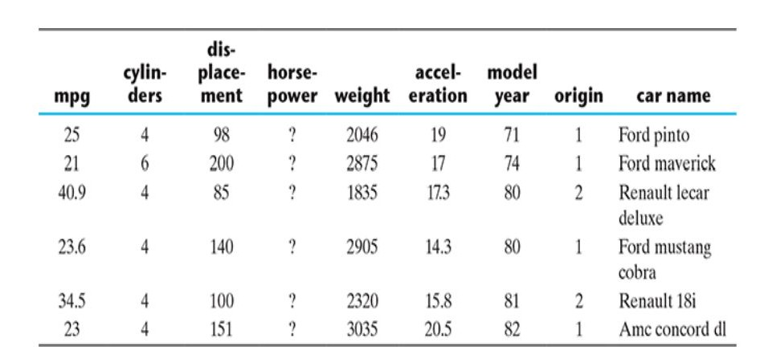
Data Cleaning
Data in the Real World Is Dirty: Lots of potentially incorrect data, e.g., instrument faulty, human or computer error, transmission error
incomplete: lacking attribute values, lacking certain attributes of interest, or containing only aggregate data
e.g., Occupation=“ ” (missing data)
noisy: containing noise, errors, or outliers
e.g., Salary=“−10” (an error)
inconsistent: containing discrepancies in codes or names, e.g.,
Age=“42”, Birthday=“03/07/2010”
Was rating “1, 2, 3”, now rating “A, B, C”
discrepancy between duplicate records
Intentional (e.g., disguised missing data)
Jan. 1 as everyone’s birthday?

Slide 38
Handling Missing Values
Eliminate records having a missing value of data elements
Imputing missing values ( mean-median / similarity based mean or median)
Assigning similar values for relevant attributes

Slide 39
Dimensionality Reduction
In both Statistics and Machine Learning, the
number of attributes, features or input variables of a dataset is referred to as its dimensionality.
Dimensionality reduction simply refers to the
process of reducing the number of attributes in a dataset while keeping as much of the variation in the
original dataset as possible.
Dimensionality reduction refers to the techniques of reducing the dimensionality of a data set by creating new attributes by combining the original attributes.
The most common approach for dimensionality reduction is known as Principal Component Analysis (PCA)/Feature Subset Selection.

Slide 40
Dimensionality Reduction
Advantages of Dimensionality Reduction
A lower number of dimensions in data means less training time and less computational resources and increases the overall performance of machine learning algorithms
Dimensionality reduction avoids the problem of overfitting
Dimensionality reduction is extremely useful for data visualization
Model accuracy
improves due to less
misleading data
Algorithms train faster thanks to fewer data
It removes noise and redundant features

Slide 41
Dimensionality Reduction
Decomposition algorithms
Discriminant Analysis
Principal Component Analysis
Kernel Principal Component Analysis
Linear Discriminant Analysis
Non-Negative Matrix Factorization
Singular Value Decomposition

Slide 42
Principal Component Analysis (PCA)
PCA is a statistical technique to convert a set of correlated variables into a set of transformed, uncorrelated variables called principal components.
It is a projection based method that transforms the data by projecting it onto a set of orthogonal(perpendicular) axes.
It is unsupervised learning algorithm
We are expecting high variance in for PCA to cover majority of original dataset information.

Slide 43




How Does PCA Work?
Original Data
Covariance Matrix
How PCA Works
Eigen Value Decomposition
K Largest Eigen values
PCA = eigenvectors(K largest Eigen values)

Slide 44
PCA: Covariance Matrix
a covariance matrix is the covariance between each given random vector.
a square matrix giving pair of elements of a
Any covariance matrix semi-definite and its
is symmetric and positive
main diagonal
contains variances (i.e., the covariance of each element with itself). – source Wikipedia

Slide 45

PCA: Covariance Matrix
Happiness in getting fruits
Apple | Banana
1 | 1
3 | 0
-1 | -1
Cov(A,A)
Cov(A,B)
Cov(B,A)
Cov(B,B)
4
1
It’s simple to see that the covariance matrix is a square matrix of
order num_features.
1
1

Slide 46
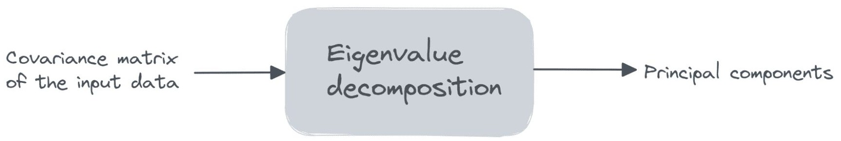
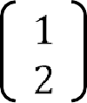
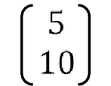
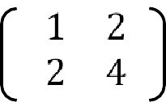

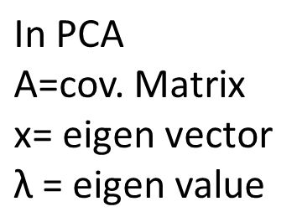
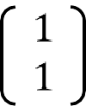



PCA: Eigen Value Decomposition
Eigen values and vectors
A vector which undergoes pure scaling without any rotation is known as eigen vector.
Scaling factor (stretch ratio is known as eigen values.
A | x | Ax

Slide 47
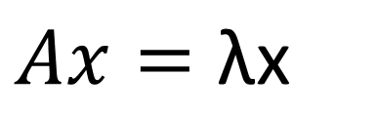

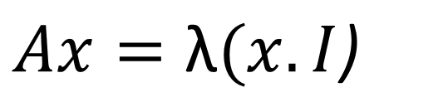
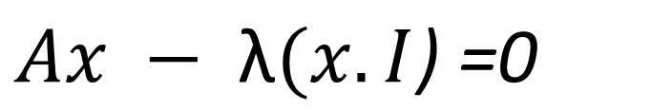
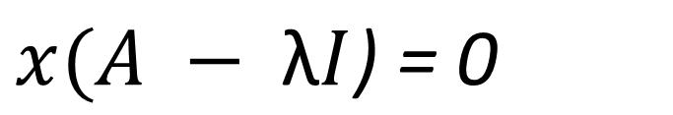
PCA: Eigen Value Decomposition (Optional)
4
1
1
1
This represents a homogeneous system of linear equations and it has a non-trivial solution only when the determinant of the coefficient matrix is 0.
|A - λI| = 0

Slide 48
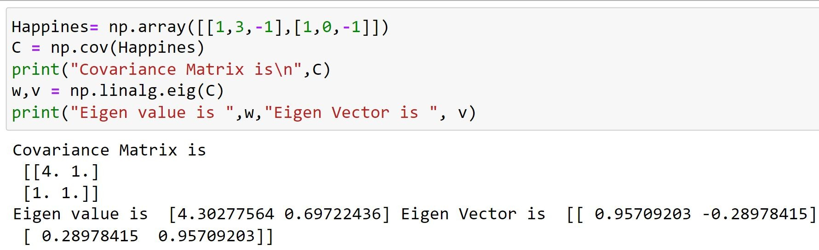
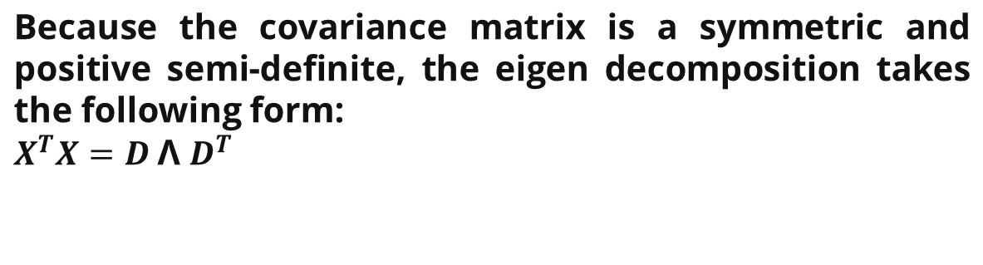
The first k principal components are the eigenvectors corresponding to the k largest eigenvalues.

Slide 49
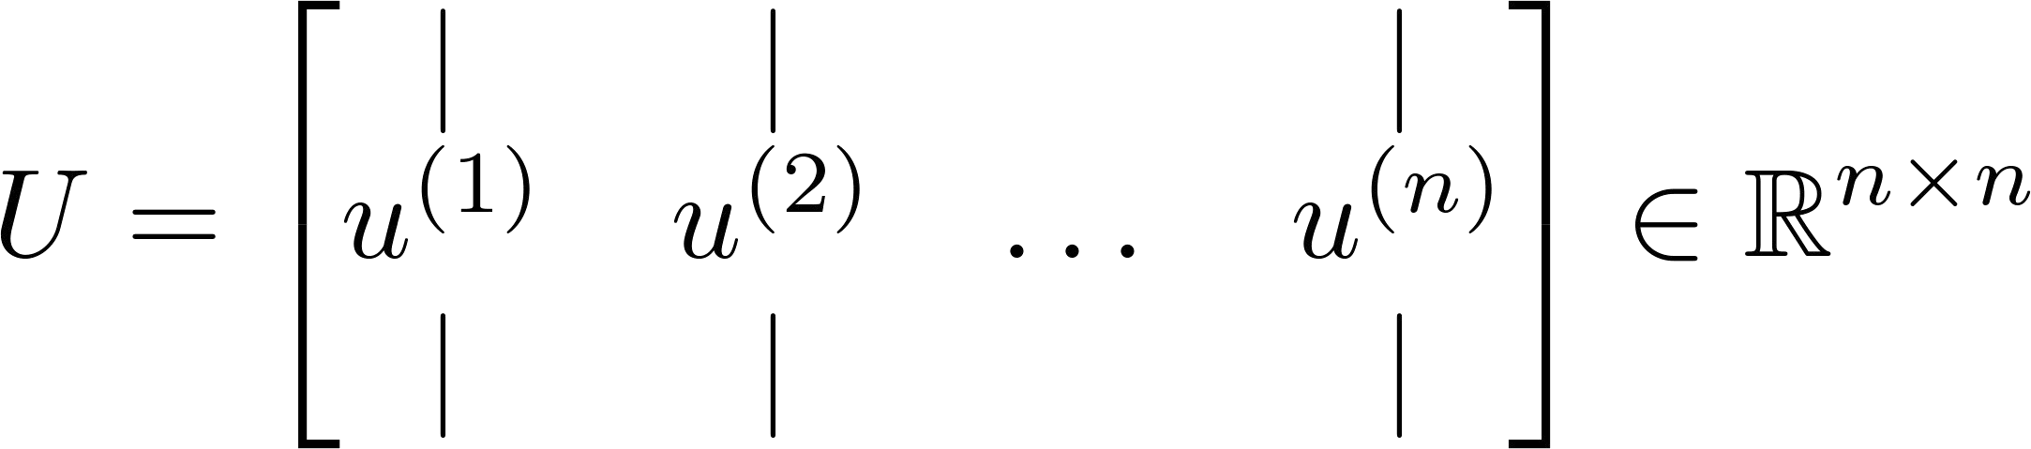
Principal Components Using SVD
Another matrix factorization technique that can be used to compute principal components is singular value decomposition or SVD.
[U,S,V] = SVD (C)
C is covariance matrix (nXn)

Slide 50
PCA in scikit-learn
Steps to perform PCA in scikit learn library
Feature Scaling (Mean normalization)
Run PCA algorithm to fit data to obtain 2/3 new axis (principal component) from original data set
fit function in scikit learn automatically carries out mean normalization
Examine variance by each principal component with original data set.
explained_variance_ration function in scikit learn
Transform (project) data into the new axes.
transform

Slide 51
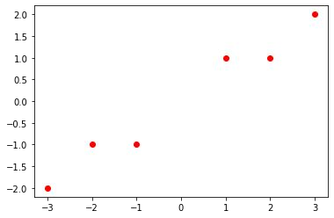
PCA in scikit-learn (Example)
X = np.array([[1,1],[2,1],[3,2],[-1,-1],[-2,-1],[-3,-2]])
pca = PCA(n_components=1)
pca.fit(X)
pca.explained_variance_ratio_
0.99244289 (High Variance ? 99.24% of data is covered)
new_axis = pca.transform(X)
[[ 1.38340578] [ 2.22189802] [ 3.6053038 ]
[-1.38340578] [-2.22189802] [-3.6053038 ]]

Slide 52
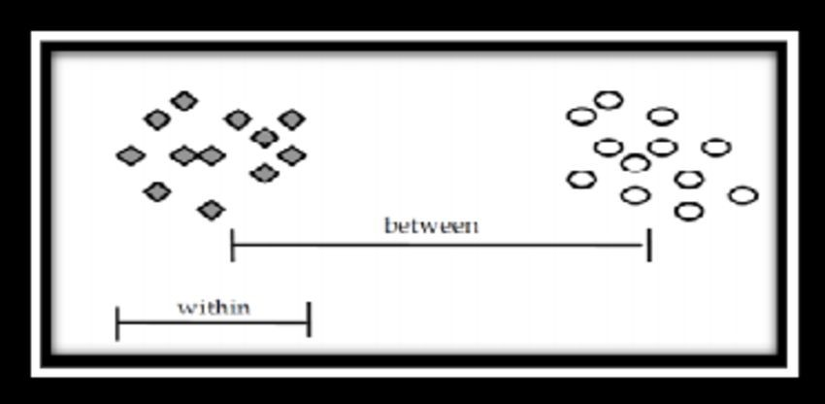
Linear discriminant analysis (LDA)
The objective of LDA is similar to the sense that it intends to transform a data set into a lower dimensional feature space.
However, unlike PCA, the focus of LDA is not to capture the data set variability. Instead, LDA focuses on maximizing class separability.
separating the features based on class separability so as to avoid over-fitting of the machine learning model.
Unlike PCA that calculates eigenvalues of the covariance matrix of the data set, LDA calculates eigenvalues and eigenvectors within a class and inter-class scatter matrices.

Slide 53
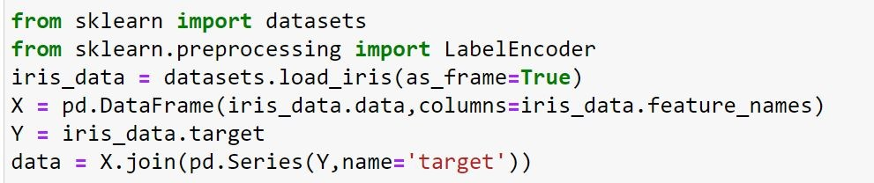
HOW LDA WORKS
Calculate the mean vectors for the individual classes.
Calculate intra-class and inter-class scatter matrices.
Calculate eigenvalues and eigenvectors for SW and SB , where SW is the intra-class scatter matrix and SB is the inter-class scatter matrix.
Identify the top ‘k’ eigenvectors having top ‘k’ eigenvalues

Slide 54
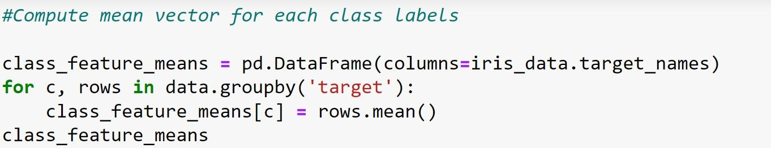
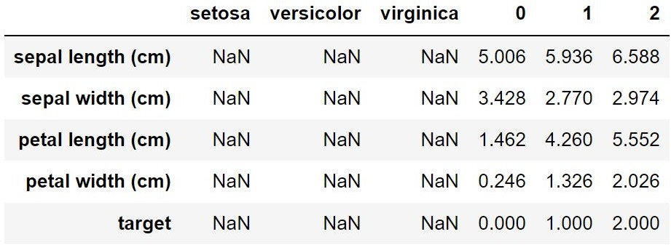
Compute mean vector for each class labels

Slide 55

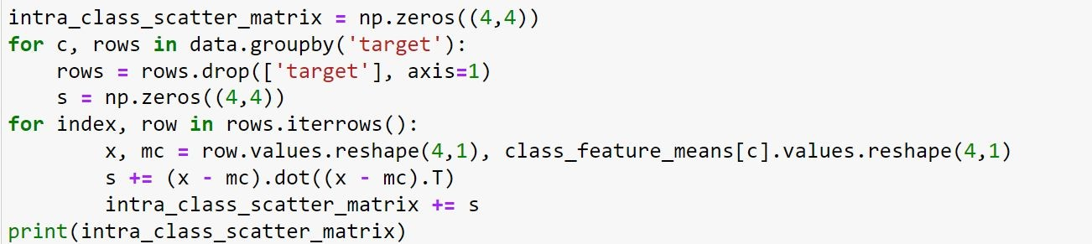


Calculate intra-class scatter matrix

Slide 56


Calculate Inter-class scatter matrix

Slide 57

Calculate eigenvalues and eigenvectors

Slide 58
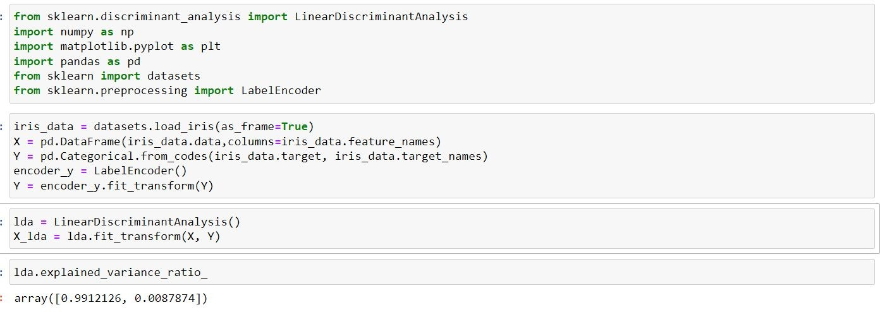
LBA using scikit learn

Slide 59
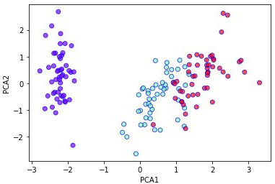
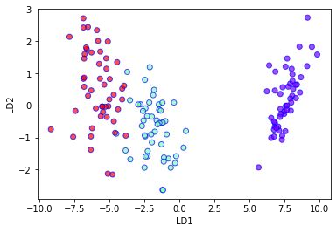
Comparison between PCA and LCA

Slide 60
