Slide 1

Concepts of Probabilities

Slide 2
Outline
Conditional, Joint, Marginal Probabilities
Sum Rule and Product Rule
Bayes’ Theorem
Probability Distribution
Bernoulli Distribution
Normal/Gaussian Distribution
Central Limit Theory
Monte Carlo Approximation

Slide 3
Introduction to Probability

Slide 4


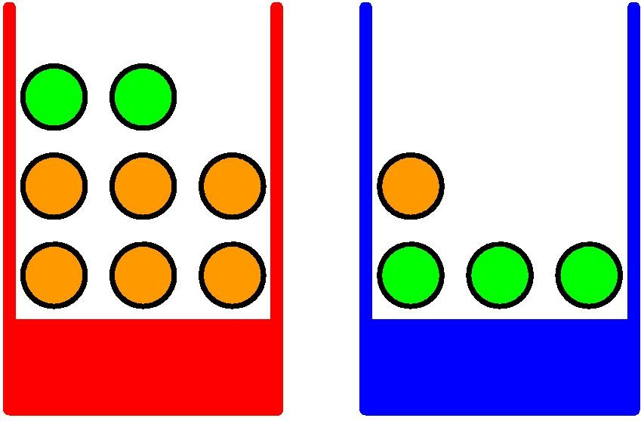


A simple orienting example
Random Variables: B = {b,r} □ Baskets F = {a,p} □ Fruits
What is the probability of picking a fruit is orange?
What is the probability that I will peak the fruit from red basket given that fruit was orange?

Slide 5




A simple orienting example
100 trials Probability
Distribution
Table
 | F=o | F=a
B=r | r,o 30 | r,a 10
B=b | b,o 15 | b,a 45
40
60
45 55

Slide 6
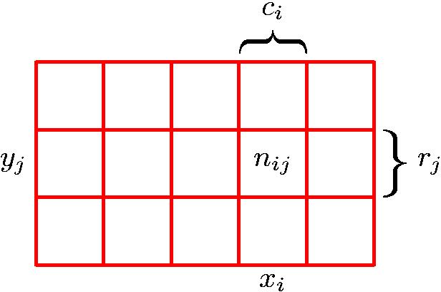
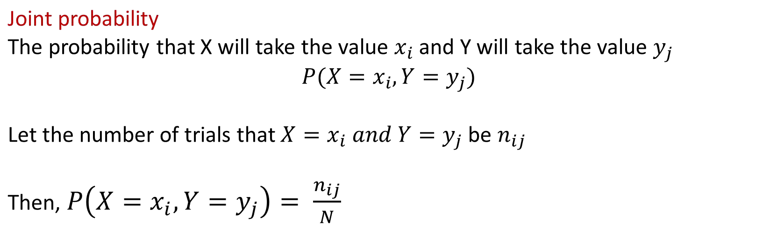

Joint Probability (Discrete)
 | F = o | F= a | Total
B = r | 30 | 10 | 40
B = b | 15 | 45 | 60
 | 45 | 55
Adapted from Dr Christopher Bishop’s slides

Slide 7
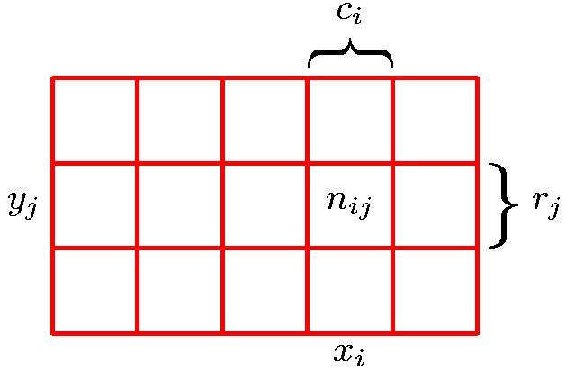
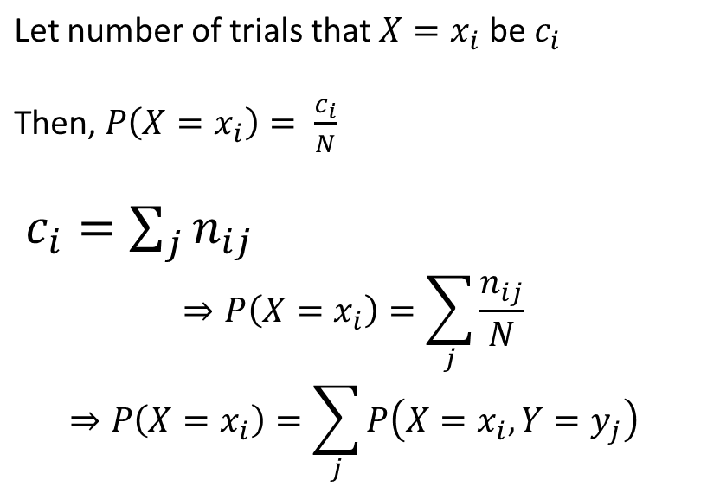
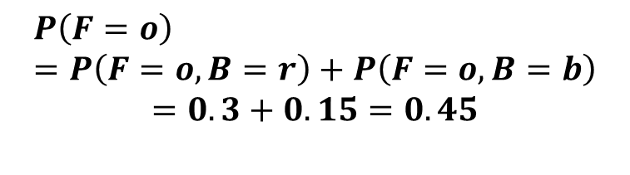
Sum Rule
 | F = o | F= a | Total
B = r | 30 | 10 | 40
B = b | 15 | 45 | 60
 | 45 | 55
Marginal probability
Sum rule of probability
Adapted from Dr Christopher Bishop’s slides

Slide 8
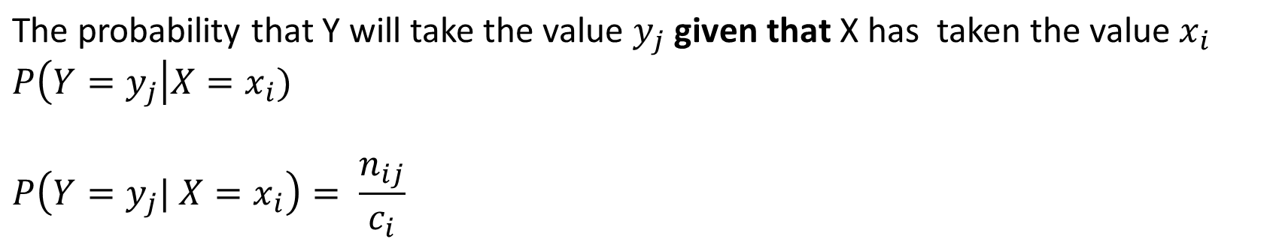
Conditional Probability
 | F = o | F= a | Total
B = r | 30 | 10 | 40
B = b | 15 | 45 | 60
 | 45 | 55
Adapted from Dr Christopher Bishop’s slides

Slide 9
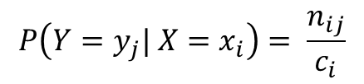




Product Rule
 | F = o | F= a | Total
B = r | 30 | 10 | 40
B = b | 15 | 45 | 60
 | 45 | 55
Product rule of probability
Joint probability
Conditional probability
Marginal probability
Adapted from Dr Christopher Bishop’s slides

Slide 10
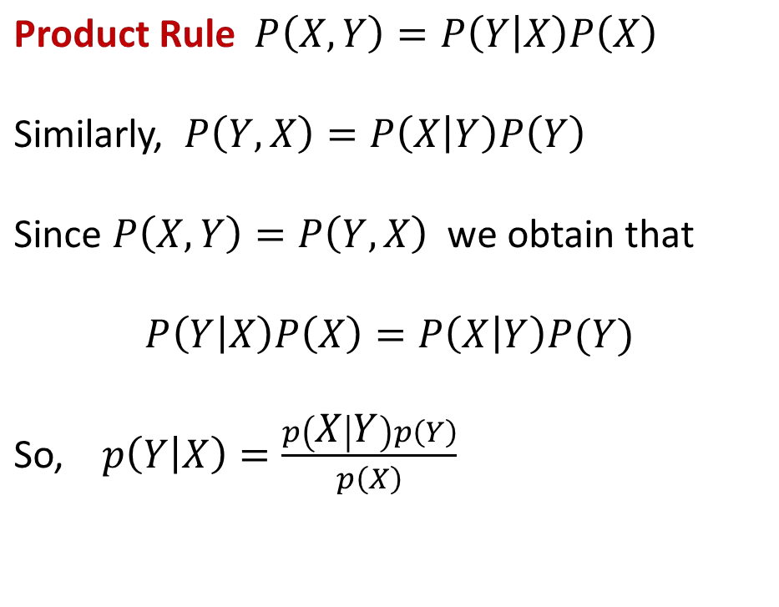
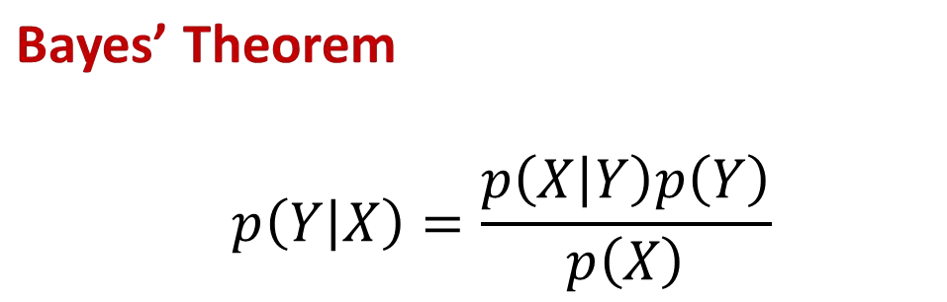
Bayes’ Theorem

Slide 11
Bayesian Theorem
Generative Model

Slide 12



Discriminative vs Generative Model
A Discriminative model models the decision boundary between the classes.

Slide 13
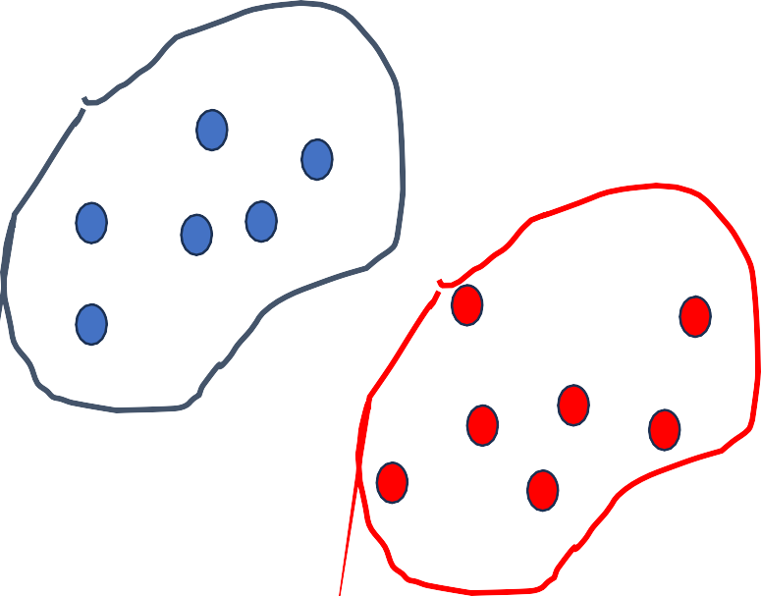
Discriminative vs Generative Model
In final both of them is predicting the conditional probability P(Animal | Features)
A Generative Model explicitly models the actual distribution of each class

Slide 14
Discriminative vs Generative Model
A Generative Model learns the joint probability distribution p(x,y). It predicts the conditional probability with the help of Bayes Theorem.
P(Y|X) = P(X|Y)* P(Y) / P(X)
Posterior = ( Likelihood * Prior ) / Evidence
Discriminative model learns
the conditional
Both of these models were generally used
probability
distribution p(y|x).
in supervised
learning problems.

Slide 15
Discriminative vs Generative Model
Generative classifiers
Assume some functional form for P(Y), P(X|Y)
Estimate parameters of P(X|Y), P(Y) directly from training data
Use Bayes rule to calculate P(Y |X)
Discriminative Classifiers
Assume some functional form for P(Y|X)
Estimate parameters of P(Y|X) directly from training data
Generative classifiers
Naïve Bayes
Bayesian networks
Markov random fields
Hidden Markov Models (HMM)
Discriminative Classifiers
Logistic regression
Scalar Vector Machine
Traditional neural networks
Nearest neighbour

Slide 16
Application of Bayesian classifiers
Text-based classification such as spam or junk mail filtering, author identification, or topic categorization
Medical diagnosis such as given the presence of a set of observed symptoms during a disease, identifying the probability of new patients having the disease
Network security such as detecting illegal intrusion or anomaly in computer networks

Slide 17
Naïve Bayes Algorithm
Naïve Bayes algorithm is a supervised learning algorithm, which is based on Bayes theorem and used for solving classification problems.
It is a probabilistic classifier, which means it predicts on the basis of the probability of an object.
Naïve: The occurrence of a certain feature is independent of the occurrence of other features.
Bayes: It is called Bayes because it depends on the principle of Bayes' Theorem.
P(Y|X) = P(X|Y)* P(Y) / P(X)
Posterior = ( Likelihood * Prior ) / Evidence

Slide 18
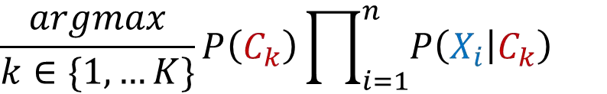
Naïve Bayes Algorithm
P(Y=1|X) = P(X|Y=1)* P(Y=1) / P(X) P(Y=0|X) = P(X|Y=0)* P(Y=0) / P(X)
By changing the class label, there is no change on denominator. So, we can eliminate calculation of Evidence (P(X)) in the Naïve Bayes.
P(Y|X) = P(X|Y)* P(Y)
One assumption in Naïve Bayes is all the features are independent and contribute same to the class label. So, considering this, above equation can be re-write as considering 4 features i.e X=[x1,x2,x3,x4];
P(Y|X) = P(X1|Y) *P(X2|Y)* P(X3|Y)* P(X4|Y)* P(Y)
Class assignment is selected based on maximum a posteriori
(MAP) rule

Slide 19
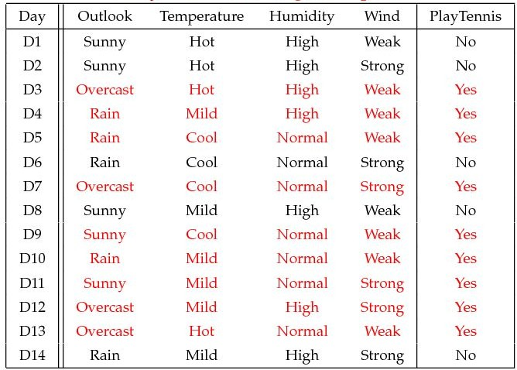
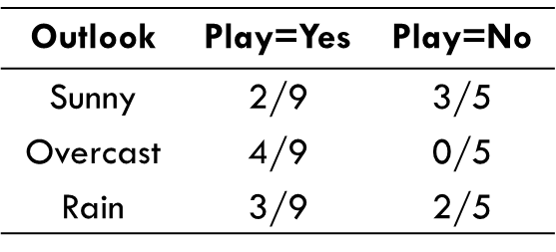
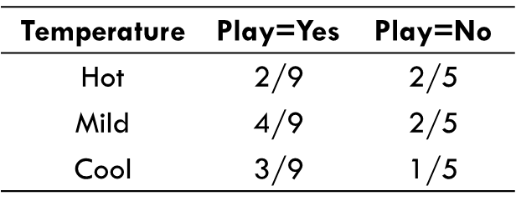
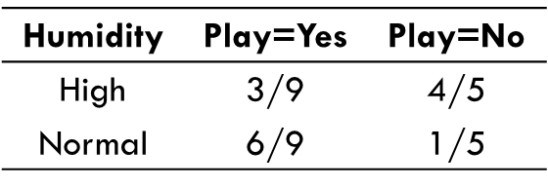
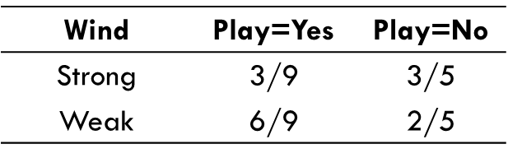
Example: Training Naïve Bayes Tennis Model
P(Play=Yes) = 9/14 P(Play=No) = 5/14
Create probability lookup tables based on training data
P(Y=Yes|(Sunny, Cool, High, Strong)) = 2/9 * 3/9 * 3/9 * 3/9 * 9/14 P(Y=No|(Sunny, Cool, High, Strong)) = 3/5 * 1/5 * 4/5 * 3/5 * 5/14
=0.0053
=0.0206
P(Y=Yes|(Sunny, Cool, High, Strong)) = P(Sunny|Y=Yes) *P(Cool|Yes)* P(High|Yes)* P(Strong |Yes)* P(Y)

Slide 20
Example: Training Naïve Bayes Tennis Model
P(Play=Yes) = 9/14 P(Play=No) = 5/14
Create probability lookup tables based on training data
P(Y=Yes|(D9)) = ?
P(Y=Yes|(D9)) = 2/9 * 3/9 * 6/9 * 6/9 * 9/14 P(Y=No|(D9)) = 3/5 * 1/5 * 1/5 * 2/5 * 5/14
=0.021
=0.003

Slide 21
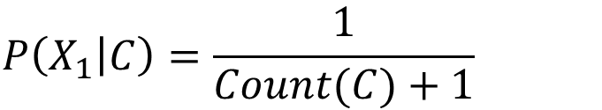
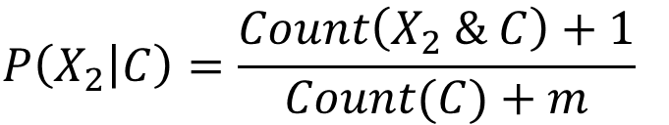
Laplace Smoothing
0
Problem: categories with no entries result in a value of "0" for conditional probability
Solution: add "1" to numerator and denominator of empty categories

Slide 22
Types of Naïve Bayes
Naïve Bayes Model
Data Type
Bernoulli
Binary (T/F)
Multinomial
Discrete (e.g. count)
Gaussian
Continuous

Slide 23
Probability Distribution
Bernoulli, Gaussian (Normal), Central Limit Theory

Slide 24

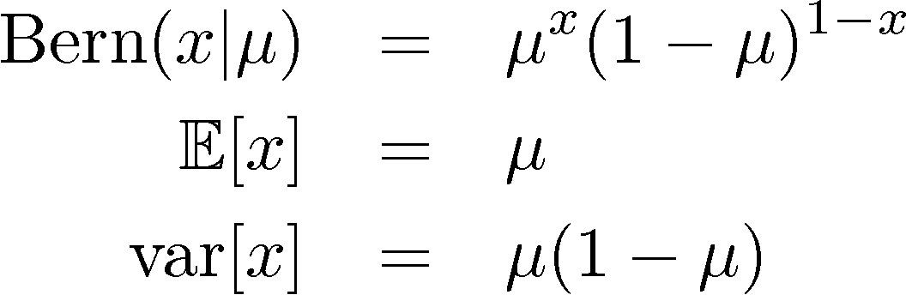
Binary Variables (1)
Coin flipping: heads=1, tails=0
Bernoulli Distribution

Slide 25
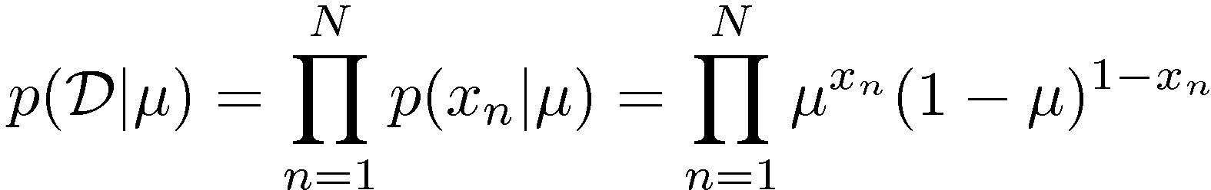
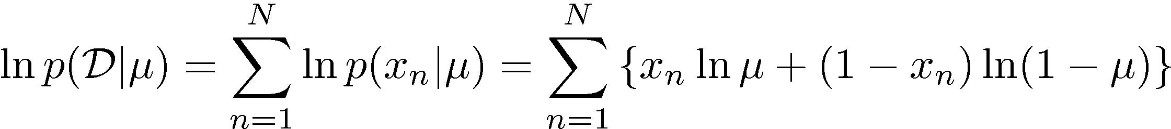
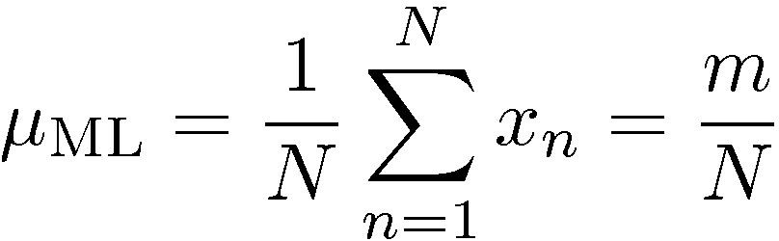
Parameter Estimation (1)
Maximum Likelihood for Bernoulli
Given:
•

Slide 26
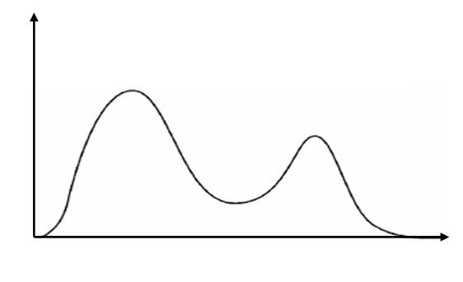
Bimodal Distribution
The bimodal distribution occurs due to the combination of two groups that have different mean heights between them.

Slide 27
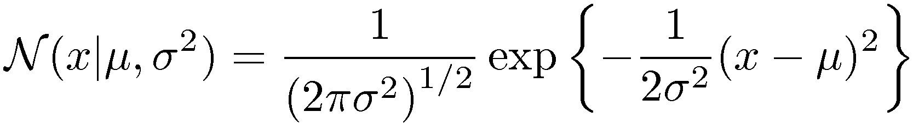
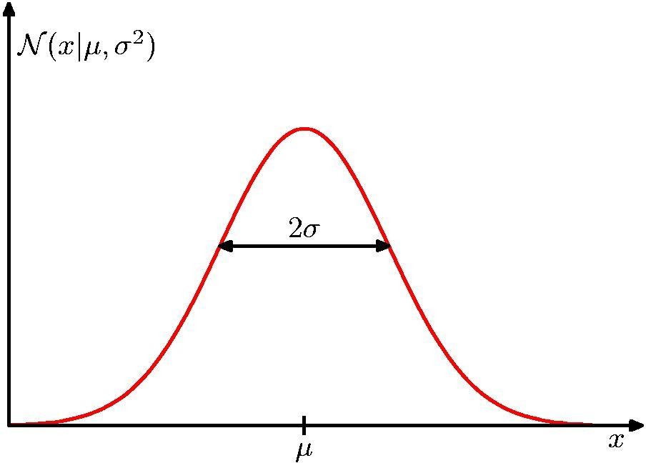
The Gaussian Distribution

Slide 28
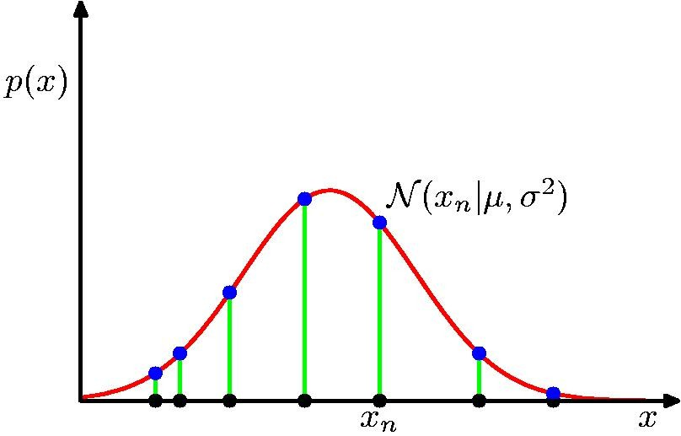
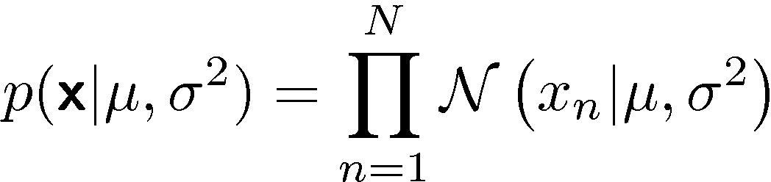
Gaussian Parameter Estimation
Likelihood function

Slide 29
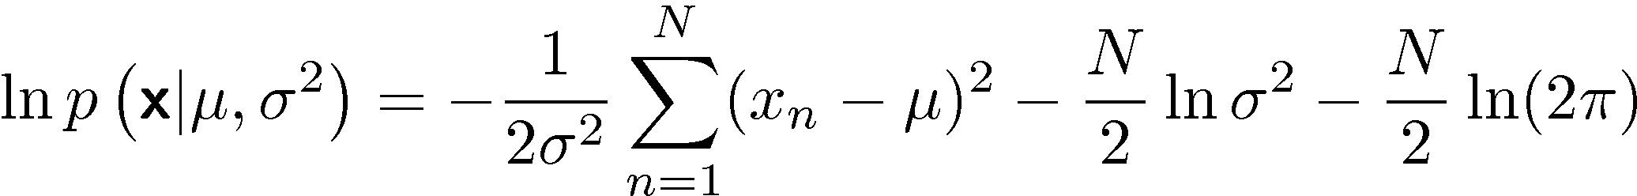
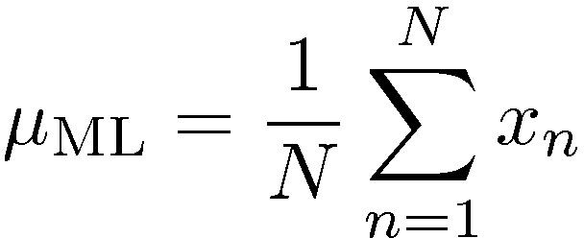
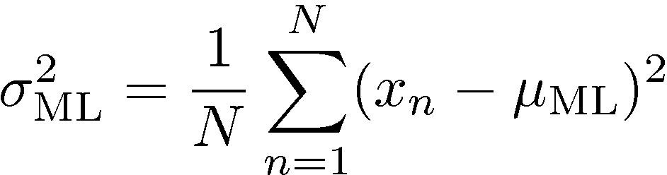
Maximum (Log) Likelihood

Slide 30
Central Limit Theory
Central Limit Theorem is generally used to predict the characteristics of a population from a set of sample.
It uses sampling distribution to generalize the samples and use to calculate approx mean, standard daviation and other important parameters.
CLT states that if you have a population with mean μ, sd σ, and take sufficiently large random samples from the population with replacement, then the distribution of the sample means will be normally distributed.
Example Self study : https://www.geeksforgeeks.org/central-limit-theorem/

Slide 31
Bayesian Network
Supervised Machine Learning

Slide 32
Introduction
Probabilistic graphical model which represents a set of variables and their conditional dependencies using a directed acyclic graph.
Bayes network, belief network, decision network, or Bayesian model.
Applications:
Prediction, anomaly detection, diagnostics, automated insight, reasoning, time series prediction, and decision making under uncertainty

Slide 33
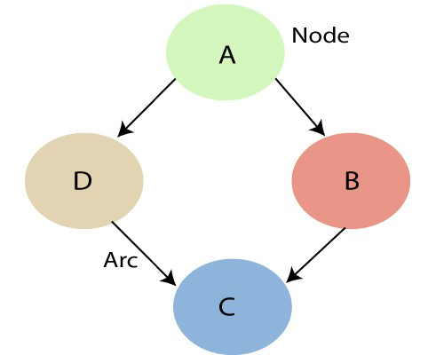
Introduction
Consists of two parts
Directed Acyclic Graph
Table of conditional probabilities.

Slide 34
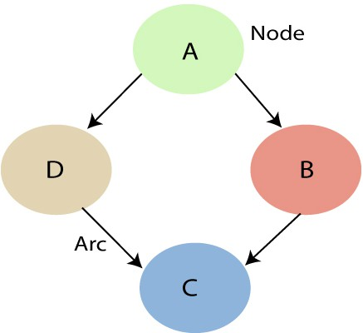
Each node corresponds to the random variables, and a variable can be continuous or discrete.
Arc or directed arrows represent the causal relationship or conditional probabilities between random variables.
Each node in the Bayesian network has condition probability distribution P(Xi
|Parent(Xi) ), which determines the effect of the parent on that node.
Bayesian network is based on Joint probability distribution and conditional probability.

Slide 35
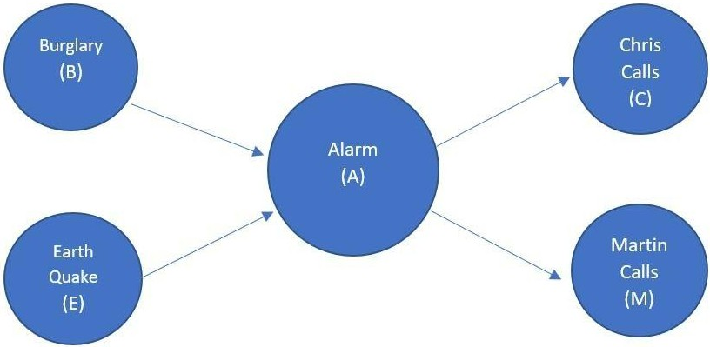
P(B,E,A,C,M)=P(C|A)*P(M|A
)*P(A|B,E)*P(B|E)*P(E)

Slide 36

Example
P(B,E,A,C,M)=P(C|A)*P(M|A
)*P(A|B,E)*P(B|E)*P(E)

Slide 37
Support Vector Machine
Supervised Learning Model

Slide 38
Support Vector Machine (SVM)
Used for both classification and regression
Goal: To draw a best line/Decision boundary to separate class labels?
Hyper plain
•

Slide 39
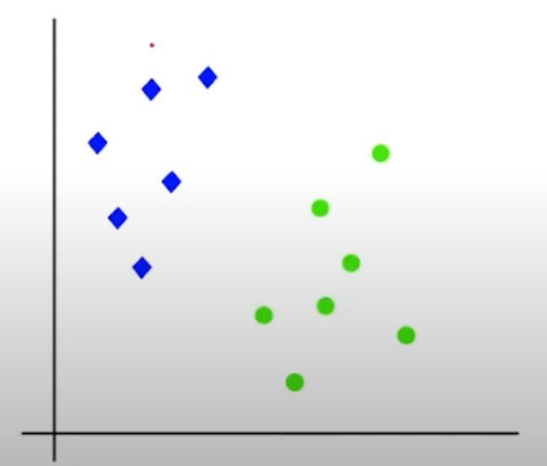
Nearest points to the decision boundary will be the Support Vector for that Respective boundary.
Two Types of SVM:
Linear (Decision boundary is linearly separable)
Non-Linear (Decision boundary is not linearly separable)

Slide 40
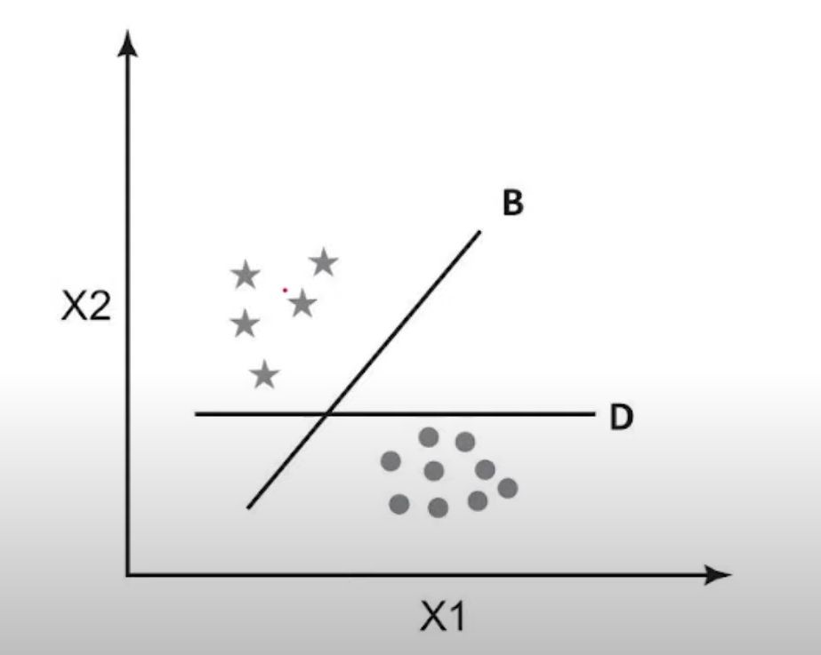
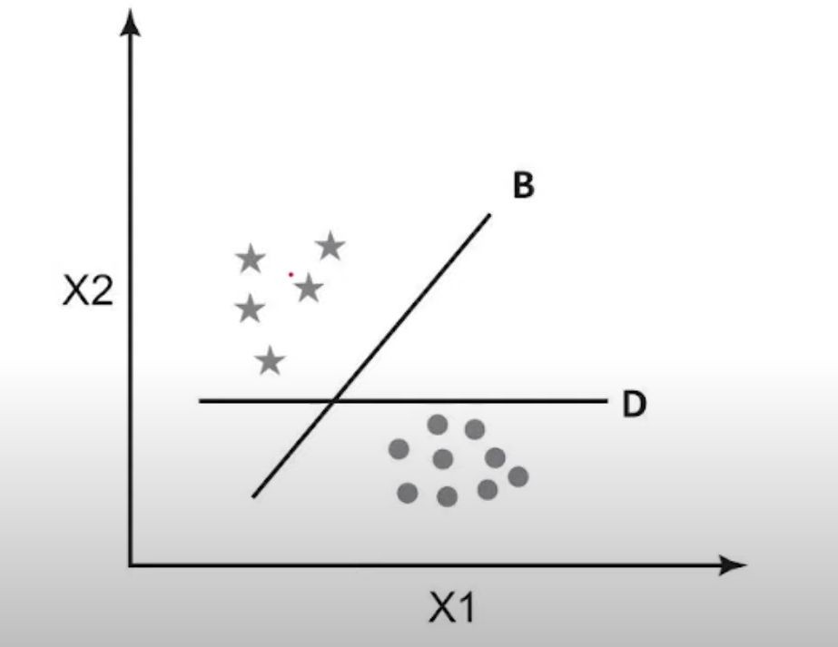
Linear SVM
Line with maximum
Margin will
be selected as best decision line.
Margin M2
Margin M1

Slide 41
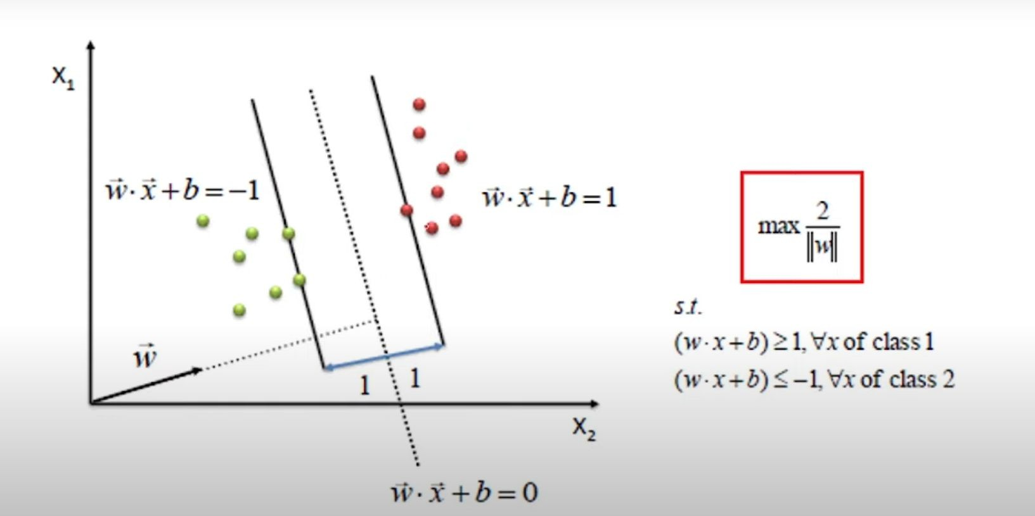
SVM

Slide 42
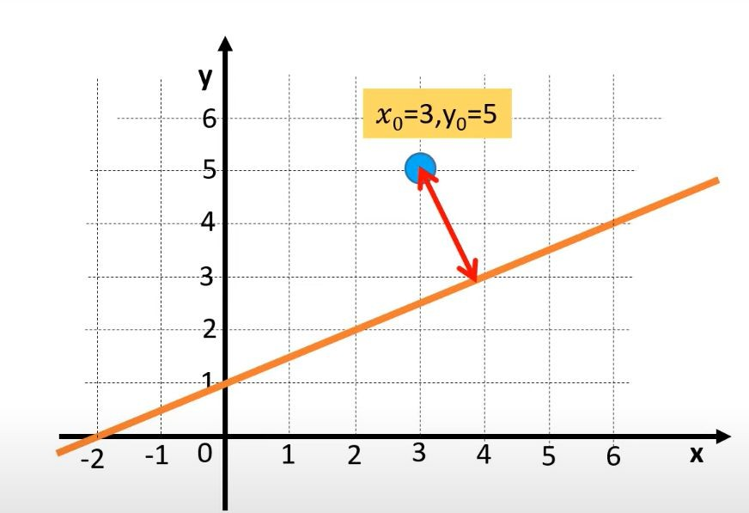
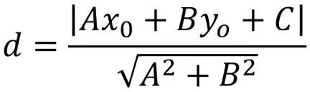
How to calculate Distance

Slide 43
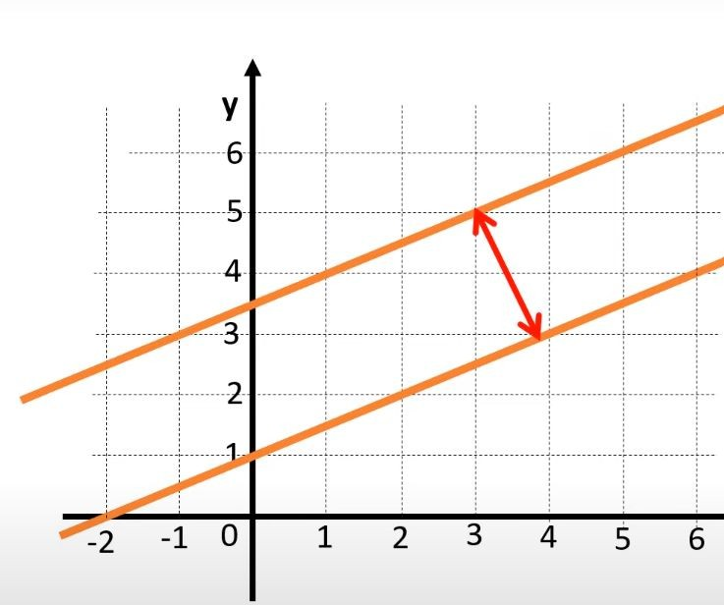
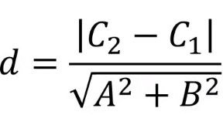
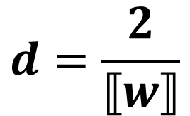
How to calculate Distance

Slide 44
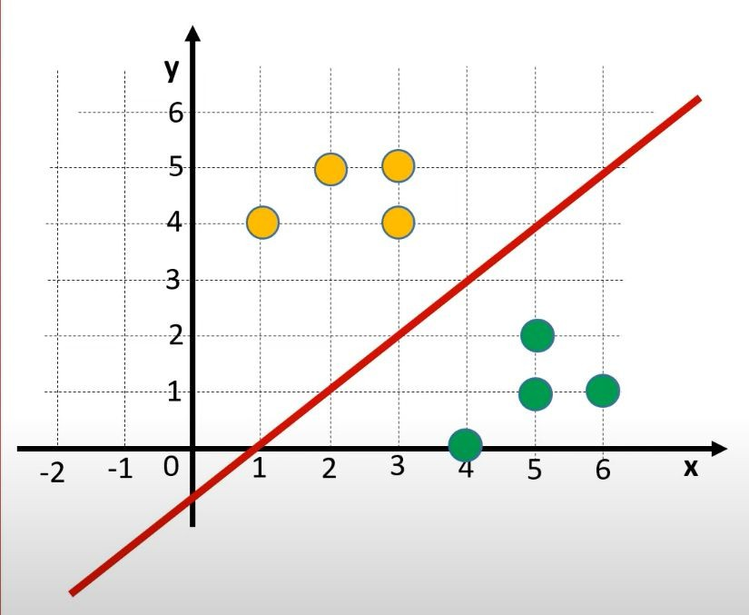
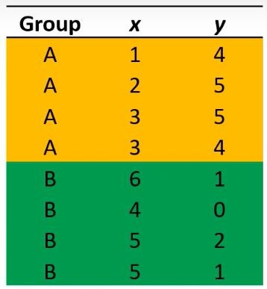

Example

Slide 45
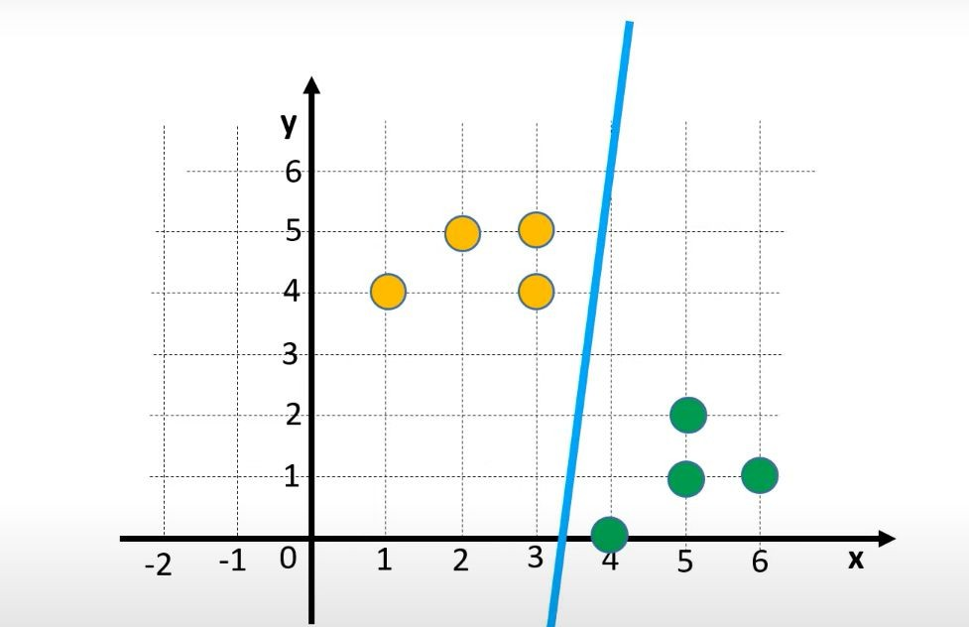
Example

Slide 46
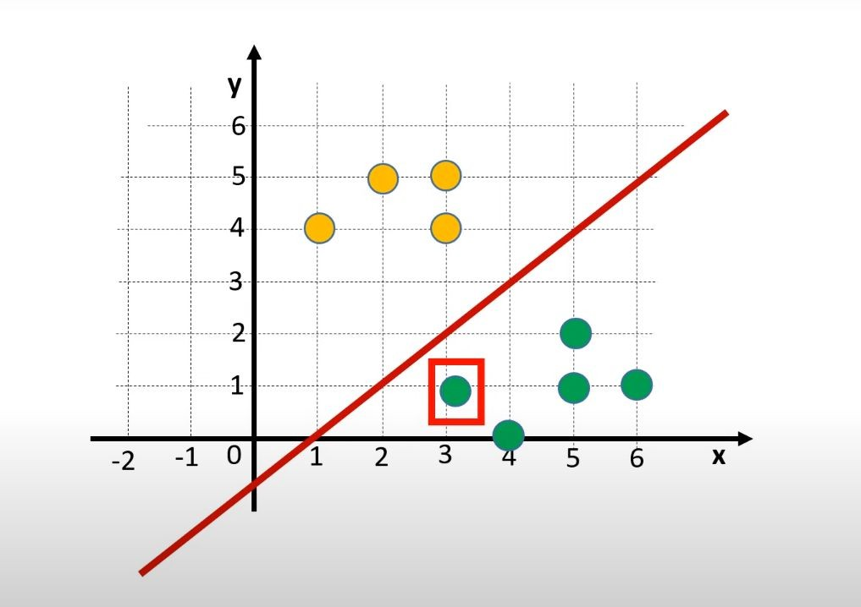
Example

Slide 47


Example

Slide 48

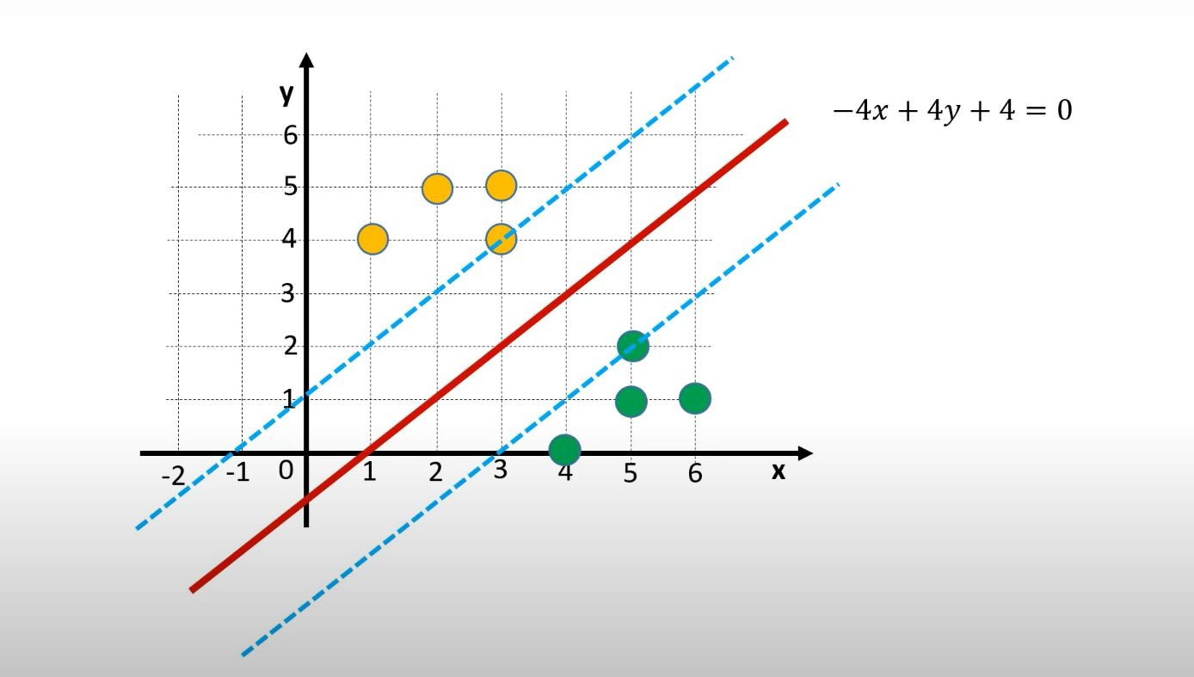

Example

Slide 49
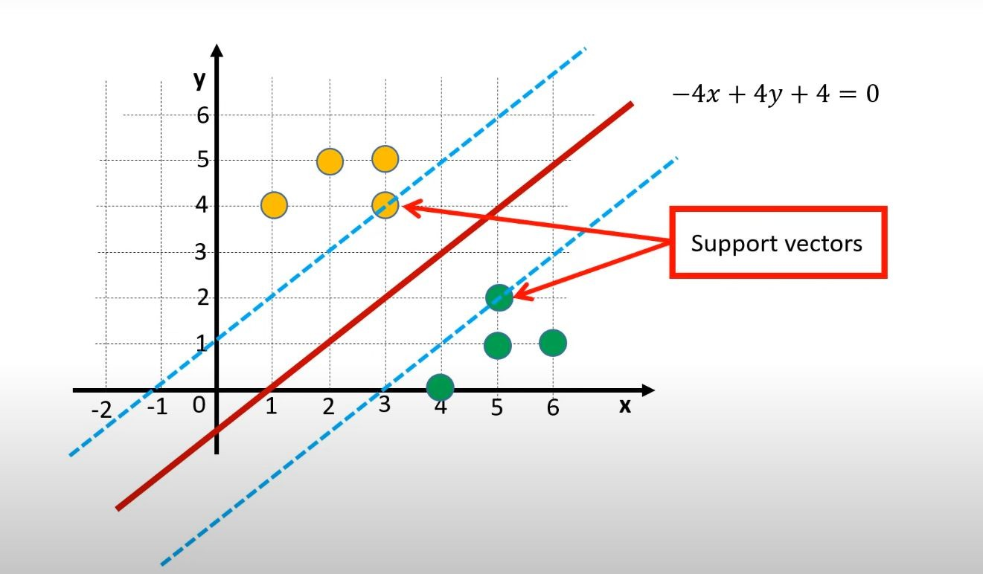

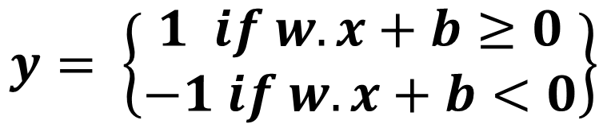
Example: Try your self to plug the training data

Slide 50
Summary of SVM
Used for both classification and regression
Goal: To draw a best line/Decision boundary to separate class labels?
Hyper plain
When the data is perfectly linearly separable only then we can use Linear SVM. Perfectly linearly separable means that the data points can be classified into 2 classes by using a single straight line(if 2D).
When the data is not linearly separable then we can use Non-Linear SVM, which means when the data points cannot be separated into 2 classes by using a straight line (if 2D) then we use some advanced techniques like kernel tricks to classify them.

Slide 51
Summary of SVM
Important Terms
Support Vectors: These are the points that are closest to the hyperplane. A separating line will be defined with the help of these data points.
Margin: it is the distance between the hyperplane and the observations closest to the hyperplane (support vectors). In SVM large margin is considered a good margin.
Kernel: Kernel is the mathematical function, which is used in SVM to map the original input data points into high-dimensional feature spaces, so, that the hyperplane can be easily found out even if the data points are not linearly separable in the original input space.

