Slide 1
BankBuddy: AI Customer Support Bank of Baroda Hackathon 2024
Team Name : FinBytes
Team Members : Devanshi Dudhatra (CSE Undergrad)
Heet Dobariya (CSE Undergrad)
Date : 28-06-2024

Slide 2
Problem Statement
Objective: To enhance the customer service experience by leveraging generative AI technologies to provide personalized, efficient, and proactive support across multiple channels.
Problem:
Manual handling of customer inquiries is time-consuming.
Lack of personalized and real-time responses.
Difficulty in integrating new solutions with existing platforms.
Why Solve It?
Improve customer satisfaction.
Reduce response time.
Streamline customer service operations.

Slide 3
Pre-Requisite
Existing Solutions:
Traditional call centers and customer service desks.
Basic chatbots and automated response systems.
Challenges with Existing Solutions:
Limited AI capabilities.
Lack of personalization.
Poor integration with existing platforms.

Slide 4
Tools or resources
Azure Cognitive Services: For natural language processing and understanding.
Azure Bot Service: To develop, deploy, and manage the chatbot.
Azure AI & Machine Learning: For training generative AI models.
Azure Security Center: To ensure data security and compliance.
Azure Maps: To get the location of branch and ATMs.

Slide 5
Any Supporting Functional Documents
Methodology:
Use AI to analyze and understand customer queries.
Generate real-time responses based on customer data and interaction history.
Architecture:
Front-end chatbot interface.
Back-end AI and data processing.
Integration layer with existing customer service platforms.
Scalability:
Modular design for adding new features.

Slide 6
Key Differentiators & Adoption Plan
Key Differentiators:
Advanced AI capabilities for more accurate responses.
Personalized recommendations based on customer data.
Seamless integration with existing systems.
Adoption Plan:
Pilot testing with a select group of customers.
Gradual rollout with continuous feedback and improvement.
Marketing and training to ensure customer and staff adoption.

Slide 7
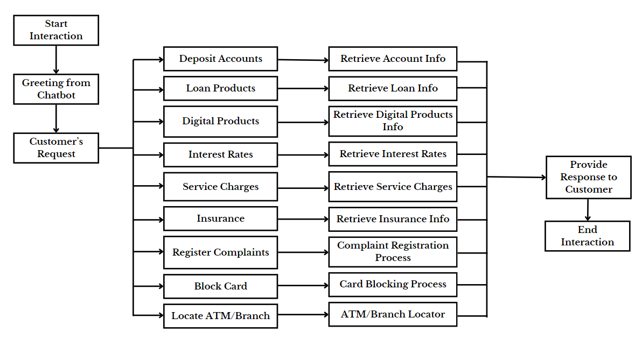
GitHub Repository Link & supporting diagrams, screenshots, if any
Flowchart of customer interaction.

Slide 8
Business Potential and Relevance
Applications:
Customer support automation.
Enhanced customer relationship management.
Potential Benefits:
Increased customer satisfaction and loyalty.
Cost savings through automation.
Enhanced efficiency and productivity.

Slide 9
Uniqueness of Approach and Solution
Unique Features:
Use of generative AI for real-time responses.
Integration with multiple customer service channels.
Personalized recommendations based on interaction history.

Slide 10
User Experience
Benefits:
Faster and more accurate responses.
Personalized interactions.
Consistent and proactive support.
User Feedback:
Plan for gathering and incorporating user feedback to improve the chatbot.

Slide 11
Scalability
Scalability Plan:
Use of Azure’s scalable infrastructure.
Efficient handling of increased customer interactions.
Regular updates and improvements to the AI model.

Slide 12
Ease of Deployment and Maintenance
Deployment:
Step-by-step deployment plan.
Integration with existing customer service platforms.
Maintenance:
Regular updates and improvements.
Monitoring and analytics for performance tracking.

Slide 13
Security Considerations
Security Measures:
Data encryption and secure storage.
Regular security audits and compliance checks.
Use of Azure Security Center for threat detection and prevention.

Slide 14
Thank You
Heet Dobariya
Devanshi Dudhatra

