Slide 1
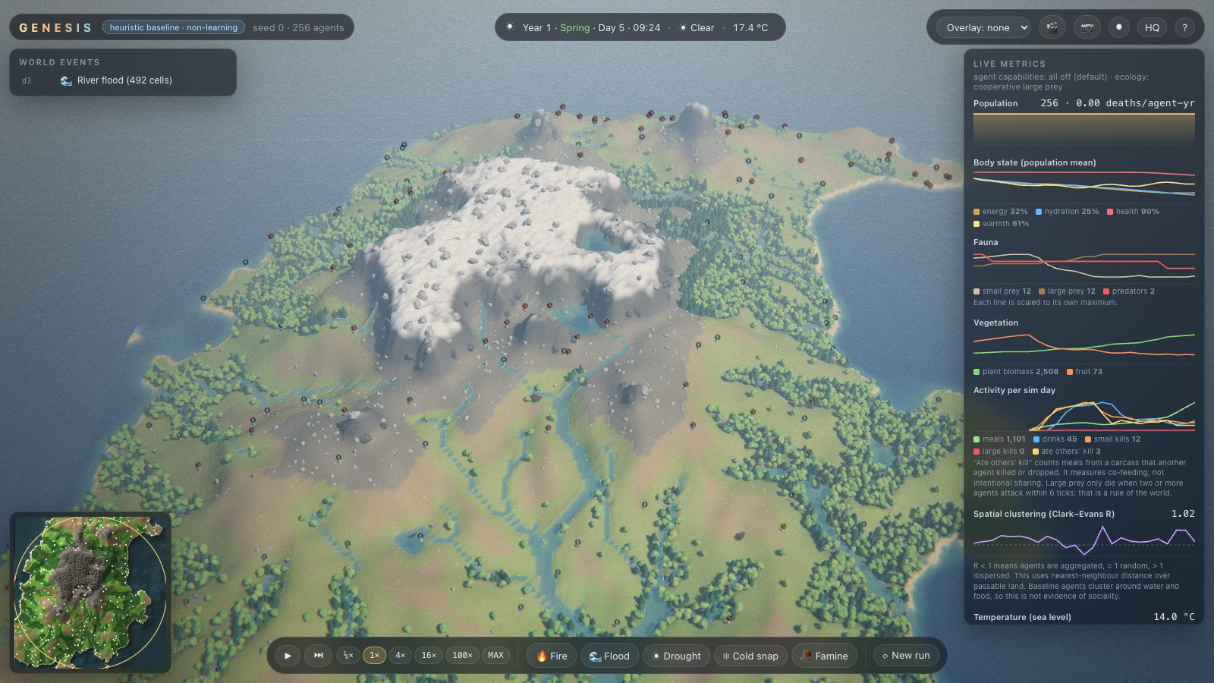
Do learning agents build societies when nothing social is rewarded?
GENESIS · Concept presentation · VIP Design Experience I (Semester IV)
Heet Ranpura, Advik Divekar · Mentor: [to fill]
Notes:
Open with the question. GENESIS is a testbed where every agent is paid only for keeping its own body healthy; we measure what social behaviour appears anyway.

Slide 2
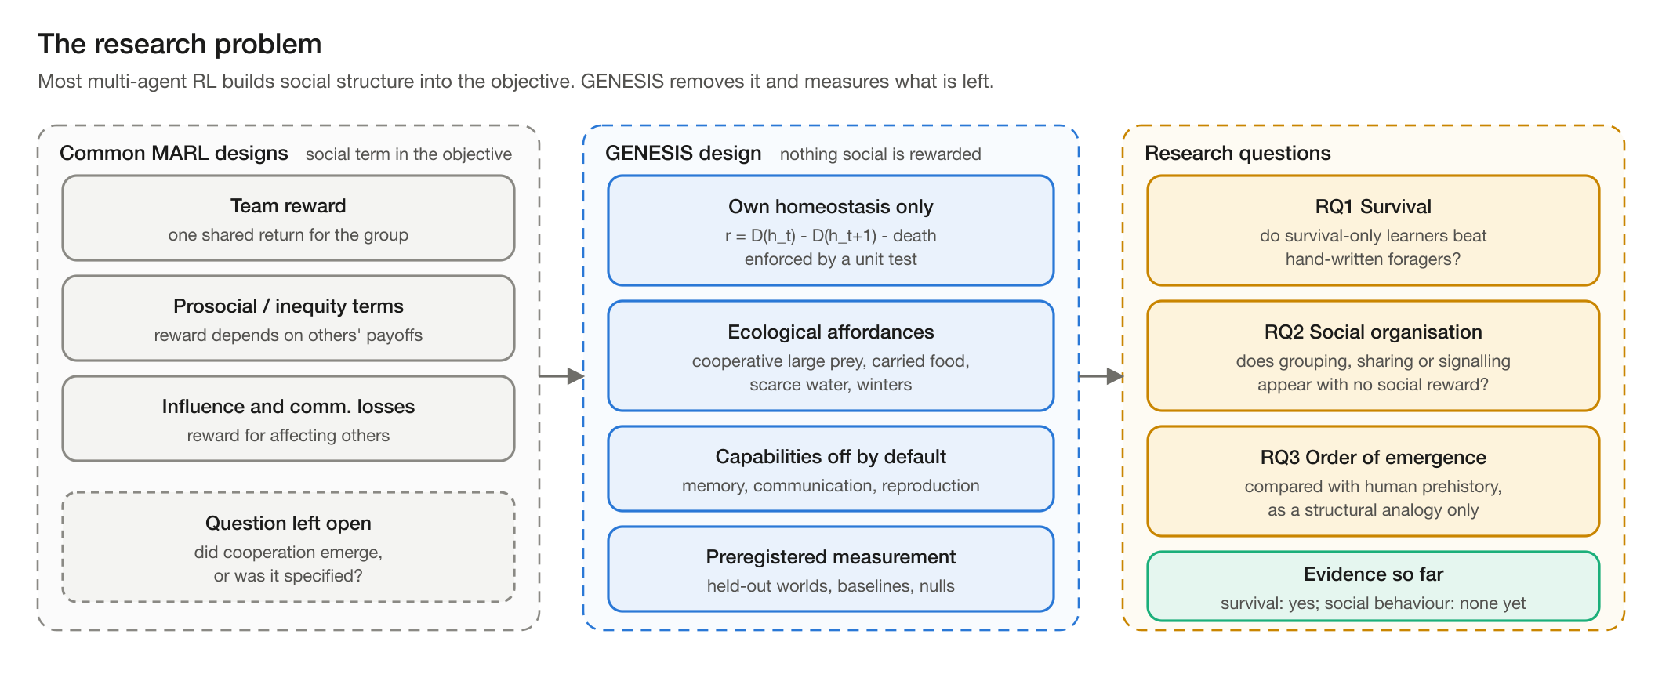
Most multi-agent AI studies build cooperation into the reward
Notes:
Team rewards, prosocial bonuses, influence terms and communication losses all specify the social outcome. That makes it impossible to say whether cooperation emerged. GENESIS removes every social term.

Slide 3




Why the question matters
Multi-agent AI safety
Computational social science
Agents from different developers already share markets, roads and the web. Which collective behaviours appear without being designed in?
Grow societies bottom-up, like Sugarscape, but with learning instead of hand-written rules.
Origins of social organisation
Trustworthy methods
Compare the order in which structure appears with human prehistory, as a structural analogy only.
Preregistration, held-out worlds and baselines answer known reproducibility problems in deep RL.
Notes:
Four reasons, one per card. Keep the safety framing concrete: autonomous agents already share markets, roads and the web.

Slide 4
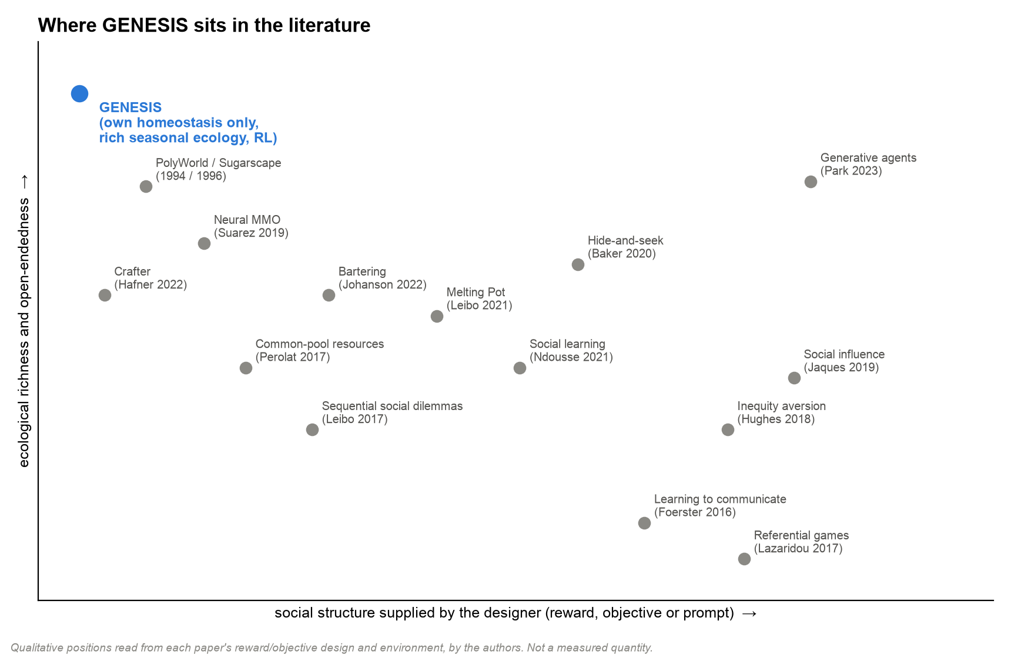
Where GENESIS sits among prior work
Artificial-life worlds (PolyWorld, Sugarscape) are rich but not learned
Social-dilemma RL uses selfish reward in small, purpose-built games
Cooperation-boosting methods add a social term to the reward
Generative agents get their social behaviour from language models
Gap: survival-only learners in a rich ecology, measured against nulls
Notes:
Positions are our qualitative reading of each paper's reward design and environment, not measurements. All references verified online on 27 Oct 2026.

Slide 5
The gap: four ingredients no prior system combines
1
Own-body reward only
Homeostatic reward (Keramati & Gutkin 2014); no term depends on others
2
An ecology where cooperation could pay
Large prey need two hunters; food can be carried; water is scarce; winters bite
3
Capabilities switched on one at a time
Memory, communication, reproduction, social learning: all off by default
4
Preregistered measurement
Held-out worlds, three baselines, null models, negative results kept
Notes:
These four ingredients define the project. Each one maps to a hard rule or a design feature.

Slide 6




Design principles we will not break
Reward = own homeostasis
Capabilities off by default
Seeded and reproducible
No scripted agents
Baselines everywhere
Enforced by a unit test
Each one a config switch
Bit-identical runs, hash RNG
Animals scripted, agents never
Random, greedy, heuristic
Notes:
Each rule is enforced in code or tests, not just in documentation.

Slide 7
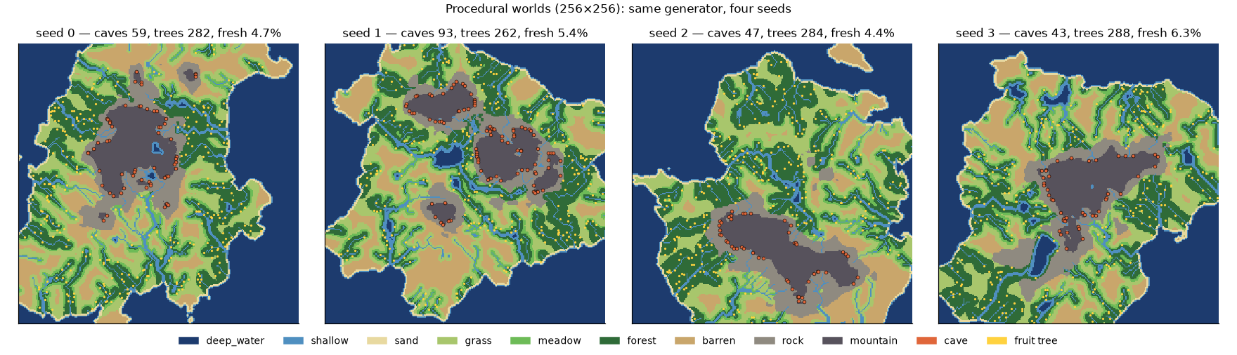
The world: a seeded, seasonal island ecology
256 x 256 cells, ten terrain types, rivers and lakes
Plants, fruit trees, small prey, large prey (need 2 hunters), predators
Animals limited by food, not by caps
Day and night, four seasons, rain, fog, droughts, cold snaps
Wildfires, floods and famines, random or triggered
Ocean is salt: fresh water only in rivers and lakes
Notes:
Every seed gives a different island. Fresh water is only in rivers and lakes, so it is spatially scarce.

Slide 8
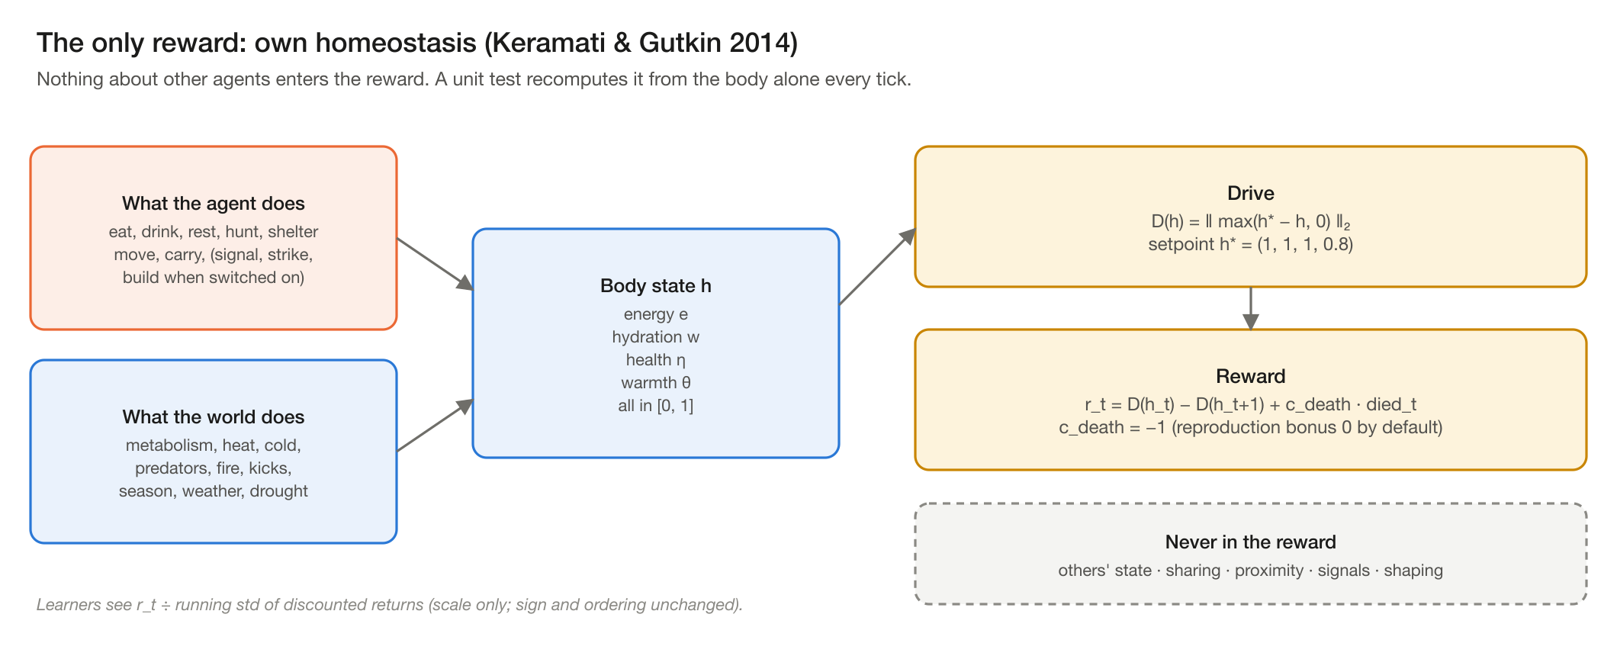
The agent is paid only for keeping its own body healthy
Notes:
Reward is the reduction in the agent's distance below its set-point, minus a death penalty. Nothing in it refers to other agents.

Slide 9
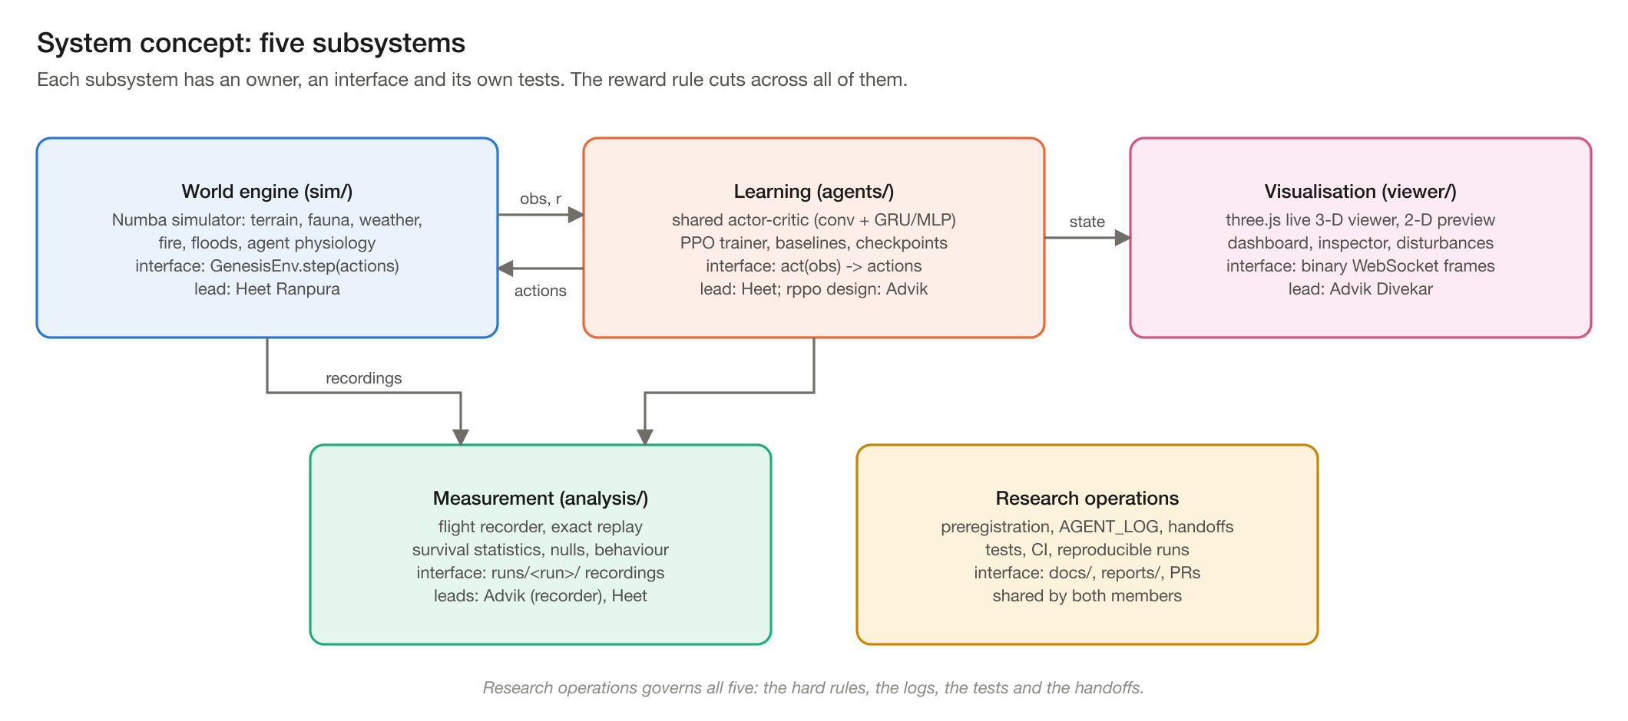
System concept: five subsystems with clear interfaces
Notes:
Owners and interfaces were fixed at concept stage so two people could work in parallel.

Slide 10
Feasible on two laptops, without a GPU cluster
112k
~1 h
63 MB
75-90
environment steps per minute with observations, 1,000 agents
to train 20M agent-steps of PPO on a laptop
to record every agent for one simulated year
frames per second in the live viewer at 1,000 agents
Main risk at concept stage
Learners might never discover cooperation, e.g. group hunting. That is still a result: the testbed measures its absence rigorously, against null models.
Notes:
Measured in Stage 1/1.1 and the first learner runs: benchmark on the MacBook Air M4, viewer on the M3 Pro.

Slide 11
Research questions and how each will be answered
Question | Measured by
RQ1 Do survival-only learners outlive hand-written foragers? | Deaths per agent-year on held-out worlds vs three baselines
RQ2 Does memory matter when resources leave view? | GRU vs memoryless: thirst and all-cause deaths
RQ3 Does social organisation appear without social reward? | Group hunts, food transfer, aggregation vs null models, blinding ablation
RQ4 In what order, under which capabilities? | Capability switches; cited human timeline as analogy
Notes:
Hypotheses are preregistered in docs/PREREGISTRATION.md before the runs that test them.

Slide 12
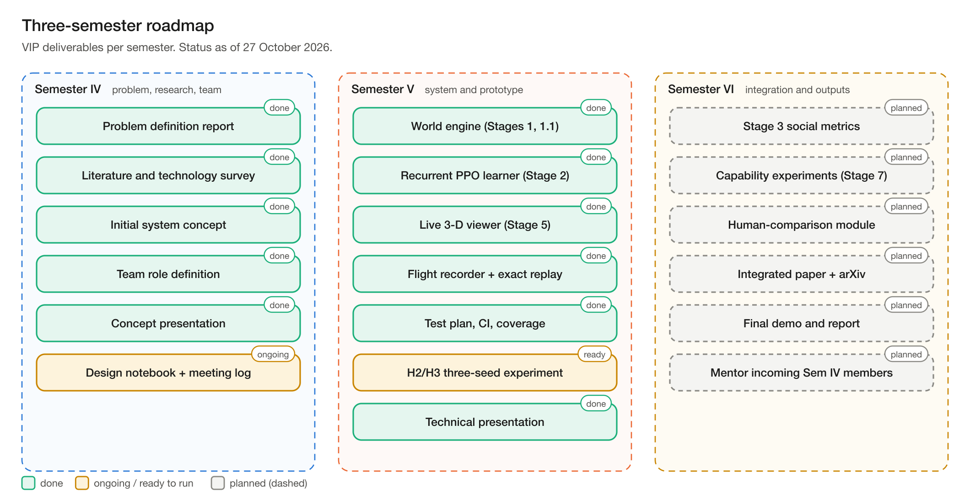
Three-semester roadmap
Notes:
Semester IV defines; Semester V builds and validates; Semester VI integrates and publishes.

Slide 13
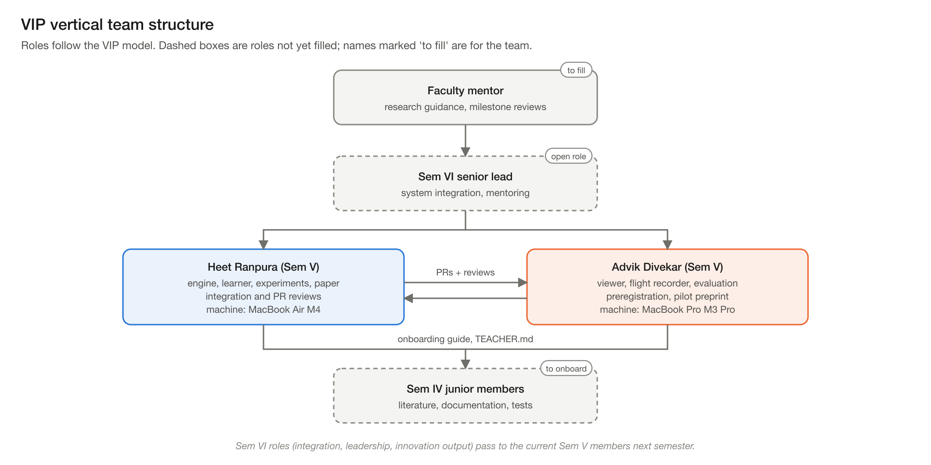
Team and roles in the VIP vertical
Notes:
Mentor and open roles are left for the team to fill; nothing here is invented.

Slide 14
Next: build the world engine
Stage 1: seeded world, ecology, physiology, baselines, tests and benchmarks.
Questions?
Notes:
Close by stating the first build milestone and its acceptance criteria.

