Slide 1
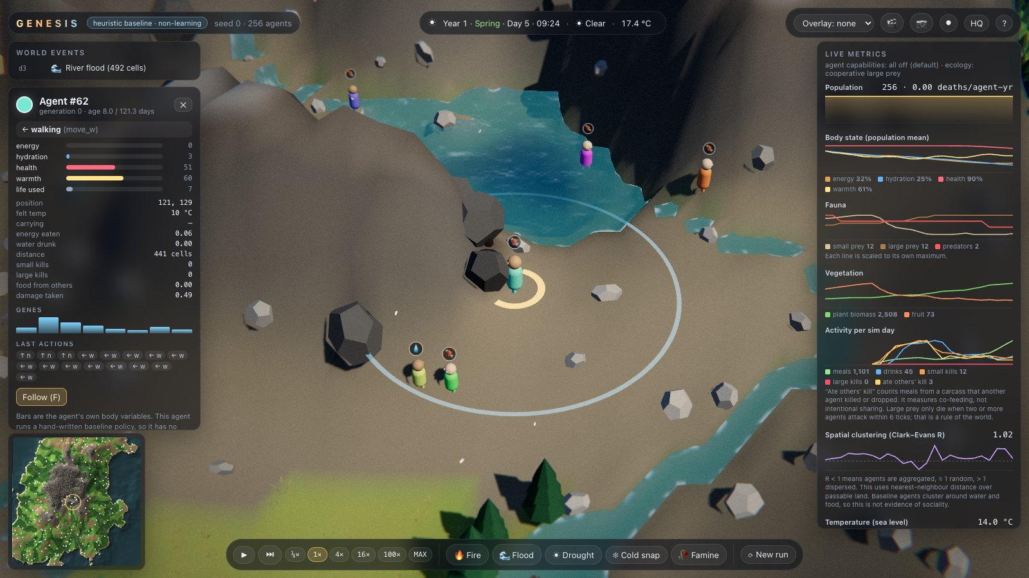
GENESIS: what we built, and what the agents did
Technical presentation · VIP Design Experience II (Semester V)
Heet Ranpura, Advik Divekar · Mentor: [to fill]
Notes:
Recap the question in one sentence, then show the system and the first results.

Slide 2
Semester V in numbers
~8,000
59
112k
4
lines of Python, plus 2,600 lines of JavaScript
automated tests, run by CI on every change
env steps/min with observations at 1,000 agents
pull requests reviewed and merged between sub-teams
World engine (Stages 1, 1.1)
Recurrent PPO learner and memoryless ablation (Stage 2)
Flight recorder with bit-exact replay
Live 3-D viewer (Stage 5)
Preregistered evaluation, CI, documentation
Notes:
Counts from the repository on 27 Oct 2026.

Slide 3
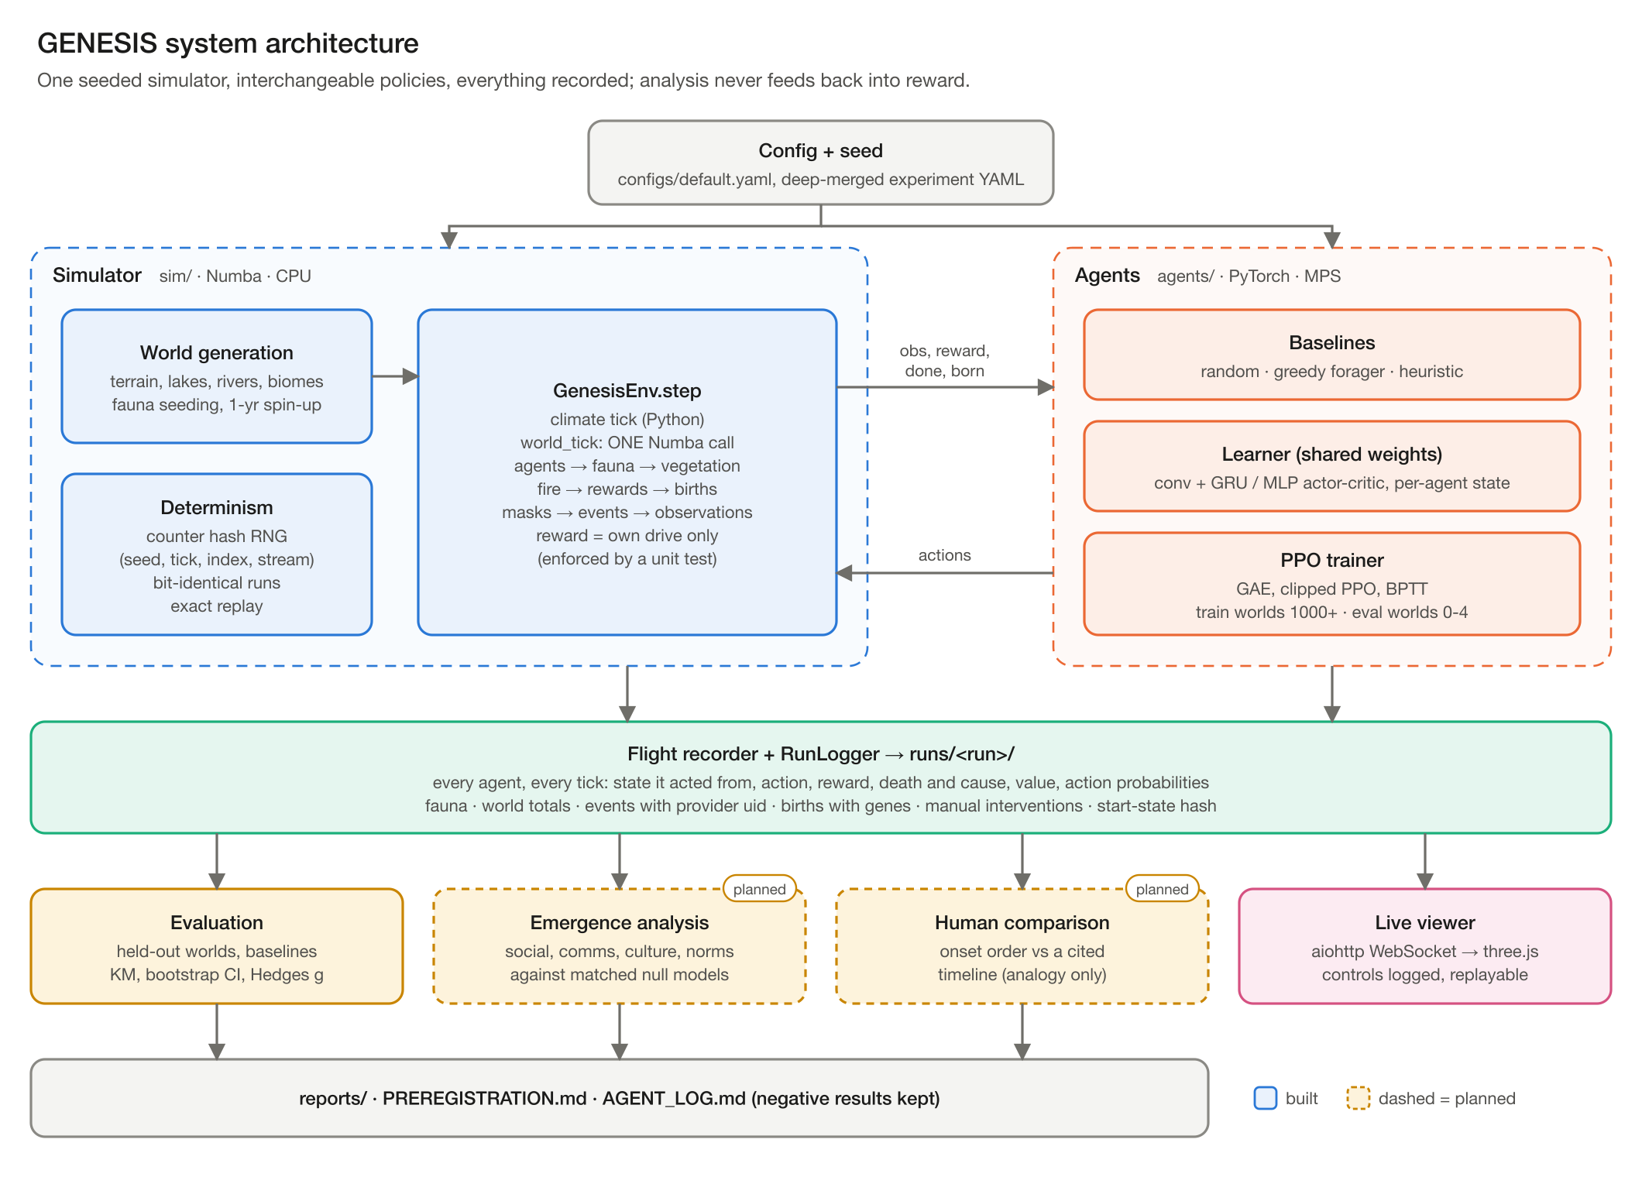
Architecture
Notes:
One seeded simulator, interchangeable policies, everything recorded; analysis never feeds back into reward. Diagram: Advik Divekar.

Slide 4
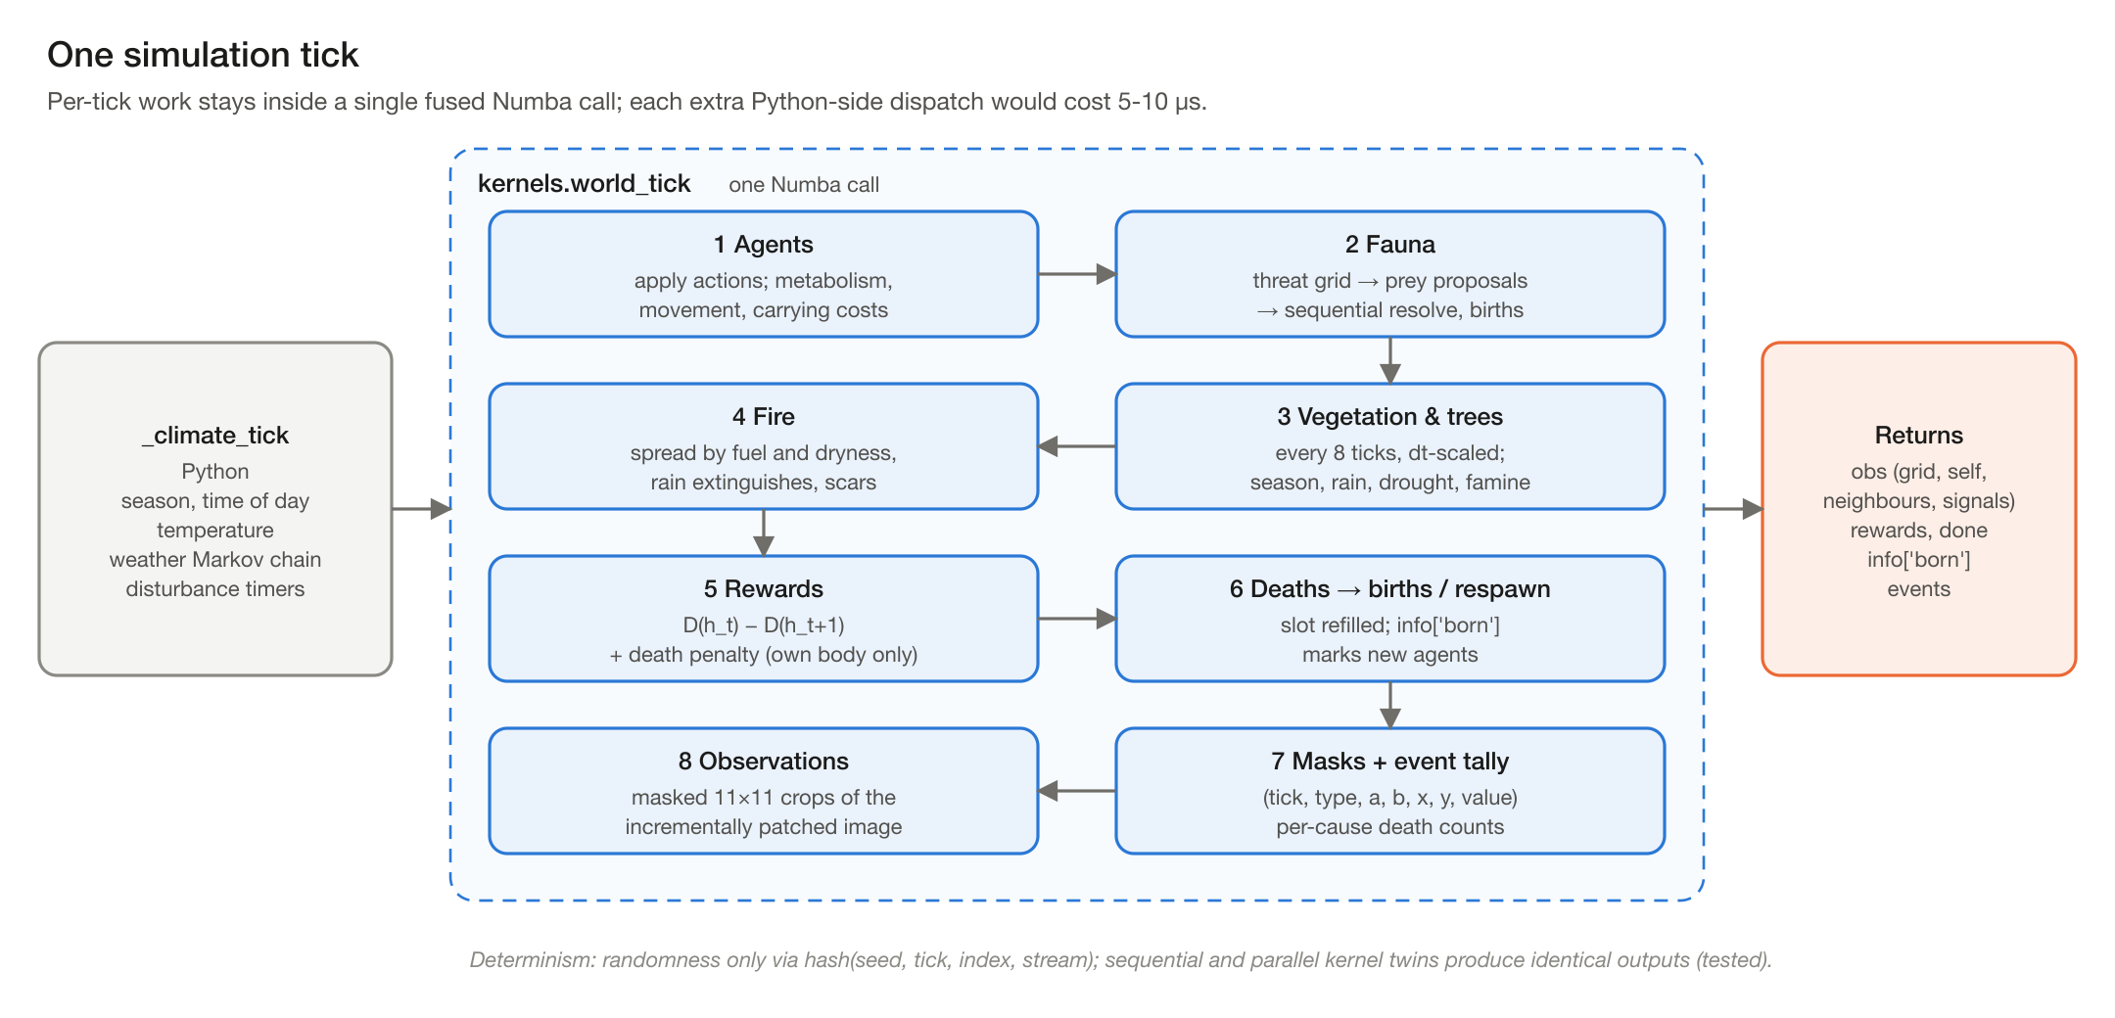
One tick is one compiled call
Notes:
Fusing all per-tick work into one Numba call removed Python dispatch overhead; observations come from an incrementally patched image.

Slide 5
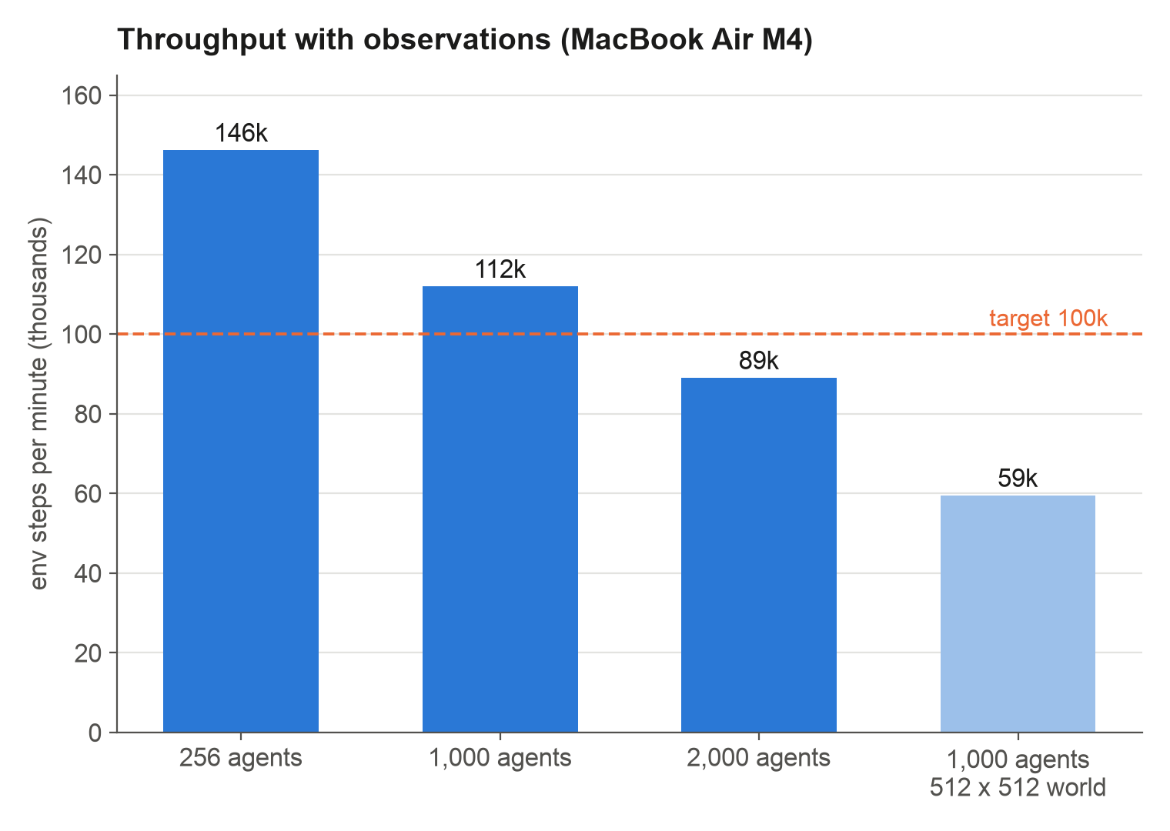
Throughput clears the 100k target
Target: 100k steps/min with observations at 1,000 agents
Measured: 112k (1.87M agent-steps per second)
Incremental observation image and precomputed line of sight were the key changes
Known regression at 512 x 512 (open issue)
Notes:
make bench on the MacBook Air M4, medians of repeated runs. Source: reports/stage1/bench.txt.

Slide 6
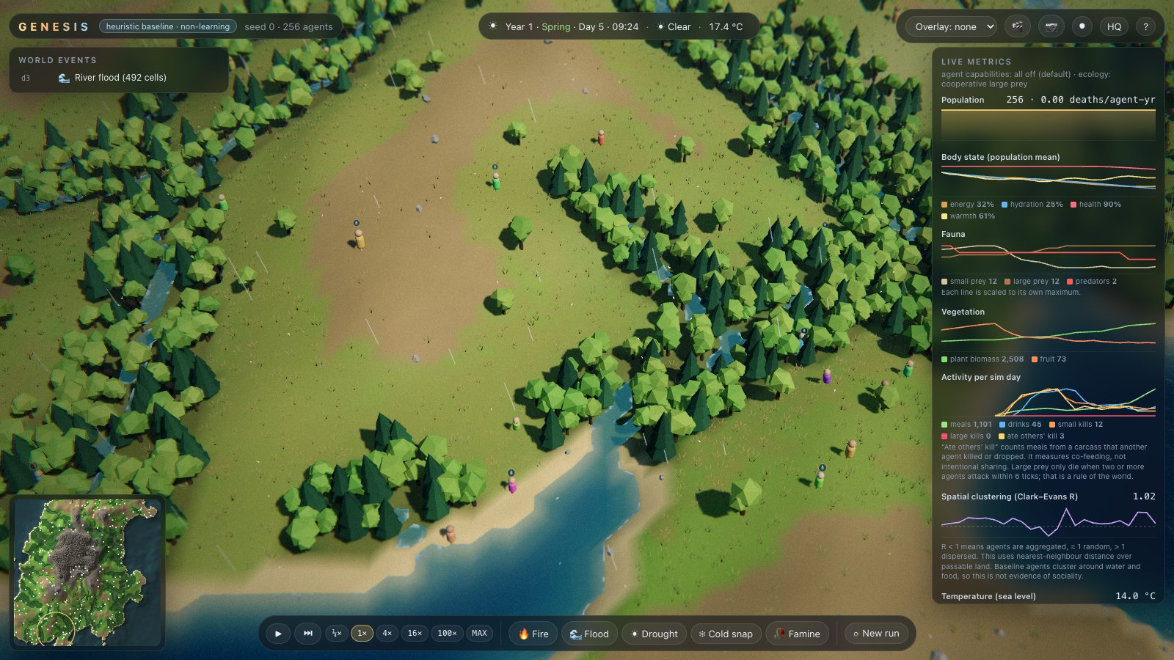
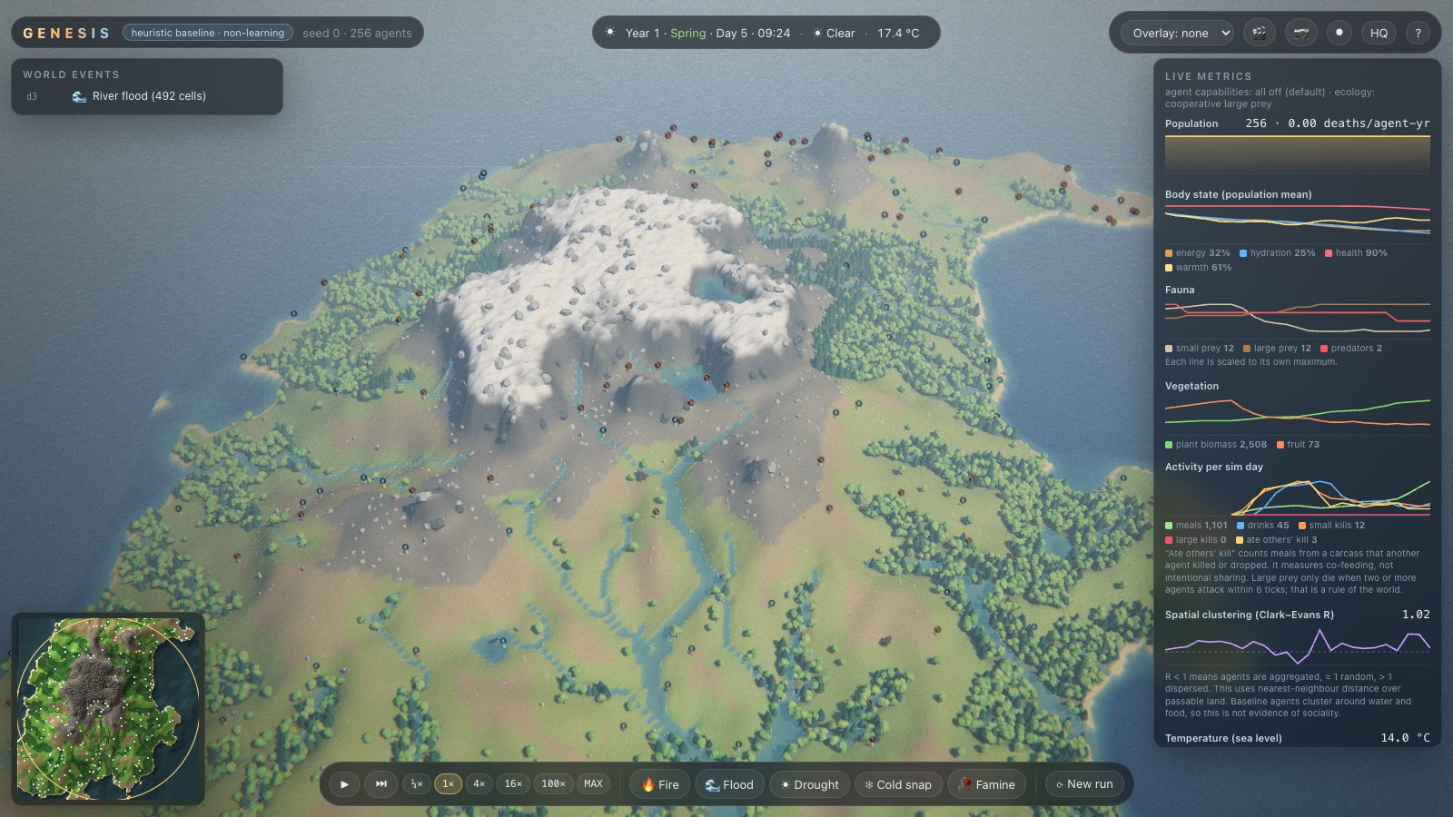
Live 3-D viewer
85-115 fps with 256 agents, 75-90 fps with 1,000 (1600 x 900, M3 Pro)
Dashboard of 7 live charts, inspector showing each agent's value estimate and action probabilities; every control logged
Notes:
The browser only renders; simulation stays in the server's sim thread, so watching never changes results.

Slide 7
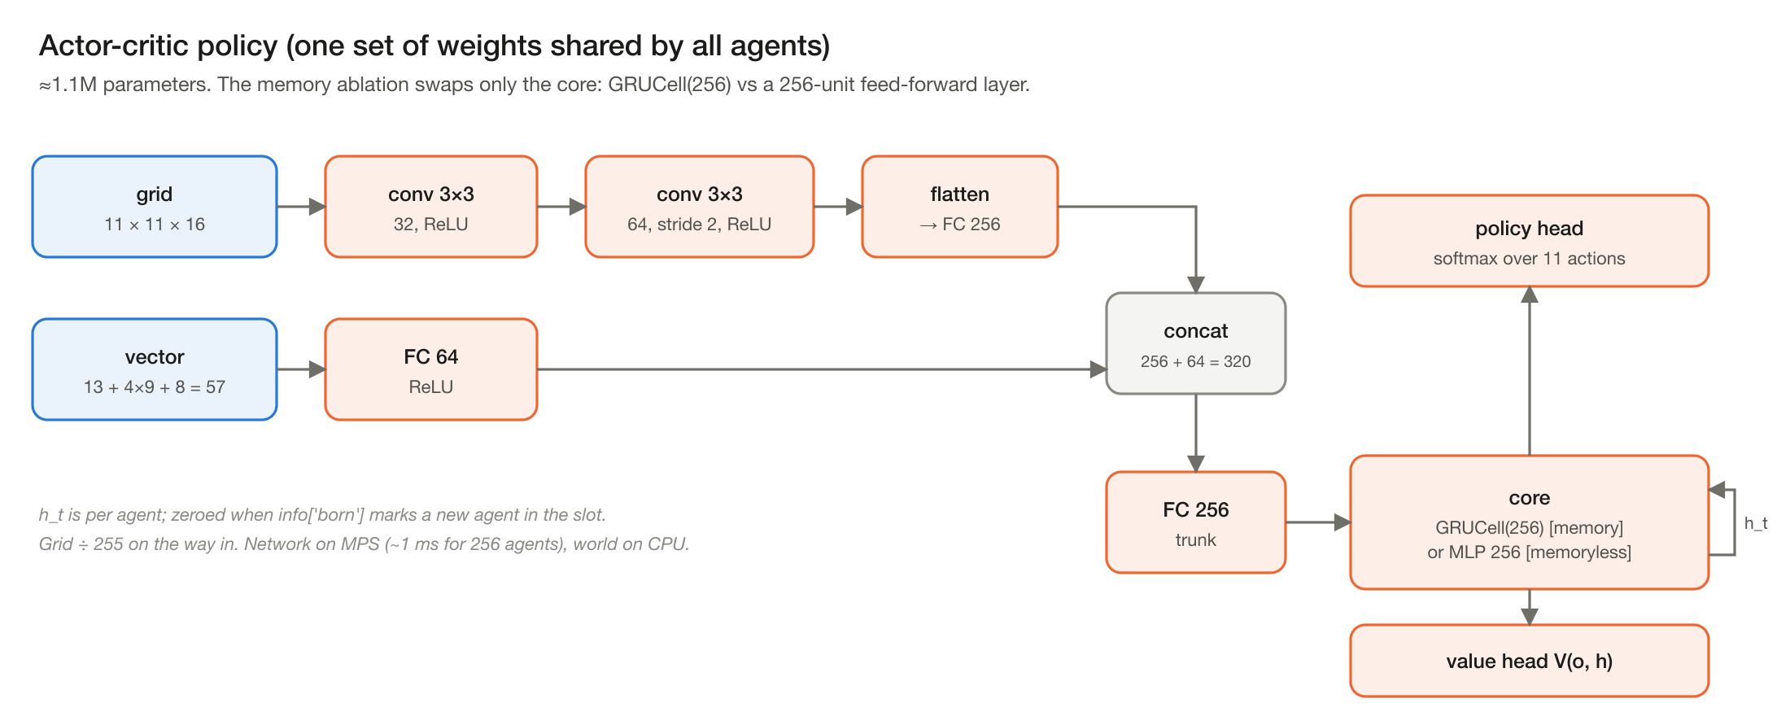
One shared network, per-agent memory
Notes:
Conv encoder for the 11 x 11 x 16 view, MLP for body signals, GRU or MLP core; PPO with full backpropagation through 128-tick rollouts.

Slide 8
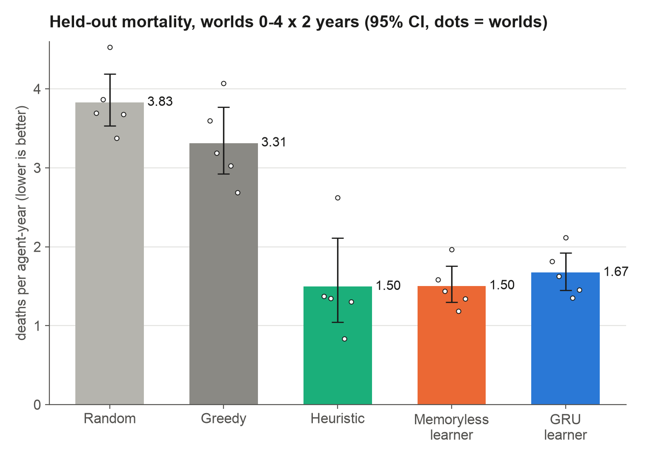
Learners beat random and greedy, but not yet the heuristic
H1 supported: learners clearly beat random (3.83) and greedy (3.31)
H2 not supported: memoryless 1.50 [1.30, 1.75] and GRU 1.67 [1.45, 1.92] overlap the heuristic 1.50 [1.04, 2.11]
H3 not supported: memory cut thirst deaths but not overall mortality
One training seed per arm, so make h2h3 runs three
Notes:
Held-out worlds 0-4 x 2 years x 256 agents; 95% bootstrap CIs in reports/. Replication runs with the unified PPOTrainer, 19.7M agent-steps each.

Slide 9
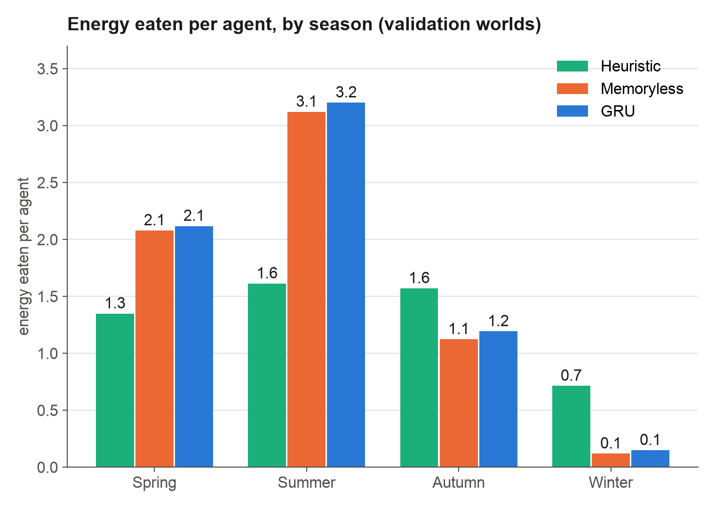
Why learners plateau: they never hunt, so winter starves them
Plants alone are below basal metabolism: a grazer eats 3.9 per year against 5.0 basal
Hunting pays: the hunter heuristic eats 5.2 per year and dies far less
Learners eat about twice as much in summer, but under a fifth of the heuristic's intake in winter
So the plateau is a learning problem, not a limit of the world
Notes:
Energy-economy probe on validation worlds: intake per agent by season. Source: reports/stage2/energy_economy.json.

Slide 10
What the learners did learn
0.52
2 cells
14-18
r = -0.7
chance of drinking when parched (0.09 when hydrated)
median distance from water (heuristic: 3.6)
cell home ranges (heuristic: 38): riverside sedentism
value estimate vs homeostatic drive (-0.65 / -0.75)
A claim we corrected
Watching one agent in the viewer suggested learners rest at night. The population data showed no night resting, so the claim was corrected in the paper and the logs.
Notes:
Population-level behaviour on test world 0. Source: paper/stats.json.

Slide 11



No social organisation yet, and we checked carefully
0 group kills
< 0.01 food shared
Clustering is habitat
Large prey need two simultaneous hunters; learners never managed one.
Energy received from others per agent-year: essentially none.
Nearest-neighbour ratio 0.84 vs habitat null, but 0.98-1.01 vs place preference; blinding leaves it intact.
H4 (no social behaviour at this stage) holds
The ingredients for cooperation exist in the world; the next semester tests which capabilities unlock them
Notes:
Aggregation is compared with null models that keep each agent's habitat and place preferences; Advik's blinding ablation zeroes the agents' view of each other.

Slide 12
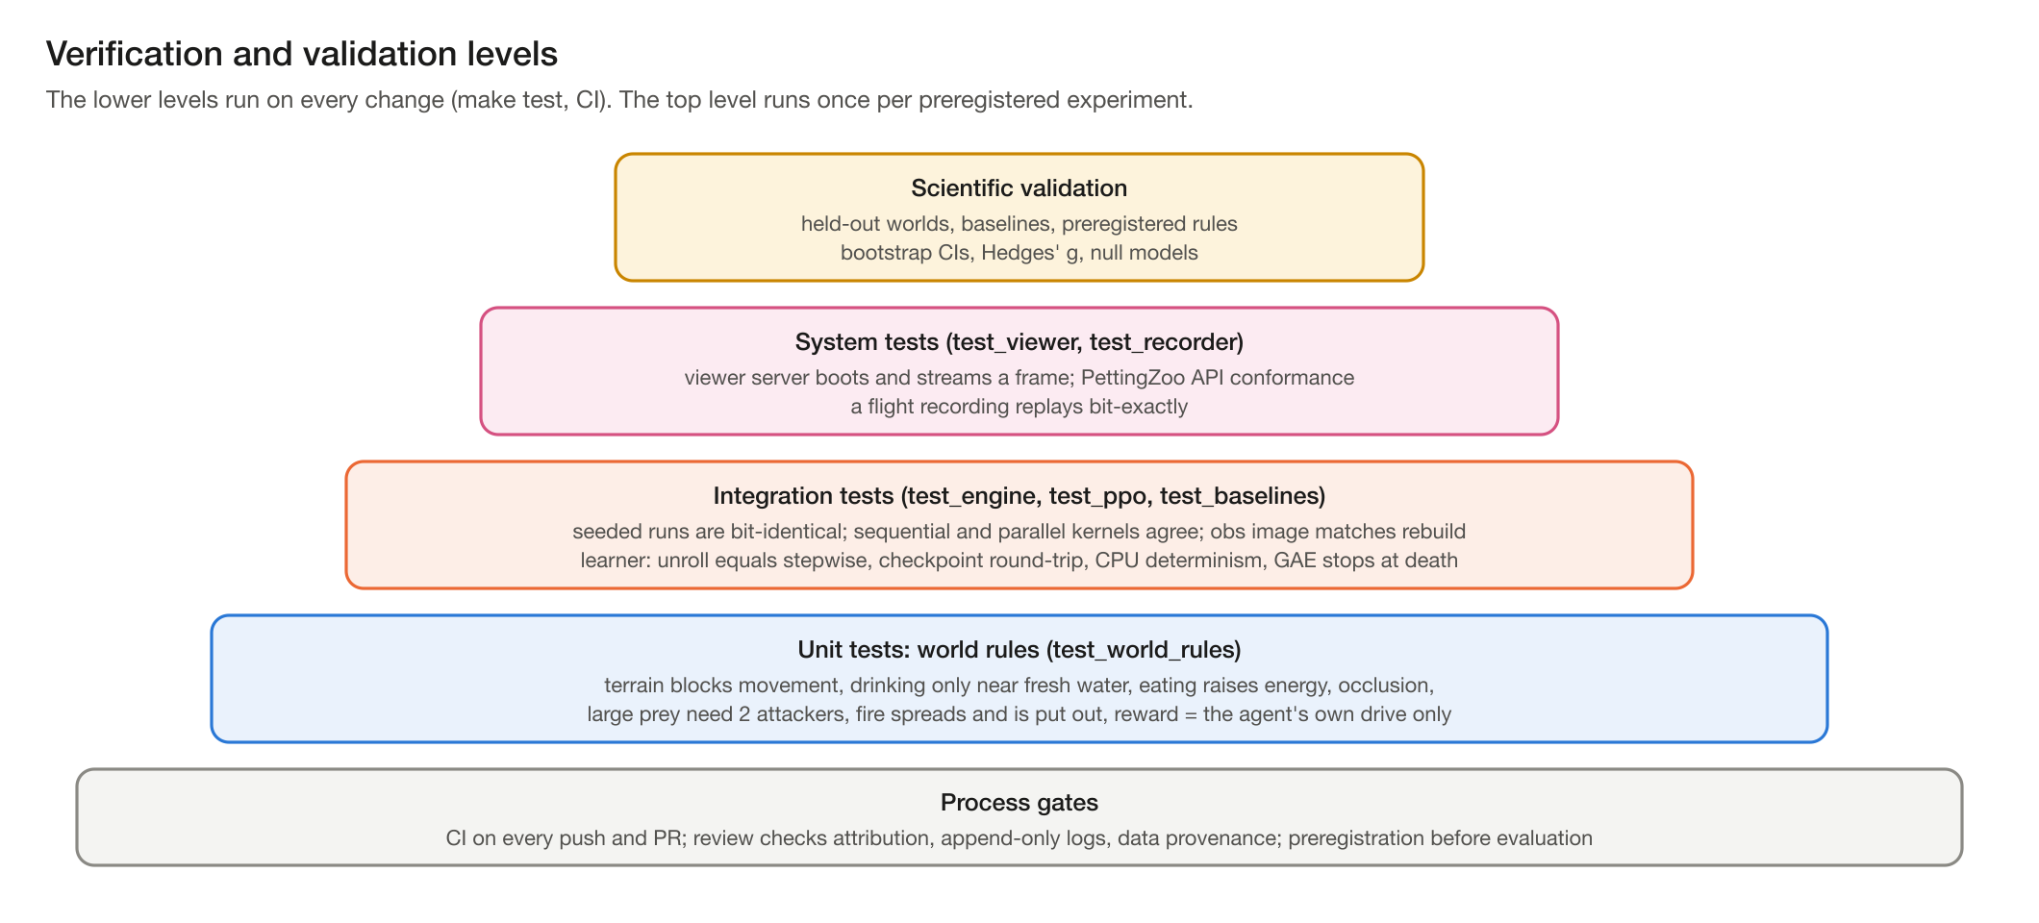
Verification: 59 tests, CI on every change
Bit-identical seeded runs catch any unintended change to dynamics
Replay of any recording is exact
Defects found and fixed are logged in the Test & Validation Plan
GitHub Actions runs everything on a clean Linux machine
Notes:
Coverage: 55% of all lines, 76% of Python-level lines; Numba-compiled kernels run as machine code and cannot be traced.

Slide 13
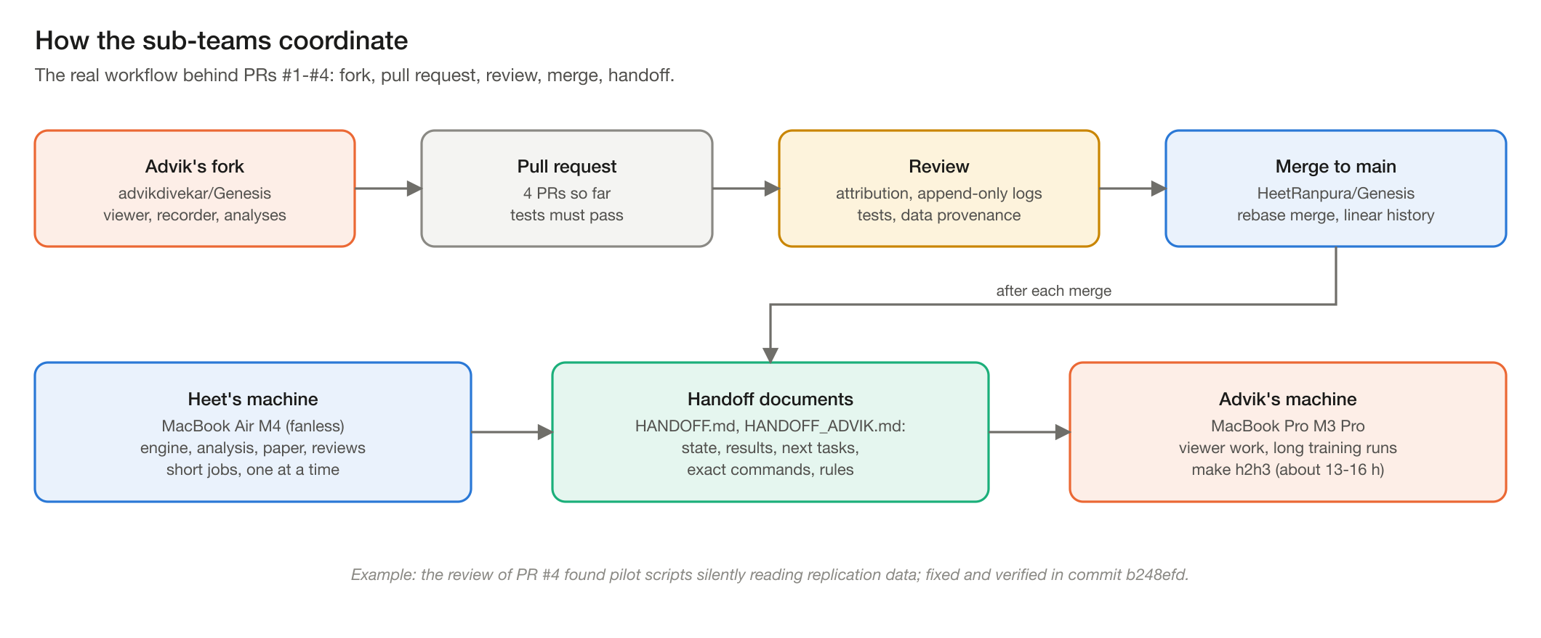
How the sub-teams work together
Notes:
Real workflow: four PRs from Advik's fork, reviewed and merged by Heet, with handoff documents after each merge.

Slide 14
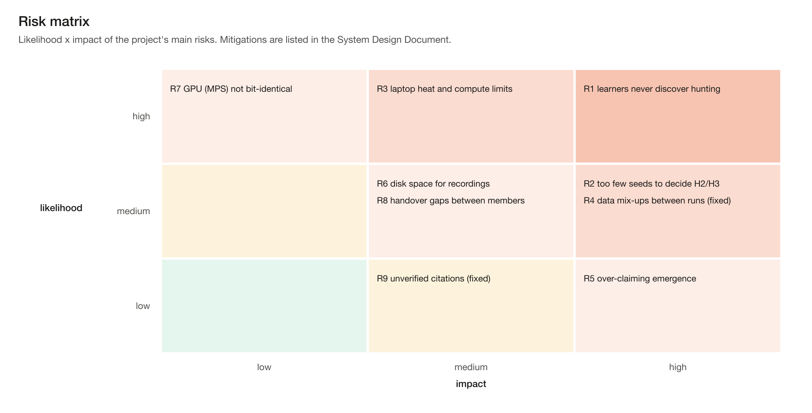
Risks we are tracking
Notes:
R1 is the main scientific risk; R2 is addressed by the three-seed experiment.

Slide 15

Next: settle H2 and H3, then measure social structure
Now: make h2h3
Then: hunting probes
Sem VI: social metrics
6 runs (GRU and memoryless x seeds 1-3) x 3,000 iterations, about 13-16 h on the M3 Pro; verdicts applied automatically.
Is hunting an exploration problem? A curriculum and a denser-prey world, each as a separate, labelled configuration.
Co-feeding, food transfer, proximity networks, signalling, each tested on synthetic data first; then the capability experiments.
Notes:
make h2h3 is preregistered and ready; it runs on the M3 Pro.

Slide 16
Thank you
Repository: github.com/HeetRanpura/Genesis
Live demo: make demo · Questions?
Notes:
Offer the live demo: make demo starts the viewer with the trained GRU learner.

