Slide 1

MMS 技术讲解
于晓蓉
2014/10/25

Slide 2
主要内容
OMA-MMS-CONF-V1 彩信结构及表述方式
Android Mms Model与Presenter
Android Mms 单一附件的添加、显示与播放
Android Mms 幻灯片的添加、显示
Android Mms 幻灯片播放
Android Mms 接收与发送
Android Mms 彩信数据库与ContentProvider
Notes:
Basically there are four layers in Android Telephony Architecture.
The first layer is the application layer. The phone operation related code lies in Phone Application, other applications only communicates with Phone Application through Intent. Phone Application also exposes a service “phone” which is only called from service “telephony. registry” right now. InCallScreen activity in the Phone Application is the main UI for handing voice call.
The second layer is the telephony framework. In this layer, Android provides implementation for both GSM and CDMA phone. It invokes RIL’s API to communicate with the down layer rild. And also it provides service “telephony. registry” to let upper layer monitor the phone’s state.
The third layer is a background daemon process to communicate with base band. Vendor should provide its own RIL implementation to be called by this daemon process.
The last layer includes both kernel driver and base band image, from Android point of view, we can see only one layer.

Slide 3
彩信概述
MMS 是 Multimedia Messaging Service (多媒体消息服务) 的缩写，中文译为“彩信”，可以用于传送文字、图片、动画、音频和视频等多媒体信息。 。
不直接投递给接收方。先发送给一个中间服务器 彩信网关(MMS Proxy-Relay)。彩信网关暂时保存彩信，然后通过Push 协议给接收方发送一个Push 短消息通知，接收方收到通知后再从MMS Proxy-Relay 上获取彩信内容。当MT手机由于某种原因无法接受彩信的时候，由MT控制的交互方式就显出了作用。
彩信(MMS) 是WAP协议的主要应用之一。它包括HTTP传输协议，也包括SMIL这样的内容表示协议。
由来。较早的短信业务由于受到modem发送和接受速率的限制导致传输大数据时要耗费很长的时间，于是依靠网络来传输的彩信业务就应运而生了。

Slide 4
彩信支持的基本类型
图片
视频
音频
文本
aac
aac-adts
amr
imelody
mid
midi
mp3
mpeg3
mpeg
mpg
x-m4a
wav
mp4
x-mid
x-midi
x-mp3
x-mpeg3
x-mpeg
x-mpg
3gpp
x-wav
ogg
jpeg
jpg
gif
png
vnd.wap.wbmp
x-ms-bmp
3gpp
3gpp2
h263
mp4
plain
html
x-vCalendar
x-vCard
Android的framework中有vcard和vcalendar解析的库，开发人员需要实现的是vcard和vcalendar应用层。

Slide 5
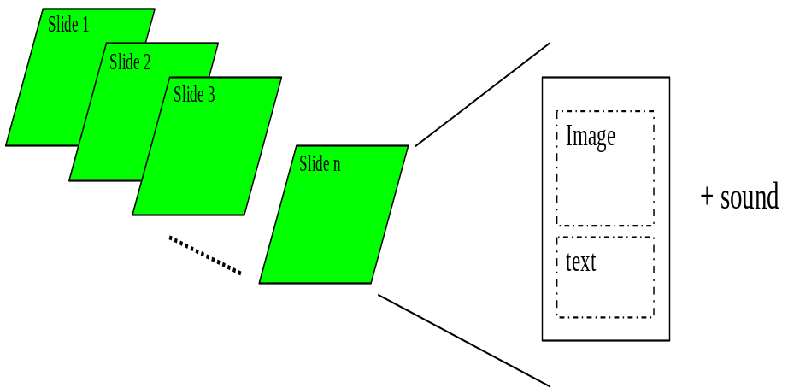
彩信结构及表述方式
彩信组成：
由一系列类似于PPT类型的幻灯片组成，来组织视频、文本和音频。
彩信的表述与播放：
SMIL语言用来表述彩信的组织和播放，可以控制多媒体对象的布局和播放时间，限制了各种信息元素在何时何地显示。
SMIL由W3C制定，是基于XML的表述语言标准
Image和Text定义的只是区域大小，比如Image既可以存放图片也可以存放视频
Notes:
Basically there are four layers in Android Telephony Architecture.
The first layer is the application layer. The phone operation related code lies in Phone Application, other applications only communicates with Phone Application through Intent. Phone Application also exposes a service “phone” which is only called from service “telephony. registry” right now. InCallScreen activity in the Phone Application is the main UI for handing voice call.
The second layer is the telephony framework. In this layer, Android provides implementation for both GSM and CDMA phone. It invokes RIL’s API to communicate with the down layer rild. And also it provides service “telephony. registry” to let upper layer monitor the phone’s state.
The third layer is a background daemon process to communicate with base band. Vendor should provide its own RIL implementation to be called by this daemon process.
The last layer includes both kernel driver and base band image, from Android point of view, we can see only one layer.

Slide 6
SMIL语言分析 (1)
<smil>
  <head>
  <meta name="title" content="mms" />
  <meta name="author" content="John Smith" />
  <layout> <! --This an "landscape" screen (2*qcif)-->
  <root-layout width="352" height="144"/>
  <region id="Image" width="176" height="144" left="0" top="0" />
  <region id="Text" width="176" height="144" left="176" top ="0"/>
  </layout>
  </head>
  <body>
  <par dur = "8000ms">
  <img src = "FirstImage.jpg" region="Image" />
  <text src = "FirstText.txt" region="Text" />
  <audio src = "FirstSound.amr"/>
  </par>
  <par dur = "4000ms" >
  <video src="videoclipname.3gp" region="Image" />
  <text src="Text1.txt" region="Text" />
  </par>
  </body>
</smil>

Slide 7
SMIL语言分析 (2)
SMIL结构模块 (smil)
模块 | 作用 | 参数 | 包含的模块
<smil> | 表述一条彩信 |  | <head> <body>
<head> | 包含了用户、布局信息 |  | <meta> <layout>
<body> | 彩信的正文（各媒体元素） |  | <par>
Notes:
From the above picture, we can look into more detail in telephony framework layer. Phone is the abstract interface for all phone related action, which will be called from Phone Application. Android provides two implementations: GSMPhone and CDMAPhone. CommandsInterface is the abstract interface to be called by telephony framework layer; RIL is the default implementation of CommandsInterface. PhoneNotifier is the abstract interface to provide callback for up layer, DefaultPhoneNotifier implements this interface based on calling “telephony. registry” service’s API.

Slide 8
    SMIL语言分析 (3)
SMIL 布局模块 (layout)
模块 | 作用 | 参数 | 包含的模块
<layout> | 彩信布局 |  | <region> <root-layout>
<region> | 媒体元素的区域大小 | left, top, height, width, fit, id
<root-layout> | 默认的尺寸是终端显示屏的大小 | width,height

Slide 9
SMIL语言分析 (4)
SMIL 幻灯片（par）
模块 | 作用 | 参数 | 包含的模块
<text> | 文本 | src, region, alt, begin, end, dur
<img> | 图片 | src, region, alt , begin, end, dur
<audio> | 音频 | src, alt, begin, end, dur
<video> | 视频 | src, region, alt, begin, end, dur
<ref> | 参考 | src, region, alt, begin, end, dur
每个<par>代表幻灯片中的一页。
每<par>中最多有两个region，android默为Text和Image。
每个元素的播放时间可以单独设定，在参数begin,end上体现。

Slide 10
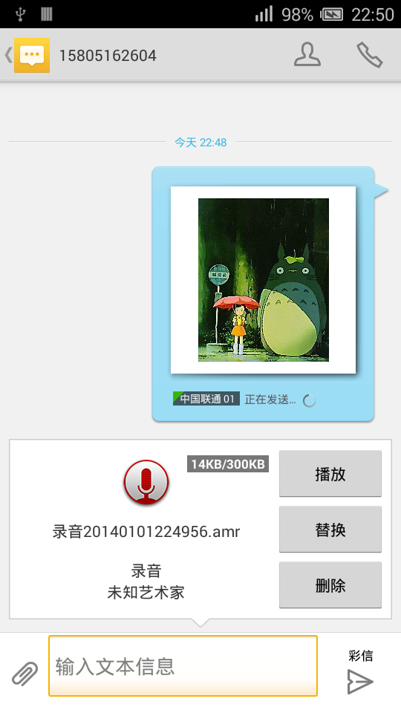

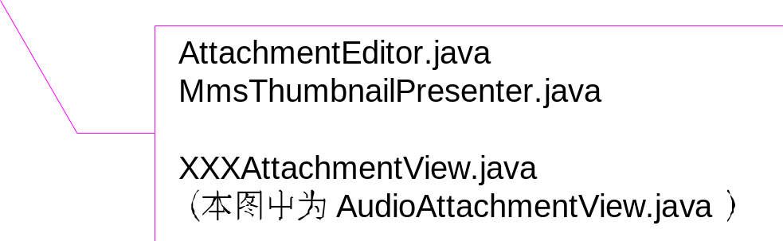
彩信相关的显示、编辑和播放界面(1)
ComposeMessageActivity
信息编辑界面
Notes:
The following is a step by step description about what happened when placing a call from UI.
The Place Call task is started from Contacts application, it only call startActivity with the following three actions: ACTION_CALL_PRIVILEDGED, ACTION_CALL, ACTION_EMERGENCY.
All these three intents are handled in Phone Application by OutgoingCallBroadcaster. It will broadcast with another Intent ACTION_NEW_OUTGOING_CALL which allows other app to monitor, redirect or prevent the call.
After ACTION_NEW_OUTGOING_CALL is processed, OutgoingCallBroadcaster calls startAcrivity with the Intent ACTION_CALL which will bring up InCallScreen activity.
InCallScreen always call PhoneUtils to do the real work. For this scenario, it calls placeCall.
The call is translated to a dial call to PhoneProxy.
PhoneUtils then set the system audio mode as MODE_IN_CALL;

Slide 11
ComposeMessageActivity有关彩信的显示
控制已结束编辑的彩信显示MmsThumbnailPresenter
收/发的彩信显示
MessageListItem
附件的显示
AttachmentEditor
图片ImageAttachmentView
音频AudioAttachmentView
视频VideoAttachmentView
幻灯片SlideshowAttachmentView

Slide 12
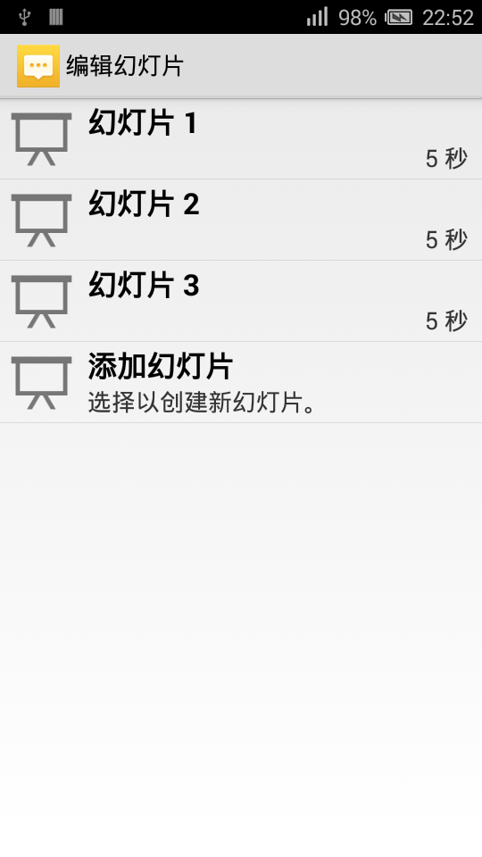

彩信相关的显示、编辑和播放界面(2)
SlideshowEditActivity
信息编辑界面
Notes:
The following is a step by step description about what happened when PhoneProxy handling dial call.
1. PhoneProxy is just a simple wrapper for GSMPhone.
2. GSMPhone then calls GsmCallTracker’s dial API.
3. During the processing, GsmCallTracker calls RIL’s setMute and dial API.
4. RIL will send out the corresponding RIL requests of RIL_REQUEST_SET_MUTE and RIL_REQUEST_DIAL.
5. After that, GsmCallTracker to let GSMPhone notify phone state changed event, InCallScreen registered an observer for this event, so it will be notified through a PHONE_STATE_CHANGED event. Then InCallScreen can update UI according to current’s phone state.
After the remote terminal accept the call, RIL will report a CALL_STATE_CHANGED event, then GsmCallTracker will call notifyPreciseCallStateChanged, finally InCallScreen notice this change and update UI corresponding.

Slide 13
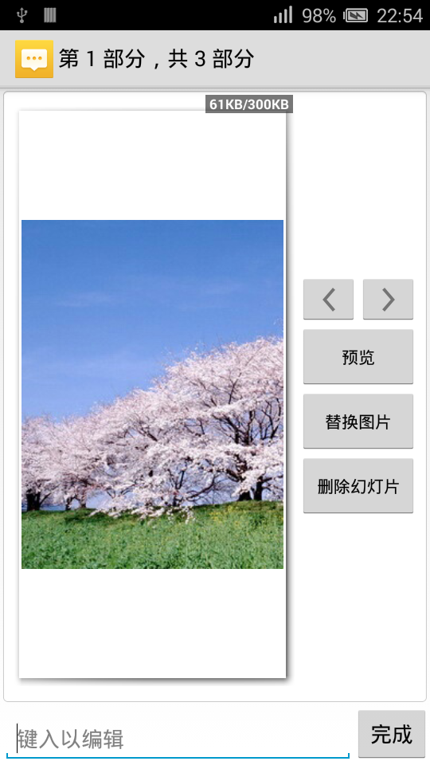
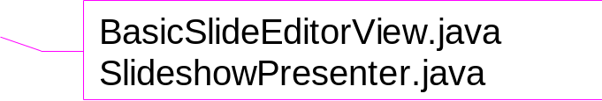
彩信相关的显示、编辑和播放界面(3)
SlideEditorActivity
幻灯片编辑界面
Notes:
The following is a step by step description about what happened when an incoming call arrived.
First, RIL has a dedicated thread to continuously receive message from rild daemon.
When there is an incoming call, a RIL_UNSOL_RESPONSE_CALL_STATE_CHANGED message will be read by RIL.
RIL sends an EVENT_CALL_STATE_CHANGE event to GsmCallTracker.
GsmCallTracker then call getCurrentCalls to ask RIL about current call information.
RIL implements getCurrentCalls by sending a RIL_REQUEST_GET_CURRENT_CALLS to rild.
RIL gets response from rild, and t sends an EVENT_POLL_CALLS_RESULT to GsmCallTracker.
Now this time, GsmCallTracker knows there is a new incoming call, so it calls notifyNewRingingConnection to let GSMPhone.
CallNotifier has registered an observer for new connection, so GSMPhone sends a PHONE_NEW_RINGING_CONNECTION message to it.
Until now, the Phone Application knows a new incoming call through CallNotifier. The following picture shows the process in the Phone Application.

Slide 14
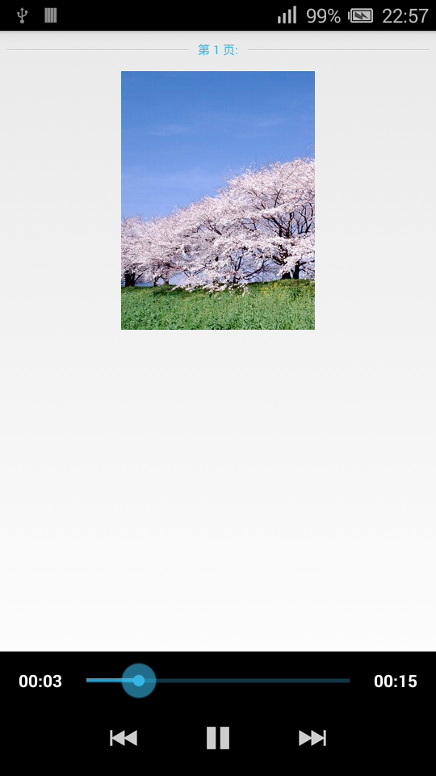

彩信相关的显示、编辑和播放界面(4)
SlideshowActivity
幻灯片播放界面
Notes:
CallNotifier calls requestWakeState to acquire a PARTIAL_WAKE_LOCK, so that CPU will keep running.
Then it sets the ring tone and starts to retrieve caller information.
Finally play the ring tone and call showIncomingCallUi in PhoneUtils.
Here to workaround a flicker issue (LockScreen may be shown before the InCallScreen), PhoneUtils first calls preventScreenOn to prevent the screen from turning on even if it *should* turn on due to a subsequent full wake lock being acquired.
Then calls requestWakeState to acquire a FULL_WAKE_LOCK.
Finally calls displayCallScreen to let PhoneApp startActivity through Intent ACTION_MAIN, which will bring up InCallScreen activity.

Slide 15
彩信编辑和播放界面的显示
控制幻灯片显示SlideshowPresenter
彩信编辑
SlideEditorActivity
彩信播放
SlideshowActivity
每页幻灯片编辑BasicSlideEditorView
每页幻灯片播放
SlideView

Slide 16
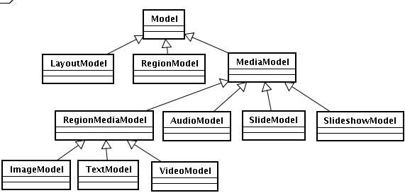
彩信的构造方式- Model
彩信模块定义了Model类用于储存彩信数据。SlideshowModel对应整个SMIL，为一条彩信，由多个SlideModel组成。
Model | SMIL
LayoutModel | <root-layout>
RegionModel | <region>
SlideModel | <par>
ImageModel | <img>
TextModel | <text>
VideoModel | <video>
AudioModel | <audio>
SlideshowModel | <smil>

Slide 17
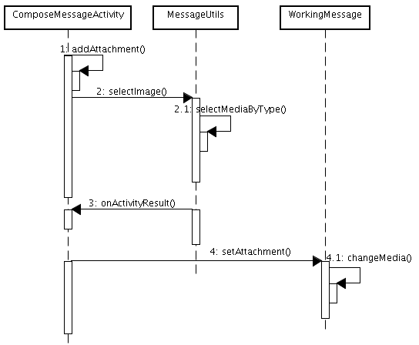
Android Mms 单一附件的添加
添加彩信时，会新建一个SlideshowModel。单一附件的彩信为只含有一个SlideModel的SlideshowModel。再根据media的类型，构造对应的MediaModel，并将该Model添加进SlideModel，最后将该SlideModel加入SlideshowModel。
Notes:
The sequence is quite simple, hangup call just makes RIL send a RIL_REQUEST_HANGUP_WAITING_OR_BACKGROUND to rild.

Slide 18
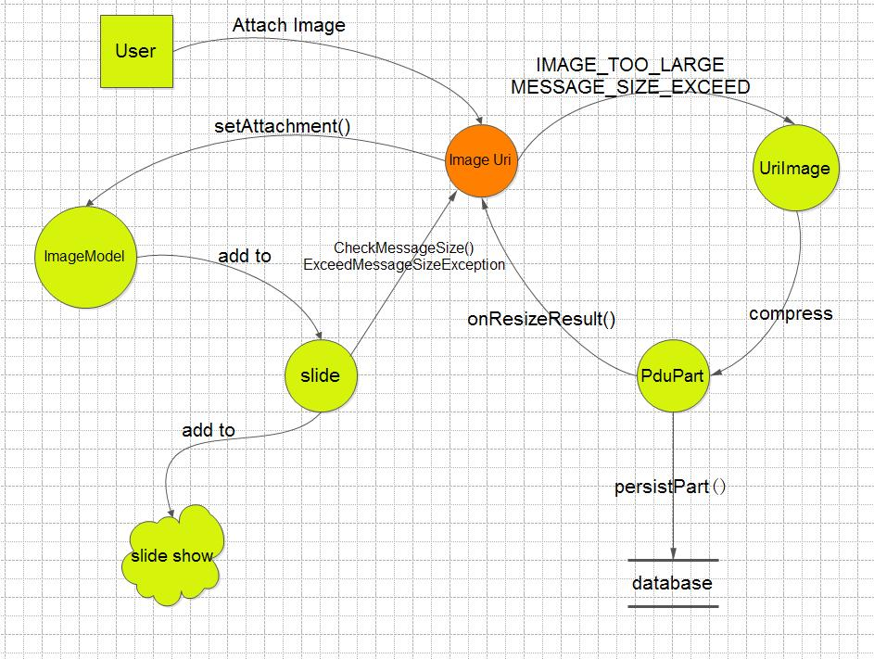
添加图片数据流图

Slide 19
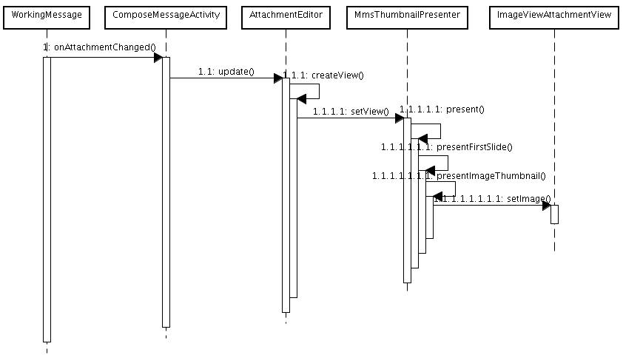
Android Mms 单一附件的界面显示
Notes:
The sequence is quite simple, hangup call just makes RIL send a RIL_REQUEST_HANGUP_WAITING_OR_BACKGROUND to rild.

Slide 20
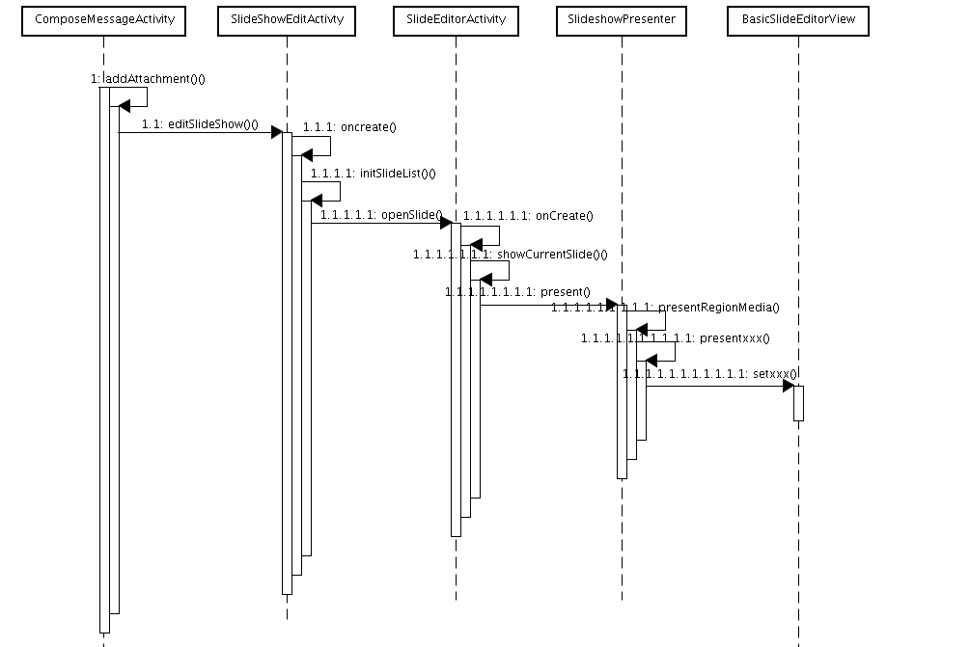
Android Mms 幻灯片的添加、显示
Notes:
The sequence is quite simple, hangup call just makes RIL send a RIL_REQUEST_HANGUP_WAITING_OR_BACKGROUND to rild.

Slide 21
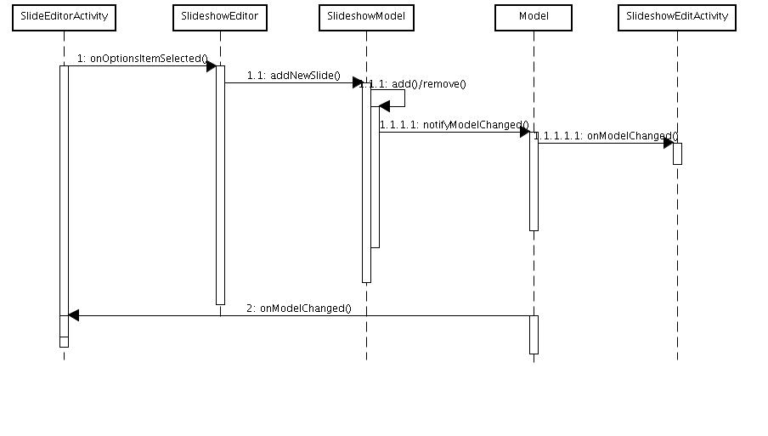
Android Mms 幻灯片上元素添加/删除
Notes:
一。 NetworkMangementService会创建一个NativeDaemonConnector的实例，并创建NativeDaemonConnector的线程，NativeDaemonConnector就是用于本地Socket连接通讯的一个类。在这里也就是和前面Netd进程的netd套接字通讯。
二。Netd进程中的CommandListener对象会处理从INetWorkManagementService接口发送过来的数据。
ComamndListener继承自FrameworkListener, 主要是注册相关的Comamnd命令。
FrameworkListener继承自SocketListener,主要提供注册命令、分发命令的功能。
SocketListener，主要监听Socket,在Socket上有数据到来的时候通过虚函数调用FrameworkListener中的函数，来分发消息。
FrameworkComamnd，命令基类。
NetCommand继承自FrameworkCommand,无实际意义。
PppCmd继承自NetCommand，提供处理FrameworkListener分发来的数据的处理函数
The following is a step by step description about what happened after request data service.
In the previous section, we send RIL_REQUEST_SETUP_DATA_CALL to ril and it send AT command to modem. Now it will start pppd.
1.When the AT command complete, we will call attachPppd function in INetworkManagementService.
2.NetworkMangementService that provide INetworkManagementService will create a NativeDaemonConnector object, that has s socket to connect to SocketListener.
3.Netd process hold a CommandListener object to receiver socket packets and dispatch to corresponding FrameworkCommand, such as PppdCmd.
4.PppdCmd will call PppController to start pppd process.

Slide 22
彩信的交互过程
发送过程
接收过程
彩信发送方把彩信发送给MMS Proxy-Relay。
MMS Proxy-Relay在收到彩信后会给发送方一个确认消息。
MMS Proxy-Relay通过PUSH协议给接收方发送一条短信通知消息，这个消息通常是一条特殊短信，里面包含彩信的位置URL。
接收方收到短信通知后，从中取出URL，然后通过标准的HTTP GET请求从MMS Proxy-Relay上获取彩信。
当MMS Proxy-Relay成功的通知彩信接收方后，它会给彩信发送方发送一个消息表明彩信投递成功。

Slide 23
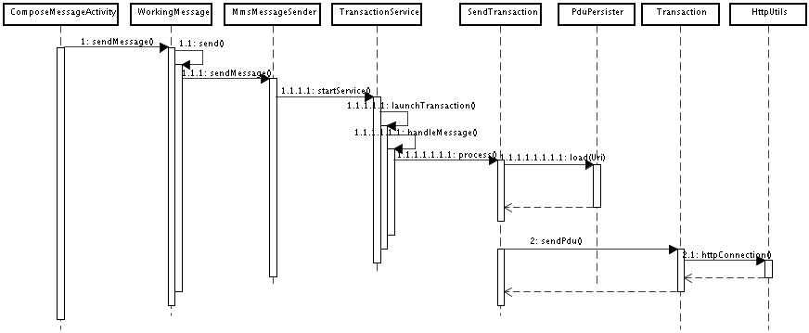
Androd Mms 彩信发送流程
彩信发送时,先封装为MMS PDU, Android以HTTP协议将内容传送给MMS中继器，中继器再传至MMSC。

Slide 24
Android Mms 彩信接收
当接收一条彩信时，首先会从彩信中心收到一条push信息，PushReciever.java的OnReceive()方法被触发，接着会执行ReceivePushTask的doInbackground（）方法，在该方法里，会获取raw push-pdu 信息，解析并存入到数据库中（pdu表）中。这时会把彩信的date字段和expir字段加到数据库中，然后执行TransactionService服务。
从彩信服务中心获得彩信后，存入inbox，ContentObserver收到通知，界面内容刷新。刷新流程与发送时相同。

Slide 25
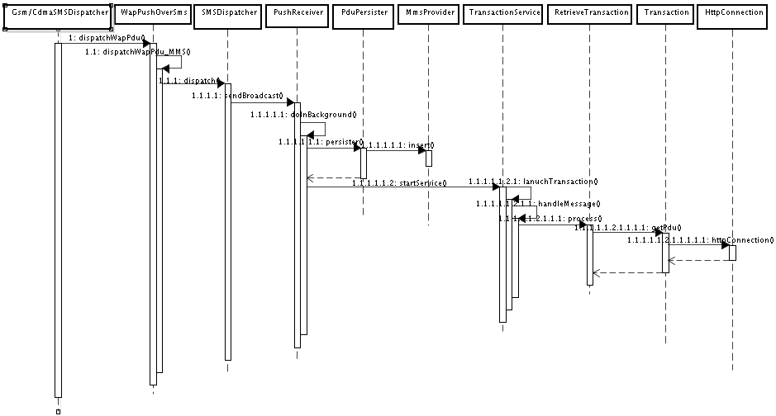
Android Mms 彩信接收

Slide 26
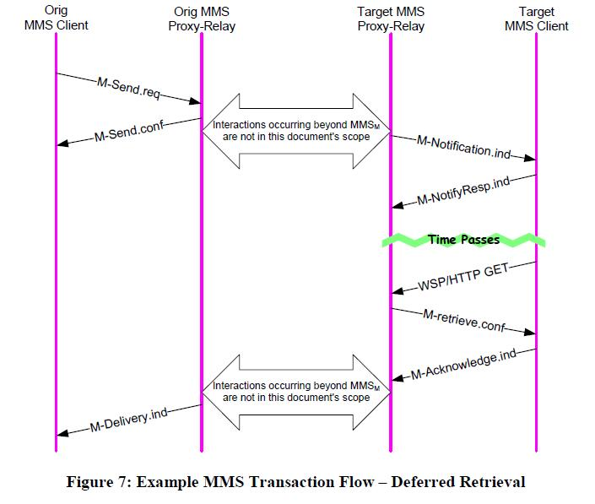
彩信协议
所有的PDU
------------------------------------------
M-Send.req
M-Send.conf
M-delivery.ind
M-Notification.ind
M-NotifyResp.ind
M-Retrieve.conf
M-Acknowledge.ind
M-Forward.req
M-Forward.conf
M-Cancel.req
M-Cancel.conf
M-Delete.req
M-Delete.conf

Slide 27
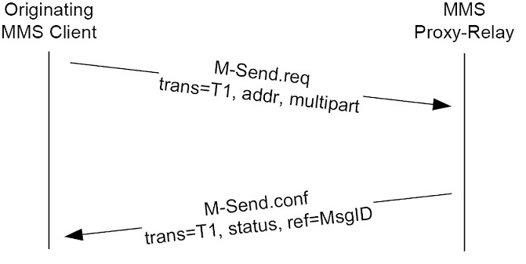
M-Send.req
M-Send ：MMS 客户端发送消息到MMS Proxy-Relay 服务器 ；当 MMS Relay服务器 收到一个M-Send.req PDU时，它会回应一个M-Send.conf数据包，其中包含有请求处理结果的状态代码。如果MMS Relay能够成功处理该请求，那状态代码将为'OK'，并会返回一个message-ID作为MM的唯一标识。

Slide 28
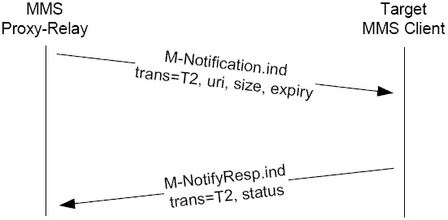
M-Notification.ind
M-Notification ：MMS Proxy-Relay服务器发送通知到MMS 客户端；MMS Relay服务器发送 M-NotificationPDU 给MMS Client，以告知其有新的多媒体消息，同时MMS Client 会 回应状态代码。MMS Client收到M-Notification.ind PDU后会主动回应一个M-NotifyResp.ind数据包，以表明已得到通知。

Slide 29
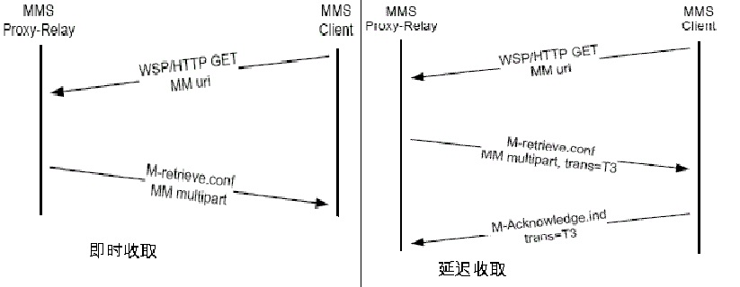
M-Retrieve.conf
M-Retrieve ：MMS 客户端从MMS Proxy-Relay服务器收取MM——多媒体消息；MMS Client发送给 MMS Relay服务器以收取MM的请求，该请求的PDU传输在WSP/HTTP协议之上，会以 M-Notification.ind PDU中的URI为参数，向MMS Relay服务器索取MM内容。服务器回应M-retrieve.conf数据包，如果成功的话其中会包含完整的MM内容，当然回应中的状态代码会指示操作是否成功。

Slide 30
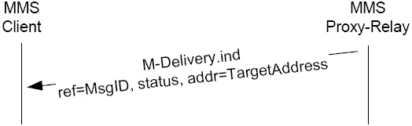
M-delivery.ind
M-Delivery ：MMS Proxy-Relay服务器发送投送报告给MMS 客户端；M-Delivery业务允许源MMS Client及时得到信息被投递的通知，该通知是一个M-Delivery.ind数据包，MMS Client的PDU 包含了源消息的发送情况，如果有多个目标用户，则会有多条 M-Delivery.ind 数据包 。

Slide 31
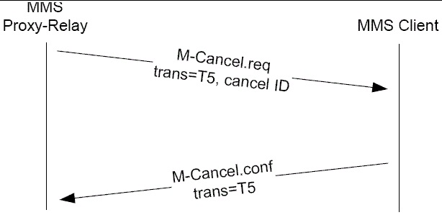
M-Cancel.req
M-Delete ：MMS 客户端从MMS Proxy-Relay服务器上删除多媒体消息；MMS Client想要删除1条或多条存储在MMS-Relay服务器上的MM时，可以发送M-Delete.req数据包到MMS-Relay服务器，该数据包含1个或多个标识具体MM的URI，而MMS-Relay服务器会回应M-Delete.conf数据包，其中包含有操作完成情况的状态码

Slide 32
彩信PDU
MMS PDU（Protocol Data Unit，协议数据单元）由MMS Header和MMS Body组成，MMS头由多个域名和域值组成，由客户端指定。
一个MMS PDU对应一种消息格式。不同类型的MMS PDU有不同的MMS Header 。常见的PDU的类型有
-发送请求: M-send.req
-发送确认: M-send.conf
-彩信通知: M-notification.ind
-通知回应: M-notifyresp.ind
-获取彩信回应: M-retrieve.conf
-接收确认: M-acknowledge.ind
-彩信回执: M-delivery.ind
大多数MMS PDU只含有MMS头，它们起到建立和维持通信的作用，只有在M-Send.req和M-Retrieve.conf PDU中才有消息体
在用HTTP发送彩信前的最后一步是把格式化的PDU数据结构转化
成字节流。相反的，在用HTTP接收彩信后的第一步是把字节流转化
成PDU数据结构。构造是由PduComposer完成的，解析是由
PduParser完成的。有兴趣的可以去看源代码。

Slide 33
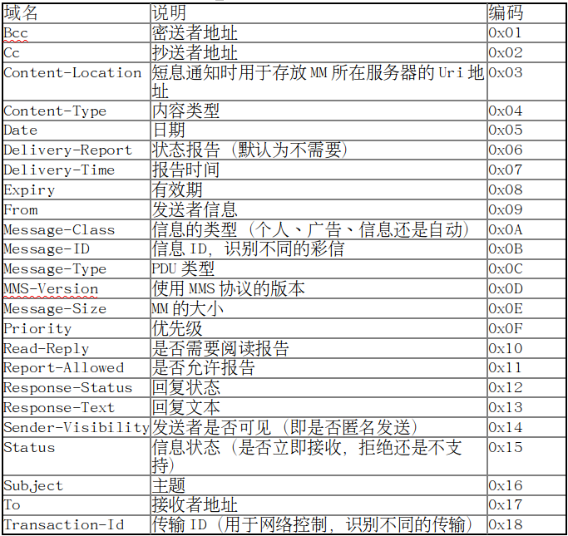
常见的PDU header域名及其编码

Slide 34
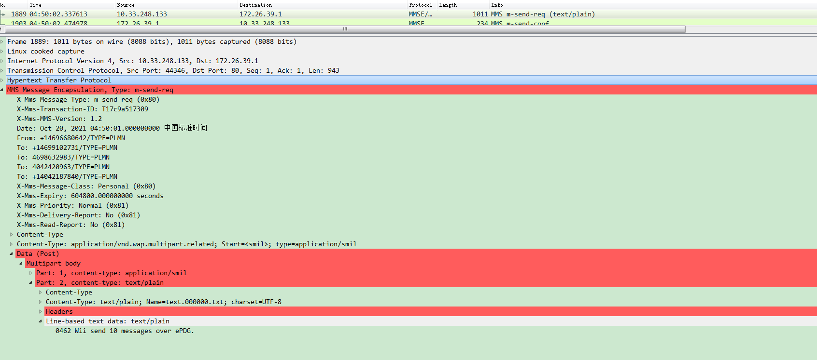
M-Send.req MMS PDU 结构LOG

Slide 35
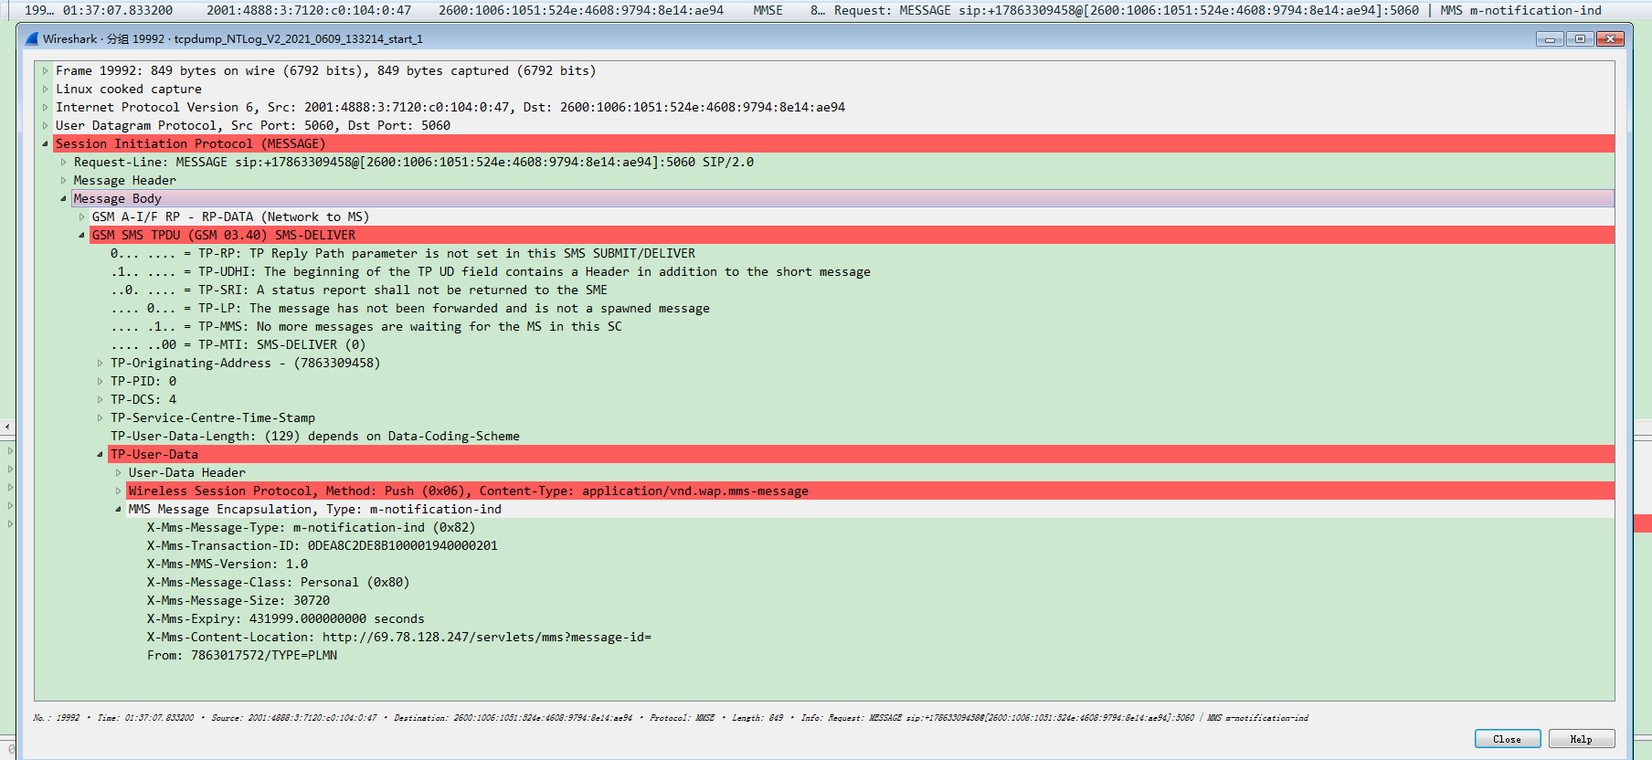
M-Notification.ind MMS PDU 结构LOG

Slide 36
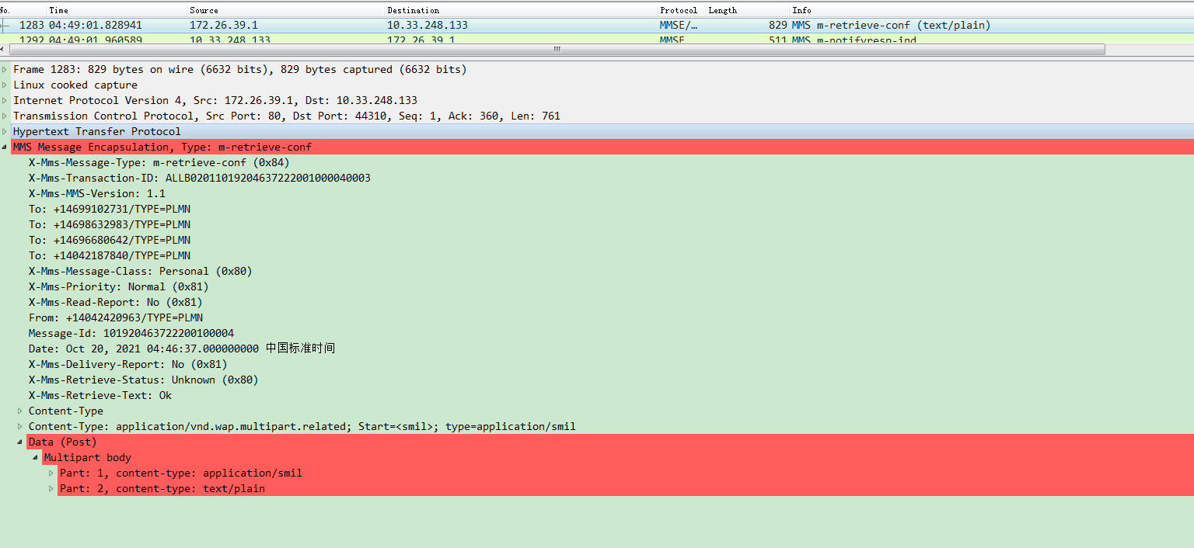
M-Retrieve.conf MMS PDU 结构LOG

Slide 37
MMS 的传输过程
1. 激活MMS APN ，建立与WAP网关的数据连接。
2. 建立连接以后再通过HTTP协议与彩信服务中心建立会话。
3. 发送MMS数据包，把按MMS协议打包好的数据通过HTTP协议Post PDU发送出去 。如果是接收，则通过发送带有接收Uri的Get PDU来实现。
4. 断开与彩信服务中心的连接。

Slide 38
Android Mms 彩信数据库与ContentProvider
数据库
data/data/com.android.providers.telephony/
data/data/com.android.providers.telephony/
threads
threads
mmssms.db
mmssms.db
pdu
pdu
part
part
位置
ContentProvider
数据库
package/providers/TelephonyProvider
MmsProvider.java
MmsSmsProvider.java
MmsSmsDatabaseHelper.java

Slide 39
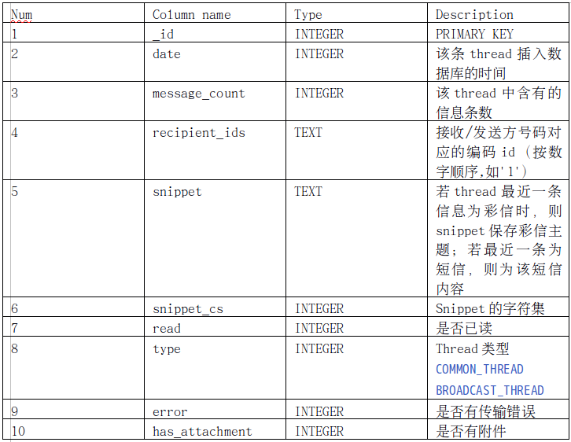
threads table

Slide 40
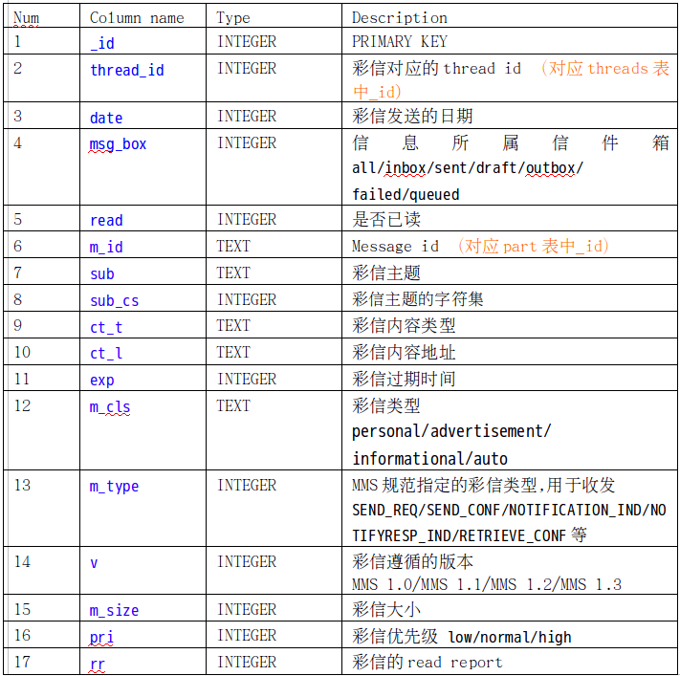
pdu table - 1

Slide 41
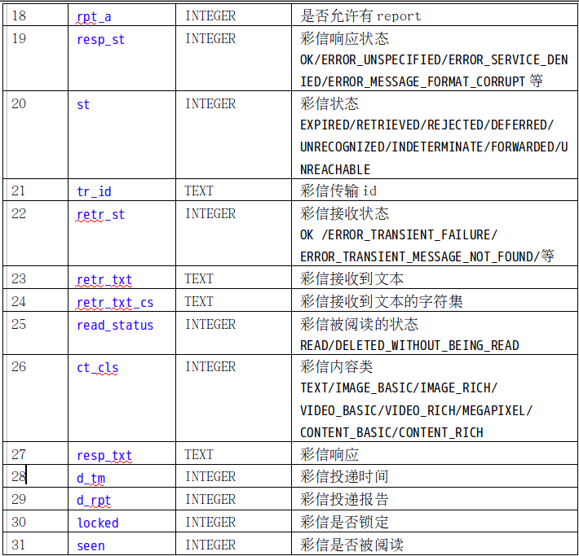
pdu table - 2

Slide 42

创新，我们帮您实现！
中国
南京市广州路191号
五环大厦二层
电话: +86-25-5188-7700
USA
265 Madison Ave. 4th floor
New York, NY 10016, USA
Phone: +1-415-215-2123
Canada
17 PebbleCreek Drive
Brampton, Ontario Canada L6P 2T8
Phone: +1-647- 802-7708
日本
東京都墨田区八広6-54-1-602
〒131-0041
Phone: +81-090-5546-6819

