Slide 1

BETEL NUT TRADERS

Slide 2
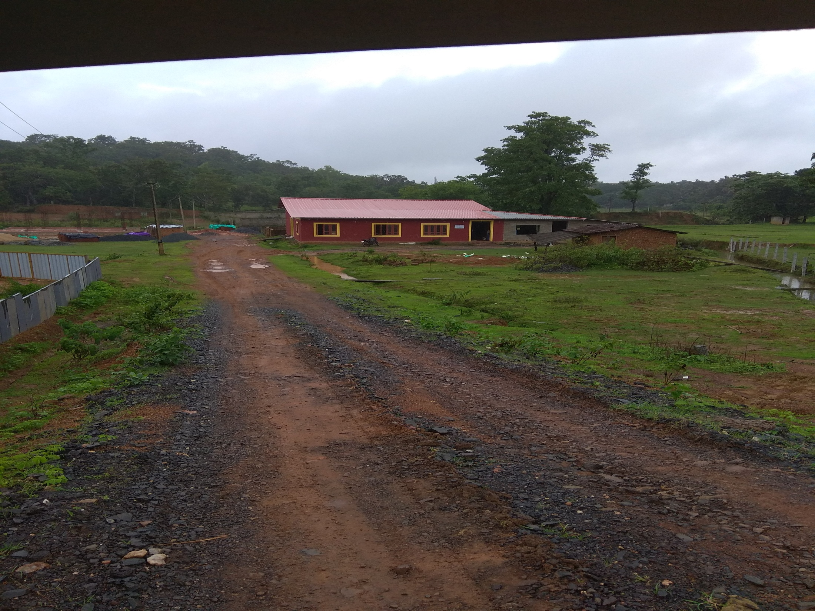
INTRODUCTION
Siri Traders is situated in yellapur,UttarKannada.
Their main Business is Purchase and sales of Betel nuts
They purchase variety of Betel nuts from various distributors.
The refinement of Betel nuts takes place.
Further it’s been transported to various branches.

Slide 3
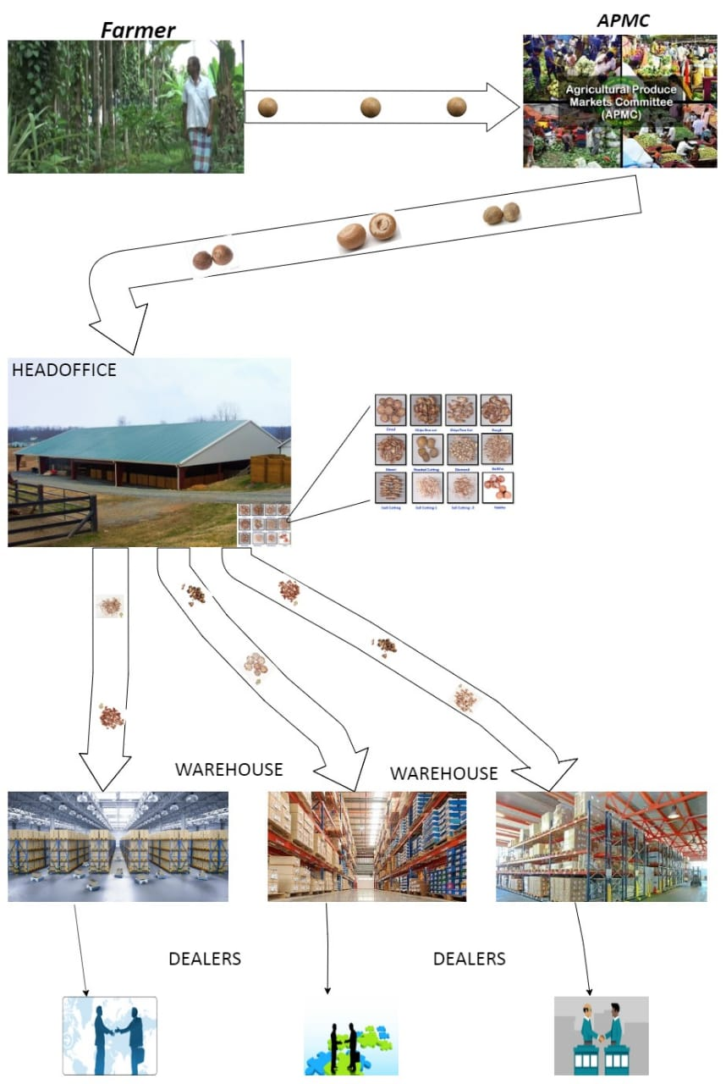

Slide 4

OBJECTIVE OF THE PROJECT
1.To provide a Digital platform for Enhancement of their Business.
2.It provides the information about:
Distributor.
Admin.
franchises.
Head office
Dealers.
3.It provides the facility of Order request and payment.
4.It provides information about Purchase and sales billing.

Slide 5

EXISTING SYSTEM
In present system all the works are non- computerized.
Information is shared through manually.
It consumes more time and also needs more human effort.
It is difficult to handle warehouses present in different places.

Slide 6

PROPOSED SYSTEM
Information is shared through website.
It reduces the manual work.
It removes the difficulty of communication.
It provides main server at Head office and can able to control different franchises.

Slide 7
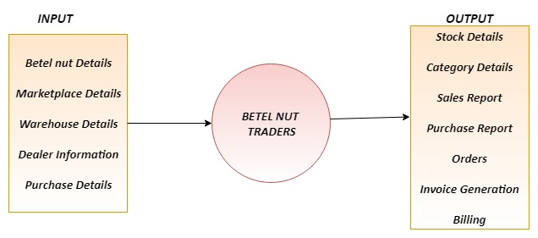
PROCESS LOGIC

Slide 8
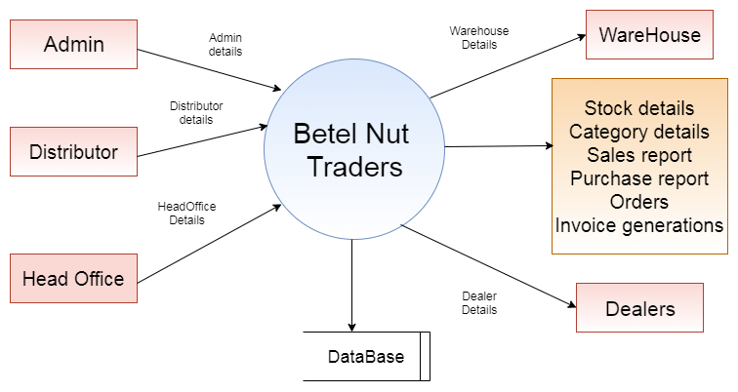
DATAFLOW DIAGRAM

Slide 9

TOOLS &LANGUAGES
1.Languages used:
Frontend – HTML,CSS,JavaScript
Middle tier-PHP
DataBase-MySQL
2.Software used:
Dreamviewer
WAMP server

Slide 10
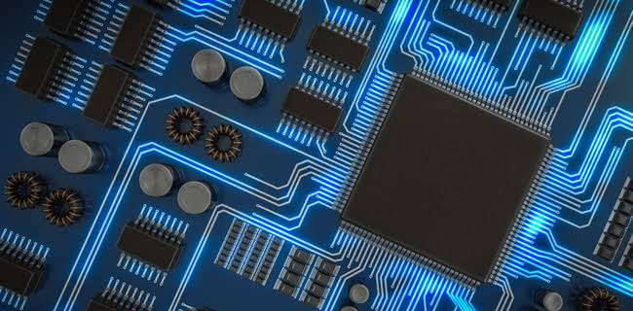
HARDWARE REQUIREMENTS
1. Processor core i3 and above
2. RAM 2GB
3. HardDisk 10GB free space

Slide 11

LIMITATIONS
Betel nut quality cannot be identified using application.
Market price will be changing contineusly but we are Updating periodically.

Slide 12

SCOPE OF THE PROJECT
1.This Application will be used for inhouse management of stock and sales .
2.This will be used as a private website of a company.
Future Enhancements
In future we can develop a android app to reduce the cost of computer , printer etc.
Easy to make orders to keep track of transportation.

Slide 13

MODULES USED
Admin
Distributor
Head office
Warehouse
Dealer

Slide 14


