Slide 1
CS406: Compilers
Spring 2020
Week 4: Parsers

Slide 2
Parsers - Overview
Also called syntax analyzers
Determine two things:
  1. If a program is valid syntactically
  - Is an English sentence grammatically correct?
  2. Structure of programming language constructs
  - E.g. the sequence IF, ID(a), OP(<), ID(b), {, ID(a), ASSIGN, LIT(5), }, ;, } refers to if-statement ?
  - Diagramming English sentences

Slide 3
Parsers - Overview
Input: stream of tokens
Output: Parse tree
  sometimes implicit
if
(
ID(a)
OP(<)
LIT(4)
)
Stream of tokens:
{
ID(b)
=
LIT(5)
}
If-stmt
expr
{
stmt-list
}
Parse tree:
(
expr
)
assign-stmt
a
<
4
b
=
5

Slide 4
Parsers – what do we need to know?
How do we define language constructs?
  Context-free grammars
How do we determine: 1) valid strings in the language? 2) structure of program?
  LL Parsers, LR Parsers
How do we write Parsers?
  E.g. use a parser generator tool such as Bison

Slide 5
Languages
A language is (possibly infinite) set of strings
Regular expressions describe regular languages
weakness: can’t describe a string of the form:
{ (^{i} )^{i} | i>=1}
Parenthesized expressions:
((( int x; )))
IF
IF
IF
FI
IF
FI
Programming language syntax is i.e. recursive
Nested structures:

Slide 6
Trivia
Regular expressions can describe strings: { mod k | k = # states in FA}
1
1
“accept all strings having odd number of 1s”

Slide 7
Context Free Grammar (CFG)
Natural notation for describing recursive structure definitions. Hence, suitable for specifying language constructs.
Consist of:
  A set of Terminals
  A set of Non-terminals
  A Start Symbol
  A set of Productions

Slide 8
Context Free Grammar (CFG)
Terminology:
Terminals – T
Non-terminals – N
Start Symbol – S∈N
Productions – P (also called rules sometimes)
X Y₁Y₂Y₃..Y_{N} | X∈N, Y_{i}∈ N ⋃ T ⋃ ϵ/λ
Grammar G = (T, N, S, P)
E.g. G = ({a,b}, {S, A, B}, S, {S AB, S Aa
A a, B Bb, B b})
G is context free. Why?

Slide 9
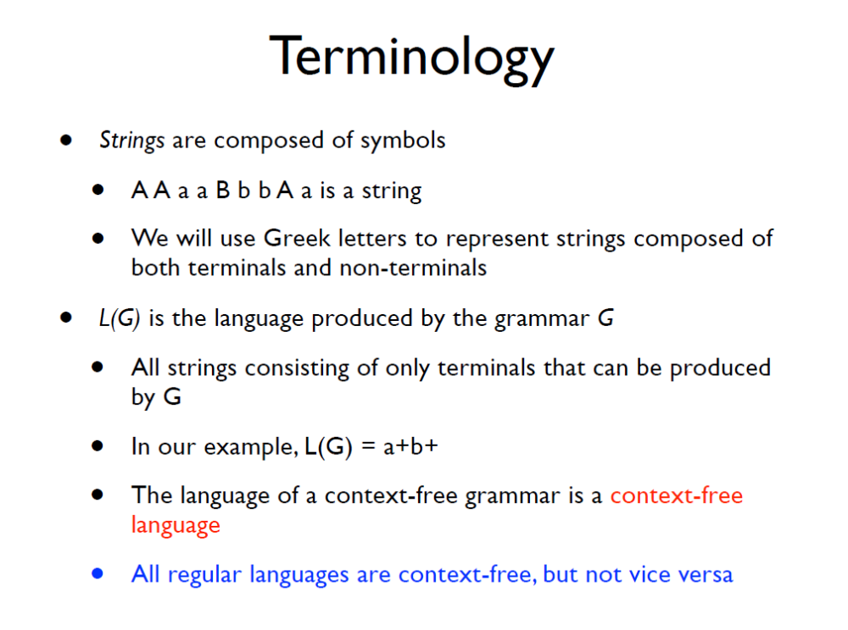

Slide 10
String Derivations
How do we apply the grammar rules repeatedly to determine the validity of a string? (i.e. string belongs to the language specified by the grammar)
  Always start with the Start Symbol
  Replace any Non-terminal X in the string by the right-hand side of the production
  Repeat Step 2 until there are no more non-terminals

Slide 11
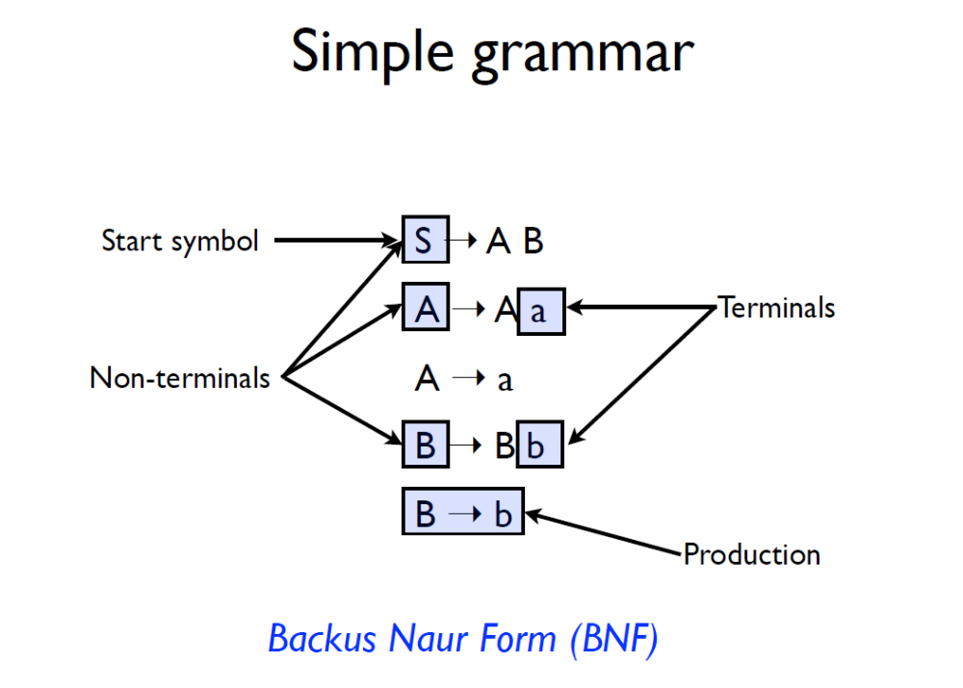

Slide 12
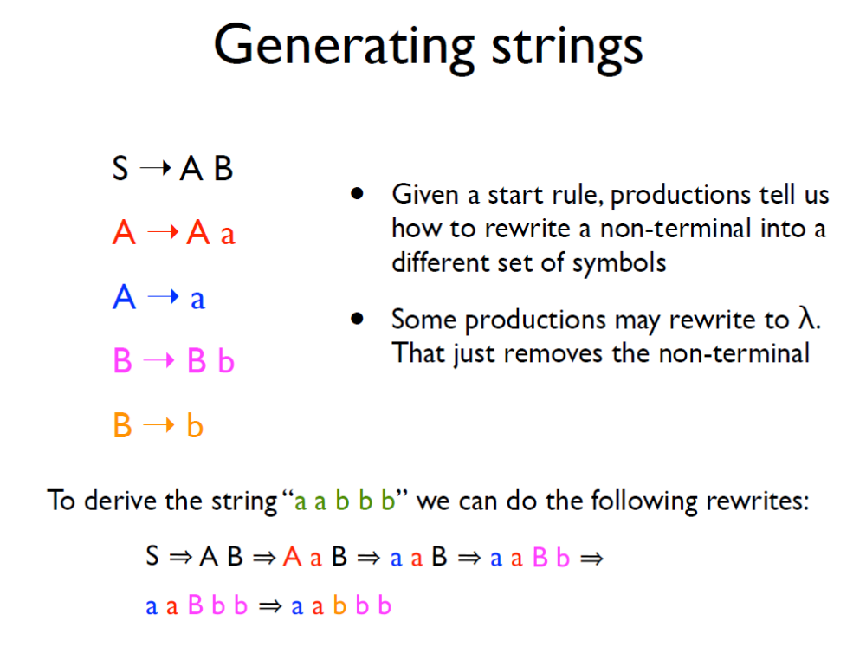

Slide 13
Exercise
Which of the below strings are accepted by the grammar:
A aAa
A bBb
A λ
B cA
B λ
abcba
abcbca
abba
abca

Slide 14
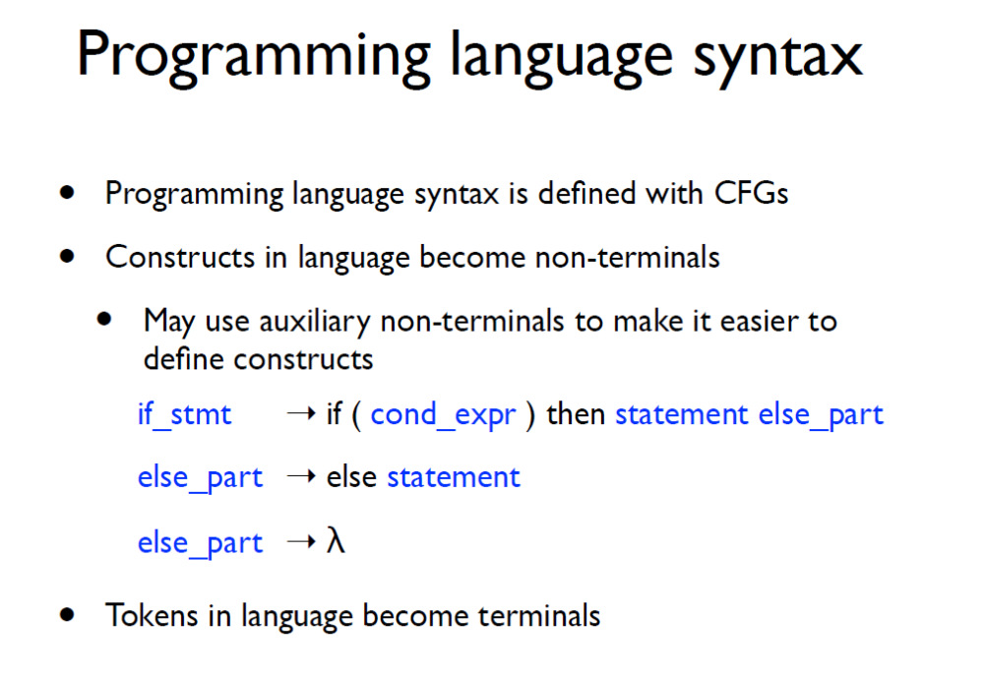

Slide 15
CFG Contd..
Is it enough if parsers answer “yes” or “no” to check if a string belongs to context-free language?
  Also need a parse tree
What if the answer is a “no”?
  Handle errors
How do we implement CFGs?
  E.g. Bison

Slide 16
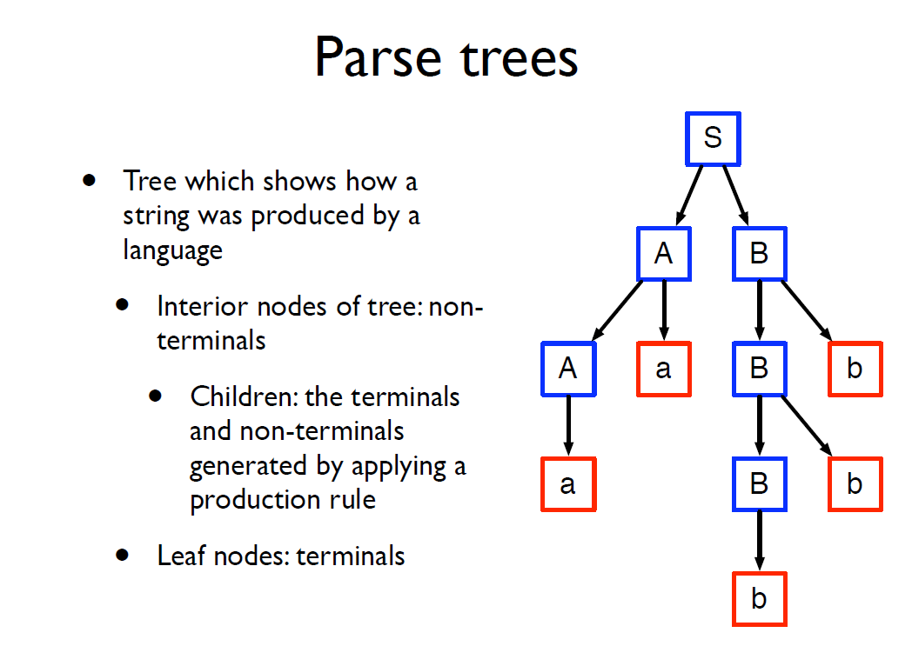

Slide 17
String Derivations Revisited..
Sequence of rules applied to produce a string
A derivation defines a parse tree
  A parse tree may have many derivations
Grammar for arithmetic expressions
  E -> E + E
  E -> E * E
  E -> id

Slide 18
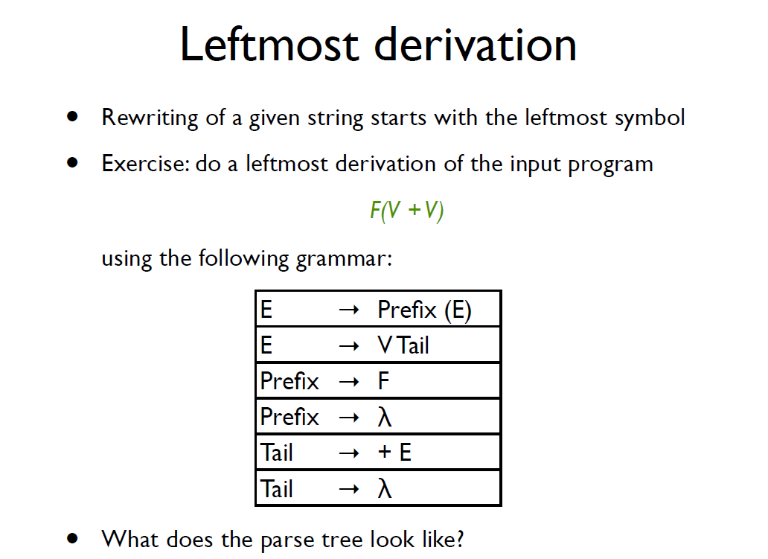

Slide 19
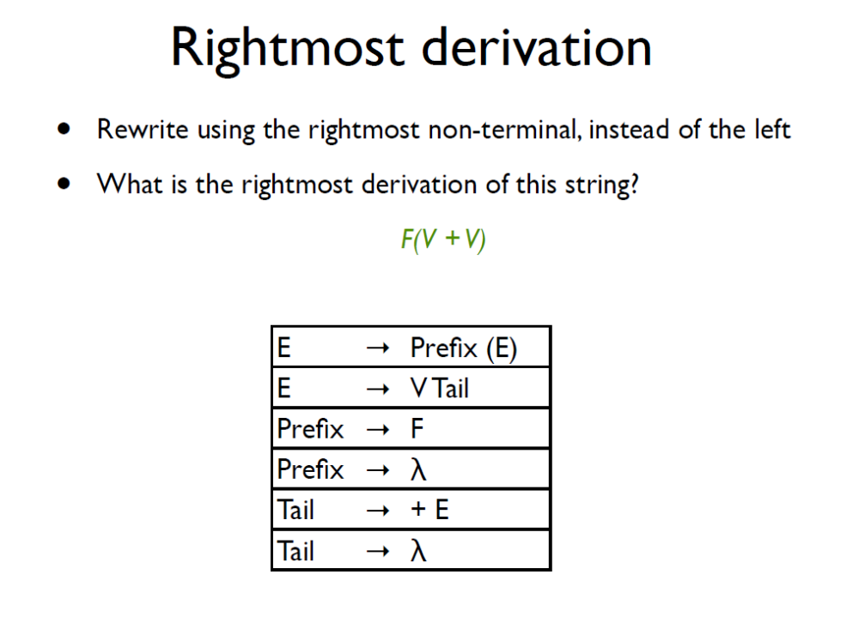

Slide 20
Exercise
Which of the below strings are accepted by the grammar:
A aAa
A bBb
A λ
B cA
B λ
abcba
abcbca
abba
abca

Slide 21
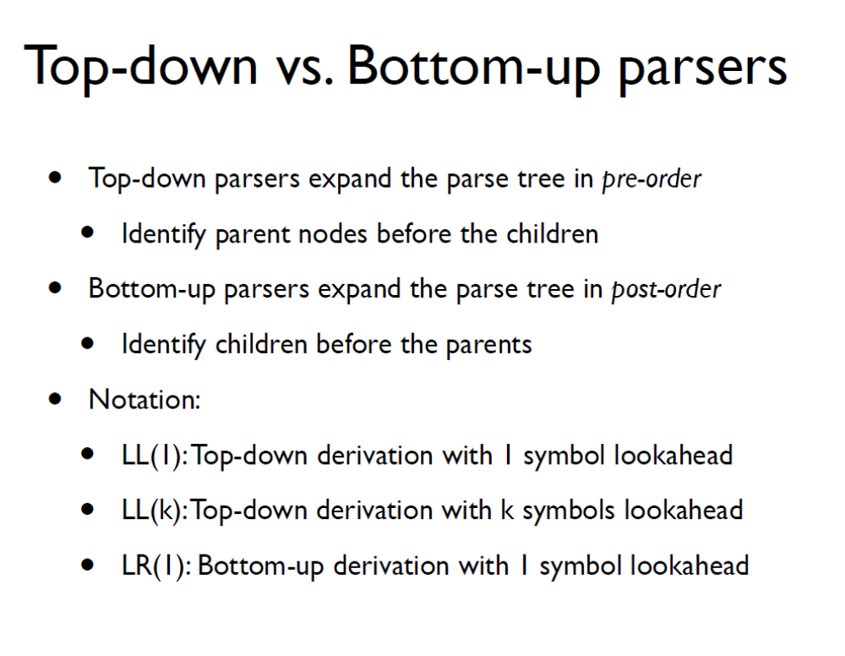

Slide 22
