Slide 1
CS406: Compilers
Spring 2020
Week 5: Parsers, AST, and Semantic Routines

Slide 2
Recap

Slide 3
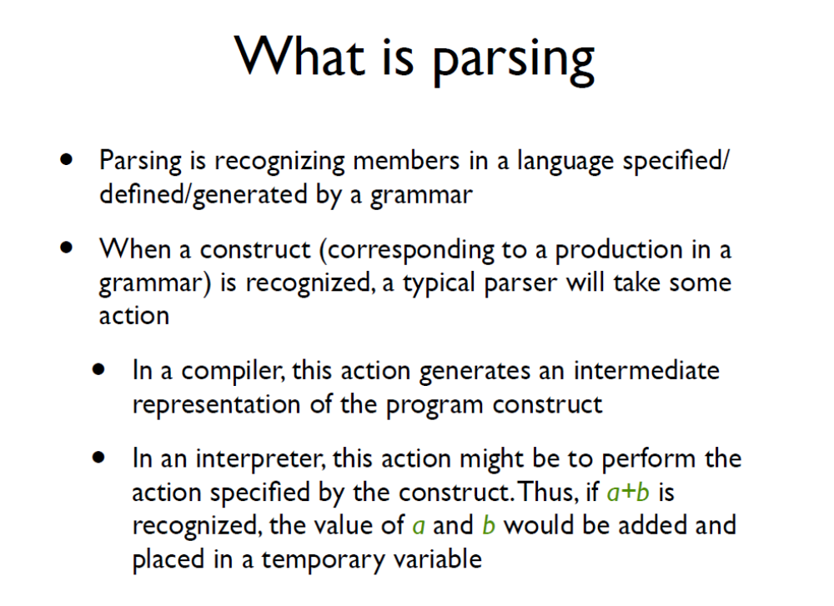

Slide 4
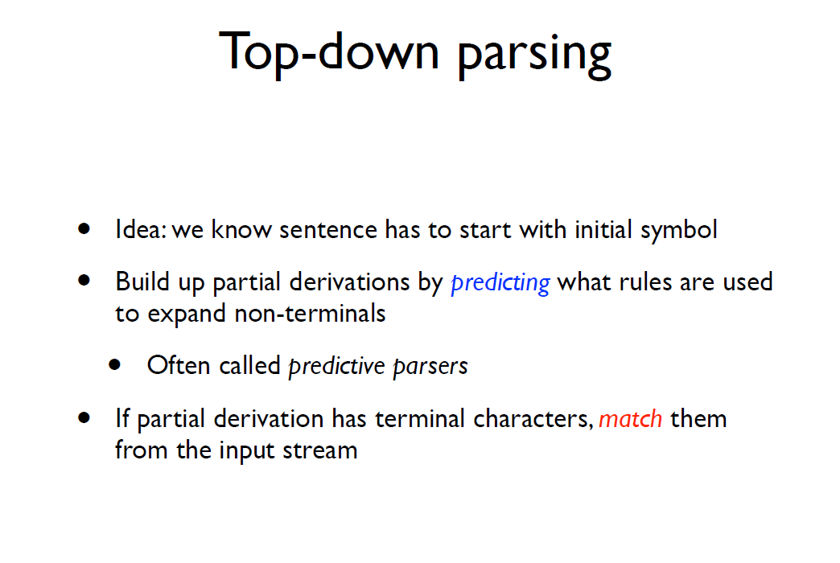
Top-down Parsing – predictive parsers
Suggested reading: https://en.wikipedia.org/wiki/LL_parser

Slide 5
Top-down Parsing – contd..
Also called recursive-descent parsing
Equivalent to finding the left-derivation for an input string
  Recall: expand the leftmost non-terminal in a parse tree
  Expand the parse tree in pre-order i.e. identify parent nodes before children

Slide 6
Top-down Parsing
 | ( | ) | a | + | $
S | 2 | - | 1 | - | -
F | - | - | 3 | - | -
  1) S -> F
  2) S -> (S + F)
  3) F -> a
  Table-driven (Parse Table) approach doesn’t require backtracking
string: (a+a)
string’: (a+a)$
Assume that the table is given.
But how do we construct such a table?

Slide 7
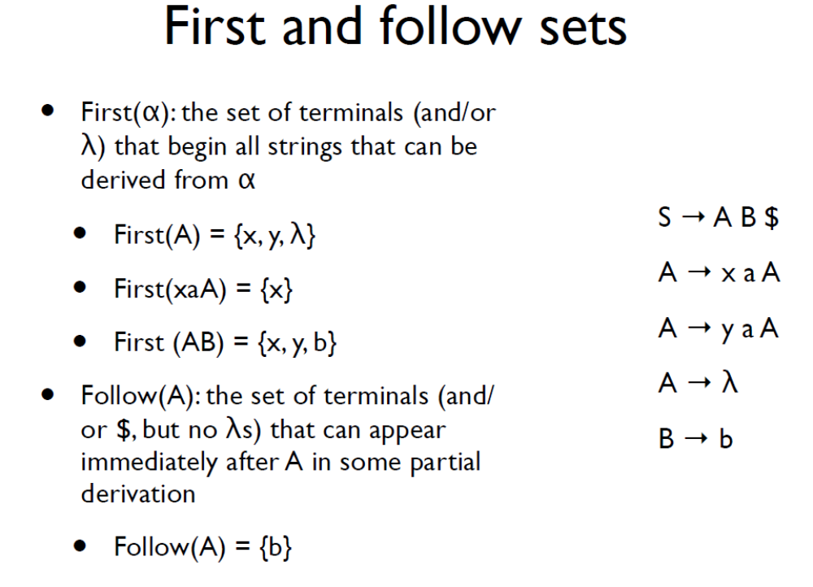

Slide 8
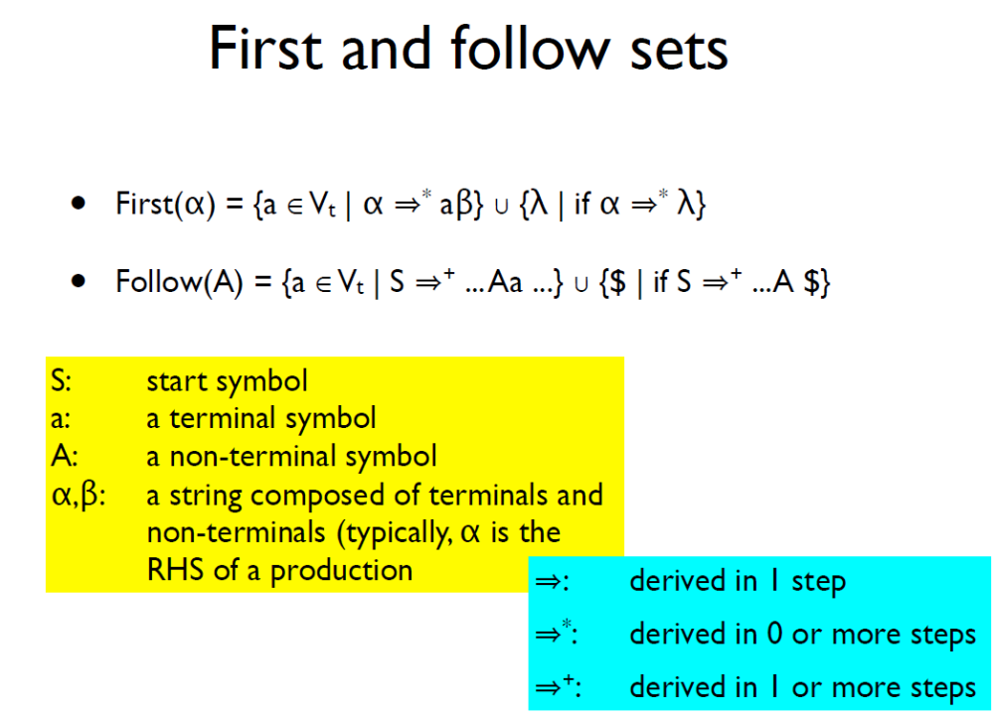

Slide 9
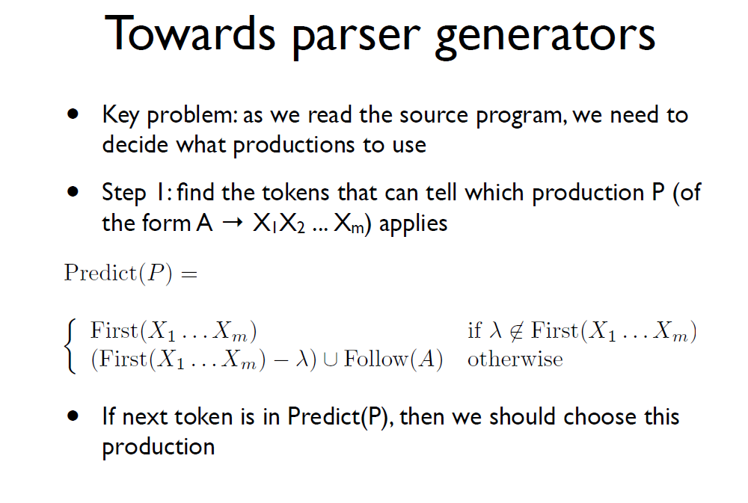

Slide 10
Computing Parse-Table
 | x | y | a | b | c | $
S | 1 | 1 |  |  | 1
A | 2 | 3 |  |  | 4
B |  |  |  | 5 | 6
  S -> ABc$
  A -> xaA
  A -> yaA
  A -> c
  B -> b
  B -> λ
first (S) = {x, y, c}
first (A) = {x, y, c}
first(B) = {b, λ}
follow (S) = {}
follow (A) = {b, c}
follow(B) = {c}
P(1) = {x,y,c}
P(2) = {x}
P(3) = {y}
P(4) = {c}
P(5) = {b}
P(6) = {c}

Slide 11
Parsing using stack-based model (non-recursive) of a predictive parser

Slide 12
Computing Parse-Table
  string: xacc$
  S xacc$ Predict(1) S->ABc$
  ABc$ xacc$ Predict(2) A->xaA
  xaABc$ xacc$ match(x)
  aABc$ acc$ match(a)
  ABc$ cc$ Predict(4) A->c
  cBc$ cc$ match(c)
  Bc$ c$ Predict(6) B->λ
  c$ c$ match(c)
  c$ c$ Done!
Stack* Remaining Input Action
* Stack top is on the left-side (first character) of the column

Slide 13
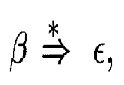

Identifying LL(1) Grammar
  What we saw was an example of LL(1) Parser
  Not all Grammars are LL(1)
    A Grammar is LL(1) iff for a production A -> α | β, where
    α and β are distinct:
    For no terminal a do both α and β derive strings beginning with a
    At most one of α and β can derive an empty string
    If then α does not derive any string beginning with a terminal in Follow(A). If then does not derive any string beginning with a terminal in Follow(A)

Slide 14
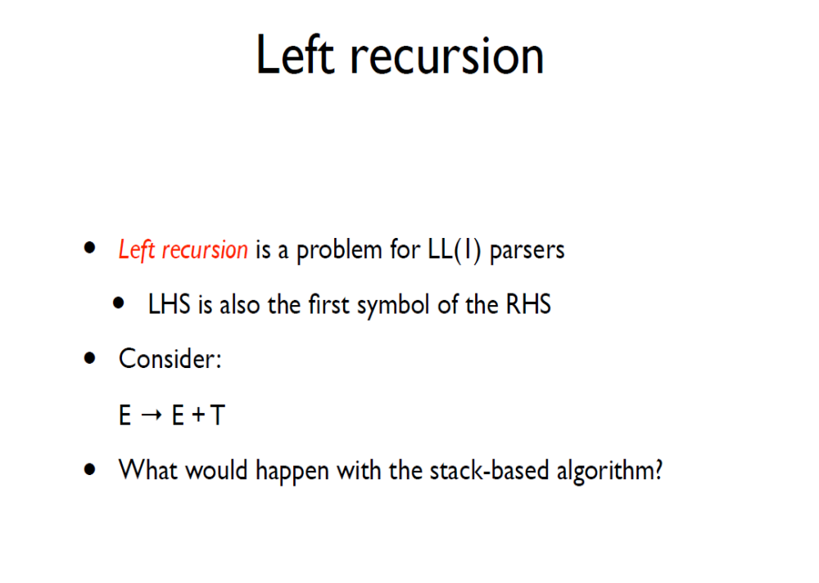

Slide 15
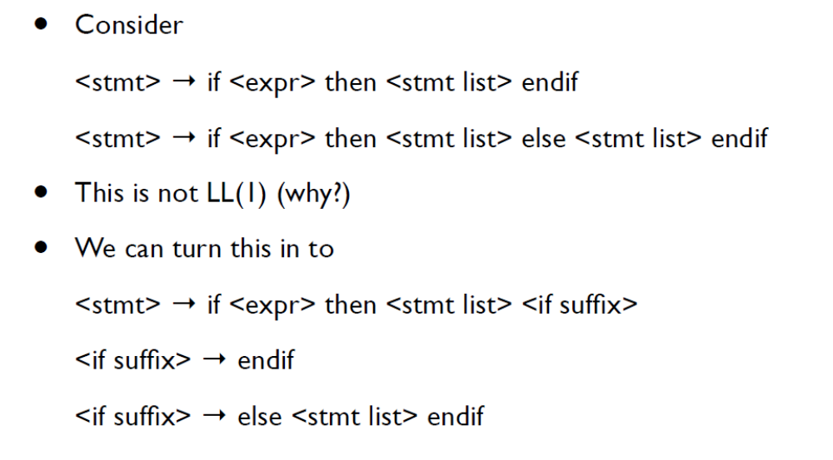
Example (Left Factoring)

Slide 16
Eliminating Left Recursion
A -> A α | β
A -> βA’
A’ -> αA’ | λ

Slide 17
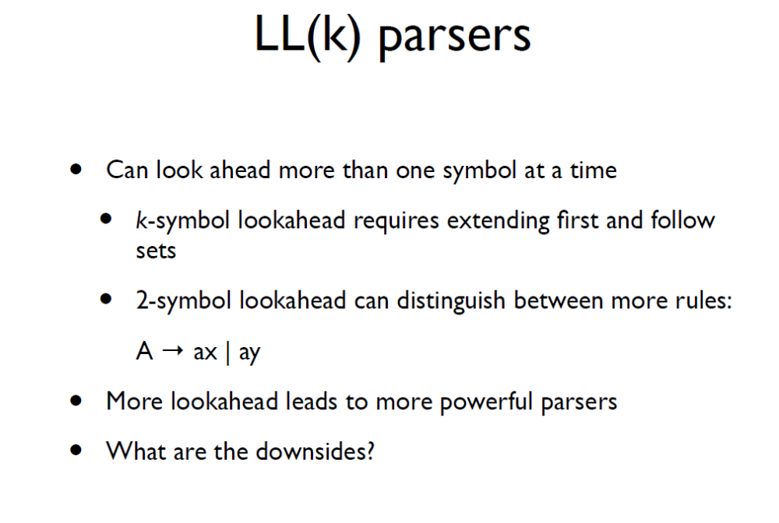

Slide 18
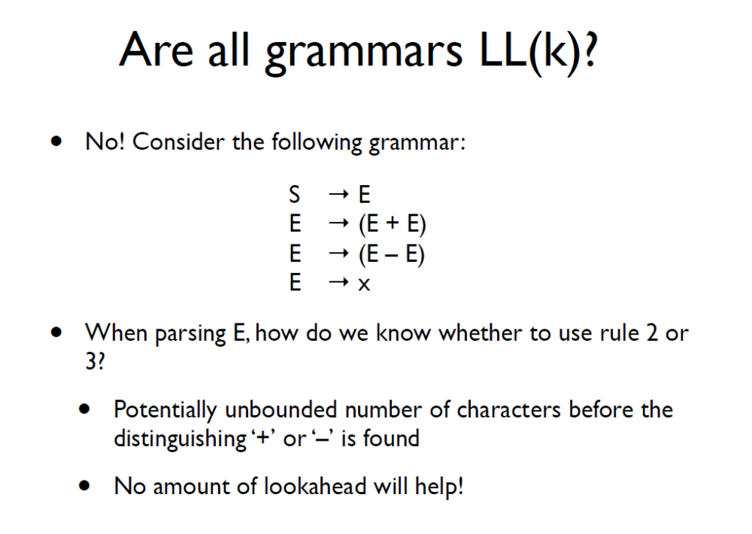

Slide 19
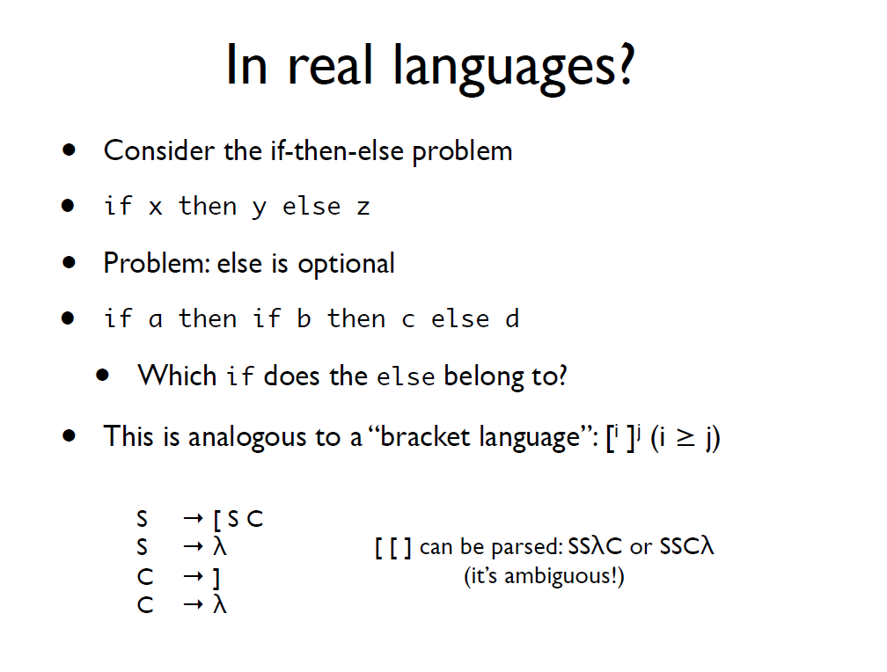

Slide 20
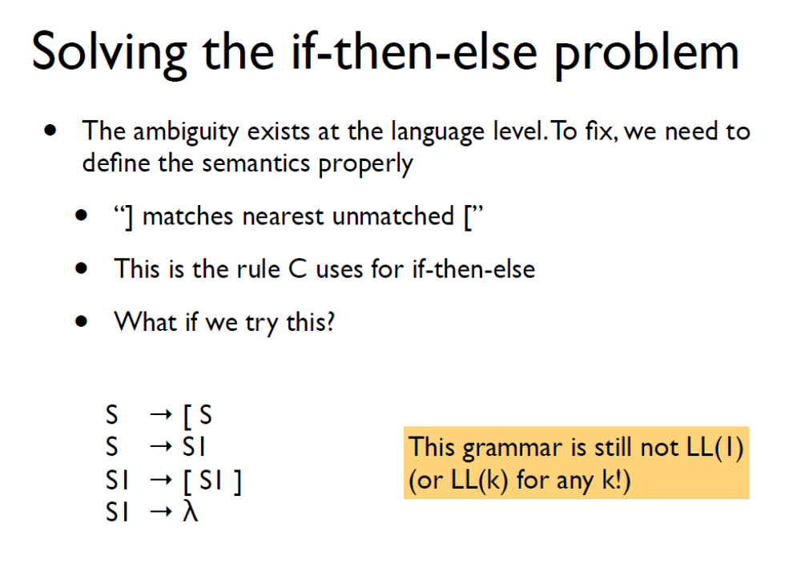

Slide 21
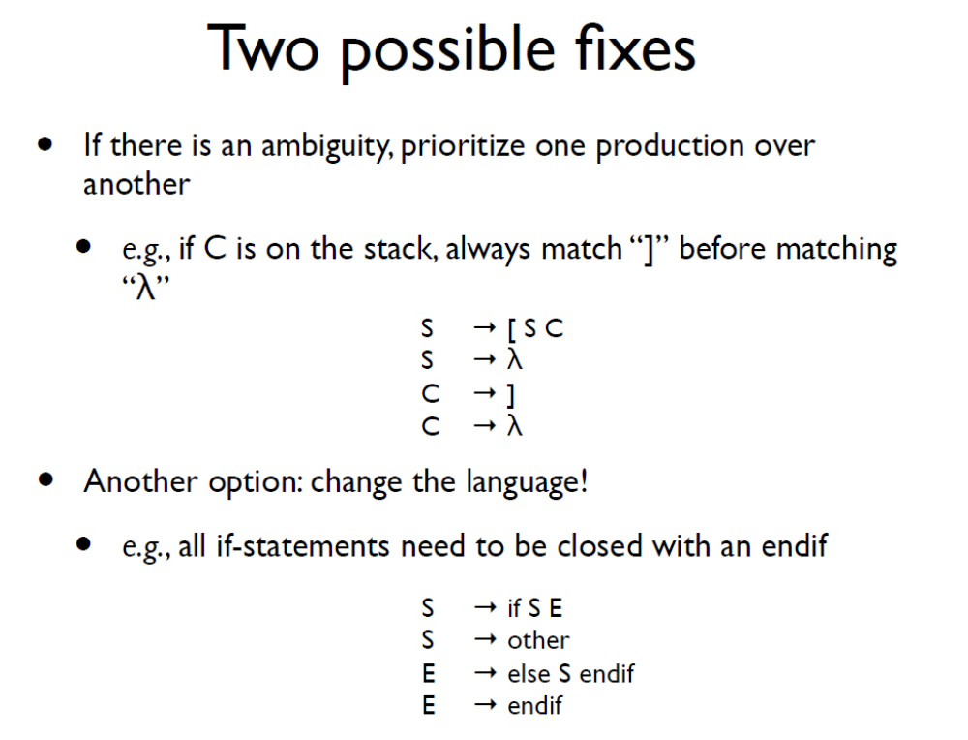

Slide 22
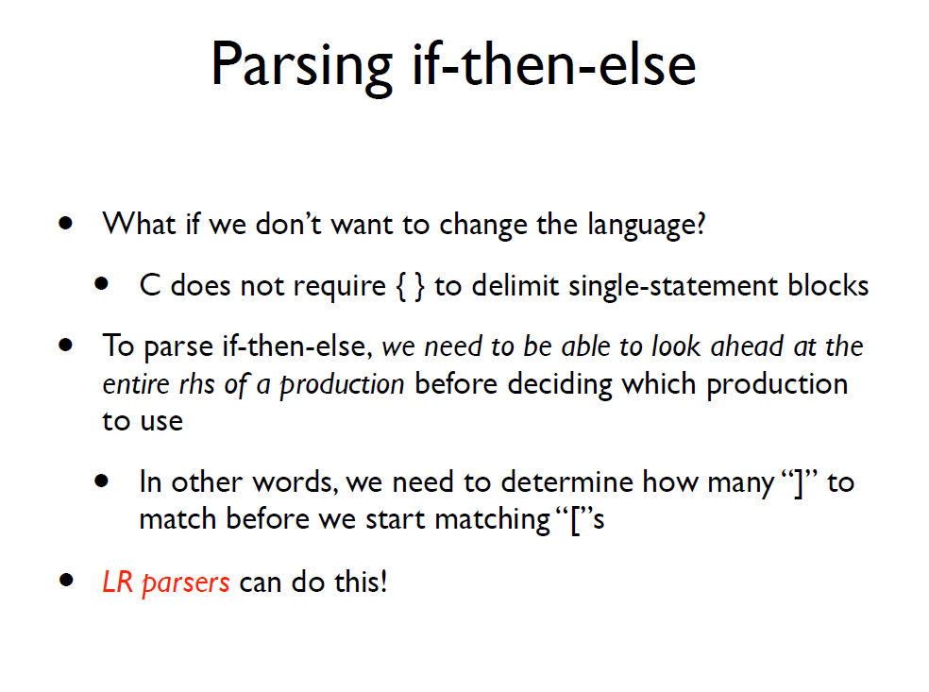

Slide 23
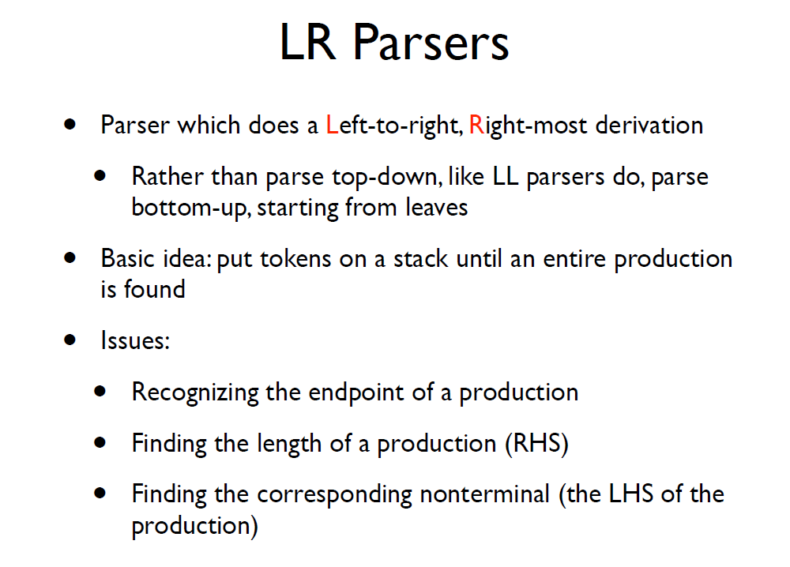
  Example:
  E -> E + T | T
  T -> T * F | F
  F -> (E) | id
  String: id*id
Demo

Slide 24
Basic idea: put tokens on a stack until an entire production is found
- shift tokens onto the stack. At any step, keep the set of
productions that could generate the read-in token
  - reduce the RHS of recognized productions to the
  corresponding non-terminal on the LHS of the production.
  Replace the RHS tokens on the stack with the LHS non-terminal.
Issues:

Slide 25
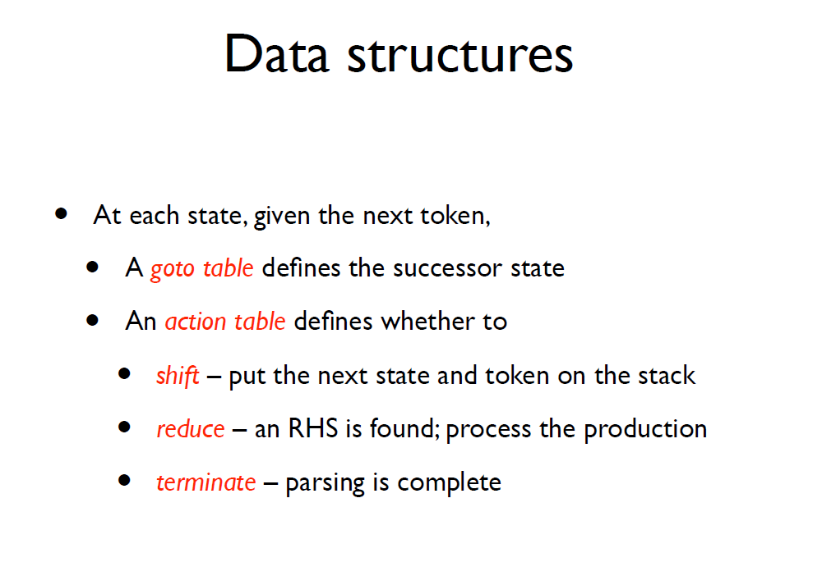

Slide 26
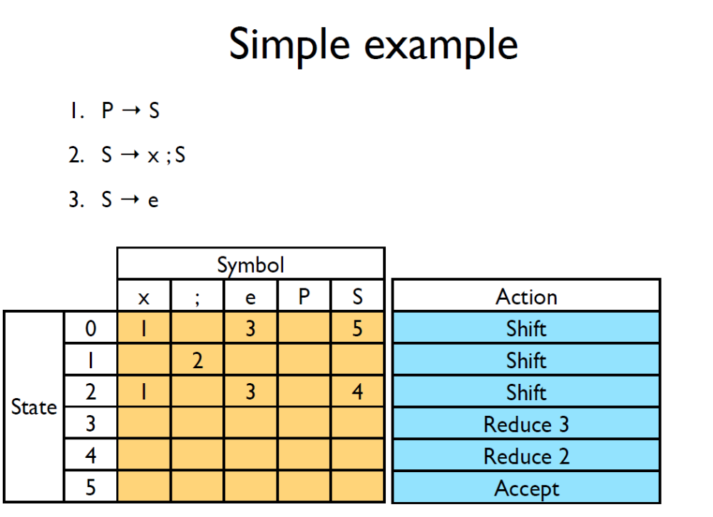

Slide 27
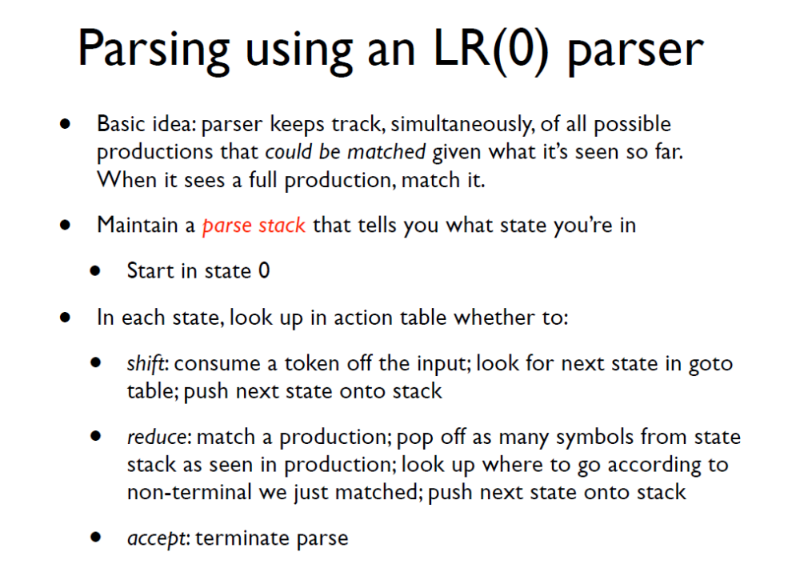

Slide 28
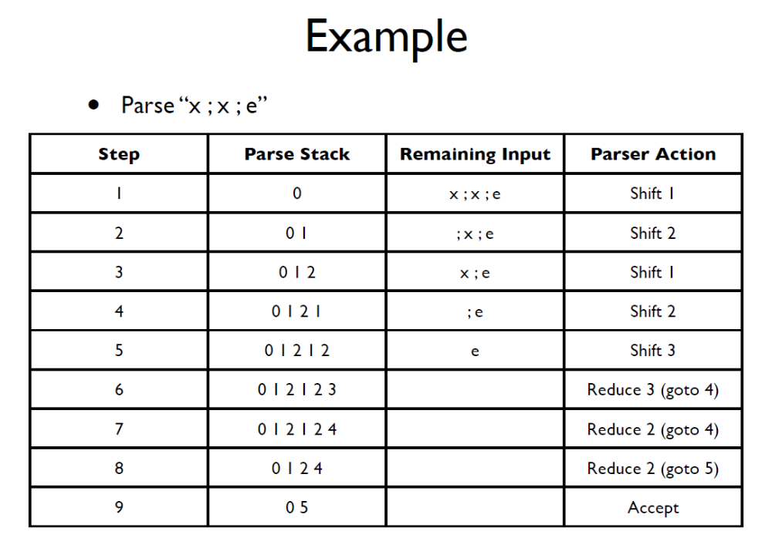

Slide 29
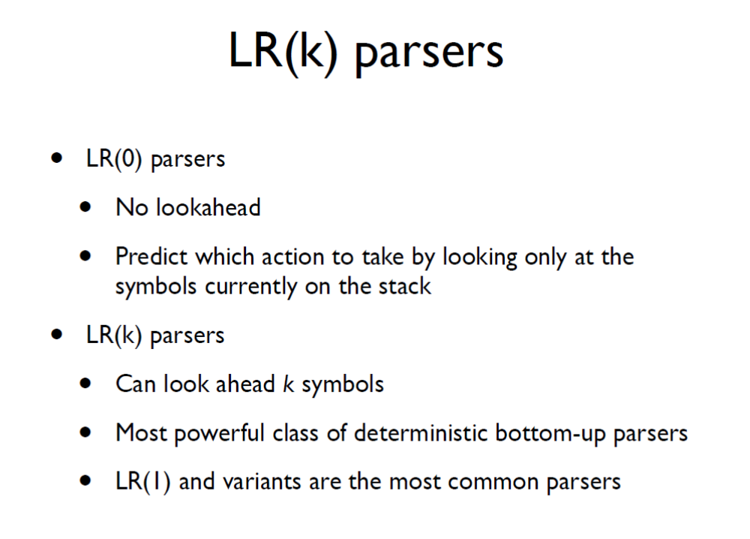

Slide 30
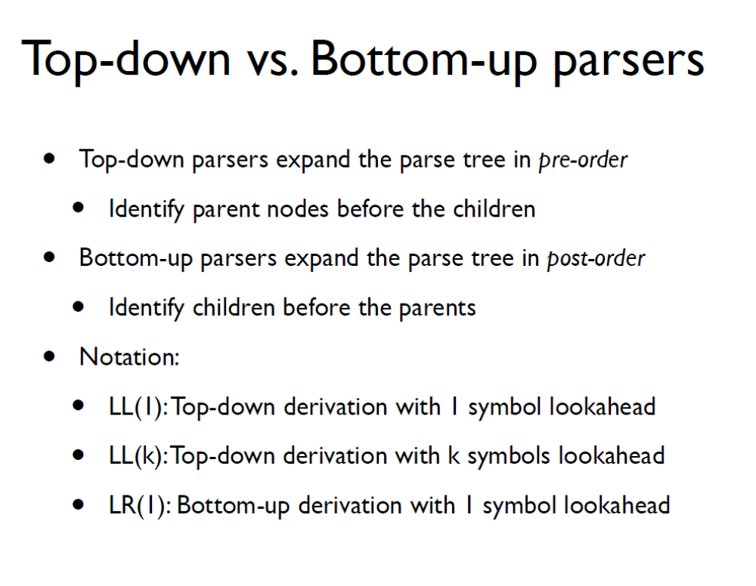

Slide 31
Abstract Syntax Trees
  Parsing recognizes a production from the grammar based on a sequence of tokens received from Lexer
  Rest of the compiler needs more info: a structural representation of the program construct
    Abstract Syntax Tree or AST

Slide 32
Abstract Syntax Trees
  Are like parse trees but ignore certain details
  Example:
  E -> E + E | (E) | int
  String: 1 + (2 + 3)
Demo

Slide 33
Semantic Actions for Expressions

Slide 34
Review
  Scanners
    Detect the presence of illegal tokens
  Parsers
    Detect an ill-formed program
  Semantic actions
    Last phase in the front-end of a compiler
    Detect all other errors
    What are these kind of errors?

Slide 35
What we cannot express using CFGs
  Examples:
    Identifiers declared before their use (scope)
    Types in an expression must be consistent
    Number of formal and actual parameters of a function must match
    Reserved keywords cannot be used as identifiers
    etc.
  Depends on the language..

Slide 36
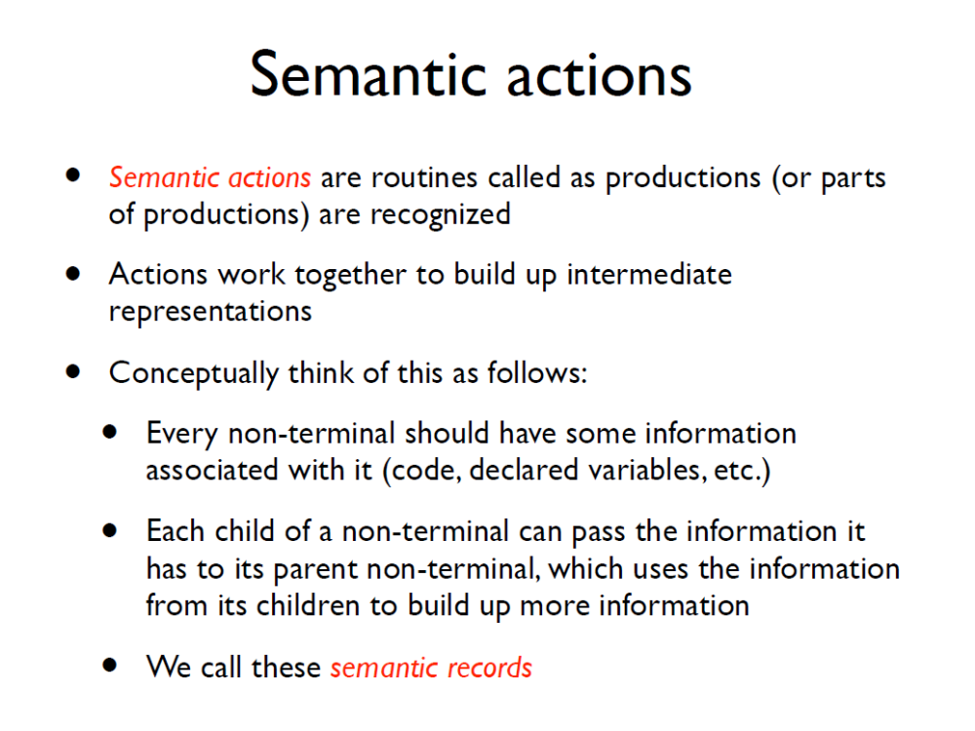

Slide 37
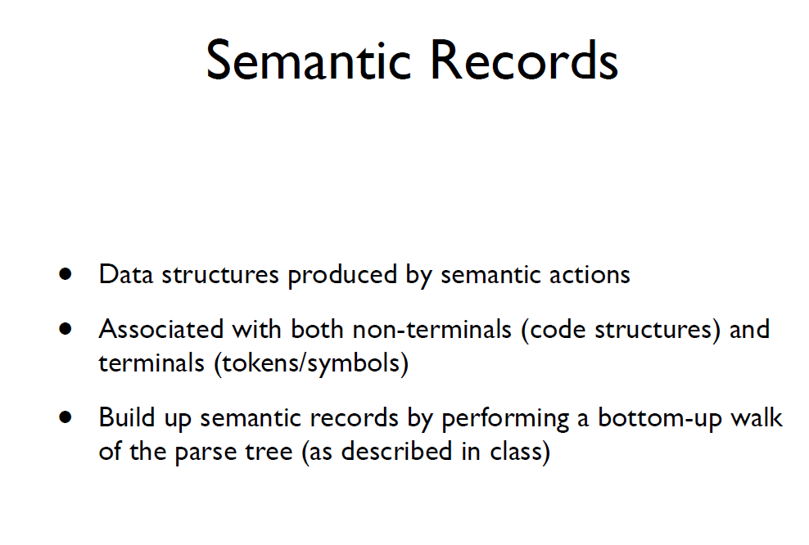
abstract syntax tree

Slide 38
Scope
  Scope of an identifier is the part of the program where the identifier is accessible
  Multiple scopes for same identifier name possible
  Static vs. Dynamic scope
    exercise: what are the different scopes in Micro?

Slide 39
Types
  Static vs. Dynamic
  Type checking
  Type inference

Slide 40
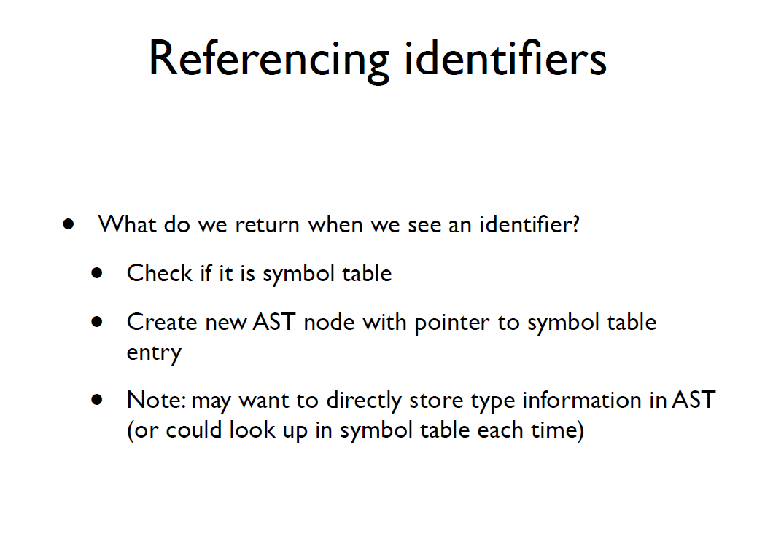
in
Λ

Slide 41
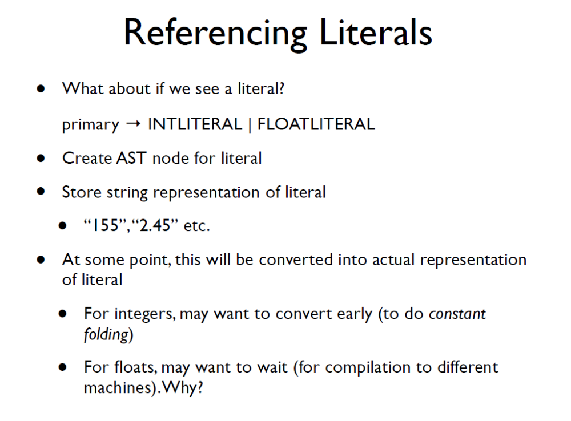

Slide 42
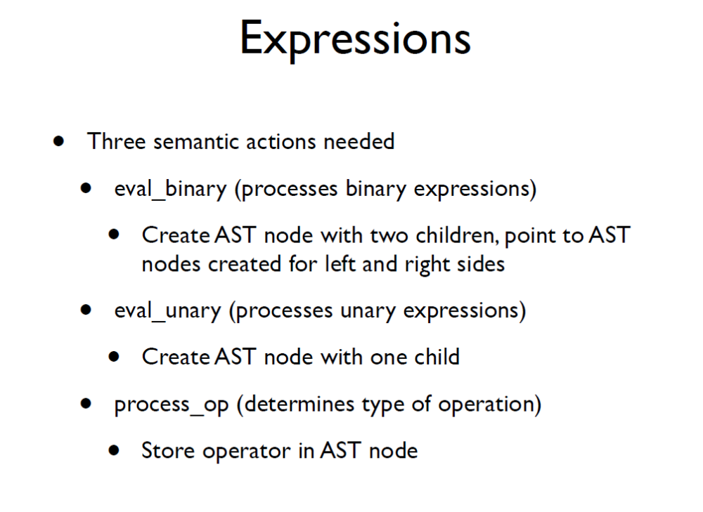

Slide 43
Expressions Example
  x + y + 5

Slide 44
Expressions Example
  x + y + 5
identifier “x”

Slide 45
Expressions Example
  x + y + 5
identifier “x”
identifier “y”

Slide 46
Expressions Example
  x + y + 5
binary_op
operator: +
identifier “x”
identifier “y”

Slide 47
Expressions Example
  x + y + 5
binary_op
operator: +
literal “5”
identifier “x”
identifier “y”

Slide 48
Expressions Example
  x + y + 5
binary_op
operator: +
binary_op
operator: +
literal “5”
identifier “x”
identifier “y”

